Slide 1

AI Chatbot App
A modern mobile experience
September 10, 2025

Slide 2
Agenda
• Welcome
• Onboarding & Access
• Discover
• Profile & Settings
• Notifications & Engagement
• API & AI Overview

Slide 3

Welcome Screen
First Impressions Matter
The welcome screen greets users with our vibrant logo and a friendly call to action. It sets the tone for an engaging experience.
[1] [2]

Slide 4
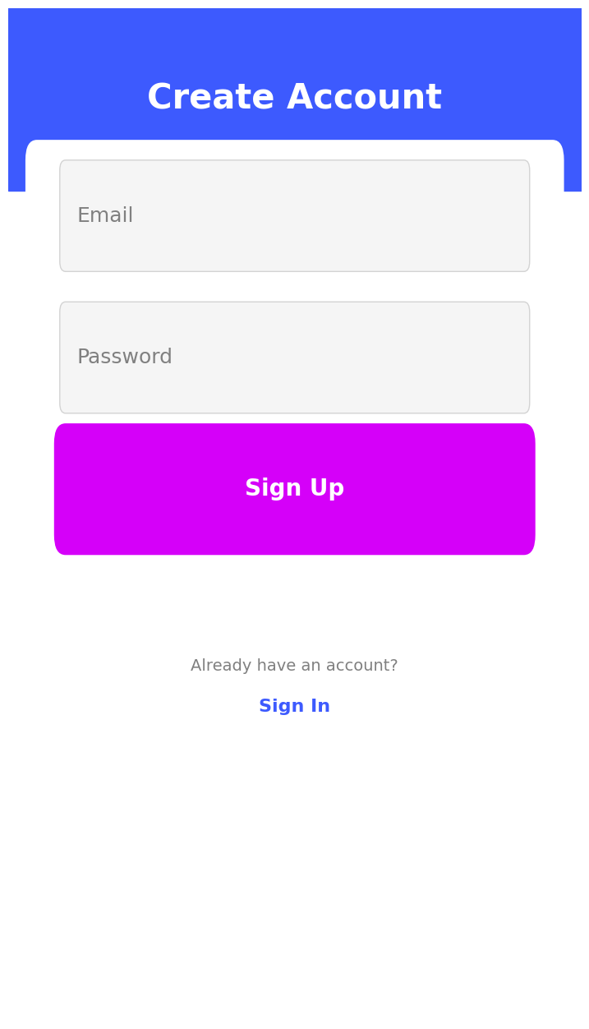
Onboarding & Access
Smooth Registration
A clean sign‑up and login flow invites users to get started quickly. Minimal fields and clear labels promote ease of use.
[1] [2]

Slide 5
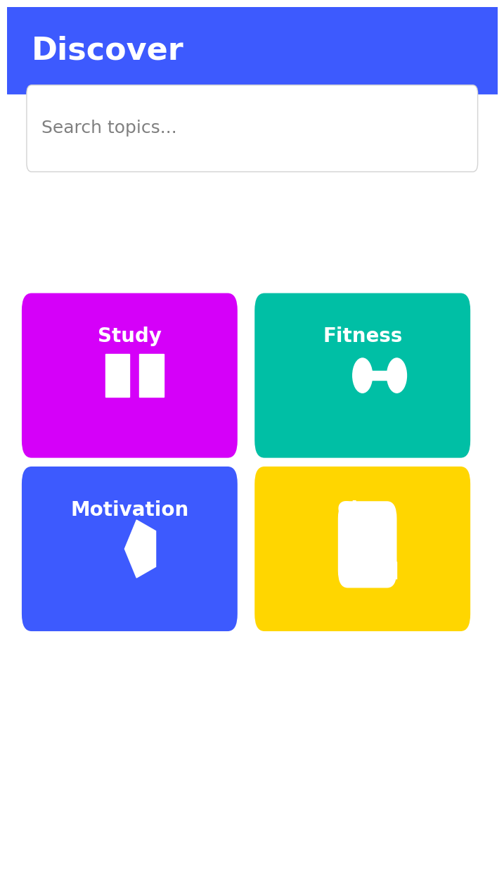
Discover
Explore Categories
The Discover screen offers a search bar and colourful category cards for study, fitness, motivation and chat. Users can quickly find what they need.
[1] [2]

Slide 6
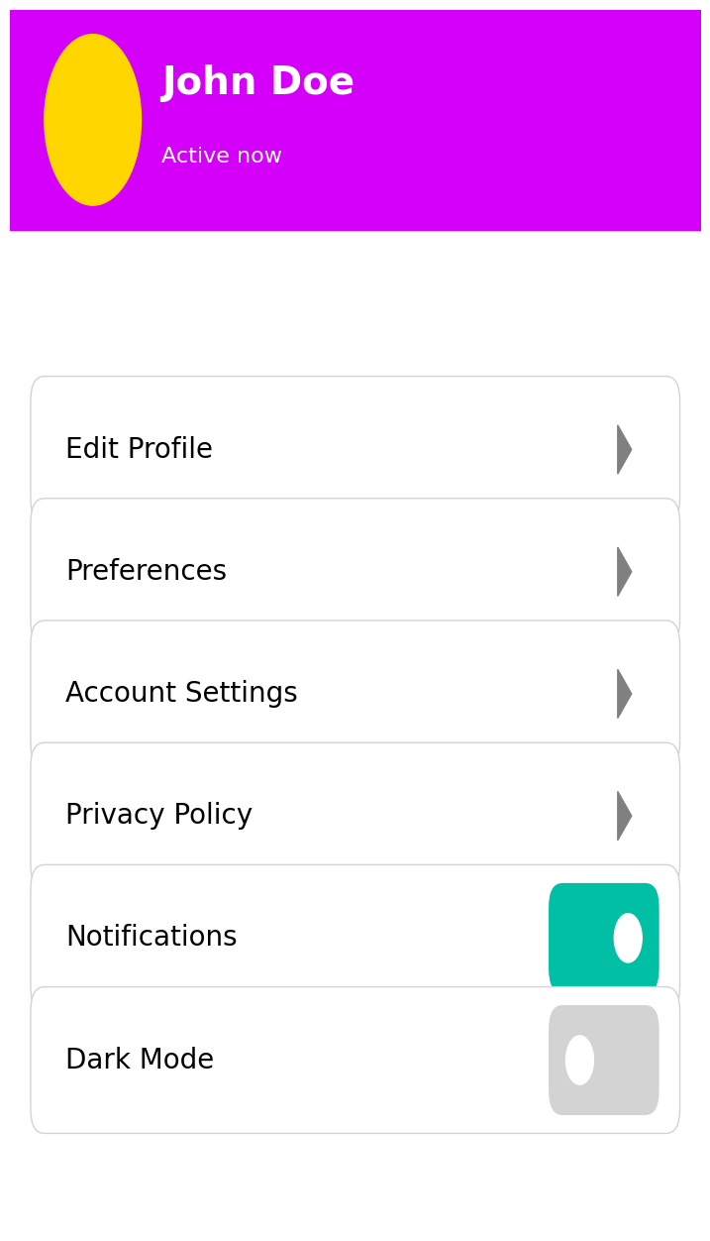
Profile & Settings
Personalise Your Experience
Users can view their profile, edit preferences, toggle notifications and switch dark mode. Intuitive card layouts keep settings organised.
[1] [2]

Slide 7
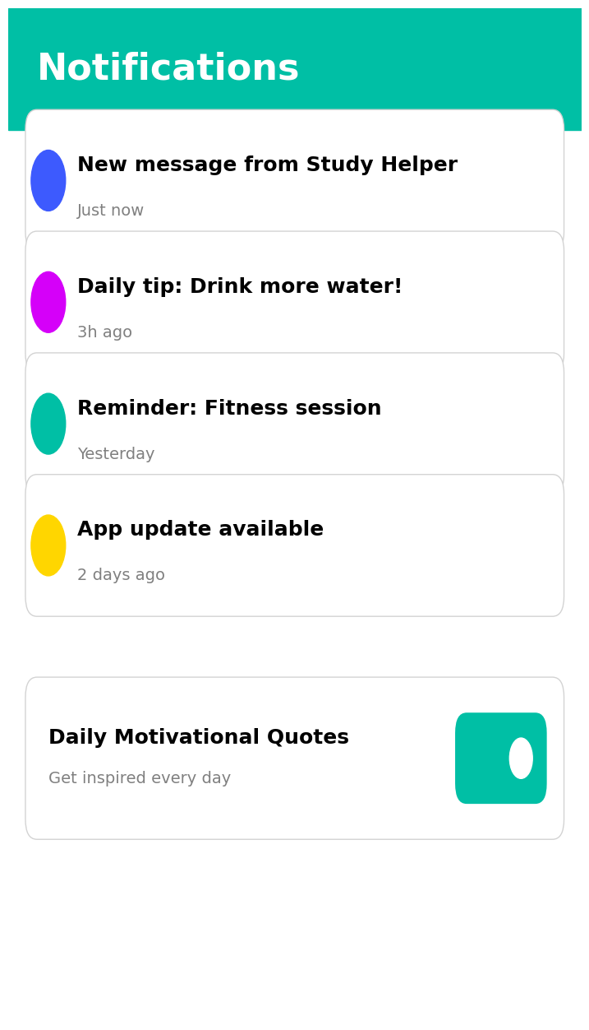
Notifications & Engagement
Stay Connected
A dedicated feed shows incoming notifications and daily motivational prompts. A toggle invites users to opt‑in for regular engagement.
[1] [2]

Slide 8
API & AI Overview
API | Endpoint | Purpose
Typhoon (Chat) | POST /v1/chat/completions | Generate conversational replies
Spoonacular | GET /recipes/search | Search recipes by ingredients
Edamam | GET /nutrition-data | Retrieve nutrition details
Conversational AI
Our chatbot uses Typhoon (OpenAI‑compatible) models to generate human‑like responses.
Recipe & Nutrition
Integration with Spoonacular and Edamam APIs enables recipe search and nutritional analysis. Users can ask for meal suggestions or dietary adjustments, and the app retrieves relevant information.
[3] [4] [5]

Slide 9
Conclusion
A Cohesive Experience
Our AI Chatbot app combines vibrant design, intuitive onboarding, exploratory discovery, personalised settings, and meaningful notifications.
Integrated APIs & AI
Seamless integration of Typhoon chat completions, Spoonacular recipes, and Edamam nutrition data provides real value to users, enabling informative conversations and personalised suggestions.
Next Steps
Future enhancements could include voice input, analytics, and more categories. Together, these elements ensure the app continues to delight and inform.
[1] [2] [3]

