Slide 1
Sahara Analytics
Written by: Zahara Docena

Slide 2
Goals
Learn how archive.org is used
Wanted to answer some of these questions...
Common user languages
How many users?
Referrers?
Website performance?

Slide 3
Method
Data Collection
Data Processing

Slide 4

Data Collection
It’s simple!

Slide 5
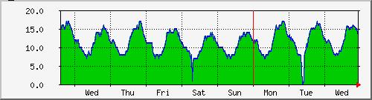
Data Collection
Requires minimal changes to infrastructure
Extensible
Easy concentration of log data
One log record per page load (archive.org gets ~1.1 million page views per day, = 13 page views per second, = easy)
Has access to information the web browser contains
A key statistic we access this way is the user experienced page load time

Slide 6
Data Collection
How it works (in the browser):
analytics.js registers onload handler and records time of JavaScript start
onload handler is triggered when page is fully loaded in browser
onload handler computes load time and gathers other data (locale, etc.)
onload handler returns results in query argument of 0.gif
http://analytics.archive.org/0.gif?loadtime=50&locale=en-us

Slide 7
Data Processing
Data is processed as tab delimited files with one record per line
Fields are named for easy data crunching
Allows for parsing and working with large log files
Simple UNIX pipelines enable powerful straightforward data processing

Slide 8
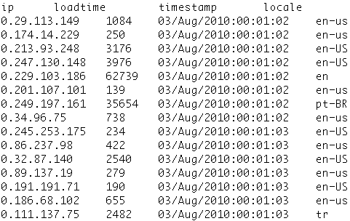
Flat File Example

Slide 9
Tools
I have developed a small set of python programs for processing log data
zd_add – computes sum of fields in a record
zd_combine – concatenates multiple fields
zd_cut – extracts selected columns
zd_reorder – change order of fields in records
zd_select – return rows matching a given criteria
zd_sort – sorts by multiple keys
zd_stat – computes statistics for record groups
zd_uniq – collapses record groups

Slide 10
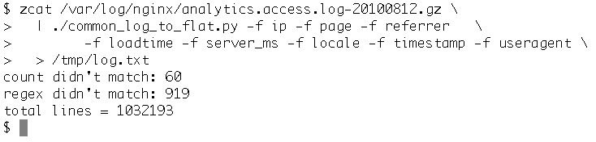
Examples
Start by parsing the web server log:

Slide 11
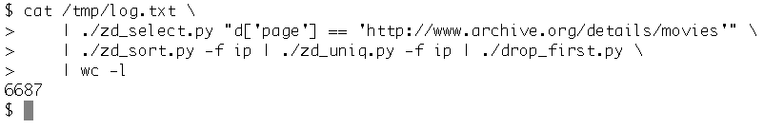
Examples
Number of visitors for a particular page

Slide 12
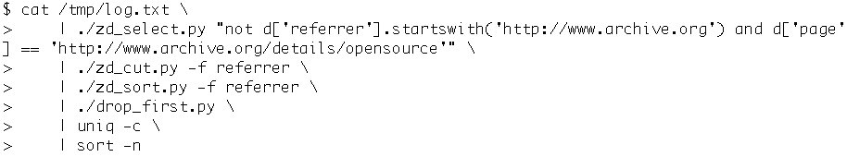
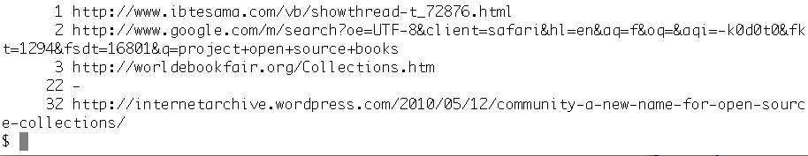
Examples
Referrers for a particular page

Slide 13
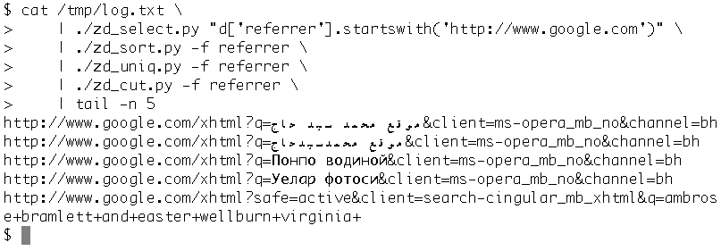
Examples
Interested in Google search queries?

Slide 14
Some basic reporting scripts are included:
These single scripts use a combination of zd_tools and UNIX commands
bounce-rate – computes the bounce rate a log file
top-field – returns top n values of a field
top-field-select – top n values filtered by a criteria
slowest_serverms – returns pages with slowest server ms time
slowest_server_load – returns pages with slowest (server ms + loadtime) sum

Slide 15
Links
http://home/~zahara/reports/
http://home/~zahara/reports/analytics.access.log-20100812.gz.html
http://github.com/zdocena/SaharaAnalytics

Slide 16
Future Work
Click trails
In browser graphing
In browser drill down
Reports covering more than one day
Record download & stream events

