Slide 1
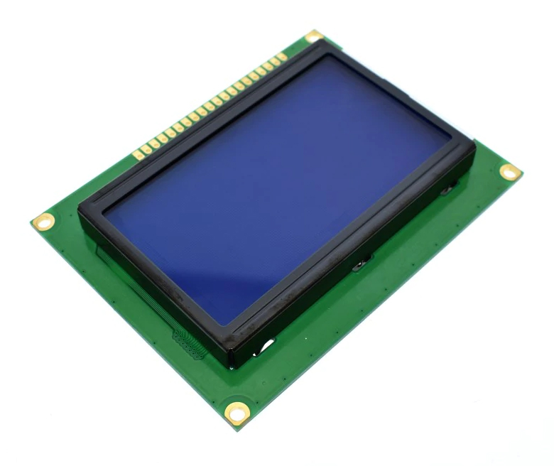
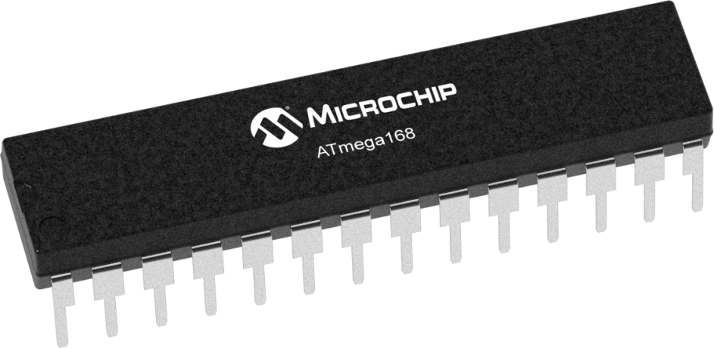
Mini oscilloscope
PWM Signal Drawer using :
ATMega32A Microcontroller
GLCD ( ks0108 )
AMIT Graduation Project Presented by: Eng. Ali Muhammad
Emb.61
alimuhammadabuamer@gmail.com

Slide 2
Layered Architecture
APPLICATION Layer
App.h
Hardware Abstraction Layer
glcd.h
Microcontroller Abstraction Layer
dio.h
pwm.h
icu.h

Slide 3
FlowChart
Initialization
Measure Signal
Draw Signal
PWM
ICU
GLCD
ICU
GLCD

Slide 4
Measure Signal
Duty = Ton / T ;
Period time = B-A high Time = C-B
ICU_GetSignal();
Wait for Input Capture →
Set value to c
Clear Input Capture Flag Set Trigger Edge: RISING_EDGE
Clear Input Capture Flag Set Trigger Edge: Falling_EDGE
Wait for Input Capture →
Set value to A
Clear Input Capture Flag Set Trigger Edge: RISING_EDGE
Wait for Input Capture →
Set value to B

Slide 5
Draw Signal
repeat
Draw_Signal();
GLCD_DisplayString();
GLCD Line 7: Display the PWM signal shape
Get duty cycle from ICU
GLCD Line 6: Display Arrow on First Cycle Period Time
GLCD Line 0: Display Frequency Value in kHz
GLCD Line 0: Display Duty Cycle Value in %.
GLCD Line 4: Display Period Time Value in milliseconds.

Slide 6
Start
Initialization
Get signal
Draw time arrow
loop sync
stop
I continue
end

Slide 7
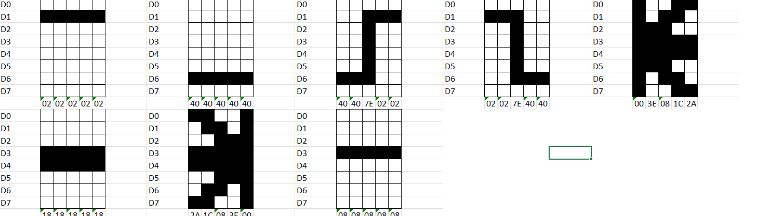
Special Patterns on Graphical LCD

Slide 8
Thank you !

