Slide 1

RetailX: Turning Sales Data into Smarter Business Moves
Group members:
Muhammad Salman Saleem
Muhammad Ahsan Shazad
Assingment : 03

Slide 2

About Dataset
This is a transactional data set which contains all the transactions occurring between 01/12/2010 and 09/12/2011 for a UK-based and registered non-store online retail. The company mainly sells unique all-occasion gifts. Many customers of the company are wholesalers.

Slide 3
Agenda
Area | Benefit / Strategy
🛍️ Inventory Control | Reduce dead stock, increase fast-moving items.
📣 Advertising | Focus ads on popular products and high-revenue countries.
📅 Promotion Timing | Offer discounts in low-sales months to boost revenue.
🤝 Customer Retention | Engage repeat customers through loyalty programs.
🔢 Sales Forecasting | Plan ahead using predictions from regression models.
📊 Data-Driven Decisions | Make smart decisions based on customer, product, and trend analysis.

Slide 4
Dataset overview
Dataset Characteristics Multivariate, Sequential, Time-Series | Subject Area Business | Associated Tasks Classification, Clustering
Feature Type Integer, Real | # Instances 541909 | # Features 6

Slide 5
Problem 01
Fast moving Products. Most Revenue Generated by Top countries
Total Revenue in Seasons

Slide 6
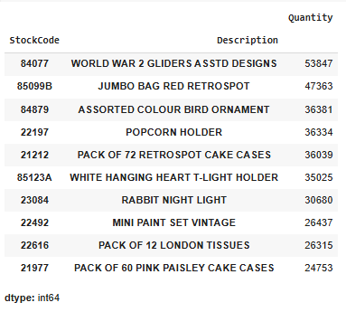
Top 10 Products

Slide 7
Strategy Based on Top 10 Products
Objective: Maximize revenue from best-selling items.
✅ Restock aggressively to avoid lost sales on top items.
💡 Bundle with accessories or complementary products to increase cart value.
🛍️ Highlight in ads & homepage to attract more buyers to proven products.

Slide 8
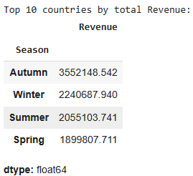
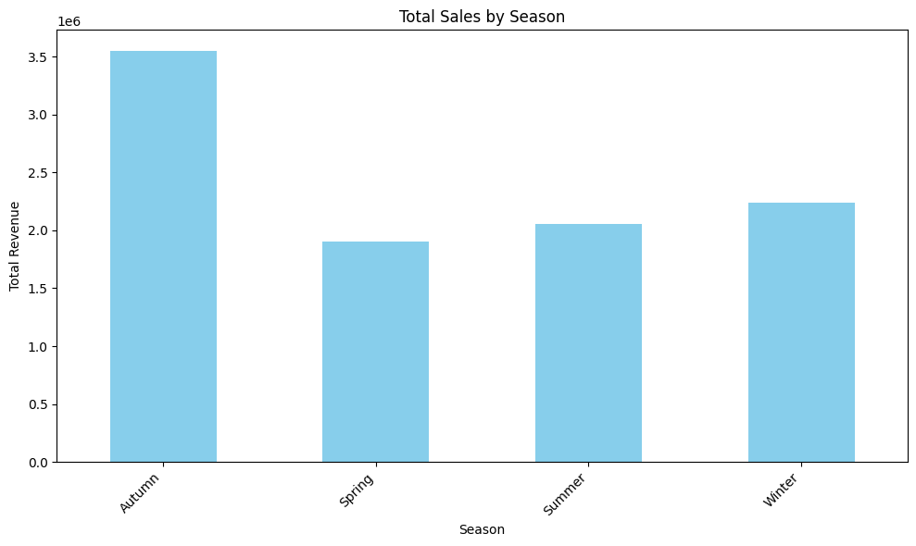
Total Revenue Sells in all Seaons

Slide 9
Strategy Using Seasonal Sales Data
Objective: Capitalize on sales peaks and trends.
📅 Prepare inventory in advance for seasonal high-demand periods.
🎯 Launch timed campaigns during top sales seasons (e.g., Ramadan, Black Friday).
🔁 Repeat past successes—reuse top-performing seasonal ads/products.

Slide 10
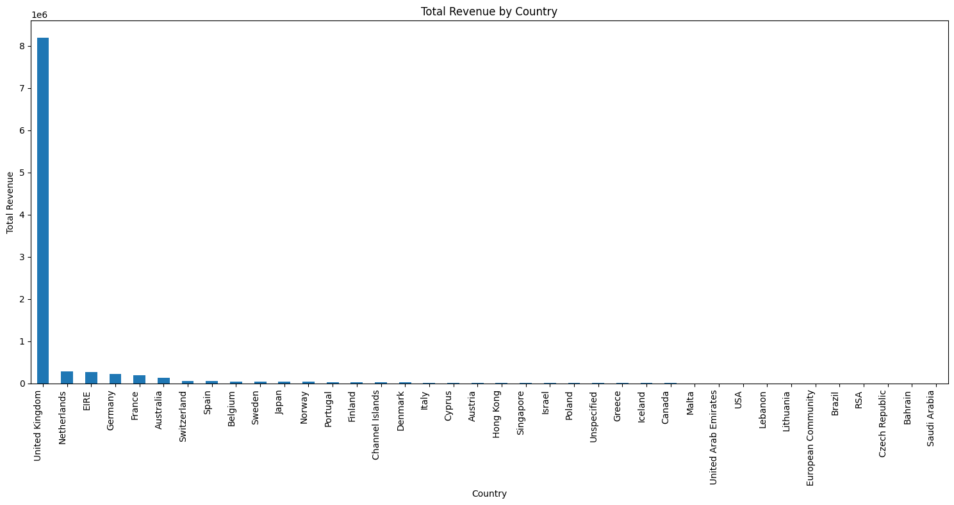
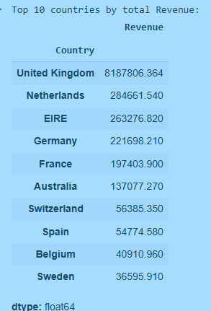
Total Revenue by Top 10 Countries.

Slide 11
Strategy for Top Buying Countries
Objective: Increase sales from high-performing regions.
📌 Run localized marketing (language, timezone, currency).
🚚 Improve shipping options—offer free or fast delivery to top countries.
🤝 Partner with local influencers to build trust and expand reach.

Slide 12
Problem 02 and Strategies
See the trends.
Top 3 buyers

Slide 13
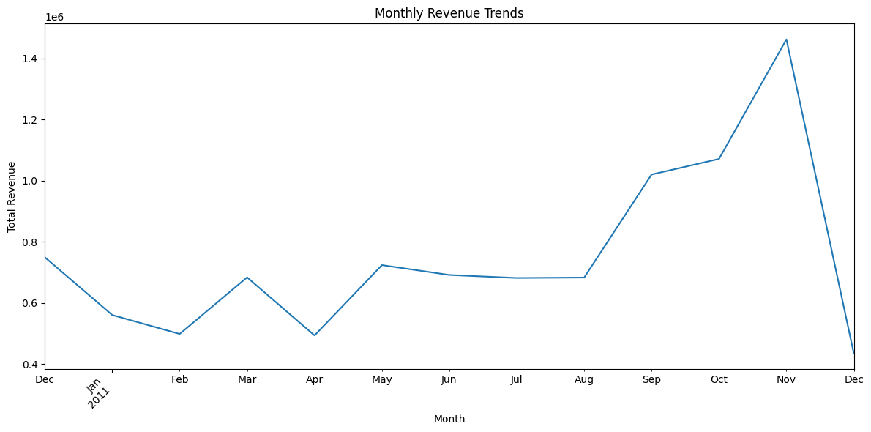
Monthly Revenue

Slide 14
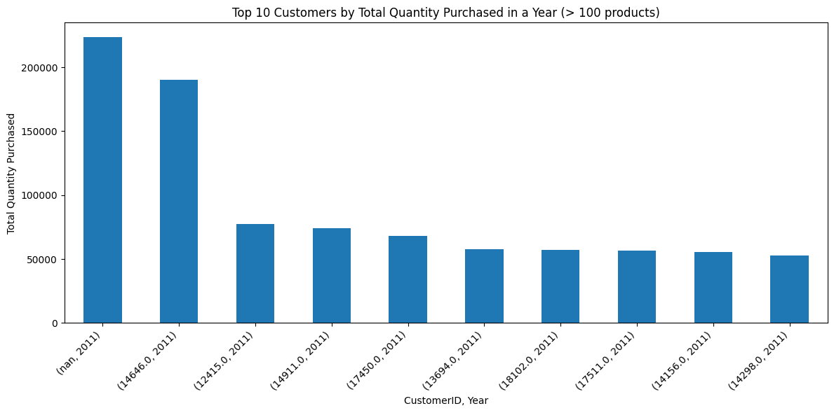
Top 10 Customers (100+ Purchases/Year)

Slide 15
VIP Buyer Strategy (100+ Purchases/Year)
Objective: Retain & maximize lifetime value of high-volume customers
🎁 Exclusive Rewards: VIP-only discounts, gifts, and early access to new products
✉️ Personalized Communication: Tailored emails, thank-you messages, and curated offers
📦 Premium Experience: Free express shipping, priority support, and surprise upgrades
🎯 Behavior-Based Promotions: Smart reorders & product suggestions based on buying trends
🤝 Relationship Building: Collect feedback, offer referral perks, and involve them in product launches

Slide 16
Problem 03 and Strategies
Predection and Model Selection

Slide 17
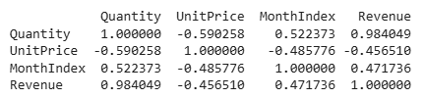
Correlation

Slide 18
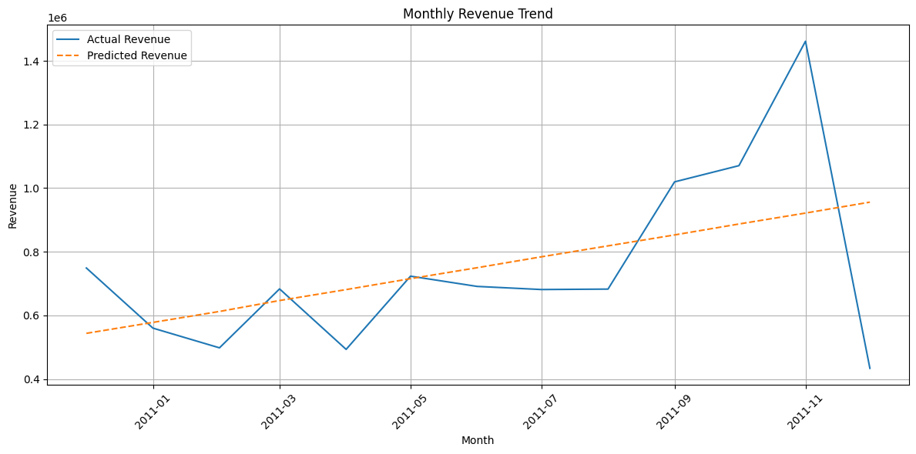
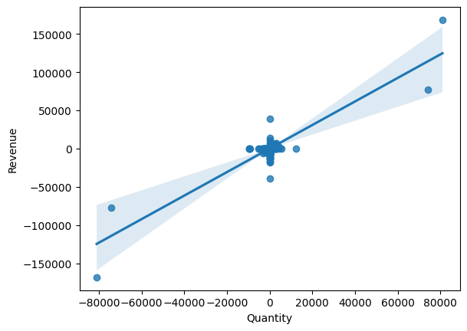
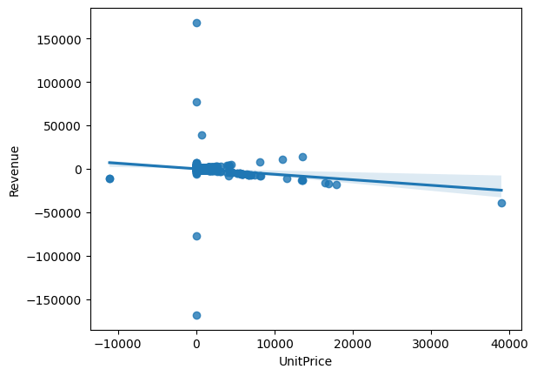
SLR model selection using visualization

Slide 19
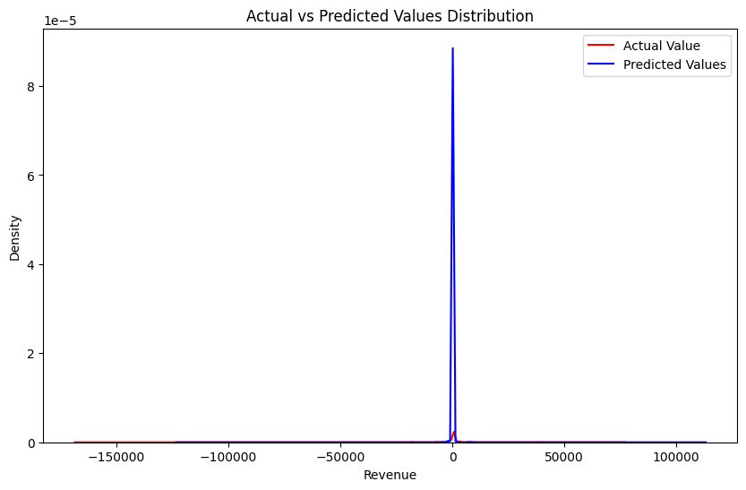
MLR Model Selection using Visualization

Slide 20
Model R² (Higher is better) MSE (Lower is better) Comments
Multiple Linear Regression (MLR): This model has the highest R-squared
value (0.8008) and the lowest Mean Squared Error (46298.45).
SLR with Quantity: This model has a decent R-squared (0.7862) and MSE (30679.26),
SLR with MonthIndex: This model has a very low R-squared (0.2225) and a high
MSE (30679.26 which seems incorrect given the R squared value is lower than the SLR
with Quantity model) indicating it does not explain much of the variance in revenue.

Slide 21
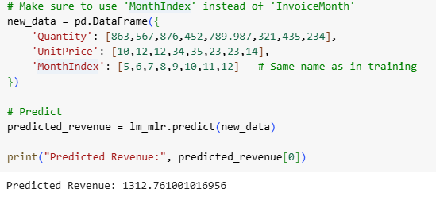
Prediction of Revenue Using MLR

Slide 22
Thank you

