Slide 1





SWE3028-Fall-2024
Capstone Design Project
NLP-based
Psychological Diagnostic Diary
Midterm Presentation
런닝머신 팀(TEAM C)
김나영 김예담 박준현 방기호

Slide 2


CONTENTS
01
Planned Schedule
02
Progress
⓵ UX/UI Design ⓶ Front-end ⓷ Back-end ⓸ AI
03
Challenges / Limitations
04
Plan
Capstone Design Project

Slide 3











01. Planned Schedule
Week 2-3 | Week 4-5 | Week 6-7 | Week 8-9 | Week 10-11 | Week 12-13 | Week 14-15
Topic Ideation
Data Collection
AI Model Design
Data PreProcessing
Model & Algorithm Implementation
UX/UI Design & Implementation
Beta Service & FeedBack
Capstone Design Project

Slide 4






01. Role of Each Member
Yehdarm
Nayeong
Giho
Junhyun
UX / UI design
AI Implementation
Front-end
Back-end
Capstone Design Project

Slide 5
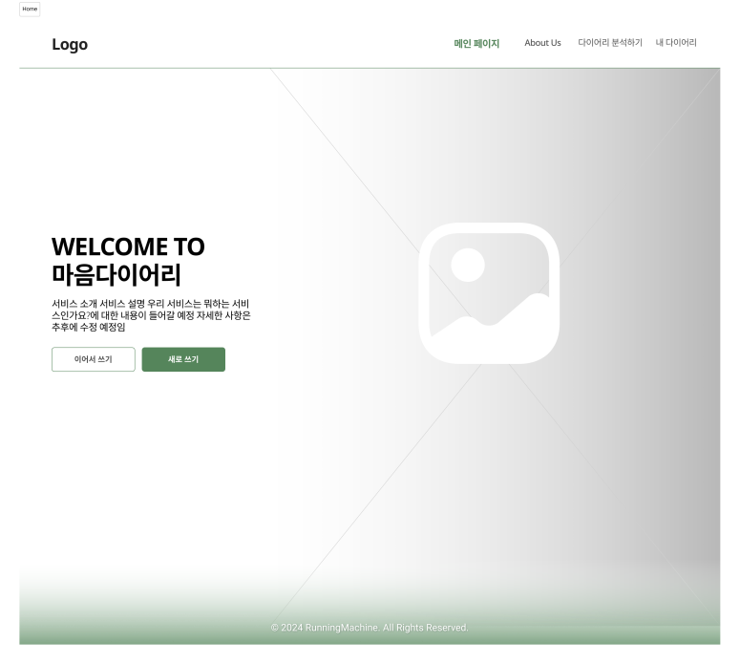
02. Progress - UX / UI Design
<Main Page>
Navigation Bar
Button to Writing Page
Capstone Design Project

Slide 6
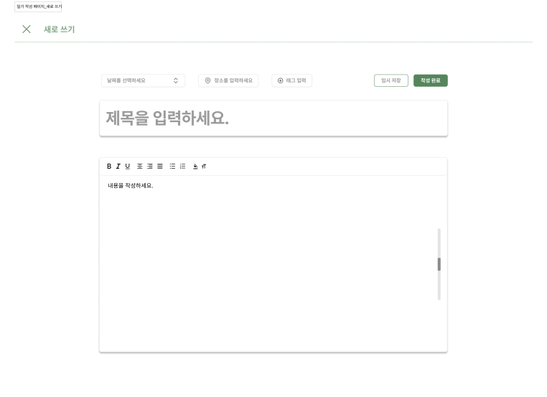
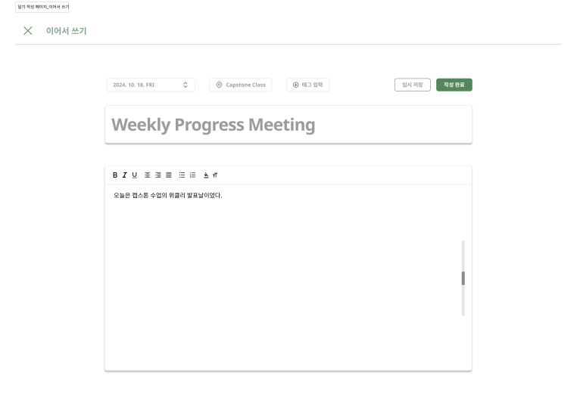
02. Progress - UX / UI Design
<Writing Page>
Create New Journal
Use Drafted Journal
Capstone Design Project

Slide 7
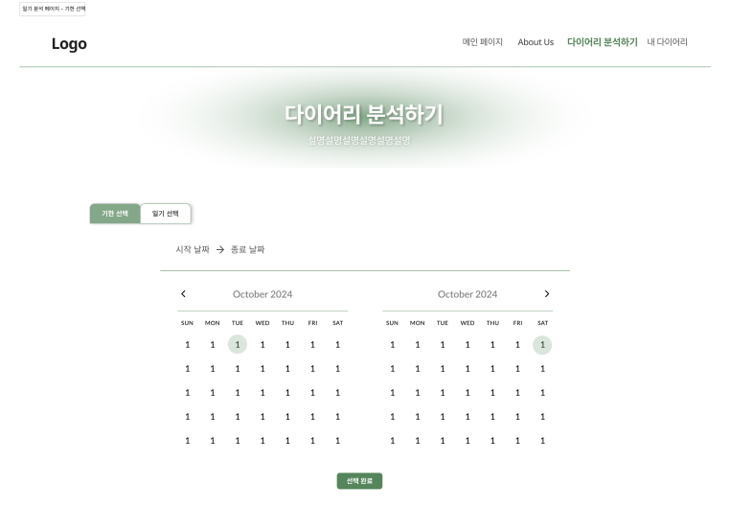
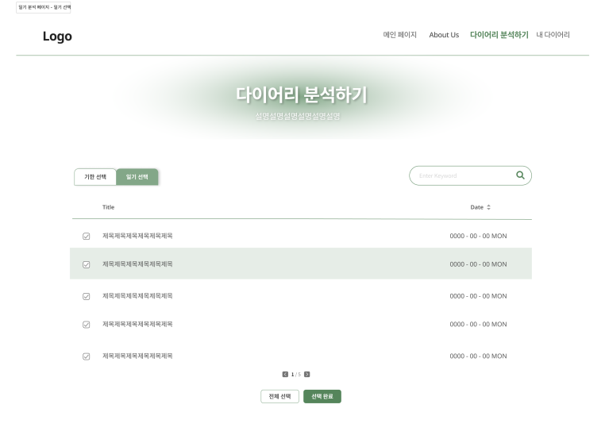
02. Progress - UX / UI Design
<Analyzing Page>
Choosing by Date
Choosing Manually
Capstone Design Project

Slide 8
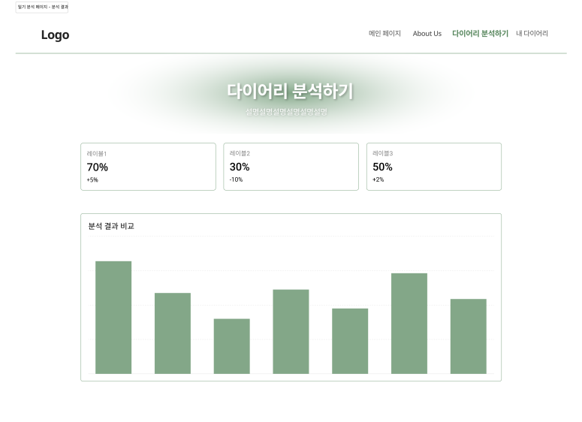
02. Progress - UX / UI Design
<Analyzing Page>
Capstone Design Project

Slide 9



02. Progress – Front-end
Utilizing React to build Web pages
1. easy to reuse components
2. high performance in changing web pages
Capstone Design Project

Slide 10
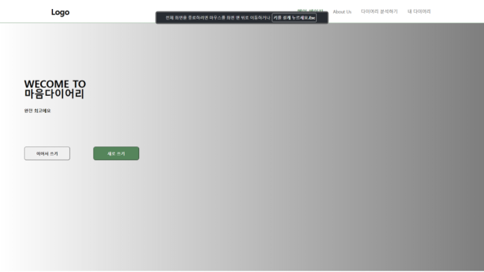
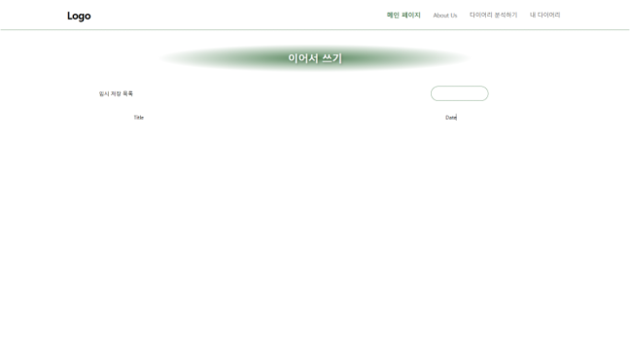
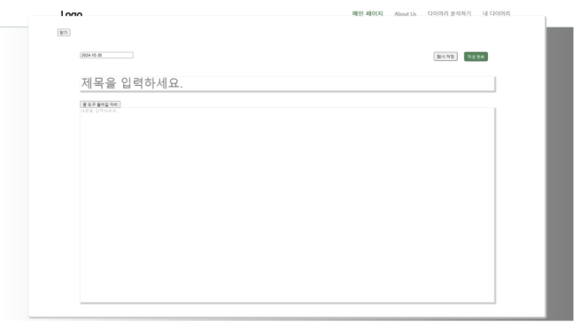
02. Progress – Front-end
Capstone Design Project

Slide 11

02. Progress – Front-end
For communication with Back-end
1. more confortable and intuitive
2. provide more secure environment
Capstone Design Project

Slide 12
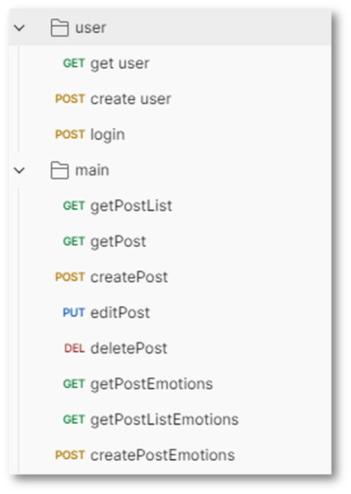
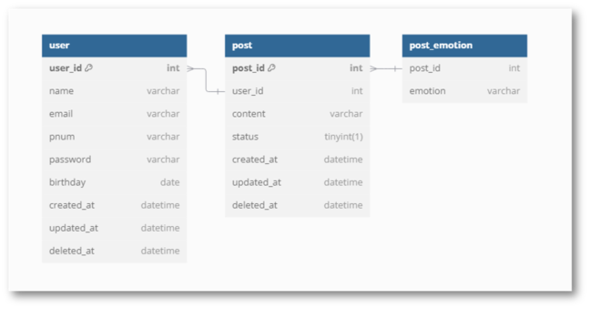
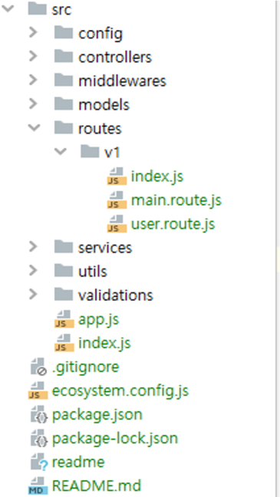
02. Progress – Front-end
API List
ERD
Framework
Capstone Design Project

Slide 13



02. Datasets - AI
Data Collection
Wellness Conversation Script Dataset
From 16,000 counsel data received from Gangnam Severance,
5,232 user utterances were extracted
when the patient himself/herself visited the hospital.
Depression / Sadness / Loneliness / Anger / Lethargy / Abnormal Emotional Control
Sense of Loss / Loss of Appetite / Increase in Appetite / Insomnia
Nervousness / Fatigue / Feeling of Guilt / Loss of Concentration
Decrease in Confidence / Decline in Self-esteem
Feeling of Despair / Suicidal Impulse / Feeling of Insecurity
19 emotional labels in total
Capstone Design Project

Slide 14
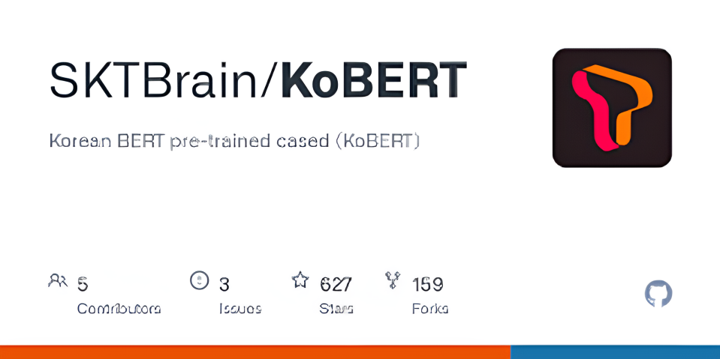

02. Model description - AI
A version of BERT fine-tuned for Korean
Capstone Design Project

Slide 15



02. Model description - AI
Why?
BERT
Bidirectional to understand context
back and forth
KoBERT
Optimized for Korean
reflecting irregular language changes in Korean
Capstone Design Project

Slide 16
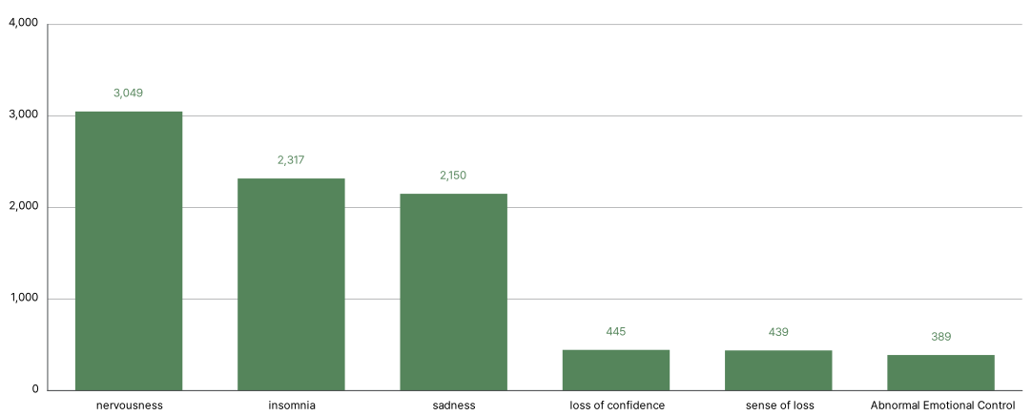
02. Data augmentation - AI
Imbalance in the number
of utterances by emotion label
Capstone Design Project

Slide 17

02. Data augmentation - AI
nervous | 3049
insomnia | 2317
sadness | 2150
...
Data Augmentation
for 8 emotions
with less than 1000 utterances
loneliness | 956
hopeless | 887
suicidal | 727
appetite↑ | 540
concentration↓ | 458
confidence↓ | 445
loss | 439
emotion control↓ | 389
Capstone Design Project

Slide 18
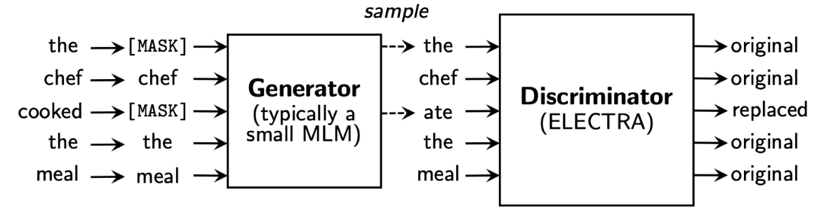
02. Data augmentation - AI
< ELECTRA >
Efficiently Learning an Encoder that Classifies Token Replacements Accurately
Replaced Token Detection (RTD): Binary classification problem
where generator turns some of the tokens into a plausible fake token
and discriminator guesses whether each token is a real or a replaced token
Capstone Design Project

Slide 19



02. Data augmentation - AI
< KoELECTRA >
A natural language model that learns ELECTRA with 34GB of Korean text
Efficient learning structure
Korean-specialized
Capstone Design Project

Slide 20
02. Data augmentation - AI
1. Random Masking Replacement
그런데 완전히 죽기에는 3층이 너무 낮았던 거죠.
Randomly
그런데 [MASK] 죽기에는 3층이 너무 낮았던 거죠.
KoELECTRA's fill-mask pipeline
그런데 이게 죽기에는 3층이 너무 낮았던 거죠.
Capstone Design Project

Slide 21
02. Data augmentation - AI
2. Random Masking Insertion
그런데 완전히 죽기에는 3층이 너무 낮았던 거죠.
Randomly
그런데 완전히 죽기에는 3층이 너무 낮았던 [MASK] 거죠.
KoELECTRA's fill-mask pipeline
그런데 완전히 죽기에는 3층이 너무 낮았던 그런 거죠.
Capstone Design Project

Slide 22



02. Data augmentation - AI
Random Masking
Replacement
Random Masking
Insertion
Vocabulary diversity
-> Different expressions
for context
Various expressions
-> Can be transformed or emphasized
Meaning distortion
-> Meaning of a sentence can be distorted
Limited semantic change
-> Generatesimilar data
Capstone Design Project

Slide 23
02. Evaluation Metrics - AI
epoch = 5, batch size = 32, learning rate = 5e-5
 | Test Acc | F1-score | Precision | Recall | Cosine Similarity
base | 0.840 | 0.871 | 0.861 | 0.863 | -
Only Replacement | 0.876 | 0.855 | 0.856 | 0.856 | 0.951
Only Insertion | 0.867 | 0.881 | 0.864 | 0.885 | 0.973
Both | 0.865 | 0.864 | 0.864 | 0.865 | 0.964
Capstone Design Project

Slide 24
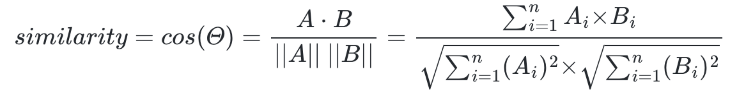




02. Evaluation Metrics - AI
< Cosine Simularity >
The similarity between two vectors that can be obtained
using the cosine angle between the two vectors
Calculate the mean
cosine simularity
with augmented data
Calculate the mean of the extracted vector
BERT Embedding
Capstone Design Project

Slide 25
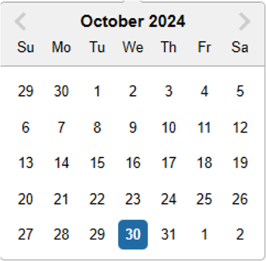
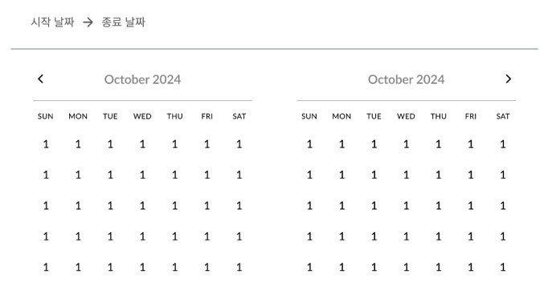

03. Challenges - Front-end
Limitations of the imported module, datepicker
customize it and make our own datepicker
Capstone Design Project

Slide 26


03. Challenges - Front-end
Keep the page at the same time as the details change
Create a tab component
Capstone Design Project

Slide 27



03. Challenges - Back-end
Handling Large-scale Data
Optimized Database Indexing
Large Data
Make Slow
Distributed Processing Technique
Capstone Design Project

Slide 28





03. Limitations - Front-end
Limitations of fitting web pages based on user's environment
Capstone Design Project

Slide 29


03. Limitations - Back-end
Potential Delay in Real-time Analysis
Export emotion analysis Results
Need constant time
Response Delay
Capstone Design Project

Slide 30



04. Plan
UX/UI Design
Front-end
AI
Advance existing design
Implementation
of an Unimplemented Pages
Hyperparameter tuning
Create a Branding Design
Identify the KoELECTRA architecture and devise ways
to improve performance
Logo CI, Color Chip, Typography
Back-end
Planning Additional Features and Building Wireframes
AI model serving with flask
Developing Framework
Capstone Design Project

Slide 31


Q & A
NLP-based Psychological Diagnostic Diary
Capstone Design Project

