Slide 1
LOL.GRN
Home
Champions
Items
Duo Synergy
Community
Enter Summoner Name
Search
TOP | JGL | MID | ADC | SPT
Rank | Icon | Name | Win Rate | Pick Rate | Ban Rate | Number of Samples
LOL.GRN is a integrated League of Legends statistics website that uses Garena’s Match History website to gather data exclusively for Garena server games, and display them to users for the best gaming experience of the LoL users.
To find more about this website, visit here.
To provide us feedback, navigate here.
For business contact, please email at: kjaehyeok21@gmail.com

Slide 2
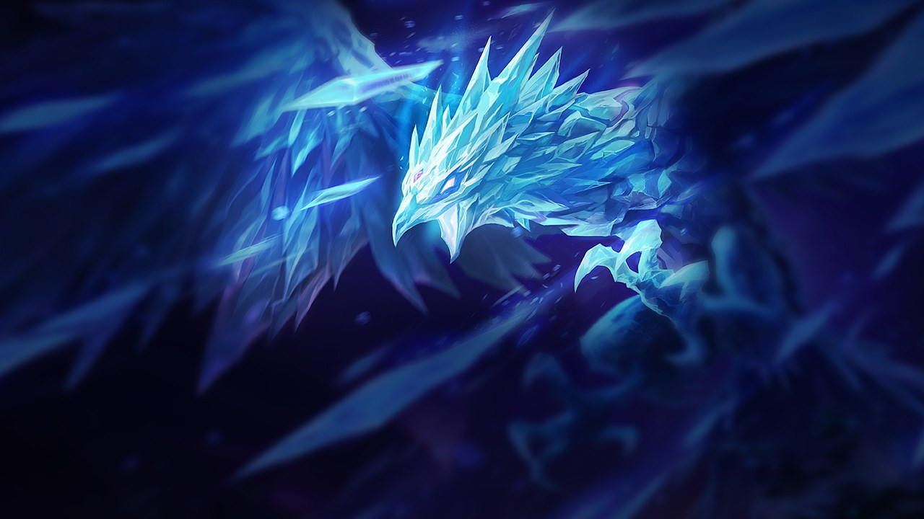


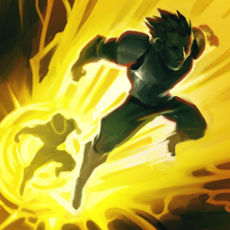

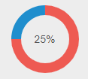
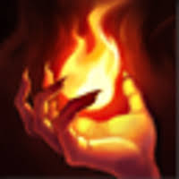
LOL.GRN
Home
Champions
Items
Duo Synergy
Community
Debugging Nerd
Last Played: 7 hours ago
8/5/20
5.6 KDA
Level 15
208 CS
74% KP
0.79 Vis/Min
6.3 CS/Min
1186 DMG/Min
Anivia
8/5/20
5.6 KDA
Level 15
208 CS
74% KP
0.79 Vis/Min
6.3 CS/Min
1186 DMG/Min
Recent games: 15G 8W 7L
Anivia
8/5/20
5.6 KDA
Level 15
208 CS
74% KP
0.79 Vis/Min
6.3 CS/Min
1186 DMG/Min
Anivia
8/5/20
5.6 KDA
Level 15
208 CS
74% KP
0.79 Vis/Min
6.3 CS/Min
1186 DMG/Min
Anivia
8/5/20
5.6 KDA
Level 15
208 CS
74% KP
0.79 Vis/Min
6.3 CS/Min
1186 DMG/Min
Anivia

Slide 3
LOL.GRN
Home
Champions
Items
Duo Synergy
Community
TOP | JGL | MID | ADC | SPT
10.25
Rank | Icon | Name | Position | Win Rate | Pick Rate | Ban Rate | Number of Samples

Slide 4
LOL.GRN
Home
Champions
Items
Duo Synergy
Community
All | Legendary | Mythic
10.25
Rank | Icon | Name | Win rate | Selection Rate | Average Time Bought | Short Term Efficiency | Long Term Effiency | Number of Samples

Slide 5
LOL.GRN
Home
Champions
Items
Duo Synergy
Community
Select Champion
ADC + SPT | MID + JGL | TOP + JGL | JGL + SPT
10.25
Rank | Icon | Name | Win rate | Selection Rate | Average Time Bought | Short Term Efficiency | Long Term Effiency | Number of Samples

