Slide 1

CS225
Data Structure
Final Presentation
🌳🍊👩🐶
Zhu Zhongbo, Xie Tian, Yang Zhaohua, Guan Zimu
GROUP 7

Slide 2
PART ONE
01
Framework
Overall view of our database system

Slide 3
Framework
Query Engine
Index Structure
B/B+ Trees
Main Data
Sequences of blocks

Slide 4
PART TWO
02
MainBlock
Place where all data are preserved

Slide 5
PART TWO
02
MainBlock
Place where all data are preserved
structure
The way different types of records are preserved
functionality
Fundamental operation: Insert, delete, merge, split

Slide 6
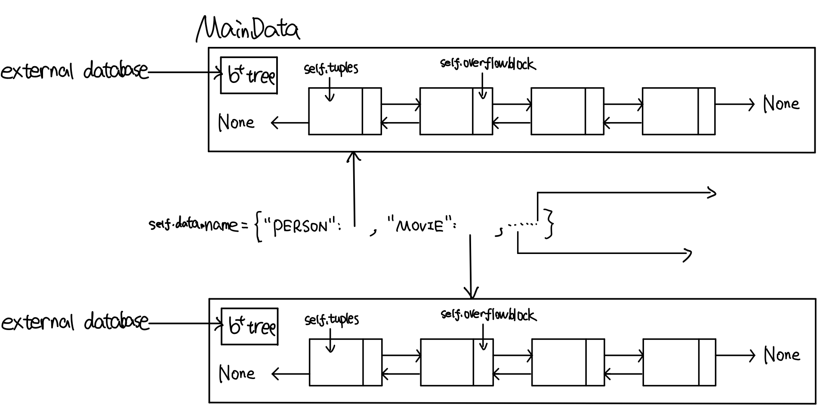
STRUCTURE
- One linked-list preserves one relation
- Interface is a dictionary with name of relation as keys

Slide 7
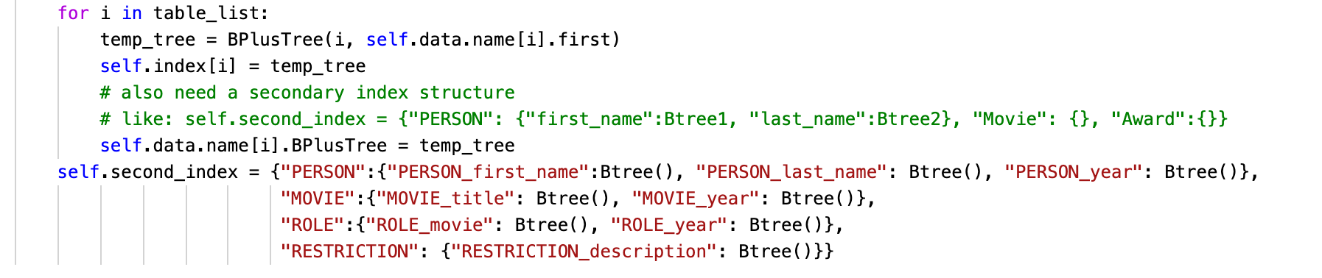
STRUCTURE
- One linked-list preserves one relation
- Interface is a dictionary with name of relation as keys

