Slide 1
PART FOUR
04
B+ Trees and B-Trees
Primary && Secondary Keys index structure in database

Slide 2
OOP Design
MainData | Index | Second Index
list1 | B+ Tree1 | attr1 attr2 ……
list2 | B+ Tree2 | attr1 attr2 ……
…… | …… | ……

Slide 3

OOP Design
MainData | Index | Second Index
list1 | B+ Tree1 | attr1 attr2 ……
list2 | B+ Tree2 | attr1 attr2 ……
…… | …… | ……
$$\left\{\begin{aligned}quick insert \\ quick delete \\ quick search\end{aligned}\right.$$

Slide 4
OOP Design
MainData | Index | Second Index
list1 | B+ Tree1 | attr1 attr2 ……
list2 | B+ Tree2 | attr1 attr2 ……
…… | …… | ……
$$\left\{\begin{aligned}quick insert \\ quick delete \\ quick search\end{aligned}\right.$$
Class Database:
--Main Data
--B+ trees for primary keys
--B tree for secondary keys
--IO functions
----insert
----delete
----search & search attributes

Slide 5
OOP Design
MainData | Index | Second Index
list1 | B+ Tree1 | attr1 attr2 ……
list2 | B+ Tree2 | attr1 attr2 ……
…… | …… | ……
$$\left\{\begin{aligned}quick insert \\ quick delete \\ quick search\end{aligned}\right.$$
Class Database:
--Main Data
--B+ trees for primary keys
--B tree for secondary keys
--IO functions
----insert
----delete
----search & search attributes
The class database controls all the dataflow and play a role in controlling every sub-classes.

Slide 6
This structure improve efficiency !!!
Previously, we insert data into the main block by linear search:
a. Find one appropriate block to insert.
b. Find one None position for data.
c. See if the splitting of data is necessary.

Slide 7
This structure improve efficiency !!!
Previously, we insert data into the main block by linear search:
a. Find one appropriate block to insert.
b. Find one None position for data.
c. See if the splitting of data is necessary.
The process of searching for one appropriate block can be greatly accelerated by index structure.

Slide 8
This structure improve efficiency !!!
Previously, we insert data into the main block by linear search:
a. Find one appropriate block to insert.
b. Find one None position for data.
c. See if the splitting of data is necessary.
The process of searching for one appropriate block can be greatly accelerated by index structure.
The idea to maintain one pointer of corresponding B+ tree in one table of relation, we can reduce the cost from O(n) to O(log(n)).

Slide 9
This structure improve efficiency !!!
Previously, we insert data into the main block by linear search:
a. Find one appropriate block to insert.
b. Find one None position for data.
c. See if the splitting of data is necessary.
The process of searching for one appropriate block can be greatly accelerated by index structure.
The idea to maintain one pointer of corresponding B+ tree in one table of relation, we can reduce the cost from O(n) to O(log(n)).
Within the block, the linear search is unavoidable.

Slide 10
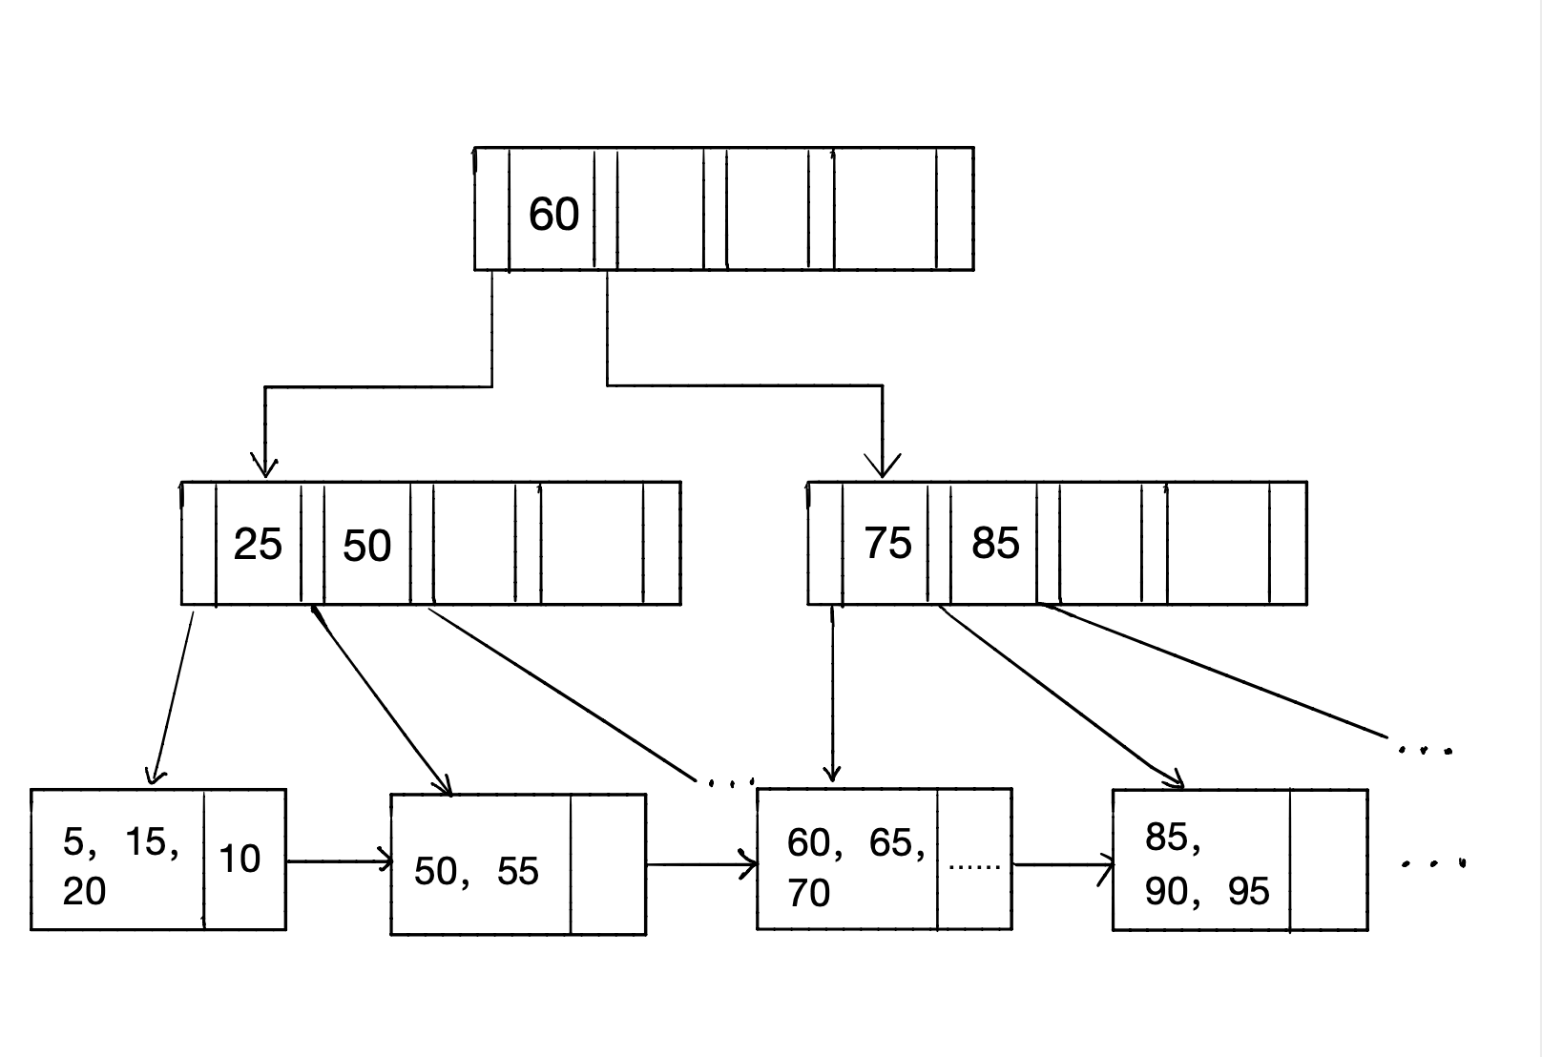
B+ Tree implementation
Upper Layer = False
Disk Layer = True
Leaf Node
—— actually MainData Block
Main data and B+ tree was written in two different files but connected by database.

Slide 11
B+ Tree implementation
How to INSERT ?
How to SEARCH ?
How to DELETE ?

Slide 12
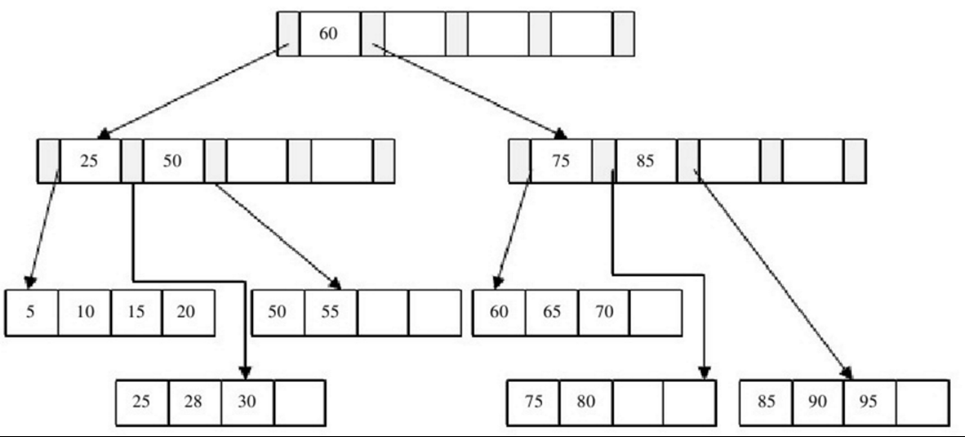










INSERT
Relation with MainData blocks:
Once the blocks in MainData split, the B+ tree will have a new entry.
Find one separator in the middle and insert to the parents.
Main data’s insert() returns the information of the separator and class database will re-send it to trigger insertion of B+ tree.
Update B trees !

Slide 13
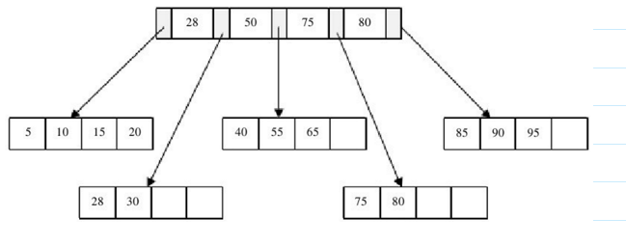








SEARCH
Procedure:
Search in B+ tree or B tree
Get the block
Search in block
Combing results if there are
multiple attributes.
Return value

Slide 14



DELETE
This operation is very complicated, so I will illustrate it by examples
Delete 85
No merge doesn’t mean that you have nothing to do.
Consider the sequence of operations :
--delete 85
--delete 90
The second one triggers a merge which means that the B+ tree node should also be updated.

Slide 15
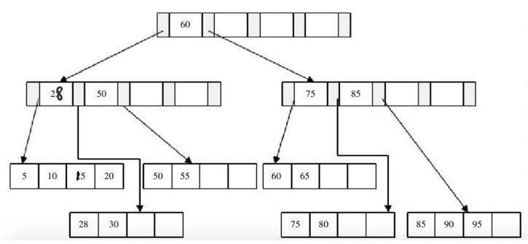
DELETE
Delete 60
By deleting 60 here, a merge was required.
How can we delete a node which is not at bottom (aka. Disk layer node).
We find successors!
Just put 75 into the position of 60 and delete 75.

Slide 16
DELETE
Delete 60 (Continued)
But why is this operation different from the operation of deleting 75 directly?

Slide 17
DELETE
Proposition:
Every time when you want delete a tree node which is not in the disk-layer, you can transfer this problem into a deletion of child which is the leftmost child of some B+ tree node in the disk layer.
Proof:
Define the one you delete to be V1 which is not in the disk layer.
Replacing this key value by a key value of its right child, and you can go down one layer of this tree and transfer the problem of deletion in children.
Redo the previous step until you reach the delete(Vn) state where Vn is in the disk layer.
We must have partial order: V1<V2<V3< … < Vn
According to the B+ tree property, V1 should appear in the main blocks otherwise you won’t receive the command of delete(V1) in the beginning. Then we know that the final target must be some left child of a B+ tree node in the disk layer.

Slide 18
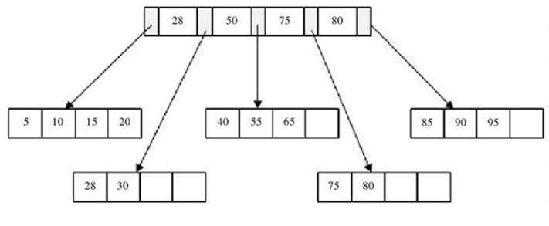

DELETE
Delete 60 (Continued)
Then we know that by deleting 75 directly, the right child should be deleted.
If you delete something in the upper layer, the left child of 75 must be deleted.
We can use two recursive functions to realize this!

Slide 19




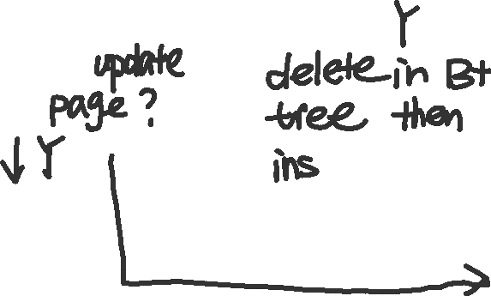



















DELETE (flow chart)

Slide 20





















DELETE (flow chart continued)

Slide 21
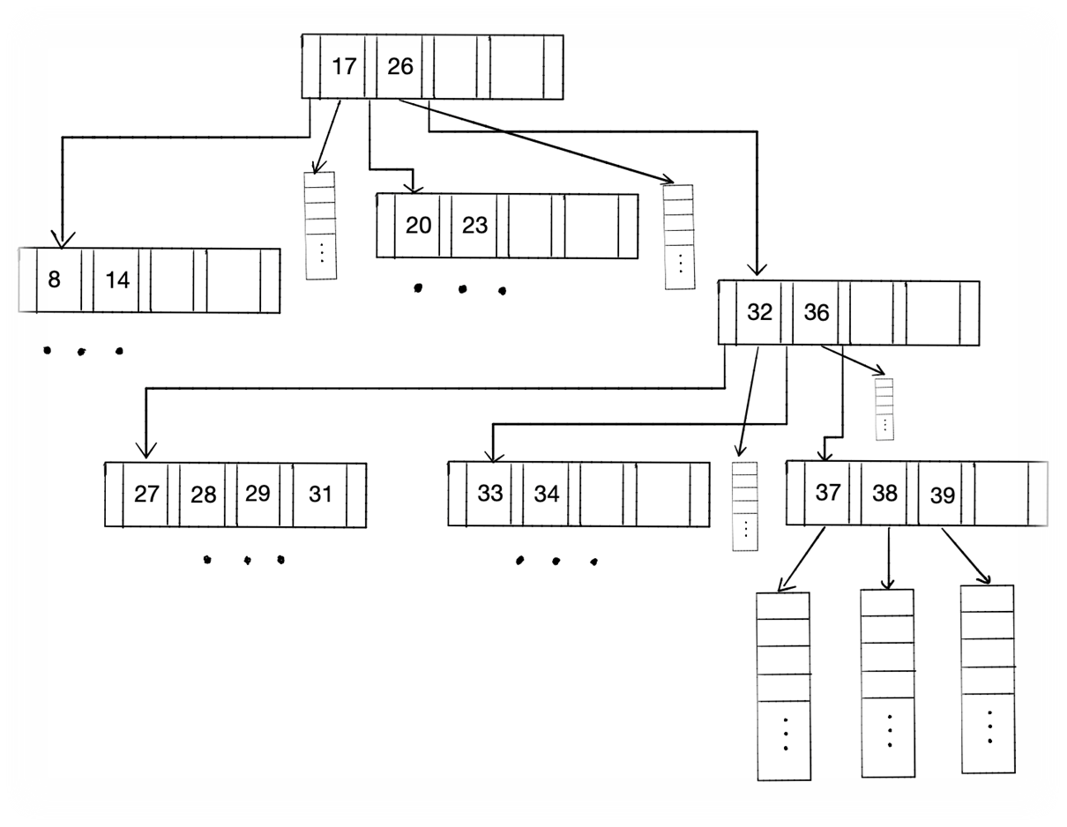
B Tree implementation
Insertion, deletion and search are similar.
Spider: A way to manage secondary index!

Slide 22
B Tree implementation
Insertion, deletion and search are similar.
Spider: A way to manage secondary index!
How to delete one record in spider?
Just find the node and remove the tuple pointers ->
empty spider? Then delete the node.

Slide 23
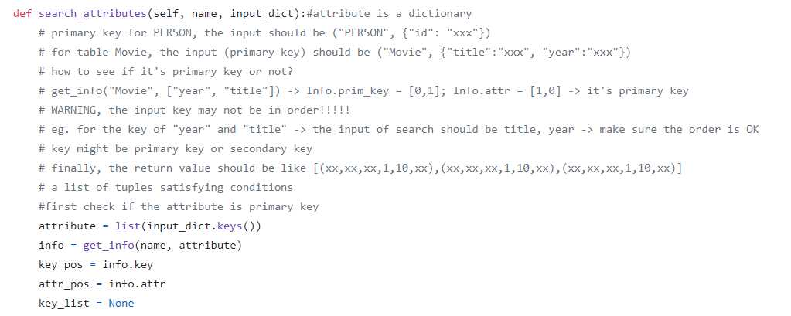











IO for query – search attributes
Just see the picture below

Slide 24
PART FIVE
05
Q&A

Slide 25

THANK YOU
🌳🍊👩🐶
Zhu Zhongbo, Xie Tian, Yang Zhaohua, Guan Zimu
GROUP 7

