Slide 1
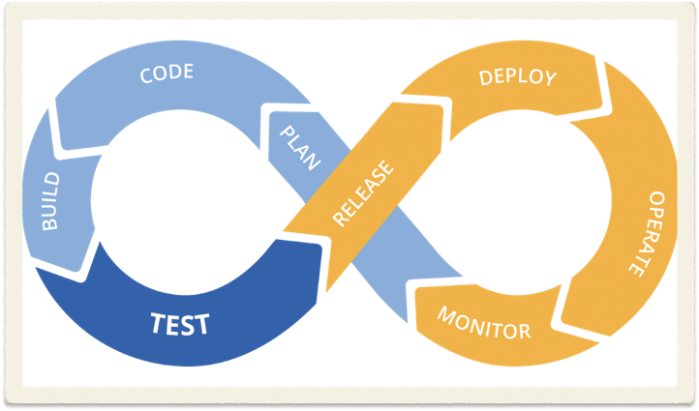
Continuous integration
and continuous deployment
With Travis

Slide 2

What is CI/CD?
Continuous Integration is the practice of integrating code into a shared repository and building/testing each change automatically, as early as possible - usually several times a day.
Continuous Delivery adds that the software can be released to production at any time, often by automatically pushing changes to a staging system.
Continuous Deployment goes further and pushes changes to production automatically.

Slide 3
Hot CI/CD tools
Jenkins
ElectricFlow
Octopus Deploy
DeployBot
TeamCity
CircleCI
Source: <<21 Automated Deployment Tools You Should Know>> from DevOps Zone-Opinion Mar. 15, 17

Slide 4
Hands-on practice
with Travis
——-Continuous Integration

Slide 5

Prerequisites
GitHub login
Project hosted as a repository on GitHub
Working code in your project
Working build or test script

Slide 6
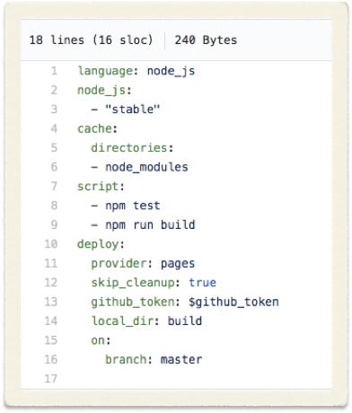
Enable the repository you want to build
Add a .travis.yml file to your repository to tell Travis CI what to do.
Add the .travis.yml file to git, commit and push, to trigger a Travis CI build
Make some changes to code

Slide 7
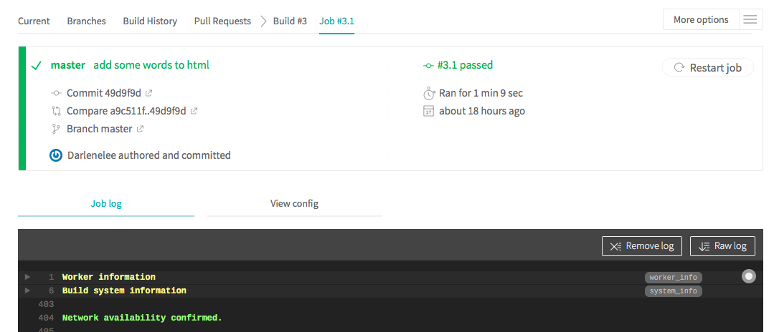

Slide 8
Security Issues
Github_token configuration
Github settings > developer settings > personal access tokens > generate new token
TravisCI settings > environmental variables

Slide 10

Add an icon to your repo:
[![Build Status](https://travis-ci.org/githubid/reponame.svg?branch=master)](https://travis-ci.org/githubid/reponame)

Slide 11
Hands-on practice
with Travis
——-Continuous Deployment

