Slide 1

Subreddit Classification
Pei Qing: r/EatCheapAndHealthy and r/Supplements
Elaine: r/Singapore and r/Malaysia

Slide 2
Problem statement
A business man in the FF fitness industry wants to expand his business by venturing into new market sector. However, he cannot decide whether to venture into selling supplements or seting up resturants that sells healthy and afforable food. He wants his team to do some market study using post from subreddit since it is the sixth-most-popular website.
Reddit admins sent one big dataset without seperating the subreddit post. Being a data analysts in the FF fitness company, I was assigned to seperate the posts and send to the relevent marketing team for market studies.

Slide 3
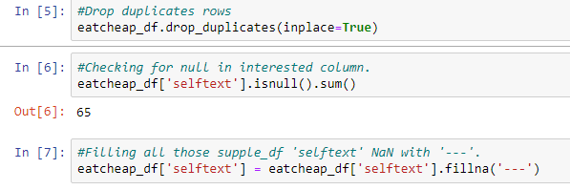
Cleaning

Slide 4
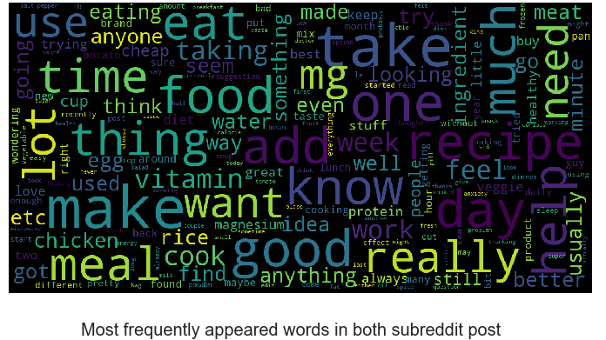
EDA 1

Slide 5
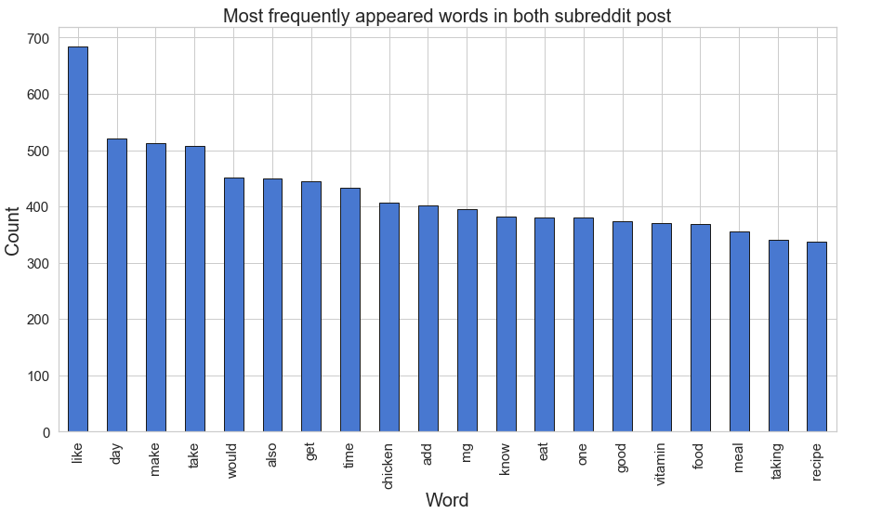
EDA 2

Slide 6
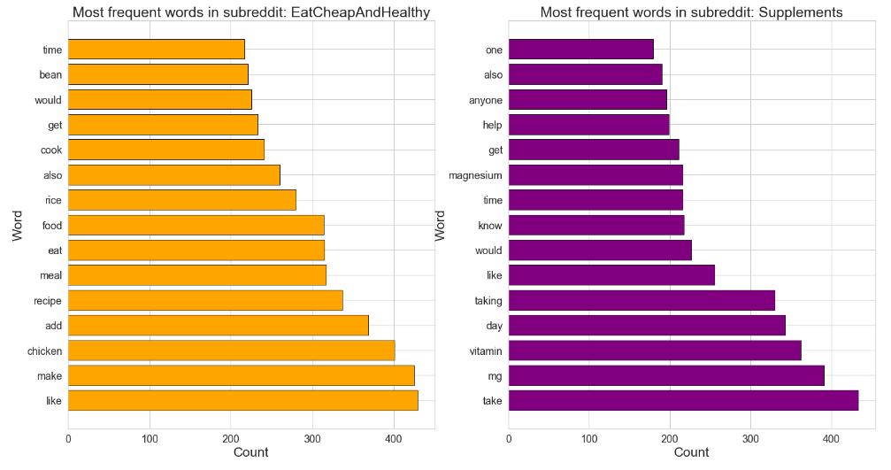
EDA 3

Slide 7
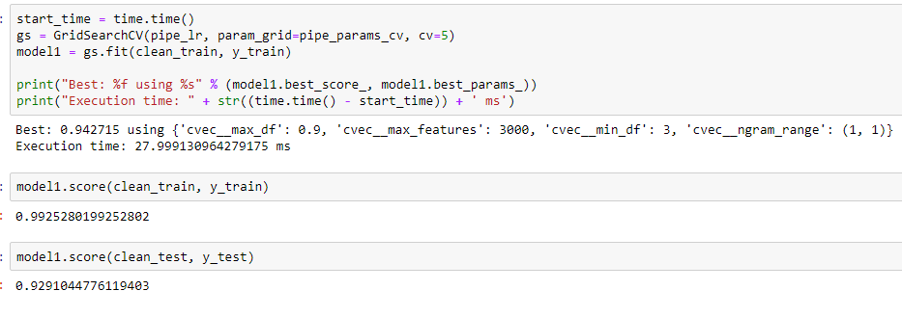
Model (Result)
1) Model 1 - Logistic Regresssion

Slide 8
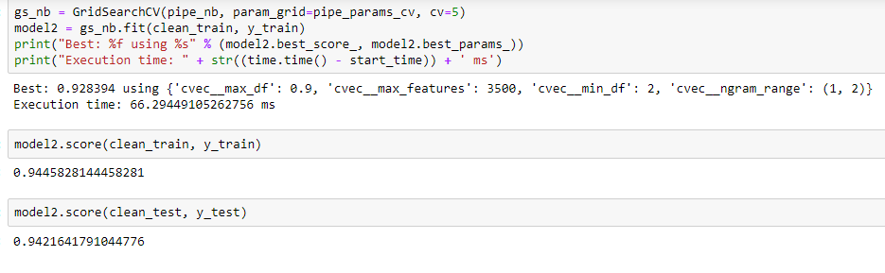
Model (Result)
2) Model 2 - Naive Bayes

Slide 9
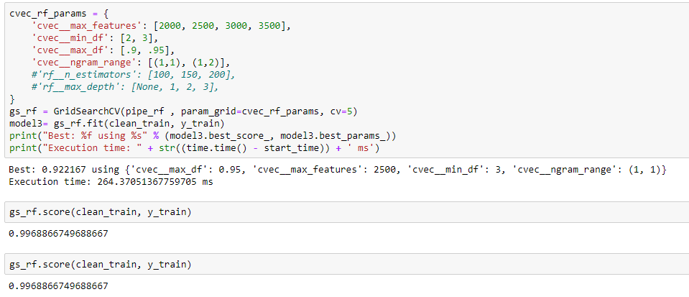
Model (Result)
3) Model 3 - Random Forest

Slide 10
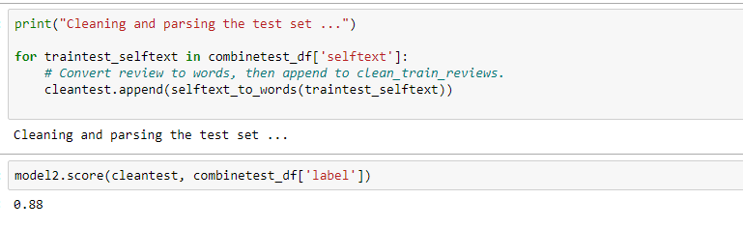
Model Select

Slide 11
Problem Statement
Using a binary classification model, this project aims to predict which subreddit a post belongs to – r/Singapore or r/Malaysia.
Would one be able to tell apart subreddit posts from r/Singapore and r/Malaysia?
How different really are the two countries?
Data source: r/Singapore, r/Malaysia (23 Sep – 22 Oct 2019)

Slide 12
Exploratory Data Analysis (EDA)
During EDA, the main issues explored were:
Lack of post content
Content lengths
Noise in the corpus

Slide 13
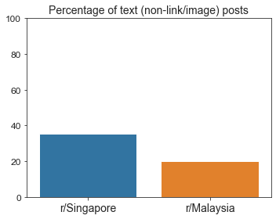
Lack of posts containing text
Notes:
Very few posts have texts in their body. Majority of the posts are links, images, or consists purely of e.g. a question in the title.
So it would not be a good idea to predict new posts based on their post contents as it would be absent in most of them.

Slide 14
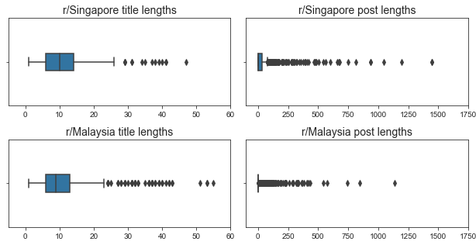
Content lengths
Titles
Posts
Notes:
Very right-skewed distributions with a lot of outliers
Title lengths between the two subreddits are quite similar
r/singapore has longer posts

Slide 15
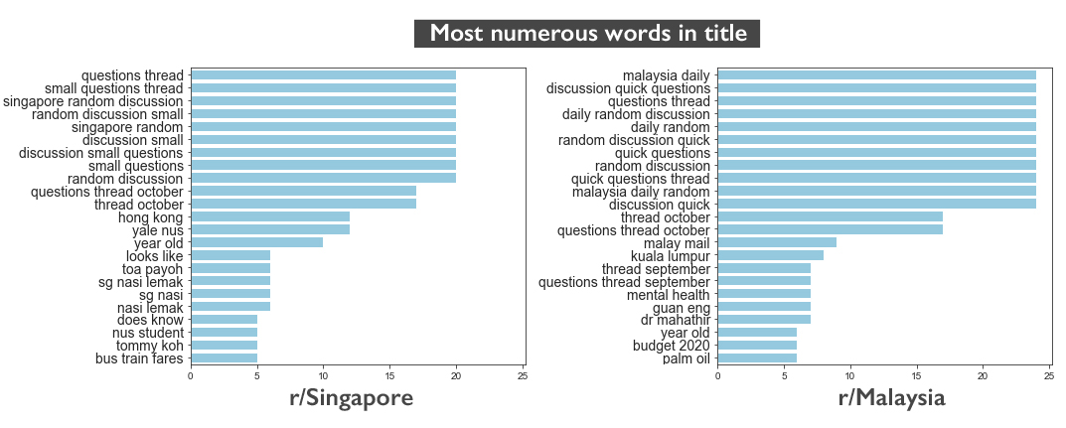
Noise
Notes:
During a preliminary EDA, the top words by count in the two subreddits are dominated by noise, which can be attributed to daily discussion posts made by moderators (evident from the "questions thread", "singapore random discussion", "malaysia daily random" etc)
These I will address during preprocessing

Slide 16
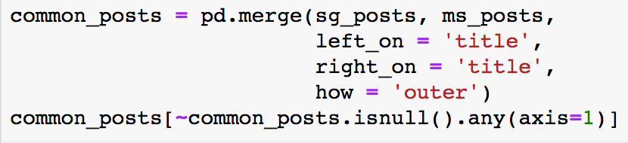
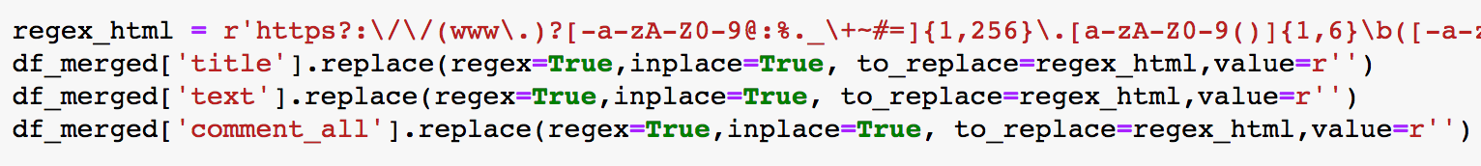
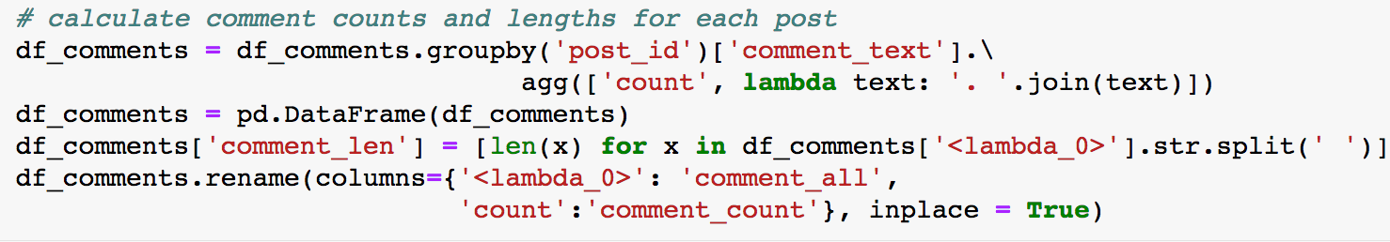
Preprocessing
1 | Check for crossposts | 4 | Remove html links
2 | Remove moderator posts | 5 | Engineer new features
 |  |  | Comment lengths: Title and post lengths:
3 | Fill null values
Notes:
Main preprocessing steps, mainly to
Clean up noise in the data
Engineer new features

Slide 17
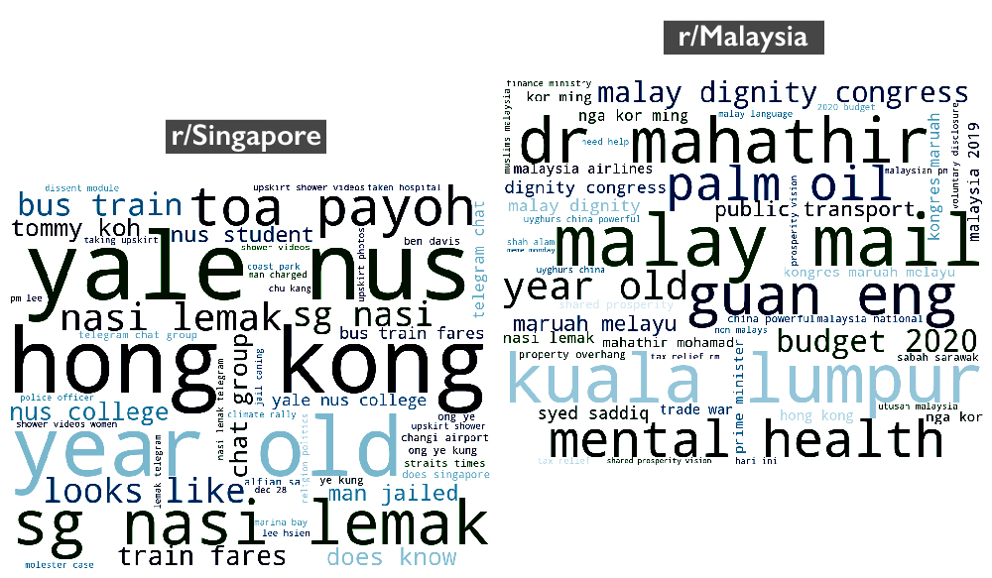
Most common words after preprocessing
Notes:
After preprocessing, I looked at the most common words again
Signals are clearer
Topic words are mostly unique to each subreddit

Slide 18
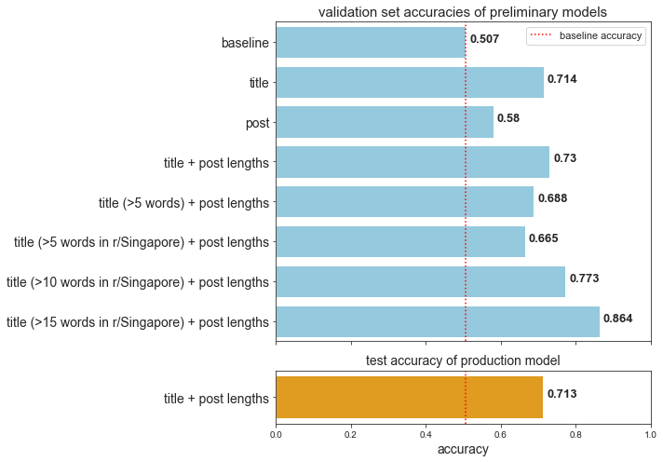
Model performance
Notes:
I tested a total of 8 models with a slightly different approach - I placed all my vectoriser and model parameters to test (like which vectoriser, which model etc) into a gridsearch so I can easily test different predictors.
Between title and post lengths, titles performed better, because of the lack of posts
Therefore I excluded posts from my model, and added post lengths to titles as post lengths are quite different between the subreddits (as shown in the previous slide)
This gave the best score so far, so I fine-tuned it further by excluding very short titles
As you can see the validation set accuracy improved with longer words used in the train and validation sets
However the median title length is actually 10, and using the best performing model would mean that it would only be able to accurately classify half the posts
Therefore I decided to go with the original model 4 as a production model (using title and post lengths), in order to have a model that balances performance with generalisation
With the production model, I got an accuracy of about 70% on the test data

Slide 19
Production model parameters:
Trained/predict using title and post lengths
CountVectorizer; max_df = 0.05, n_grams = (1, 3)
Normalising post lengths with RobustScaler
Multinomial naïve Bayes model

Slide 20
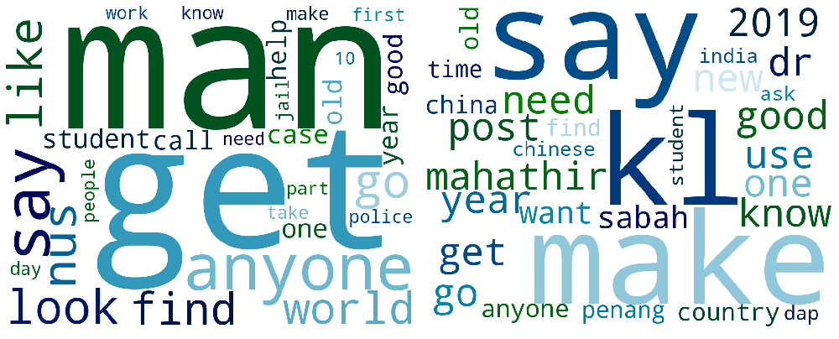
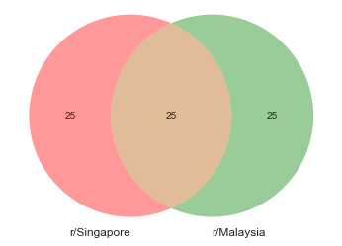
High overlap in words used for prediction
r/Singapore
r/Malaysia
Notes:
The misclassifications in the production model are likely due to the high degree of overlap in the words that have the highest probabilities of occurring in each class
This shows that there are some similarities in what people discuss in both subreddits

Slide 21
Conclusion and recommendations
The accuracy of the production model shows that posts in r/Malaysia and r/Singapore are fairly different, but still have a good amount of similarities
The differences are mainly due to differences in current affairs in Singapore and Malaysia
It would not be enough to train the model from past subreddit posts
To improve the model: using a bigger training corpus such as English news sites, which would contain more keywords on current affair issues
Further applications for such a classification model: automating CRM tasks based on topic matching, recommending similar articles to readers, spam email filtering

Slide 22
Extra slides

Slide 23
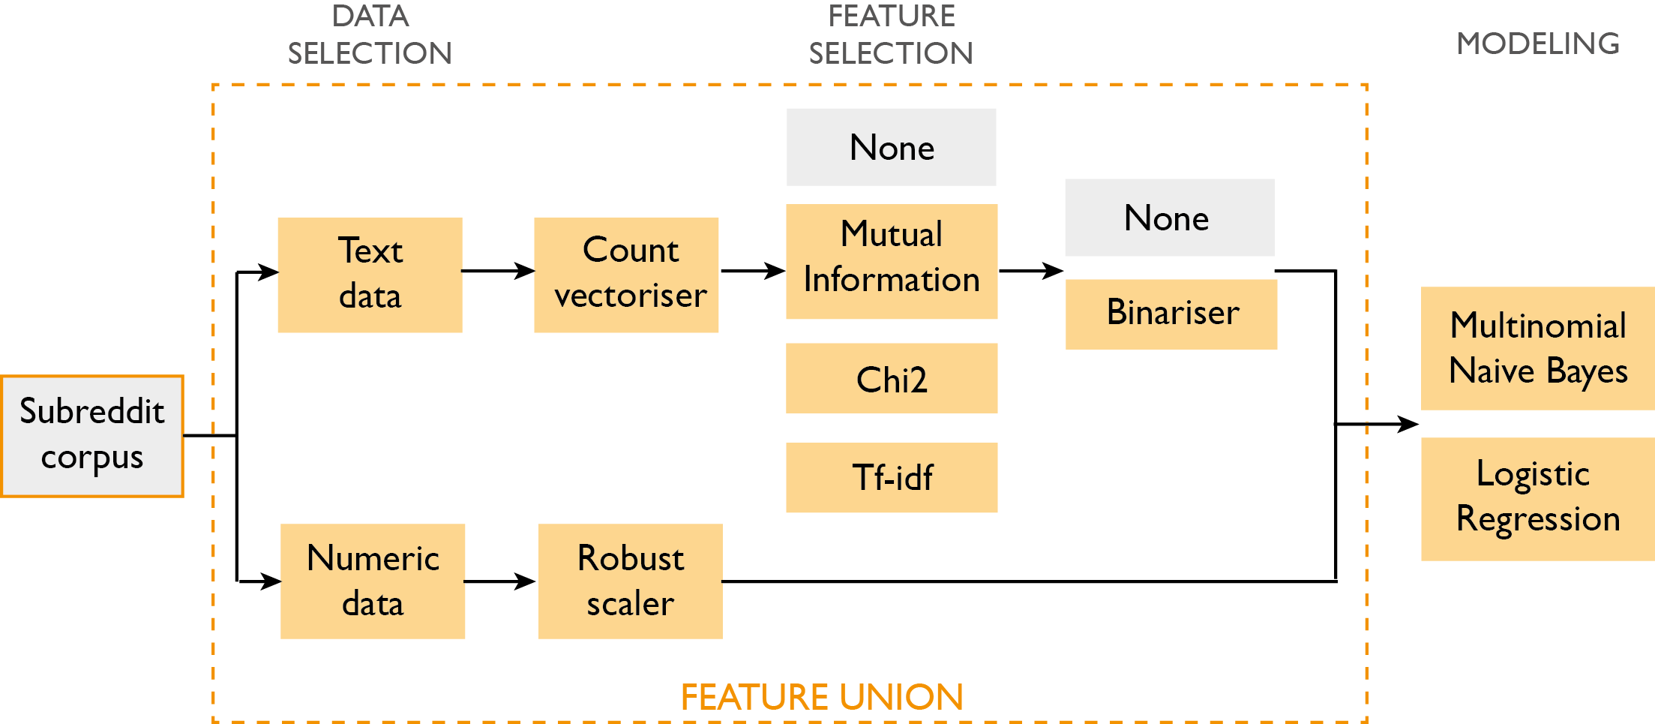

Slide 24
Model performance
No. | Predictor | Model | Train accuracy | Validation accuracy
1 | Baseline | Most frequent | 0.507 | 0.507
2 | Title | Multinomial NB | 0.994 | 0.714
3 | Posts | Logistic regression | 0.674 | 0.580
4 | Title + post lengths | Multinomial NB | 0.931 | 0.730
5 | Title (>5 words) + post lengths | Multinomial NB | 0.930 | 0.688
7 | Title (>10 words) + post lengths | Multinomial NB | 0.971 | 0.773
8 | Title (>15 words) + post lengths | Multinomial NB | 0.987 | 0.864
Notes:
I tested a total of 8 models with a slightly different approach - I placed all my vectoriser and model parameters to test (like which vectoriser, which model etc) into a gridsearch so I can easily test different predictors.
Between title and post lengths, titles performed better, because of the lack of posts
Therefore I excluded posts from my model, and added post lengths to titles as post lengths are quite different between the subreddits (as shown in the previous slide)
This gave the best score so far, so I fine-tuned it further by excluding very short titles
As you can see the validation set accuracy improved with longer words used in the train and validation sets
However the median title length is actually 10, and using the best performing model would mean that it would only be able to accurately classify half the posts
Therefore I decided to go with the original model 4 as a production model (using title and post lengths), in order to have a model that balances performance with generalisation

Slide 25
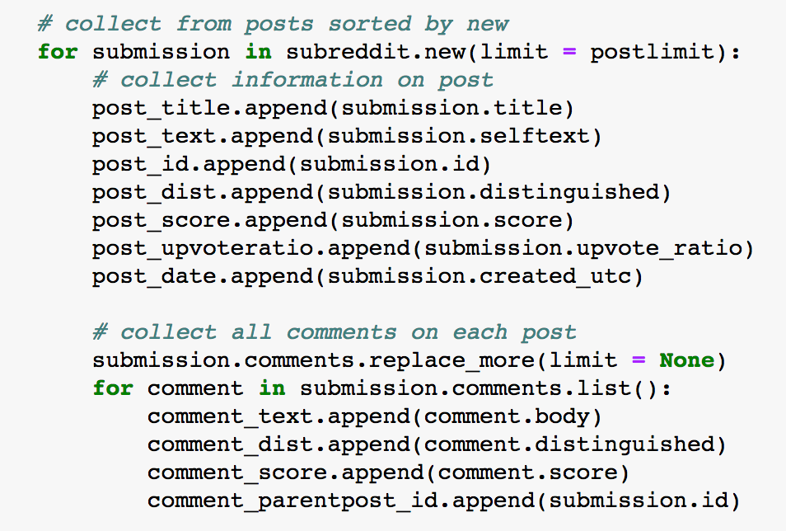
Data acquisition
Data was obtained from the two subreddits using the Python Reddit API Wrapper (PRAW)

Slide 26
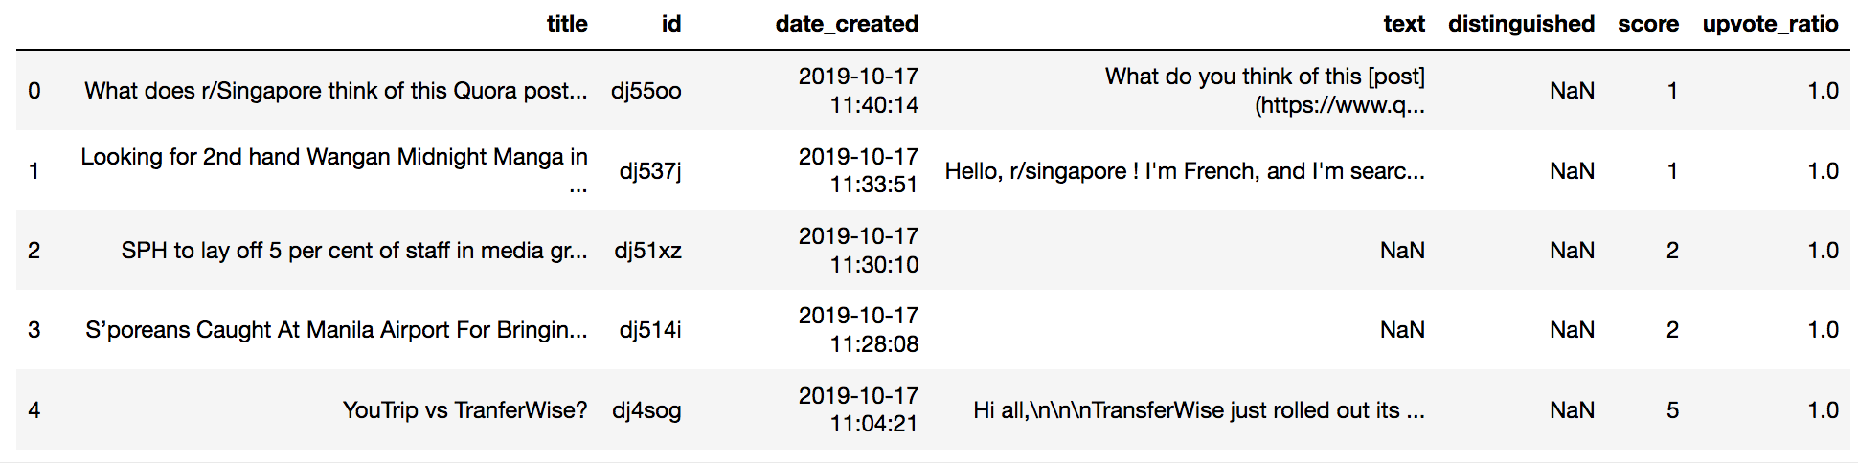
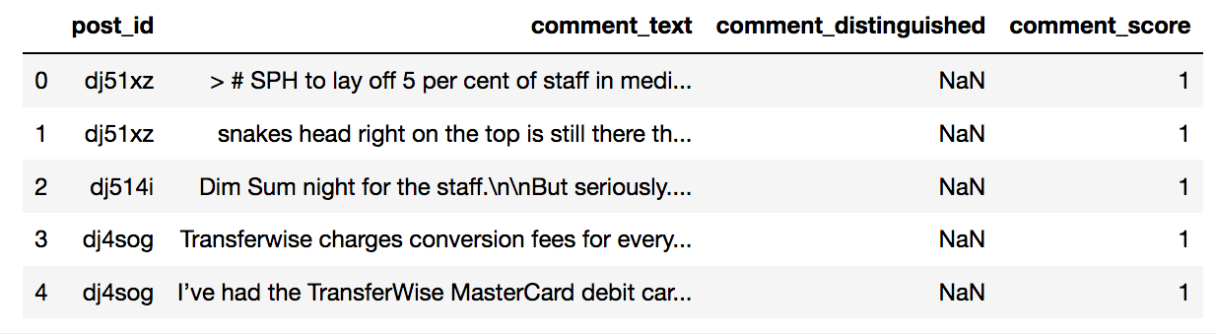
Data acquisition
Example of posts scraped from r/Singapore
Example of comments scraped from r/Singapore

