Slide 1

Subreddit Classification
Classifying posts in r/Singapore and r/Malaysia

Slide 2
Problem Statement
Using a binary classification model, this project aims to predict which subreddit a post belongs to – r/Singapore or r/Malaysia.
Would one be able to tell apart subreddit posts from r/Singapore and r/Malaysia?
How different really are the two countries?
Data source: r/Singapore, r/Malaysia (23 Sep – 22 Oct 2019)

Slide 3
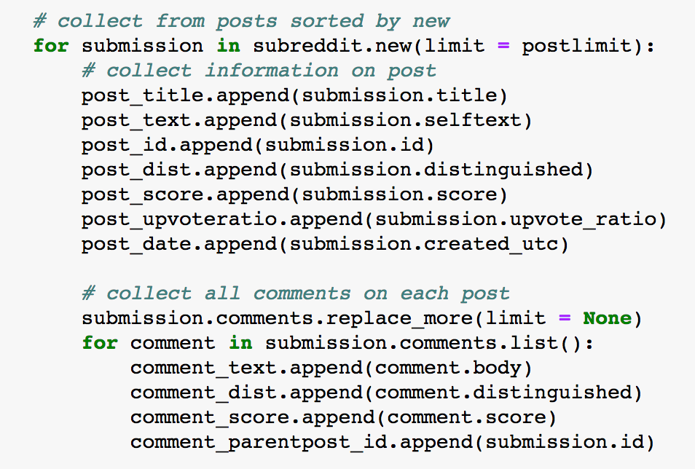
Data acquisition
Data was obtained from the two subreddits using the Python Reddit API Wrapper (PRAW)

Slide 4
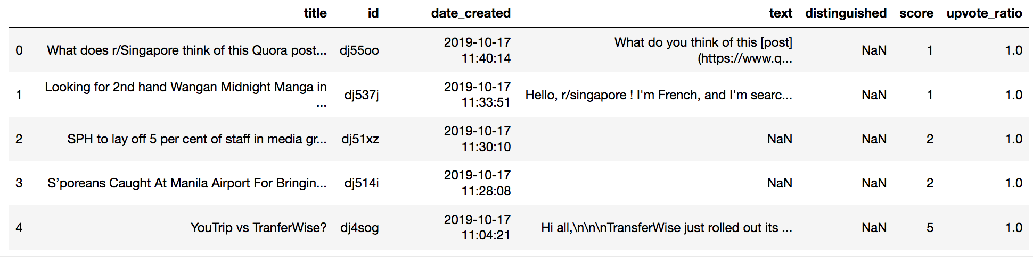
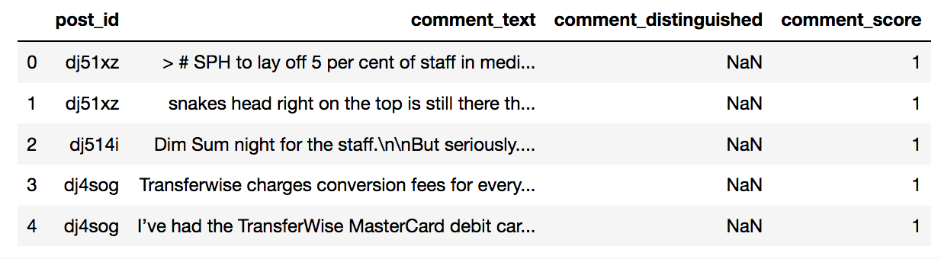
Data acquisition
Example of posts scraped from r/Singapore
Example of comments scraped from r/Singapore

Slide 5
Exploratory Data Analysis (EDA)
During EDA, the main issues explored were:
Lack of post content
Content lengths
Noise in the corpus

Slide 6
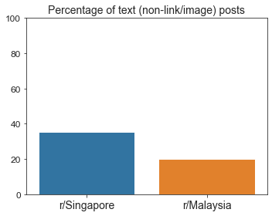
Lack of posts containing text
Notes:
Very few posts have texts in their body. Majority of the posts are links, images, or consists purely of e.g. a question in the title.
So it would not be a good idea to predict new posts based on their post contents as it would be absent in most of them.

Slide 7
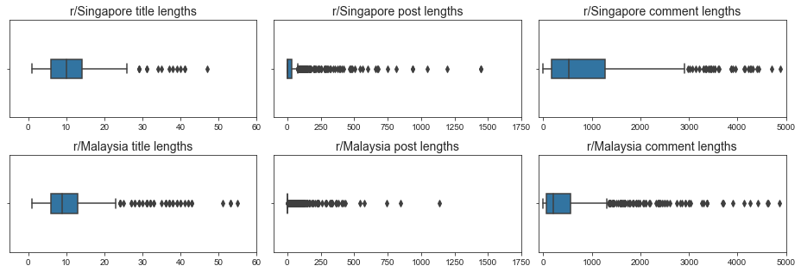
Content lengths
Titles
Posts
Comments
Notes:
Very right-skewed distributions with a lot of outliers
Title lengths between the two subreddits are quite similar
r/singapore has longer posts and longer comments

Slide 8
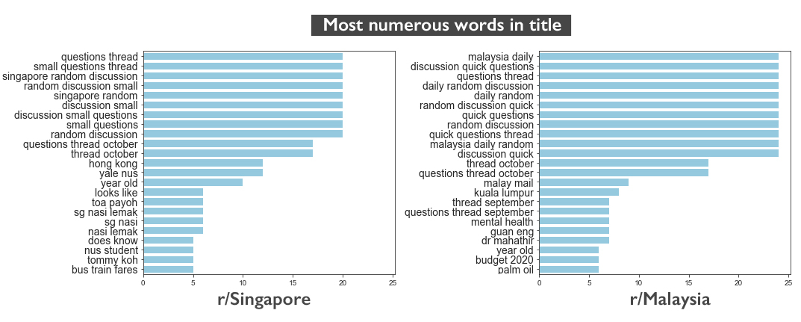
Noise
Notes:
The top words by count in the two subreddits are dominated by noise, which can be attributed to daily discussion posts made by moderators (evident from the "questions thread", "singapore random discussion", "malaysia daily random" etc)

Slide 9
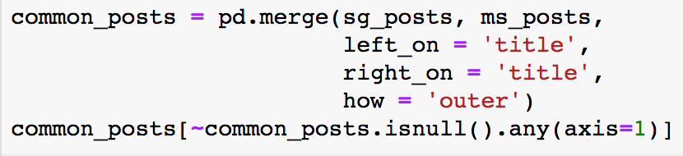
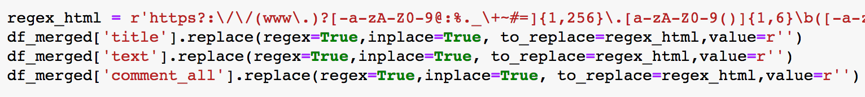
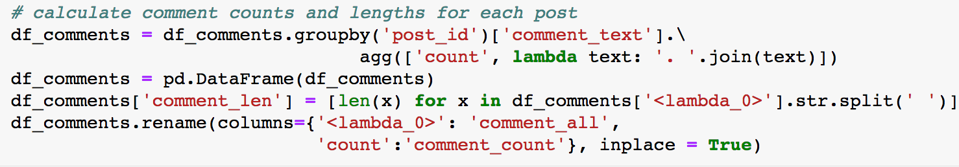
Preprocessing
1 | Check for crossposts | 4 | Remove html links
2 | Remove moderator posts | 5 | Engineer new features
 |  |  | Comment lengths: Title and post lengths:
3 | Fill null values
Notes:
Main preprocessing steps, mainly to
Clean up noise in the data
Engineer new features

Slide 10
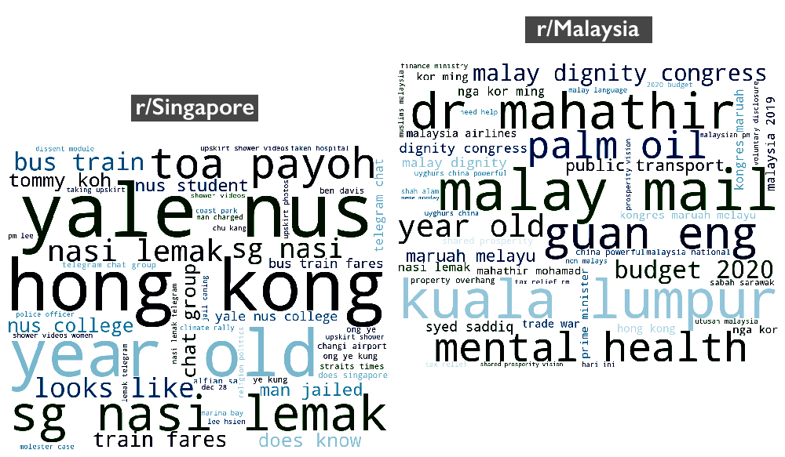
Most common words after preprocessing
Notes:
After preprocessing, I looked at the most common words again
Signals are clearer
Topic words are mostly unique to each subreddit

Slide 11
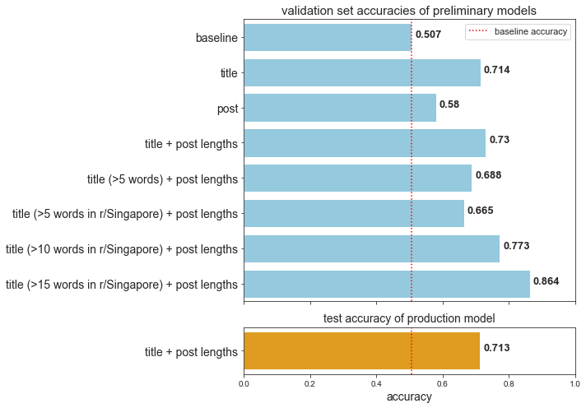
Model performance
Notes:
I tested a total of 8 models with a slightly different approach - I placed all my vectoriser and model parameters to test (like which vectoriser, which model etc) into a gridsearch so I can easily test different predictors.
Between title and post lengths, titles performed better, because of the lack of posts
Therefore I excluded posts from my model, and added post lengths to titles as post lengths are quite different between the subreddits (as shown in the previous slide)
This gave the best score so far, so I fine-tuned it further by excluding very short titles
As you can see the validation set accuracy improved with longer words used in the train and validation sets
However the median title length is actually 10, and using the best performing model would mean that it would only be able to accurately classify half the posts
Therefore I decided to go with the original model 4 as a production model (using title and post lengths), in order to have a model that balances performance with generalisation
With the production model, I got an accuracy of about 70% on the test data

Slide 12
Production model parameters:
Trained/predict using title and post lengths
CountVectorizer; max_df = 0.05, n_grams = (1, 3)
Normalising post lengths with RobustScaler
Multinomial naïve Bayes model

Slide 13

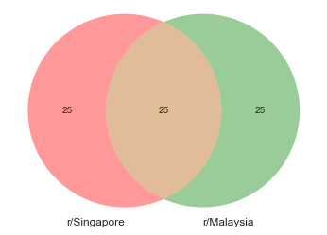
High overlap in words used for prediction
r/Singapore
r/Malaysia
Notes:
The misclassifications in the production model are likely due to the high degree of overlap in the words that have the highest probabilities of occurring in each class
This shows that there are some similarities in what people discuss in both subreddits

Slide 14
Conclusion and recommendations
The accuracy of the production model shows that posts in r/Malaysia and r/Singapore are fairly different, but still have a good amount of similarities
The differences are mainly due to differences in current affairs in Singapore and Malaysia
It would not be enough to train the model from past subreddit posts
To improve the model: using a bigger training corpus such as English news sites, which would contain more keywords on current affair issues
Further applications for such a classification model: automating CRM tasks based on topic matching, recommending similar articles to readers, spam email filtering

Slide 15
Extra slides

Slide 16
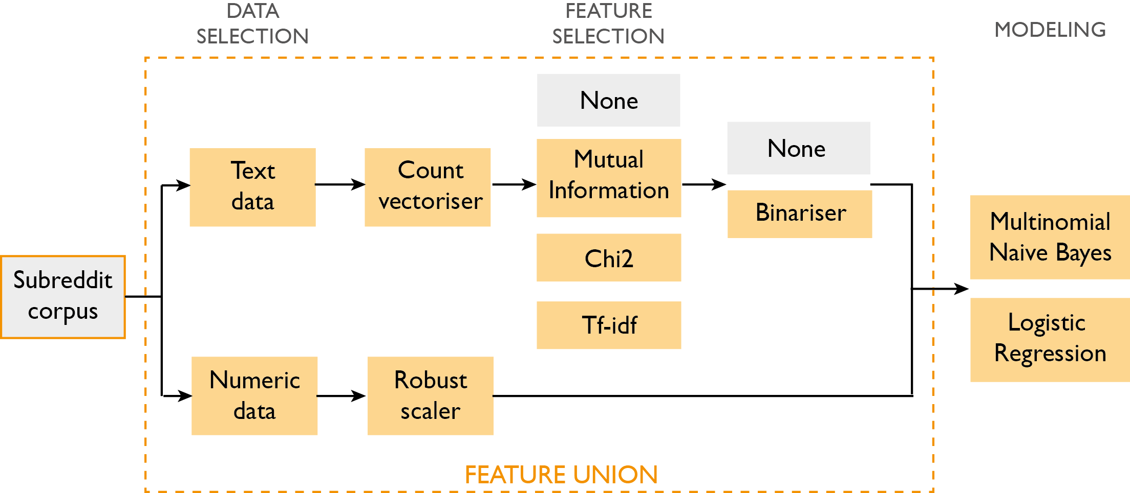

Slide 17
Model performance
No. | Predictor | Model | Train accuracy | Validation accuracy
1 | Baseline | Most frequent | 0.507 | 0.507
2 | Title | Multinomial NB | 0.994 | 0.714
3 | Posts | Logistic regression | 0.674 | 0.580
4 | Title + post lengths | Multinomial NB | 0.931 | 0.730
5 | Title (>5 words) + post lengths | Multinomial NB | 0.930 | 0.688
7 | Title (>10 words) + post lengths | Multinomial NB | 0.971 | 0.773
8 | Title (>15 words) + post lengths | Multinomial NB | 0.987 | 0.864
Notes:
I tested a total of 8 models with a slightly different approach - I placed all my vectoriser and model parameters to test (like which vectoriser, which model etc) into a gridsearch so I can easily test different predictors.
Between title and post lengths, titles performed better, because of the lack of posts
Therefore I excluded posts from my model, and added post lengths to titles as post lengths are quite different between the subreddits (as shown in the previous slide)
This gave the best score so far, so I fine-tuned it further by excluding very short titles
As you can see the validation set accuracy improved with longer words used in the train and validation sets
However the median title length is actually 10, and using the best performing model would mean that it would only be able to accurately classify half the posts
Therefore I decided to go with the original model 4 as a production model (using title and post lengths), in order to have a model that balances performance with generalisation

