Slide 1
West Nile Virus Prediction
Chenyze | Elaine | Kenrick | Raphael

Slide 2
Agenda
What we set out to achieve
The data
What’s in it
What were the challenge
What were the patterns
How we built a model to make predictions
How we fared
What were the key predictors of WNV?

Slide 3
Problem Statement
Predict probability of the presence of the West Nile Virus for a given location, date, and species
Understand key factors (features) for making accurate predictions…
… is it the amount of rainfall (i.e. total precipitation)?
… is it the temperature?
… is it the location?
… is it the frequency of spraying?
Just as importantly… what’s the timeframe for looking at weather / spraying patterns?

Slide 4
EDA: train.csv (a.k.a. trap records)
10,506 rows with 12 columns
No null rows
1,062 duplicate rows (~10.11%)

Slide 5
EDA: train.csv (a.k.a. trap records)
10,506 rows with 12 columns
No null rows
1,062 duplicate rows (~10.11%)
1) Multiple rows for the same
date
trap
location (latitude and longitude)
species
WHY?
mosquitoes collected from traps
sorted by species
bundled into “pools” of <= 50 with records for each “pool”
—> combined the split records

Slide 6
EDA: train.csv (a.k.a. trap records)
10,506 rows with 12 columns
No null rows
1,062 duplicate rows (~10.11%)
2) WnvPresent
does not indicate proportion of WNV-carrying mosquitoes in each test tube
binary indicator; threshold unknown
WHY?
1 test tube: 1 “pool” of <= 50 mosquitoes
Mosquito diluent to “homogenise” all specimens in each test tube

Slide 7
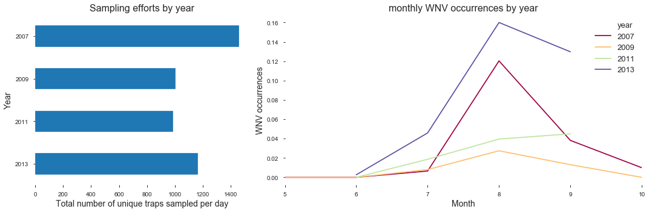
EDA: traps.csv
Records: May-Oct only

Slide 8
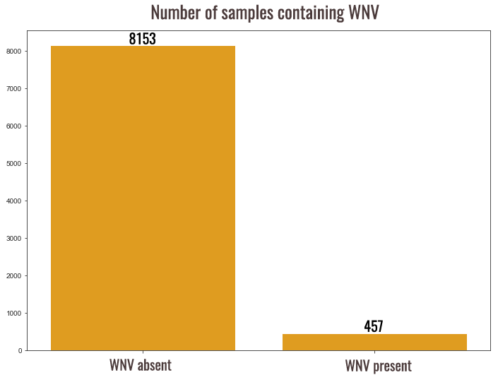
Imbalanced dataset

Slide 9
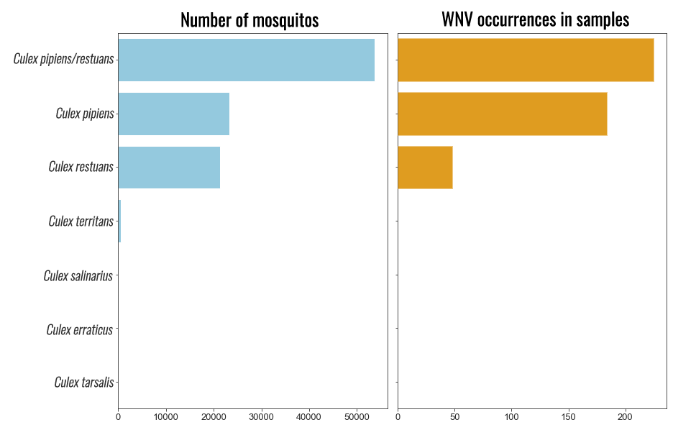
3 main species
responsible for WNV

Slide 10
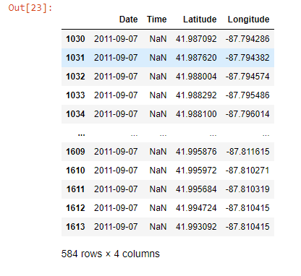
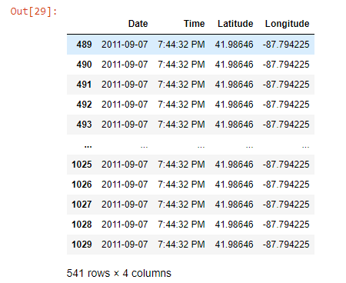
EDA: spray.csv
14,835 rows with 4 columns
584 null rows (~3.94%)
543 duplicate rows (~3.66%)
1) null cells
Caused by missing data in ‘Time’ column —> drop column
2) duplicate cells
Caused by data entry error —> drop duplicates

Slide 11
EDA: Correlation between spray activity and mosquitos
Created Geometric Point for trap and spray records using GeoPandas
For each trap record, look up spray records within a certain date range (e.g. ndays = 7)
Assign the nearest spray location to each trap record
Calculate distance to the spray location
Ran this for ndays = 3, 7, 14
 | NumMosquitos | WnvPresent
n3_spray_dist_deg | 0.030035 | -0.06716
n7_spray_dist_deg | -0.11254 | -0.10416
n14_spray_dist_deg | -0.11867 | -0.08696
CONCLUSION: extremely weak correlation between spray distance and mosquitoes

Slide 12
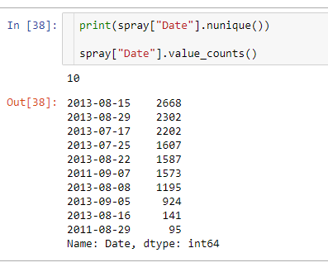
EDA: spray.csv
10 unique spray dates
2 spray dates in 2011
8 spray dates in 2013

Slide 13
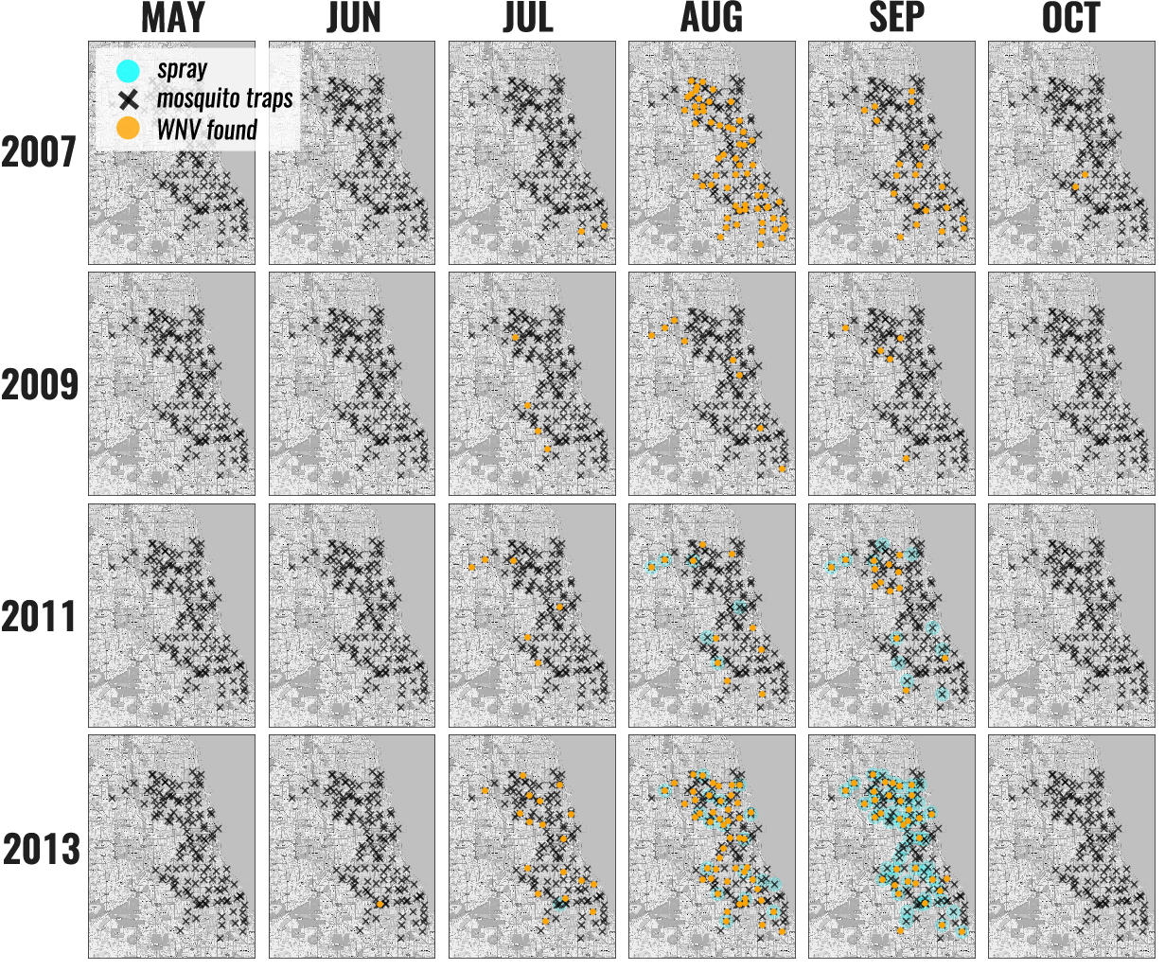
Spraying activity was highest in 2013 Sep
whereas WNV peaks in August

Slide 14
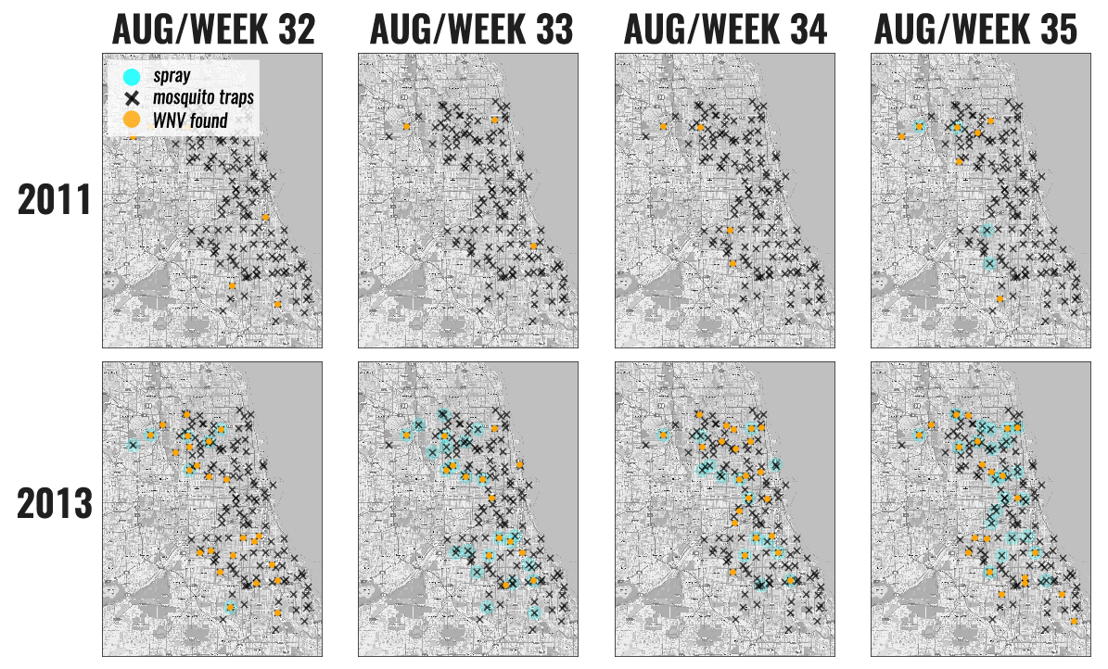
Spraying in August did not have noticeable effects

Slide 15
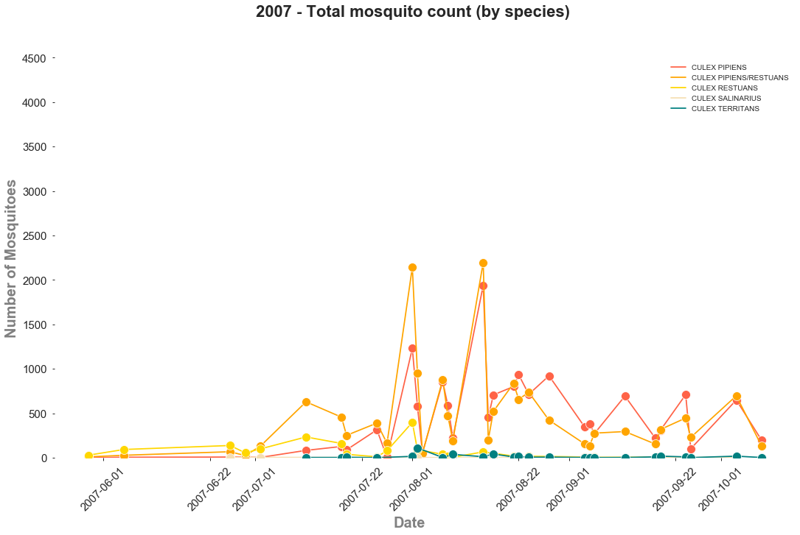
No spray records for this year

Slide 16
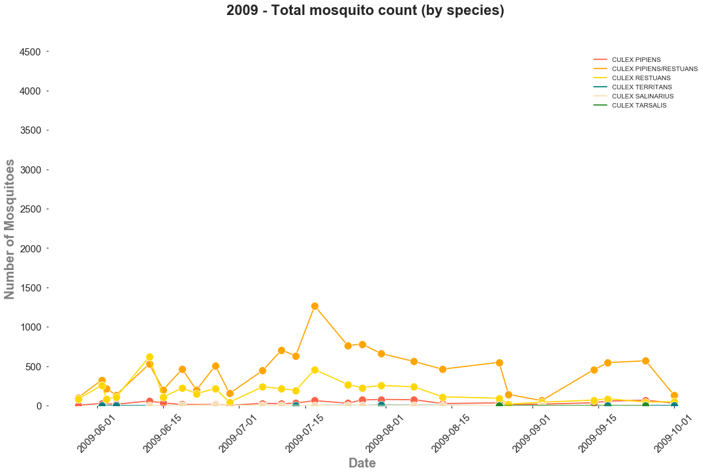
No spray records for this year

Slide 17
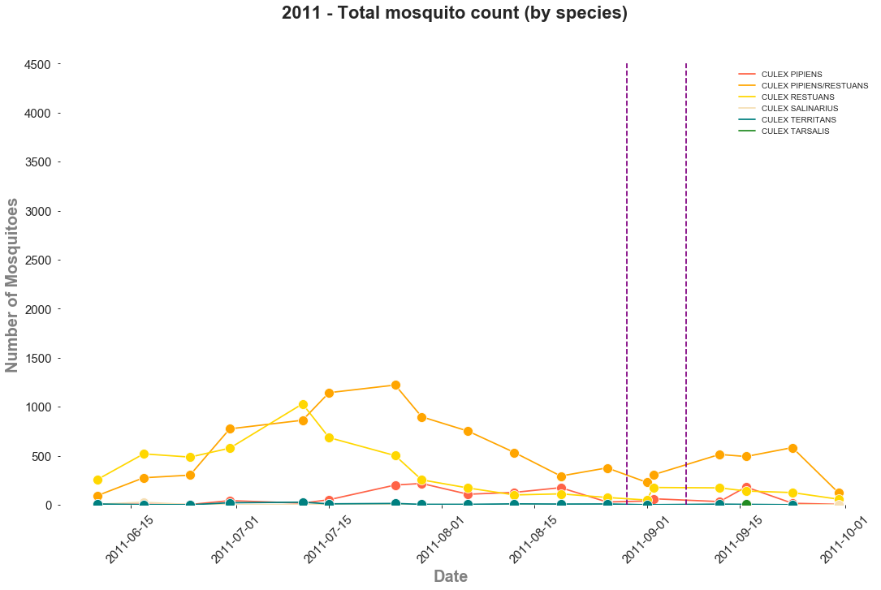
Spray activity

Slide 18
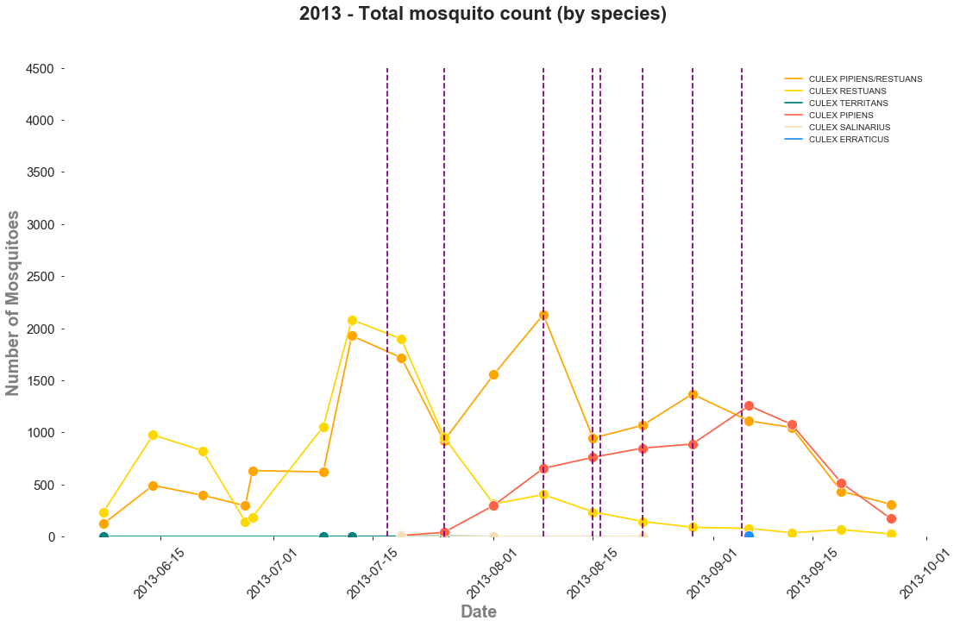
Spray activity

Slide 19
CONCLUSION: spraying does not have a clear effect on mosquito population
Spray activity

Slide 20
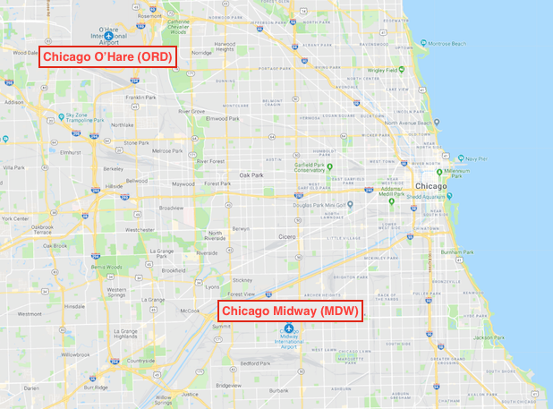
EDA: weather.csv
Daily records May-Oct, 2007 -2014
2 weather stations
2944 rows, 22 columns
No duplicate rows

Slide 21
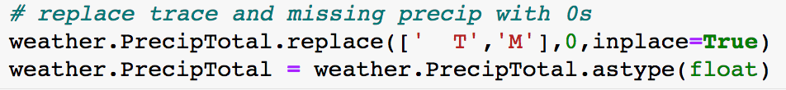
EDA: weather.csv
Daily records May-Oct, 2007 -2014
2 weather stations
2944 rows, 22 columns
No duplicate rows
Missing values represented by M: drop
Trace values represented by T: replace with 0

Slide 22
Revisiting the heatmap
WNV most prevalent in Aug - Sep

Slide 23
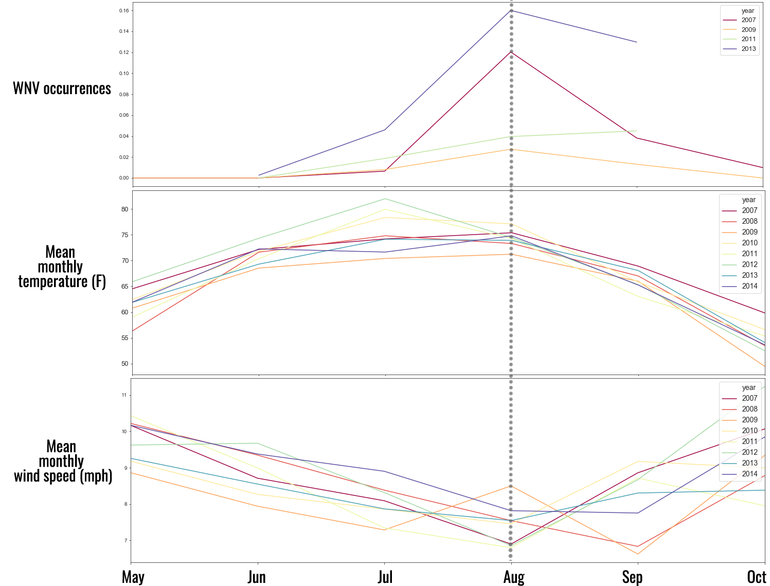
Likely effects of weather

Slide 24
Pre-processing summary
Parsed dates into year, month, week of year, day of year
Dropped all address-related columns, except latitude and longitude
Mapped nearest weather station for each trap record to retrieve weather conditions

Slide 25
Feature Engineering
Tavg x (PrecipTotal + 1)
Likely synergistic effects of temperature and precipitation on mosquito life cycle
Relative humidity
Certain humidity ranges (45-65%) are conducive for mosquito breeding
Temperature range
Delayed weather parameters
The average life cycle (eggs - adult) of a Culex mosquito: 14 days (Kauffman et al., 2017)
Daylight hours
DBSCAN
Clustering trap records using lat, long, and number of mosquitos. 102 clusters.
Rearing of Culex spp. and Aedes spp. Mosquitoes (2017) Elizabeth Kauffman et al. Bio Protoc 7(17)

Slide 26
Models tried
Logistic Regression
K Nearest Neighbors
Support Vector Machine
Decision Tree Classifier
Random Forest Classifier
Extra Trees Classifier
Voting Classifier (DT, RF, ET, KNN, LR)
XGBoost

Slide 27
Modeling results
Model | Rolling days | Best Hyper-Parameters | Validation ROC-AUC
Logistic Regression | 18 | {'lr__C': 1.0, 'lr__class_weight': 'balanced', 'lr__penalty': 'l1', 'lr__solver': 'liblinear'} | 0.79293
K Nearest Neighbor | 10 | {‘knn__metric’: ‘manhattan’, ‘knn__n_neighbors’: 15, knn__weights’: ‘uniform’} | 0.73425
Decision Tree | 14 | {‘dt__max_depth’:7, dt__min_samples_leaf’: 3, ‘dt__min_samples_split’: 20} | 0.80157
Random Forest | 14 | {‘rf__max_depth’: 10, ‘rf__min_samples_leaf’: 10, ‘rf__n_estimators’: 150} | 0.82908
Extra Trees | 14 | {‘et__max_depth’: 20, ‘et__min_samples_leaf’: 10, ‘et__n_estimators’: 150} | 0.82321
XGBoost | 14 | {‘xgc__colsample_bytree’: 0.5, ‘xgc__eval_metric’:’auc’, xgc__learning_rate’:0.1, ‘xgc__max_depth’:3, ‘xgc__n_estimators’: 500, ‘xgc__scale_pos_weight’:19, ‘xgc__subsample’: 0.7} | 0.83291

Slide 28
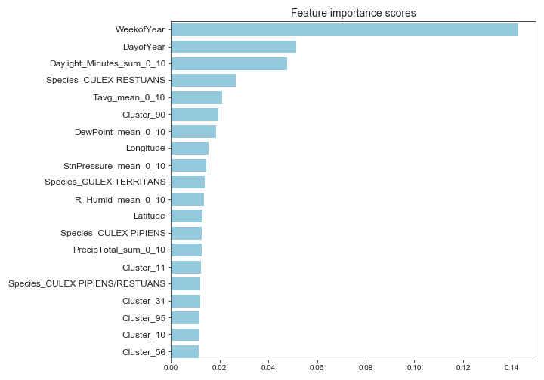
Final model: XGBoost

Slide 29
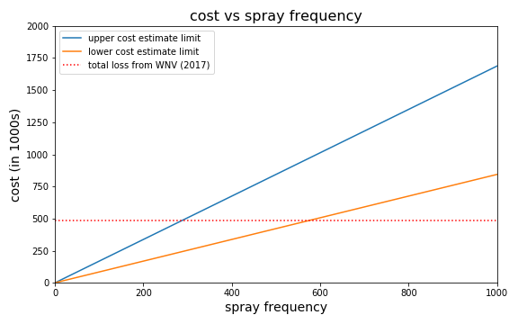
Cost-benefit analysis
Costs (using pesticide Zenivex E4):
1 sprayer truck:
$844 - $1688 per spraying event (~5 hrs)
approximate area of effect of 0.6 km²
~1000 trucks to cover Chicago (606.1 km²)
Benefits:
Fewer people dying/falling ill —> increased workplace productivity and healthcare savings
90 WNV cases in 2017:
total income loss ~ -$19,353
medical bill ~ -$450,000
Money saved from reducing WNV cases would fund about 300 - 500 sprays

Slide 30
Conclusion & Recommendations
WNV is more prevalent under certain conditions:
Certain weeks/days of the year
Longer daylight hours
Higher average temperatures
Spraying efforts should be focused during these periods
Not enough evidence to conclude that current spraying efforts are effective
Need better designed spraying regime: e.g. spray at the beginning of august

Slide 31
SCRAPS AFTER THIS

Slide 33
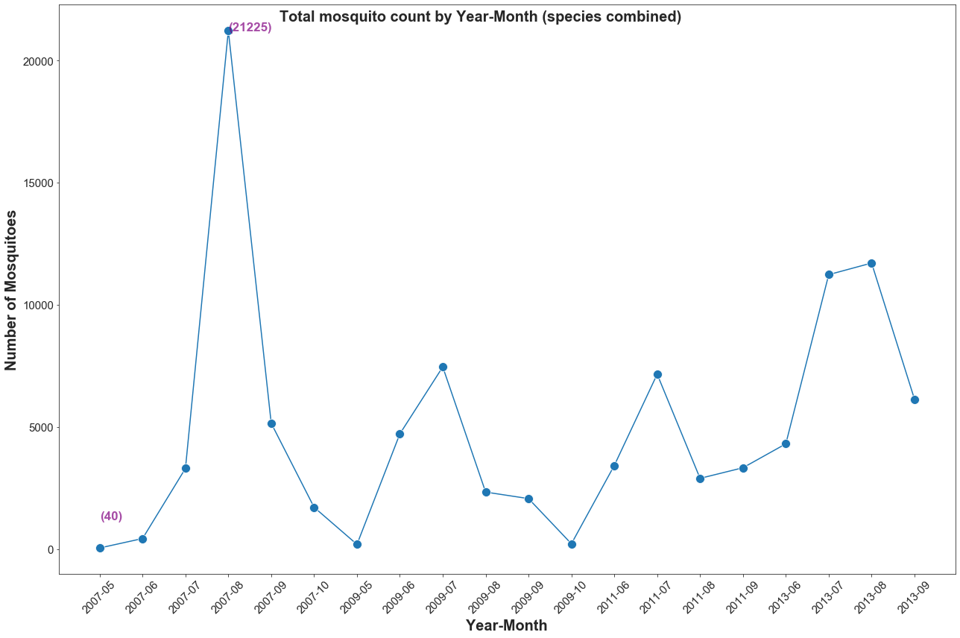

Slide 34
Feature Engineering
featuretools library
To do deep feature synthesis using automated feature engineering
Aggregations/transformations tried:
'multiply_numeric'
'percentile'
'cum_mean'
'cum_sum'
'haversine' - calculate circular distance between two points on a sphere
'and' - boolean function to compare if two values are both True
'divide_by_feature'
'subtract_numeric'
'diff'
'add_numeric’

Slide 35
Feature Engineering
featuretools library
To do deep feature synthesis using automated feature engineering
Aggregations/transformations tried:
'multiply_numeric'
'percentile'
'cum_mean'
'cum_sum'
'haversine' - calculate circular distance between two points on a sphere
'and' - boolean function to compare if two values are both True
'divide_by_feature'
'subtract_numeric'
'diff'
'add_numeric’
406 new features, but still < 8610 rows

Slide 36
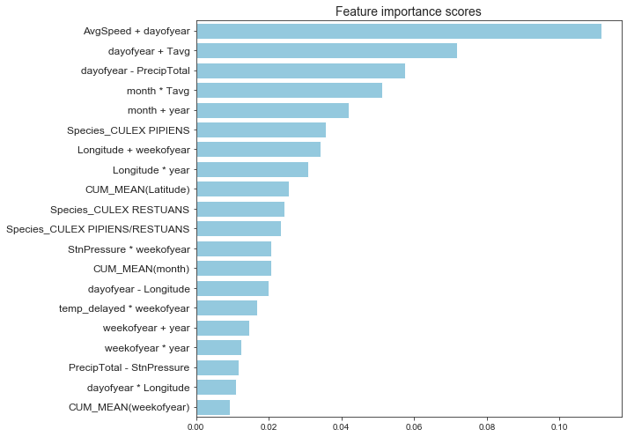
Feature Engineering

Slide 37
Modeling: Of trees and forests
Round one: Compare models
Decision Tree Classifier
Random Forest Classifier
Extra Trees Classifier
Voting Classifier
Best: Extra Trees Classifier
Highest ROC-AUC score for validation set
Minimal overfitting
Model | Parameters | train ROC-AUC | validation ROC-AUC
Decision Tree Classifier | {'max_depth': 5, 'min_samples_leaf': 4, 'min_samples_split': 20} | 0.7897020 | 0.7486660
Random Forest Classifier | {'max_depth': 10, 'min_samples_leaf': 20, 'n_estimators': 100} | 0.8388980 | 0.8349510
Extra Trees Classifier | {'max_depth': 10, 'min_samples_leaf': 20, 'n_estimators': 50} | 0.8365630 | 0.8440520
Voting Classifier | hyper-tuned DT, RF, ET | 0.9048682 | 0.8346046

Slide 38
Modeling: Of trees and forests
Model | Feature Engineering | Private score | Public score
Extra Trees Classifier | Kept Year, Month, Day, Week features With rolling weather conditions from 14 days ago | 0.71901 | 0.72772
Extra Trees Classifier | Dropped Year, Month, Day; Retained Week With rolling weather conditions from 14 days ago | 0.69116 | 0.70558
Extra Trees Classifier | With rolling weather conditions from 14 days ago, and 10 days ago | 0.7018 | 0.71639
Extra Trees Classifier | Balanced training data by oversampling WNV-containing rows (imblearn) With rolling weather conditions from 14 days ago, and 10 days ago | 0.59237 | 0.5779

Slide 39
Modeling: XGBoost
Multiple runs of GridSearchCV to test different sets of parameters
Stopped when best_parameters converged

Slide 40
Modeling: XGBoost
Round | Tuning parameters | Beset parameters | train ROC-AUC | validation ROC-AUC
1 | {'classifier__max_depth': [5, 10], 'classifier__gamma': [0.5, 1, 3], 'classifier__reg_lambda': [2, 5], 'classifier__reg_alpha': [1.5, 2, 3]} | {'classifier__gamma': 3, 'classifier__max_depth': 10, 'classifier__reg_alpha': 1.5, 'classifier__reg_lambda': 2}
2 | {'classifier__max_depth': [2, 5], 'classifier__gamma': [3, 5], 'classifier__reg_lambda': [2, 2.5, 3], 'classifier__reg_alpha': [1, 1.5]}
3 | {'classifier__max_depth': [1, 2], 'classifier__gamma': [2, 2.5, 3], 'classifier__reg_alpha': [0.5, 1]}

Slide 41
Modeling results
Model | Rolling days | Best Hyper-Parameters | Validation ROC-AUC | Private score | Public score
Logistic Regression | 18 | {'lr__C': 1.0, 'lr__class_weight': 'balanced', 'lr__penalty': 'l1', 'lr__solver': 'liblinear'} | 0.79293
K Nearest Neighbor | 10 | {‘knn__metric’: ‘manhattan’, ‘knn__n_neighbors’: 15, knn__weights’: ‘uniform’} | 0.73425
Decision Tree | 14 | {‘dt__max_depth’:7, dt__min_samples_leaf’: 3, ‘dt__min_samples_split’: 20} | 0.80157
Random Forest | 14 | {‘rf__max_depth’: 10, ‘rf__min_samples_leaf’: 10, ‘rf__n_estimators’: 150} | 0.82908
Extra Trees | 14 | {‘et__max_depth’: 20, ‘et__min_samples_leaf’: 10, ‘et__n_estimators’: 150} | 0.82321
XGBoost | 14 | {‘xgc__colsample_bytree’: 0.5, ‘xgc__eval_metric’:’auc’, xgc__learning_rate’:0.1, ‘xgc__max_depth’:3, ‘xgc__n_estimators’: 500, ‘xgc__scale_pos_weight’:19, ‘xgc__subsample’: 0.7} | 0.83291

