Slide 1
ACT & SAT Analysis
Choosing the best state to improve SAT participation rates

Slide 2
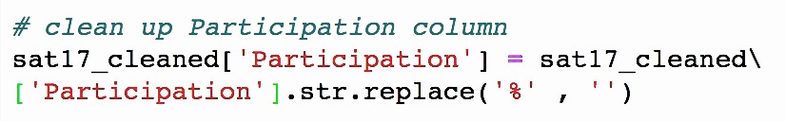
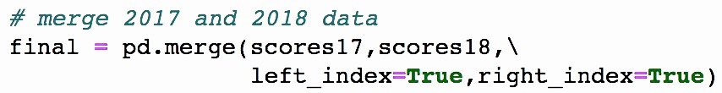
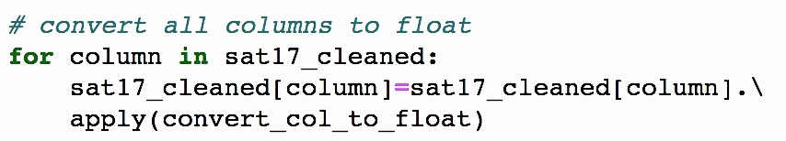
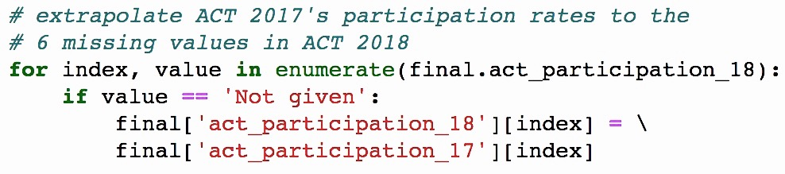
Challenges with raw participation rate data Sources: SAT & ACT participation rates in 2017 and 2018
1 | Extra characters | 3 | Merged both tests’ and both years’ dataframes
2 | Incorrect data types | 4 | Missing values in certain rows
Notes:
The data I looked at for this project are the SAT and ACT participation rates for 2017 and 2018
There were some challenges
The % sign in participation rate columns were causing the to be read as strings instead of integers, so had to be removed.
And then I standardised all columns to float and merged both years’ dataframes
For ACT 2018, there were some missing participation rates that I was not able to find online. For these I extrapolated 2017’s participation rates.’
So with the cleaned data

Slide 3
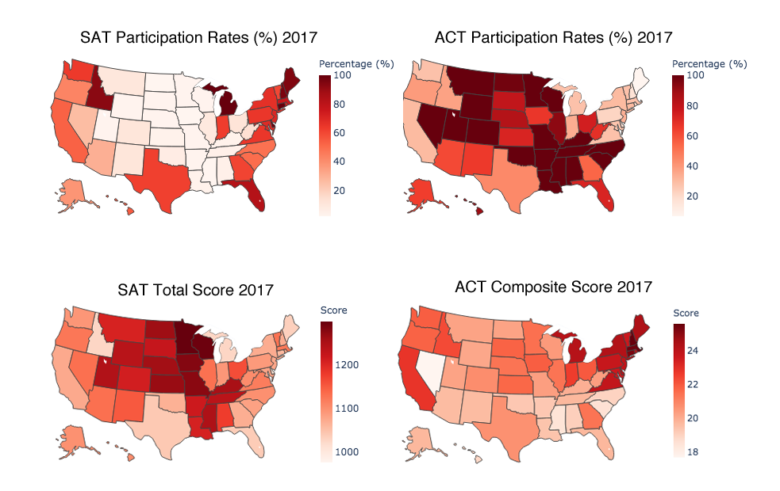

SAT participation rates are lower where ACT participation rates are high
Notes:
These maps show the SAT and ACT participation rates in 2017 and 2018. The darker colours represent higher participation rates and the lighter ones mean lower participation rates.
From here you can see that SAT participation rates are lower (in the middle) where ACT participation rates are high.

Slide 4
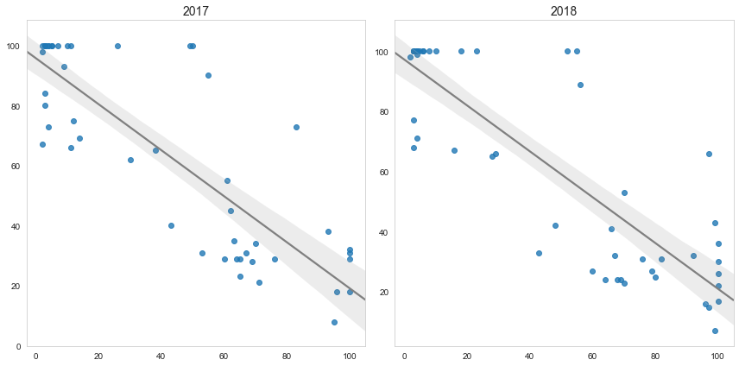
Inverse relationship between SAT and ACT participation rates.
ACT participation rates (%)
r = -0.74
r = -0.85
SAT participation rates (%)
Notes:
So there is an inverse relationship between SAT and ACT participation rates.
These are the ACT participation rates plotted against SAT participation rates. The inverse relationship means that the higher the SAT participation rates are, the lower the ACT participation rates (bottom right of graph), and vice versa for ACT (top left of graph).

Slide 5
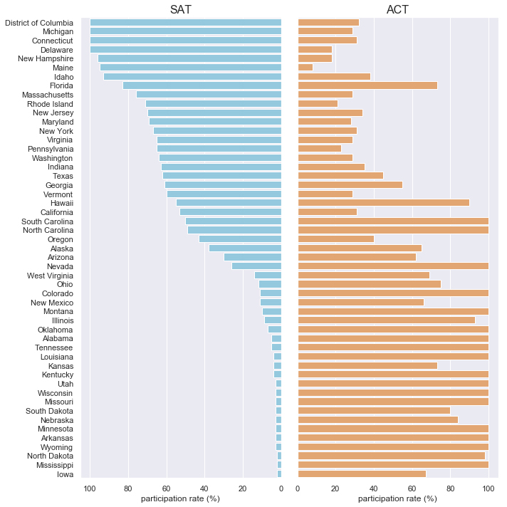
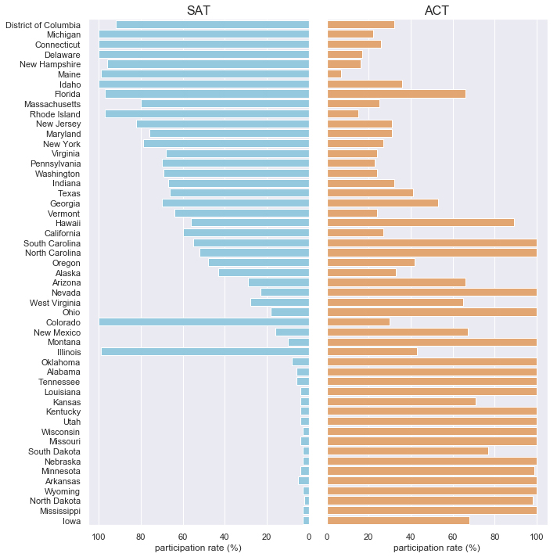
High participation rates in one test usually means low participation rates in the other.
Participation rates (%) 2017
Participation rates (%) 2018
Notes:
Here we can see the inverse relationship between the two tests again. This is the SAT and ACT participation rates by state, in decreasing order of SAT participation rates.
This trend was observed for both years (click for 2018 graph)
And this was especially true in states where the SAT or the ACT is compulsory. So states with 100% participation rates (the ones here for SAT and the ones here for ACT) generally had the lowest participation rates for the other test.
States with compulsory ACT also saw especially low SAT participation rates.
Some states also saw drastic changes in participation rates, like Colorado and Illinois (SAT), and Ohio (ACT)
These are the states that either made the SAT compulsory in 2018 or made the ACT compulsory

Slide 6
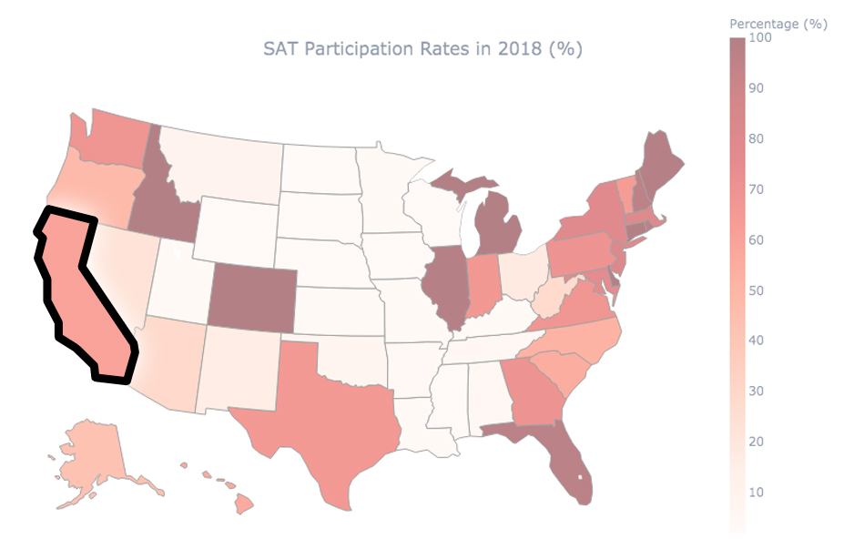
Efforts should focus on improving SAT participation rates in California
1. No mandatory ACT testing
2. Low rates
3. High population density
Notes:
Based on the data I think efforts to improve SAT participation rates should be focused on California.
The first reason is that it does not have mandatory ACT tests.
As we saw earlier, mandatory testing for the ACT usually results in very low participation rates of the SAT.
It will be difficult to raise low participation rates in SAT without first making ACT voluntary.

Slide 7
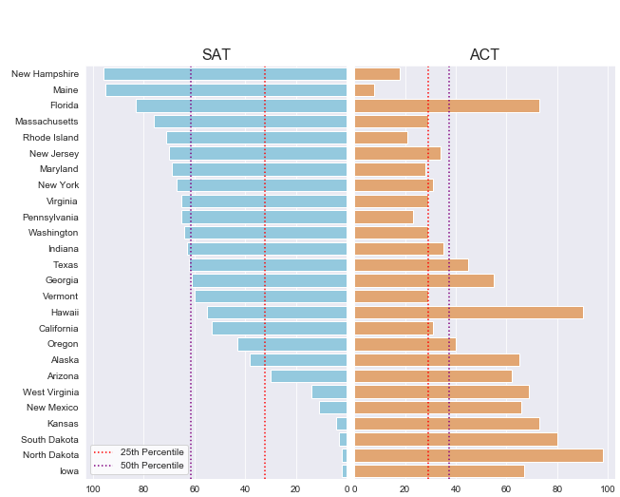
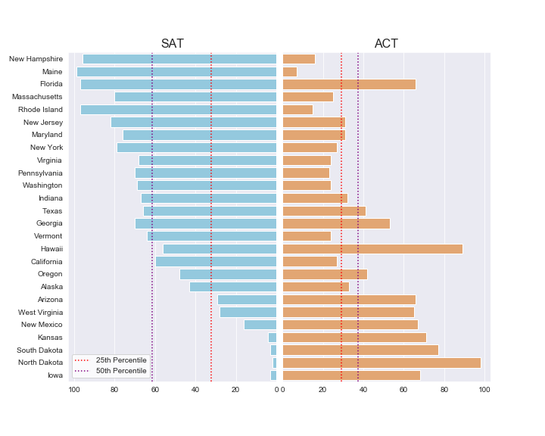
Participation rates (%) 2018
Participation rates (%) 2017
Efforts should focus on improving SAT participation rates in California
1. No mandatory ACT testing
2. Low rates
3. High population density
Notes:
The second reason is that California has pretty low SAT participation rates currently.
it wasn’t among the lowest, but it was still below the 50th percentile in both 2017 and 2018.

Slide 8
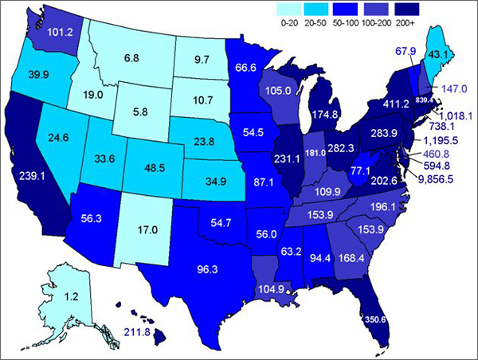
Efforts should focus on improving SAT participation rates in California
1. No mandatory ACT testing
2. Low rates
3. High population density
US population density 2010 (individuals per square mile).
Source: US Office of Energy Efficiency and Renewable Energy (https://www.energy.gov/eere/vehicles/fact-661-february-7-2011-population-density)
Notes:
And lastly, California was the most populous state in the US in both 2017 and 2018, and it is also the 9th most dense .
This map shows the population densities in the US, and you can see that California is one of the most dense.
This far surpasses the population densities of the other states that also had low participation rates.
This would allow greater efficiency in distributing efforts to increase SAT participation rates.

Slide 9
Recommendations
Reducing SAT fees, either by lowering cost of participation or having more inclusive fee waiver criteria
Make practice resources more readily available (online or in libraries)
Notes:
These are some possible measures to improve participation rates
SAT fees could be reduced, either by lowering cost of participation or having more inclusive fee waiver criteria
Practice resources could be made more readily available, either online or in libraries

Slide 11
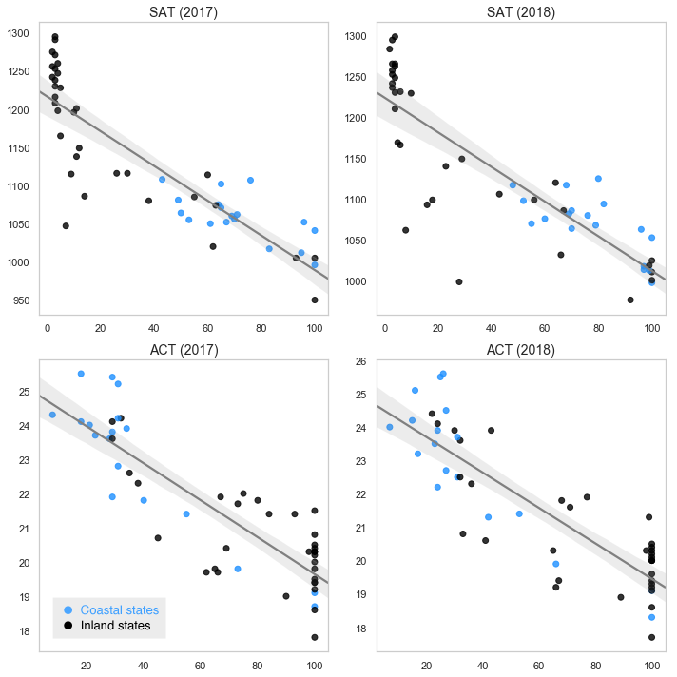
Participation rates are negatively correlated with test scores
Test score
Participation rate (%)
Notes:
Participation rates are negatively correlated with test scores
States with 100% participation rates are all clustered in the lower half of the range of test scores
And as mentioned in the previous slide, coastal states don’t perform as well for SAT. But for ACT they’re more spread out along the range of scores despite participation rates.

Slide 12
Extra slides

Slide 13
SAT is more popular among the coastal states, whereas ACT is more popular inland.
SAT scores tend to be lower among the coastal states; ACT scores are less varied.
Notes:
SAT is more popular among the coastal states, whereas ACT is more popular inland.
However SAT scores tend to be lower among the coastal states. For ACT the scores are less varied.
The states that saw the biggest changes were the ones that implemented mandatory tests (Colorado, Illinois, Ohio).
From these maps you can also begin to see an inverse relationship between participation rates and total score
States with generally low participation rates had higher average scores
Which leads to the next slide

Slide 14
Data Processing
Final dataset:
State | SAT 2017 |  |  |  | ACT 2017 |  |  |  |  | 2018
 | Participation (%) | ERW Score | Math Score | Total Score | Participation (%) | Reading Score | Math Score | Science Score | Composite Score | …
Alabama | 5 | 593 | 572 | 1165 | 100 | 19.7 | 18.4 | 19.4 | 19.2 | …
Alaska | 38 | 547 | 533 | 1080 | 65 | 20.4 | 19.8 | 19.9 | 19.8 | …
… | … | … | … | … | … | … | … | … | … | …
v
v
v
v
Notes:
The cleaned dataset looks like this.
- The key columns are the participation rates and the total scores.

