Slide 1

Machine learning: Applying classification models to predict categorical identity
Tao Zhou & Zeping Zhang
KU Leuven Campus groupT Leuven
2021.12

Slide 2
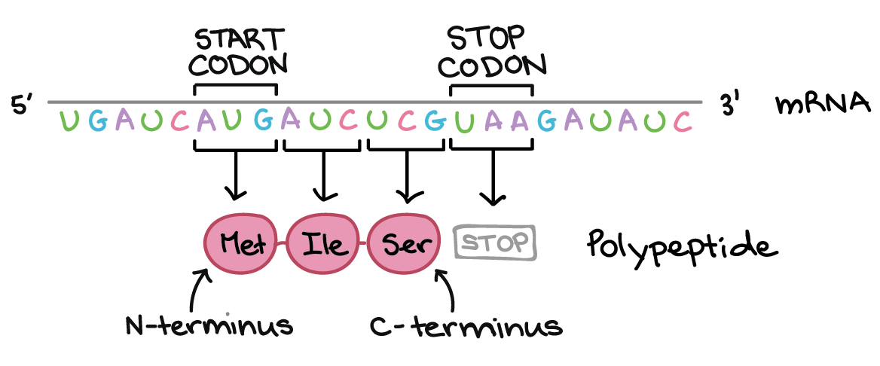
Motivation
Analyze the codon usage frequencies instead of coding DNA sequence
Notes:
Different organisms not only differ in the amino acid sequence of their proteins but also the degree to which they use synonymous codons for different amino acids. The inherent redundancy of the genetic code allows the same amino acid to be specified by one to five different codons, so there are many different nucleic acids to describe the primary structure of a given protein. Therefore, the coding DNA sequence can carry more information than is required to code the amino acid sequence. To simplify the procedure of nucleic acids classification, instead of analyzing individual nucleotide sequences themselves, it’s much easier to study it from the usages of different synonymous codons.

Slide 3
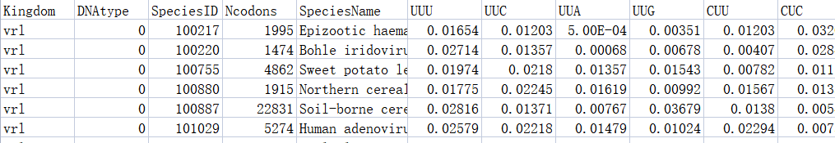
Dataset and features
Column 1: Kingdom (Output)
Column 2: DNAtype
Column 3: SpeciesID
Column 4: Ncodons
Column 5: SpeciesName
Columns 6-69: codon (header: nucleotide bases; entries: frequency of usage (5 digit floating point number)) (Input)
Notes:
The first column 'Kingdom' is a 3-letter code, which is the output of the dataset. The second column 'DNAtype', The third column ’SpeciesID’, The forth column ’Ncodons’ and the fifth column ’SpeciesName’ are not related to our topic. The headers from the sixth column to the sixty-ninth column are nucleotide bases, including 'UUU', 'UUA', 'UUG', 'CUU', etc. and entries are the codon usage frequencies, which are used as input. Because the input in the data set is codon frequency, so we don’t need to do preprocessing, including normalization or standardization.

Slide 4
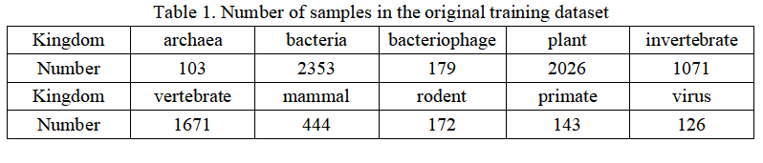
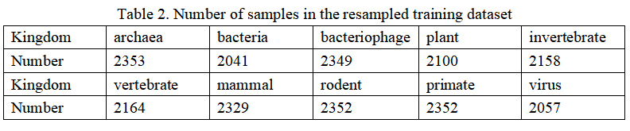
Balancing the dataset
SMOTE+ENN
Notes:
we exclude the genome entries classified as ‘plm’ mostly to avoid extremely imbalanced classes in our machine learning models, since there are only 18 plasmids. Then, We divide the entire dataset into 80% for training data and 20% for test data. If we only use undersampling, because the data set is extremely unbalanced, a lot of data needs to be deleted, which leads to information loss. So we choose oversampling. SMOTE is a method of oversampling, which can generate new sample points near the minority class instead of simply copying the minority class sample. But this will produce a lot of noise. So, we combine over- and undersampling using SMOTE and Edited Nearest Neighbours to solve the problem of unbalanced sample category distribution and overfitting

Slide 5
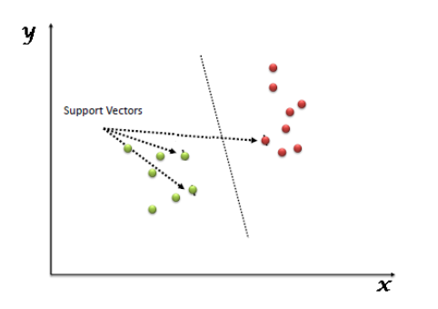
Support Vector Machine
m=13008
n=64
}
Radial Basis Function (RBF) kernel
Notes:
In the SVM algorithm, we plot each data item as a point in n-dimensional space (where n is a number of features you have) with the value of each feature being the value of a particular coordinate. Then, we perform classification by finding the hyper-plane that differentiates the two classes very well [9]. Since the SVM code of the assignment does not support multi-classification and the number our training data exceeds 20,000, we are advised to use highly optimized SVM toolboxes such as scikit-learn. According to Andrew Ng [10], we choose to use SVM with Radial Basis Function (RBF) kernel when n (number of features) is small (1-1000), m (number of samples) is intermediate (10-10000).

Slide 6



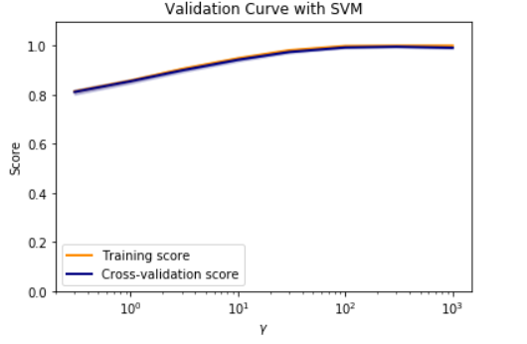
Tuning parameters
After tuning, C= 10 and gamma= 300
Notes:
When training an SVM with the Radial Basis Function (RBF) kernel, two parameters must be considered: C and gamma. 5-fold cross-validation is used in this method and the results are the accuracy of training and the accuracy of cross-validation which determine whether these two parameters fit the SVM model. Both parameters are initialized to be 0.01 for building the SVM model, and arrived at an optimal value of C= 10 and gamma= 300.

Slide 7
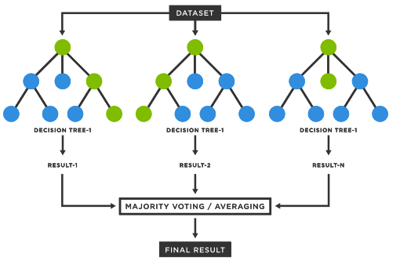
Random Forest
Tuning the number of trees from 500 and arrived at an optimal value of 300
Notes:
The Random Forest (RF) classifier is an ensemble method that combines the results of different decision trees by voting across them. RF classifiers are advantageous in preventing over-fitting and handling large datasets with high dimensionality. The number of trees is initialized to be 500 for building the random forest model, and arrived at an optimal value of 300.

Slide 8
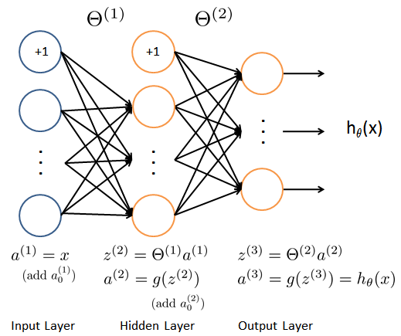
Neural Network – build a model
Step 1: Perform forward propagation to obtain the corresponding loss.
Step 2: Backpropagate the loss to get the gradients.
Step 3: Use the gradients to update the weights of the network.
Step 4: Train the weight parameters and obtain a basic neural network model
Notes:
the main procedure of implementing neural network model is first to

Slide 9
Neural Network – choose parameters
Hiden layer size
Hidden layer number
Lambda
Maxiter
Notes:
after we have the basic neural network model, we select the hypoparameters of model . The training sequence was first to select the hidden layer size. Then we select the best parameters of the first layer according to the validation dataset accuracy. After the first layer had been decided, the feature of the first layer was fixed and the second layer was trained as well. We added two more hidden layers in total and observed how it influenced the model.
As we can see in the figure2, the accuracy changes quite randomly when changing the hidden layer size. We choose the hidden layer size as 32 since it once reached the highest level. Then we chose the parameters of the first layer. For the maxiter, we took 500 as it has the best performance.

Slide 10
Results – Neural network
hidden layer size | validation accuracy range
1 | 75.86% ~81.32%.
2 | 80.32%~83.24%
3 | 84.02%~84.36%
Notes:
After choosing the parameters of the first hidden layer, we added the second hidden layer to the model. We kept the parameters of the first fixed and used the same method the train the weight parameters of the second hidden layer. The increase of validation accuracy can be observed. The accuracy range of one hidden layer is 75.86% ~81.32%. After tunning the parameters, the accuracy range of two hidden layers is 80.32%~83.24%. The accuracy of model is not improved so much after adding the second hidden layer. the improvement is even less after adding the third layer, as the acc rang is….
After selecting the parameters, we use test dataset to evaluate the behavior of the trained model. From the classification report, we find that the accuracy of the test dataset is 84% and the macro-F1 score is 74%. Compared to the training dataset (accuracy:93%; macro-F1 score:92%), the test error is lower than the training error and the training error is pretty low already, the model is overfitting. It also has high variance. Also, we can see it from the figure4 that class0, class2 and class8 have more mistakes (accuracy less than 50%), because the amount of data of these classes is very small. Thus, it is hard to predict these classes.

Slide 11
Results & Conclusion
 | accuracy | macro-F1 score
Random Forest | 0.9143 | 0.8680
Support Vector Machine | 0.9431 | 0.8998
Neural Network | 0.8436 | 0.74
Notes:
According to the result, the Support Vector Machine model has the highest performance (0.8998 macro-F1 score), the next highest model is Random Fores model with the macro-F1 score of 0.8680. The lowest one is neural network as its macro-F1 score is 0.74. The reason of the first two is higher than the neural network could be that they use the k-fold method to train the model. It could make the model has more training data and improve the model. One other reason could be that neural network need more data to make predictions less mistakes, SVM and RF require less input. The dataset input is not large enough to neural network.
About future work, due to the long running time, we didn’t implement the k-fold validation and draw the learning curve, we would like to explore more if we have more time. Also , we could calibrate better when choosing the hyperparameters .

Slide 12
Future work
Apply k-fold cross-validation to neural network model
Draw learning curve
Add more layers
Calibrate better
Notes:
According to the result, the Support Vector Machine model has the highest performance (0.8998 macro-F1 score), the next highest model is Random Fores model with the macro-F1 score of 0.8680. The lowest one is neural network as its macro-F1 score is 0.74. The reason of the first two is higher than the neural network could be that they use the k-fold method to train the model. It could make the model has more training data and improve the model. One other reason could be that neural network need more data to make predictions less mistakes, SVM and RF require less input. The dataset input is not large enough to neural network.
About future work, due to the long running time, we didn’t implement the k-fold validation and draw the learning curve, we would like to explore more if we have more time. Also , we could calibrate better when choosing the hyperparameters .

Slide 13
Contribution
Random Forest & Support Vector Machine : Tao Zhou
Neural network: Zeping Zhang
Report:
Abstract, intrduction, related work dataset features – Tao Zhou
Results and disscusion, conclusion and future work - Zeping Zhang
Methods: Tao Zhou, Zeping Zhang
Presentation: Tao Zhou, Zeping Zhang

Slide 14
Questions?

