Slide 1
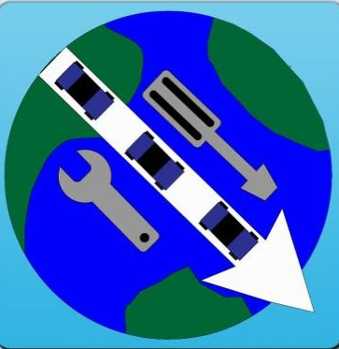


ROADIES
A global roadside assistance solution
CSSE7024/CSSE3004
Research Project Provided by

Slide 2
Agenda
About Client & Project Brief
Team roadies
What is Roadies?
Features
Technologies
Prototyping & User Research
Timeline/Milestones

Slide 3

SAP Research & Project Brief
Research division of leading Software solution provider SAP.
Provided Global roadside assistance as a project for CSSE7023/3004 course at UQ.
Considered as our client in the project.

Slide 4
Client Brief on Global roadside assistance
Global Roadside Assistance
What it is
A service paid for by roadside assistance providers
A free service for motorists
An application for iPhone, Android and other mobile platforms
Accessible globally
What it does
Automates Who, Where, and What questions usually asked of motorists when they request help
Replaces the need for a call centre to answer significant part of roadside assistance calls
Where the service cannot help, only then is a call centre operator required (exceptional cases)

Slide 5
Team Roadies
Aabhushan MAINALI (42507590)
Christoph NIESEL (41521030)
Jue WANG (41913710)
Yu-jen CHEN (42520580)
Zhiguon ZENG (41870288)

Slide 6


What is Roadies?
A global roadside assistance solution
Android Application + Web application
Accessed using:
Android Phone
Internet Browsers

Slide 7
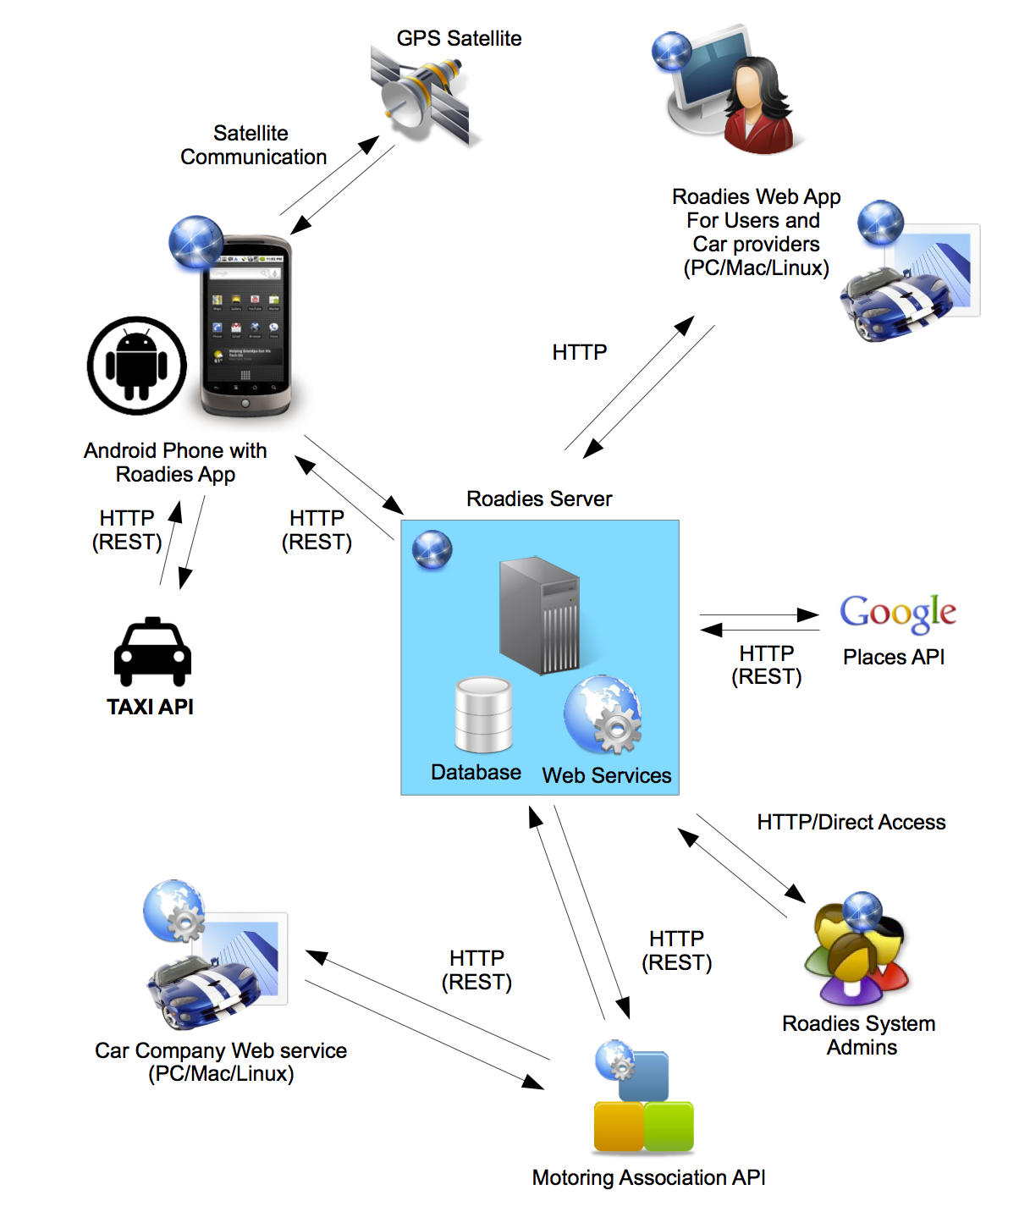
Roadies Architecture

Slide 8
Progress?
Brainstorming
Product research
User research
Early Prototype
User Feedback
Prototype
Final Design

Slide 9


Brainstorming & Product Research
Brainstorming led to clean and simple UI for usability.
Decided to follow current trends of Mobile App design.
Current applications are individualistic to companies.
Current solutions are not global.

Slide 10

User Research
Larger screen icons
Greater choice in options
Easy to use
Free
Quick in giving response

Slide 11
Roadies & its features
Mobile Application based:
Repair reporting
TAXI booking
Emergency/ Police number
Fuel Station information
Web based history viewing

Slide 12
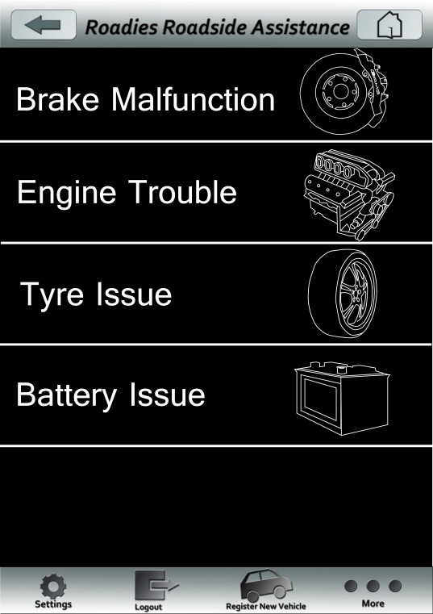
Roadies’ Repair
User can report an issue
User’s problem, location and chosen vehicle details will be sent to the server
Server connects with International Motoring Association API to communicate with car companies, dealers and motoring clubs.

Slide 13

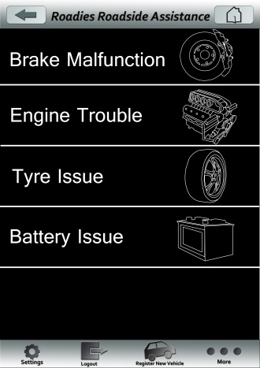
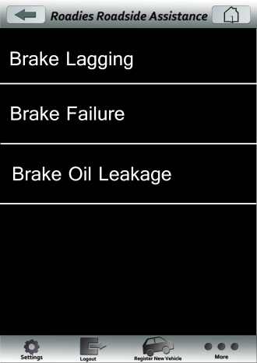
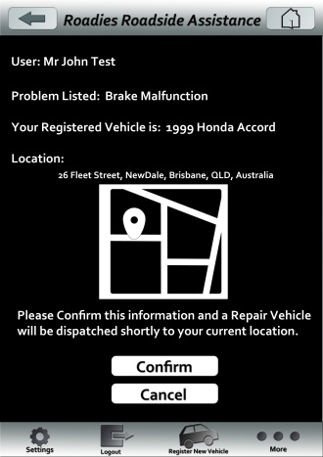
Roadies’ Repair

Slide 14



Other Features
Report Injury
allow the user to ask medical help
Taxi Booking
allow user to book and confirm a taxi booking.
As we have no taxi club that provides API, a mock API will be used

Slide 15
Other Features
Police Emergency
police emergency number from the country/city the user currently is in.
Operator Call
The user can be asked to pay yearly charge for this.
Nearest Fuel Depot
Nearest Fuel from the current location.

Slide 16
Technologies
Android Development Platform (Framework version 2.3)
Java Spring Framework
MySQL
Tomcat Server

Slide 17
Project Timeline
Suggested to start on 23rd July, 2012 and finish on 22nd October, 2012.
Milestones according to functionalities and Resource availability

Slide 18
Resources required
Responsibilities:
Project Manager
Android and Web Application Developers
Web Designer
Testers
Time required 280 Hours.
Internet Facility
Personal/Lab Computers

Slide 19
Resources available
Jue, Aabhushan, Zhigou (Gary), Dean available for maximum 15 Hrs/Wk
Christoph available for 10 Hrs/Wk
Aabhushan will be Project Managing and developing.
Gary, Jue and Dean will be developing.
Christoph will be designing.
Everybody will be testing.

Slide 20
Work break down
Basic feature: (about 2 weeks) | Time Allocated (Hrs)
Log in
Realizing Log in and log out | 3
Realizing Login recovery | 3
Test Log and validation | 3
 | Subtotal: 9 hours
Register new car
Create input | 1
Validate data | 3
Realize applying new car function | 1.5
Test registration function | 3
 | Subtotal: 8.5 hours

Slide 21
Project Milestones
Database – July 26th
Basic functionalities like login, register – August 2nd
Major functionalities – August 22nd
Remaining mobile features – August 30th
Functionalities of web – September 7th
Final Package – 22nd October

Slide 22

Questions? Feedback?

Slide 23
Thank you!!

