Slide 1
Socket Programming
Computer Network
Project 1

Slide 2
What is Socket?
Socket is an API to use internet.
API = Application Programming Interface.
Work at the Transport layer.
Application Layer
Socket API
Transport Layer
Network Layer
Link Layer
Physical Layer

Slide 3
Formal Definition
Definition: A host-local, application-created, OS-controlled interface (a “door”) into which application process can both send and receive messages to/from another application.
controlled by
application
developer
controlled by
application
developer
process
process
socket
socket
TCP with
buffers,
variables
TCP with
buffers,
variables
controlled by
operating
system
controlled by
operating
system
Internet
host or
server
host or
server

Slide 4
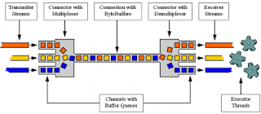
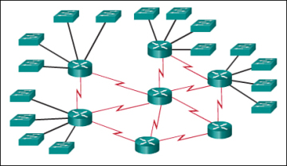
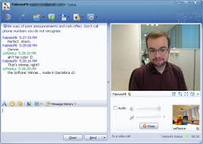


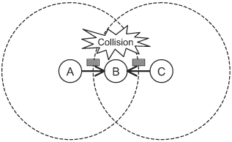
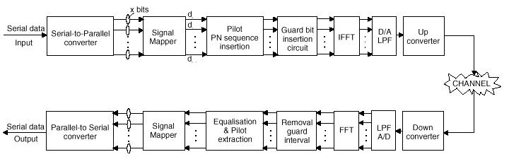
Why do we need socket?
Layering

Slide 5
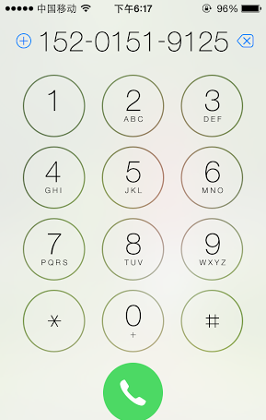
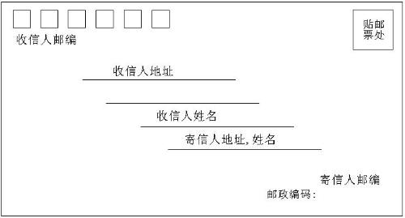
Socket Identification
Socket | Mail | Call
Local Socket Address | Your Address | Your Phone Num.
Remote Socket Address | Her Address | Her Phone Num.
Protocol | Envelop | Radio
Socket?

Slide 6
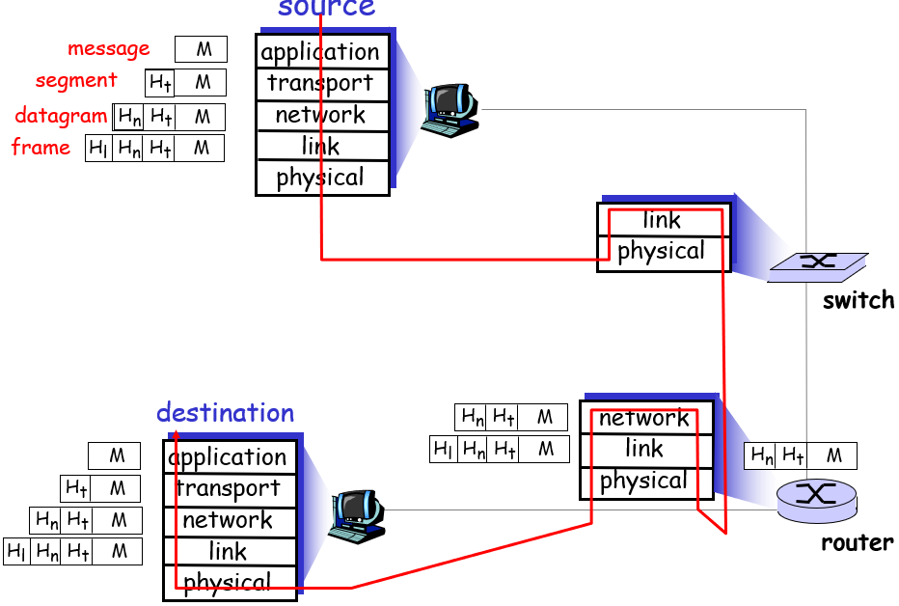
Message Transmission

Slide 7
Address
The address must identify the sender/receiver.
Address of the host – IP Address
IPv4: 32bit, X.X.X.X, X:8 bit
IPv6: 128bit, Y:Y:Y:Y:Y:Y:Y:Y, Y:16 bit
Address of the process – Port
0~65535
Socket is identified by a combination of IP and Port

Slide 8
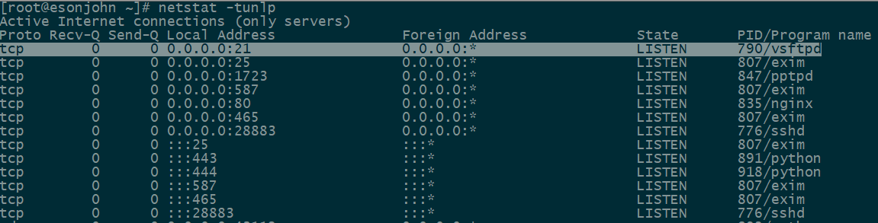
Port Usage
Popular applications have “well-known ports”.
By convention, between 0 and 1023; privileged
E.g., port 80 for HTTP, 25 for SMTP, 21 for FTP
For more, refer to Wikipedia.
Custom client gets an unused “ephemeral” port.
By convention, between 1024 and 65535.

Slide 9
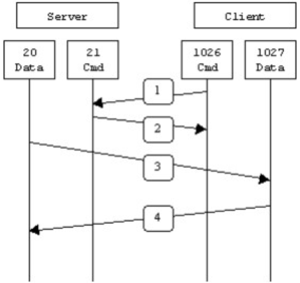
Port in FTP
PORT(Active Model)
Server monitor default control port 21
Client request control port N1 from OS
Client request data port N2 from OS and notify Server
Server setup connection between local 20 port and client N2 port
Data streams between server 20 port and client N2 port

Slide 10
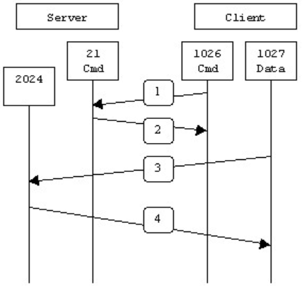
Port in FTP
PASV(Passive Model)
Server monitor default control port 21
Client request control port N1 from OS
Client request data connection from Server on N1
Server request data port N2 from OS and notify Client
Client request data port N3 from OS
Client setup connection between local port N3 and server port N2
Data streams between server port N2 and client port N3

Slide 11
Protocol
Socket at Transport Layer.
UDP
TCP

Slide 12
A Preview on UDP
UDP Service: Best-effort transfer of groups of bytes (“datagrams”) between client and server.
Datagrams == Groups of bytes
port + length + checksum
Address information: port
No ack: package loss
No sequence: out-of-order
Best-effort == unreliable
Connectionless: You have no idea whether the packet is received, unless notified by the receiver.
Lightweight and fast
Multi-media
Routing protocol
DNS

Slide 13
Socket Programming with UDP
Server (running on hostid)
Client
create socket,
port=x, for
incoming request:
create socket,
clientSocket =
DatagramSocket()
serverSocket =
DatagramSocket()
Create, address (hostid, port=x,
send datagram request
using clientSocket
read request from
serverSocket
write reply to
serverSocket
specifying client
host address,
port number
read reply from
clientSocket
close
clientSocket

Slide 14
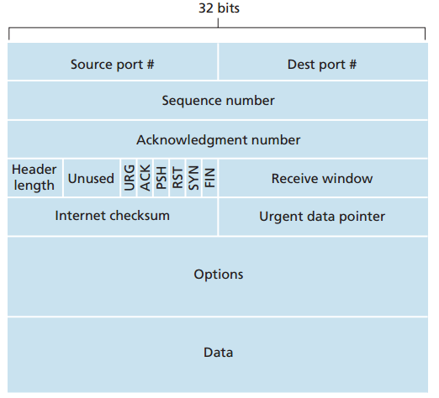
A Preview on TCP
Segment Structure
Seq number, Ack number, Rcv Window: Reliable transmission

Slide 15
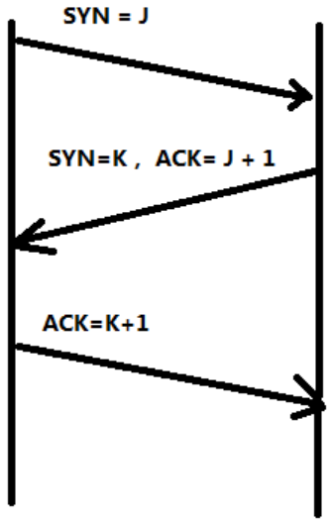
A Preview on TCP
Connection setup: 3-way handshake
Client notify server with SYN indicator
Server acknowledge client with SYN/ACK indicator
Client acknowledge server with ACK indicator
Client
Server

Slide 16
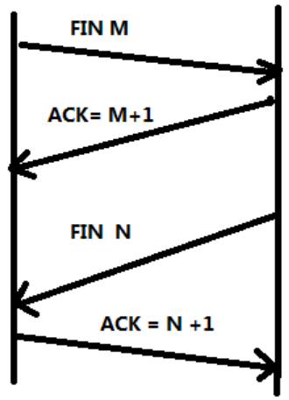
A Preview on TCP
Connection termination: 4-way handshake
Client notify server with FIN indicator
Server acknowledge client with ACK indicator
Server notify client with FIN indicator
Client acknowledge server with ACK indicator
Client
Server

Slide 17
A Preview on TCP
TCP Service: Reliable transfer of byte-stream from one process to another.
Reliable:
Ack
Connection oriented and maintenance of the connection
Byte-stream
A sequence of characters that flow into or out of a reliable process(stdin, stdout, socketin, socketout)
Seq: In order
Build a reliable “pipe” on the unreliable network.

Slide 18
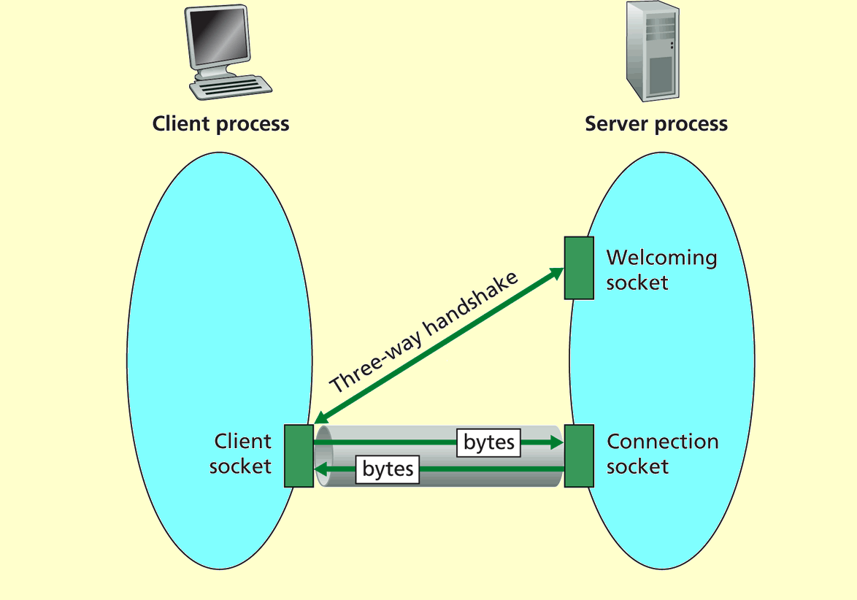
Reliable “pipe” in TCP

Slide 19
Socket Programming with TCP
Server (running on hostid)
Client
create socket,
port=x, for
incoming request:
welcomeSocket =
ServerSocket()
TCP
connection setup
create socket,
connect to hostid, port=x
wait for incoming
connection request
connectionSocket =
welcomeSocket.accept()
clientSocket =
Socket()
send request using
clientSocket
read request from
connectionSocket
write reply to
connectionSocket
read reply from
clientSocket
close
connectionSocket
close
clientSocket

Slide 20
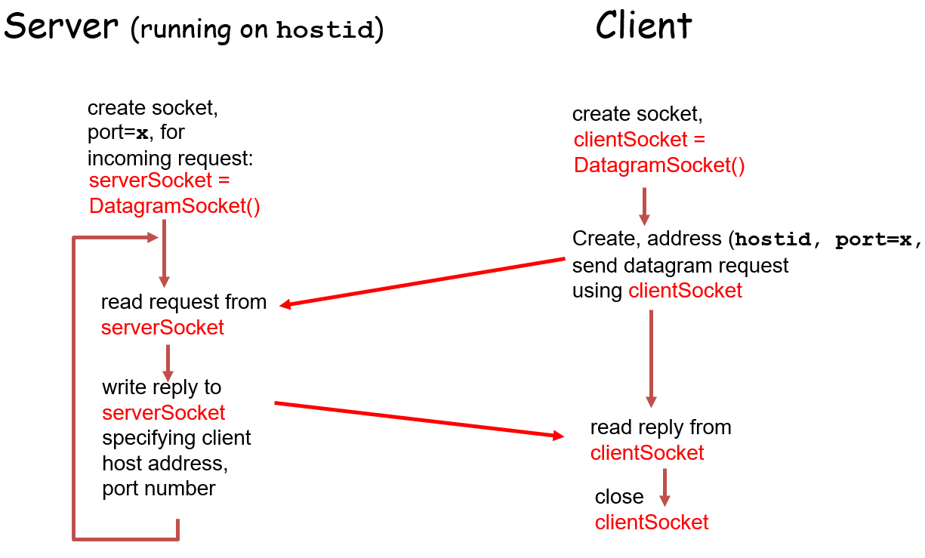
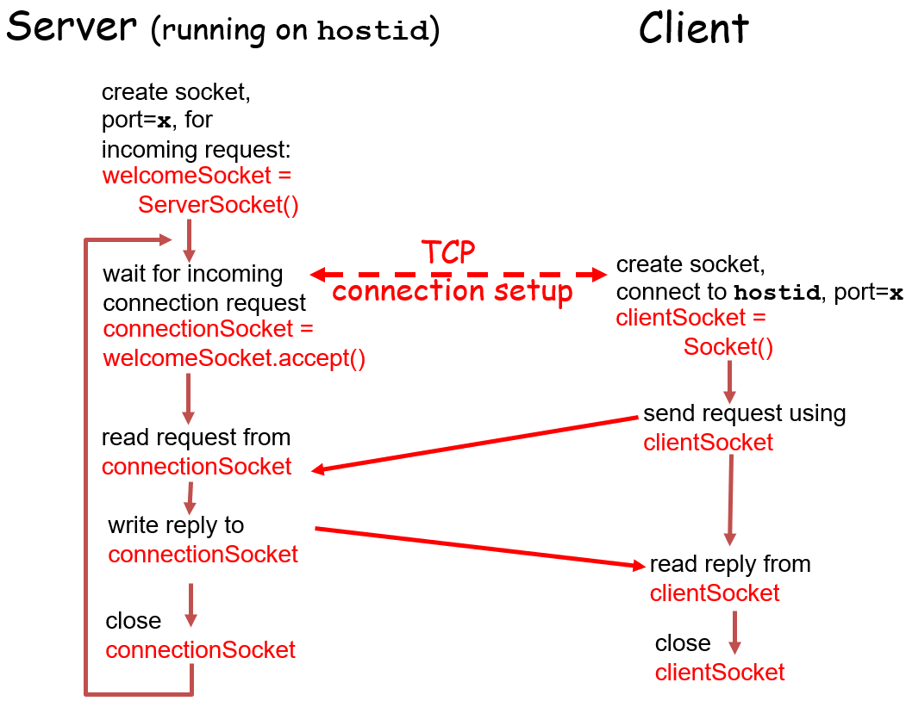
Difference between UDP & TCP

Slide 21
Tips on Socket Programming
When you chat with someone else.
If TCP, how many streams at client side?
4: stdin, stdout, socketin, socketout.
If UDP, how many streams at client side?
2: stdin, stdout

Slide 22
Tips on Socket Programming
Multi-clients.
All clients connect to the same port number (Web).
How do you distinguish between clients?
Source IP Address!
How do you distinguish between multiple connections from the same IP Address?
Port number!
The five tuples to specify a socket:
(SrcAddr, SrcPort, DstAddr, DstPort, Protocol)

Slide 23
Socket Programming in C
Create a socket
int socket(int domain, int type, int protocol)
Domain: ipv4/ipv6
Type: SOCK_STREAM/SOCK_SEQPACKET/…
Protocol: TCP/UDP/…
Client/Server Establish a connection
int connect((int sockfd, struct sockaddr *serv_addr, int addrlen)
sockfd: socket handler
serv_addr: server address
addrlen: serv_addr length

Slide 24
Socket Programming in C
Byte Ordering
unsigned long int htonl(unsigned long int hostlong)
unsigned short int htons(unsigned short int hostshort)
unsigned long int ntohl(unsigned long int netlong)
unsigned short int ntohs(unsigned short int netshort)
IP Addresses
int inet_aton(const char *cp, struct in_addr *inp)
char *inet_ntoa(struct in_addr in);

Slide 25
Socket Programming in C
For TCP, Send Data
ssize_t write(int sockfd, const void *buf, size_t nbytes);
ssize_t send(int sockfd, const void *buf, size_t nbytes, int flags);
sockfd: socket handler
buf: data buffer
nbytes: write/send data length
flags: block/nonblock/…
For TCP, Receive Data
ssize_t read(int sockfd, void *buff, size_t nbytes);
ssize_t recv(int sockfd, void *buff, size_t nbytes, int flags);
For UDP, use
ssize_t sendto (int sockfd, void *buff, size_t nbytes, int flags, const struct sockaddr *dest_addr, int addrlen);
ssize_t recvfrom (int sockfd, void *buff, size_t nbytes, int flags, const struct sockaddr *src_addr, int addrlen);

Slide 26
Socket Programming in C
Server listening
Bind some port
int bind (int sockfd, struct sockaddr *my_addr, int addrlen)
sockfd: socket handler
my_addr: local listening address
addrlen: my_addr length
Define how many connections can be pending
int listen(int sockfd, int backlog)
sockfd: socket handler
backlog: maximum connections
Accept a new connection from a client
int accept(int sockfd, struct sockaddr *addr, int *addrlen)
sockfd: socket handler
addr: client address
addrlen: addr length

Slide 27
Socket Programming in C
Handle multiple sockets, stdin and timers.
Polling
Socket setup require 3-way handshake, time consuming
Very inefficient.
Select
Connect, accept, recv are blocking
Select returns indicator of whether sockets available: Non-blocking
Wait on multiple file descriptors/sockets and timeout
int select(int maxfdp, fd_set *readfds, fd_set *writefds, fd_set *errorfds, struct timeval *timeout);
Macros
FD_ZERO(fd_set *set) – clears a file descriptor set
FD_SET(int fd, fd_set *set) – adds fd to the set
FD_CLR(int fd, fd_set *set) – removes fd from the set
FD_ISSET(int fd, fd_set *set) – tests to see if fd is in the set
1024 maximum, does not scale to large number of descriptors/sockets
Epoll

Slide 28
Socket Programming in C
Client
Server
socket
socket
bind
listen
Connection Request
connect
accept
write
read
read
write
Waiting for next
connection Request
EOF
close
read
close

Slide 29
Socket Programming in C
Debug
perror(“socket error: ”)
prints "socket error: " + the error message.
printf("an error: %s\n", strerror(errno));
prints "an error: " + the error message from errno.

Slide 30
Other Tools
How to check if particular port is listening
Windows – use netstat
netstat -an
Linux – use nmap
nmap -sT -O localhost
bind status can indicate whether port is in use
Not knowing what exactly gets transmitted on the wire
Use tcpdump or Ethereal (www.ethereal.com)
Check RFCs if in doubt about protocols.
RFC 959

Slide 31
Project
Goal
Learn to setup communications between PCs with socket.
To be familiar with FTP protocol;
To be familiar with network protocol stack;
Learn to build client/server applications that communicate using sockets.

Slide 32
Task1: UDP Programming
Read the sample code
Choose any language you are familiar with(C, C#, Java, node, Python).
Modify the UDP Server and Client According to the homework guide.
Questions:
How to write a chat programming (two clients chat with each other) with UDP?
Can we use the UDP to transfer a file? If so, how?

Slide 33
Task2: Implementing FTP Server
Stage 1
Must use the Berkeley Socket API(Linux) and write your server in C.
Must serve files from a designated directory on your system to clients making requests on a designated TCP port.
Must handle USER, PASS, RETR, STOR, QUIT, SYST, TYPE, PORT, PASV, MKD, CWD, PWD, LIST, RMD, MV commands.

Slide 34
Task2: Implementing FTP Server
Stage 1
Handling invalid input reasonably and generating defensible error codes.
May not use any libraries containing code specifically designed to implement FTP functionality.

Slide 35
Task2: Implementing FTP Server
Stage 2
Transmit large files without blocking the server;
Resume transmitting after connection terminated;
Support connections from multiple clients.

Slide 36
Task3: Implementing FTP Client
Stage 1
You can write your client in your favorite programming language.
Must handle USER, PASS, RETR, STOR, QUIT, SYST, TYPE, PORT, PASV, MKD, CWD, PWD, LIST, RMD, MV commands
Able to log in a common server and download/upload files.
Stage 2
GUI

Slide 37
Some Important Issues
Grading
UDP Programming (10%)
Implementation of FTP (70%)
Server (25%+15%=40%)
Client (20%+10%=30%)
Project Report (20%)

Slide 38
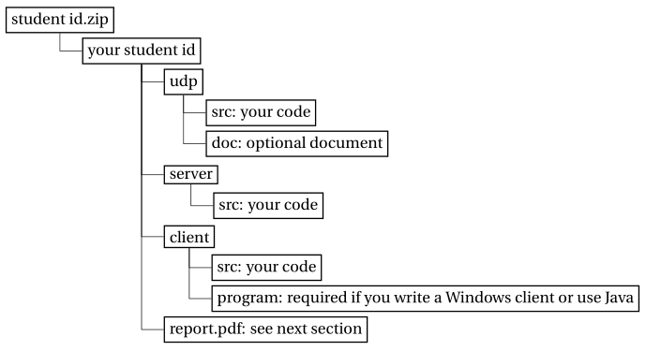
Some Important Issues
Submission
Stage 1
Server source code
Stage 2
Source code for udp, server and client;
Executable file and how to run it;
Report: no longer than THREE pages.
Files are to be organized as follows:
Evaluation
Stage 1
Auto-grading program for FTP server.
Face-to-face check for FTP client.
Stage 2
Submit source code & executable file & report(for overall project).

Slide 39
Some Important Issues
Important Date
Start up: today (2018.10.10.)
Due date:
Stage 1: 3 weeks later (2018.10.31.)
Stage 2: 6 weeks later (2018.11.21.)

Slide 40
Some Important Issues
Award (with Computer Architecture part)
Best Overall Project
Best Implementation
Best Design
Best Robust
Award requirements
Less or no systematic errors.
Clear program architecture & decent coding style & comprehensive comments.
Innovative features.

Slide 41
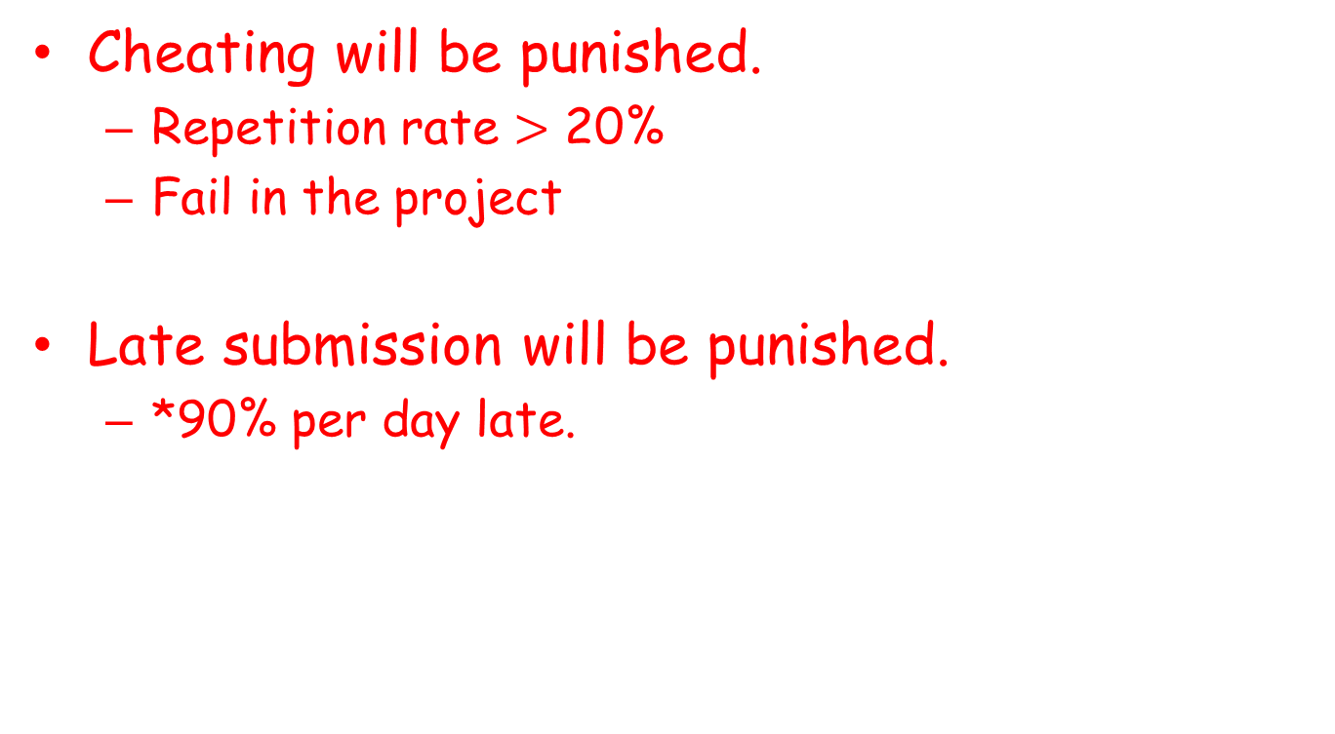
Some Important Issues
Cheating will be punished.
Repetition rate $>$ 20%
Fail in the project
Late submission will be punished.
*90% per day late.

Slide 42
Problems Emerged
Improper use of control/data socket(list, pwd)
Illegal design of command
Fails to connect to standard FTP server
Follow RFC protocol
Security Issue
Fails to checkout username & password
cd ..
Handle exceptions
Socket exception
I/O exception

Slide 43
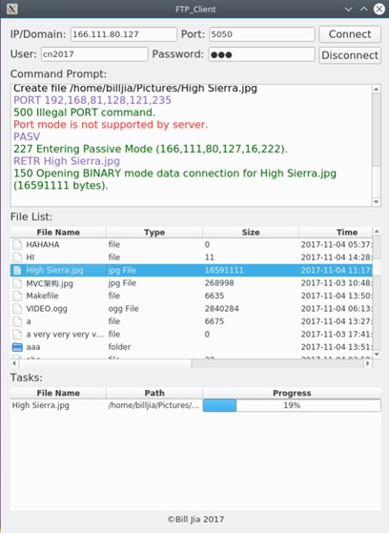
Outstanding Project
Student A

Slide 44
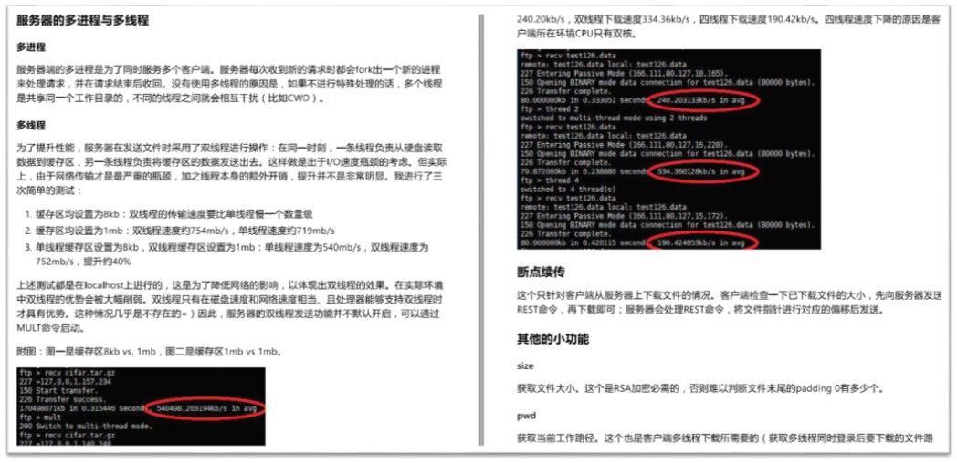
Outstanding Project
Student B

Slide 45
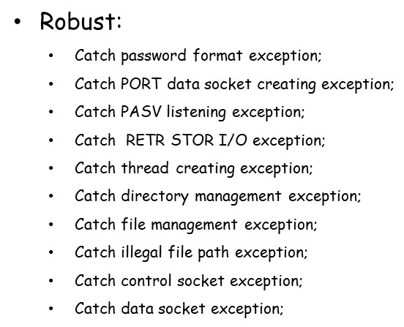
Outstanding Project
Student C

Slide 46
Q&A

