Slide 1
Hack Bloomberg
Code B:
*Typo… what we really mean is “Bloomberg Hackathon”

Slide 2




Why are you here?
To have fun!
(And eat free food, get free swag, win cool prizes!!!)

Slide 3
A: A simulation of an Exchange where people can Write Code that Trades Stocks
Q: What kind of hackathon we talkin ’bout here?
Why?
Bloomberg is a perfect marriage of finance and software
Everyone associates finance with trading stocks (accessibility)
An Exchange requires writing difficult software that performs trades in a timely manner on the best quality securities.
We, the organizers, love to write server software in our free time
*** No prior financial knowledge is needed!
(And no, it will NOT help)
The answer may or may not be (d)

Slide 4
Cool, so how does it work?
There will be securities on the exchange
You will own cash
You can post BIDs on the exchange
How much are you willing to pay for a number of shares of a security
Must have enough cash
You can also post ASKs
How much do you want for each of a number of shares of a security
Must have enough shares

Slide 5
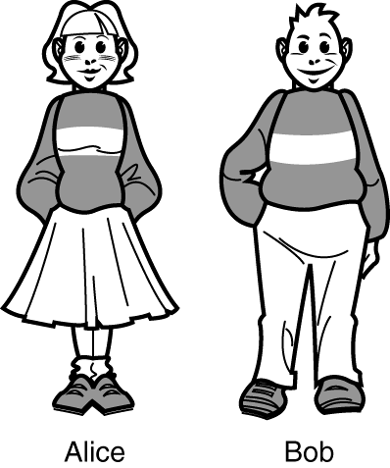
Bids and Asks?
Example 1:
BID: 10 shares of MSFT at $57
ASK: 10 shares of MSFT at $57

Slide 6
Bids and Asks?
Example 1:
Buys 10 shares of MSFT for $57 from Bob
Sells 10 shares of MSFT at $57 to Alice
MATCH!!!

Slide 7
Bids and Asks?
Example 2:
BID: 100 shares of AAPL $104
ASK: 50 shares of AAPL $100

Slide 8
Bids and Asks?
Example 2:
Buys 50 shares of AAPL $102 from Bob
Sells 50 shares of AAPL $102
to Alice
SORT OF MATCH!!!

Slide 9
Bids and Asks?
Example 1:
Bid: Alice wants to buy 10 shares of Microsoft stock for $57
Ask: Bob wants to sell 10 shares of Microsoft stock for $57
Result: MATCH! Bob sells 10 shares at $57 to Alice.
Example 2:
Bid: Alice wants to buy 100 shares of Apple for $104
Ask: Bob wants to sell 50 shares of Apple for $102
Result: Sort of match! Bob sells 50 shares at $103 to Alice.

Slide 10
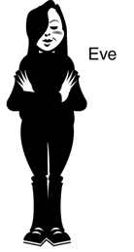
Bids and Asks?
BID: 1,000 shares of GOOGL $530
ASK: 1,000 shares of GOOGL $500
Example 3:
ASK: 1,000 shares of GOOGL $550

Slide 11
Bids and Asks?
Buys 1,000 shares of GOOGL $515 from Eve
Sells 1,000 shares of GOOGL $515 to Alice
Example 3:
No shares are sold ☹
SORT OF MATCH!!!

Slide 12
Bids and Asks?
BID: 300 shares of XOM $104
ASK: 150 shares of XOM $100
Example 4:
ASK: 150 shares of XOM $104

Slide 13
Bids and Asks?
Buys
150 shares of XOM $102 from Eve &
150 shares of XOM $104 from Bob
Sells 150 shares of XOM $102 to Alice
Example 4:
Sells 150 shares of XOM $104 to Alice
SORT OF MATCH!!!
SORT OF MATCH!!!

Slide 14
Bids and Asks?
Example 3:
Bid: Alice wants to buy 1,000 shares of Google stock for $530
Ask: Bob wants to sell 1,000 shares of Google for $550
Eve wants to sell 1,000 shares of Google for $500
Result: Sort of match! Eve sells 1,000 shares at $515 to Alice
Example 4:
Bid: Alice wants to buy 300 shares of Exxon stock for $104
Ask: Bob wants to sell 150 shares for $104
Eve wants to sell 150 shares for $100
Result: Sort of match! Eve sells 150 shares at $102 to Alice. Also, Bob sells 150 shares at $104 to Alice.

Slide 15
Bids and Asks?
Example 5:
BID: 10 shares of AAPL $100
ASK: 10 shares of AAPL $75

Slide 16
Bids and Asks?
Example 5:
Buys 10 shares of AAPL $100
to someone
Sells 10 shares of AAPL $75
from someone
Eve loses $250!!!
Make sure your BIDs are below your ASKs!!!
The market will NOT check for you!

Slide 17
Bids and Asks?
Example 5:
Eve wants to buy 10 shares of Apple for $100 and sell 10 shares for $75.
Result: Someone else buys the shares for $75 and someone sells shares for $100. Eve loses $250.
MAKE SURE YOUR BIDS ARE BELOW YOUR ASKS!!! THE MARKET WILL NOT CHECK FOR YOU!

Slide 18

More exposition…
The exchange will always post (unfair) BIDs and ASKs for all securities
If a BID and ASK price overlap, a trade is made
If your bid trades, your other bids will be withdrawn if you lack cash for them
You are worth your total cash plus the valuation of all shares you own
Shares of a security are influenced by trades on the market
Exchange BID & ASK prices moves as valuation moves
What if I buy something way above valuation? or
- You just seriously overpaid, dude
+ It’s not all bad, the valuation just majorly increased

Slide 19

I think I will just keep my cash forever!
Net Worth
WINNER
Runner up
YOU
Time
Notes:
Securities pay dividends
Every Second
A lot of dividends
You should definitely buy stuff
You will recoup your cost in minutes
That’s like a less than hours
Think about it
You’ll even have enough money to buy more stuff
Just try it
Protip: PowerPoint refuses more levels of bullets

Slide 20
I think I will just keep my cash forever!
BAD IDEA
Securities pay dividends
Every Second
A lot of dividends
You should definitely buy stuff
You will recoup your cost in minutes
That’s like a less than hours
Think about it
You’ll even have enough money to buy more stuff
Just try it
Protip: PowerPoint refuses more levels of bullets
Notes:
Securities pay dividends
Every Second
A lot of dividends
You should definitely buy stuff
You will recoup your cost in minutes
That’s like a less than hours
Think about it
You’ll even have enough money to buy more stuff
Just try it
Protip: PowerPoint refuses more levels of bullets

Slide 21
Fine, I will just not sell anything then
Dividends
Time

Slide 22
Fine, I will just not sell anything then
BAD IDEA
Dividends diminish over time
Every Second
They will soon pay almost nothing
You should definitely sell stuff
You can buy other stuff if you get the cash back
That’s like other securities paying dividends
Think about it
You’ll create an endless cycle of wealth
Just try it
Protip: Copy Pasting slides saves time creating presentations

Slide 23
Ok what about Securities, which do I trade?
The dividend payout varies with the net worth of a company
The net worth of a company is a predetermined curve
That means trades will not effect the dividend payout per share
Ok lets talk portfolio diversification… Good or bad ?
Much harder to make one bad bet
More likely to find a buyer for what you have
You will end up with bad securities (Can you figure out the curves?)
Easier to sell off one thing everyone wants

Slide 24
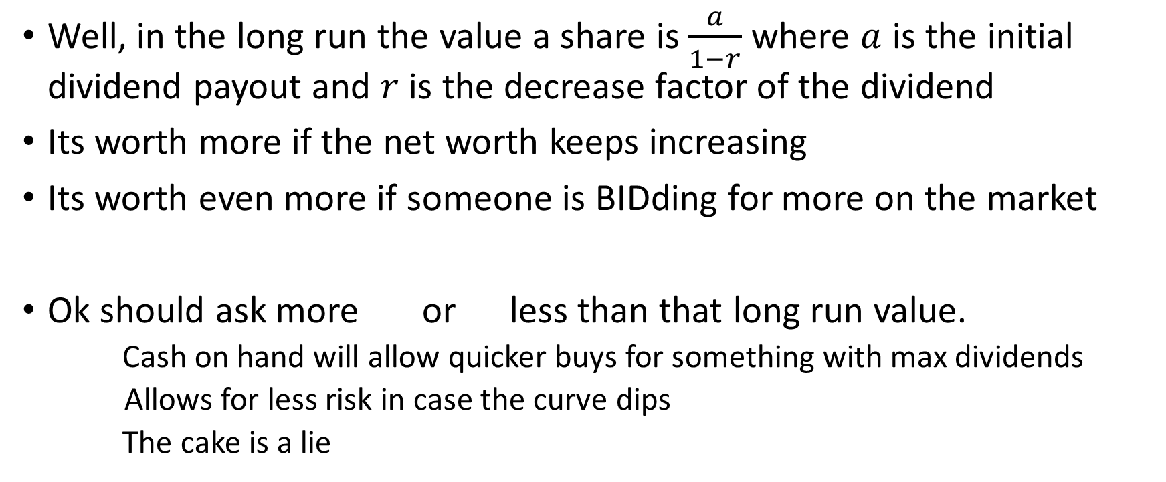
Ok just give me the answer… what do I do?
Well, in the long run the value a share is $\frac{a}{1−r}$ where $a$ is the initial dividend payout and $r$ is the decrease factor of the dividend
Its worth more if the net worth keeps increasing
Its worth even more if someone is BIDding for more on the market
Ok should ask more or less than that long run value.
Cash on hand will allow quicker buys for something with max dividends
Allows for less risk in case the curve dips
The cake is a lie

Slide 25
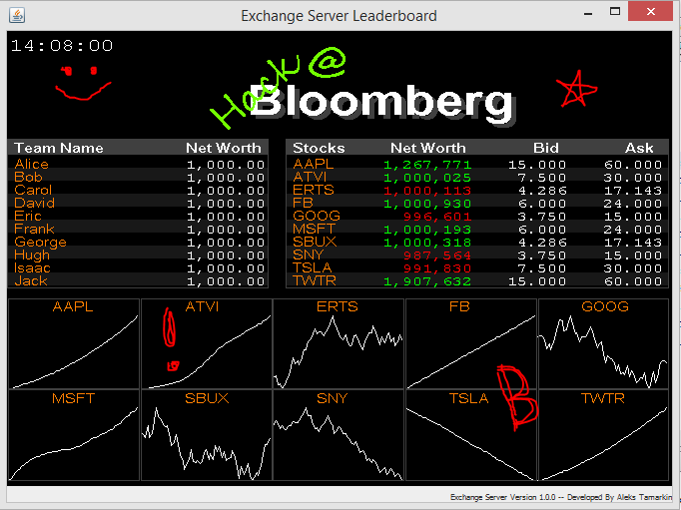
UI is half the prizes

Slide 26
We are done here
Let’s get hacking!

