Slide 1
WSI-DI curve in Calsim 3
Zhenlin Zhang
October, 2024.

Slide 2
Overview
Minimize the standard deviation between the curve DI and the demand calculated from the sum of total delivery plus carryover storage: Automatic and iterative process (typically x 3).
Need to be modified when water supply and climate scenario changes.
Need to be reviewed when the coefficient used to generate the curve changes: 2015 DCR (most recent version).

Slide 3
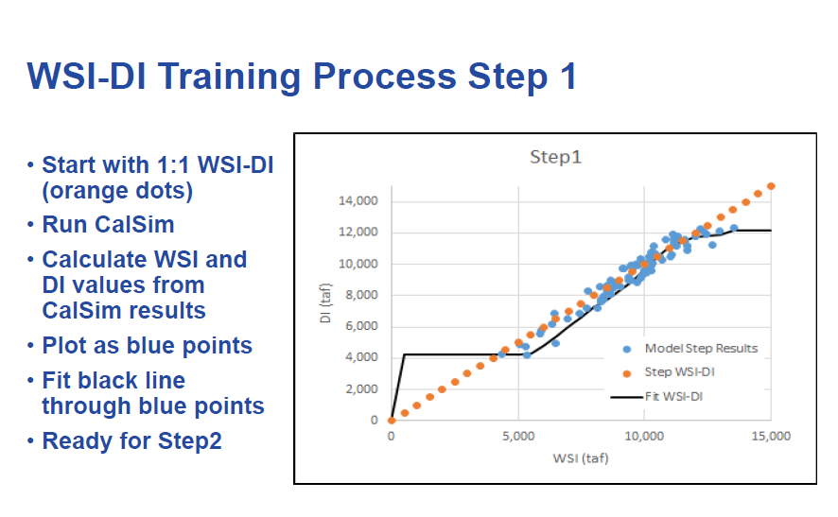
The manual way
Reference: Calsim-II Rebuttal

Slide 4
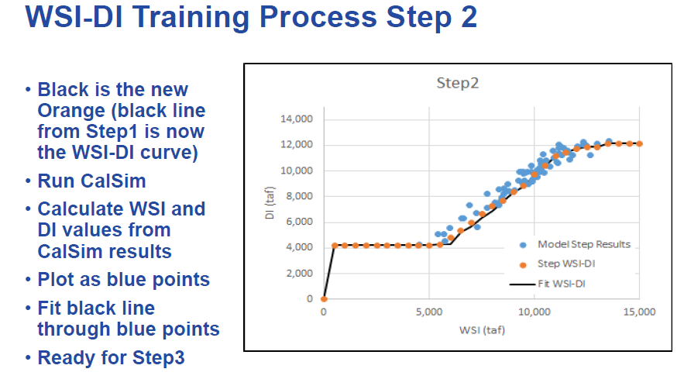
The manual way
Reference: Calsim-II Rebuttal

Slide 5
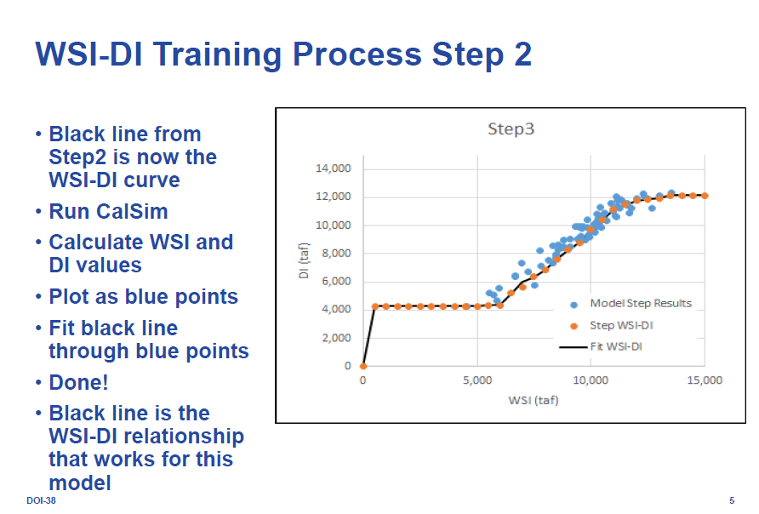
The manual way
Three iteration is good enough to obtain the WSI-DI cureve!
Reference: Calsim-II Rebuttal

Slide 6
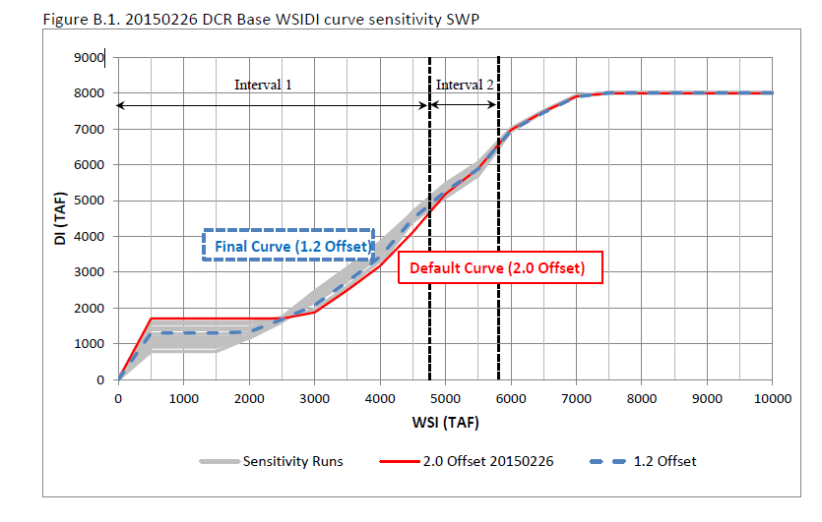
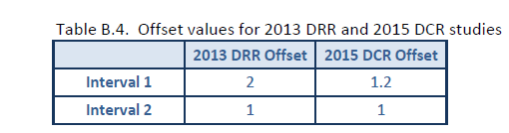
The 2015 DCR modification
Offset1 is revised to 1.2 to better utilize SWP San Luis reservoir storage during dry years
Reference: 2015dcr_appendices
Notes:
A sensitivity test is performed for a whole range of offset1 and offset 2.
I am assuming that ‘Interval 1’ and ‘Interval 2’ are the same as ‘offset 1’ and ‘offset 2’.
I think that ‘Interval 1’ and ‘Interval 2’ drawn on this slide are incorrect. Offset should be on the DI axis, not on Wsi axis.

Slide 7
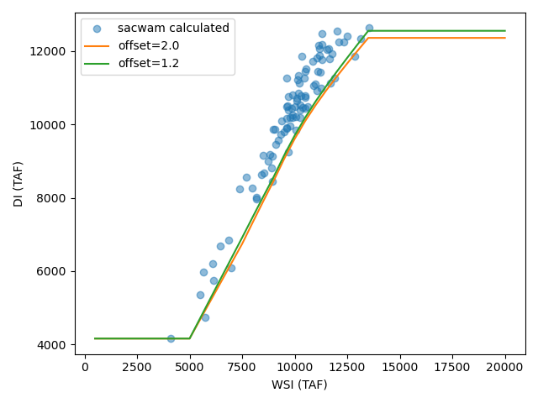
Sacwam WSI-DI curve automation (not iterative yet)
Notes:
Sacwampy\wsidigenerator.py

Slide 8
Sacwam WSI-DI curve calculation
Calculated WSI: April reservoir storage + Water supply estimated (This is an output from Sacwam).
Calculated DI: carryover storge (September storage) for the four big reservoirs for CVP (Shasta, Trinity, Folsom, and San Luis CVP) and the two reservoirs (Oroville and San Luis SWP) for SWP + Annual total transmission link flows summing over specific months for each year. A list of transmission links are in: sacwampy/ transmission_links_appendix_mapping_tablea.csv. The branch, and the start and end months over which to sum up the flows, for each transmission link are listed in column ‘branch’, ‘start’ and ‘end’. In summary,
For CVP, settlement contracts (SU or SA) sums from April to October; all other CVP contract types sum from March to the following February.
For SWP, all contact types sum over the entire calendar year (January to December).
CVP DI adds up transmission link flows for all contract types plus the conveyance losses, whereas SWP only adds up transmission link flows for Table A (conveyance losses are not include). This follows a similar approach to CALSIM 3 (please see attached email exchange with Raymond Hoang below).

Slide 9
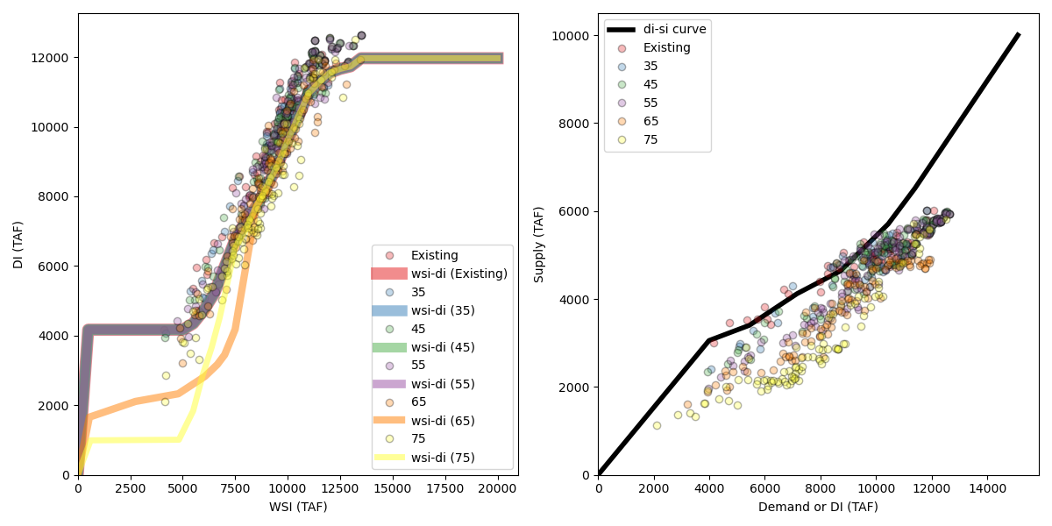
Sacwam WSI-DI curve calculation (CVP)
Two curves: first curve maps WSI to DI, and then the DI is used in the second curve to map to Supply (or delivery).
DI = Supply (or delivery) + Carryover Storage (September storage)
Notes:
This figure was generated by: C:\sacwam\scripts\calcwsi.py

Slide 10
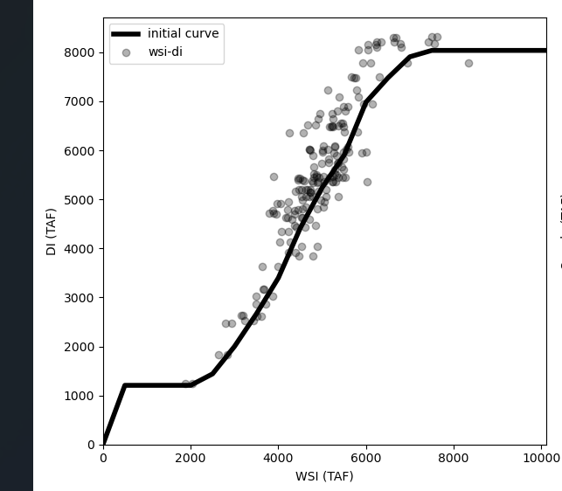
WSI-DI curve for SWP
WSI is first mapped to DI, and then the DI is mapped to delivery through a dynamic process.

Slide 11
The automatic python script by DWR
Python script (wsidigenerator):WRIMS GUI - Wsi-Di Generator - California Natural Resources Agency Open Data
Iterate three times by default but can be changed to higher numbers.
WSI interval: 500 TAF, Maxmum: 20 000 TAF, so roughly 40 points.
The algorithm first finds the minimum and maximum values and draw the horizontal lines for the upper and lower limits. For the rising part of the WSI-DI curve (values between min and max values), An average slope is calculated within each interval using the calculated WSI and the actual delivery points from Calsim. If we extend the line with this slope, it will intersect with the DI-axis. The intercept is described as an offset (or interval).
Tunable parameters: offset1 and offset2, which is a non-dimenstional multiplication factor that increases the offset described above and the revised offset will be used to calculate DI. Offset1=1.2 to 2.0, and offset2=1.0. Offset1 applies to the first third of the WSI values along the rising part of the curve and Offset 2 applies to the WSI value range of (1/3, ½) part of rising part of the curve. And when WSI value is greater than ½, offset is set to zero.
A larger offset1 or offset2 result in smaller DI, since in one step of the calculation WSI value is calculated based on a value equal to the estimated DI minus the offset. So the larger the offset, the smaller the WSI value is. In a way, offset1 and offset2 greater than 1 means that the line is shifted downwards by a fraction defined by (offset1-1).
More details refer to function getSlope() in WsiDiGenpy.

Slide 12
Sacwam python api: Sacwampy
Prerequisites:
Anaconda (No external libraries required).
Git: github link.
Python editor: Spyder, Ipython, and VScode.
Open a Python editor, type ‘spyder’ or ‘ipython’.
Setting up the editor (Spyder as an example).
Add Sacwampy to the environment path.
PEP8: removing trailing space.
Interactive plotting: Tools > preferences > IPython console > Graphics > Graphics backend > Backend: Automatic.
Run the script: %run wsidi_main.py
Quick debugging tool: pdb (%debug) or set breakpoints.

Slide 13
WSI-Di calculation by different approaches
Term | CALSIM | Stantec VB script | PYTHON (Sacwampy)
CVP Supply Est | SC: April - October others: March to Feb. | • SC: March - October • others: same as CALSIM | Same as CALSIM
CVP conveyance losses | included | included | Same as CALSIM
CVP WSI | Both April & May values | May values only | Same as CALSIM
SWP Supply Est | Calendar year | same as CALSIM | same as CALSIM
SWP Article21 Supply | Excluded | same as CALSIM | same as CALSIM
SWP conveyance losses | Not included | Included | Not included (same as CALSIM)
Current accounts (first year) | NA | Included | Excluded
Last year | Excluded | Excluded | Excluded (same as CALSIM)
CVP delivery calculation |  | cvp_total + cvp conveyance losses but some are calculated as supply delivered instead of transmission flow. | Same as VB script but use transission link flow instead (this includes transmission losses).
SWP delivery calculation | Table A | Table A + delivery to U_11_NU1 + conveyance losses | swp_table_a_total

Slide 14
Step-by-step calculation
For WSI-DI curve: starting from 1:1
The first and last year of WSI and DI are eliminated in Sacwampy.

Slide 15
References
WEAP API: https://www.weap21.org/webhelp/api.htm
Sacwampy documentation:
2015dcr_appendices: California Natural Resources Agency Open Data
Calsim wsidigenerator: WRIMS GUI - Wsi-Di Generator - California Natural Resources Agency Open Data
WRIMS GUI: https://data.cnra.ca.gov/dataset/wrims-2-gui
WRIMS source code: https://github.com/CentralValleyModeling/wrims

