Slide 1
Sequence-to-sequence prediction of spatial-temporal systems
A review of paper
Guorui Shen, Jurgen Kurths, Ye Yuan
Sep 9, 2020
Published on Chaos

Slide 2
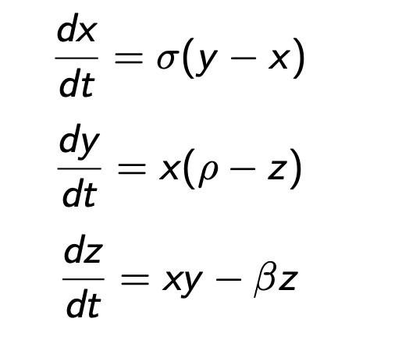
Background
The paper applied seq2seq technique to make predictions on
ODEs
PDEs
Lorenz system
KdV equation
Burger’s equation
Sin-Gordon equation

Slide 3
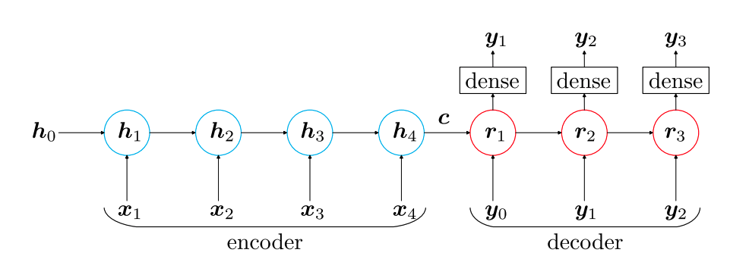

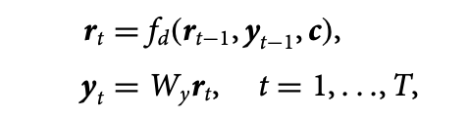
Background
Traditional seq2seq model

Slide 4
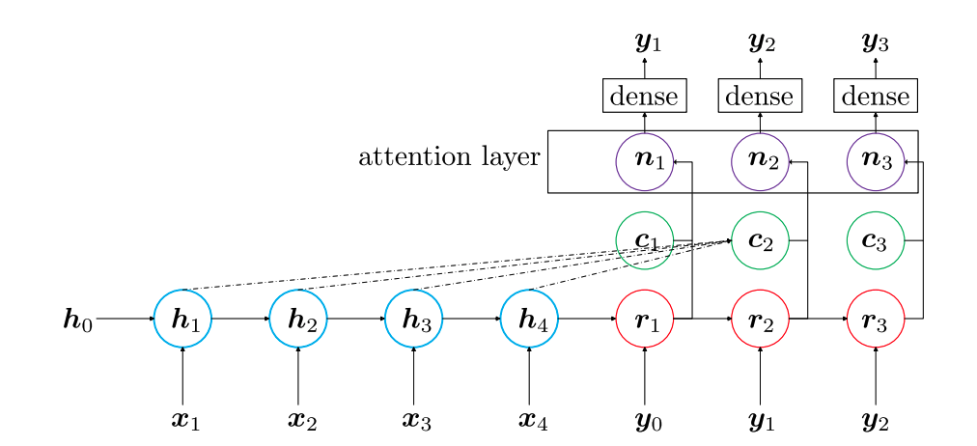
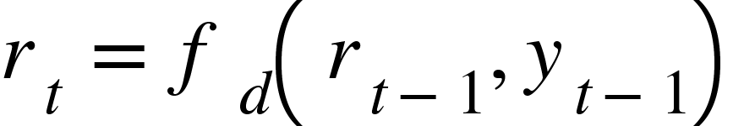
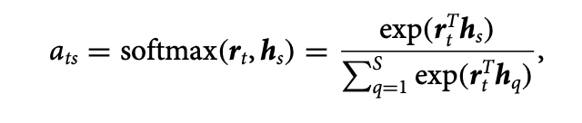
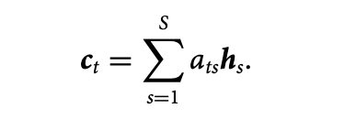

Background
Attention-based seq2seq model

Slide 5
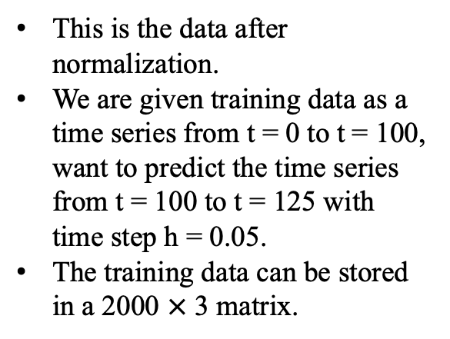
Data Preprocessing
This is the data after normalization.
We are given training data as a time series from t = 0 to t = 100, want to predict the time series from t = 100 to t = 125 with time step h = 0.05.
The training data can be stored in a 2000 $×$ 3 matrix.
Training data
Test data

Slide 6

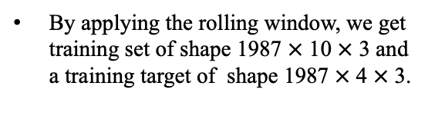
Data Processing
By applying the rolling window, we get training set of shape 1987 $×$ 10 $×$ 3 and a training target of shape 1987 $×$ 4 $×$ 3.

Slide 7
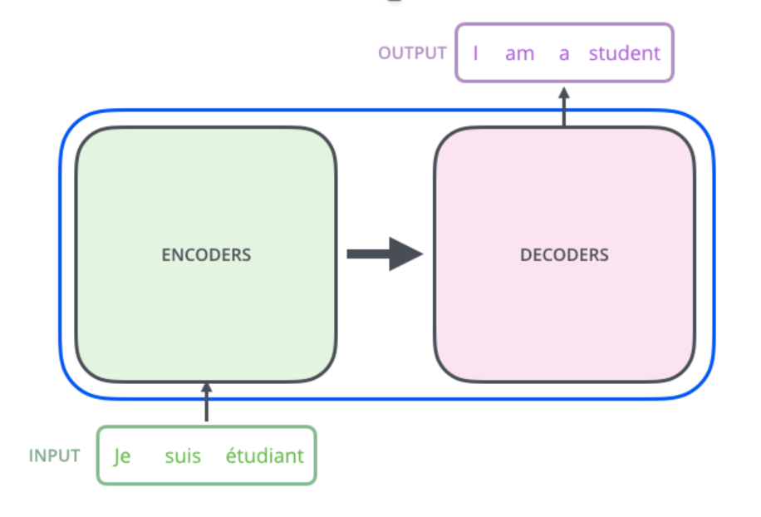
Training Phase
X_target
X_set
Minimize L(Decoder(Encoder(X_set)), X_target)
L could be L2 error for example.

Slide 8
Prediction Phase

Slide 9
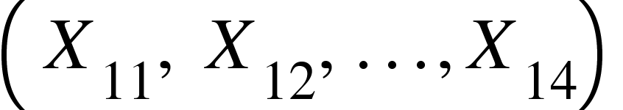
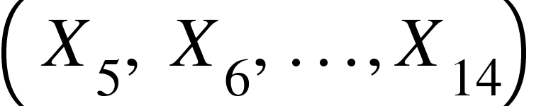
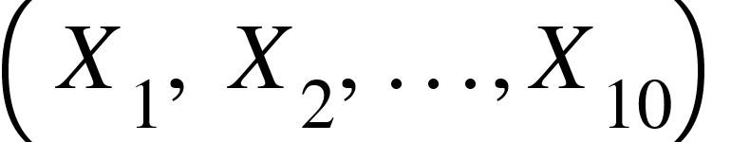
Prediction Phase

Slide 10
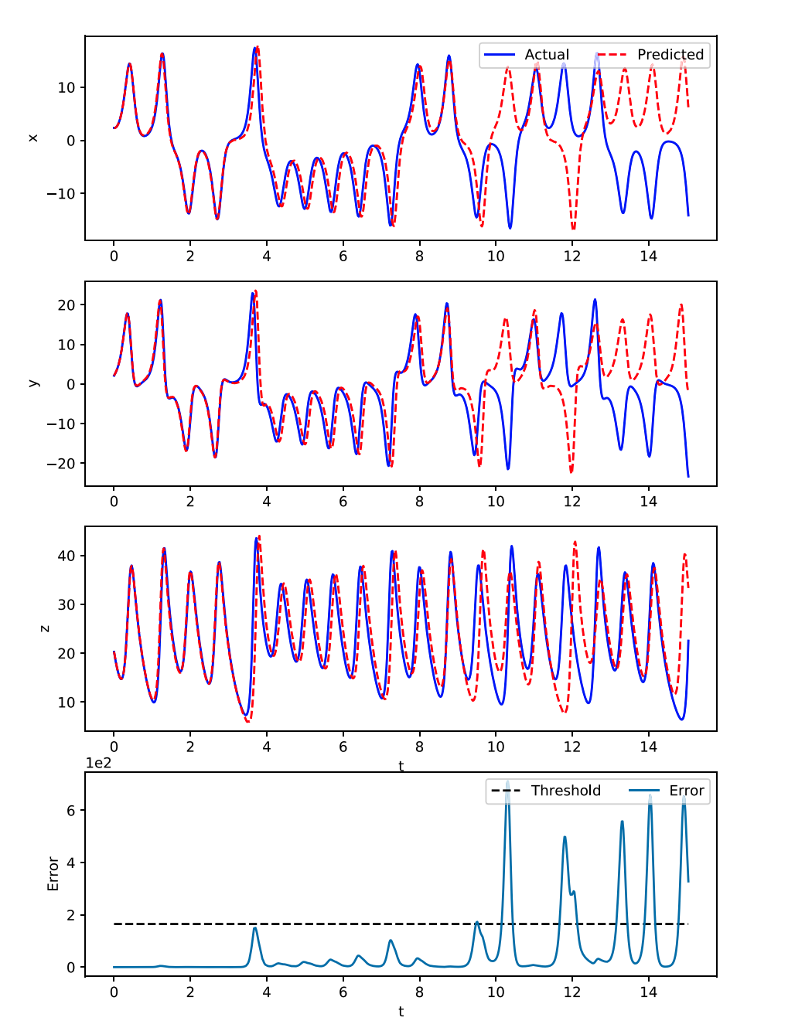
Results
Could predict up to t = 10 using attention-based seq2seq (t = 0 denote the starting time of the prediction phase)
But…

Slide 11
Results

Slide 12
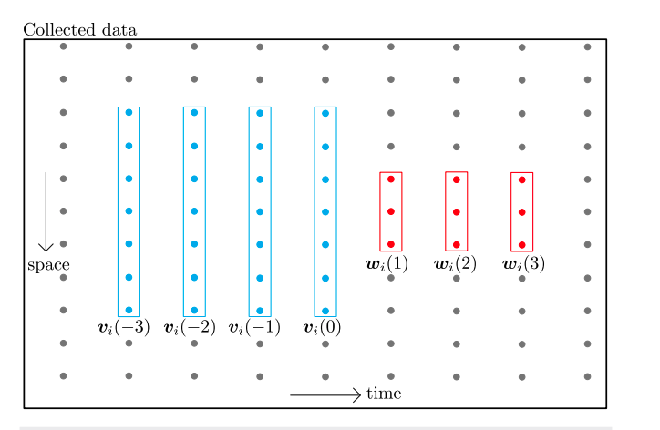
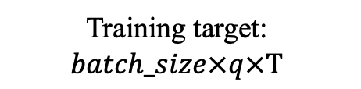
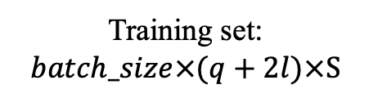
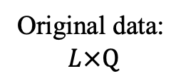
Spatial-temporal Systems
S
T
Original data:
$$L×Q$$
Training set:
$$batch_size×(q+2l)×S$$
l
Q
q
Training target:
$$batch_size×q×T$$
L
This is a naïve way to partition data.
Could use other methods like spectral decomposition, but not used in this paper.

Slide 13

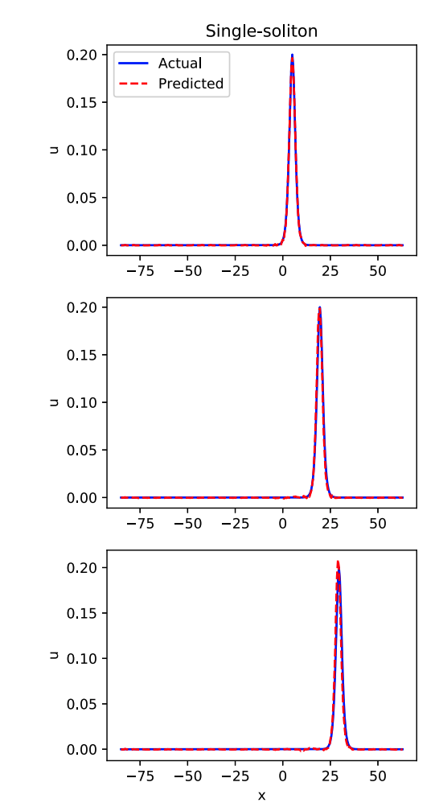

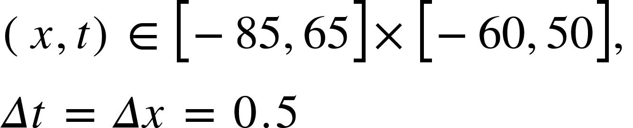



KdV Equation
A single soliton solution would take the form
$$t=50$$
$$t=65$$
The wave propagate with speed c.
$$t=75$$

Slide 14
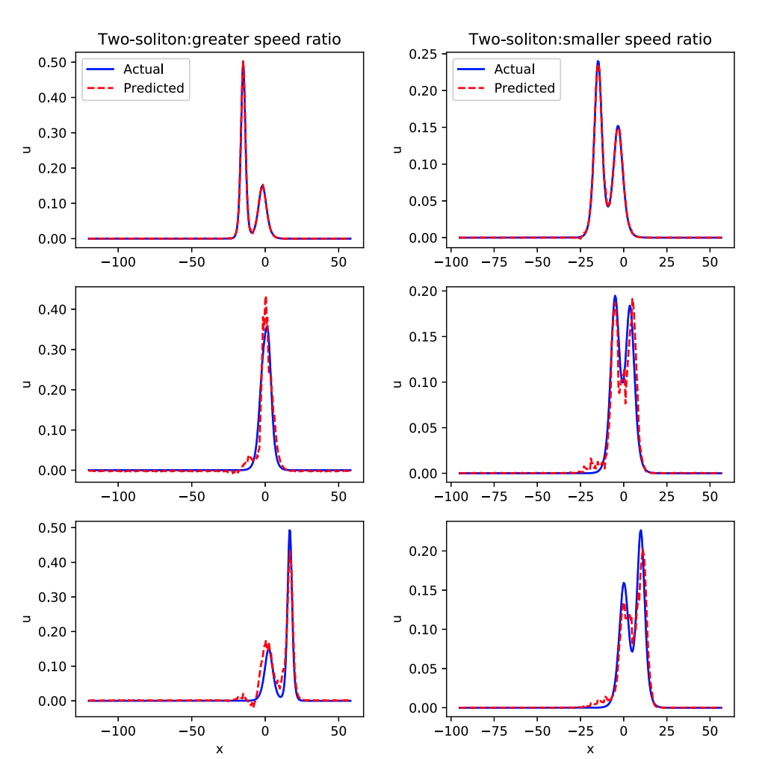

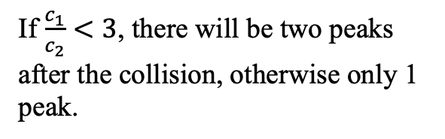
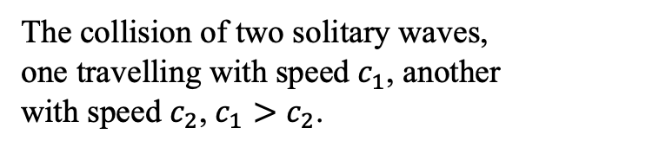




KdV Equation
The collision of two solitary waves,
one travelling with speed $c_{1}$, another
with speed $c_{2}$, $c_{1}{>c}_{2}$.
$$c_{1}=1,c_{2}=0.3$$
$$c_{1}=0.5,c_{2}=0.3$$
$$t=50$$
Training with data before collision, seq2seq model can predict what would happen during and after collision.
$$t=65$$
If $\frac{c_{1}}{c_{2}}<3$, there will be two peaks after the collision, otherwise only 1 peak.
We present the result for both cases on RHS, with the same temporal domain as the previous example.
$$t=75$$

Slide 15
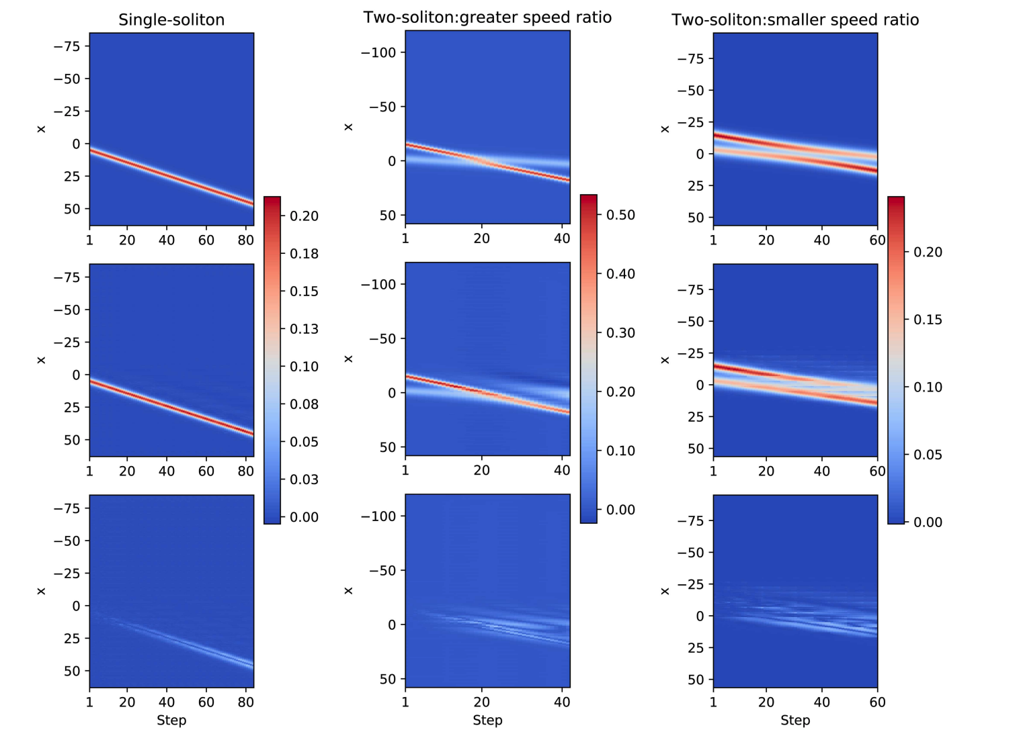
KdV Equation
Ground truth
Prediction
Discrepancy

Slide 16
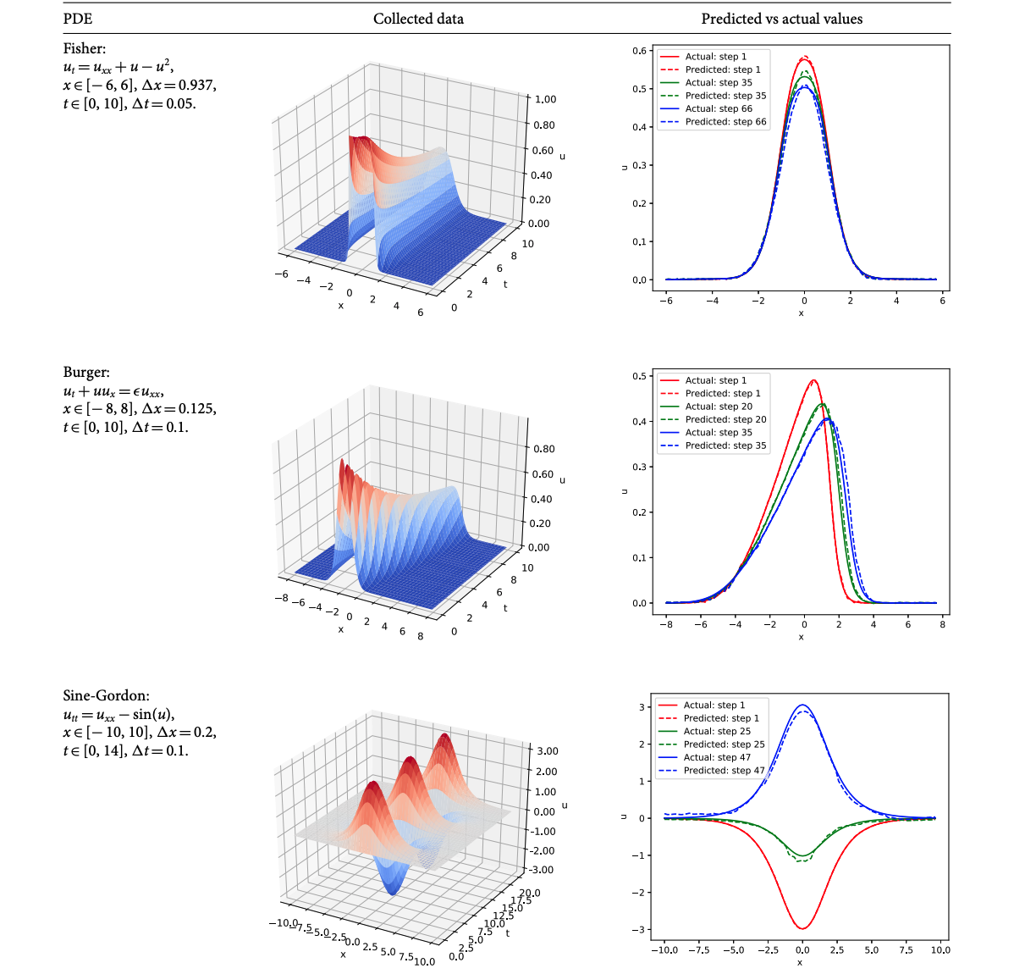
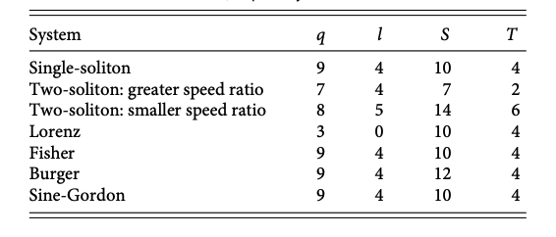
Other Equations

Slide 17
Conclusion
Seq2seq models can be used to predict (simple) time series as well as spatial-temporal systems
Seq2seq models can ‘understand’ some physics because they can predict the interaction of two solitary waves only using the data before the collision.

