Slide 1


Memory Interface and Controller Designs and Optimizations for Next Generation Memory Systems
By:
Trung Le
Defense Committee:
Zhichun Zhu (Chair and Advisor)
Zhao Zhang (Co-advisor)
Ajay Kshemkalyani (Computer Science)
Debjit Pal
Wenjing Rao
Doctoral Dissertation Defense
July 15, 2024

Slide 2
Outline
Introduction
Background and Motivation
POMI: Polling-Based Memory Interface for Hybrid Memory System
DGS: Dynamic Grouping Scheduler For Polling-Based Memory Interface
MSF: Memory-Side Perceptron-Based Prefetch Filtering
Summary

Slide 3
Introduction
“Memory-wall” gap is increasing between CPU and memory
- Processors are designed for high speed and throughput
Main memory focuses on capacity and bandwidth
Volatile Memories can no longer keep up
- Modern day applications require large capacity and high bandwidth
- Volatile memories consume 30% of total system’s energy
Prefetching is used to close the memory-wall gap
- Brings data into cache before it is consumed
- Might lead to cache pollution and wasted resources
Notes:
Introduction
Memory-wall gap is increasing between CPU and memory, since the processors are typically designed for high speed and throughput,
While the main memory focuses on capacity and bandwidth.
This difference creates a “memory-wall” performance gap
Furthermore, DRAM volatile memories has been the preferred technology for main memory and it can no longer keep up with the modern-day applications ,
As they require much larger capacity and higher bandwidth.
DRAM consumes on average 30% of total system’s energy, which makes it a limiting factor for many server platforms.
Moreover, to further combat the “memory-wall” issue, data prefetching is used in most modern processors.
It is a technique to pre-loading data into the cache before it is consumed by the processor.
However, prefetching can lead to excessive use of memory bandwidth, and lead to cache pollution if the prefetched data is not actually used.

Slide 4
Our Work
POMI: Polling-Based Memory Interface for Hybrid Memory System [ICCD2021]
Hybrid memory architecture framework
Supports both DRAM and NVM under one memory subsystem
Uses polling-based bus protocol for communications
DGS: Dynamic Grouping Scheduler for Polling-Based Memory Interface [TODAES2022]
Optimized polling-based memory interface design
Utilizes Command/Address bus for communications via 2 new scheduling policies
MSF: Memory-Side Perceptron-Based Prefetch Filtering [Submitted HPCA2024]
- Discards useless prefetch requests via hashed perceptron learning
- Works for any underlying prefetcher, low storage overhead
Notes:
Our Work
Our first 2 works, POMI and DGS, were presented at my preliminary exam before.
POMI: Polling-Based Memory Interface for Hybrid Memory System
Hybrid memory architecture framework
Supports both DRAM and NVM under one memory subsystem
Uses polling-based bus protocol for communications
DGS: Dynamic Grouping Scheduler for Polling-Based Memory Interface
Optimized polling-based memory interface design
Utilizes Command/Address bus for communications via 2 new scheduling policies
MSF: Memory-Side Perceptron-Based Prefetch Filtering
- Discards useless prefetch requests via hashed perceptron learning
- Works for any underlying prefetcher, low storage overhead

Slide 5
Non-Volatile Memory Technologies
Actively researched as DRAM alternative
Higher densities, zero refresh power, and lower cost-per-bit
Volatile memory (DRAM) must periodically refresh to retain data
Non-Volatile memory does not need to refresh
Example: Phase-Change Memory (PCM), Spin-Transfer-Torque RAM (STT-RAM), Magnetic RAM (MRAM)
Good idea to use both DRAM and NVM in a system
NVM offers better cost-per-bit, densities and zero-refresh power
DRAM is faster and has higher bandwidth
Hybrid Memory System: contains both high-performance, low-latency DRAM and slower but energy-efficient NVM.
Notes:
Non-Volatile memory technologies
Non-Volatile memories are actively being researched as DRAM alternative because
They have higher densities, zero refresh power, and lower cos—per-bit compared to DRAM
Furthermore, volatile memories (such as DRAM) has to periodically refresh itself to retain data. While DRAM is being refreshed, its operations are temporarily stalled until refresh is done.
In comparison, Non-Volatile memory does not need to refresh to maintain data as it is persistent storage.
There are few available NVM such as Phase-Change Memory, Spin-Transfer-Torque RAM, and Magnetic RAM. They all use different mechanism to store data bits and are significantly more energy efficient than DRAM.
2) It is a good idea to use both DRAM and NVM in a system
While NVM offers greater cost-per-bit, densities and zero-refresh power, it has higher access latency, lower bandwidth as compared to DRAM
The co-existence of both DRAM and NVM under the same system is called hybrid memory system, usually consists of high performance, low-latency memory component, like DRAM, and a slower, highly dense, energy-efficient memory, such as NVM

Slide 6
POMI: Polling-Based Memory Interface for Hybrid Memory System
ICCD 2021
POMI:
Hybrid memory architecture framework to support both DRAM and NVM
A buffer chip is inserted on each memory module to perform local operations
Uses new polling-based protocol for communications
Sends ‘Detail’ and ‘Transfer’ packets to communicate data ready time, and to grant bus ownership
POMI enables hybrid memory system, allowing both DRAM and NVM
Notes:
To enable Hybrid memory system, we propose POMI: a polling-based memory interface for hybrid memory system.
POMI is a hybtrid memory architecture framework to support both DRAM and NVM under one memory subsystem.
A buffer chip is inserted on each memory module that performs local scheduling of operations, such as read, write, activate, precharge, refresh.
Since all the schedulings are offloaded to the buffer chip, the memory controller now uses new polling-based protocol for communications between itself and the buffer chips.
The bus protocol sends Detail and Transfer packets to communicate when the data is ready, and when to grant a DIMM bus ownership.
Combined together, POMI enables hybrid memory system, allowing both DRAM and NVM technologies to be housed under one system.

Slide 7
POMI: Evaluation
Simulation:
Gem5 simulation + DRAMPower energy analysis.
SPEC CPU2006 and CPU2017 benchmarks
Homogeneous Performance:
POMI performs 9.7% better than TL, 5.1% over baseline in memory-intensive workloads
POMI outperforms TL by 4.2%, and 1.3% over baseline in mixed workloads
POMI performs well in homogeneous configurations
Hybrid Memory Performance:
Memory-intensive workloads, POMI outperforms by 22.0% over TL, 14.5% over TL-dynamic
Mixed workloads, POMI improves performance by 9.4% over TL, and 7.0% over TL-dynamic
→ POMI performs significantly better than TL in hybrid memory environments
Notes:
Evaluation
We implemented the proposed framework in gem5 simulator, and used DRAMPower for energy analysis.
The simulation used SPEC CPU2006 and CPU2017 benchmarks
Homogeneous performance:
POMI performs 9.7% better than Twinload, and 5.1% over baseline in memory-intensive workloads
And for mixed workloads, POMI outperforms TL by 4.2%, and over baseline by 1.3%
This shows that POMI can perform as efficient as conventional system in homogeneous configurations.
Hybrid Memory Performance
Memory-intensive (HIGH): average performance improvement of 22.0% over TL, 14.5% over TL-dynamic.
Mixed workloads (MIX): 9.4% better than TL, and 7.0% over TL-dynamic.
This shows that POMI performs significantly better than TL in hybrid memory configurations.

Slide 8
Dynamic Grouping Scheduler for Polling-Based Memory Interface
TODAES 2022
POMI design adds additional bus lines
To transfer communication packets, POMI adds additional bus lines.
Produces best performance, but at the cost of extra bus lines
Dynamic Grouping Scheduler (DGS)
To avoid the overhead, DGS utilizes Command/Address bus to transfer communication packets
Command/Address bus now supports bi-directional transfers
Two new scheduling policies
Static Grouping: groups fixed K number of requests together to send over the bus
Dynamic Grouping: dynamically adjust K number for best performance
Notes:
-The POMI design adds additional bus lines dedicated to transfer communication packets.
-This approach produces the best performance at the cost of adding extra bus lines
- We propose Dynamic Grouping Scheduler (DGS), which is an improvement that utilizes the Command/Address
bus to transfer the communication packets.
- In order to do so, the Command/Address bus needs to support bi-directional transfer.
We also proposed 2 new bus scheduling policies due to the new changes
1) Static grouping: the scheduler groups a fixed K number of requests together to send over the bus before flipping the bus’s direction
2) Dynamic grouping: dynamically adjust the K number of grouping for best performance.

Slide 9
Dynamic Grouping Scheduler: Evaluation
Simulation:
Gem5 simulation + DRAMPower energy analysis.
SPEC CPU2006 and CPU2017 benchmarks
Bi-Directional Command/Address performance:
Memory-intensive: POMI-bi performs 4.0% worse than POMI
Mixed: POMI-bi performs 2.9% worse than POMI
Performance is worse due to inefficiency of continuously turning the bus
No longer needs additional Detail/Transfer bus
Static-Grouping and Dynamic-Grouping Scheduler performance:
Memory-intensive: POMI-static performs 1.1% - 2.2% worse than POMI.
Mixed: POMI-static performs 1.2% - 1.6% worse than POMI
→ POMI-dynamic still outperforms optimally-picked K-value Static Grouping.
Notes:
Evaluation
We implemented the proposed scheme in gem5 simulator, and used DRAMPower for energy analysis.
The simulations used SPEC CPU2006 and CPU2017 applications
Bi-Directional Command/Address performance:
Memory-intensive (HIGH): POMI-bi performs 4.0% worse than POMI, on average.
Mixed workloads (MIX): POMI-bi performs 2.9% worse than POMI, on average.
**Performance degradation comes from inefficiency by continuous bus turnarounds.
**No longer needs additional Detail/Transfer bus.
To improve the performance degradation, we proposed the 2 new bus scheduling policies, static-grouping and dynamic-grouping
Memory-intensive (HIGH): POMI-static performs 1.1% - 2.2% worse than POMI, with K ranges from 2 to 5
For mixed workloads, POMI-static performs 1.2% to 1.6% worse than POMI.
As compared to the static grouping scheduler,
Dynamic Grouping Scheduler can still outperforms optimally-picked K-value Static Grouping.

Slide 10
MSF: Memory-Side Perceptron-Based Prefetch Filtering
HPCA 2024 (Submitted)

Slide 11
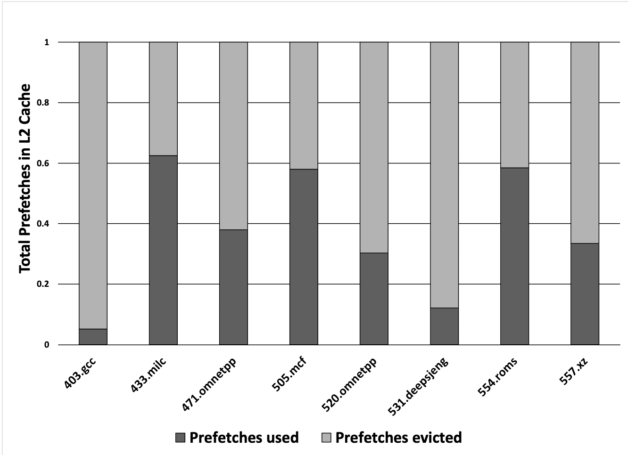
Background and Motivation
Prefetching technique is used in most processors
Inaccurate prefetcher negatively impact performance
In our experiments, 62.7% of prefetched data are evicted without being referenced once
Wasted resources
Wasted bandwidth
Figure: Percentage of used/evicted prefetches in L2
Notes:
Data prefetching is a technique used in most modern processors to bring data into cache before it is requested by the core, effectively hiding the memory access latency.
However, inaccurate prefetcher negatively impact performance by consuming valuable bandwidth and pollutes the cache.
On the right side is a figure, showing the percentage of prefetches used/evicted from L2 cache for several SPEC CPU workloads.
On average, 62.7% of the prefetched data are evicted without being referenced once.
These prefetches consumed resources and bandwidth that could been used for useful requests

Slide 12
Background: Data Prefetching
Core
Data prefetching is a technique deployed in most computer systems.
Preemptively fetch data into cache before it is requested
Most prefetchers utilize metadata within the core
PC, tag, delta, signature, etc.
Goal: increase accuracy while moderates the aggressiveness
L1D
L1I
Prefetcher
L2
L3
(shared)
Figure: Underlying prefetcher housed in L2
Notes:
-Data prefetching is a well-studied technique deployed in most computer system nowadays.
- The goal of prefetching is to preemptively fetch data into cache before it is actually requested by the processor, effectively hiding the memory access latency.
Most prefetcher utilize metadata within the core to predict memory access patterns , such as PC, request’s tag, delta, signature
Most prefetchers aim to increase accuracy while moderating their aggressiveness to prevent over-fetching.

Slide 13
Background: Prefetch Filtering
Inaccurate prefetchers can impact the performance of the system
by causing cache pollution and waste memory bandwidth
Prefetch filtering is used to filter unnecessary prefetch requests
Acts as an independent check on quality of incoming prefetches
Typically housed in cache hierarchy
Previously proposed filters only examine core-side information
Filter should examine both core-side and memory-side
Prefetch Filter
Should we proceed with the prefetch ?
Prefetcher
L2
Yes/No
L3
(shared)
Figure: Prefetch Filter housed in L2
Notes:
However, inaccurate prefetcher can impact the performance of the system by causing cache pollution
and increasing contention on memory bandwidth
Therefore, prefetch filtering is used to filter unnecessary prefetch requests.
It acts as an independent check on the quality of incoming prefetches.
The hardware-based filter is typically housed directly in the cache hierarchy, and requires
-Previously proposed filters only examine core-side information such as prefetcher accuracy, or confidence level. However, this decision should consider both the cache and memory status.
On the right, we have a figure of a typical prefetch filter engine.
A question of “Should we proceed with the prefetch?” is asked for every generated request, and the filter usually answers yes or no, meaning that we should continue normally or discard the generated request.

Slide 14
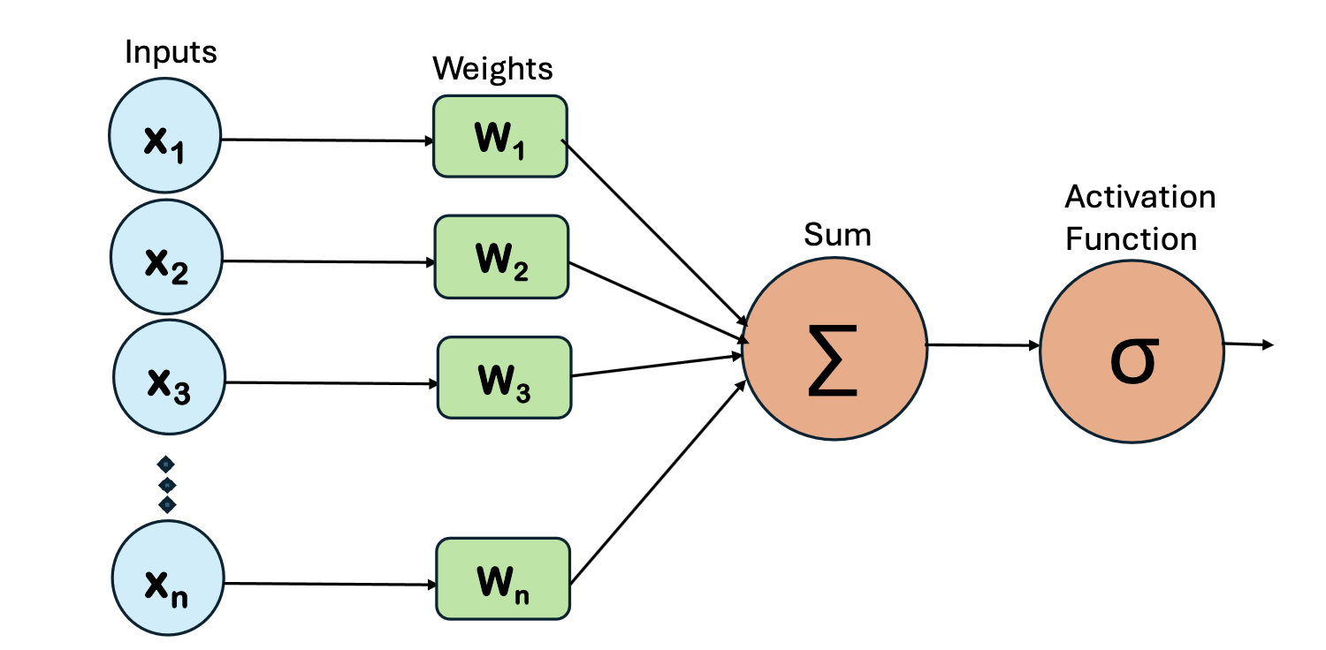
Background: Hashed Perceptron Learning
Perceptron is simple neural network to recognize correlation
However, dot-product operation is expensive
Hashed Perceptron Learning
Hashes the input features into indices of weight tables
Applies sum operation across indexed weights
Binary decision is made based on threshold
Training is simple
Significantly reduces latency
Figure: Original perceptron architecture
Notes:
Perceptron is a simple neural network to recognize correlation between its input and the pattern.
However, the original perceptron architecture requires dot-product operation, which is expensive and long calculations which is not acceptable in architectural designs.
Instead, we will be using hashed perceptron variation of the original perceptron design.
The hashed perceptron hashes the features into indices of the weight table
Then, a sum operation is applied across all indexed weights and a binary decision is made if the sum passes a threshold.
Furthermore, training hashed perceptron is simple because it’s just increment/decrement the indexed weight values.
The hashed perceptron significantly reduces latency of both inference and training stage compared to original perceptron architecture.

Slide 15
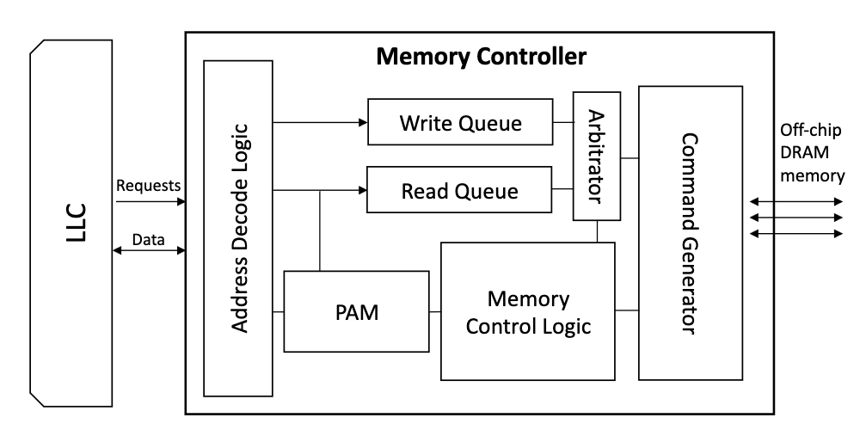
MSF Overview
Memory-Side perceptron-based prefetch Filtering
The Prefetch Analyzer Module (PAM) is placed in the Memory Controller
Oversees all Read memory requests
Pulls features together
Determines the usefulness of prefetch requests
Inference is triggered on every prefetch requests
Training is triggered on LLC feedbacks
Figure: Overview of MSF
Notes:
MSF Overview.
On the right is a figure showing high-level overview of MSF.
- The Prefetch Analyzer Module (PAM) is placed in the memory controller, overseeing all Read memory requests coming from LLC.
– PAM uses perceptron learning technique to pull features together, derived from the metadata available within MC.
There are 2 stages of perceptron learning, inference and training.
Inference is triggered on every prefetch memory requests
Training is triggered on LLC feedbacks

Slide 16
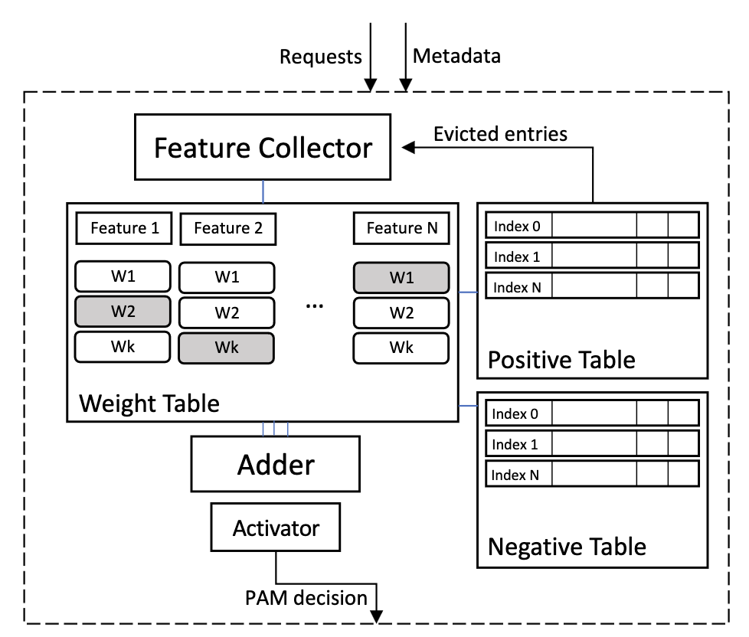
Prefetch Analyzer Module
Core components of PAM:
Feature Collector: gathers all the metadata
Figure: Prefetch Analyzer Module design
Notes:
Prefetch Analyzer Module
On the right is a figure showing the core components of PAM.
There are a few core components of PAM:
Feature Collector is in charge of gathering all the metadata required to compute the features.

Slide 17
Prefetch Analyzer Module
Core components of PAM:
Feature Collector: gathers all the metadata
Weight Table: contains all features’ weights
Figure: Prefetch Analyzer Module design
Notes:
Prefetch Analyzer Module
On the right is a figure showing the core components of PAM.
There are a few core components of PAM:
Feature Collector is in charge of gathering all the metadata required to compute the features.
All the features are hashed into their respective index within the Weight Table

Slide 18
Prefetch Analyzer Module
Core components of PAM:
Feature Collector: gathers all the metadata
Weight Table: contains all features’ weights
Adder: accumulates all indexed weights
Activator: checks if sum passes threshold
Figure: Prefetch Analyzer Module design
Notes:
Prefetch Analyzer Module
On the right is a figure showing the core components of PAM.
There are a few core components of PAM:
Feature Collector is in charge of gathering all the metadata required to compute the features.
All the features are hashed into their respective index within the Weight Table
The weights are accumulated and fed into the Activator for the final decision

Slide 19
Prefetch Analyzer Module
Core components of PAM:
Feature Collector: gathers all the metadata
Weight Table: contains all features’ weights
Adder: accumulates all indexed weights
Activator: checks if sum passes threshold
Positive/Negative Table: holds the metadata of decisions for training opportunities
Figure: Prefetch Analyzer Module design
Notes:
Prefetch Analyzer Module
On the right is a figure showing the core components of PAM.
There are a few core components of PAM:
Feature Collector is in charge of gathering all the metadata required to compute the features.
All the features are hashed into their respective index within the Weight Table
The weights are accumulated and fed into the Activator for the final decision
Once the decision is finalized, the metadata values are used to form an entry in the Positive and Negative Tables.
Depending on if the decision is an approved decision (positive), then the entry goes in Positive Table, otherwise Negative Table.
These entries are used as training opportunities

Slide 20
PAM Inference Stage
There are 2 types of Read requests arriving at Memory Controller:
Speculative prefetch request
True demand request
Inference is triggered on every prefetch requests:
PAM analyzes prefetch request to determine usefulness
Deemed Unnecessary : requests are discarded
Deemed Useful: requests proceed as normal
Metadata values are stored in logging tables (Positive/Negative tables)
Figure: Prefetch Analyzer Module design
Notes:
Inference stage
There are 2 types of read requests arriving at the controller:
1) Speculative prefetch request
2) True demand request
Inference is triggered on every Read requests:
1) PAM analyzes the prefetch and makes a binary decision on whether or not the prefetch is needed.
If a prefetch is deemed unnecessary, it is simply discarded and the MSHR entry can be freed.
If a prefetch is deemed useful, the request can proceed as normal request.
After the decision is finalized, the metadata values are stored in the logging tables , along with any information needed to retrieve the state of this decision, for later training stage.

Slide 21
PAM Training Stage
Deemed Useful: requests proceed as normal
Two scenarios if a prefetch is approved:
Good approve decision: cache-line is used
Bad approve decision: cache-line is never used, evicted
→ LLC sends feedbacks on both scenarios
Training occurs on feedback signals:
Address of the request is used to retrieve metadata
Metadata values are hashed into indices to weight tables
Weights are incremented/decremented
LLC feedbacks
Positive Table
Training
Feature 1
Feature 2
Feature N
w1
w1
w1
w2
w2
w2
w2
w2
w2
wN
wN
wN
Notes:
Training Stage of Prefetch Analyzer
Recall that
If a prefetch is approved by the PAM, the request proceeds normally and is treated like a typical read request.
Therefore,
There are 2 scenarios that can happen if a prefetch is approved:
Either it's a good prefetch: meaning the cacheline is used in the LLC,
or it's a bad prefetch: meaning the prefetched data is never used and resides in LLC for a long time until it is evicted.
The Last Level Cache sends feedback if a prefetched cacheline is used by the processor, and similarly if a prefetched block is evicted from the LLC.
Once PAM receives feedback from LLC, the address of the cache line is used to retrieve the metadata and the decision from the logging tables, previously stored at the inference stage. Next, the metadata values are hashed into indices to their corresponding weight tables. The weights are incremented if the true outcome is a positive, increasing the chance a needed prefetch be accepted next time. Vice versa, the weights are decremented if the true outcome is a negative

Slide 22
PAM Training Stage (Cont.)
Deemed Useless: requests are discarded
Two scenarios if a prefetch is rejected:
Good reject: no true demand comes from processor to the prefetch address
Bad reject: true demand eventually comes
PAM analyzes every true demand requests from LLC
Training occurs on matched address
Address used to look up the Negative Table
If entry is found: previous reject was bad reject
If entry is not found: nothing happens
True Demands
Negative Table
Training
Feature 1
Feature 2
Feature N
w1
w1
w1
w2
w2
w2
w2
w2
w2
wN
wN
wN
Notes:
Similarly, there are 2 scenarios that can happen if a prefetch is rejected.
Either it's a good reject: meaning the discarded prefetch is correct, and no true demand comes from the processor to that specific address.
Or it’s a bad reject, meaning the discarded prefetch is actually correct, and a true demand comes later to the same address of the prefetch.
Hence, PAM need to analyze every true demand requests coming from LLC to see if previously rejected prefetch matches with the current request
For each of the true demand’s address, a lookup is performed on the Negative Table to check if there exists an entry for the same address.
If an entry is found, that means a previous prefetch was rejected, and turns out it was actually needed by the processor.
If the entry is not found, then nothing happens.

Slide 23
PAM Tables
Decisions are logged in Positive/Negative Tables
Approved requests → Positive Table
Rejected requests → Negative Table
Simple 4-way cache with LRU replacement
An entry contains metadata when prediction was made
Training occurs on eviction:
Evicted from Positive Table = bad decision
Evicted from Negative Table = good decision
Notes:
PAM Tables
If the prediction is a positive, meaning the requested prefetch will proceed as a typical read request, PAM logs the metadata values in the Positive Table. Otherwise, PAM logs the metadata values in the Negative Table.
The table is a simple 4-way cache with LRU replacement policy
The entry in the logging table contains enough information to retrieve each feature and its state when the prediction was made.
Furthermore, PAM also trains and improves itself if an entry is evicted from the tables.
1) If an entry is evicted from the Positive Table, it means the approved prefetch data is currently sitting in the cache hierarchy without being used once. PAM treats this as a bad decision and train itself.
2) If an entry is evicted from Negative Table, it means no true-demand request was sent to the same address. PAM treats this as a good decision

Slide 24
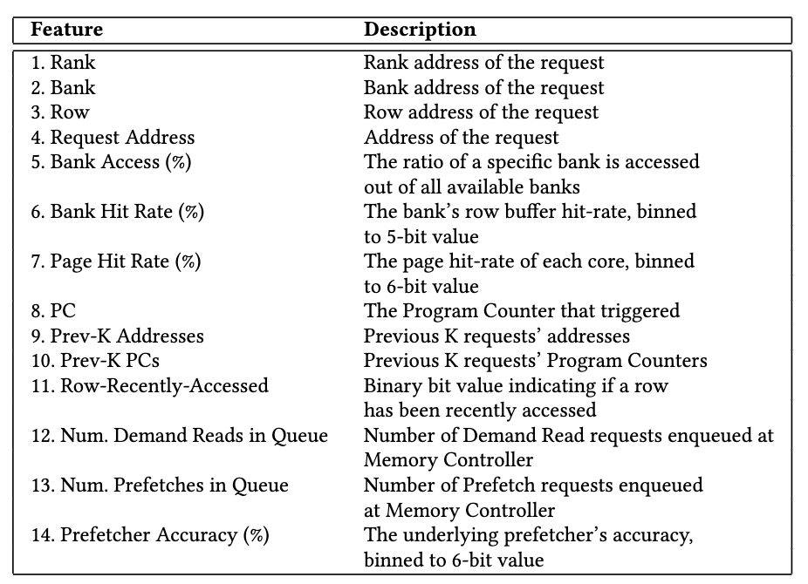
Offline Feature Selection
All features can be derived from MC or LLC
Initial 14 single features
Many are easily derived within MC
Few features require counters
Offline training starts with 23 set of features
Notes:
Offline feature selection
Let’s discuss on the offline feature selection
All the features can be derived from the information available in the Memory Controller or from LLC.
First, we initially produced 14 single features, as shown on the table to the right
Features such as rank, bank, row, request address, etc are easily derived within the controller
A few feature such as Bank Hit rate, Page Hit rate require additional counters, which we will discuss later
We combine the single features to form 23 set of features that are used together to convey more meaningful information.

Slide 25
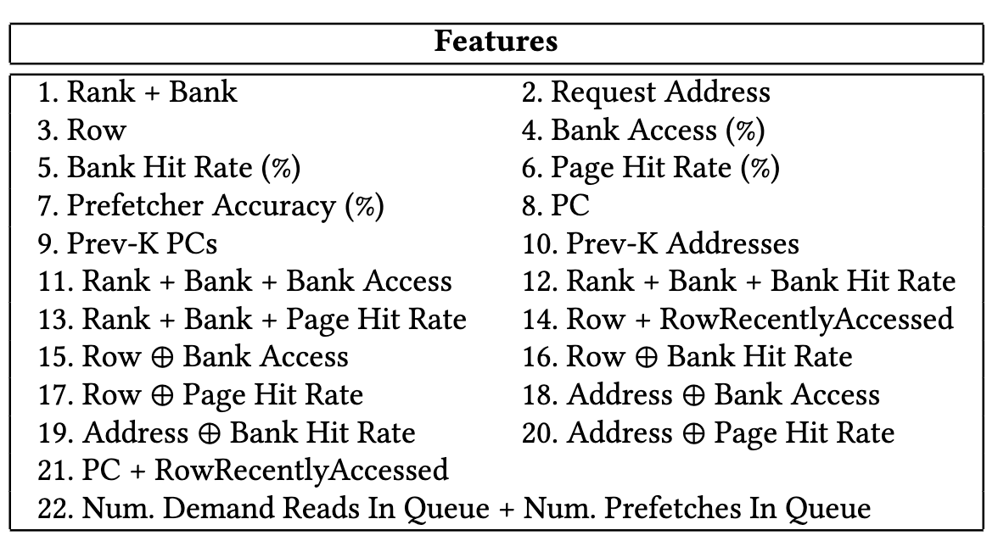
Offline Feature Selection (Cont.)
Figure: Initial set of features
Notes:
Here is the full list of 23 features that are used in the offline training stage.

Slide 26
Offline Feature Selection Steps
5 set of HIGH and 5 set of MIX workloads are randomly selected
5 set of HIGH workloads
H2
H17
H33
H7
H19
M1
M3
M5
M14
M8
5 set of MIX workloads
Notes:
1) At each training iteration, a random set of five high memory- intensive (HIGH) and five mixed (MIX) workloads are selected.

Slide 27
Offline Feature Selection Steps
2. Simulation is launched with single feature to collect statistics. Top-N features are selected to pass onto the next iteration.
Feature 5
Feature 13
Top-N features are selected
Feature 7
Feature 21
Feature 4
.
.
Normalized Performance
Notes:
At each training iteration, a random set of five high memory- intensive (HIGH) and five mixed (MIX) workloads are selected.
Next, Simulation is launched with one single feature to collect statistics, this is repeated for all 23 single feature.
Top-N features are selected to pass onto the next training iteration.
In our paper, we used N = 10

Slide 28
Offline Feature Selection Steps
3. Selected features are coupled with another single feature to form a
set-of-2 combination.
Set-of-2 combination
Feature 5 + Feature 1
Feature 13 + Feature 1
Feature 7 + Feature 1
. . .
Feature 5 + Feature 2
Feature 13 + Feature 2
Feature 7 + Feature 2
Feature 5 + Feature 3
Feature 13 + Feature 3
Feature 7 + Feature 3
Feature 5 + Feature 4
Feature 13 + Feature 4
Feature 7 + Feature 4
Feature 5 + Feature 6
Feature 13 + Feature 5
Feature 7 + Feature 5
.
.
.
.
.
.
.
.
.
Notes:
At each training iteration, a random set of five high memory- intensive (HIGH) and five mixed (MIX) workloads are selected.
Next, Simulation is launched with one single feature to collect statistics, this is repeated for all 23 single feature.
Top-N features are selected to pass onto the next training iteration.
In our paper, we used N = 10
3) The selected features are coupled with another single feature to form a set-of-2 combinations
Once the new feature set are formed, the steps are repeated

Slide 29
Offline Feature Selection Steps
4. Simulations are launched for set-of-2 combinations
Feature 5 + Feature 1
Feature 7 + Feature 4
Feature 13 + Feature 5
Feature 21 + Feature 2
.
Feature 13 + Feature 3
.
Normalized Performance
Notes:
At each training iteration, a random set of five high memory- intensive (HIGH) and five mixed (MIX) workloads are selected.
Next, Simulation is launched with one single feature to collect statistics, this is repeated for all 23 single feature.
Top-N features are selected to pass onto the next training iteration.
In our paper, we used N = 10
3) The selected features are coupled with another single feature to form a set-of-2 combinations
Once the new feature set are formed, the steps are repeated
4) New 5 set of HIGH and 5 set of MIX are randomly selected
Then, the simulations are launched again on set-of-2 combination to get the Top-N features.

Slide 30
Offline Feature Selection Steps
5. Set-of-3 combinations are formed
Set-of-3 combination
Feature 5 + Feature 1 + Feature 2
Feature 21 + Feature 2 + Feature 1
. . .
Feature 5 + Feature 1 + Feature 3
Feature 21 + Feature 2 + Feature 3
Feature 5 + Feature 1 + Feature 4
Feature 21 + Feature 2 + Feature 4
Feature 5 + Feature 1 + Feature 6
Feature 21 + Feature 2 + Feature 5
Feature 5 + Feature 1 + Feature 7
Feature 21 + Feature 2 + Feature 6
.
.
.
.
.
.
Notes:
4) New 5 set of HIGH and 5 set of MIX are randomly selected
Then, the simulations are launched again on set-of-2 combination to get the Top-N features.
5) Based on the simulation results, set-of-3 combinations are formed and this repetitive process continues until there are no more improvement on the performance.

Slide 31
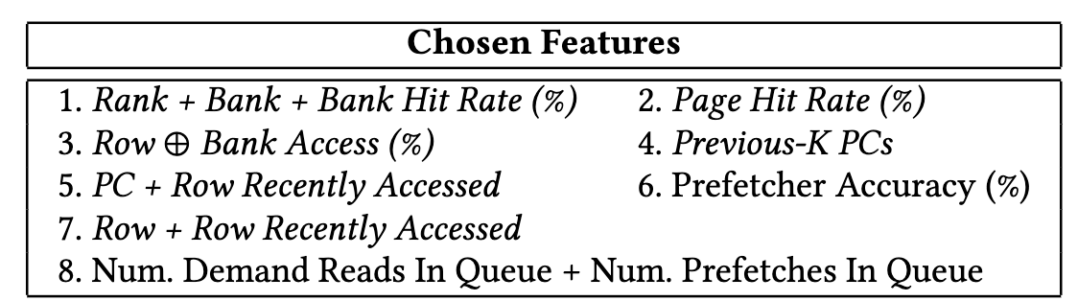
Offline Training Results
Final list of selected program features:
→ Activation Threshold = 16
Notes:
This is the final list of 8 selected program features in the offline training stage.
Rank + Bank + Bank HitRate
Page Hit Rate
3) Row XOR Bank Access
4) Previous-K PCs
5) PC + Row-recently-accessed
6) Prefetcher Accuracy
7) Row + Row-recently-accessed
8) Number Demand Reads in Queue + Number Prefetches in Queue
Once the list of features are finalized, we launched simulations to determine the optimal activation threshold.
Base on our experiments, the activation threshold is 16

Slide 32
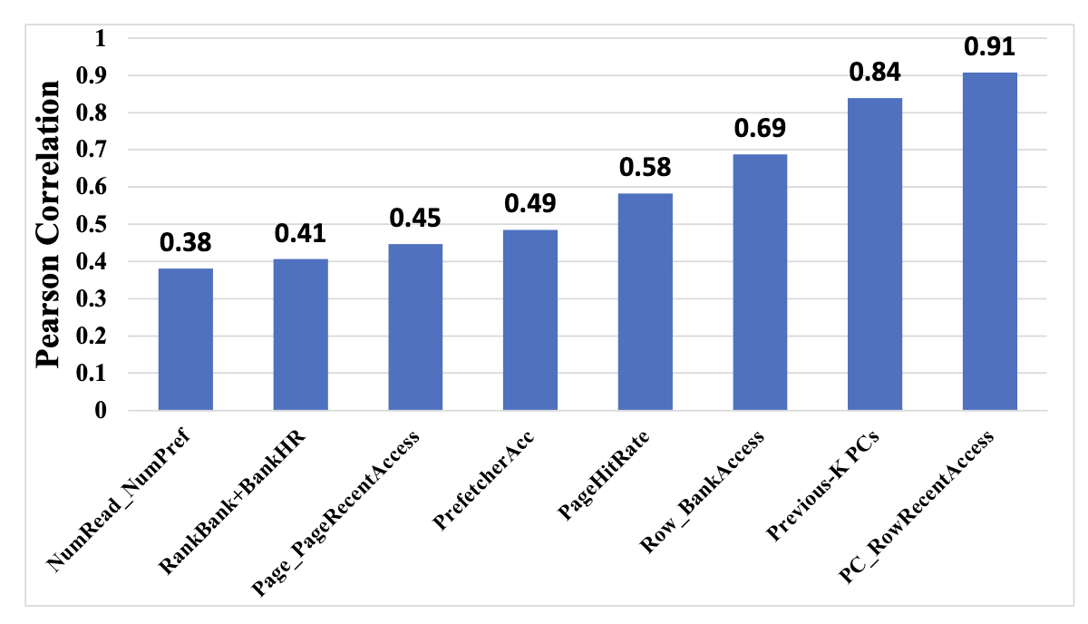
Pearson Correlation Coefficient
Pearson Correlation Coefficient (PCC) measures linear correlation between two sets of data
Ranges from +1 to -1
Indicates strong positive/negative correlation between two input
Notes:
Pearson Correlation Coefficient
Next, we analyze the Pearson Correlation Coefficient (PCC) for all the selected features.
PCC measures the linear correlation and its strength
between two sets of data. The coefficient ranges from -1 to +1, where a value of
0 indicates no association, and +1/-1 indicates strong
positive/negative association between the two variables.
The statistics are collected at the end of each simulation run to calculate PCC value for each of the 8 feature.
Feature 5 (PC + Row-recently-accessed) has the highest PCC value at 0.91,
With Feature 4 (Previous-K PC) has the second highest PCC value at 0.84
As shown, all the selected features provide moderate to high correlation to the prefetching usefulness prediction.

Slide 33
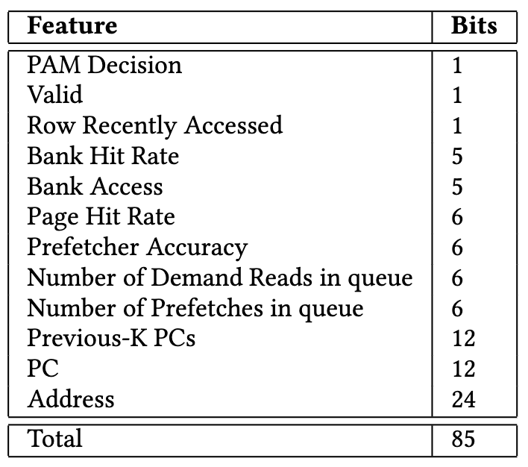
Overhead: Logging Tables
Each entry has enough information to retrieve the system state + all features
Positive Table: 1024 entries = 10.75KB
Negative Table: 512 entries = 5.375KB
Notes:
Overhead: Logging Tables
For each decision MSF makes, it stores all the metadata values in logging tables.
Each entry has enough information to retrieve the system state when the prediction was made, along with all the features used.
Each entry is 85-bits, and the Positive Table contains 1024 entries, while the Negative Table has 512 entries.
That means the Positive Table overhead is 10.75KB, and the Negative Table consumes 5.375KB of storage overhead.

Slide 34
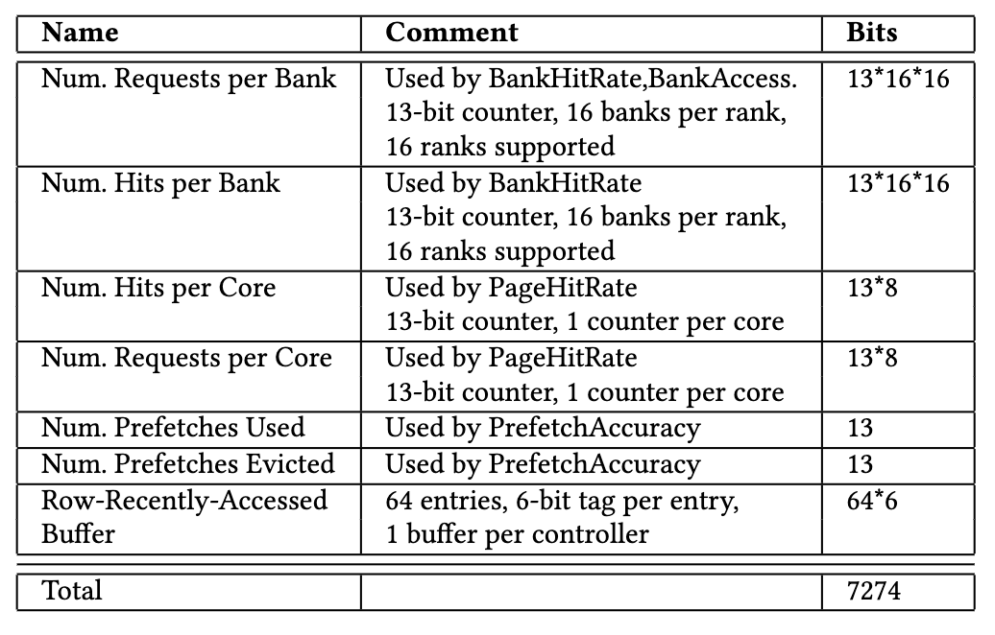
Overhead: Counters and Buffers
To compute the features in MSF, the MC has several counters and buffers to store necessary information.
Total of 7274 bits of counters and buffers
Notes:
Overhead: Counters and Buffers
To compute the features in MSF, the MC has several counters and buffers to store necessary information.
Overall, the Memory Controller requires 7274 bits of counters and buffers.

Slide 35
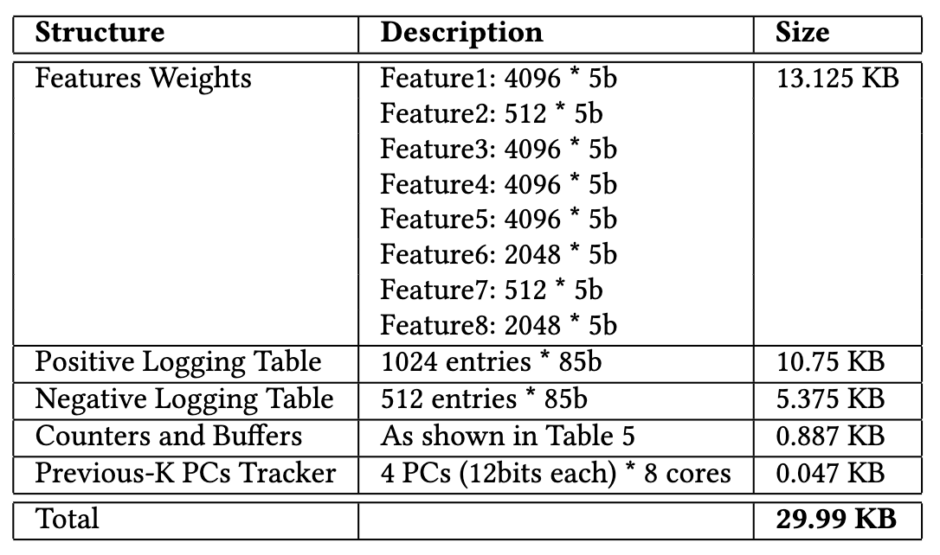

Total Overhead
Overall, MSF consumes 29.99KB of storage overhead.
Note that this overhead is per-memory-controller, instead of per-core as in similar prefetch filtering schemes
Notes:
Total Overhead
Overall, MSF consumes 29.99 KB of storage overhead.
Note that this overhead is per memory controller, instead of per core as in similar prefetch filtering schemes. Which means MSF consumes significantly less storage overhead since there are typically only one to two memory channels in a system, while there could be up to 16 cores in a processor.

Slide 36
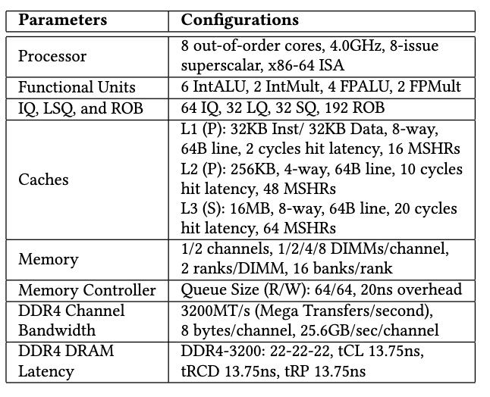
Experiments and Simulation
MSF evaluated in gem5 simulator
Extended to simulate 2 related schemes
PPF and PADC
4.0GHz 8 out-of-order cores, x86-64 ISA
3 level caches, LLC 16MB
Simulations are fast-forwarded to their checkpoints
Run for 1 billion instructions
Table: Major Simulation Parameters
Notes:
Experiments and Simulation
We evaluate our proposed scheme by using cycle accurate x86-64 simulator gem5 \cite{gem5}. The gem5 simulator is extended
to support our scheme MSF.
- We also extended the codebase to simulate 2 related schemes: PPF and PADC. Which we will discuss the details later
The details of our baseline simulation
configurations are shown in Table to the right.
We are running a 4.0GHz 8 out-of-order cores, with 3 level of caches, the LLC has 16MB size
The simulations are fast-forwarded to their checkpoints, which is generated by SimPoint3.0, then the detailed simulation is run for 1 billion instructions

Slide 37
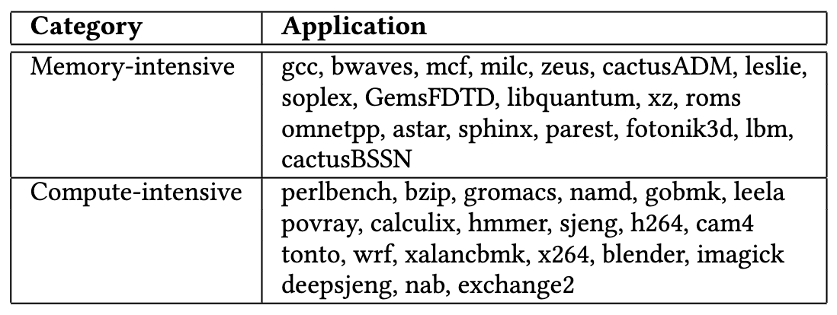
Workloads
SPEC CPU2006 and CPU2017 applications
Categorized misses-per-kilo-instructions (MPKI)
Memory-intensive workloads: MPKI > 10.0
Compute-intensive workloads: MPKI <= 10.0
Each workload set consists of 8 applications
All workload sets must have >= 3.0 MPKI
Total 55 workload sets
37 memory-intensive sets
18 mixed sets
Notes:
Workloads
-We evaluate our schemes using SPEC CPU2006 and SPEC CPU2017 benchmarks
-The workload is categorized based on misses-per-kilo-instruction (MPKI)
Applications with LLC MPKI values higher than ten will be categorized as memory-intensive applications.
Those with MPKI values lower or equal to ten will be classified as compute-intensive applications
Each HIGH workload consists of eight randomly selected memory-intensive
applications; while each MIX workload consists of randomly selected
four memory-intensive applications and four compute-intensive applications.
- After combining the applications together to form a set, we discard any workload sets that have below three LLC MPKI
values for our experiments.
- Overall, we have 55 workload sets, with 37 memory-intensive (HIGH) ones
and 18 mixed (MIX) workloads.

Slide 38
Underlying Prefetchers
SignaturePath Prefetcher (SPP): uses compressed history table to accurately predict complex memory access patterns based on its confidence level
AMPM Prefetcher: prefetcher uses memory access mapping to detect any access patter
DCPT Prefetcher: prefetcher stores the deltas of request misses, which are used to detect patterns.
Tagged-Correlating Prefetcher: tag sequences to correlate the highly-repetitive tag patterns
Notes:
Underlying Prefetchers
In our simulations, we implemented 4 prefetchers in gem5
Signature Path Prefetcher
AMPM Prefetcher
DCPT Prefetcher
Tagged-Correlating Prefetcher
We will not go into much details of each prefetcher, but they do have different behavior and aggressiveness on generating prefetch requests.

Slide 39
Evaluated Schemes
Perceptron-Based Prefetch Filter (PPF):
Filters prefetches generated by SignaturePath prefetcher
Uses metadata directly from SPP (signature, depth, confidence, etc.)
The engine is placed directly in the underlying prefetcher, works only for SPP
Prefetch-Aware DRAM Controller (PADC)
Monitors prefetcher’s accuracy to adaptively schedule requests
Removes prefetches from Read Queue based on age metric
Memory-Side prefetch Filter (MSF): our work
Notes:
Evaluated Schemes
In our experiemnts, we evaluate the following related schemes that are implemented in gem5
PPF: The scheme uses perceptron-learning mechanism to filter prefetch requests generated by SignaturePath prefetcher specifically.
The filter engine uses metadata directly from SPP such as signature, depth and confidence metrics.
Moreover, the engine is placed directly in the underlying prefetcher, and it only works for SPP.
2) PADC: the scheme monitors the underlying prefetcher’s accuracy to adaptively schedule requests with different policies.
PADC also remove prefetch requests from read queue based on age metric.
3) Lastly, we have MSF

Slide 40
Results: Performance with Different Prefetchers
Performance results of different prefetchers using our prefetch filter
Sorted in increasing order using IPC values
Memory-intensive workloads:
+7.5% performance with SPP
+3.2% performance with AMPM
+5.8% performance with DCPT
+11.2% performance with Tagged
Notes:
Results: Performance with Different Prefetchers
- The figure shows the performance comparison between different underlying prefetchers using our prefetch filter.
All the results are normalized to their respective baseline with the prefetcher enabled, and sorted in increasing order using IPC values.
- For memory-intensive workloads, MSF improves the performance by 7.5% on av- erage (up to 18.4%) with SignaturePath, 3.2% on average (up to 8.1%) with AMPM, 5.8% on average (up to 20.9%) with DCPT, and 11.2% on average (up to 33.4%) with Tagged-Correlating as the underlying prefetcher, respectively.

Slide 41
Results: Performance with Different Prefetchers (Cont)
Performance results of different prefetchers using our prefetch filter
Sorted in increasing order using IPC values
Mixed workloads:
+5.9% performance with SPP
+3.7% performance with AMPM
+4.5% performance with DCPT
+8.0% performance with Tagged
Notes:
Results: Performance with Different Prefetchers
- The figure shows the performance comparison between different underlying prefetchers using our prefetch filter.
All the results are normalized to their respective baseline with the prefetcher enabled, and sorted in increasing order using IPC values.
For memory-intensive workloads, MSF improves the performance by 7.5% on av- erage (up to 18.4%) with SignaturePath, 3.2% on average (up to 8.1%) with AMPM, 5.8% on average (up to 20.9%) with DCPT, and 11.2% on average (up to 33.4%) with Tagged-Correlating as the underlying prefetcher, respectively.
For mixed (MIX) workloads, MSF performs better by 5.9% on average (up to 12.8%) than the baseline with SignaturePath prefetcher, 3.7% on average (up to 8.7%) with AMPM, 4.5% on average (up to 10.4%) with DCPT, and 8.0% on average (up to 23.8%) with Tagged- Correlating prefetcher, respectively.

Slide 42
Results: Performance with Different Prefetchers (Cont)
Performance results of different prefetchers using our prefetch filter
Sorted in increasing order using IPC values
Overall workloads:
+7.0% performance with SPP
+3.3% performance with AMPM
+5.3% performance with DCPT
+10.5% performance with Tagged
MSF works well with any underlying prefetcher
Notes:
Results: Performance with Different Prefetchers
- Overall, out of the full 55 SPEC workloads, MSF improves performance over the baseline by 7.0% with SignaturePath, 3.3% with AMPM, 5.3% with DCPT, and 10.5% with Tagged-Correlating as their underlying prefetcher, respectively. This proves that MSF can work well with any prefetcher respectively.

Slide 43
Results: Prefetcher’s Accuracy
MSF filters out unnecessary prefetch requests => Improves accuracy
Figure shows SPP prefetcher’s accuracy between no filter vs MSF filter
Overall, MSF increases SPP’s accuracy by 11.4%
Notes:
Results: Accuracy and Coverage
The main benefit of MSF is that it filters out unnecessary prefetch requests coming in from LLC.
Here we show the prefetcher’s accuracy comparison between the baseline with no filter, and with MSF as the filter
Since we have total of 55 workloads, we will only show a representative set of workloads.
- Overall, Across 55 workloads, MSF increases SPP’s accuracy by 11.4%

Slide 44
Results: Prefetcher’s Accuracy(Cont.)
Figure shows AMPM prefetcher’s accuracy between no filter vs MSF filter
Overall, MSF increases AMPM accuracy by 9.1%
Notes:
Results: Accuracy and Coverage
For AMPM Prefetcher, MSF increases the accuracy by 9.1% across all workloads.

Slide 45
Results: Prefetcher’s Accuracy(Cont.)
Figure shows DCPT prefetcher’s accuracy between no filter vs MSF filter
Overall, MSF increases DCPT accuracy by 5.1%
Notes:
Results: Accuracy and Coverage
For DCPT Prefetcher, MSF increases the accuracy by 5.1% across all workloads.

Slide 46
Results: Prefetcher’s Accuracy(Cont.)
Figure shows Tagged-Correlating prefetcher’s accuracy between no filter vs MSF filter
Overall, MSF increases Tagged-Correlating accuracy by 14.2%
Notes:
Results: Accuracy and Coverage
For Tagged-Correlating Prefetcher, MSF increases the accuracy by 14.2% across all workloads.

Slide 47
Results: Prefetcher’s Coverage
MSF does not always make the correct decision => Decreased coverage
Coverage: portion of cache misses that are avoided due to prefetching
Figure shows the SPP prefetcher’s coverage between no filter vs MSF filter
MSF decreases SPP coverage by 6.3%
Notes:
Results: Accuracy and Coverage
MSF does not always make the correct decision, this leads to decreased coverage overall.
Coverage measures the proportion of cache misses that are avoided due to prefetching
The figure below shows the coverage of SPP prefetcher between the baseline of no filter vs MSF filter
Overall, across 55 workloads, MSF decreases SPP coverage by 6.3%

Slide 48
Results: Prefetcher’s Coverage (Cont.)
Figure shows the AMPM prefetcher’s coverage between no filter vs MSF filter
MSF decreases AMPM coverage by 3.3%
Notes:
Results: Accuracy and Coverage
For AMPM Prefetcher, MSF decreases the coverage by 3.3%

Slide 49
Results: Prefetcher’s Coverage (Cont.)
Figure shows the DCPT prefetcher’s coverage between no filter vs MSF filter
MSF decreases DCPT coverage by 2.8%
Notes:
Results: Accuracy and Coverage
For DCPT Prefetcher, MSF decreases the coverage by 2.8%

Slide 50
Results: Prefetcher’s Coverage (Cont.)
Figure shows the Tagged-Correlating coverage between no filter vs MSF filter
MSF decreases Tagged-Correlating coverage by 6.1%
Notes:
Results: Accuracy and Coverage
For Tagged-Correlating Prefetcher, MSF decreases the coverage by 6.1%
However, even with the decrease in coverage, MSF still manages to improve the overall performance due to the larger increase on accuracy

Slide 51
Results: LLC Evicted Prefetches
Inaccurate prefetchers bring data into cache that aren’t used => Cache Pollution
Figure shows the normalized number of LLC Evicted Prefetches without references
Across 55 workloads, MSF reduces LLC evicted prefetches by:
52.6% less for SPP 40.8% less for DCPT
24.7% less for AMPM 50.8% less for Tagged-Correlating
Notes:
Results: Number of LLC Evicted Prefetches
Furthermore, inaccurate prefetchers bring data into cache that aren’t used by the core, which causes cache pollution
The figure below shows the normalized number of LLC evicted prefetches without references between no filter vs MSF filter under SPP prefetcher.
On average, out of 55 workloads, MSF reduces the number of LLC evicted prefetches without references by 52.6% for SignaturePath, 24.7% for AMPM, 40.8% for DCPT, and 50.8% for Tagged-Correlating prefetcher, respectively.

Slide 52
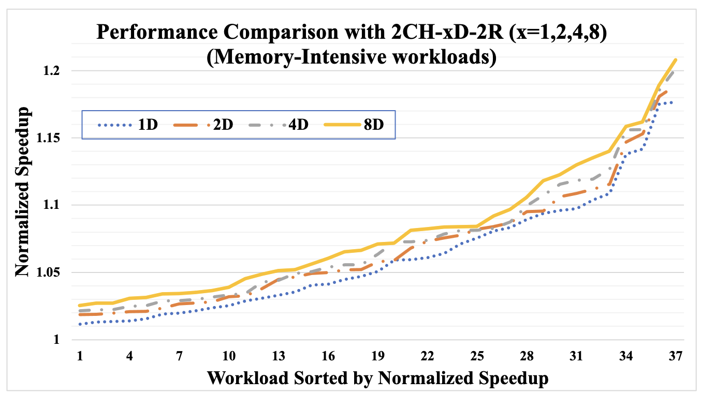
Results: Scalability
Showcase MSF is scalable across different memory configurations
Memory-intensive workloads: performance +7.0% to +8.7%
Mixed workloads: performance +5.2% to 6.2%
→ MSF can scale well as number of DIMMs increases.
Notes:
Results: Scalability
To showcase that MSF is scalable, we ran experiemnts on two-channel memory system, varying one to eight DIMMs per channel.
The figure on the left shows the performance comparison under 37 memory-intensive workloads, from 1 DIMM to 8 DIMMs per channel
And the figure on the right shows the performance of the remaining 18 mixed workloads.
For memory-intensive workloads, MSF improves the performance compared to the baseline from 7.0% to 8.7% as the number of DIMMs grow from 1D to 8D
For mixed workloads, MSF increases the performance by 5.2% to 6.2%.
The results indicate that MSF can scale well as the number of DIMMs per channel increase

Slide 53
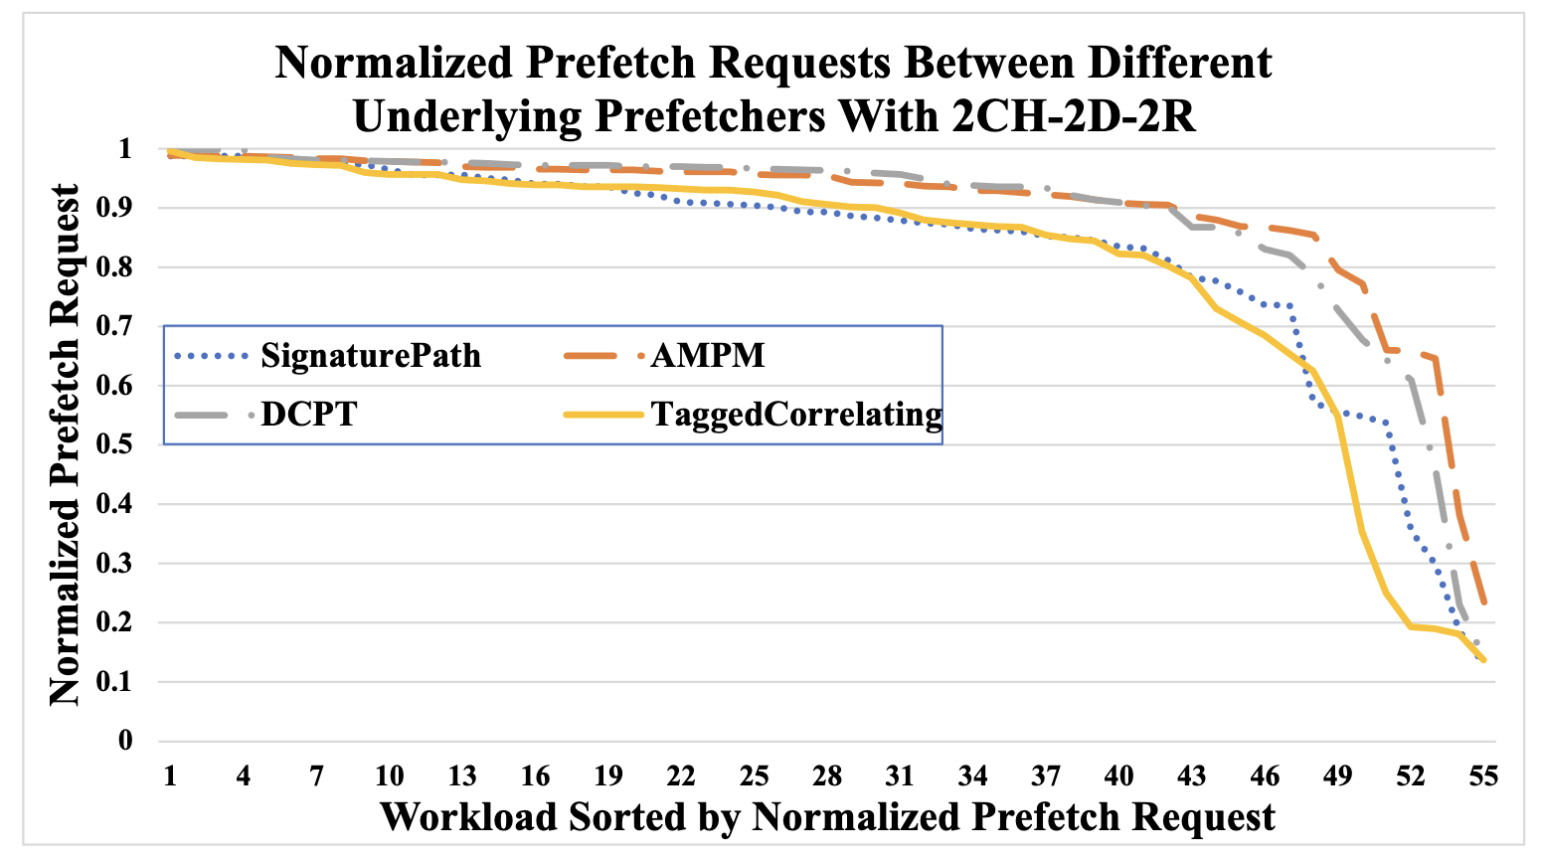
Results: Reduction in Requests
MSF filters out unnecessary requests => saving valuable resources
Figure shows the normalized prefetch requests under different prefetchers
Out of 55 workloads, MSF reduces prefetch requests by:
17.9% for SPP 11.3% for DCPT
10.1% for AMPM 19.5% for Tagged-Correlating
→ MSF significantly reduces total number of prefetch requests MC need to serve
Notes:
Results: Reduction in Requests
As shown previously, MSF can successfully filters out unnecessary prefetch requests, saving valuable resources and bandwidth.
- The figure below shows the normalized number of prefetch requests between the baseline of no filtering vs MSF filter under various prefetcher.
The results are normalized to their respective baseline.
Out of all 55 workloads, on average MSF reduces 17.9% prefetch requests for SignaturePath, 10.1% for AMPM, 11.3% for DCPT, and 19.5% for Tagged-Correlating prefetchers, respectively.
This shows that MSF significantly reduces the total number of prefetch requests that the MC need to serve, as compared to no filtering

Slide 54
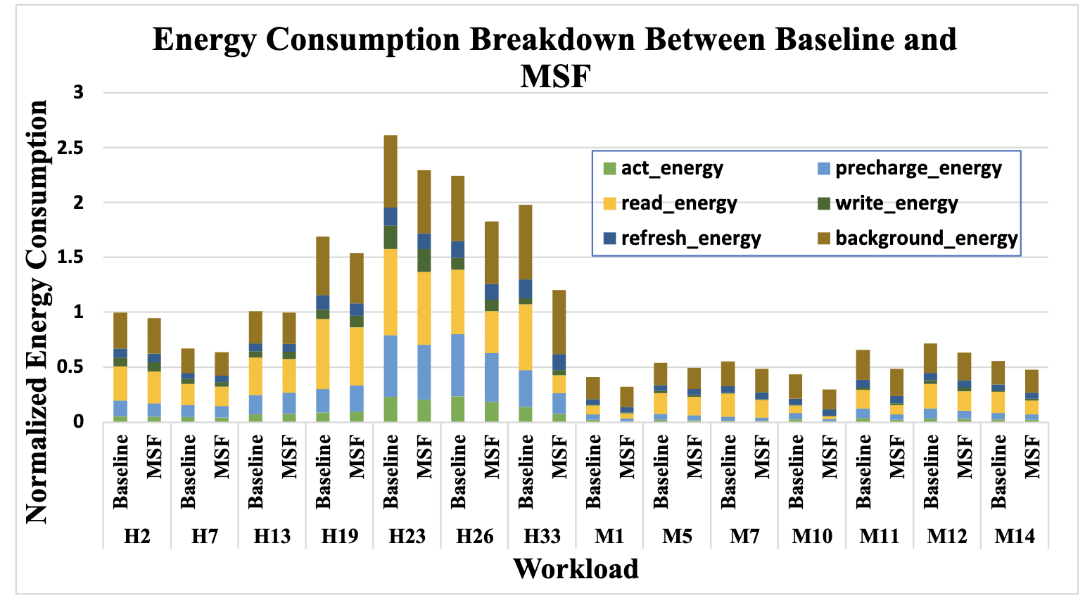
Results: Energy Savings
Benefit of filtering out unnecessary prefetches is saving in memory energy consumption
Figure shows memory energy breakdown between baseline and MSF (SPP prefetcher)
MSF saves activation and precharge energy proportionally to reduction in prefetch requests
MSF saves read energy by 17.5%, overall energy by 10.6%
Notes:
Results: Energy Savings
A direct benefit of filtering out unnecessary prefetches is saving in memory energy consumption, as the memory controller does not waste resources serving unused requests
The figure below shows the memory energy consumption breakdown between baseline and MSF with SPP prefetcher.
There are 6 portions that contribute to the memory energy
1) activation energy
2) precharge energy
3) read energy
4) write energy
5) refresh energy
6) background energy
First, compared to that of the baseline, the activation and precharge energy of MSF drops proportionally to the reduced number in requests. This is because the Memory Controller spends less energy preparing the memory devices for fewer number of requests
Second, the read energy of MSF also drops significantly, because the controller in MSF sends fewer read bursts back to the core
The average read energy reduction is 17.5%, and the overall energy saving is 10.6% on average as compared to the baseline
The write energy, refresh energy, and background energy stay almost the same as they are independent to the reduction in read requests

Slide 55
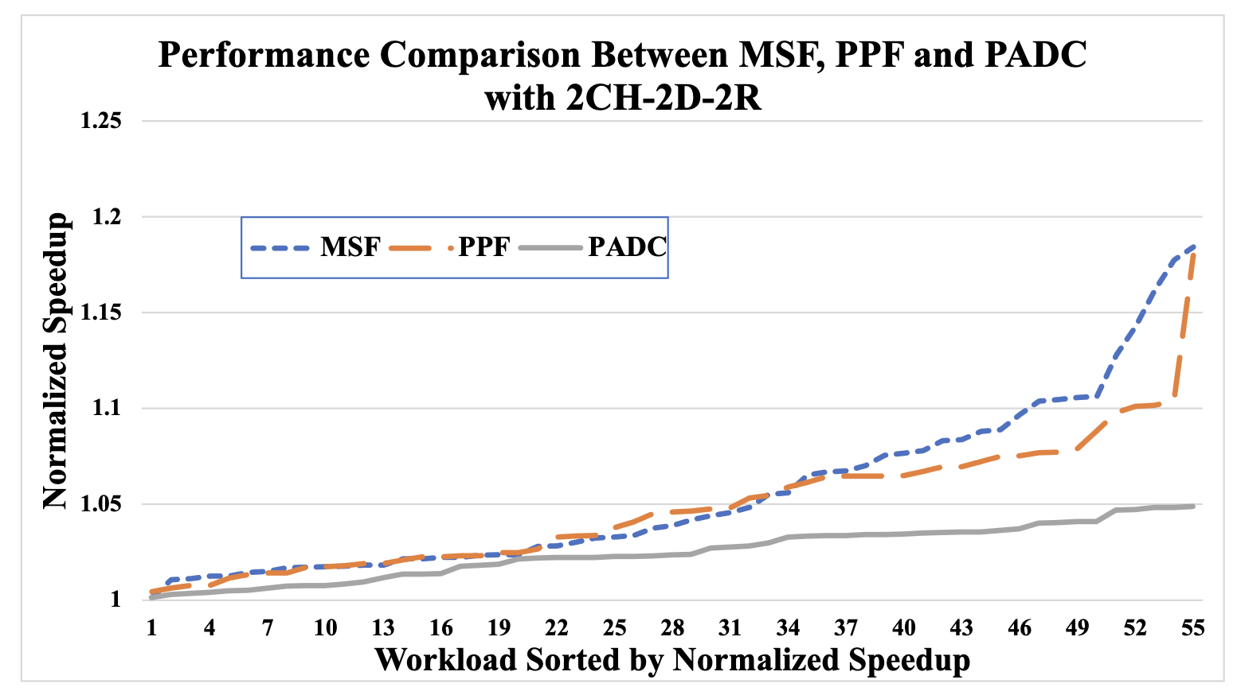
Results: Performance Versus Related Filtering Schemes
Figure shows the performance comparison between MSF vs PPF and PADC (SPP prefetcher)
For memory-intensive workloads, MSF improves 1.6% over PPF, and 5.2% over PADC
For mixed workloads, MSF improves 0.1% over PPF, and 3.1% over PADC
Overall, +1.3% over PPF and +4.6% over PADC
→ MSF performs better than both filtering schemes and works for any underlying prefetcher
Notes:
Results: Performance Versus Related Schemes
Figure below compares the performance obtained by MSF, PPF, and PADC under the 2CH-2D-2R configuration with SignaturePath as the underlying prefetcher.
For memory-intensive workloads, MSF improves performance by 1.6% over PPF and by 5.2% over PADC on average, respectively.
For mixed workloads, MSF performs better by 0.1% on average than PPF, and 3.1% on average than PADC, respectively.
MSF is able to perform better than PPF while using only memory-side information, whereas PPF uses specific metadata from SPP prefetcher

Slide 56
MSF: Summary
Main ideas:
Filters unnecessary prefetch requests using both memory-side and core-side metadata
Uses hashed-perceptron variation to determine request’s usefulness
Works for any underlying prefetcher
Overhead:
29.99KB storage overhead per-channel
Significantly less than related filtering scheme (39.34KB per-core, 314.72KB for octa-core)
Results:
+7.0% performance with SPP, 3.3% with AMPM, 5.3% with DCPT, 10.5% with Tagged-Corr
+5.2% performance over related scheme PADC, +1.3% over PPF
-10.6% energy consumption overall
Notes:
MSF Summary
MSF main ideas are
1) Filtering unnecessary prefetch requests using both memory-side and core-side metadata, whereas a similar scheme uses core-side specific information
2) MSF uses hashed-perceptron variation to determine the request’s usefulness
3) MSF is designed to work for any underlying prefetcher
As for overhead, MSF storage overhead is 29.99KB per memory channel
Which is significantly less than PPF scheme, they consume 39.34KB of storage overhead per-core, which equals to 314.72KB for an 8-core system.
For the results, MSF manages to improve performance by 7.0% with SPP as the underlying prefetcher, 3.3% with AMPM, 5.3% with DCPT and 10.5% with Tagged-Correlating prefetcher
As compared with related schemes, MSF performs better by 5.2% over PADC, and 1.3% over PPF, while consuming significantly less area overhead.
Finally, MSF saves energy consumption overall because it serves fewer requests, which leads to a reduction of 10.6% energy consumption.

Slide 57
Summary
The ”memory-wall” gap is increasing between CPU and memory; conventional memory system can’t keep up
NVM technology is promising alternative to DRAM, hybrid memory system is needed
We proposed several schemes to implement hybrid memory framework with optimizations to the bus overhead.
To further combat the “memory-wall”, prefetching is used
We proposed MSF as a technique to filter unnecessary prefetching
Good performance, low storage overhead, works for any underlying prefetcher
Notes:
Summary
The memory-wall gap is increasing between the CPU and memory, as the conventional memory system can no longer keep up with the modern-day applications.
NVM technology is a promising alternative to DRAM, hence making a system with contains both DRAM and NVM is needed to close the memory-wall gap.
With that, we proposed several schemes to implement hybrid memory framework, with optimizations to the bus overhead.
To further combat the memory-wall, prefetching is typically used in most modern processors to pre-loading the data into the cache before it is actually needed.
We proposed MSF as a technique to filter unnecessary prefetching, it has good performance, low storage overhead and could work for any underlying prefetcher.

Slide 58
Publications
T. Le, Z. Zhang and Z. Zhu, "POMI: Polling-Based Memory Interface for Hybrid Memory System," 2021 IEEE 39th International Conference on Computer Design (ICCD), Storrs, CT, USA, 2021, pp. 447-455 [ICCD 2021]
T. Le, Z. Zhang, and Z. Zhu. 2023. Polling-Based Memory Interface. ACM Trans. Des. Autom. Electron. Syst. 28, 3, Article 47, 23 pages. [TODAES 2023]
T.Le, P. Wu, Z. Zhang, and Z. Zhu. MSF: Memory-Side Perceptron-Based Prefetch Filtering [Submitted HPCA 2024]

Slide 59
Thank You
Notes:
Summary
The memory-wall gap is increasing between the CPU and memory, as the conventional memory system can no longer keep up with the modern-day applications.
NVM technology is a promising alternative to DRAM, hence making a system with contains both DRAM and NVM is needed to close the memory-wall gap.
With that, we proposed several schemes to implement hybrid memory framework, with optimizations to the bus overhead.
To further combat the memory-wall, prefetching is typically used in most modern processors to pre-loading the data into the cache before it is actually needed.
We proposed MSF as a technique to filter unnecessary prefetching, it has good performance, low storage overhead and could work for any underlying prefetcher.

