Slide 1
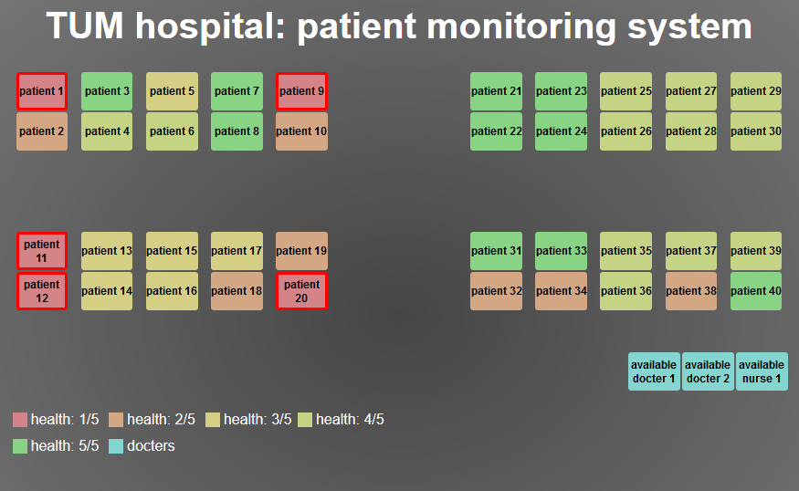
VentMonitor
An overall monitoring system for ventilation systems

Slide 2

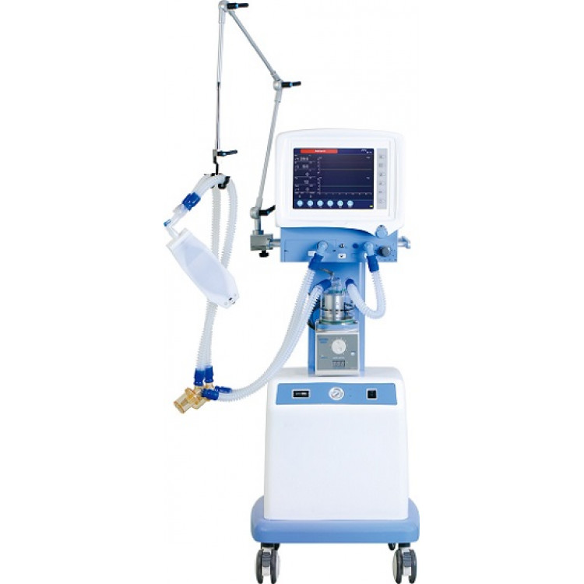
Problem statement
How to monitor all patients efficiently?
https://www.m3india.in/contents/editor_pick/64574/a-peek-into-the-one-doctor-many-patients-crisis
https://www.superstar-med.net/s1100-icu-ventilator.html

Slide 3
Solution
Overall monitoring system for ventilation systems
View data of patient
-> live demo

