Slide 1
Artificial Intelligence
Huhe
Information School, Renmin University of China

Slide 2
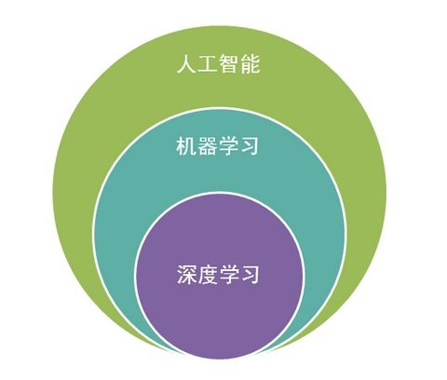
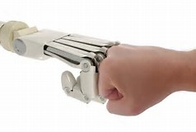
AI class

Slide 3
About this course
Textbook
Class Project
Grading
Scheduling

Slide 4
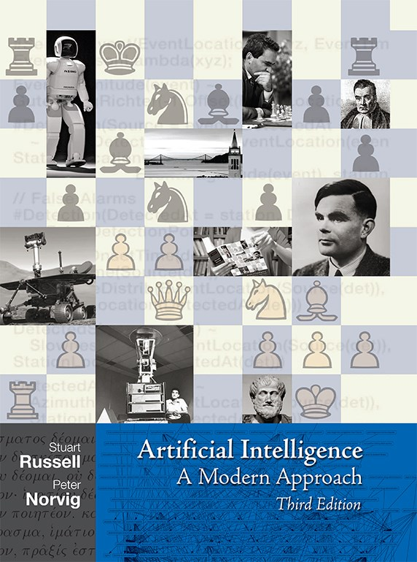
Textbook
Reasoning
Searching
A classic book

Slide 5
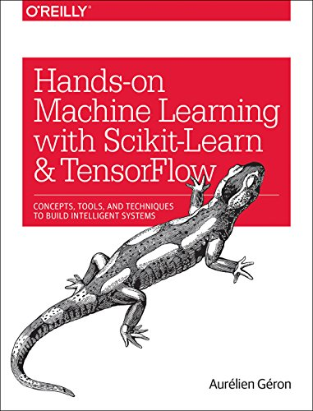
Textbook
Machine Learning
Deep Learning
Scikit
Tensorflow

Slide 6
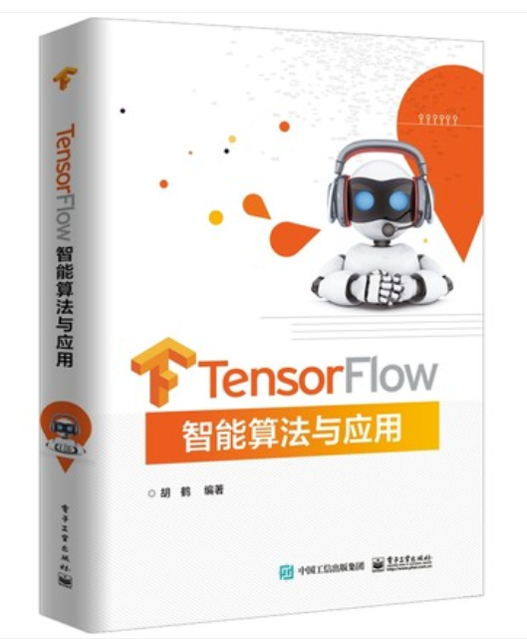
Textbook
Tensorflow
Estimator
Keras
CNN/RNN/AE/GAN

Slide 7
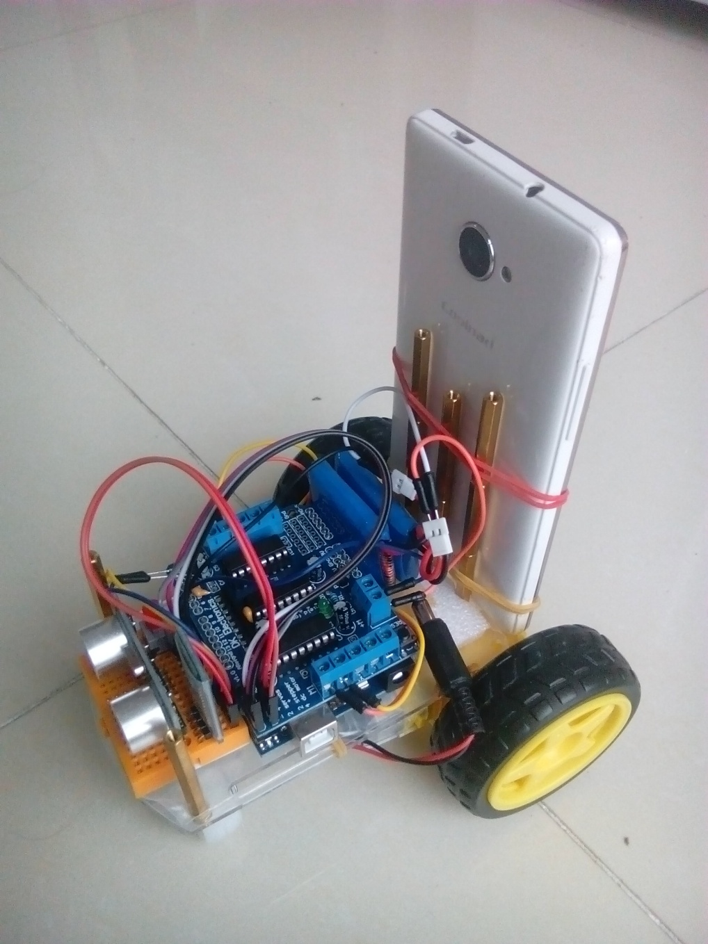
Class Project - A
Aicar
A physical agent with …
  Two driving wheels
  (differentially steered)
  Ultrasonic sensor
  Video streaming (Phone)
  Bluetooth control
  LBNL affordable (~ 50￥)

Slide 8
Class Project - A
Three Projects
  Random Walker
  Sensored Walker
  DeepAI Walker

Slide 9
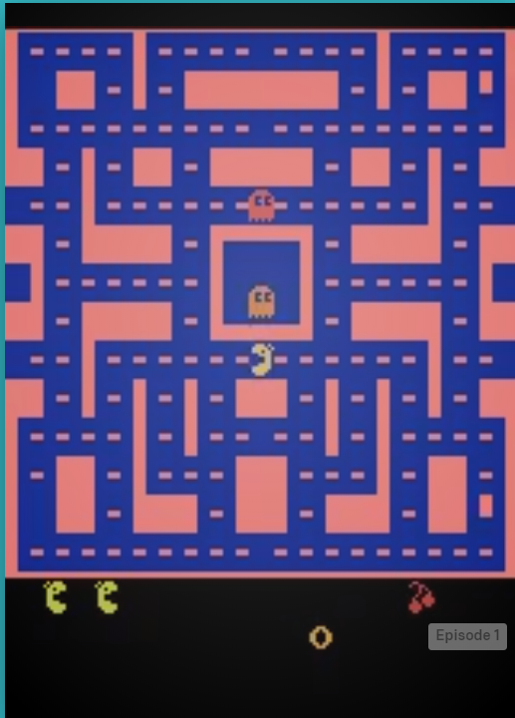
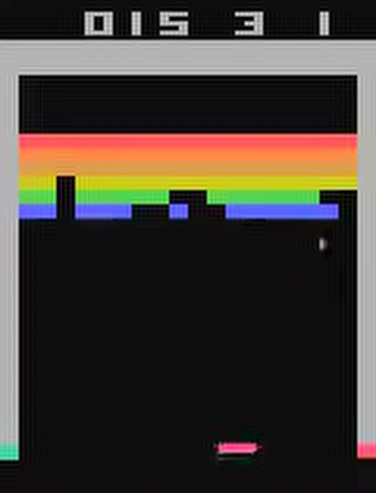
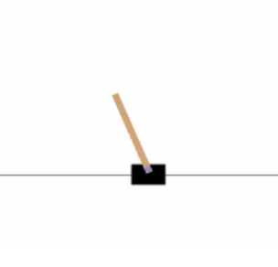
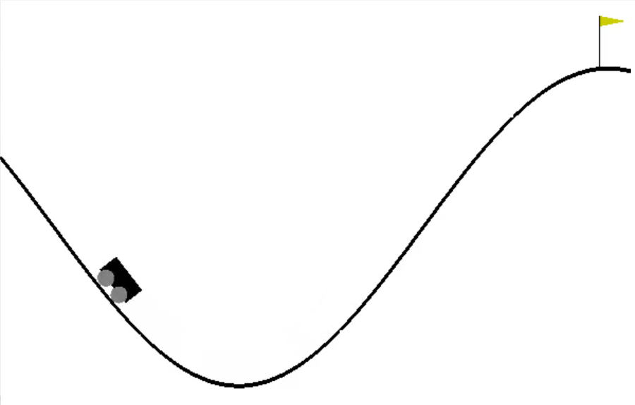
Class Project - B
OpenAI Gym
Virtual agents with …
  various environments
  various sensors
  various control methods
  zero cost

Slide 10
Grading
  Three class project reports
    60%
  Final Presentation
    40%

Slide 11
Project Scheduling
  Random Walker(A)/Rule-based Agent(B)
    4 weeks later ( Oct. 18)
  Sensored Walker(A)/Machine Learning Agent(B)
    8 weeks later (Nov. 15)
  DeepAI Walker(A)/Deep Learning Agent(B)
    12 weeks later(Dec. 13 )
  Final Presentation
    14 weeks later(Dec. 27 )

Slide 12
Class Scheduling
  Introduction, Classical AI, Agent up and running
    (4 weeks)
  Machine Learning with Scikit
    (5 weeks)
  Deep Learning with Tensorflow/Keras
    (5 weeks)
  Class Reporting
    (1 week)

