Slide 1
a Study workflow
1. Adult human HF
transcriptomic reference
2. Frozen molecular
projection
3. Cardiopedia organoid
perturbation screen
adult LV failing vs non-failing
fixed gene weights;
not tuned on functional
outcomes
82 ligands, 382 paired organoids;
RNA + 24-h Force
6. Component decomposition
HF-concordant vs HF-discordant
5. External functional transport tests
4. Independent adult LV
molecular anchor
hiPSC-CM pharmacology
Engineered heart tissue
7. Robustness analyses
RNA + CaT amplitude;
compound/dose level
direct-Force challenge;
condition level
full-expression cohort;
21 failing, 5 non-failing donors
cross-half wells, ligand class, plate,
generic-response burden, temporal triangulation
b Evidence map across datasets
c Hierarchy and interpretation
Dataset | Molecular data | Functional endpoint | Primary unit | Study role
Cardiopedia | RNA | 24-h Force | ligand / organoid well | Discovery
hiPSC-CM pharmacology | RNA | CaT amplitude | compound / dose | External functional test
Engineered heart tissue | RNA | Direct Force | condition | External direct-Force functional test
Adult LV cohort | RNA | - | donor / gene | Independent molecular anchor
Cardiopedia: well → ligand
hiPSC-CM: dose → compound
Cross-half validation
multiple organoid wells
per ligand
multiple doses
per compound
non-overlapping well sets
Ligand X
Compound Y
Half A RNA → Half B Force
Half A
Half B
···
···
(RNA)
(Force)
organoid wells
Dose conditions
(82 ligands; multiple replicates)
(e.g. 0.03, 0.1, 0.3, 1 μM)
Half B RNA → Half A Force
Adult-HF molecular anchoring
Cross-system functional transport
supported
not supported
Molecular disease resemblance and functional transportability are distinct properties.

Slide 2
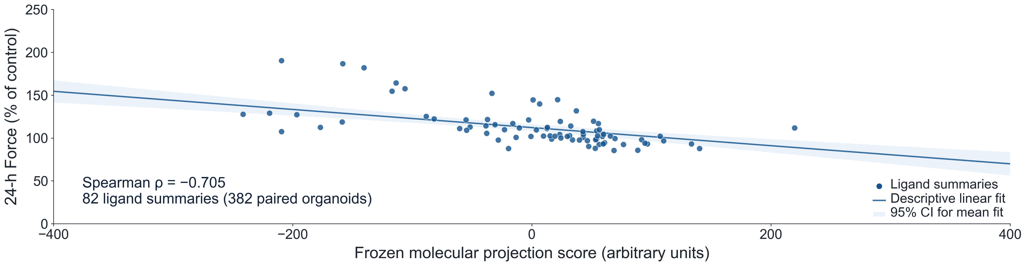
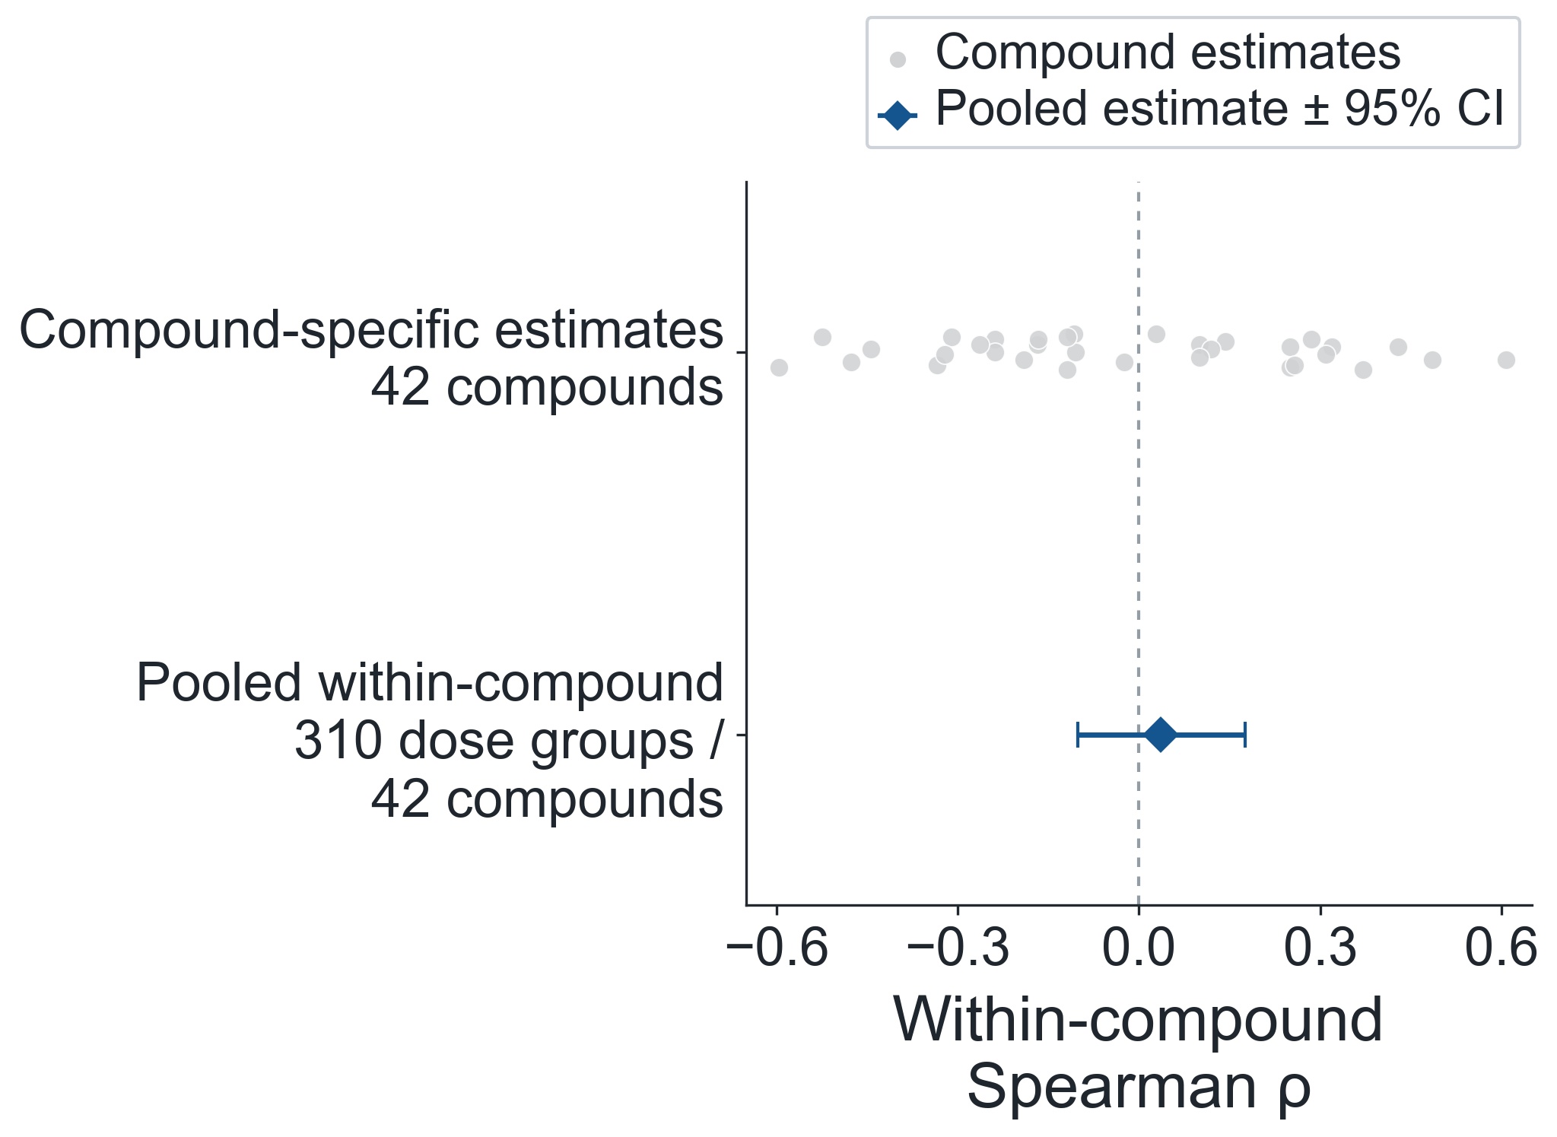
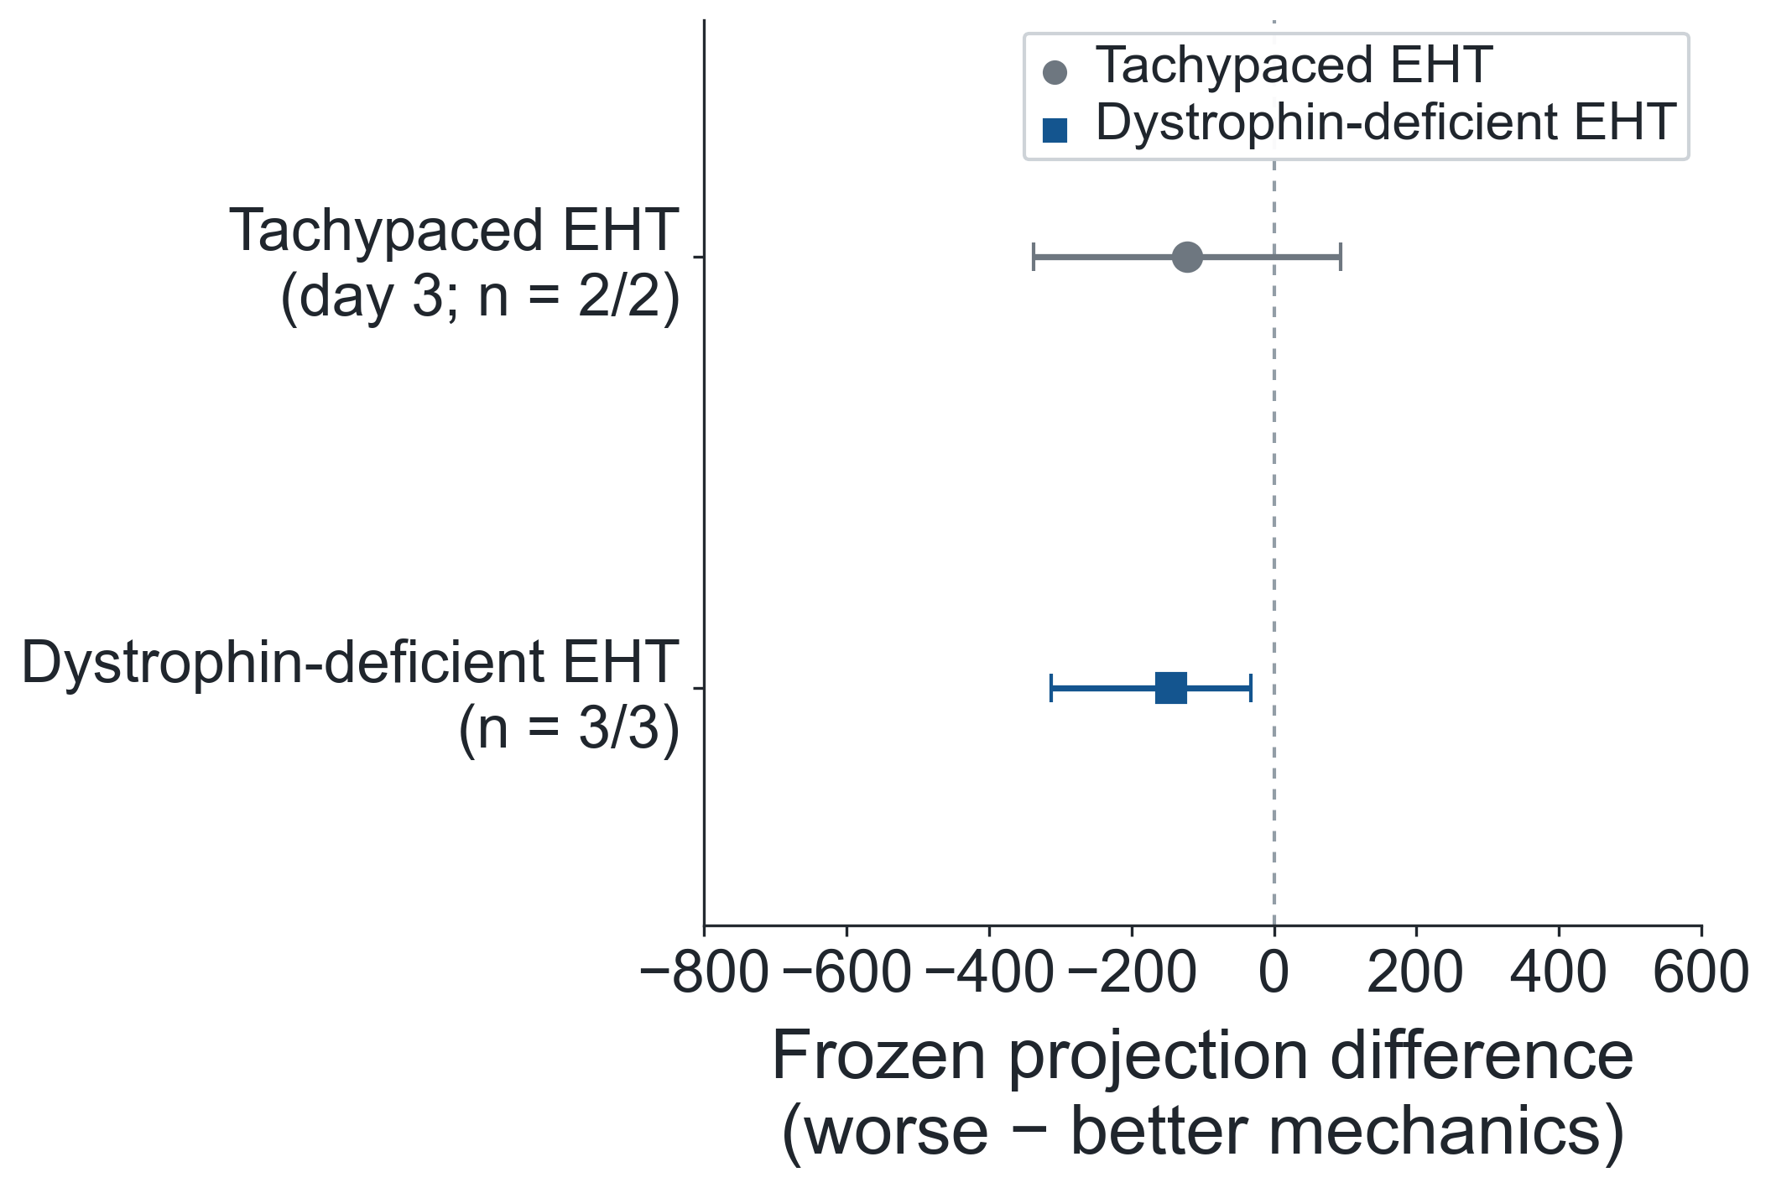
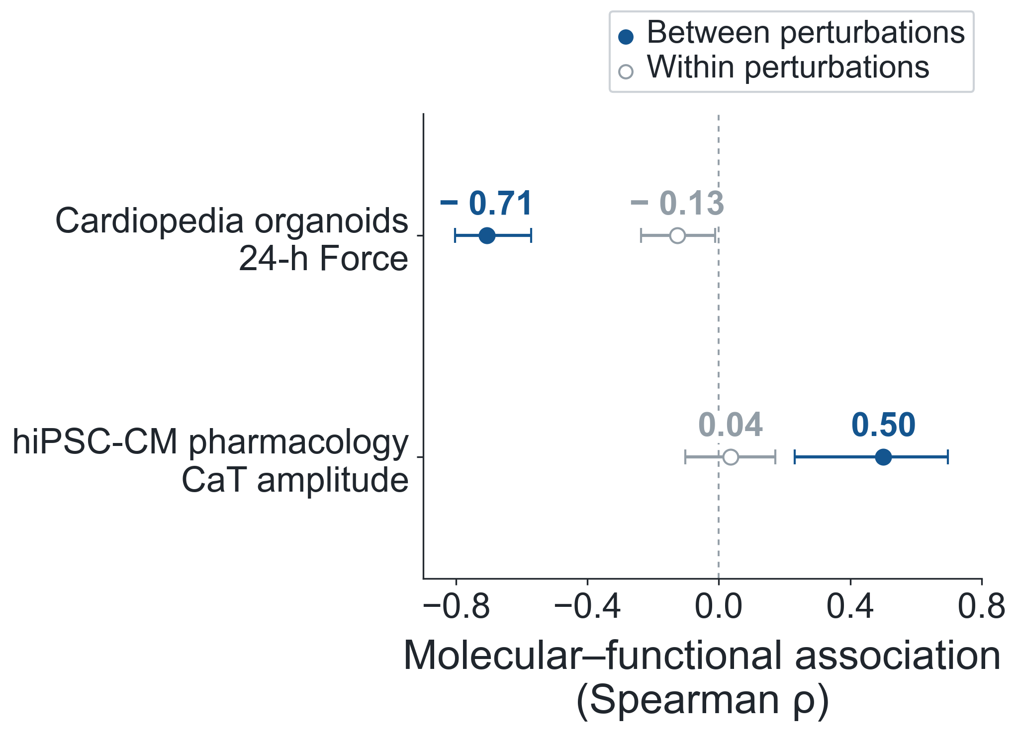
a
b
c
d

Slide 3
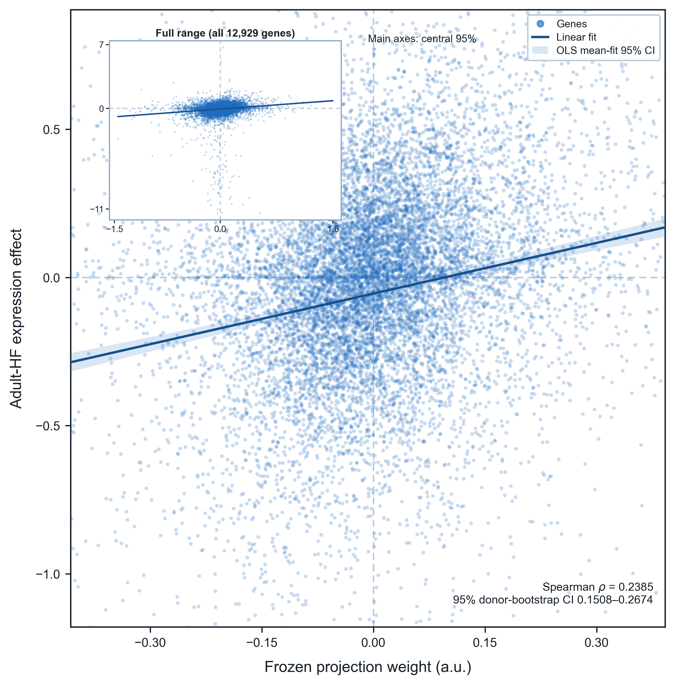
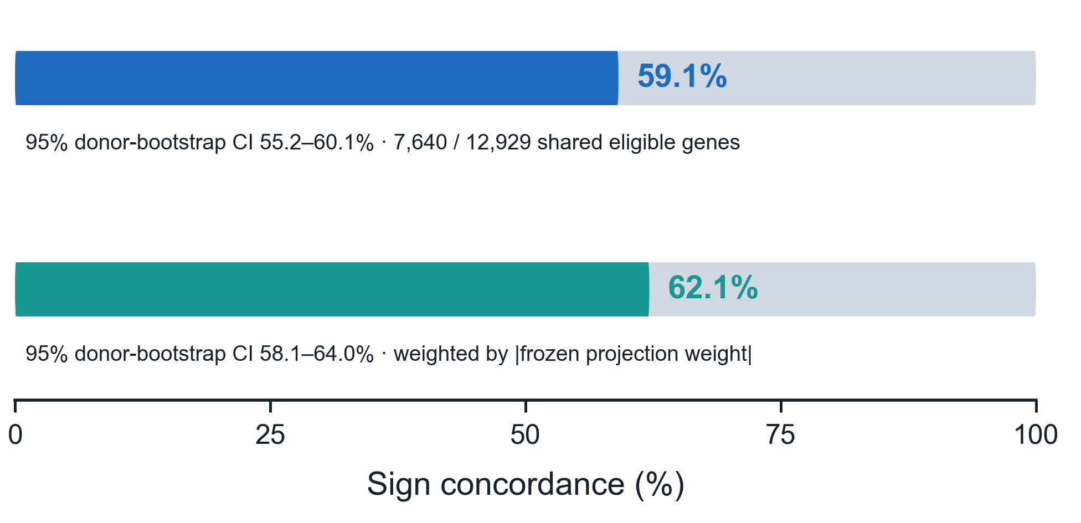
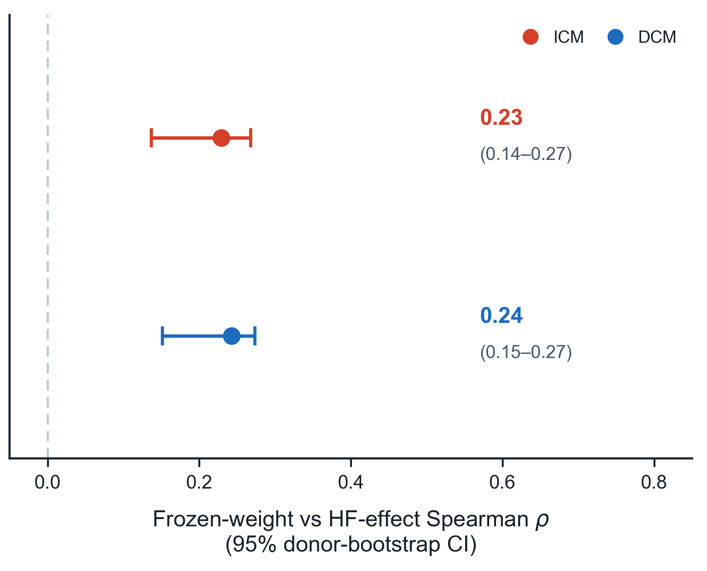
a
b
c

Slide 4
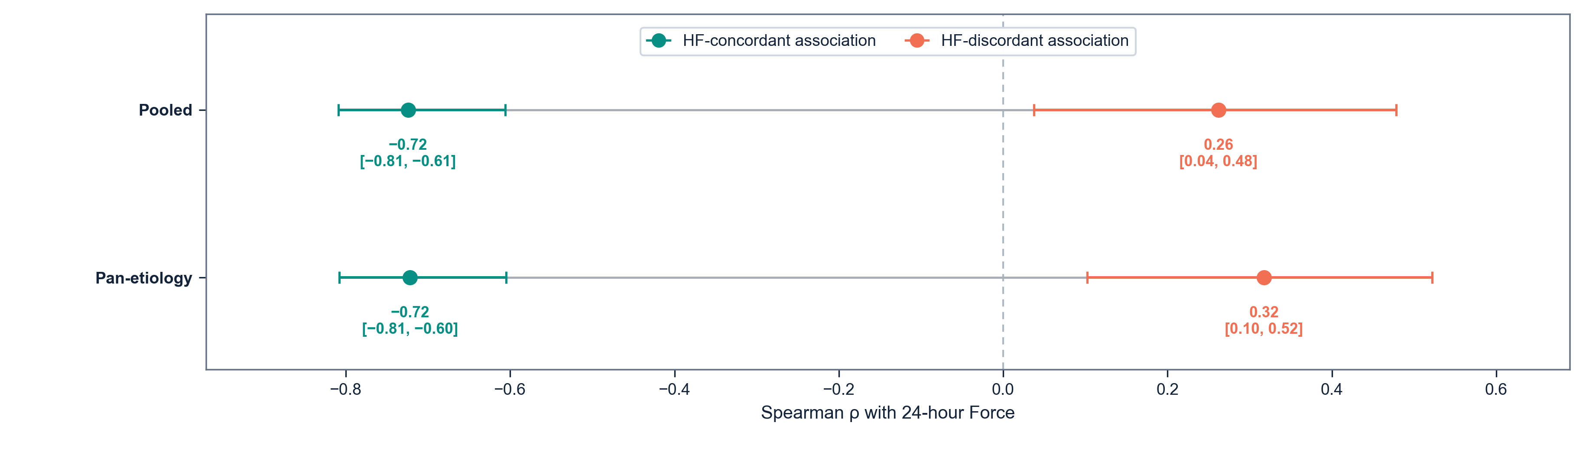
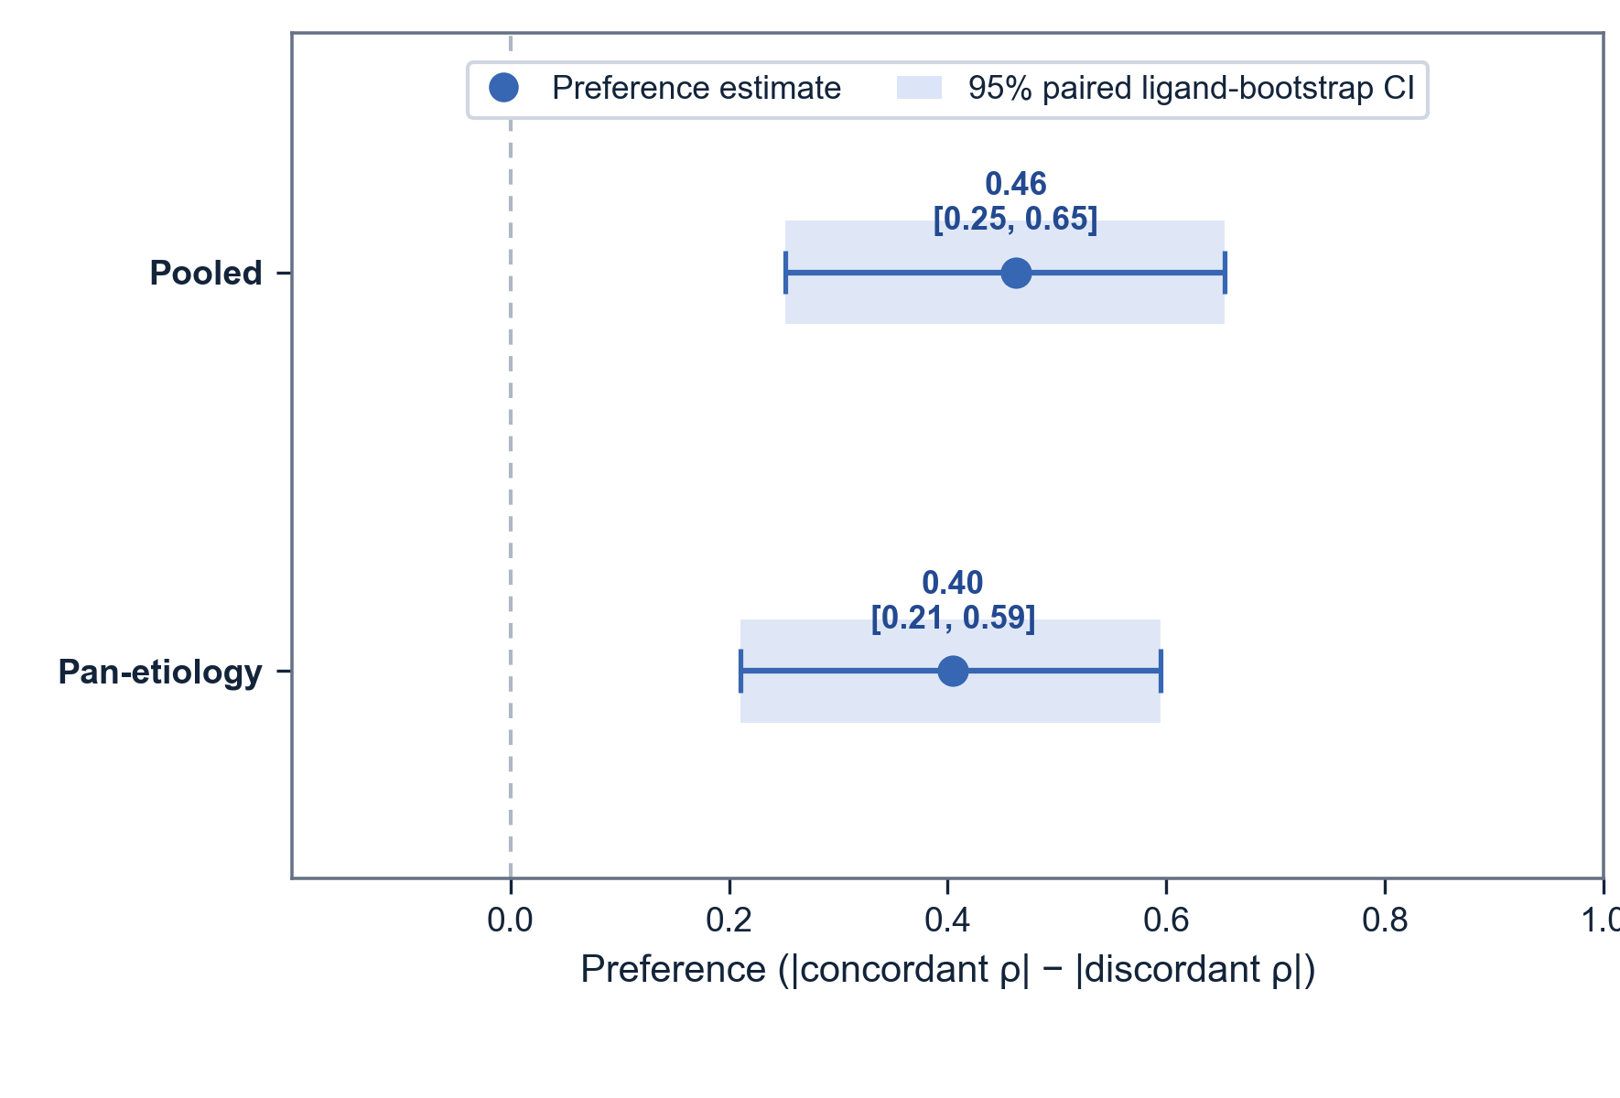
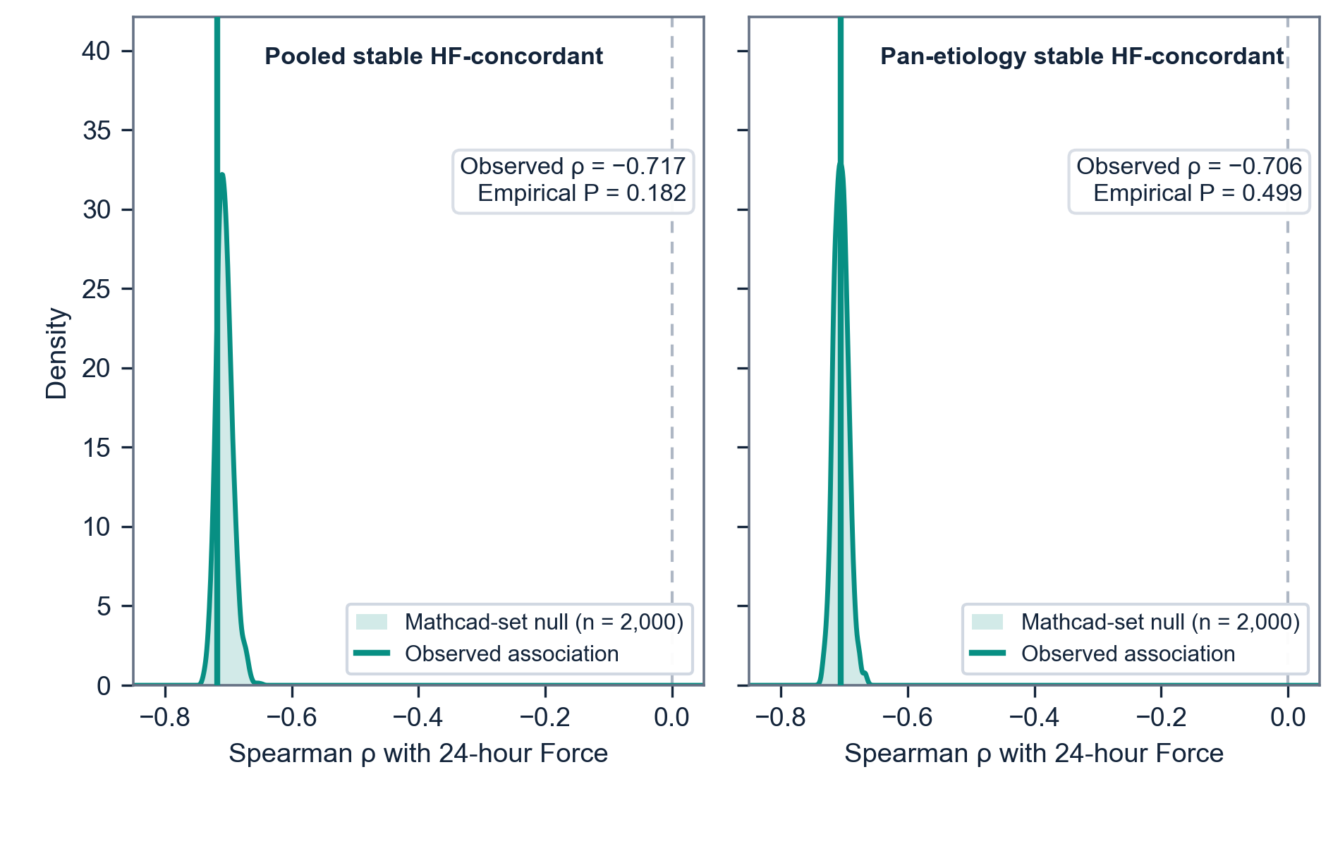
a
b
c

Slide 5
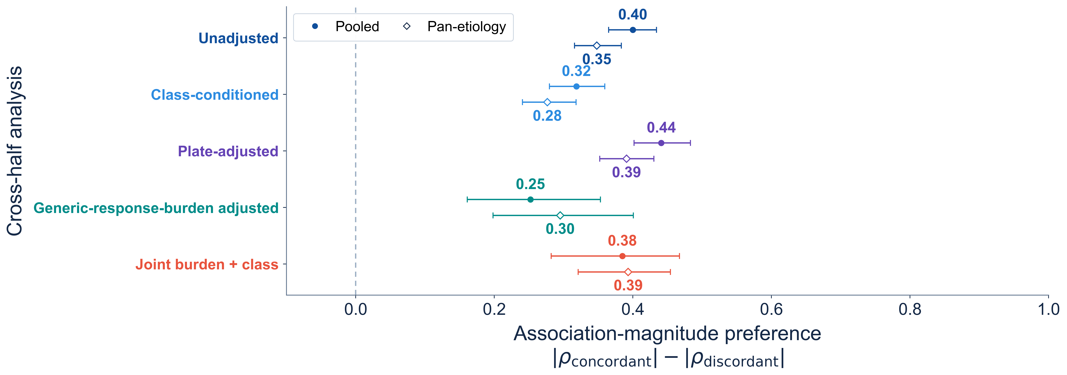
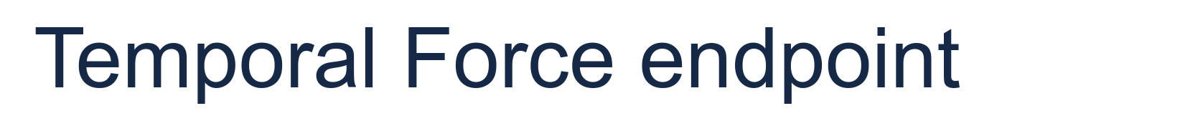

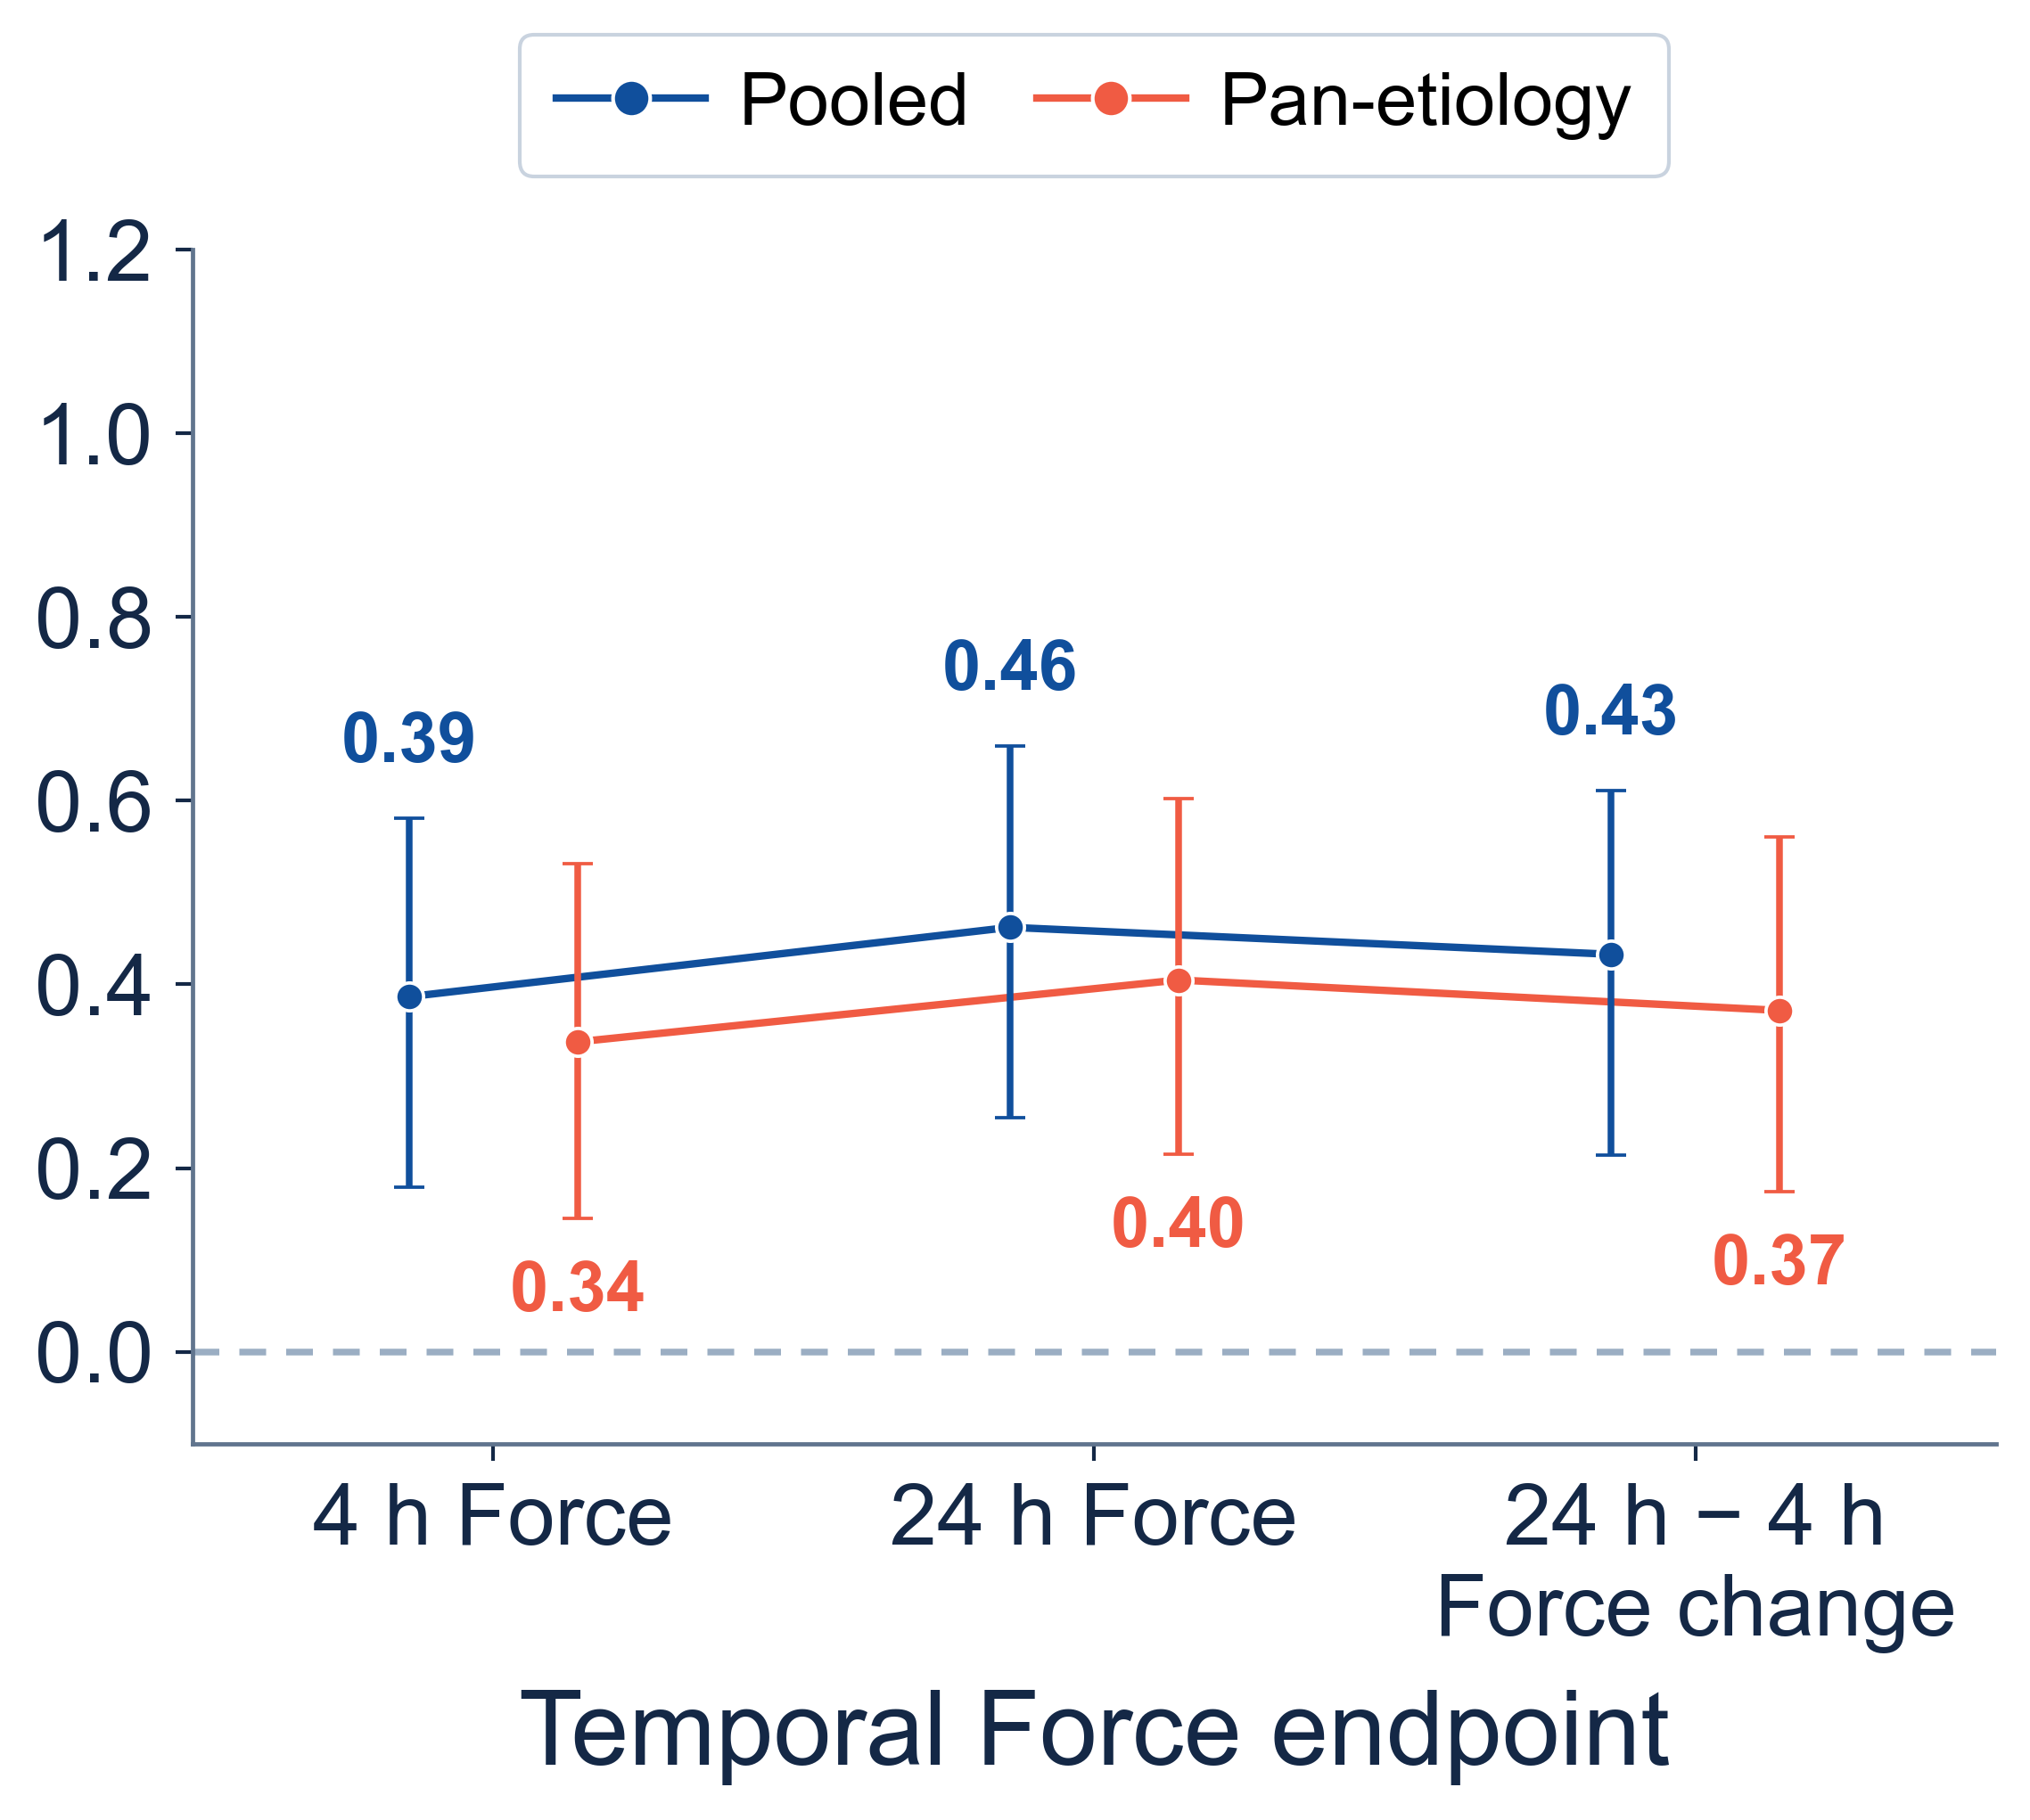
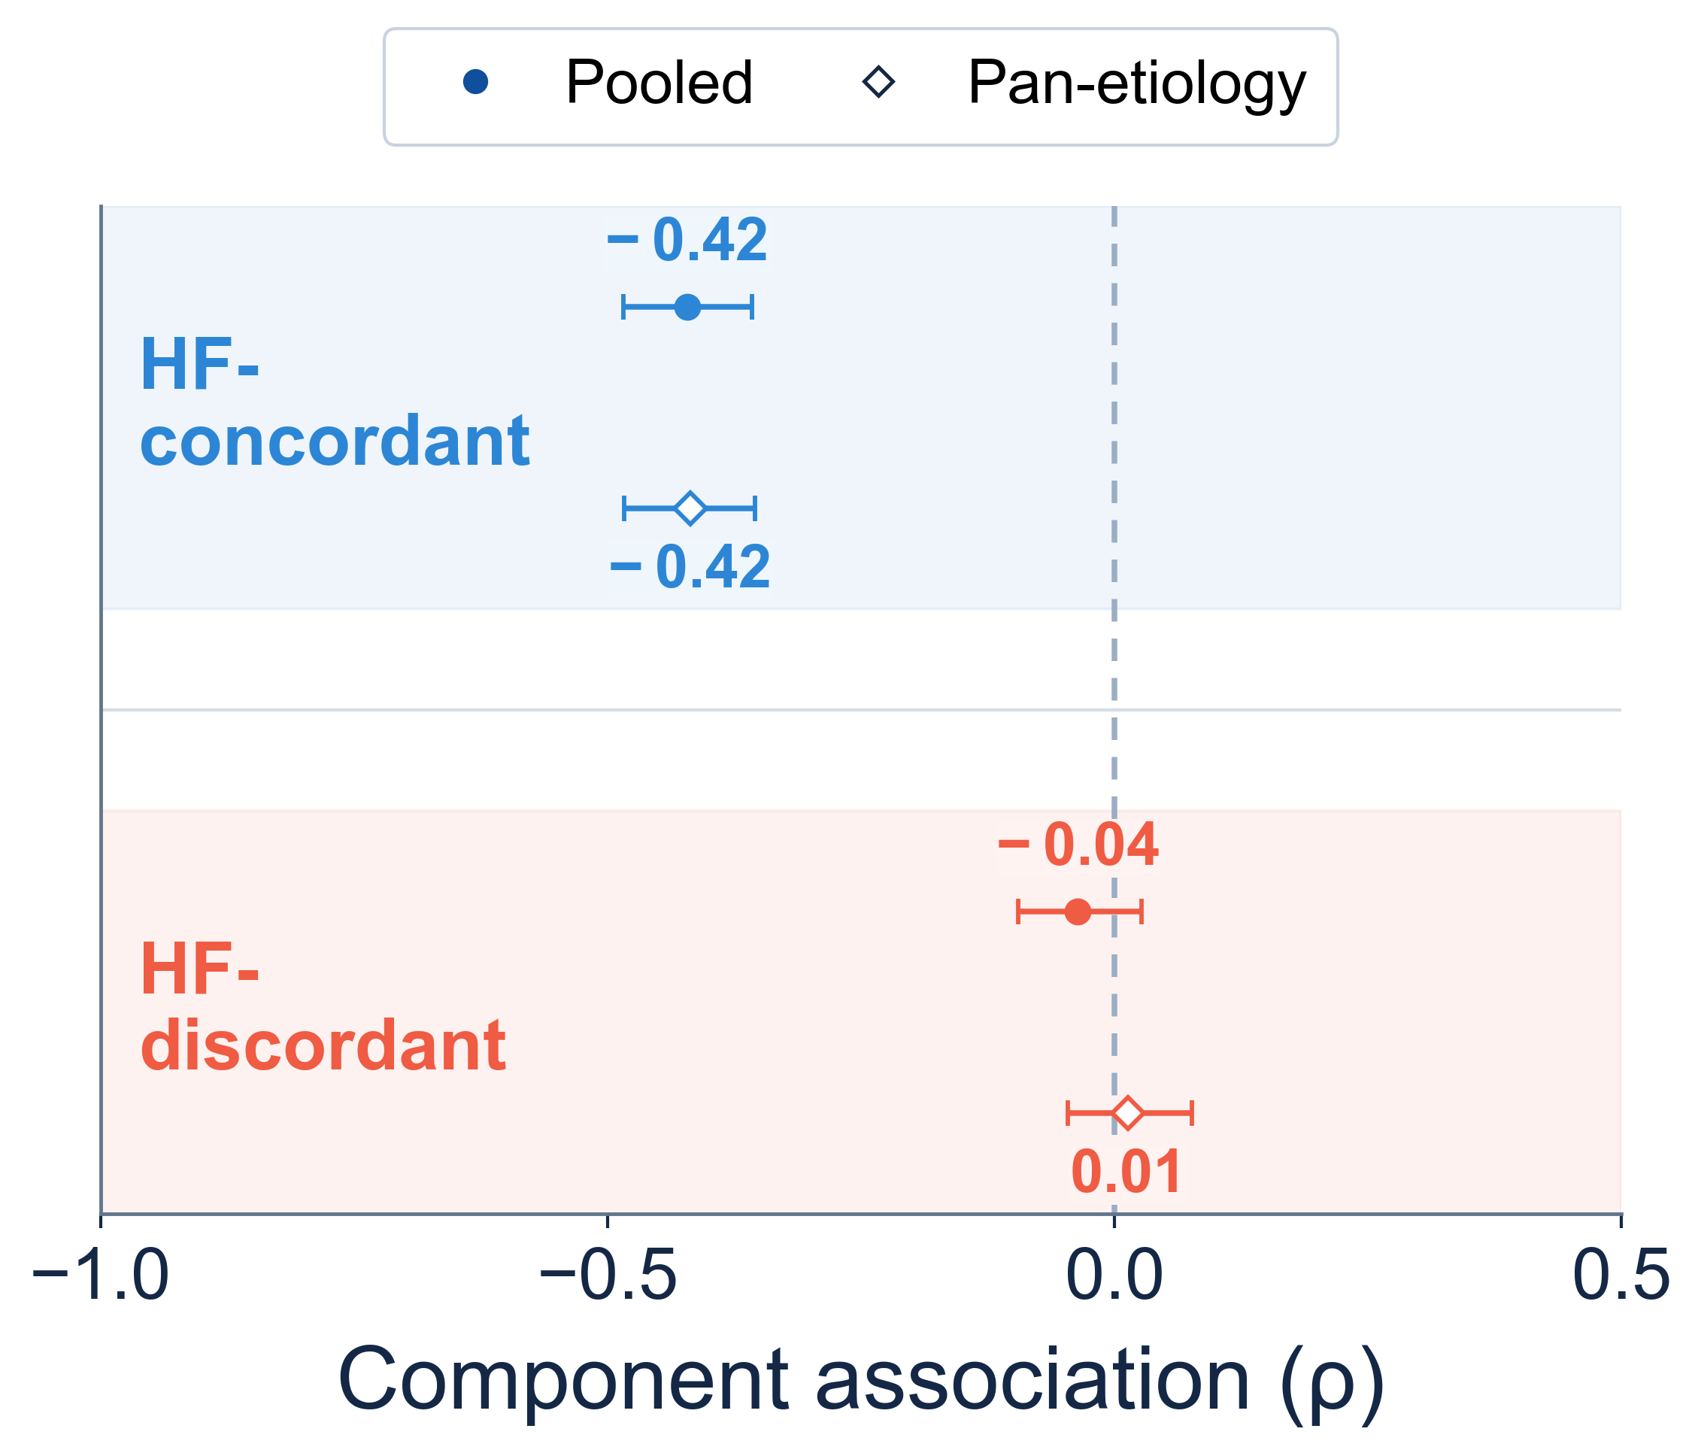
a
b
c

