Slide 1
PART 2 of the HDB Assignment
Architecting Data Ingestion &
Data Exploitation Solution Patterns
AWS Solution Architecture, HDB Resale Flat Prices Data Platform
Prepared by Lee Zhong Zin

Slide 2
Assignment Requirement
This assignment asks for two connected designs. First, a safe way to bring housing data from a public government website into our private cloud storage, even when files are large. Second, a safe way for our analysts to query that stored data using Tableau, without that query traffic ever needing to travel over the public internet. Both designs are explained on their own slides further in this deck, with a diagram for each.
Data Ingestion
Data Exploitation
Batch ingestion from data.gov.sg (public internet)
Must support large file transmission (>100MB)
Source is public-facing; HDB's platform sits in private VPCs
Design must factor in network / system segmentation for security
Data Science team uses Tableau on AWS for analysis
Integration via the Athena JDBC/ODBC Driver
Athena's public endpoint is normally used by the driver
Design must make this traffic private where possible
2

Slide 3
Design Assumptions
The assignment does not specify every detail of HDB's real environment, so reasonable assumptions were needed to complete a concrete design. Each assumption below is stated openly rather than silently built into the diagrams, so it can be corrected easily if it does not match HDB's actual setup.
Area | Assumption
Region / Account | A single AWS account and region (for example, ap-southeast-1) is used for this design. A multi-account landing-zone setup is a natural next step for production, but is kept out of scope here to keep the design focused.
Source authentication | data.gov.sg is assumed to need no API key, since it is an open public dataset. If a key were needed, it would be stored safely in AWS Secrets Manager and retrieved only by the ingestion task's role.
Ingestion cadence | Data is pulled on a schedule (for example, monthly), matching how often data.gov.sg publishes new files, not as a continuous, real-time stream.
Ingestion compute | AWS Fargate, not AWS Lambda, is used to run the download step. The reasoning for this choice is explained on a later slide.
Data format for exploitation | The cleaned data from Part 1 of this assignment is assumed to be converted into a column-based format called Parquet, split into folders by month, to make Athena queries faster.
Tableau deployment | Tableau Server is assumed to run on a virtual machine (EC2) inside HDB's own private network, reached by analysts only through the corporate network or a VPN, never directly from the public internet.
Metadata layer | AWS Glue Data Catalog is used to keep track of what tables and columns exist in the data, and a Glue Crawler keeps this information up to date automatically.
IAM policies | Access permissions are described only at a conceptual, least-privilege level. Writing the exact permission policy documents is intentionally left out, as the assignment states this is not required.
3

Slide 4
Understanding the Private Shortcut
The diagrams in the next slides use the phrase private shortcut. For example when a file is saved into Amazon S3, or when Tableau queries Amazon Athena. This slide explains exactly what that shortcut is, how it works, and why it exists, since it is the direct technical answer to two specific requirements in this assignment.
What it actually is
Normally, if a computer inside a private network wants to reach an AWS service like Amazon S3 or Amazon Athena, its request has to leave the private network, travel across the public internet, and arrive at that service's public address, even though both the computer and the AWS service sit inside AWS's own data centres. A VPC Endpoint removes that unnecessary trip. It creates a direct, private connection from inside HDB's own private network straight to the AWS service, entirely over AWS's internal network, without ever touching the public internet and without needing a NAT Gateway or Internet Gateway.
Gateway Endpoint
Interface Endpoint (AWS PrivateLink)
Used for Amazon S3, in both diagrams
Used for Amazon Athena and AWS Glue
How it works: it adds a special entry to the private network's own route table, telling it "traffic addressed to Amazon S3 should go this private way", instead of out through the internet. Think of it as a dedicated private lane added directly onto the network's internal road map, rather than sending traffic onto the public highway.
Cost: free of charge. Amazon S3 is one of the few AWS services that supports this cheaper endpoint type.
How it works: it creates an actual private doorway, technically called an elastic network interface, sitting inside HDB's own private subnet with its own private address. When Tableau's Athena driver tries to reach Athena, AWS automatically redirects that request to this private doorway instead of Athena's public address, with no reconfiguration needed on Tableau's side.
Cost: AWS charges an hourly fee plus a small fee per gigabyte transferred. Most AWS services, including Athena and Glue, only support this type, not the free Gateway type.
Why this matters, at least for the assignment?
Ingestion requirement: the assignment states that data.gov.sg is public facing while HDB's platform sits in private VPCs, and asks the design to factor in network segmentation for security. The Gateway Endpoint for S3 answers this directly: it lets the private network reach storage without opening any doorway for the public internet to reach back in.
Exploitation requirement: the assignment separately states that the Athena driver normally calls Athena's public endpoint, and asks the design to make that traffic private where possible. The Interface Endpoint (PrivateLink) for Athena and Glue answers this directly: it replaces the public endpoint entirely, so the driver's queries never touch the public internet at all.
4

Slide 5
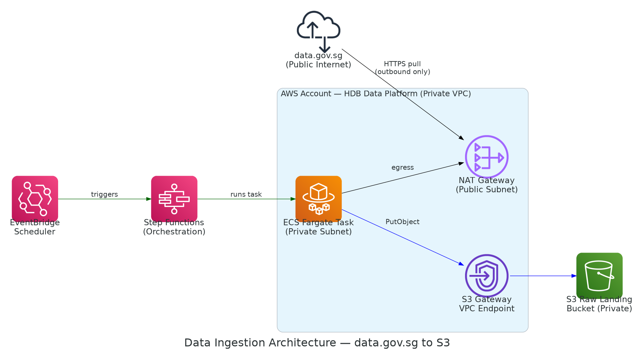
Data Ingestion Architecture
data.gov.sg (public) to S3 (private VPC) using the AWS icon pack
The Story, Step by Step
Step 1: A schedule (EventBridge Scheduler) wakes up automatically, for example once a month, and tells Step Functions to start the job.
Step 2: Step Functions starts a temporary task using AWS Fargate. This task only exists for as long as it takes to finish the job, then it shuts down.
Step 3: The Fargate task reaches out to the public internet to download the file from data.gov.sg. This is the only moment in the whole process that touches the public internet.
Step 4: The download happens through a NAT Gateway, a one way door. It lets our task reach out, but nothing from the internet can ever come back in through it.
Step 5: The task saves the file into Amazon S3 using a private shortcut (a VPC Gateway Endpoint), so the upload itself never touches the public internet.
Step 6: If the file is larger than 100MB, it is automatically uploaded in smaller pieces, so a brief connection hiccup does not ruin the whole file.
5

Slide 6
Ingestion: Security, Scalability & Performance
Security is about keeping the system safe from outside threats. Scalability is about coping well if the amount of data grows. Performance is about making sure the process stays fast and reliable. Each column below explains how the ingestion design addresses one of these three concerns.
Security
Scalability
Performance
The download task lives in a private subnet and is never given a public IP address
The NAT Gateway only allows traffic to leave; nothing from outside can use it to get in
The storage bucket only accepts connections coming through our private endpoint, and requires an encrypted (TLS) connection
Stored files are encrypted at rest, and public access to the bucket is completely blocked
The download task can only perform the one action it needs (saving files), nothing more
Every action is logged (CloudTrail) and all network activity is recorded (VPC Flow Logs) for later review
Fargate automatically sizes the compute needed for each run. There is no server to plan for ahead of time
Step Functions can run several file downloads at the same time if needed, without any redesign
The scheduler and the actual work are kept separate, so adding more scheduled jobs later is simple
Cataloguing new data (Glue Crawler) runs independently and does not slow down ingestion
Splitting large files into smaller pieces during upload means a brief network hiccup only affects one piece, not the whole file
Using the private storage shortcut avoids the slower, more limited path that internet-bound traffic would need to take
If a step fails, it is automatically retried instead of requiring the entire job to be restarted from scratch
6

Slide 7
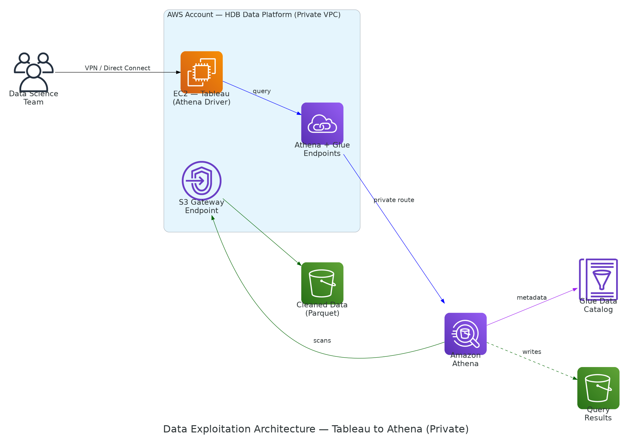
Data Exploitation Architecture
Tableau → Athena Driver, routed privately via AWS PrivateLink
The Story, Step by Step
Step 4: The request travels entirely inside AWS's own network and never touches the public internet at any point.
Step 5: Athena checks the Glue Data Catalog to understand the tables and columns, then reads the actual data straight from Amazon S3 using another private shortcut (a VPC Gateway Endpoint).
Step 6: The result is saved briefly into its own separate, private storage bucket, before being shown back to the analyst in Tableau.
Step 1: An analyst in Tableau runs a query. Tableau itself runs on a server (EC2) that lives inside our own private network.
Step 2: That query needs to reach Amazon Athena, the AWS service that actually runs it.
Step 3: Instead of going out over the public internet, the query passes through a private doorway called PrivateLink (an Interface Endpoint).
7

Slide 8
Exploitation: Security, Scalability & Performance
The same three concerns apply here, but from the point of view of analysts querying the data rather than data arriving from outside. Each column below explains how the exploitation design keeps queries private, handles many analysts at once, and keeps queries fast.
Security
Scalability
Performance
Athena's normal public address is never used. All traffic goes through the private Interface Endpoint instead
The endpoint only accepts connections from the Tableau server itself, on the standard secure web port
Source data and query results are kept in two separate buckets, both private and both encrypted
The Tableau server's permissions are limited to specific databases and storage locations only
Every Athena and Glue action taken through this path is logged for later review
Athena requires no servers to manage. AWS automatically handles more queries as demand grows
Several analysts can run queries at the same time, up to an adjustable limit that can be raised if the team grows
There is no infrastructure that needs to be resized as query volume increases over time
Storing data in the Parquet format lets Athena skip over columns it does not need, making queries faster and cheaper
A query limit can be set so that one very large, poorly written query cannot slow down queries from other analysts
Repeated dashboard refreshes in Tableau can reuse earlier query results instead of recalculating from scratch
8

Slide 9
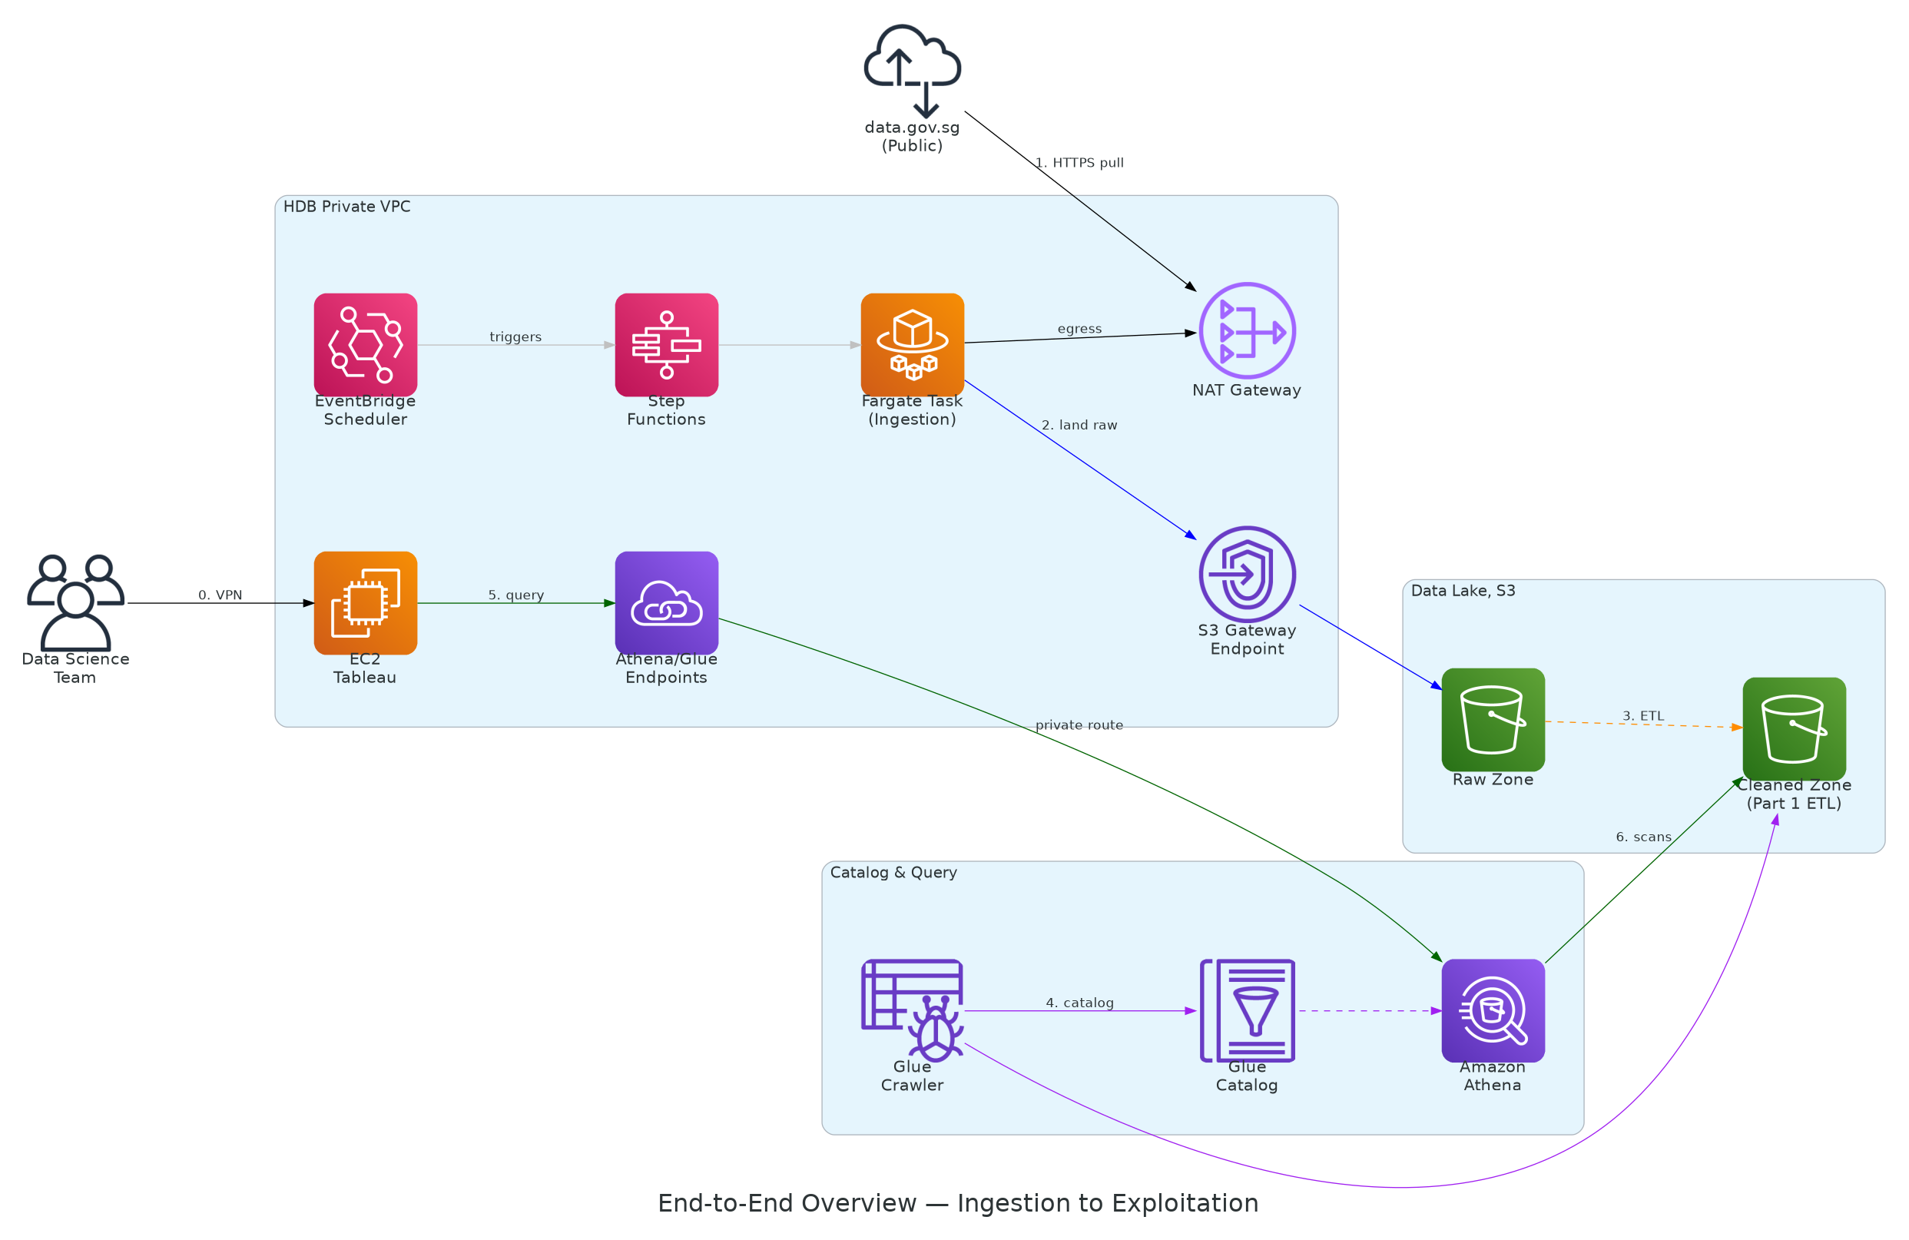
End-to-End Overview
Ingestion and Exploitation patterns joined at the S3 data lake
The Whole Journey, Step by Step
Step 4: AWS Glue catalogs the cleaned data, so the system knows what tables and columns exist.
Step 5: When an analyst runs a query in Tableau, the request travels privately (via PrivateLink) to Amazon Athena.
Step 6: Athena reads the cleaned data straight from storage and returns the answer, without ever touching the public internet again after the very first step.
Step 1: A scheduled job pulls the file from data.gov.sg, the public government website, using an outbound only connection.
Step 2: The file lands in the raw zone of Amazon S3, our private storage.
Step 3: The ETL pipeline from Part 1 of this assignment cleans, checks, and transforms that raw data into a trustworthy version.
9

Slide 10
Key Design Decisions & Trade-offs
None of the choices in this design were arbitrary. Each row below explains a decision that solved a specific problem, together with the cost or limitation that came with it. Being upfront about these trade-offs is more useful than pretending the design has no downsides.
Decision | Reasoning & Trade-off
Fargate over Lambda for ingestion | Fargate has no strict time limit and more temporary storage space than Lambda, giving room to handle files that grow well past 100MB in the future. The trade-off is a bit more setup complexity than a single Lambda function would need.
Private routing (PrivateLink) for Athena & Glue | This directly satisfies the requirement to keep Athena driver traffic private. The trade-off is that AWS charges an hourly fee plus a per-data fee for this private connection, unlike the free default public connection.
Two different types of private connection used | Amazon S3 supports a free type of private connection called a Gateway Endpoint. Most other AWS services, including Athena and Glue, only offer the paid Interface Endpoint type, so the diagrams correctly use whichever type each service actually supports.
Parquet format instead of CSV for analysis | This reduces how much data Athena has to read for each query, making queries both faster and cheaper for Tableau users. The trade-off is that it requires one extra conversion step beyond what Part 1 of this assignment currently produces.
A single AWS account and region | This keeps the design simpler and easier to follow for this assignment. In a real production rollout, splitting this across multiple AWS accounts would likely be considered, to better contain the impact if any one part of the system were ever compromised.
10

