Slide 1

Data Structures and
Program Design In C++
Robert L. Kruse Alexander J. Ryba
吴 向 军
中山大学软件学院
E-Mail: issxjwu@mail.sysu.edu.cn

Slide 2
Chapter 10 Binary Trees
中山大学软件学院
10.1. General Binary Trees
10.2. Binary Search Trees
10.3. Building a Binary Search Tree
10.4. Height Balance: AVL Trees
10.5. Splay Trees: A Self-Adjusting Data Structure

Slide 3


Chapter 10 Binary Trees
中山大学软件学院
Binary Trees
Definition A binary tree is either empty, or it consists of a node called the root together with two binary trees called the left subtree and the right subtree of the root.
There is one empty binary tree, one binary tree with one node, and two with two nodes:
These are different from each other. We never draw any part of a binary tree to look like

Slide 4





Chapter 10 Binary Trees
中山大学软件学院
Binary Trees
The binary trees with three nodes are:

Slide 5
Chapter 10 Binary Trees
中山大学软件学院
Traversal of Binary Trees
At a given node there are three tasks to do in some order: Visit the node itself (V); traverse its left subtree (L); traverse its right subtree (R). There are six ways to arrange these tasks: VLR, LVR, LRV, VRL, RVL, RLV.
By standard convention, these are reduced to three by considering only the ways in which the left subtree is traversed before the right.
VLR LVR LRV
preorder inorder postorder

Slide 6
Chapter 10 Binary Trees
中山大学软件学院
Traversal of Binary Trees
These three names are chosen according to the step at which the given node is visited.
1) With preorder traversal we first visit a node, then traverse its left subtree, and then traverse its right subtree.
2) With inorder traversal we first traverse the left subtree, then visit the node, and then traverse its right subtree.
3) With postorder traversal we first traverse the left subtree, then traverse the right subtree, and finally visit the node.

Slide 7
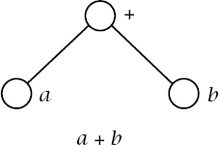
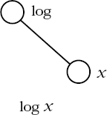
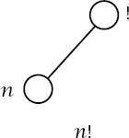
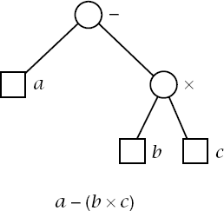
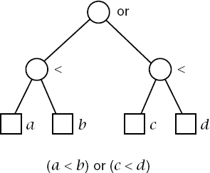
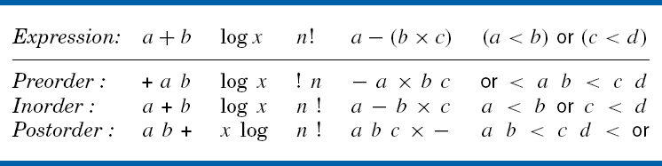
中山大学软件学院
Expression Trees

Slide 8
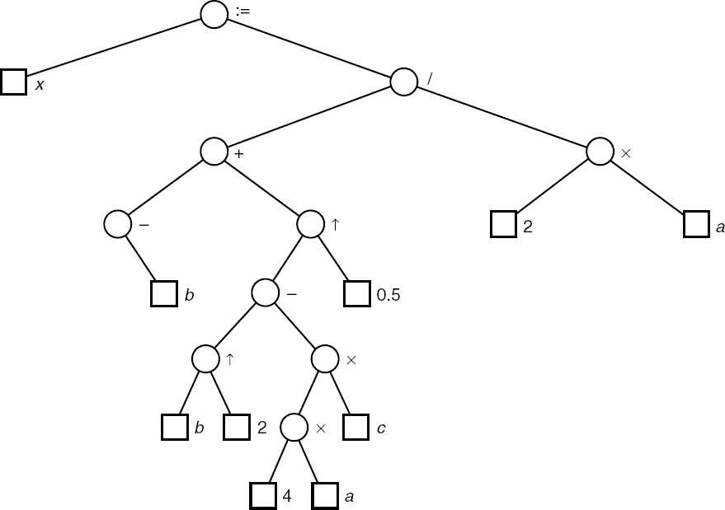
中山大学软件学院
Expression Trees

Slide 9
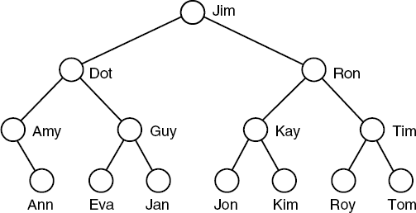
Chapter 10 Binary Trees
中山大学软件学院
Linked Binary Trees
Comparison tree

Slide 10
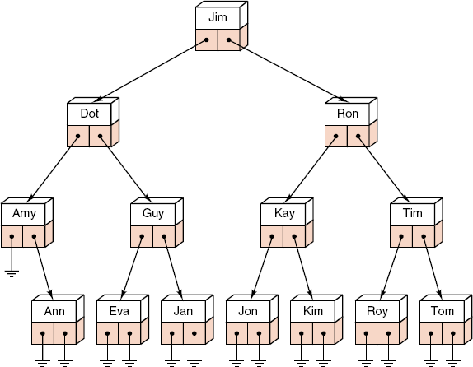
Chapter 10 Binary Trees
中山大学软件学院
Linked Binary Trees
Linked implementation
of binary tree

Slide 11
Chapter 10 Binary Trees
中山大学软件学院
Linked Binary Tree Specifications
Binary node class
template <class Entry>
struct Binary_node {
Entry data; // data members:
Binary_node<Entry> *left, *right;
Binary_node(); // constructors:
Binary_node(const Entry &x);
};

Slide 12
Chapter 10 Binary Trees
中山大学软件学院
Linked Binary Tree Specifications
Binary tree class
template <class Entry>
class Binary_tree {
public:
// Add methods here.
protected:
// Add auxiliary function prototypes here.
Binary_node<Entry> *root;
};

Slide 13
Chapter 10 Binary Trees
中山大学软件学院
Linked Binary Tree Specifications
Constructor
template <class Entry>
Binary_tree<Entry> :: Binary_tree()
{
root = NULL;
}
Empty
template <class Entry>
bool Binary_tree<Entry> :: empty() const
{
return root == NULL;
}

Slide 14
Chapter 10 Binary Trees
中山大学软件学院
Linked Binary Tree Specifications
Inorder traversal
template <class Entry>
void Binary_tree<Entry> :: inorder(void (*visit)(Entry &))
{
rec_inorder(root, visit);
}
Most Binary_tree methods described by recursive processes can be implemented by calling an auxiliary recursive function that applies to subtrees.
template <class Entry>
void Binary tree<Entry> :: rec_inorder(Binary_node<Entry> *root1, void (*visit)(Entry &))
{
if (root1 != NULL) {
rec_inorder(root1->left, visit);
visit(root1->data);
rec_inorder(root1->right, visit);
}
}

Slide 15
Chapter 10 Binary Trees
中山大学软件学院
Binary Tree Class Specification
template <class Entry>
class Binary_tree {
protected:
Binary_node<Entry> *root;
public:
Binary_tree();
bool empty() const;
void preorder(void (*visit)(Entry &));
void inorder(void (*visit)(Entry &));
void postorder(void (*visit)(Entry &));
......
};
int size() const;
void clear();
int height() const;
void insert(const Entry &);
Binary_tree (const Binary tree<Entry> &original);
Binary_tree & operator = (const Binary tree<Entry> &original);
~Binary_tree();

Slide 16
Chapter 10 Binary Trees
中山大学软件学院
Binary Search Trees
Definition A binary search tree is a binary tree that is either empty or in which the data entry of every node has a key and satisfies the conditions:
1). The key of the left child of a node (if it exists) is less than the key of its parent node.
2). The key of the right child of a node (if it exists) is greater than the key of its parent node.
3). The left and right subtrees of the root are again binary search trees.

Slide 17
Chapter 10 Binary Trees
中山大学软件学院
Binary Search Trees
We always require: No two entries in a binary search tree may have equal keys.
1) We can regard binary search trees as a new ADT.
2) We may regard binary search trees as a specialization of binary trees.
3) We may study binary search trees as a new implementation of the ADT ordered list.

Slide 18
Chapter 10 Binary Trees
中山大学软件学院
The Binary Search Tree Class
The binary search tree class will be derived from the binary tree class; hence all binary tree methods are inherited.
template <class Record>
class Search_tree: public Binary_tree<Record> {
public:
Error_code insert(const Record &new data);
Error_code remove(const Record &old data);
Error_code tree_search(Record &target) const;
private:
// Add auxiliary function prototypes here.
};

Slide 19
Chapter 10 Binary Trees
中山大学软件学院
The Binary Search Tree Class
1) The inherited methods include the constructors, the destructor, clear, empty, size, height, and the traversals preorder, inorder, and postorder.
2) A binary search tree also admits specialized methods called insert, remove, and tree_search.
3) Each Record is associated with a Key. The keys can be compared with the usual comparison operators.

Slide 20
Chapter 10 Binary Trees
中山大学软件学院
Tree Search
Error_code Search_tree<Record> :: Tree_search (Record &target) const;
Post: If there is an entry in the tree whose key matches that in target, the target is replaced by the corresponding record from the tree and success is returned. Otherwise not_present is returned.
This method is called with a parameter target that contains only a key value.
To search for the target, we compare it with the entry at the root of the tree. If their keys match, we are finished. Otherwise, we go to the left/right subtree.

Slide 21
Chapter 10 Binary Trees
中山大学软件学院
Tree Search
We program this process by calling a recursive function.
The search process terminates when it either finds the target or hits an empty subtree.
The search function returns a pointer to the node that contains the target back to the calling program.
Binary_node<Record> *Search_tree<Record> :: search_for_node (Binary_node<Record> *root1, const Record &target) const;
Pre: root1 is NULL or points to a subtree of a Search tree
Post: If the key of target is not in the subtree, NULL is returned. Otherwise, a pointer to the subtree node containing the target is returned.

Slide 22
Chapter 10 Binary Trees
中山大学软件学院
Tree Search
Recursive auxiliary function
template <class Record>
Binary_node<Record> *Search_tree<Record> :: search_for_node (Binary_node<Record>*root1, const Record &target) const
{
if (root1 == NULL || root1->data == target) return root1;
if (root1->data < target)
return search_for_node(root1->right, target);
return search_for_node(root1->left, target);
}

Slide 23
Chapter 10 Binary Trees
中山大学软件学院
Tree Search
Nonrecursive version
template <class Record>
Binary_node<Record> *Search_tree<Record> :: search_for_node (Binary_node<Record> *root1, const Record &target) const
{
while (root1 != NULL && root1->data != target)
if (root1->data < target) root1 = root1->right;
else root1 = root1->left;
return root1;
}

Slide 24
Chapter 10 Binary Trees
中山大学软件学院
Tree Search
Public method for tree search
template <class Record>
Error_code Search_tree<Record> :: tree_search(Record &target) const
{
Error_code result = success;
Binary_node<Record> *found = search_for_node(root, target);
if (found == NULL) result = not_present;
else target = found->data;
return result;
}

Slide 25
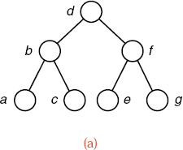
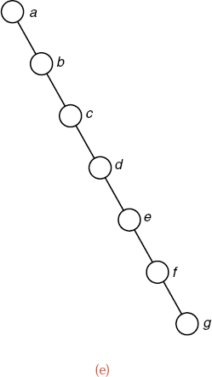
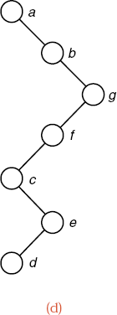
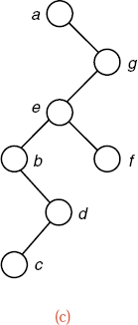
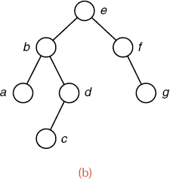
Chapter 10 Binary Trees
中山大学软件学院
Binary Search Trees with the Same Keys

Slide 26
Chapter 10 Binary Trees
中山大学软件学院
Analysis of Tree Search
Draw the comparison tree for a binary search (on an ordered list). Binary search on the list does exactly the same comparisons as tree_search will do if it is applied to the comparison tree.
By Section 7.4, binary search performs O(logn) comparisons for a list of length n. This performance is excellent in comparison to other methods, since logn grows very slowly as n increases.
The same keys may be built into binary search trees of many different shapes.

Slide 27
Chapter 10 Binary Trees
中山大学软件学院
Insertion into a Binary Search Tree
Error_code Search_tree<Record> :: insert(const Record &new_data);
Post: If a Record with a key matching that of new_data already belongs to the Search tree, a code of duplicate_error is returned.
Otherwise, the Record new_data is inserted into the tree in such a way that the properties of a binary search tree are preserved, and a code of success is returned.

Slide 28

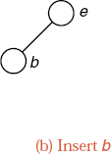
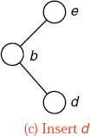
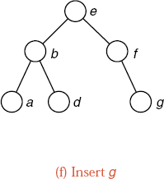
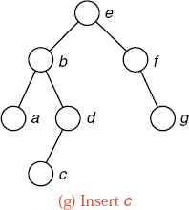
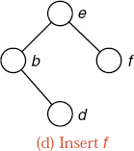
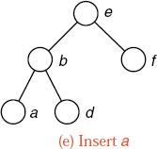
Chapter 10 Binary Trees
中山大学软件学院
Insertion into a Binary Search Tree

Slide 29
中山大学软件学院
Method for Insertion
template <class Record>
Error_code Search_tree<Record> :: insert(const Record &new_data)
{
return search_and_insert(root, new_data);
}
template <class Record>
Error_code Search_tree<Record> :: search_and_insert (Binary_node<Record> * &root1, const Record &new_data)
{
if (root1 == NULL) {
root1 = new Binary_node<Record>(new_data);
return success;
}
if (root1->data == new_data) return duplicate_error;
if (root1->data > new_data)
return search_and_insert(root1->left, new_data);
return search_and_insert(root1->right, new_data);
}

Slide 30
Chapter 10 Binary Trees
中山大学软件学院
Method for Insertion
The method insert can usually insert a new node into a random binary search tree with n nodes in O(logn) steps.
It is possible, but extremely unlikely, that a random tree may degenerate so that insertions require as many as n steps.
If the keys are inserted in sorted order into an empty tree, however, this degenerate case will occur.

Slide 31
Chapter 10 Binary Trees
中山大学软件学院
Treesort
When a binary search tree is traversed in inorder, the keys will come out in sorted order.
This is the basis for a sorting method, called treesort: Take the entries to be sorted, use the method insert to build them into a binary search tree, and then use inorder traversal to put them out in order.
Theorem 10.1 Treesort makes exactly the same comparisons of keys as does quicksort when the pivot for each sublist is chosen to be the first key in the sublist.

Slide 32
Chapter 10 Binary Trees
中山大学软件学院
Treesort
Corollary 10.2 In the average case, on a randomly ordered list of length n, treesort performs
2nlnn + O(n) ≈ 1.39nlgn + O(n)
comparisons of keys.
First advantage: The nodes need not all be available at the start of the process, but are built into the tree one by one as they become available.
Second advantage: The search tree remains available for later insertions and removals.
Drawback: If the keys are already sorted, then treesort will be a disaster -- the search tree it builds will reduce to a chain.
Treesort should never be used if the keys are already sorted, or are nearly so.

Slide 33
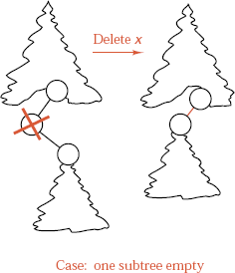
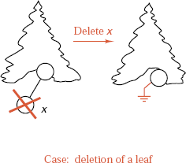
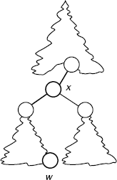
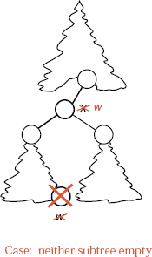
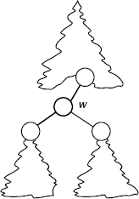
中山大学软件学院
Removal from a Binary Search Tree
Replace x by w
w is predecessor
of x
Delete
original w

Slide 34
Chapter 10 Binary Trees
中山大学软件学院
Removal Method
template <class Record>
Error_code Search_tree<Record> :: remove(const Record &target)
{
return search_and_destroy(root, target);
}
This method uses an auxiliary recursive function that refers to the actual nodes in the tree.

Slide 35
Chapter 10 Binary Trees
中山大学软件学院
Removal Method
template <class Record>
Error_code Search_tree<Record> :: search_and_destroy (Binary_node<Record>* &root1, const Record &target)
{
if (root1 == NULL || root1->data == target)
return remove_root(root1);
if (target < root1->data)
return search_and_destroy(root1->left, target);
return search_and_destroy(root1->right, target);
}

Slide 36
中山大学软件学院
Auxiliary Function to Remove One Node
template <class Record>
Error_code Search_tree<Record> :: remove_root (Binary_node<Record>* &root1)
{
if (root1 == NULL) return not_present;
Binary_node<Record> *to_delete = root1;
if (root1->right == NULL) root1 = root1->left;
else if (root1->left == NULL) root1 = root1->right;
else {
to_delete = root1->left;
Binary_node<Record> *parent = root1;
while (to_delete->right != NULL) {
parent = to_delete; to_delete = to_delete->right;
}
root1->data = to_delete->data;
if (parent == root1) root1->left = to_delete->left;
else parent->right = to_delete->left;
}
delete to_delete; return success;
}

Slide 37
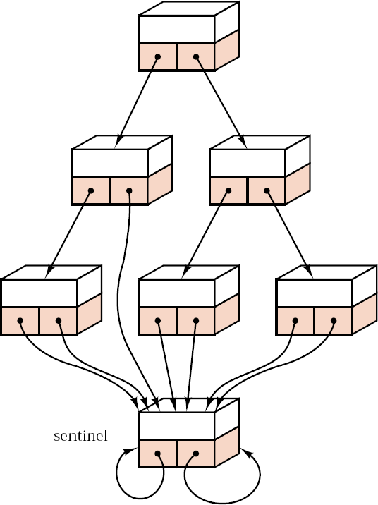
Chapter 10 Binary Trees
中山大学软件学院
Linked Binary Tree with Sentinel

Slide 38
Chapter 10 Binary Trees
中山大学软件学院
Information Retrieval Project
Purpose of project: Compare several different kinds of binary search trees useful for information retrieval. The information-retrieval package using ordinary binary search trees.
Outline of project:
1). Create the data structure (binary search tree).
2). Ask the user for the name of a text file and open it to read.
3). Read the file, split it apart into individual words, and insert the words into the data structure.
The same word will not be inserted twice in the tree.

Slide 39
Chapter 10 Binary Trees
中山大学软件学院
Information Retrieval Project
4). Print the number of comparisons done and the CPU time used in part 3.
5). If the user wishes, print out all the words in the data structure, in alphabetical order, with their frequency counts.
6). Put everything in parts 2)~5) into a do ... while loop that will run as many times as the user wishes.
Thus the user can build the data structure with more than one file if desired.
By reading the same file twice, the user can compare time for retrieval with the time for the original insertion.

Slide 40
Chapter 10 Binary Trees
中山大学软件学院
Further Specifications, Information Retrieval
The input will be a file. The program will be executed with several different files; the name of the file to be used should be requested from the user while the program is running.
A word is defined as a sequence of letters, together with apostrophes (') and hyphens (-), provided that the apostrophe or hyphen is both immediately preceded and followed by a letter.
Uppercase and lowercase letters should be regarded as the same.
A word is to be truncated to its first 20 characters, but words longer than 20 characters may appear in the text.
Nonalphabetic characters may appear in the text le. The appearance of any of these terminates a word, and the next word begins only when a letter appears.
Be sure to write your driver so that it will not be changed at all when you change implementation of data structures later.

Slide 41
Chapter 10 Binary Trees
中山大学软件学院
Function Specifications, Information Retrieval
void update(const String &word, Search_tree<Record> &structure, int &num_comps);
Post: If word was not already present in structure, then word has been inserted into structure and its frequency count is 1.
If word was already present in structure, its frequency count has been increased by 1. The variable parameter num_comps is set to the number of comparisons of words done.
void print(const Search_tree<Record> &structure);
Post: All words in structure are printed at the terminal in alphabetical order together with their frequency counts.
void write_method();
Post: The function has written a short string identifying the abstract data type used for structure.

Slide 42
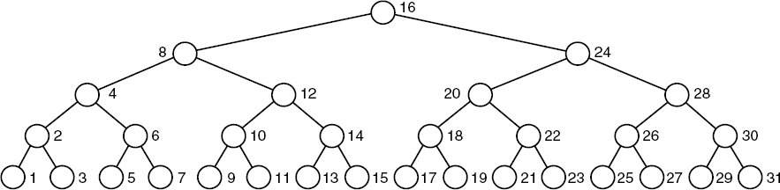
Chapter 10 Binary Trees
中山大学软件学院
Function Specifications, Information Retrieval

Slide 43
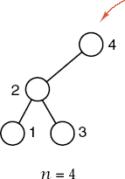
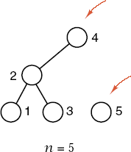

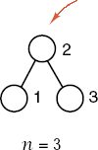

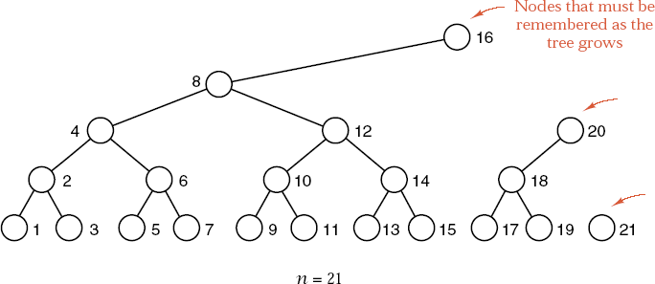
Chapter 10 Binary Trees
中山大学软件学院
Building a Balanced Binary Search Tree

Slide 44
Chapter 10 Binary Trees
中山大学软件学院
Building a Balanced Binary Search Tree
Problem: Start with an ordered list and build its entries into a binary search tree that is nearly balanced.
If the nodes of a complete binary tree are labeled in inorder sequence, starting with 1, then each node is exactly as many levels above the leaves as the highest power of 2 that divides its label.

Slide 45
Chapter 10 Binary Trees
中山大学软件学院
Algorithm Development
1) As each new node is added, it is clearly the last one received in the order, so we can place it in the List last_node and set its right pointer to NULL.
2) The left pointer of the new node is NULL if it is a leaf. Otherwise it is the entry in last_node one level lower than the new node.
3) We treat the leaves in the same way as other nodes, we consider the leaves to be on level 1, and we set up the initial element of last node, in position 0, to have the pointer value NULL permanently.
4) This convention means that we shall always count levels above the leaves inclusively, so the leaves themselves are on level 1, and so on.

Slide 46
Chapter 10 Binary Trees
中山大学软件学院
Algorithm Development
While we build up a tree, we need access to the internal structure of the tree in order to create appropriate links. Therefore, the new function will be implemented as a (public) method for a class of search trees.
We will create a new class called a Buildable tree that is derived from the class Search tree and possesses a new method, build tree. The specification for a buildable tree is thus:
template <class Record>
class Buildable_tree: public Search_tree<Record> {
public:
Error_code build_tree(const List<Record> &supply);
private:
// Add auxiliary function prototypes here.
};

Slide 47
中山大学软件学院
Method to Build Binary Search Tree
template <class Record>
Error_code Buildable_tree<Record> :: build_tree(const List<Record> &supply)
{
Error_code ordered_data = success;
int count = 0;
Record x, last_x;
List < Binary_node<Record> * > last_node;
Binary_node<Record> *none = NULL;
last_node.insert(0, none);
while (supply.retrieve(count, x) == success) {
if (count > 0 && x <= last_x) {
ordered_data = fail; break;
}
build_insert(++count, x, last_node); Last_x = x;
}
root = find_root(last_node); connect_trees(last_node);
return ordered_data;
}

Slide 48
中山大学软件学院
Inserting a Node
template <class Record>
void Buildable_tree<Record> ::build_insert(int count, const Record &new_data, List <Binary_node<Record> *> &last_node)
{
int level;
for (level = 1; count%2 == 0; level++) count /= 2;
Binary_node<Record> *node1, *parent;
node1 = new Binary_node<Record>(new_data);
last_node.retrieve(level - 1, node1->left);
if (last_node.size( ) <= level) last_node.insert(level, node1);
else last_node.replace(level, node1);
if (last_node.retrieve(level + 1, parent) == success &&
parent->right == NULL)
parent->right = node1;
}

Slide 49
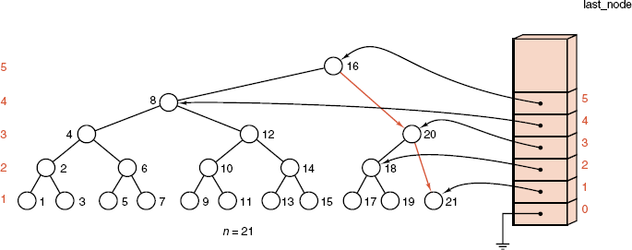
Chapter 10 Binary Trees
中山大学软件学院
Finishing the Task

Slide 50
Chapter 10 Binary Trees
中山大学软件学院
Finishing the Task
Finding the root
template <class Record>
Binary_node<Record> *Buildable_tree<Record> :: find_root(List <Binary_node<Record>*> &last_node)
{
Binary_node<Record> *high_node;
last_node.retrieve(last_node.size() - 1, high_node);
return high_node;
}

Slide 51
中山大学软件学院
Tying Subtrees Together
template <class Record>
void Buildable_tree<Record> :: connect_trees(const List <Binary_node <Record>* > &last_node)
{
Binary_node<Record> *hnode, *lnode;
int hlevel = last_node.size() - 1, llevel;
while (hlevel > 2) {
last_node.retrieve(hlevel, hnode);
if (hnode->right != NULL) hlevel--;
else {
llevel = hlevel;
do {
last_node.retrieve(--llevel, lnode);
} while (lnode!=NULL && lnode->data < hnode->data);
hnode->right = lnode;
hlevel = llevel;
}
}
}

Slide 52
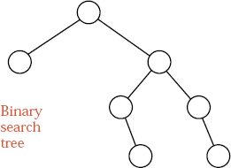
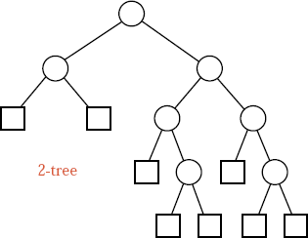
Chapter 10 Binary Trees
中山大学软件学院
Random Search Trees and Optimality
Problem: we assume that the keys have been inserted into a binary search tree in random order, on average, how many more comparisons are needed in a search of the resulting tree than would be needed in a completely balanced tree?
becomes

Slide 53
Chapter 10 Binary Trees
中山大学软件学院
Random Search Trees and Optimality
There is a one-to-one correspondence between binary search trees and 2-trees in which left and right are considered different from each other.
Assume that the n! possible orderings of keys are equally likely in building the binary search tree.
When there are n nodes in the tree, we denote by S(n) the number of comparisons done in the average successful search and by U(n) the number in the average unsuccessful search.
Recurrence relation: S(n) = 1 + (∑_{i=0..n-1}U(i))/n.

Slide 54
Chapter 10 Binary Trees
中山大学软件学院
Performance of Random Binary Search Trees
Relation between internal and external path length:
S(n) = (1+1/n)U(n) - 3
Solve, subtracting case n - 1 from case n:
U(n)= U(n-1) + 4 / (n+1)
Evaluate by expanding down to case 0 and using the Harmonic Number:
H_{n} = 1 + 1/2 + 1/3 + ... + 1/n = lnn

Slide 55
Chapter 10 Binary Trees
中山大学软件学院
Performance of Random Binary Search Trees
Theorem 10.3 The average number of nodes visited during a search of the average binary search tree with n nodes is approximately
2lnn = (2ln2)(lgn) ≈ 1.39lgn
and the number of key comparisons is approximately
4lnn = (4ln2)(lgn) ≈ 2.77lgn
Corollary 10.4 The average binary search tree requires approximately 2ln2 ≈ 1.39 times as many comparisons as a completely balanced tree.

Slide 56
Chapter 10 Binary Trees
中山大学软件学院
Height Balance: AVL Trees
Definition
An AVL tree is a binary search tree in which the heights of the left and right subtrees of the root differ by at most 1 and in which the left and right subtrees are again AVL trees.
With each node of an AVL tree is associated a balance factor that is left higher, equal, or right higher according, respectively, as the left subtree has height greater than, equal to, or less than that of the right subtree.

Slide 57
Chapter 10 Binary Trees
中山大学软件学院
Height Balance: AVL Trees
History
The name AVL comes from the discoverers of this method, G. M. Adel'son-Vel'ski and E. M. Landis. The method dates from 1962.
Convention in diagrams
In drawing diagrams, we shall show a left-higher node by ‘/’, a node whose balance factor is equal by ‘-’, and a right-higher node by ‘\’.

Slide 58

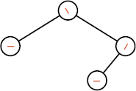
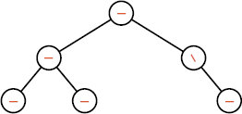
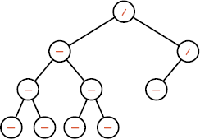
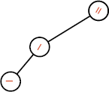
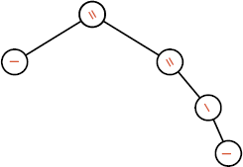
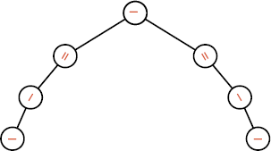
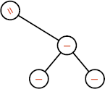
Chapter 10 Binary Trees
中山大学软件学院
Height Balance: AVL Trees
AVL Trees
non-AVL Trees

Slide 59
Chapter 10 Binary Trees
中山大学软件学院
C++ Conventions for AVL Trees
enum Balance_factor { left_higher, equal_height, right_higher };
AVL nodes are structures derived from binary search tree nodes with balance factors included:
template <class Record>
struct AVL_node: public Binary_node<Record> {
Balance_factor balance; // additional data member
AVL_node(); // constructors
AVL_node(const Record &x);
void set_balance(Balance_factor b); // virtual functions
Balance_factor get_balance( ) const;
};

Slide 60
Chapter 10 Binary Trees
中山大学软件学院
C++ Conventions for AVL Trees
In a Binary_node, left and right have type Binary_node *, so the inherited pointer members of an AVL_node have this type too, not the more restricted AVL_node *.
In the insertion method, we must make sure to insert only genuine AVL nodes.
The benefit of implementing AVL nodes with a derived structure is the reuse of all of our functions for processing nodes of binary trees and search trees.

Slide 61
Chapter 10 Binary Trees
中山大学软件学院
Methods for Balance Factors
template <class Record>
void AVL_node<Record> :: set_balance(Balance_factor b)
{
balance = b;
}
template <class Record>
Balance_factor AVL_node<Record> :: get_balance() const
{
return balance;
}

Slide 62
Chapter 10 Binary Trees
中山大学软件学院
Dummy Methods and Virtual Methods
To enable calls such as left->get_balance(), we include dummy versions of get_balance() and set balance() in the underlying Binary_node structure.
template <class Entry>
void Binary_node<Entry> :: set_balance(Balance_factor b)
{
}
template <class Entry>
Balance_factor Binary_node<Entry> :: get_balance() const
{
return equal_height;
}

Slide 63
Chapter 10 Binary Trees
中山大学软件学院
Dummy Methods and Virtual Methods
The correct choice between the AVL version and the dummy version of the method can only be made at run time, when the type of the object *left is known.
We declare the Binary_node versions of set_balance and get_balance as virtual methods:
template <class Entry>
struct Binary_node {
Entry data; // data members
Binary_node<Entry> *left, *right;
Binary_node( ); // constructors
Binary_node(const Entry &x);
virtual void set_balance(Balance_factor b);// virtual methods
virtual Balance_factor get_balance() const;
};

Slide 64
Chapter 10 Binary Trees
中山大学软件学院
Class Declaration for AVL Trees
We must override the insertion and deletion functions for binary search trees with versions that maintain the balanced structure of AVL trees.
All other binary search tree methods can be inherited without any changes.
template <class Record>
class AVL_tree: public Search_tree<Record> {
public:
Error_code insert(const Record &new_data);
Error_code remove(const Record &old_data);
private:
// Add auxiliary function prototypes here
};

Slide 65
Chapter 10 Binary Trees
中山大学软件学院
Class Declaration for AVL Trees
The inherited data member of this class is the pointer root, which has type Binary_node<Record> * and thus can store the address of either an ordinary binary tree node or an AVL tree node.
We must ensure that the overridden insert method only creates nodes of type AVL_node; doing so will guarantee that all nodes reached via the root pointer of an AVL tree are AVL nodes.

Slide 66


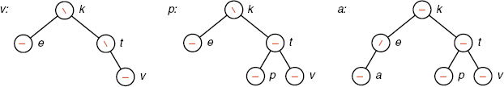
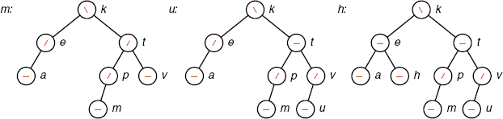
Chapter 10 Binary Trees
中山大学软件学院
Insertions into an AVL tree

Slide 67

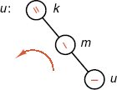

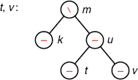
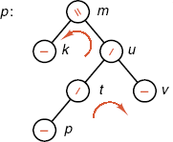
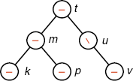
Chapter 10 Binary Trees
中山大学软件学院
Insertions into an AVL tree
Rotate left
Double rotation left

Slide 68
Chapter 10 Binary Trees
中山大学软件学院
Public Insertion Method
template <class Record>
Error_code AVL_tree<Record> :: insert(const Record &new_data)
{
bool taller;
return avl_insert(root, new_data, taller);
}

Slide 69
中山大学软件学院
Recursive Function Specifications
template <class Record>
Error_code AVL_tree<Record> :: avl_insert(Binary_node<Record> * &root1, const Record &new_data, bool &taller)
{
Error_code result = success;
if (root1 == NULL) {
root1 = new AVL_node<Record>(new_data);
taller = true;
return success;
}
if (new_data == root1->data) {
taller = false;
return duplicate_error;
}
......

Slide 70
中山大学软件学院
......(续)
if (new_data < root1->data) { // Insert in left subtree
result = avl_insert(root1->left, new_data, taller);
if (taller == true)
switch (root1->get_balance()) { // Change balance factors
case left_higher:
left_balance(root1); taller = false;
break;
case equal_height:
root1->set_balance(left_higher);
break;
case right_higher:
root1->set_balance(equal_height); taller = false;
break;
}
return result;
}

Slide 71
中山大学软件学院
......(续)
// Insert in right subtree.
result = avl_insert(root1->right, new_data, taller);
if (taller == true)
switch (root1->get_balance()) {
case left_higher:
root1->set_balance(equal_height); taller = false;
break;
case equal_height:
root1->set_balance(right_higher);
break;
case right_higher:
right_balance(root1); taller = false;
break;
}
return result;
}

Slide 72
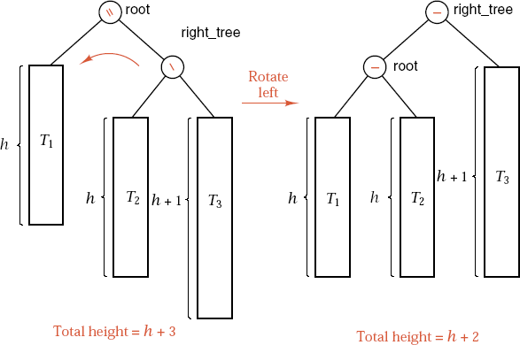
Chapter 10 Binary Trees
中山大学软件学院
Rotations of an AVL Tree

Slide 73
Chapter 10 Binary Trees
中山大学软件学院
Rotations of an AVL Tree
template <class Record>
void AVL_tree<Record> :: rotate_left(Binary_node<Record> * &root1)
{
if (root1 == NULL || root1->right == NULL)
cout << "WARNING: program error detected in rotate left\n";
else {
Binary_node<Record> *rtree = root1->right;
root1->right = rtree->left;
rtree->left = root1;
root1 = rtree;
}
}

Slide 74
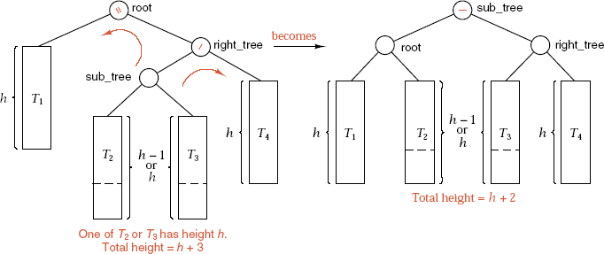
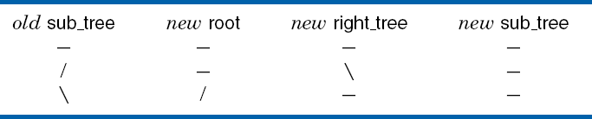
中山大学软件学院
Double Rotation
The new balance factors for root and right tree depend on the previous balance factor for sub tree:

Slide 75
中山大学软件学院
Double Rotation
template <class Record>
void AVL_tree<Record> :: right_balance(Binary_node<Record> * &root1)
{
Binary_node<Record> * &rtree = root1->right;
switch (rtree->get_balance()) {
case right_higher: // single rotation left
root1->set_balance(equal_height);
rtree->set_balance(equal_height);
rotate_left(root1);
break;
case equal_height:
cout << "WARNING: program error in right balance\n";
break;
......

Slide 76
中山大学软件学院
......
case left_higher: // double rotation left
Binary_node<Record> *stree = rtree->left;
switch (stree->get_balance()) {
case equal_height:
root1->set_balance(equal_height);
rtree->set_balance(equal_height); break;
case left_higher:
root1->set_balance(equal_height);
rtree->set_balance(right_higher); break;
case right_higher:
root1->set_balance(left_higher);
rtree->set_balance(equal_height); break;
}
stree->set_balance(equal_height);
rotate_right(rtree); rotate_left(root1);
break;
}
}

Slide 77
Chapter 10 Binary Trees
中山大学软件学院
Removal of a Node
1). Reduce the problem to the case when the node x to be removed has at most one child.
2). Delete x. We use a bool variable shorter to show if the height of a subtree has been shortened.
3). While shorter is true do the following steps for each node p on the path from the parent of x to the root of the tree. When shorter becomes false, the algorithm terminates.
4). Case 1: Node p has balance factor equal. The balance factor of p is changed according as its left or right subtree has been shortened, and shorter becomes false.
5). Case 2: The balance factor of p is not equal, and the taller subtree was shortened. Change the balance factor of p to equal, and leave shorter as true.

Slide 78
Chapter 10 Binary Trees
中山大学软件学院
Removal of a Node
6). Case 3: The balance factor of p is not equal, and the shorter subtree was shortened. Apply a rotation as follows to restore balance. Let q be the root of the taller subtree of p.
7). Case 3a: The balance factor of q is equal. A single rotation restores balance, and shorter becomes false.
8). Case 3b: The balance factor of q is the same as that of p. Apply a single rotation, set the balance factors of p and q to equal, and leave shorter as true.
9). Case 3c: The balance factors of p and q are opposite. Apply a double rotation (first around q, then around p), set the balance factor of the new root to equal and the other balance factors as appropriate, and leave shorter as true.

Slide 79



Chapter 10 Binary Trees
中山大学软件学院

Slide 80


Chapter 10 Binary Trees
中山大学软件学院

Slide 81


Chapter 10 Binary Trees
中山大学软件学院

Slide 82


Chapter 10 Binary Trees
中山大学软件学院

Slide 83
Chapter 10 Binary Trees
中山大学软件学院
Analysis of AVL Trees
The number of recursive can be as large as the height of the tree.
At most one (single or double) rotation will be done per insertion.
A rotation improves the balance of the tree, so later insertions are less likely to require rotations.
It is very difficult to find the height of the average AVL tree, but the worst case is much easier. The worst-case behavior of AVL trees is no worse than the behavior of random search trees.
The average behavior of AVL trees is much better than that of random trees, almost as good as that which could be obtained from a perfectly balanced tree.

Slide 84
Chapter 10 Binary Trees
中山大学软件学院
Worst-Case AVL Trees
To find the maximum height of an AVL tree with n nodes, we instead find the minimum number of nodes that an AVL tree of height h can have.
Let F_{h} be such a tree, with left and right subtrees F_{l} and F_{r}. one of F_{l} and F_{r}, say F_{l}, has height h-1 and the minimum number of nodes in such a tree, and F_{r} has height h-2 with the minimum number of nodes.

Slide 85




Chapter 10 Binary Trees
中山大学软件学院
Worst-Case AVL Trees
These trees, as sparse as possible for AVL trees, are called Fibonacci trees.

Slide 86
Chapter 10 Binary Trees
中山大学软件学院
Analysis of Fibonacci Trees
If we write |T| for the number of nodes in a tree T, we then have the recurrence relation for Fibonacci trees:
|F_{h}| = |F_{h-1}| + |F_{h-2}| + 1
where |F₀| = 1 and |F₁| = 2.
By the evaluation of Fibonacci numbers in Section A.4,
|F_{h}| + 1 ≈ 5^{-1/2}((1+5^{1/2})/2)^{h+2}
Take the logarithms of both sides, keeping only the largest terms: h ≈ 1.44lg|F_{h}|.

Slide 87
Chapter 10 Binary Trees
中山大学软件学院
Analysis of Fibonacci Trees
The sparsest possible AVL tree with n nodes has height about 1.44lgn compared to:
A perfectly balanced binary search tree with n nodes has height about lgn.
A random binary search tree, on average, has height about 1.39lgn.
A degenerate binary search tree has height as large as n.
The algorithms for manipulating AVL trees are guaranteed to take no more than about 44% more time than the optimum.
In practice, AVL trees do much better than this on average, perhaps as small as lgn + 0.25.

Slide 88
Chapter 10 Binary Trees
中山大学软件学院
Splay Trees: A Self-Adjusting Data Structure
In some applications, we keep records that are newly inserted or frequently accessed very close to the root, while records that are inactive may be placed far off, near or in the leaves.
We make a binary search tree into a self-adjusting data structure that automatically changes its shape to bring records closer to the root as they are more frequently accessed, allowing inactive records to drift slowly out toward the leaves.
In a splay tree, every time we access a node, whether for insertion or retrieval, we lift the newly-accessed node all the way up to become the root of the modified tree.

Slide 89
Chapter 10 Binary Trees
中山大学软件学院
Splay Trees: A Self-Adjusting Data Structure
We use rotations like those of AVL trees, but now with many rotations done for every insertion or retrieval in the tree.
We move the target node two levels up the tree at each step.
Consider the path going from the root down to the accessed node.
If we move left, we say that we zig, and if we move right we say that we zag.
A move of two steps left (going down) is then called zig-zig, two steps right zag-zag, left then right zig-zag, and right then left zag-zig. If the length of the path is odd, either a single zig move or a zag move occurs at the end.

Slide 90

Chapter 10 Binary Trees
中山大学软件学院
Splay Rotations

Slide 91

Chapter 10 Binary Trees
中山大学软件学院
Splay Rotations

Slide 92

Chapter 10 Binary Trees
中山大学软件学院
Splay Rotations

Slide 93
Chapter 10 Binary Trees
中山大学软件学院
Notes on Splay Rotations
The zig-zag case is identical to that of an AVL double rotation, and the zig case is identical to a single rotation.
The zig-zig case is not the same as would be obtained by lifting the target node twice with single rotations.
Always think of lifting the target two levels at a time (except for a single zig or zag step at the end).
It is only the nodes on the path from the target to the root whose relative positions are changed, and that only in the ways shown by colored dashed curves in the figures.
None of the subtrees off the path (T₁, T₂, T₃, and T₄) changes its shape at all, and these subtrees are attached to the path in the only places they can go to maintain the search-tree ordering of all the keys.

Slide 94



中山大学软件学院
Zig-Zig and Single Rotations
A zig-zig movement is not the same as would be obtained by lifting the target node twice with single rotations.
incorrect
result
becomes
becomes

Slide 95




中山大学软件学院
Zig-Zig and Single Rotations
Zig-Zig
Zig-Zag
Zig

Slide 96
Chapter 10 Binary Trees
中山大学软件学院
Top-Down and Bottom-Up Splaying
We perform bottom-up splaying, beginning at the target node and moving up the path to the root two steps at a time. A single zig or zag move may occur at the top of the tree.
Bottom-up splaying is essentially a two-pass method, searching down the tree and splaying the target up to the root.
In a computer algorithm, we splay from the top down while we are searching for the target node. When we find the target, it is moved to the root of the tree, or, if the search is unsuccessful, a new root is created that holds the target.

Slide 97
Chapter 10 Binary Trees
中山大学软件学院
Top-Down and Bottom-Up Splaying
In top-down splaying, a single zig or zag move occurs at the bottom of the splaying process.
If you run the splaying function we develop on the example trees, you will obtain the same results as doing bottom-up splaying by hand when the target is moved an even number of levels, but the results will be different when it moves an odd number of levels.

Slide 98
Chapter 10 Binary Trees
中山大学软件学院
Algorithm Development
Given a target key, we develop a function that searches down the tree for the key, splaying as it goes. If it finds the key, then it retrieves it; if not, then the function inserts it in a new node. In either case, the node with the target key becomes the root of the tree.
We implement splay trees as a derived class of class Search tree.
template <class Record>
class Splay_tree: public Search_tree<Record> {
public:
Error_code splay(const Record &target);
private:
// Add auxiliary function prototypes here.
};

Slide 99
Chapter 10 Binary Trees
中山大学软件学院
Algorithm Development
A splay tree does not keep track of heights and does not use any balance factors like an AVL tree.
Top-down splaying uses the same moves (zig-zig, zig-zag, and the rest) as bottom-up splaying, but expressed differently.
During splaying, the root is left empty so that, at the end, the target node can be moved or inserted directly into the root.

Slide 100
Chapter 10 Binary Trees
中山大学软件学院
The Three-Way Tree Partition
During splaying, the tree temporarily falls apart into three separate subtrees, which are reconnected after the target is made the root.
The central subtree contains nodes within which the target will lie if it is present.
The smaller-key subtree contains nodes whose keys are strictly less than the target. Every key in the smaller-key subtree is less than every key in the central subtree.
The larger-key subtree contains nodes whose keys are strictly greater than the target. Every key in the largerkey subtree is greater than every key in the central subtree.

Slide 101



Chapter 10 Binary Trees
中山大学软件学院
The Three-Way Tree Partition
These conditions hold throughout the splaying process; we call them the three-way invariant.

Slide 102
Chapter 10 Binary Trees
中山大学软件学院
The Three-Way Tree Partition
Initially, the central subtree is the whole tree, and the smaller-key and larger-key subtrees are empty.
As splaying proceeds, nodes are stripped off the central subtree and joined to one of the other two subtrees.
When the search ends, the root of the central subtree will be the target node if it is present, and the central subtree will be empty if the target was not found.
All the components will be joined together with the target as the root.

Slide 103
Chapter 10 Binary Trees
中山大学软件学院
Basic Action: link_right
Suppose the target is smaller than the key in the root of the central subtree.
In this case, we take the root and its right subtree and adjoin them to the larger-key tree, reducing the central subtree to the former left subtree of the root.
We call this action link right.
link_right is exactly a zig move, except that the link from the former left child down to the former parent is deleted; instead, the parent (with its right subtree) moves into the larger-key subtree.

Slide 104
Chapter 10 Binary Trees
中山大学软件学院
Basic Action: link_right
The three-way invariant tells us that every key in the central subtree comes before every key in the larger-key subtree; hence this parent (with its right subtree) must be attached on the left of the leftmost node (first in ordering of keys) in the larger-key subtree.
Note that, after link right is performed, the three-way invariant continues to be true.

Slide 105



Chapter 10 Binary Trees
中山大学软件学院
Action of link right: a Zig Move
Before: Case - target is less than root key

Slide 106



Chapter 10 Binary Trees
中山大学软件学院
Action of link right: a Zig Move
After

Slide 107



Chapter 10 Binary Trees
中山大学软件学院
Action of link right: a Zig Move
Case: target is less than left child of root

Slide 108



Chapter 10 Binary Trees
中山大学软件学院
Action of link right: a Zig Move
After rotate_right

Slide 109



Chapter 10 Binary Trees
中山大学软件学院
Action of link right: a Zig Move
After link_right

Slide 110



Chapter 10 Binary Trees
中山大学软件学院
Action of link right: a Zig Move
Case: target is between root and its left child

Slide 111



Chapter 10 Binary Trees
中山大学软件学院
Action of link right: a Zig Move
After link_right

Slide 112



Chapter 10 Binary Trees
中山大学软件学院
Action of link right: a Zig Move
After link_left

Slide 113
Chapter 10 Binary Trees
中山大学软件学院
Programming Conventions
1) We use five pointer variables to keep track of required positions in the three subtrees:
(1) cur gives the root of the central subtree of nodes not yet searched.
(2) child refers to either the left or right child of current, as required.
(3) small gives the largest (that is, the rightmost) node in the smaller-key subtree, which is the place where additional nodes must be attached.

Slide 114
Chapter 10 Binary Trees
中山大学软件学院
Programming Conventions
(4) large gives the smallest (that is, the leftmost) node in the larger-key subtree, which is the place where additional nodes must be attached.
(5) dummy points to a dummy node that is created at the beginning of the splaying function and is deleted at its end.
2) The dummy node contains no key or other data.
3) We initialize both small and large to dummy.
Hence these pointers always refer to actual nodes, and therefore link_right and link_left will not attempt to dereference NULL pointers.

Slide 115
Chapter 10 Binary Trees
中山大学软件学院
C++ Functions
template <class Record>
void Splay_tree<Record> :: link_right(Binary_node <Record> * &current, Binary_node<Record> * &large)
{
large->left = current;
large = current;
current = current->left;
}

Slide 116
Chapter 10 Binary Trees
中山大学软件学院
C++ Functions
The rotation functions do not use the dummy node, and they do not cause any change in the three-way partition.
template <class Record>
void Splay_tree<Record> :: rotate_right(Binary_node <Record> * &current)
{
Binary_node<Record> *ltree = current->left;
current->left = ltree->right;
ltree->right = current;
current = ltree;
}

Slide 117
Chapter 10 Binary Trees
中山大学软件学院
Finishing the Task
When the search finishes, the root of the central subtree points at the target node or is NULL.
If the target is found, it must become the root of the whole tree, but, before that, its left and right subtrees are now known to belong in the smaller-key and larger-key subtrees, so they should be moved there.
If the search instead terminates unsuccessfully, with current == NULL, a new root containing target must be created.
Finally, the left and right subtrees of the new root should now be the smaller-key and larger-key subtrees.

Slide 118
Chapter 10 Binary Trees
中山大学软件学院
Finishing the Task
How do we find the roots of these subtrees, since we have kept pointers only to their rightmost and leftmost nodes?
Remember what happened at the beginning of the search.
Initially, both pointers small and large were set to refer to the dummy node.
When a node (and subtree) are attached to the larger-key subtree, they are attached on its left, by changing large->left.

Slide 119
Chapter 10 Binary Trees
中山大学软件学院
Finishing the Task
Since large is initially dummy, we can at the end of the search, find the first node inserted into the larger-key subtree, and its root, simply as dummy->left.
Similarly, dummy->right points to the root of the smaller-key subtree. Hence the dummy node provides us with pointers to the roots of the smaller- and larger-key subtrees that would otherwise be lost.
Note that the pointers are stored in positions reversed from what one might expect.

Slide 120

Chapter 10 Binary Trees
中山大学软件学院
Finishing the Task
After splaying

Slide 121

Chapter 10 Binary Trees
中山大学软件学院
Finishing the Task
Reconnect into one tree

Slide 122
中山大学软件学院
Splaying: The Final Method
template <class Record>
Error code Splay tree<Record> :: splay(const Record &target)
{
Binary_node<Record> *dummy = new Binary_node<Record>;
Binary_node<Record> *cur = root, *child, *small = dummy, *large = dummy;
while (cur != NULL && cur->data != target)
if (target < cur->data) {
child = cur->left;
if (child == NULL || target == child->data) link_right(cur, large);
else if (target < child->data) {
rotate_right(cur); link_right(cur, large);
}
else { link_right(cur, large); link_left(cur, small); }
}
else ......

Slide 123
中山大学软件学院
while (cur != NULL && cur->data != target)
if (target < cur->data) {
......
}
else { // case: target > current->data
child = cur->right;
if (child == NULL || target == child->data) link_left(cur, small);
else if (target > child->data) {
rotate_left(cur);
link_left(cur, small);
}
else {
link_left(cur, small);
link_right(cur, large);
}
}
......

Slide 124
中山大学软件学院
// Move root to the current node, which is created if necessary
Error_code result;
if (current == NULL) { // Search unsuccessful: make a new root
cur = new Binary_node<Record>(target);
result = entry_inserted;
small->right = large->left = NULL;
}
else { // successful search
result = entry_found;
small->right = cur->left; // Move remaining central nodes
large->left = cur->right;
}
root = cur; // Dene the new root
root->right = dummy->left; // root of larger-key subtree
root->left = dummy->right; // root of smaller-key subtree
delete dummy;
return result;
}

Slide 125
Chapter 10 Binary Trees
中山大学软件学院
Amortized Algorithm Analysis: Introduction
In both worst-case analysis and average-case analysis, we take a single event or single situation and attempted to determine how much work an algorithm does to process it.
Amortized analysis differs in that it considers a long sequence of events rather than a single event in isolation.
Amortized analysis gives a worst-case estimate of the cost of a long sequence of events.
One event in a sequence may affect the cost of later events. One task may be difficult, but it may leave a data structure in a state where the tasks that follow become much easier.

Slide 126
Chapter 10 Binary Trees
中山大学软件学院
Amortized Algorithm Analysis: Introduction
In finance, amortization means to spread a large expense over a period of time. Accountants amortize a large capital expenditure over it lifetime. Insurance actuaries amortize high-risk cases over the general population.
Amortized analysis is not the same as average-case analysis, since the former considers a sequence of related situations and the latter all possible independent situations.

Slide 127



Chapter 10 Binary Trees
中山大学软件学院
Tree Traversal
Consider the inorder traversal of a binary tree, where we measure the cost of visiting one vertex as the number of branches traversed to reach that vertex from the last one visited.

Slide 128
Chapter 10 Binary Trees
中山大学软件学院
Tree Traversal
The best-case cost of visiting a vertex is 1, when we go from a vertex to one of its children or to its parent.
The worst-case cost, for a tree with n vertices, is n-1, as shown by the tree that is one long chain to the left, where it takes n-1 branches to reach the first (leftmost) vertex.
The amortized cost of going from each vertex to the next over the traversal of any binary tree is less than 2.

Slide 129
Chapter 10 Binary Trees
中山大学软件学院
Credit Balance: Making Costs Level
We invent a function, which we call a credit balance, chosen so that it will be large when the next operation is expensive and smaller when the next operation can be done quickly.
Think of the credit balance as helping to bear some of the cost of expensive operations. For inexpensive operations, we set aside more than the actual cost, using the excess to build up the credit balance for future use.

Slide 130
Chapter 10 Binary Trees
中山大学软件学院
Credit Balance: Making Costs Level
Definition The amortized cost a_{i} of each operation in a sequence of m operations is defined to be a_{i} = t_{i} + c_{i} - c_{i-1} for i=1, 2, ..., m, where t_{i} is the actual cost of operation i, c₀ is the credit balance before the first operation, and c_{i} is the credit balance after operation i, for 1 ≤ i ≤ m.
Goal: Choose the credit-balance function c_{i} so as to make the amortized costs a_{i} as nearly equal as possible, no matter how the actual costs t_{i} may vary.
Lemma 10.5 The total actual cost and total amortized cost of a sequence of m operations on a data structure are related by ∑_{i=1..m}t_{i} = ∑_{i=1..m}a_{i} + c₀ - c_{m}.

Slide 131
Chapter 10 Binary Trees
中山大学软件学院
Incrementing Binary Integers
Consider an algorithm that continually increments a binary (base 2) integer by 1. The cost of each step is the number of bits (binary digits) that are changed from one number to the next.

Slide 132

中山大学软件学院
Incrementing Binary Integers
t_{i} = actual cost
= number of digits
changed
c_{i} = credit-balance function
= number of 1's in integer
a_{i} = amortized cost
= t_{i} + c_{i} - c_{i-1}

Slide 133
Chapter 10 Binary Trees
中山大学软件学院
Amortized Analysis of Splaying
Let T be a binary search tree, T_{i} be T as it is after step i of splaying, T_{i}(x) be the subtree with root x in T_{i} , |T_{i}(x)| be the number of nodes in T_{i}(x), and define the rank of x to be r_{i}(x) = lg(|T_{i}(x)|.
The Credit Invariant: For every node x of T and after every step i of splaying, node x has credit equal to its rank r_{i}(x).
The total credit balance for the tree is defined as the sum of the individual credits for all the nodes in the tree,
c_{i} = ∑_{x∈Ti}r_{i}(x)

Slide 134
Chapter 10 Binary Trees
中山大学软件学院
Amortized Analysis of Splaying
If the tree is empty or contains only one node, then its credit balance is 0. As the tree grows, its credit balance increases, and this balance should reflect the work needed to build the tree.
Lemma 10.6 If α, β and γ are positive real numbers with α + β ≤ γ, then lgα + lgβ ≤ 2lgγ - 2.

Slide 135

Chapter 10 Binary Trees
中山大学软件学院
Amortized Complexity of Splay Steps
Lemma 10.7 If the i^{th} splaying step is a zig-zig or zag-zag step at node x, then its amortized complexity a_{i} satises the inequality a_{i} < 3(r_{i}(x) – r_{i-1}(x)).

Slide 136
Chapter 10 Binary Trees
中山大学软件学院
Amortized Complexity of Splay Steps
Lemma 10.8 If the i^{th} splaying step is a zig-zag or zag-zig step at node x, then its amortized complexity a_{i} satisfies
a_{i} < 2(r_{i}(x) – r_{i-1}(x))
Lemma 10.9 If the i^{th} splaying step is a zig or a zag step at node x, then its amortized complexity a_{i} satisfies
a_{i} < 1 + (r_{i}(x) – r_{i-1}(x))

Slide 137
Chapter 10 Binary Trees
中山大学软件学院
Amortized Complexity of Splaying
To find the total amortized cost of a retrieval or insertion, we must add the costs of all the splay steps done during the retrieval or insertion.
Theorem 10.10 The amortized cost of an insertion or retrieval with splaying in a binary search tree with n nodes does not exceed 1 + 3lgn upward moves of the target node in the tree.
Corollary 10.11 The total complexity of a sequence of m insertions or retrievals with splaying in a binary search tree that never has more than n nodes does not exceed m(1 + 3lgn) + nlgn upward moves of a target node in the tree.

