Slide 1

Data Structures and
Program Design In C++
Robert L. Kruse Alexander J. Ryba
吴 向 军
中山大学软件学院
E-Mail: issxjwu@mail.sysu.edu.cn

Slide 2
Chapter 11 Multiway Trees
中山大学软件学院
11.1. Orchards, Trees, and Binary Trees
11.2. Lexicographic Search Trees: Tries
11.3. External Searching: B-Trees
11.4. Red-Black Trees

Slide 3
Chapter 11 Multiway Trees
中山大学软件学院
On the Classification of Species
Definitions
A tree is any set of points and any set of pairs of distinct vertices such that there is a path from any vertex to any other, and there are no circuits.
A rooted tree is a tree which it has the root.
An ordered tree is a rooted tree which the children of each vertex are assigned an order.
A forest is a set of trees. All trees in a forest are rooted.
An orchard (an ordered forest) is an ordered set of ordered trees.

Slide 4
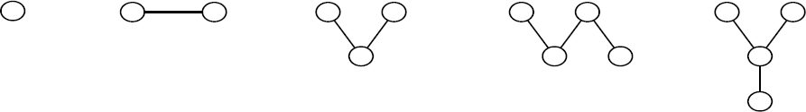
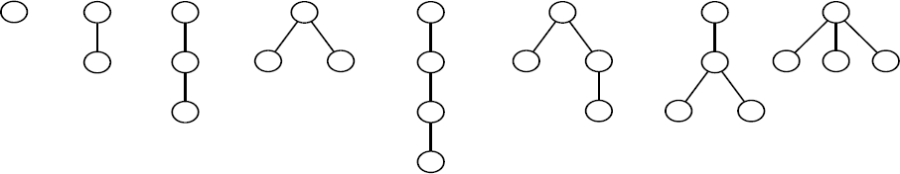
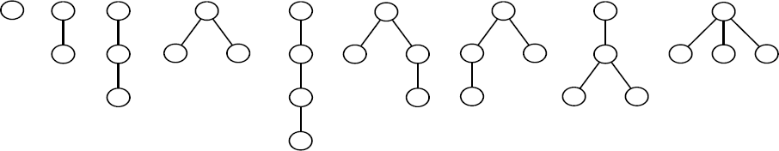
Chapter 11 Multiway Trees
中山大学软件学院
On the Classification of Species
Arrangement of vertices is irrelevant
Root is at the top of tree
Ordered trees with four or fewer vertices

Slide 5
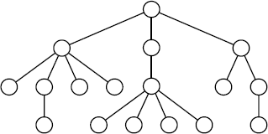
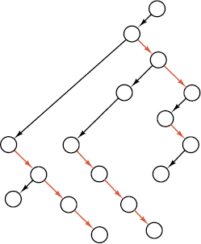
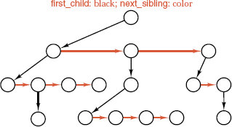
Chapter 11 Multiway Trees
中山大学软件学院
Implementations of Ordered Trees
1) Multiple links
2) first child and next sibling links
3) Correspondence with binary trees
Linked implementation of ordered tree:
Rotated form:

Slide 6
Chapter 11 Multiway Trees
中山大学软件学院
Recursive Definitions
Definition A rooted tree consists of a single vertex v, called the root of the tree, together with a forest F, whose trees are called the subtrees of the root.
A forest F is a set of rooted trees.
Definition An ordered tree T consists of a single vertex v, called the root of the tree, together with an orchard O, whose trees are called the subtrees of the root v.
We may denote the ordered tree with the pair T = {v, O}.
An orchard O is either the empty set ∅, or consists of an ordered tree T together with another orchard O'.
We may denote the orchard with the pair O = (T, O').

Slide 7
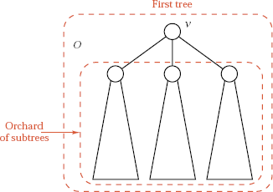
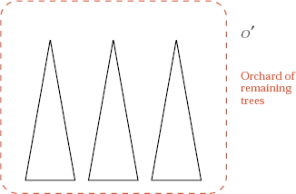
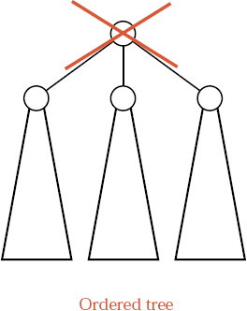
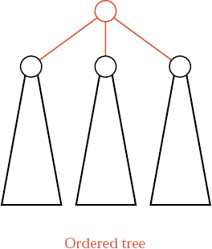
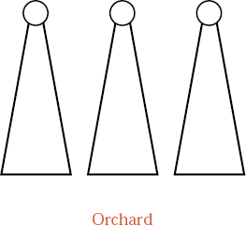
Chapter 11 Multiway Trees
中山大学软件学院
Adjoin New root
Delete root

Slide 8
Chapter 11 Multiway Trees
中山大学软件学院
The Formal Correspondence
Definition A binary tree B is either the empty set ∅; or consists of a root vertex v with two binary trees B₁ and B₂. We may denote the binary tree with the ordered triple B = [v, B₁, B₂]:
Theorem 11.1 Let S be any finite set of vertices. There is a one-to-one correspondence f from the set of orchards whose set of vertices is S to the set of binary trees whose set of vertices is S.

Slide 9
Chapter 11 Multiway Trees
中山大学软件学院
Rotations
1). Draw the orchard so that the first child of each vertex is immediately below the vertex.
2). Draw a vertical link from each vertex to its first child, and draw a horizontal link from each vertex to its next sibling.
3). Remove the remaining original links.
4). Rotate the diagram 45 degrees clockwise, so that the vertical links appear as left links and the horizontal links as right links.

Slide 10
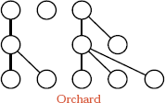
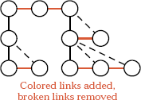
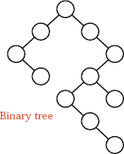
Chapter 11 Multiway Trees
中山大学软件学院
Rotations
Rotate 45º
Summary
Orchards and binary trees correspond by any of:
1) first child and next sibling links,
2) rotations of diagrams,
3) formal notational equivalence.

Slide 11
Chapter 11 Multiway Trees
中山大学软件学院
Lexicographic Search Trees: Tries
Definition A trie of order m is either empty or consists of an ordered sequence of exactly m tries of order m.

Slide 12
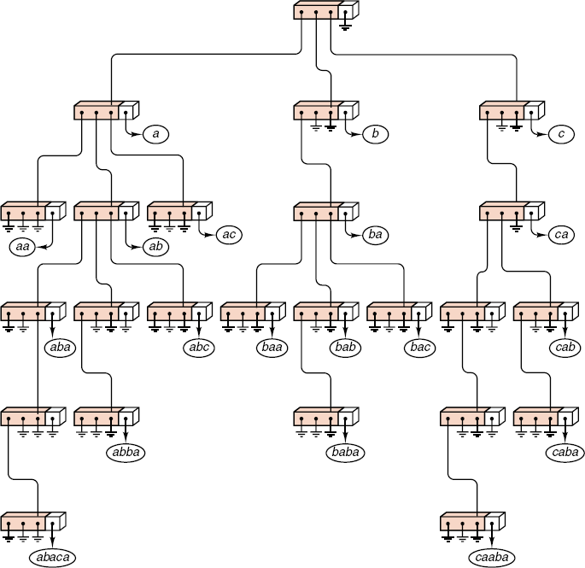
中山大学软件学院

Slide 13
Chapter 11 Multiway Trees
中山大学软件学院
C++ Trie Declarations
Every Record has a Key that is an alphanumeric string.
Method char key_letter(int position) returns the character in the given position of the key or returns a blank, if the key has length less than position.
Auxiliary function int alphabetic_order(char symbol) returns the alphabetic position of the character symbol, or 27 for nonblank, nonalphabetic characters, or 0 for blank characters.

Slide 14
Chapter 11 Multiway Trees
中山大学软件学院
C++ Trie Declarations
const int num_chars = 28;
struct Trie node {
Record *data; // data members
Trie_node *branch[num_chars];
Trie_node(); // constructors
};
class Trie {
public: // Add method prototypes here.
private: // data members
Trie_node *root;
};

Slide 15
Chapter 11 Multiway Trees
中山大学软件学院
Searching a Trie
Error_code Trie::trie_search(const Key &target, Record &x) const
{
int pos = 0;
char ch1;
Trie_node *Pt = root;
while (Pt != NULL && (ch1 = target.key_letter(pos)) != 0) {
Pt = Pt->branch[alphabetic_order(ch1)];
pos++;
}
if (Pt == NULL || Pt->data == NULL) return not_present;
x = *(Pt->data);
return success;
}

Slide 16
中山大学软件学院
Insertion into a Trie
Error_code Trie :: insert(const Record &new_entry)
{
if (root == NULL) root = new Trie_node;
char ch1;
int pos = 0;
Trie_node *Pt = root;
Error_code result = success;
while (Pt != NULL && (ch1=new_entry.key_letter(pos)) != 0) {
int pos1 = alphabetic_order(ch1);
if (Pt->branch[pos1]==NULL)
Pt->branch[pos1] = new Trie_node;
Pt = Pt->branch[pos1];
pos++;
}
if (Pt->data != NULL) result = duplicate_error;
else Pt->data = new Record(new_entry);
return result;
}

Slide 17
Chapter 11 Multiway Trees
中山大学软件学院
Multiway Search Trees
An m-way search tree is a tree in which, for some integer m called the order of the tree, each node has at most m children.
If k ≤ m is the number of children, then the node contains exactly k - 1 keys, which partition all the keys into k subsets consisting of all the keys less than the first key in the node, all the keys between a pair of keys in the node, and all keys greater than the largest key in the node.

Slide 18
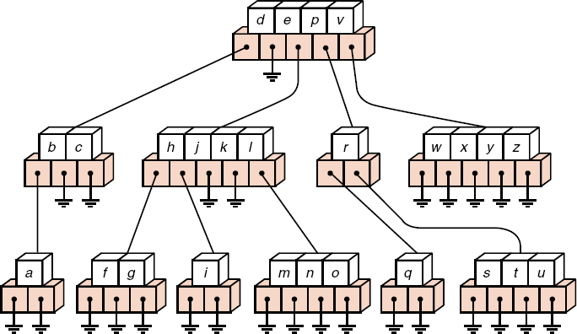
Chapter 11 Multiway Trees
中山大学软件学院
Multiway Search Trees

Slide 19
Chapter 11 Multiway Trees
中山大学软件学院
Balanced Multiway Trees (B-Trees)
Definition A B-tree of order m is an m-way search tree in which
1). All leaves are on the same level.
2). All internal nodes except the root have at most m > 0 children, and at least ⎡m/2⎤ nonempty children.
3). The number of keys in each internal node is one less than the number of children, and these keys partition the keys in the children in the fashion of a search tree.
4). The root has at most m children, but may have as few as 2 if it is not a leaf, or none if the tree consists of the root alone.

Slide 20
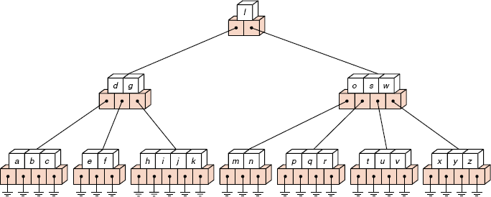
Chapter 11 Multiway Trees
中山大学软件学院
Balanced Multiway Trees (B-Trees)

Slide 21
Chapter 11 Multiway Trees
中山大学软件学院
Insertion into a B-Tree
General insertion method:
1). Search the tree for the new key. This search will terminate in failure at a leaf.
2). Insert the new key into to the leaf node. If the node was not full, then the insertion is finished.
3). When a key is added to a full node, then the node splits into two nodes, side by side on the same level, except that the median key is not put into either of the two new nodes.
4). When a node splits, move up one level, insert the median key into this parent node, and repeat the splitting process if necessary.
5). When a key is added to a full root, then the root splits in two and the median key sent upward becomes a new root. This is the only time when the B-tree grows in height.

Slide 22





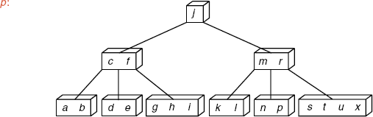

Chapter 11 Multiway Trees
中山大学软件学院
Growth of a B-Tree

Slide 23
Chapter 11 Multiway Trees
中山大学软件学院
B-Tree Declarations in C++
Node declaration
template <class Record, int order>
struct B_node {
int count; // data members
Record data[order - 1];
B_node<Record, order> *branch[order];
B_node(); // constructor
};

Slide 24
Chapter 11 Multiway Trees
中山大学软件学院
B-Tree Declarations in C++
B_tree<int, 5> sample tree; declares sample tree as a B tree of order 5 that holds integer records.
B-tree class declaration
template <class Record, int order>
class B_tree {
public: // Add public methods.
private: // data members
B_node<Record, order> *root;
// Add private auxiliary functions here.
};

Slide 25
Chapter 11 Multiway Trees
中山大学软件学院
Conventions
1) count gives the number of records in the B_node.
2) the node has count + 1 children.
3) branch[0] points to the subtree containing all records with keys less than that in data[0].
4) for 1 ≤ position ≤ count-1, branch[position] points to the subtree with keys between those in the subtrees pointed to by data[position-1] and data[position].
5) branch[count] points to the subtree with keys greater than that of data[count-1].

Slide 26
Chapter 11 Multiway Trees
中山大学软件学院
Searching in a B-Tree
Public method
template <class Record, int order>
Error_code B_tree<Record, order>::search_tree(Record &target)
{
return recursive_search_tree(root, target);
}

Slide 27
Chapter 11 Multiway Trees
中山大学软件学院
Searching a Node
This function determines if the target is present in the current node, and, if not, finds which of the count C+1 branches will contain the target key.
template <class Record, int order>
Error_code B_tree<Record, order>::search_node(B_node<Record, order> *cur, const Record &target, int &pos)
{
pos = 0;
while (pos < cur->count && target > cur->data[pos]) pos++;
if (pos < cur->count && target == cur->data[pos])
return success;
return not_present;
}

Slide 28
Chapter 11 Multiway Trees
中山大学软件学院
Searching in a B-Tree
Recursive function
template <class Record, int order>
Error code B_tree<Record, order>::recursive_search_tree(B_node <Record, order> *cur, Record &target)
{
int pos;
Error_code result;
if (cur == NULL) return not_present;
result = search_node(cur, target, pos);
if (result == success) target = cur->data[pos];
else result = recursive_search_tree(cur->branch[pos], target);
return result;
}

Slide 29
Chapter 11 Multiway Trees
中山大学软件学院
Insertion: Parameters and push_down
1) Insertion is done with recursion in a function called push_down.
2) The record new_entry being inserted is not present in the tree.
The recursive function push_down uses three parameters.
1) current is the root of the current subtree under consideration.
2) If *current splits to accommodate new_entry, push_down returns a code of overflow, and the following come into use:
3) The old node *current contains the left half of the entries.
4) median gives the median record.
5) right branch points to a new node containing the right half of the former *current.

Slide 30
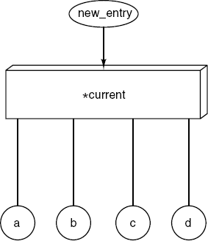
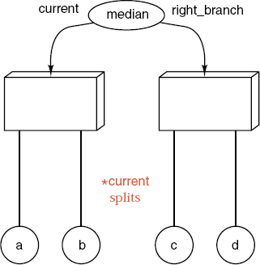
Chapter 11 Multiway Trees
中山大学软件学院
Insertion: Parameters and push_down

Slide 31
Chapter 11 Multiway Trees
中山大学软件学院
Public Insertion Method
template <class Record, int order>
Error_code B_tree<Record, order>::insert(const Record &nentry)
{
Record median;
B_node<Record, order> *pt, *root1;
Error_code result =push_down(root, nentry, median, pt);
if (result == overflow) {
root1 = new B_node<Record, order>;
root1->count = 1; root1->data[0] = median;
root1->branch[0] = root; root1->branch[1] = pt;
root = root1; result = success;
}
return result;
}

Slide 32
Chapter 11 Multiway Trees
中山大学软件学院
Recursive Insertion into a Subtree
template <class Record, int order>
Error_code B_tree<Record, order> :: push_down(
B_node<Record, order> *cur, const Record &nentry,
Record &median, B_node<Record, order> * &rbch)
{
Error_code result;
int pos;
if (cur == NULL) {
median = nentry;
rbch = NULL;
return overflow;
}
……

Slide 33
中山大学软件学院
……
if (search_node(cur, nentry, pos) == success)
return duplicate_error;
Record eentry;
B_node<Record, order> *ebch;
result = push_down(cur->branch[pos], nentry, eentry, ebch);
if (result == overflow)
if (cur->count >= order - 1)
split_node(cur, eentry, ebch, pos, rbch, median);
else {
result = success;
push_in(cur, eentry, ebch, pos);
}
return result;
}

Slide 34
Chapter 11 Multiway Trees
中山大学软件学院
template <class Record, int order>
void B_tree<Record, order> :: push_in(B_node<Record, order> *cur, const Record &entry, B_node<Record, order> *rbch, int pos)
{
for (int i = cur->count; i > pos; i--) {
cur->data[i] = cur->data[i - 1];
cur->branch[i + 1] = cur->branch[i];
}
cur->data[pos] = entry;
cur->branch[pos + 1] = rbch;
cur->count++;
}

Slide 35
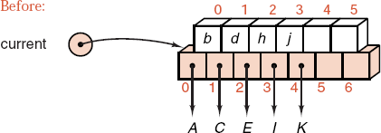
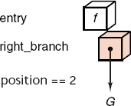
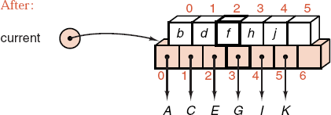
Chapter 11 Multiway Trees
中山大学软件学院

Slide 36
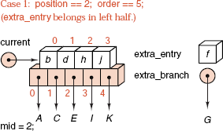
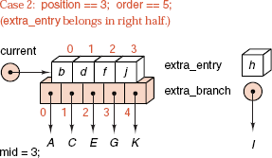
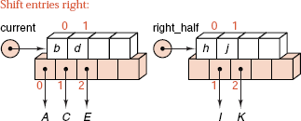
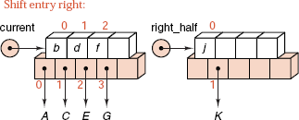
Chapter 11 Multiway Trees
中山大学软件学院
Example of Splitting a Full Node

Slide 37
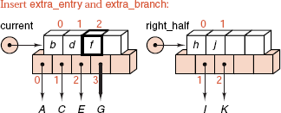
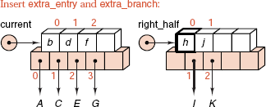
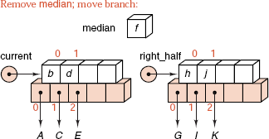
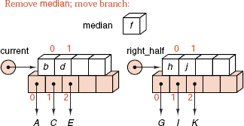
Chapter 11 Multiway Trees
中山大学软件学院
Example of Splitting a Full Node

Slide 38
中山大学软件学院
Function split node, Specifications
template <class Record, int order>
void B_tree<Record, order> :: split_node(B_node<Record, order> *cur, const Record &eentry, B_node<Record, order> *ebch, int pos, B_node<Record, order> * &rhalf, Record &median)
{
rhalf = new B_node<Record, order>;
int mid = order/2;
if (pos <= mid) {
for (int i = mid; i < order - 1; i++) {
rhalf->data[i-mid] = cur->data[i];
rhalf->branch[i-mid+1] = cur->branch[i + 1];
}
cur->count = mid; rhalf->count = order - 1 - mid;
push_in(cur, eentry, ebch, pos);
}
else ......

Slide 39
中山大学软件学院
Function split node, Specifications
......
else {
mid++;
for (int i = mid; i < order - 1; i++) {
rhalf->data[i - mid] = cur->data[i];
rhalf->branch[i+1-mid] = cur->branch[i + 1];
}
cur->count = mid;
rhalf->count = order - 1 - mid;
push_in(rhalf, eentry, ebch, pos - mid);
}
median = cur->data[cur->count - 1];
rhalf->branch[0] = cur->branch[cur->count];
cur->count--;
}

Slide 40
Chapter 11 Multiway Trees
中山大学软件学院
Deletion from a B-Tree
If the entry that is to be deleted is not in a leaf, then its immediate predecessor (or successor) under the natural order of keys is guaranteed to be in a leaf.
We promote the immediate predecessor (or successor) into the position occupied by the deleted entry, and delete the entry from the leaf.
If the leaf contains more than the minimum number of entries, then one of them can be deleted with no further action.
If the leaf contains the minimum number, we look at the two leaves that are adjacent to each other and are children of the same node.
If one of these has more than the minimum number of entries, one of them can be moved into the parent node, and the entry from the parent moved into the leaf where the deletion is occurring.

Slide 41
Chapter 11 Multiway Trees
中山大学软件学院
Deletion from a B-Tree
If the adjacent leaf has only the minimum number of entries, the two leaves and the median entry from the parent can all be combined as one new leaf.
If this step leaves the parent node with too few entries, the process propagates upward.
In the limiting case, the last entry is removed from the root, and the height of the tree decreases.

Slide 42
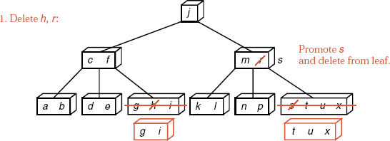
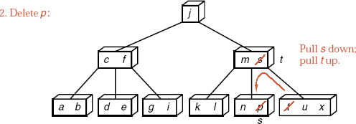
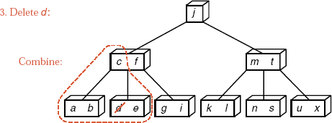
中山大学软件学院

Slide 43
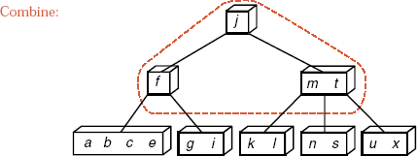

Chapter 11 Multiway Trees
中山大学软件学院

Slide 44
Chapter 11 Multiway Trees
中山大学软件学院
Public Deletion Method
template <class Record, int order>
Error_code B_tree<Record, order>::remove(const Record &target)
{
Error_code result;
result = recursive_remove(root, target);
if (root != NULL && root->count == 0) {
B_node<Record, order> *old_root = root;
root = root->branch[0];
delete old_root;
}
return result;
}

Slide 45
中山大学软件学院
Recursive Deletion
template <class Record, int order>
Error_code B_tree<Record, order> :: recursive_remove( ... )
{
int pos; Error_code result;
if (cur == NULL) return not_present;
if (search_node(cur, target, pos) != success)
result = recursive_remove(cur->branch[pos], target);
else {
result = success;
if (cur->branch[pos] == NULL) remove_data(cur, pos);
else {
copy_in_predecessor(cur, pos);
recursive_remove(cur->branch[pos],
cur->data[pos]);
}
}.......
......
if (cur->branch[pos] != NULL &&
cur->branch[pos]->count < (order − 1)/2) restore(cur, pos);
return result;
}

Slide 46
Chapter 11 Multiway Trees
中山大学软件学院
Auxiliary Functions
Remove data from a leaf
template <class Record, int order>
void B_tree<Record, order> :: remove_data(B_node<Record, order> *cur, int pos)
{
for (int i = pos; i < cur->count - 1; i++)
cur->data[i] = cur->data[i+1];
cur->count--;
}

Slide 47
Chapter 11 Multiway Trees
中山大学软件学院
Auxiliary Functions
Replace data by its immediate predecessor
template <class Record, int order>
void B_tree < Record, order > :: copy_in_predecessor(B_node <Record, order> *cur, int pos)
{
B_node<Record, order> *leaf = cur->branch[pos];
while (leaf->branch[leaf->count] != NULL)
leaf = leaf->branch[leaf->count];
cur->data[pos] = leaf->data[leaf->count - 1];
}

Slide 48
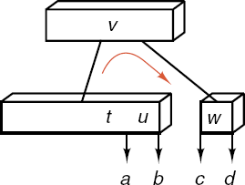
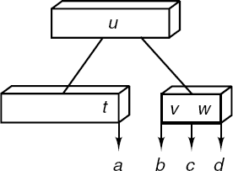
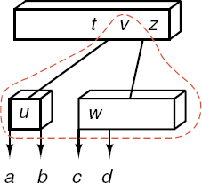
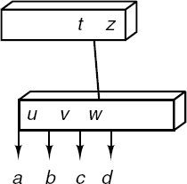
Chapter 11 Multiway Trees
中山大学软件学院
Restore Minimum Number of Entries
move_right
combine

Slide 49
中山大学软件学院
Function to Restore Minimum Node Entries
template <class Record, int order>
void B_tree<Record, order> :: restore(B_node<Record, order> *cur, int pos)
{ if (pos == cur->count)
if (cur->branch[pos - 1]->count > (order - 1)/2)
move_right(cur, pos - 1);
else combine(cur, pos);
else if (pos == 0)
if (cur->branch[1]->count > (order-1)/2) move_left(cur, 1);
else combine(cur, 1);
else if (cur->branch[pos - 1]->count > (order - 1)/2)
move right(cur, pos - 1);
else if (cur->branch[pos + 1]->count > (order - 1)/2)
move_left(cur, pos + 1);
else combine(cur, pos);
}

Slide 50
中山大学软件学院
Function move_left
template <class Record, int order>
void B_tree<Record, order> ::move_left(B_node<Record, order> *cur, int pos)
{
B_node<Record, order> *lbch = cur->branch[pos - 1],
*rbch = cur->branch[pos];
lbch->data[lbch->count] = cur->data[pos - 1];
lbch->branch[++lbch->count] = rbch->branch[0];
cur->data[pos - 1] = rbch->data[0];
rbch->count--;
for (int i = 0; i < rbranch->count; i++) {
rbch->data[i] = rbch->data[i + 1];
rbch->branch[i] = rbch->branch[i + 1];
}
rbch->branch[rbch->count] = rbch->branch[rbch->count + 1];
}

Slide 51
中山大学软件学院
Function move_right
template <class Record, int order>
void B_tree<Record, order>::move_right(B_node<Record, order> *cur, int pos)
{
B_node<Record, order> *rbch = cur->branch[pos + 1],
*lbch = cur->branch[pos];
rbch->branch[rbch->count + 1] = rbch->branch[rbch->count];
for (int i = rbch->count; i > 0; i--) {
rbch->data[i] = rbch->data[i - 1];
rbch->branch[i] = rbch->branch[i - 1];
}
rbch->count++;
rbch->data[0] = cur->data[pos];
rbch->branch[0] = lbch->branch[lbch->count--];
cur->data[pos] = lbch->data[lbch->count];
}

Slide 52
中山大学软件学院
Function combine
template <class Record, int order>
void B_tree<Record, order> :: combine(B_node<Record, order> *cur, int pos)
{
B_node<Record, order> *lbch = cur->branch[pos - 1],
*rbch = cur->branch[pos];
lbch->data[lbch->count] = cur->data[pos - 1];
lbch->branch[++lbch->count] = rbch->branch[0];
for (int i = 0; i < rbch->count; i++) {
lbch->data[lbch->count] = rbch->data[i];
lbch->branch[++lbch->count] = rbch->branch[i+1];
}
cur->count--;
for (int i = pos - 1; i < cur->count; i++) {
cur->data[i] = cur->data[i + 1];
cur->branch[i + 1] = cur->branch[i + 2];
}
delete rbch;
}

Slide 53
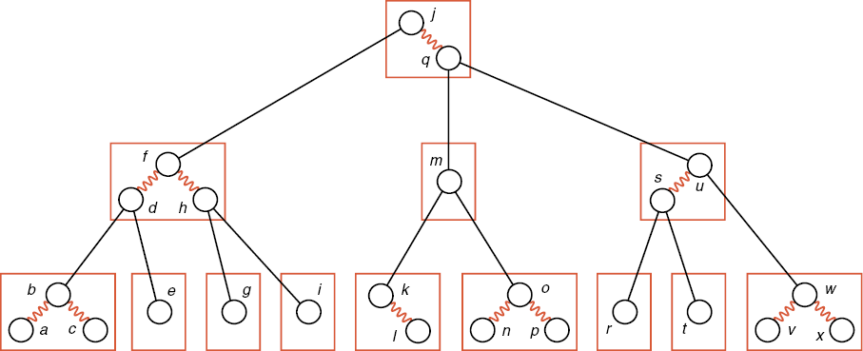
Chapter 11 Multiway Trees
中山大学软件学院

Slide 54
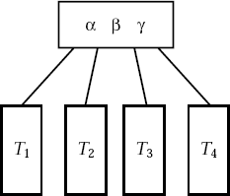
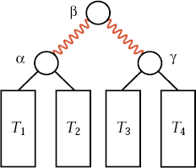
Chapter 11 Multiway Trees
中山大学软件学院
Red-Black Trees as B-Trees of Order 4
Start with a B-tree of order 4, so each node contains 1, 2, or 3 entries.
Convert a node with 3 entries into a binary search tree by:
becomes

Slide 55
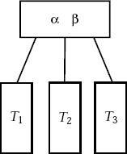
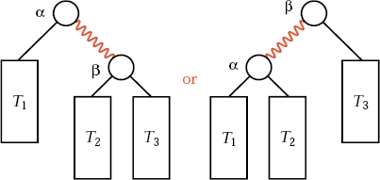
Chapter 11 Multiway Trees
中山大学软件学院
Red-Black Trees as B-Trees of Order 4
A node with two entries has two possible conversions:
becomes

Slide 56
Chapter 11 Multiway Trees
中山大学软件学院
Red-Black Trees as B-Trees of Order 4
A node with one entry remains unchanged.
A red-black tree is a binary search tree, with links colored red or black, obtained from a B-tree of order 4 by the above conversions.
Searching and traversal of a red-black tree are exactly the same as for an ordinary binary search tree.
Insertion and deletion, require care to maintain the underlying B-tree structure.

Slide 57
Chapter 11 Multiway Trees
中山大学软件学院
Red-Black Trees as Binary Search Trees
Each node of a red-black tree is colored with the same color as the link immediately above it. We need keep only one extra bit of information for each node to indicate its color.
The root is colored black and all empty subtrees are colored black.
The B-tree requirement that all its empty subtrees are on the same level becomes: the Black Condition -- Every simple path from the root to an empty subtree goes through the same number of black nodes.

Slide 58
Chapter 11 Multiway Trees
中山大学软件学院
Red-Black Trees as Binary Search Trees
To guarantee that no more than three nodes are connected by red links as one B-tree node, and that nodes with three entries are a balanced binary tree, we require: the Red Condition -- If a node is red, then its parent exists and is black.
Definition A red-black tree is a binary search tree in which each node has either the color red or black and that satisfies the black and red conditions.

Slide 59
Chapter 11 Multiway Trees
中山大学软件学院
Analysis of Red-Black Trees
Theorem 11.2 The height of a red-black tree containing n nodes is no more than 2lgn.
Searching a red-black tree with n nodes is O(logn) in every case.
The time for insertion is also O(logn).
An AVL tree, in its worst case, has height about 1.44lgn and, on average, has an even smaller height. Hence red-black trees do not achieve as good a balance as AVL trees.
Red-black trees are not necessarily slower than AVL trees, since AVL trees may require many more rotations to maintain balance than red-black trees require.

Slide 60
Chapter 11 Multiway Trees
中山大学软件学院
Red-Black Tree Specification
The red-black tree class is derived from the binary search tree class.
enum Color {red, black};
template <class Record>
struct RB_node: public Binary node<Record> {
Color color;
RB_node(const Record &new_entry)
{ color = red; data = new_entry; left = right = NULL; }
RB_node() {color = red; left = right = NULL; }
void set_color(Color c) { color = c; }
Color get_color() const { return color; }
};

Slide 61
Chapter 11 Multiway Trees
中山大学软件学院
Modified Node Specification
To invoke get_color and set_color via pointers, we must add virtual functions to the base struct Binary_node.
template <class Entry>
struct Binary_node {
Entry data;
Binary_node<Entry> *left, *right;
virtual Color get_color() const { return red; }
virtual void set_color(Color c) { }
Binary_node() { left = right = NULL; }
Binary_node(const Entry &x) { data = x; left = right = NULL; }
};

Slide 62
Chapter 11 Multiway Trees
中山大学软件学院
Red-Black Insertion
We begin with the standard recursive algorithm for insertion into a binary search tree. The new entry will be in a new leaf node.
The black condition requires the new node must be red.
If the parent of the new red node is black, the insertion is finished, but if the parent is red, we have introduced a violation of the red condition into the tree.
The major work of the insertion algorithm is to remove a violation of the red condition, and we shall find several different cases that we shall need to process separately.

Slide 63
Chapter 11 Multiway Trees
中山大学软件学院
Red-Black Insertion
When we make a node red, we do not check the conditions or repair the tree. Instead, we return from the recursive call with a status indicator showing that the node just processed is red.
After this return, we are processing the parent node.
If the parent is black, then the conditions for a red-black tree are satisfied and the process terminates.
If the parent is red, then we set the status variable to show two red nodes together, linked as left child or as right child.
Return from the recursive call.

Slide 64
Chapter 11 Multiway Trees
中山大学软件学院
Red-Black Insertion
We are now processing the grandparent node. Since the root is black and the parent is red, this grandparent must exist. By the red condition, this grandparent is black since the parent was red.
At the recursive level of the grandparent node, we transform the tree to restore the red-black conditions, using cases depending on the relative positions of the grandparent, parent, and child nodes. See following diagram.

Slide 65
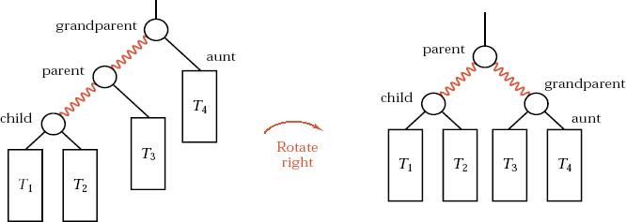
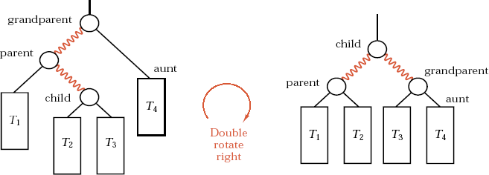
Chapter 11 Multiway Trees
中山大学软件学院

Slide 66
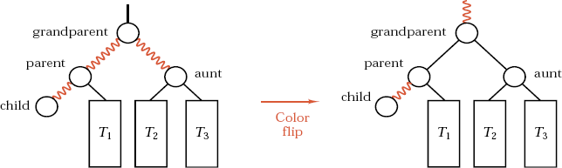
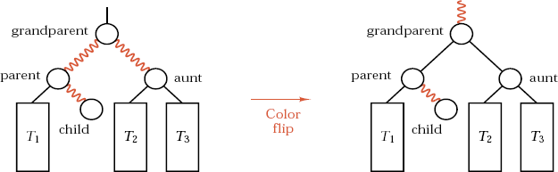
Chapter 11 Multiway Trees
中山大学软件学院

Slide 67
中山大学软件学院
Insertion Method Implementation
Class specification:
template <class Record>
class RB_tree: public Search_tree<Record> {
public:
Error_code insert(const Record &new_entry);
private: // Add prototypes for auxiliary functions here.
};
Status indicator values:
enum RB_code {okay, red_node, left_red, right_red, duplicate};
okay: The color of the current root has not changed.
red_node: The current root has changed from black to red.
right_red: The current root and its right child are now both red.
left_red: The current root and its left child are now both red.
duplicate: The entry being inserted duplicates another entry; this is an error.

Slide 68
中山大学软件学院
Public Insertion Method
template <class Record>
Error code RB tree<Record> :: insert(const Record &new entry)
{
RB_code status = rb_insert(root, new entry);
switch (status) {
case red_node: root->set color(black);
case okay: return success;
case duplicate: return duplicate_error;
case right_red:
case left_red:
cout << "WARNING: Error in RB tree::insert\n";
return internal_error;
}
}

Slide 69
中山大学软件学院
Recursive Insertion Function
template <class Record>
RB_code RB_tree<Record> ::rb_insert(Binary_node<Record> * &cur, const Record &nentry)
{
RB_code status, cstatus;
if (cur == NULL) {
cur = new RB_node<Record>(nentry); status = red_node;
}
else if (nentry == cur->data) return duplicate;
else if (nentry < cur->data) {
cstatus = rb_insert(cur->left, nentry);
status = modify_left(cur, cstatus);
}
else {
cstatus = rb_insert(cur->right, nentry);
status = modify_right(cur, cstatus);
}
return status;
}

Slide 70
中山大学软件学院
Checking the Status: Left Child
template <class Record>
RB_code RB_tree<Record> :: Modify_left(Binary_node<Record> * &cur, RB_code &cstatus)
{
RB_code status = okay;
Binary_node<Record> *aunt = cur->right;
Color color = black;
if (aunt != NULL) color = aunt->get_color();
switch (cstatus) {
case red_node:
status = (cur->get_color() == red? left_red : okay); break;
case left_red:
status = (color == black? rotate_right(cur) : flip_color(cur)); break;
case right_red:
status = (color==black? double_rotate_right(cur) : flip_color(cur));
break;
}
return status;
}

Slide 71
Chapter 12 Graphs
中山大学软件学院
10.1. Mathematical Background
10.2. Computer Representation
10.3. Graph Traversal
10.4. Topological Sorting
10.5. A Greedy Algorithm: Shortest Paths
10.6. Minimal Spanning Trees
10.7. Graphs as Data Structures

Slide 72
Chapter 12 Graphs
中山大学软件学院
Graphs: Definitions
1). A graph G=<V, E>, V: set of vertices, E: set of edges
2). e = (u, v) is an edge with vertices v
3). If the pairs are unordered, G is called an undirected graph.
4). If the pairs are ordered, G is called a directed graph.
digraph for directed graph, graph for undirected graph.
5). u and v are called adjacent if e=(u, v).
6). A path v₁, v₂, ... , v_{k} is a sequence of distinct vertices, each adjacent to the next.
7). A cycle is a path v₁, v₂, ... , v_{k} with v₁=v_{k}, and k>2.

Slide 73
Chapter 12 Graphs
中山大学软件学院
Graphs: Definitions
8). A graph is called connected if there is a path from any vertex to any other vertex.
9). A tree is defined as a connected undirected graph with no cycles.
10). In a directed graph a path or a cycle means always moving in the direction indicated by the arrows. Such a path (cycle) is called a directed path (cycle).

Slide 74
Chapter 12 Graphs
中山大学软件学院
Graphs: Definitions
11). A directed graph is called strongly connected if there is a directed path from any vertex to any other vertex.
If we suppress the direction of the edges and the resulting undirected graph is connected, we call the directed graph weakly connected.
12). The valence of a vertex is the number of edges on which it lies also the number of vertices adjacent to it.

Slide 75
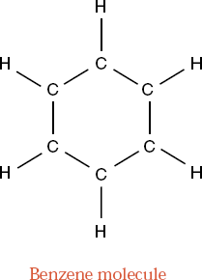
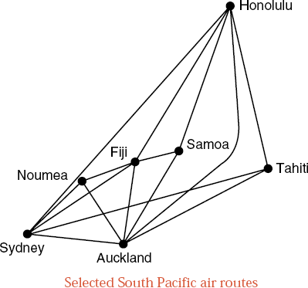

Chapter 12 Graphs
中山大学软件学院
Graphs: Definitions

Slide 76


Chapter 12 Graphs
中山大学软件学院
Graphs: Definitions

Slide 77
Chapter 12 Graphs
中山大学软件学院
Set Implementation of Digraphs
Definition A digraph G=<V, E>, for all v ∈ V, a subset A_{v} of V called the set of vertices adjacent to v.
Set as a bit string
template <int max_set>
struct Set {
bool is_element[max_set];
};
Digraph as a bit-string set
template <int max_size>
class Digraph {
int count;
Set<max_size> neighbors[max_size];
};
Digraph as an adjacency table
template <int max_size>
class Digraph {
int count;
bool adjacency[max_size][max_size];
};

Slide 78
Chapter 12 Graphs
中山大学软件学院
List Implementation of Digraphs
typedef int Vertex;
template <int max_size>
class Digraph {
int count;
List<Vertex> neighbors[max_size];
};
class Edge;
class Vertex {
Edge *first_edge;
Vertex *next_vertex;
};
class Edge {
Vertex *end_point;
Edge *next_edge;
};
class Digraph {
Vertex *first_vertex;
};

Slide 79



Chapter 12 Graphs
中山大学软件学院
List Implementation of Digraphs

Slide 80


Chapter 12 Graphs
中山大学软件学院
List Implementation of Digraphs

Slide 81

Chapter 12 Graphs
中山大学软件学院
Graph Traversal
Depth-first traversal of a graph is analogous to preorder traversal of an ordered tree.
Suppose that the traversal has just visited a vertex v, and let w₁, w₂, ..., w_{k} be the vertices adjacent to v. we shall visit w₁ and keep w₂, ..., w_{k} waiting.
After visiting w₁, we traverse
all the vertices to which it is adjacent
before returning to traverse w₂, ..., w_{k}.

Slide 82

Chapter 12 Graphs
中山大学软件学院
Graph Traversal
Breadth-first traversal of a graph is analogous to level-by-level traversal of an ordered tree.
If the traversal has just visited a vertex v, then it visits all the vertices adjacent to v, putting the vertices adjacent to these in a waiting list to be
traversed after all vertices
adjacent to v have been visited.

Slide 83
Chapter 12 Graphs
中山大学软件学院
Depth-First Algorithm
template <int max_size>
void Digraph<max_size>::depth_first(void (*visit)(Vertex &)) const
{
bool visited[max_size];
Vertex v;
for (all v in G) visited[v] = false;
for (all v in G)
if (!visited[v]) traverse(v, visited, visit);
}

Slide 84
Chapter 12 Graphs
中山大学软件学院
Depth-First Algorithm
The recursion is performed in an auxiliary function traverse.
template <int max_size>
void Digraph<max_size> :: traverse(Vertex &v, bool visited[], void (*visit)(Vertex &)) const
{
Vertex w;
visited[v] = true;
(*visit)(v);
for (all w adjacent to v)
if (!visited[w]) traverse(w, visited, visit);
}

Slide 85
中山大学软件学院
Chapter 12 Graphs
Breadth-First Algorithm
template <int max_size>
void Digraph<max_size>::breadth_first(void (*visit)(Vertex &)) const
{
Queue q;
bool visited[max size];
Vertex v, w, x;
for (all v in G) visited[v] = false;
for (all v in G) ...
}
if (!visited[v]) {
q.append(v);
while (!q.empty()){
q.retrieve(w);
if (!visited[w]) {
visited[w] = true; (*visit)(w);
for (all x adjacent to w) q.append(x);
}
q.serve();
}
}

Slide 86



Chapter 12 Graphs
中山大学软件学院
A topological order for G is a sequential listing of all the vertices in G such that, for all vertices v, w ∈ G, if there is an edge from v to w, then v precedes w in the sequential listing.

Slide 87
中山大学软件学院
Digraph Class, Topological Sort
typedef int Vertex;
template <int graph_size>
class Digraph {
public:
Digraph();
void read();
void write();
void depth_sort(List<Vertex> &topological order);
void breadth_sort(List<Vertex> &topological order);
private:
int count;
List <Vertex> neighbors[graph_size];
void recursive_depth_sort(Vertex v, bool visited[], List<Vertex> &topological order);
};

Slide 88
Chapter 12 Graphs
中山大学软件学院
Depth-First Algorithm
template <int graph_size>
void Digraph<graph_size>::depth_sort(List<Vertex> &topo_order)
{
bool visited[graph_size];
Vertex v;
for (v = 0; v < count; v++) visited[v] = false;
topo_order.clear();
for (v = 0; v < count; v++)
if (!visited[v]) recursive_depth_sort(v, visited, topo_order);
}

Slide 89
Chapter 12 Graphs
中山大学软件学院
Depth-First Algorithm
template <int graph_size>
void Digraph<graph_size> :: recursive_depth_sort(Vertex v, bool *visited, List<Vertex> &topo_order)
{
visited[v] = true;
int degree = neighbors[v].size();
for (int i = 0; i < degree; i++) {
Vertex w;
neighbors[v].retrieve(i, w);
if (!visited[w]) recursive_depth_sort(w, visited, topo_order);
}
topo_order.insert(0, v);
}

Slide 90
中山大学软件学院
Breadth-First Algorithm
template <int graph_size>
void Digraph<graph_size>::breadth_sort(List<Vertex> &tp_order)
{
tp_order.clear();
Vertex v, w;
int pred_count[graph_size];
for (v = 0; v < count; v++) pred_count[v] = 0;
for (v = 0; v < count; v++)
for (int i = 0; i < neighbors[v].size(); i++) {
neighbors[v].retrieve(i, w);
pred_count[w]++;
}
Queue ready_to_process;
......

Slide 91
中山大学软件学院
Breadth-First Algorithm
template <int graph_size>
void Digraph<graph_size>::breadth_sort(List<Vertex> &tp_order)
{
......
for (v = 0; v < count; v++)
if (pred_count[v] == 0) ready_to_process.append(v);
while (!ready_to_process.empty()) {
ready_to_process.retrieve(v);
tp_order.insert(tp_order.size(), v);
for (int j = 0; j < neighbors[v].size(); j++) {
neighbors[v].retrieve(j, w);
pred_count[w]--;
if (pred_count[w] == 0) ready_to_process.append(w);
}
ready_to_process.serve();
}

Slide 92

Chapter 12 Graphs
中山大学软件学院
A Greedy Algorithm: Shortest Paths
The problem of shortest paths
Given a directed graph in which each edge has a nonnegative weight or cost, find a path of least total
weight from a given vertex, called the source,
to every other vertex in the graph.

Slide 93
Chapter 12 Graphs
中山大学软件学院
A Greedy Algorithm: Shortest Paths
Method
We keep a set S of vertices whose closest distances to the source, vertex 0, are known and add one vertex to S at each stage.
For each vertex v, We maintain a table distance that gives the distance from 0 to v along a path all of whose vertices are in S, except possibly the last one.
To determine what vertex to add to S at each step, we apply the greedy criterion of choosing the vertex v with the smallest distance recorded in the table distance, such that v is not already in distance.

Slide 94

中山大学软件学院
Finding a Shortest Path
Choose the vertex v with the smallest distance recorded in the table distance.
Prove that the distance recorded in distance is the length of the shortest path from source to v.
Suppose that there were a shorter path from source to v.
This path first leaves S to go to some vertex x,
then goes on to v.
if this path is shorter than the colored
path to v, then its initial segment from source
to x is also shorter, so that the greedy criterion
would have chosen x rather than v as the next
vertex to add to S, since we would have
had distance[x] < distance[v].

Slide 95
Chapter 12 Graphs
中山大学软件学院
Finding a Shortest Path
When we add v to S, we think of v as now colored and also color the shortest path from source to v.
Next, we update the entries of distance by
checking, for each vertex w not in S, whether
a path through v and then directly to w
is shorter than the previously recorded
distance to w.

Slide 96






Chapter 12 Graphs
中山大学软件学院
Example of Shortest Path

Slide 97
Chapter 12 Graphs
中山大学软件学院
template <class Weight, int graph_size>
class Digraph {
public:
void set_distances(Vertex source, Weight distance[]) const;
protected:
int count;
Weight adjacency[graph_size][graph_size];
};

Slide 98
中山大学软件学院
template <class Weight, int graph_size>
void Digraph<Weight, graph_size> :: set_distances(Vertex source, Weight distance[]) const
{
Vertex v, w;
bool found[graph_size];
for (v = 0; v < count; v++) {
found[v] = false;
distance[v] = adjacency[source][v];
}
found[source] = true; distance[source] = 0;
for (int i = 0; i < count; i++) {
Weight min = infinity;
for (w = 0; w < count; w++)
if (!found[w] && distance[w] < min) {
v = w; min = distance[w];
}
found[v] = true;
for (w = 0; w < count; w++)
if (!found[w] && min+adjacency[v][w] < distance[w])
distance[w] = min + adjacency[v][w];
}
}

Slide 99

Chapter 12 Graphs
中山大学软件学院
Minimal Spanning Trees
Shortest paths from source 0 to all vertices in a network:
If the original network is based on a connected graph G, then the shortest paths from a particular source vertex to all other vertices in G form a tree that links up all the vertices of G.
A tree that is build up out of all the vertices and some of the edges of G is called a spanning tree of G.

Slide 100


Chapter 12 Graphs
中山大学软件学院
Minimal Spanning Trees
Definition A minimal spanning tree of a connected network is a spanning tree such that the sum of the weights of its edges is as small as possible.

Slide 101
中山大学软件学院
Prim's Algorithm for Minimal Spanning Trees
1) Start with a source vertex
Keep a set X of those vertices whose paths to source in the minimal spanning tree that we are building have been found.
Keep the set Y of edges that link the vertices in X in the tree under construction. The vertices in X and edges in Y make up a small tree that grows to become final spanning tree.
2) The source is the only vertex in X, and Y is empty
At each step, we add an additional vertex to X: This vertex is chosen so that an edge back to X has as small as possible a weight. This minimal edge back to X is added to Y.

Slide 102
中山大学软件学院
Prim's Algorithm for Minimal Spanning Trees
3) Keep the vertices in X as the entries of a Boolean array. Keep the edges in Y as the edges of a graph that will grow to give the output tree.
4) For each vertex v, we maintain two tables: one gives the vertex of X whose edge to v has minimal cost, and another records these minimal costs.
If a vertex v is not joined by an edge to X, we record its distance as the value infinity.
The table neighbor is initialized by setting neighbor[v] to source for all vertices v, and distance is initialized by setting distance[v] to the weight of the edge from source to v if it exists and to infinity if not.

Slide 103
中山大学软件学院
Prim's Algorithm for Minimal Spanning Trees
5) To determine what vertex to add to X at each step, we choose the vertex v with the smallest value recorded in the table distance, such that v is not already in X.
After this we must update our tables to reflect the change that we have made to X.
We do this by checking, for each vertex w ∉ X, whether there is an edge linking v and w.
if so, whether this edge has a weight less than distance[w]. In case there is an edge (v, w) with this property, we reset neighbor[w] to v and distance[w] to the weight of the edge.

Slide 104



中山大学软件学院
Chapter 12 Graphs
Example of Prim's Algorithm

Slide 105




中山大学软件学院
Chapter 12 Graphs
Example of Prim's Algorithm

Slide 106
Chapter 12 Graphs
中山大学软件学院
Implementation of Prim's Algorithm
template <class Weight, int graph_size>
class Network: public Digraph<Weight, graph_size> {
public:
Network();
void read();
void make_empty(int size = 0);
void add_edge(Vertex v, Vertex w, Weight x);
void prim_spanning(Vertex source, Network<Weight, graph_size> &tree) const;
};

Slide 107
Chapter 12 Graphs
中山大学软件学院
Implementation of Prim's Algorithm
1) read() is overridden to make sure that the weight of any edge (v, w) matches that of the edge (w, v).
2) make_empty(int size) creates a Network with size vertices and no edges.
3) add_edge adds an edge with a specified weight to a Network.
4) As for the shortest-path algorithm, we assume that the class Weight has comparison operators.
5) We expect clients to declare a largest possible Weight value called infinity.

Slide 108
中山大学软件学院
Implementation of Prim's Algorithm
template <class Weight, int GSize>
void Network < Weight, GSize > :: minimal_spanning(Vertex source, Network<Weight, GSize> &tree) const
{
tree.make_empty(count);
bool component[GSize]; // Vertices in set X
Weight distance[GSize]; // Distances of vertices adjacent to X
Vertex neighbor[GSize]; // Nearest neighbor in set X
Vertex v, w;
for (w = 0; w < count; w++) {
component[w] = false;
distance[w] = adjacency[source][w]; neighbor[w] = source;
}
......

Slide 109
中山大学软件学院
Implementation of Prim's Algorithm
component[source] = true; // source alone is in the set X.
for (int i = 1; i < count; i++) {
Weight min = infinity;
for (w = 0; w < count; w++)
if (!component[w] && distance[w] < min)
{ v = w; min = distance[w]; }
if (min == infinity) break; // finished one component
component[v] = true;
tree.add_edge(v, neighbor[v], distance[v]);
for (w = 0; w < count; w++)
if (!component[w] && adjacency[v][w] < distance[w]) {
distance[w] = adjacency[v][w];
neighbor[w] = v;
}
}
}

Slide 110



Chapter 12 Graphs
中山大学软件学院
Implementation of Prim's Algorithm

Slide 111


Chapter 12 Graphs
中山大学软件学院
Implementation of Prim's Algorithm

