Slide 1
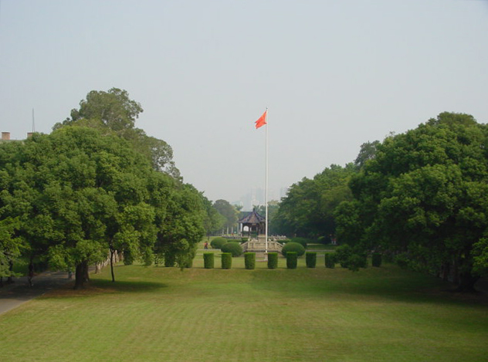
Data Structures and
Program Design In C++
Robert L. Kruse Alexander J. Ryba
吴 向 军
中山大学软件学院
E-Mail: issxjwu@mail.sysu.edu.cn

Slide 2
Chapter 4 Linked Stacks and Queues
中山大学软件学院
4.1. Pointers and Linked Structures
4.2. Linked Stacks
4.3. Linked Stacks with Safeguards
4.4. Linked Queues
4.5. Application: Polynomial Arithmetic
4.6. ADTs and Implementations

Slide 3





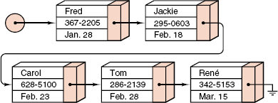
Chapter 4 Linked Stacks and Queues
中山大学软件学院
Pointers and a Linked List

Slide 4
Chapter 4 Linked Stacks and Queues
中山大学软件学院
Key Terms
Overflow: Running out of space.
Pointer: An object, often a variable, that stores the location of some other object, typically of a structure containing data that we wish to manipulate (sometimes called a link or a reference).
Linked list: A list in which each entry contains a pointer giving the location of the next entry.
Contiguous: Next to each other, touching, adjoining; used in contrast to linked.

Slide 5
Chapter 4 Linked Stacks and Queues
中山大学软件学院
Key Terms
Automatic object: An object that exists as long as the block of program declaring it is active; referenced by giving it a name when writing the program.
Dynamic object: An object that is created (and perhaps destroyed) while the program is running; accessed indirectly via pointers.

Slide 6
Chapter 4 Linked Stacks and Queues
中山大学软件学院
Pointers in C++
Notation: C++ uses an asterisk * to denote a pointer. If Item is a type, then a pointer to such an Item object has the type Item *. For example,
Item *item_ptr;
Creating dynamic objects: item_ptr = new Item; creates a new dynamic object of type Item and assigns its location to the pointer variable item_ptr.
The dynamic objects are kept in an area of computer memory called the free store (or the heap).

Slide 7
Chapter 4 Linked Stacks and Queues
中山大学软件学院
Pointers in C++
Deleting dynamic objects: delete item_ptr; disposes of the dynamic object to which item_ptr points and returns the space it occupies to the free store so it can be used again.
After this delete statement is executed, the pointer variable item_ptr is undefined and not be used until it is assigned a new value.
Following pointers: *item_ptr denotes the object to which item_ptr points. The action of taking *item_ptr is called “dereferencing the pointer *item_ptr”.

Slide 8
Chapter 4 Linked Stacks and Queues
中山大学软件学院
Pointers in C++
NULL pointers: If a pointer variable item_ptr has no dynamic object to which it currently refers, then it should be given the special value
item_ptr = NULL;
The value NULL can be assigned to a variable of any pointer type.
Undefined pointers versus NULL pointers: “item_ptr == NULL” means that item_ptr points to no dynamic object. If the value of item_ptr is undefined, then item_ptr might point to any random location in memory.

Slide 9








Chapter 4 Linked Stacks and Queues
中山大学软件学院
Pointers in C++

Slide 10
中山大学软件学院
Chapter 4 Linked Stacks and Queues
下面用整型变量及其指针来说明指针的含义和作用.
int i; // 假设变量i在内存的地址为1230
int *Pt; // 假设变量Pt在内存的地址为1240
int **Pt1; // 假设变量Pt1在内存的地址为1250
i = 500;
Pt = &i;
*Pt = 4321; // 注意与“Pt = 4321”的区别
Pt1 = &Pt;
**Pt1 = 5678;
内存
地址
内存
数值
…
5678
4321
1230
500
----
…
1230
1240
----
…
1240
1250
----
…

Slide 11
Chapter 4 Linked Stacks and Queues
中山大学软件学院
Dynamically Allocated Arrays
The following declaration creates a dynamic array of Item objects, indexed from 0 up to array_size - 1.
item_array = new Item[array_size];
For example:
int i, size, *dynamic_array;
cout << "Enter an array size: " << flush;
cin >> size;
dynamic_array = new int[size];
for (i = 0; i < size; i++) dynamic_array[i] = i;

Slide 12
Chapter 4 Linked Stacks and Queues
中山大学软件学院
Dynamically Allocated Arrays
The statement returns the storage in dynamic_array to the free store.
delete [] dynamic_array;
If i is an integer value and p is a pointer to an Item, then p+i is an expression of type Item *. The value of p+i gives the memory address offset from p by i Item objects.
The expression p+i yields the address p+i*sizeof(Item).

Slide 13
Chapter 4 Linked Stacks and Queues
中山大学软件学院
Dynamically Allocated Arrays
p
Music
*p
q
Calculus
*q
Music
Music
p
*p
p
Calculus
*p
q
Calculus
*q
q
Calculus
*q
p=q
*p=*q

Slide 14
Chapter 4 Linked Stacks and Queues
中山大学软件学院
Addresses of automatic objects
Item x;
Item *ptr = &x;
Address of an array: The address of the initial element of an array is found by using the array's name.
For example,
Item x[20];
Item *ptr = x;
Observe that an assignment expression ptr = &(x[0]) could be used to find this address.

Slide 15
Chapter 4 Linked Stacks and Queues
中山大学软件学院
Pointers to structures: p is a pointer to a structure object that has a data member called the_data, then we could access this data member with the expression:
(*p).the_data
or
p->the_data
The second expression p->the_data is more convenient.

Slide 16
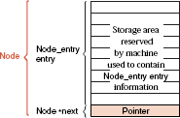
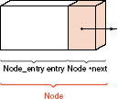
Chapter 4 Linked Stacks and Queues
中山大学软件学院
The Basics of Linked Structures
struct Node {
Node_entry entry; // data members
Node *next;
Node(); // constructors
Node(Node_entry item, Node *add_on = NULL);
};
(a) Structure of a Node
(b) Machine storage representation of a Node

Slide 17
Chapter 4 Linked Stacks and Queues
中山大学软件学院
Node Constructors
Node::Node()
{
next = NULL;
}
The second form accepts two parameters for initializing the data members.
Node::Node(Node_entry item, Node *add_on)
{
entry = item;
next = add_on;
}

Slide 18
Chapter 4 Linked Stacks and Queues
中山大学软件学院
Example:
Node first_node(‘a’); // Node rst node stores data ‘a’
Node *p0 = &first_node; // p0 points to first Node
Node *p1 = new Node(‘b’); // A second node storing ‘b’ is created
p0->next = p1; // The second Node is linked after first node
Node *p2 = new Node(‘c’, p0); // A third Node storing ‘c’ is created.
// The third Node links back to the first node *p0.
p1->next = p2; // The third Node is linked after the second Node.
p1
p2
first_node
p0
‘a’
‘b’
‘c’

Slide 19
Chapter 4 Linked Stacks and Queues
中山大学软件学院
Linked Stacks
top
entry
middle
entry
botton
entry
top_node
botton
entry
top_node
top_node
Empty stack
Stack of size 1

Slide 20
Chapter 4 Linked Stacks and Queues
中山大学软件学院
Linked Stacks
New
node
Old
top node
Old
second node
Old
botton node
top_node
Old
top node
Old
second node
Old
botton node
top_node
old_top

Slide 21
Chapter 4 Linked Stacks and Queues
中山大学软件学院
Class Declaration for Linked Stack
class Stack {
public:
Stack();
bool empty() const;
Error_code push(const Stack_entry &item);
Error_code pop();
Error_code top(Stack_entry &item) const;
protected:
Node *top_node;
};

Slide 22
Chapter 4 Linked Stacks and Queues
中山大学软件学院
Benefits of Class Implementation
1) Maintain encapsulation: If we do not use a class to contain our stack, we lose the ability to set up methods for the stack.
2) Maintain the logical distinction between the stack itself, made up of all of its entries (each in a node), and the top of the stack, which is a pointer to a single node.
3) Maintain consistency with other data structures and other implementations, where structures are needed to collect several methods and pieces of information.
4) Help with debugging by allowing the compiler to perform better type checking.

Slide 23
Chapter 4 Linked Stacks and Queues
中山大学软件学院
Pushing a Linked Stack
Error_code Stack::push(const Stack_entry &item)
{
Node *new_top = new Node(item, top_node);
if (new_top == NULL) return overflow;
top_node = new_top;
return success;
}

Slide 24
Chapter 4 Linked Stacks and Queues
中山大学软件学院
Popping a Linked Stack
Error_code Stack::pop()
{
Node *old_top = top_node;
if (top_node == NULL) return underflow;
top_node = old_top->next;
delete old_top;
return success;
}

Slide 25
Chapter 4 Linked Stacks and Queues
中山大学软件学院
Linked Stacks with Safeguards
C++ provides three devices (additional class methods) to alleviate these problems:
(1) destructors
(2) copy constructors
(3) overloaded assignment operators
These new methods replace compiler generated default behavior and are often called silently.

Slide 26
Chapter 4 Linked Stacks and Queues
中山大学软件学院
Problem Example
for (int i = 0; i < 1000000; i++) {
Stack small;
small.push(some_data);
}
Suppose that the linked Stack implementation is used. As soon as the object small goes out of scope, the data stored in small becomes garbage. A lot of garbage will accumulate.
The loop would have executed without any problem with a contiguous Stack implementation, where all allocated space for member data is released every time a Stack object goes out of scope.

Slide 27
Chapter 4 Linked Stacks and Queues
中山大学软件学院
The Destructor
Definition: A destructor is a special method in a class that is automatically executed on objects of the class immediately before they go out of scope.
Destructors are often used to delete dynamically allocated objects that would otherwise become garbage.

Slide 28
Chapter 4 Linked Stacks and Queues
中山大学软件学院
The Destructor
Declaration: The destructor must be declared as a class method without return type and without parameters. Its name is given by adding a ~ prefix to the corresponding class name. The prototype for a Stack destructor is:
Stack::~Stack();
Stack::~Stack()
{
while (!empty()) pop();
}

Slide 29
Chapter 4 Linked Stacks and Queues
中山大学软件学院
Misbehaviors:
(1) Lost data space.
(2) Two stacks have shared nodes.
(3) The destructor on inner_stack deletes outer_stack.
(4) A deletion leaves the pointer outer_stack.top_node addressing what a random memory location.
Dangers in Assignment
Stack outer_stack;
for (int i = 0; i < 1000000; i++) {
Stack inner_stack;
inner_stack.push(some_data);
inner_stack = outer_stack;
}
outer_stack.top_node
some_data
inner_stack.top_node
Lost data

Slide 30
Chapter 4 Linked Stacks and Queues
中山大学软件学院
Overloading the Assignment Operator
In C++, we implement special methods, known as overloaded assignment operators to redefine the effect of assignment. the C++ compiler checks whether the class of x has an overloaded assignment operator.
Prototype:
void Stack::operator = (const Stack &original);
This declares a Stack method called operator = , the overloaded assignment operator, that can be invoked with
x.operator = (y); or x = y;

Slide 31
Chapter 4 Linked Stacks and Queues
中山大学软件学院
Implementation outline
(1) Make a copy of the data stacked in the calling parameter.
(2) Clear out any data already in the Stack object being assigned to.
(3) Move the newly copied data to the Stack object.

Slide 32
Chapter 4 Linked Stacks and Queues
中山大学软件学院
Overloaded Assignment of Linked Stacks
void Stack::operator = (const Stack &original)
{
Node *new_top, *new_copy, *original_node = original.top_node;
if (original_node == NULL) new_top = NULL;
else { // Duplicate the linked nodes
new_copy = new_top = new Node(original_node->entry);
while (original_node->next != NULL) {
original_node = original_node->next;
new_copy->next = new Node(original_node->entry);
new_copy = new_copy->next;
}
}
while (!empty()) pop(); // Clean out old Stack entries
top_node = new_top; // and replace them with new entries.
}

Slide 33
Chapter 4 Linked Stacks and Queues
中山大学软件学院
The Copy Constructor
void destroy_the_stack(Stack copy)
{
}
int main()
{
Stack vital_data;
destroy_the_stack(vital_data);
}
In this code, a copy of the Stack vital_data is passed to the function. The Stack copy shares its nodes with the Stack vital_data.
When a Stack destructor is applied to copy, vital_data is also destroyed.

Slide 34
Chapter 4 Linked Stacks and Queues
中山大学软件学院
Solution
If a copy constructor is defined as a member of our Stack class, the copy constructor will be invoked whenever the compiler needs to copy Stack objects.
Stack objects are copied using value semantics.
For any class, a standard way to declare a copy constructor is as a constructor with one argument that is declared as a constant reference to an object of the class.
A Stack copy constructor have the following prototype:
Stack::Stack(const Stack &original);

Slide 35
Chapter 4 Linked Stacks and Queues
中山大学软件学院
Implementation outline
1). Deal with the case of copying an empty Stack.
2). Copy the first node.
3). Run a loop to copy all of the other nodes.

Slide 36
Chapter 4 Linked Stacks and Queues
中山大学软件学院
Linked-stack copy constructor
Stack::Stack(const Stack &original) // copy constructor
{
Node *Pt1, *Pt2 = original.top_node;
if (Pt2 == NULL) top_node = NULL;
else {
top_node = Pt1 = new Node(Pt2->entry);
while (Pt2->next != NULL) {
Pt2 = Pt2->next;
Pt1->next = new Node(Pt2->entry);
Pt1 = Pt1->next;
}
}
}

Slide 37
Chapter 4 Linked Stacks and Queues
中山大学软件学院
Modified Linked-Stack Specification
class Stack {
public:
Stack(); // Standard Stack methods
bool empty() const;
Error_code push(const Stack_entry &item);
Error_code pop();
Error_code top(Stack_entry &item) const;
~Stack(); // Safety features for linked structures
Stack(const Stack &original);
void operator = (const Stack &original);
protected:
Node *top_node;
};

Slide 38
Chapter 4 Linked Stacks and Queues
中山大学软件学院
Linked Queues FIFO－First In First Out
class Queue {
public:
Queue(); // standard Queue methods
bool empty() const;
Error_code append(const Queue_entry &item);
Error_code serve();
Error_code retrieve(Queue_entry &item) const;
~Queue(); // safety features for linked structures
Queue(const Queue &original);
void operator = (const Queue &original);
protected:
Node *front, *rear;
};

Slide 39
Chapter 4 Linked Stacks and Queues
中山大学软件学院
Constructor
Queue::Queue()
{
front = rear = NULL;
}

Slide 40
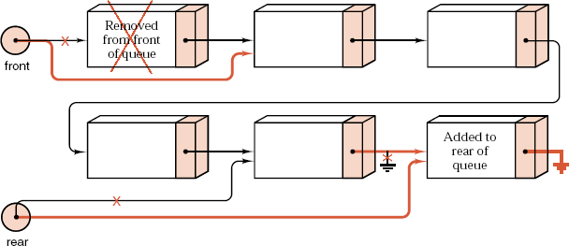
Chapter 4 Linked Stacks and Queues
中山大学软件学院
Linked Queue Methods
Error_code Queue::append(const Queue_entry &item)
{
Node *new_rear = new Node(item);
if (new_rear == NULL) return overflow;
if (rear == NULL) front = rear = new_rear;
else {
rear->next = new_rear;
rear = new_rear;
}
return success;
}

Slide 41
Chapter 4 Linked Stacks and Queues
中山大学软件学院
Serve an entry
Error_code Queue::serve()
{
if (front == NULL) return underflow;
Node *old_front = front;
front = old_front->next;
if (front == NULL) rear = NULL;
delete old_front;
return success;
}

Slide 42
Chapter 4 Linked Stacks and Queues
中山大学软件学院
Extended Linked Queues
class Extended_queue: public Queue {
public:
bool full() const;
int size() const;
void clear();
Error_code serve_and_retrieve(Queue_entry &item);
};

Slide 43
Chapter 4 Linked Stacks and Queues
中山大学软件学院
Size
int Extended_queue::size() const
{
Node *window = front;
int count = 0;
while (window != NULL) {
window = window->next;
count++;
}
return count;
}

Slide 44
Chapter 4 Linked Stacks and Queues
中山大学软件学院
Application: Polynomial Arithmetic

Slide 45
Chapter 4 Linked Stacks and Queues
中山大学软件学院
Abstract Queues
Definition A queue of elements of type T is a finite sequence of elements of T together with the following operations:
1). Create the queue, leaving it empty.
2). Test whether the queue is Empty.
3). Append a new entry onto the rear of the queue, provided the queue is not full.
4). Serve (and remove) the entry from the front of the queue, provided the queue is not empty.
5). Retrieve the front entry off the queue, provided the queue is not empty.

Slide 46
Chapter 4 Linked Stacks and Queues
中山大学软件学院
Abstract Queues
Definition An extended queue of elements of type T is a queue of elements of T together with the following additional operations:
4). Determine whether the queue is full or not.
5). Find the size of the queue.
6). Serve and retrieve the front entry in the queue, provided the queue is not empty.
7). Clear the queue to make it empty.

Slide 47
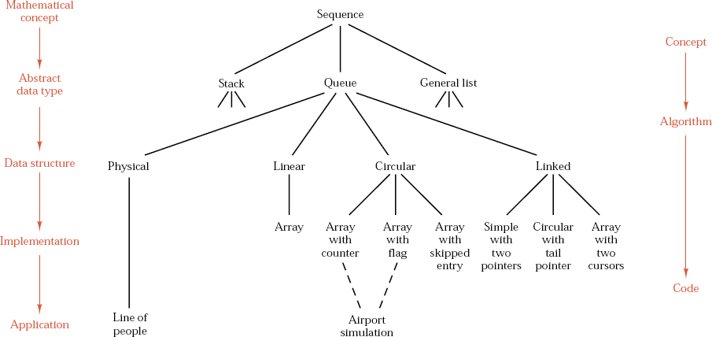
Chapter 4 Linked Stacks and Queues
中山大学软件学院

Slide 48
Chapter 5 Recursion
中山大学软件学院
5.1. Introduction to Recursion
(a) Stack Frames
(b) Recursion Trees
(c) Examples
5.2. Principles of Recursion
5.3. Backtracking: Postponing the Work
(a) The Eight-Queens Puzzle
(b) Review and Refinement
(c) Analysis
5.4. Tree-Structured Programs: Look-Ahead in Games

Slide 49
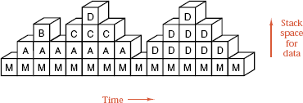
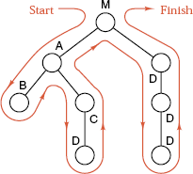
Chapter 5 Recursion
中山大学软件学院
Stacks and Trees
D
D
B
C
D
A
D
M
Finished

Slide 50
Chapter 5 Recursion
中山大学软件学院
Tree-Diagram Definitions
1). The circles in a tree diagram are called vertices or nodes.
2). The top of the tree is called its root.
3). The vertices immediately below a given vertex are called the children of that vertex.
4). The vertex immediately above a given vertex is called its parent.
5). The line connecting a vertex with one immediately above or below is called a branch.
6). Siblings are vertices with the same parent.

Slide 51
Chapter 5 Recursion
中山大学软件学院
Tree-Diagram Definitions
7). A vertex with no children is called a leaf or an external vertex.
8). Two branches of a tree are adjacent if the lower vertex of the first branch is the upper vertex of the second.
A sequence of branches in which each is adjacent to its successor is called a path.
9). The height of a tree is the number of vertices on a longest possible path from the root to a leaf. (Hence a tree containing only one vertex has height 1.)
10). The depth or level of a vertex is the number of branches on a path from the root to the vertex.

Slide 52

Chapter 5 Recursion
中山大学软件学院
Factorials: A Recursive Definition
Informal definition: The factorial function of a positive integer is n! = n × (n - 1) × ... × 1.
Formal definition:
Every recursive process consists of two parts:
1). A smallest, base case that is processed without recursion;
2). A general method that reduces a particular case to one or more of the smaller cases.

Slide 53
Chapter 5 Recursion
中山大学软件学院
int factorial(int n)
// Pre: n is a nonnegative integer.
//Post: Return the value of the factorial of n.
{
if (n == 0) return 1;
return n * factorial(n - 1);
}
void main()
{
cout << factorial(10) << endl;
}

Slide 54
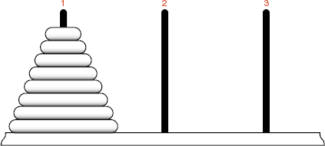
Chapter 5 Recursion
中山大学软件学院
Towers of Hanoi
Rules:
1). Move only one disk at a time.
2). No larger disk can be on top of a smaller disk.

Slide 55
Chapter 5 Recursion
中山大学软件学院
Program for Hanoi
Main program
void move(int count, int start, int finish, int temp);
main()
{
move(3, 1, 3, 2); // 1 ==> 3
}
Recursive function
void move(int count, int start, int finish, int temp)
{
if (count > 0) {
move(count - 1, start, temp, finish);
cout << count << ": " << start << " ==> " << finish << ".\n";
move(count - 1, temp, finish, start);
}
}

Slide 56
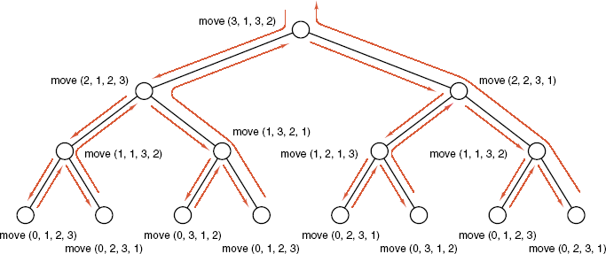
Chapter 5 Recursion
中山大学软件学院
Program for Hanoi
move(3, 1, 3, 2):
move(2, 1, 2, 3)
move(1, 1, 3, 2)
move(1, 3, 2, 1)
move(2, 2, 3, 1)
move(1, 2, 1, 3)
move(1, 1, 3, 2)

Slide 57
Chapter 5 Recursion
中山大学软件学院
Designing Recursive Algorithms
1) Find a stopping rule
The stopping rule is the small, special case that is trivial or easy to handle without recursion.
2) Find the key step
How can this problem be divided into parts? or How will the key step in the middle be done?
3) Outline your algorithm
Combine the stopping rule and the key step.
4) Draw a recursion tree

Slide 58
Chapter 5 Recursion
中山大学软件学院
Implementation of Recursion
Multiple Processors: Concurrency
Processes that take place simultaneously are called concurrent. Recursion can run on multiple processors concurrently.
Single Processor Implementation
Recursion can use multiple storage areas with a single processor.

Slide 59

Chapter 5 Recursion
中山大学软件学院
Implementation of Recursion
Example of Re-entrant Processes

Slide 60
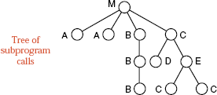
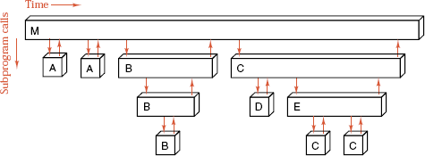
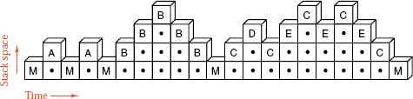
Chapter 5 Recursion
中山大学软件学院
Execution Tree and Stack Frames

Slide 61
Chapter 5 Recursion
中山大学软件学院
Tail Recursion
Definition Tail recursion occurs when the last-executed statement of a function is a recursive call to itself.
If the last-executed statement of a function is a recursive call to the function itself, then this call can be eliminated by reassigning the calling parameters to the values specified in the recursive call, and then repeating the whole function.

Slide 62
Chapter 5 Recursion
中山大学软件学院
Tail Recursion
M
M
P
P
P
P
Recursion
P
Tail recursion
P
M
P
P
P
Iteration

Slide 63
Chapter 5 Recursion
中山大学软件学院
Hanoi Without Tail Recursion
void move(int count, int start, int finish, int temp)
{
int swap;
while (count > 0) { // Replace the if statement with a loop.
move(count - 1, start, temp, finish);
cout << count << ": " << start << " ==> " << finish << ".\n";
count--;
swap = start;
start = temp;
temp = swap; // start ↔ temp
}
}

Slide 64
Chapter 5 Recursion
中山大学软件学院
Calculating Factorials
Recursive
int factorial(int n)
{
if (n == 0) return 1;
return n * factorial(n - 1);
}
Nonrecursive
int factorial(int n)
{
int count, product = 1;
for (count = 1; count <= n; count++) product *= count;
return product;
}

Slide 65
Chapter 5 Recursion
中山大学软件学院
Example:
factorial(5) = 5 * factorial(4)
= 5 * (4 * factorial(3))
= 5 * (4 * (3 * factorial(2)))
= 5 * (4 * (3 * (2 * factorial(1))))
= 5 * (4 * (3 * (2 * (1 * factorial(0)))))
= 5 * (4 * (3 * (2 * (1 * 1))))
= 5 * (4 * (3 * (2 * 1)))
= 5 * (4 * (3 * 2))
= 5 * (4 * 6)
= 5 * 24
= 120.

Slide 66
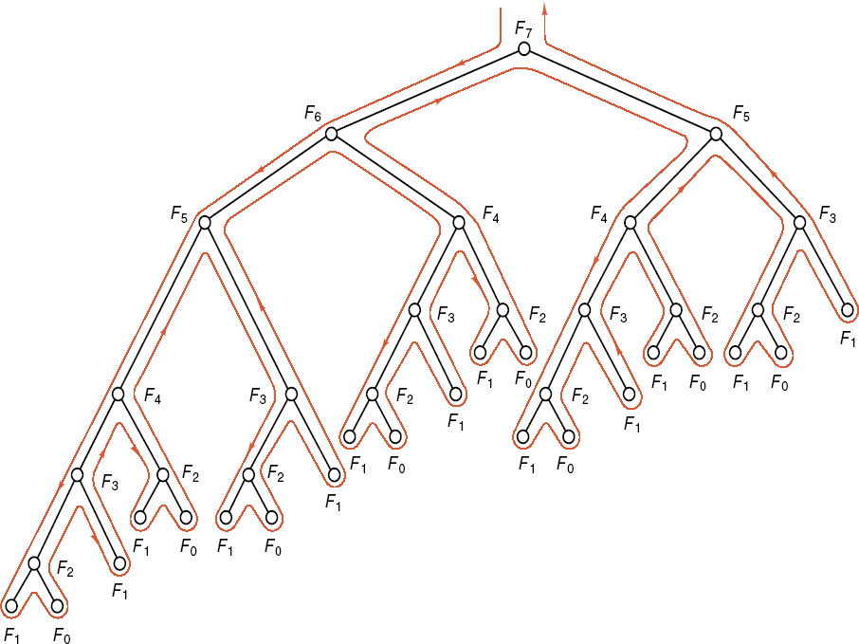
Chapter 5 Recursion
中山大学软件学院
Fibonacci Numbers
Definition: Fibonacci numbers are defined by the recurrence relation
F₀ = 0; F₁ = 1; F_{n} = F_{n-1} + F_{n-2} for n > 1.
Recursive function
int fibonacci(int n)
{
if (n <= 0) return 0;
if (n == 1) return 1;
return fibonacci(n - 1) + fibonacci(n - 2);
}

Slide 67
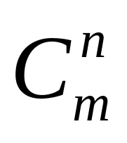
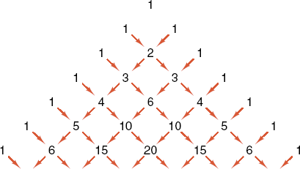
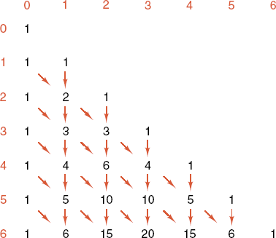
Chapter 5 Recursion
中山大学软件学院
Nonrecursive function
int fibonacci(int n)
{
int f1, f2, current;
if (n <= 0) return 0;
if (n == 1) return 1;
f1 = 0; f2 = 1; // current = f1 + f2
for (int i = 2; i <= n; i++) {
current = f1 + f2;
f1 = f2; f2 = current;
}
return current;
}

