Slide 1

Data Structures and
Program Design In C++
Robert L. Kruse Alexander J. Ryba
吴 向 军
中山大学软件学院
E-Mail: issxjwu@mail.sysu.edu.cn

Slide 2
Chapter 6 Lists and Strings
中山大学软件学院
6.1. List Specifications
6.2. List Implementations
(a) Class Templates
(b) Contiguous
(c) Simply Linked
(d) Simply Linked with Position Pointer
(e) Doubly Linked
6.3. Strings
6.4. Application: Text Editor
6.5. Linked Lists in Arrays
6.6. Application: Generating Permutations

Slide 3
Chapter 6 Lists and Strings
中山大学软件学院
List Definition
Definition A list of elements of type T is a finite sequence of elements of T together with the following operations:
1). Construct the list, leaving it empty.
2). Determine whether the list is empty or not.
3). Determine whether the list is full or not.
4). Find the size of the list.
5). Clear the list to make it empty.
6). Insert an entry at a specified position of the list.
7). Remove an entry from a specified position in the list.
8). Retrieve the entry from a specified position in the list.
9). Replace the entry at a specified position in the list.
10). Traverse the list, performing a given operation on each entry.

Slide 4
Chapter 6 Lists and Strings
中山大学软件学院
Comparison with Standard Template Library
1). The STL list provides only those operations that can be implemented efficiently in a List implementation known as doubly linked.
2). The STL list does not allow random access to an arbitrary list position.
3). The STL vector, does provide some random access to a sequence of data values, but not all the other capabilities of List.
4). The List ADT provides an introduction to both the STL classes list and vector.

Slide 5
Chapter 6 Lists and Strings
中山大学软件学院
Method Specications
1). List :: List();
Post: The List has been created and is initialized to be empty.
2). void List :: clear();
Post: All List entries have been removed; the List is empty.
3). bool List :: empty() const;
Post: The function returns true or false according to whether the List is empty or not.
4). bool List :: full() const;
Post: The function returns true or false according to whether the List is full or not.
5). int List :: size() const;
Post: The function returns the number of entries in the List.

Slide 6
Chapter 6 Lists and Strings
中山大学软件学院
Position Number in a List
1). We use an integer that gives its position within the list.
2). The first entry in the list has position 0, the second position 1, and so on.
3). Locating an entry of a list is indexing an array.
If an entry is inserted at a particular position, the position numbers of all later entries increase by 1.
If an entry is removed, the positions of all following entries decrease by 1.
4). For a contiguous list, the position is the index of the entry within the array. we use the position to find an entry within linked implementations of a list.

Slide 7
Chapter 6 Lists and Strings
中山大学软件学院
Error_code List::insert(int pos, const List_entry &x);
Post: If the List is full or 0 > pos or pos > n, the function fails with a error code. Otherwise, the function succeeds: any entry at position and all later entries have their position numbers increased by 1, and x is inserted at position.
Error_code List::remove(int pos, List_entry &x);
Post: If 0 > pos or pos ≥ n, the function fails with a error code. Otherwise, the function succeeds: the parameter x records a copy of the entry at position.
The entry at position is removed from the List, and all later entries have their position numbers decreased by 1.

Slide 8
Chapter 6 Lists and Strings
中山大学软件学院
Error_code List::retrieve(int pos, List_entry &x) const;
Post: If 0 > pos or pos ≥ n, the function fails with a error code. Otherwise, the function succeeds: the entry at position is copied to x; all List entries remain unchanged.
Error_code List::replace(int pos, const List_entry &x);
Post: If 0 > pos or pos ≥ n, the function fails with a error code. Otherwise, the function succeeds: the entry at position is replaced by x; all other entries remain unchanged.
void List::traverse(void (*visit)(List_entry &));
Post: The action specified by function *visit has been performed on every entry of the List, beginning at position 0 and doing each in turn.

Slide 9
Chapter 6 Lists and Strings
中山大学软件学院
Class Templates
1). A C++ template construction allows us to write code that uses objects of type.
2). In template code we utilize a parameter enclosed in angle brackets < > to denote the type.
3). Example: We shall implement a template class List that depends on one generic type parameter. A client can then use our template to declare several lists with different types of entries with declarations of the following form:
List<int> first_list;
List<char> second_list;

Slide 10
Chapter 6 Lists and Strings
中山大学软件学院
Contiguous Implementation
template <class List_entry>
class List {
public: // methods of the List ADT
List();
int size() const;
bool full() const;
bool empty() const;
void clear();
void traverse(void (*visit)(List_entry &));
Error_code retrieve(int position, List_entry &x) const;
Error_code replace(int position, const List_entry &x);
Error_code remove(int position, List_entry &x);
Error_code insert(int position, const List_entry &x);
protected:
int count;
List_entry entry[max_list];
};

Slide 11
Chapter 6 Lists and Strings
中山大学软件学院
template <class List_entry>
List<List_entry> :: List()
{
count = 0;
}
template <class List_entry>
int List<List_entry> :: size() const
{
return count;
}

Slide 12
Chapter 6 Lists and Strings
中山大学软件学院
Insertion
template <class List_entry>
Error_code List<List_entry> :: insert(int pos, const List_entry &x)
{
if (full()) return overflow;
if (pos < 0 || pos > count) return range_error;
for (int i=count-1; i>=pos; i--) entry[i+1]=entry[i];
entry[pos] = x;
count++;
return success;
}

Slide 13
Chapter 6 Lists and Strings
中山大学软件学院
Traversal
template <class List_entry>
void List<List_entry>::traverse(void (*visit)(List_entry &))
{
for (int i = 0; i < count; i++) visit(entry[i]);
}
Performance of Methods
In processing a contiguous list with n entries:
1). insert and remove operate in O(n).
2). List, clear, empty, full, size, replace, and retrieve operate in O(1).

Slide 14
Chapter 6 Lists and Strings
中山大学软件学院
Simply Linked Implementation
Node declaration
template <class Node_entry>
struct Node {
Node_entry entry; // data members
Node<Node_entry> *next;
Node(); // constructors
Node(Node_entry, Node<Node_entry> *link = NULL);
};

Slide 15
Chapter 6 Lists and Strings
中山大学软件学院
List declaration:
template <class List_entry>
class List {
public:
~List();
List(const List<List_entry> &copy);
void operator = (const List<List_entry> &copy);
protected:
int count;
Node<List_entry> *head;
Node<List_entry> *set_position(int position) const;
};

Slide 16

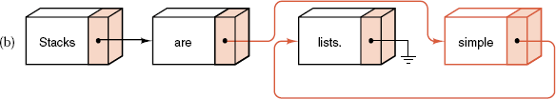
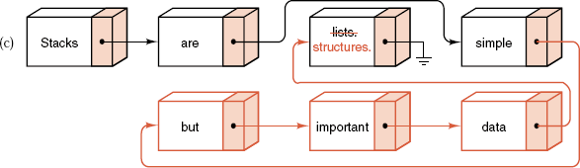
Chapter 6 Lists and Strings
中山大学软件学院
Actions on a Linked List

Slide 17
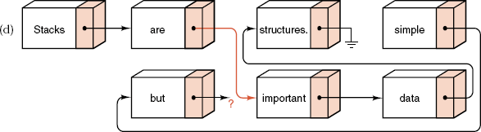
Chapter 6 Lists and Strings
中山大学软件学院
Actions on a Linked List

Slide 18
Chapter 6 Lists and Strings
中山大学软件学院
Finding a List Position
1). Function set_position takes an integer parameter position and returns a pointer to the corresponding node of the list.
2). Declare the visibility of set_position as protected, since set_position returns a pointer to a Node in the List.

Slide 19
Chapter 6 Lists and Strings
中山大学软件学院
Finding a List Position
3). To construct set position, we start at the beginning of the List and traverse it until we reach the desired node:
template <class List_entry>
Node<List_entry> *List<List_entry> :: set_position(int position) const
{
Node<List_entry> *q = head;
for (int i = 0; i < position; i++) q = q->next;
return q;
}

Slide 20
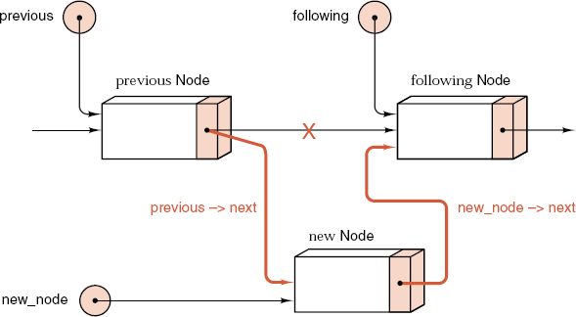
中山大学软件学院
Insertion Method
template <class List_entry>
Error_code List<List_entry>::insert(int pos, const List_entry &x)
{
if (pos < 0 || pos > count) return range_error;
Node<List_entry> *new_node, *previous, *following;
if (pos == 0) following = head;
else{
previous = set_position(pos - 1);
following = previous->next;
}
New_node = new Node<List_entry>(x, following);
if (new_node == NULL) return overflow;
if (pos == 0) head = new_node;
else previous->next = new_node;
count++;
return success;
}

Slide 21
Chapter 6 Lists and Strings
中山大学软件学院
Insertion into a Linked List
In processing a linked List with n entries:
1). clear, insert, remove, retrieve, and replace require O(n) time.
2). List, empty, full, and size operate in O(1).

Slide 22
Chapter 6 Lists and Strings
中山大学软件学院
Variation: Keeping the Current Position
1). Suppose an application processes list entries in order or refers to the same entry several times.
2). Remember the last-used position in the list and, if the next operation refers to the same or a later position, start tracing through the list from this last-used position.
3). The method retrieve is defined as const, but its implementation will need to alter the last-used position of a List. To enable this, we use the mutable qualifier.
Mutable data members of a class can be changed, even by constant methods.

Slide 23
Chapter 6 Lists and Strings
中山大学软件学院
Variation: Keeping the Current Position
template <class List_entry>
class List {
public:
......
protected:
int count;
// 可变的当前位置,它可被const成员函数修改
mutable int current_position;
Node<List_entry> *head;
mutable Node<List_entry> *current;
void set_position(int pos) const;
};

Slide 24
Chapter 6 Lists and Strings
中山大学软件学院
template <class List_entry>
void List<List_entry> :: set_position(int pos) const
{
if (pos < current_position) {
current_position = 0;
current = head;
}
for ( ; current_position != pos; current_position++)
current = current->next;
}

Slide 25

Chapter 6 Lists and Strings
中山大学软件学院
Doubly Linked Lists
Node definition
template <class Node_entry>
struct Node {
Node_entry entry; // data members
Node<Node_entry> *back, *next;
Node(); // constructors
Node(Node_entry, Node<Node_entry> *link_back = NULL,
Node<Node_entry> *link_next = NULL);
};

Slide 26
Chapter 6 Lists and Strings
中山大学软件学院
List definition
template <class List_entry>
class List {
public:
......
protected:
int count;
mutable int current_position;
mutable Node<List_entry> *current;
void set_position(int pos) const;
};

Slide 27
Chapter 6 Lists and Strings
中山大学软件学院
List definition
template <class List_entry>
void List<List_entry> :: set_position(int pos) const
{
if (current_position <= pos)
for ( ; current_position != pos; current_position++)
current = current->next;
else for ( ; current_position != pos; current_position--)
current = current->back;
}

Slide 28
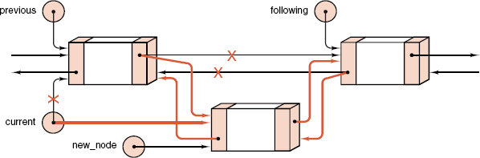
Chapter 6 Lists and Strings
中山大学软件学院
Insertion into a Doubly Linked List

Slide 29
Chapter 6 Lists and Strings
中山大学软件学院
Insertion into a Doubly Linked List
template <class List entry>
Error_code List<List_entry>::insert(int pos, const List_entry &x)
{
Node<List_entry> *new_node, *following, *preceding;
if (pos < 0 || pos > count) return range_error;
if (pos == 0) {
preceding = NULL;
if (count == 0) following = NULL;
else {set_position(0);
following = current;
}
}
......

Slide 30
Chapter 6 Lists and Strings
中山大学软件学院
......
else {
set_position(pos - 1);
preceding = current;
following = preceding->next;
}
new_node = new Node<List entry>(x, preceding, following);
if (new_node == NULL) return overflow;
if (preceding != NULL) preceding->next = new_node;
if (following != NULL) following->back = new_node;
current = new_node; current_position = pos;
count++;
return success;
}

Slide 31
Chapter 6 Lists and Strings
中山大学软件学院
Comparison of Implementations
Contiguous storage is generally preferable
1). the entries are individually very small;
2). the size of the list is known;
3). when few insertions or deletions need to be made except at the end of the list; and when random access is important.
Linked storage proves superior
1). the entries are large;
2). the size of the list is not known in advance;
3). when flexibility is needed in inserting, deleting, and rearranging the entries.

Slide 32
Chapter 6 Lists and Strings
中山大学软件学院
To choose among linked list implementations, consider:
1). Which of the operations will actually be performed on the list and which of these are the most important?
2). Is there locality of reference? That is, if one entry is accessed, is it likely that it will next be accessed again?
3). Are the entries processed in sequential order? If so, then it may be worthwhile to maintain the last-used position as part of the list structure.
4). Is it necessary to move both directions through the list? If so, then doubly linked lists may prove advantageous.

Slide 33
Chapter 6 Lists and Strings
中山大学软件学院
Strings in C
A string is defined as a sequence of characters.
Examples: "This is a string" or "Name?"
A string ADT is a kind of list, but the operations are usually quite different from other lists.
The first implementation of strings is found in the C subset of C++.

Slide 34
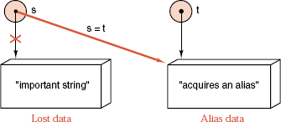
Chapter 6 Lists and Strings
中山大学软件学院
Strings in C
C-strings reflect the strengths and weaknesses of the C language:
C-strings are widely available.
C-strings are very efficient.
C-string objects are not encapsulated.
C-strings are easy to misuse, with
consequences that can be disastrous.
It is easy for a client to
create either garbage or aliases
for C-string data.

Slide 35
Chapter 6 Lists and Strings
中山大学软件学院
C-String Definitions
1). Every C-string has type char *. a C-string references the first of a contiguous set of bytes that store the characters making up the string.
2). The storage occupied by the string must terminate with the special character value ‘\0’.
3). The standard header file <cstring> (or <string.h>) contains a library of functions that manipulate C-strings.
4). In C++, the output operator << is overloaded to apply to C-strings.
5). The standard template library includes a safe string implementation in the header file <string>.

Slide 36
Chapter 6 Lists and Strings
中山大学软件学院
Standard C-String Library
char *strcpy(char *To, char *From);
Pre: The string From has been initialized.
Post: The function copies string From to string To, including ‘\0’; it returns a pointer to the beginning of the To.
char *strncpy(char *To, char *From, int n);
Pre: The string From has been initialized.
Post: The function copies at most n characters from From to To; it returns a pointer to the beginning of the To.
If From has less than n characters, the remaining positions are padded with '\0's.

Slide 37
Chapter 6 Lists and Strings
中山大学软件学院
char *strcat(char *To, char *From);
Pre: The From and To have been initialized.
Post: The function copies From to the end of To, including ‘\0’; it returns a pointer to the beginning of the To.
char *strncat(char *To, char *From, int n);
Pre: The From and To have been initialized.
Post: The function copies at most n characters from From to the end of To, and terminates to with ‘\0’; it returns a pointer to the beginning of the To.

Slide 38
Chapter 6 Lists and Strings
中山大学软件学院
size_t strlen(char *s);
Pre: The s has been initialized.
Post: The function returns the length of s, not including the null byte ‘\0’ at the end of s.
int strcmp(char *s1, char *s2);
Pre: The s1 and s2 have been initialized.
Post: The function compares s1 to s2; it returns < 0 if s1 < s2, 0 if s1 == s2, or > 0 if s1 > s2.
int strncmp(char *s1, char *s2, int n);
Pre: The s1 and s2 have been initialized.
Post: The function compares at most n characters of s1 to s2; it returns < 0 if s1 < s2, 0 if s1 == s2, or > 0 if s1 > s2.

Slide 39
Chapter 6 Lists and Strings
中山大学软件学院
char *strchr(char *s, char c);
Pre: The s has been initialized.
Post: The function returns a pointer to the first occurrence of the character c in the string s, or it returns NULL if c is not present in s.
char *strrchr(char *s, char c);
Pre: The s has been initialized.
Post: The function returns a pointer to the last occurrence of the character c in the string s, or it returns NULL if c is not present in s.

Slide 40
Chapter 6 Lists and Strings
中山大学软件学院
size_t strspn(char *s1, char *s2);
Pre: The s1 and s2 have been initialized.
Post: The function returns the length of the prefix of s1 that consists of characters that appear in s2. The type size_t is defined in the standard header file stdlib.h and it usually means unsigned int.
size_t strcspn(char *s1, char *s2);
Pre: The s1 and s2 have been initialized.
Post: The function returns the length of the prefix of s1 that consists of characters that do not appear in s2. The type size_t is defined in the standard header le stdlib.h and it usually means unsigned int.

Slide 41
Chapter 6 Lists and Strings
中山大学软件学院
char *strpbrk(char *s1, char *s2);
Pre: The s1 and s2 have been initialized.
Post: The function returns a pointer to the first occurrence in s1 of any character of s2, or it returns NULL if no character of s2 appears in s1.
char *strstr(char *s1, char *s2);
Pre: The s1 and s2 have been initialized.
Post: The function returns a pointer to the first occurrence of s2 in s1, or it returns NULL if the s2 is not present in s1.

Slide 42
Chapter 6 Lists and Strings
中山大学软件学院
Safe Implementation of Strings
Features
1). Include the string length as a data member in the String class.
2). The String class avoids the problems of aliases, garbage creation, and uninitialized objects by including an overloaded assignment operator, a copy constructor, a destructor, and a constructor.
3). Include overloaded versions of the Boolean comparison operators <, >, <= , >= , == , != .

Slide 43
Chapter 6 Lists and Strings
中山大学软件学院
Safe Implementation of Strings
Features
4). Include a constructor that uses a parameter of type char * and translates from C-string objects to String objects.
5). Include a constructor to convert from a List of characters to a String.
6). Include a String method c_str() that converts String objects to corresponding C-string objects.
7). The resulting String class is a fully encapsulated ADT, but it provides a complete interface both to C-strings and to lists of characters.

Slide 44
Chapter 6 Lists and Strings
中山大学软件学院
String Class Specification
class String {
public: // methods of the string ADT
String();
~String();
String(const String &copy); // copy constructor
String(const char *copy); // conversion from C-string
String(List<char> &copy); // conversion from List
void operator = (const String &copy);
const char *c_str() const; // conversion to C-style string
protected:
char *entries;
int length;
};

Slide 45
Chapter 6 Lists and Strings
中山大学软件学院
bool operator == (const String &first, const String &second);
bool operator > (const String &first, const String &second);
bool operator < (const String &first, const String &second);
bool operator >= (const String &first, const String &second);
bool operator <= (const String &first, const String &second);
bool operator != (const String &first, const String &second);

Slide 46
Chapter 6 Lists and Strings
中山大学软件学院
String Constructors
String :: String(const char *in_string)
// Pre: The pointer in string references a C-string.
//Post: The String is initialized by the C-string in_string.
{
length = strlen(in_string);
entries = new char[length + 1];
strcpy(entries, in_string);
}

Slide 47
Chapter 6 Lists and Strings
中山大学软件学院
String :: String(List<char> &in_list)
{
length = in_list.size();
entries = new char[length + 1];
for (int i = 0; i < length; i++) in_list.retrieve(i, entries[i]);
entries[length] = ‘\0’;
}
const char*String :: c_str() const
{
return (const char *) entries;
}
bool operator == (const String &first, const String &second)
{
return strcmp(first.c_str(), second.c_str()) == 0;
}

Slide 48
Chapter 6 Lists and Strings
中山大学软件学院
Samples of Further String Operations
void strcat(String &add_to, const String &add_on)
{
const char *cfirst = add_to.c_str();
const char *csecond = add_on.c_str();
char *copy = new char[strlen(cfirst) + strlen(csecond) + 1];
strcpy(copy, cfirst);
strcat(copy, csecond);
add_to = copy;
delete []copy;
}

Slide 49
Chapter 6 Lists and Strings
中山大学软件学院
Samples of Further String Operations
String read_in(istream &input)
{
List<char> temp;
int size = 0;
char c;
while ((c = input.peek()) != EOF && (c = input.get()) != ‘\n’)
temp.insert(size++, c);
String answer(temp);
return answer;
}

Slide 50
Chapter 6 Lists and Strings
中山大学软件学院
Overloaded version
String read_in(istream &input, int &terminator);
Post: Return a String read (as characters terminated by a newline or an end-of-file character) from an istream parameter.
The terminating character is recorded as the output parameter terminator.
void write(String &s)
{
cout << s.c_str() << endl;
}

Slide 51
Chapter 6 Lists and Strings
中山大学软件学院
void strcpy(String &copy, const String &original);
Post: The function copies String original to String copy.
void strncpy(String &copy, const String &original, int n);
Post: The function copies at most n characters from original to copy.
int strstr(const String &text, const String &target);
Post: If String target is a substring of String text, the function returns the array index of the first occurrence of the string stored in target in the string stored in text.
Otherwise, the function returns a code of -1.

Slide 52
Chapter 6 Lists and Strings
中山大学软件学院
Linked Lists in Arrays
1). This section shows how to implement linked lists using only integer variables and arrays.
2). Begin with a large workspace array and regard the array as our allocation of unused space.
3). Set up our own functions to keep track of which parts of the array are unused and to link entries of the array together in the desired order.
4). The one feature of linked lists that we must invariably lose in this implementation method is the dynamic allocation of storage.

Slide 53
Chapter 6 Lists and Strings
中山大学软件学院
Linked Lists in Arrays
5). Applications where linked lists in arrays may prove preferable are those where
(1). the number of entries in a list is known in advance,
(2). the links are frequently rearranged, but relatively few additions or deletions are made, or
(3). the same data are sometimes best treated as a linked list and other times as a contiguous list.

Slide 54
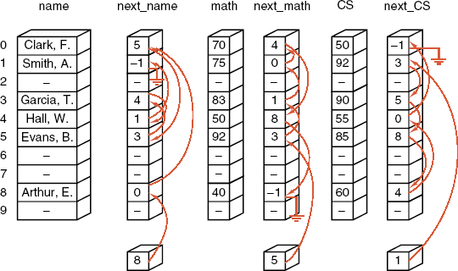
Chapter 6 Lists and Strings
中山大学软件学院

Slide 55
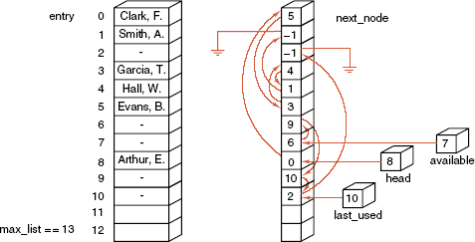
Chapter 6 Lists and Strings
中山大学软件学院

Slide 56
Chapter 6 Lists and Strings
中山大学软件学院
Class Declaration, Linked Lists in Arrays
template <class List_entry>
class Node {
public:
List_entry entry;
index next; // typedef int index;
};
template <class List_entry>
class List {
public:
List(); // Methods of the list ADT
int size() const;
bool full() const;
bool empty() const;
void clear();
void traverse(void (*visit)(List_entry &));

Slide 57
Chapter 6 Lists and Strings
中山大学软件学院
Class Declaration, Linked Lists in Arrays
template <class List_entry>
class List {
......
Error_code retrieve(int position, List_entry &x) const;
Error_code replace(int position, const List_entry &x);
Error_code remove(int position, List_entry &x);
Error_code insert(int position, const List_entry &x);
protected:
Node<List_entry> workspace[max_list]; // Data members
index available, last_used, head;
int count;
index new_node(); // Auxiliary member functions
void delete_node(index n);
int current_position(index n) const;
index set_position(int position) const;
};

Slide 58
Chapter 6 Lists and Strings
中山大学软件学院
New and Delete
template <class List_entry>
index List<List_entry> :: new_node()
{
index new_index;
if (available != −1) {
new_index = available;
available = workspace[available].next;
}
else if (last_used < max_list - 1) new_index = ++last_used;
else return -1;
workspace[new_index].next = -1;
return new_index;
}

Slide 59
Chapter 6 Lists and Strings
中山大学软件学院
New and Delete
template <class List_entry>
void List<List_entry> :: delete_node(index old_index)
{
index previous;
if (old_index == head) head = workspace[old_index].next;
else {
previous = set_position(current_position(old_index) - 1);
workspace[previous].next = workspace[old_index].next;
}
workspace[old_index].next = available;
available = old_index;
}

Slide 60
Chapter 6 Lists and Strings
中山大学软件学院
Other Operations
index List<List_entry> :: set_position(int position) const;
Pre: 0 ≤ position < count.
Post: Returns the index of the node at position in the list.
int List<List_entry> :: current position(index n) const;
Post: Returns the position number of the node stored at index n, or
-1 if there no such node.
template <class List_entry>
void List<List_entry> :: traverse(void (*visit)(List_entry &))
{
for (index n = head; n != -1; n = workspace[n].next)
visit(workspace[n].entry);
}

Slide 61
Chapter 6 Lists and Strings
中山大学软件学院
Insertion
template <class List_entry>
Error_code List<List_entry>::insert(int pos, const List_entry &x)
{
index new_index, previous, following;
if (pos < 0 || pos > count) return range_error;
if (position > 0) {
previous = set_position(pos - 1);
following = workspace[previous].next;
}
else following = head;
if ((new_index = new_node()) == -1) return overflow;
workspace[new_index].entry = x;
workspace[new_index].next = following;
......
if (pos == 0) head = new_index;
else workspace[previous].next = new_index;
count++;
return success;
}

Slide 62
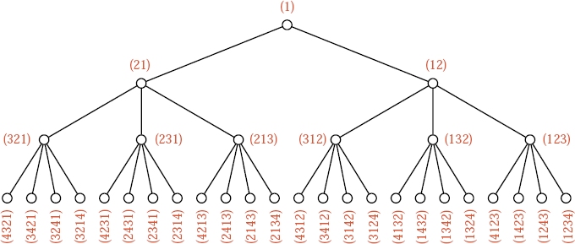
Chapter 6 Lists and Strings
中山大学软件学院
Generating Permutations
Take a given permutation of {1, 2, ... , k-1} and put its entries into a list.
Insert k into each of the k possible positions in this list, thereby obtaining k distinct permutations of {1, 2, ... , k}.

Slide 63
Chapter 6 Lists and Strings
中山大学软件学院
The General Procedure
Permute(1, n) – 从“1”开始创建长度为n的排列
void permute(int k, int n)
{
insert k into the given position; //把k插入到指定位置
if (k == n) DisplayPermutation();
else permute(k + 1, n);
remove k from the given position; //从指定位置删除k
}

Slide 64
Chapter 6 Lists and Strings
中山大学软件学院
The General Procedure
void permute(int New_entry, int Num, List<int> &permutation)
{
for (Pos = 0; Pos < permutation.size() + 1; Pos++) {
permutation.insert(Pos, New_entry);
if (New_entry == Num) DisplayPermutation(permutation);
else permute(new_entry + 1, Num, permutation);
permutation.remove(Pos, New_entry);
}
}
P_{k+1}
1
2 1
3 2 1
2 3 1
. . .
4 3 2 1
3 4 2 1
3 2 4 1
3 2 1 4
4 2 3 1
2 4 3 1
2 3 4 1
2 3 1 4
. . .
permute(1, 4, permutation)
permute(2, 4, permutation)
permute(3, 4, permutation)
permute(4, 4, permutation)
P_{k+1}
P_{k+1}
p_{k} p_{k-1} … p₁ p₀
p_{k+1} p_{k} p_{k-1} … p₁ p₀

Slide 65
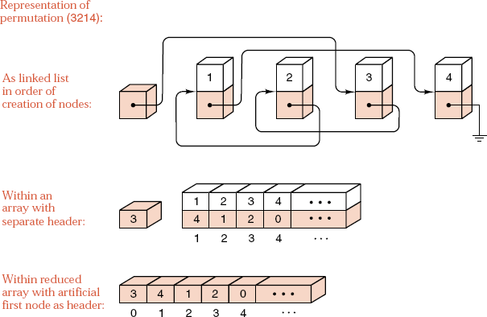
Chapter 6 Lists and Strings
中山大学软件学院
The General Procedure

Slide 66
Chapter 6 Lists and Strings
中山大学软件学院
Optimized Permute Function
void permute(int new_entry, int Num, int *permutation)
{
int current = 0;
do {
permutation[new_entry] = permutation[current];
permutation[current] = new_entry;
if (new_entry == Num) DisplayPermutation(permutation);
else permute(new_entry + 1, Num, permutation);
permutation[current] = permutation[new_entry];
current = permutation[current];
} while (current != 0);
}

Slide 67
Chapter 6 Lists and Strings
中山大学软件学院
Processing a permutation
void Display_permutation(int *permutation)
{
int current = 0;
while (permutation[current] != 0) {
cout << permutation[current] << " ";
current = permutation[current];
}
cout << endl;
}

Slide 68
Chapter 6 Lists and Strings
中山大学软件学院
(一) 多项式的书写方式
按幂指数的升序排列把一元n次多项式P_{n}(x)写成如下形式:
P_{n}(x) = c₀x⁰ + c₁x¹ + c₂x² + … + c_{n}x^{n}
该多项式可用系数线性表(c₀, c₁, c₂, …, c_{n})来表示, 其中: p_{i}是x^{i}的系数.
例如: P₆(x) = 12x⁰ + 8.4x¹ – 1.1x⁴ + 10.5x⁶.
于是, 多项式P₆(x)可用线性表(12, 8.4, 0, 0, -1.1, 0, 10.5)来表示.
多项式的这种表示法能较容易地实现多项式的各种运算, 如: 加法.
Q_{m}(x) = c′₀x⁰ + c′₁x¹ + c′₂x² + … + c′_{m}x^{m}
Q_{m} = (c′₀, c′₁, c′₂, …, c′_{m})
计算: P_{n}(x) = P_{n}(x) + Q_{m}(x) (m ≤ n)
P_{n} = (c₀+c′₀, c₁+c′₁, … , c_{m}+c′_{m}, c_{m+1}, … , c_{n}).

Slide 69
Chapter 6 Lists and Strings
中山大学软件学院
(二) 多项式的线性表表示法
(1) 幂指数为非负整数
P₁₁(x) = 12x⁰ + 8.4x¹ – 3.5x⁴ + 1.2x¹¹.
1) 用连续的幂指数顺序来表示
P₁₁(x) = (12, 8.4, 0, 0, -3.5, 0, 0, 0, 0, 0, 0, 1.2)
2) 用系数和幂指数来表示
P₁₁(x) = (<12, 0>, <8.4, 1>, <-3.5, 4>, <1.2, 11>)
这种方式虽有优点, 但也存在浪费空间的问题.
当幂太大时, 这种方法不可取.
typedef struct _Node {
float Coef; // 系数
int Expn; // 指数
struct _Node *next;
} Node;
12
8.4
-3.5
1.2
0
1
4
11

Slide 70
Chapter 6 Lists and Strings
中山大学软件学院
typedef struct _Node {
float Coef;
int Expn;
struct _Node *next;
} Node;
(二) 多项式的线性表表示法
(2) 幂指数为整数
P₁₁(x) = 1.2x⁻³ – 8.3x⁻¹ + 1.7x⁰ – 21.5x¹ + 12.3x¹¹.
1) 用连续的幂指数顺序来表示(幂指数从-3开始)
P₁₁(x) = (1.2, 0, -8.3, 1.7, -21.5, 0, 0, 0, 0, 0, 0, 0, 0, 0, 12.3)
2) 用系数和幂指数来表示
P₁₁(x) = (<1.2, -3>, <-8.3, -1>, <1.7, 0>, <-21.5, 1>, <12.3, 11>)
1.2
-8.3
1.7
-21.5
12.3
-3
-1
0
1
11

Slide 71
Chapter 6 Lists and Strings
中山大学软件学院
(三) 多项式的线性表优缺点
(1) 用顺序表存储
多项式的项数不定;
多项式的运算需要移动元素;
随机存取不重要.
(2) 用单向链表存储
多项式的项数可以是任意的;
实现多项式运算不需移动元素, 只需修改指针;
随机存取不重要.

Slide 72
Chapter 6 Lists and Strings
中山大学软件学院
(四) 多项式的ADT描述
struct PNode {
double Coef;
int Expn;
PNode *next;
public:
PNode(double coef, int expn);
};
class Poly {
public:
Poly(const char *Str=NULL);
Poly(const Poly &Src);
~Poly() { Clear(Exp); };
void Display();
void Reverse();
void Clear()
. . .
private:
void Insert(double coef, int n);
bool Ascending;
PNode *Exp;
};

Slide 73
Chapter 6 Lists and Strings
中山大学软件学院
1) 用字符串建立多项式
(1) 用字符串建立多项式
Poly::Poly(char *Str)
{
while (*Str) {
Coef = GetCoef(Str);
Expn = GetPower(Str);
if (Coef != 0) InsertItem(Coef, Expn);
}
}
str
str
str
str
12+40x-23x^3
Exp
12
40
-23
0
1
3

Slide 74
Chapter 6 Lists and Strings
中山大学软件学院
1) 用字符串建立多项式
(2) 从字符串中取多项式各项的系数
int Poly::GetCoef(const char* &Str)
{
const char *Pt;
char Data[8];
Pt = Str;
if (*Str == '-' || *Pt == '+') Str++;
while ('0' <= *Str && *Str <= '9') Str++;
int k = Str - Pt;
if (k == 0) k = 1; // 12+x^2-x^4
else if (k==1 && (*Pt=='+' || *Pt=='-')) k = (*Pt=='+' ? 1 : -1);
else { strncpy_s(Data, 7, Pt, k); Data[k] = 0; k = atoi(Data); }
return k;
}

Slide 75
Chapter 6 Lists and Strings
中山大学软件学院
1) 用字符串建立多项式
(3) 从字符串中取多项式各项的幂指数
int Poly::GetExp(const char* &Str)
{
const char *Pt;
char Data[8];
if (*Str!='x' && *Str!='X') return 0; // 12+x^2-x^4
Str++;
if (*Str != '^') return 1;
Pt = ++Str;
while ('0' <= *Str && *Str <= '9') Str++;
k = Str - Pt; strncpy_s(Data, 7, Pt, k); Data[k] = 0;
return atoi(Data);
}

Slide 76
Chapter 6 Lists and Strings
中山大学软件学院
(2) 计算P(x)的值
double Poly::Calculate(double x)
{
Value = 0;
while (P != NULL) {
Value1 = P->Coef;
for (i = 0; i < P->Expn; i++) Value1 *= x;
Value += Value1;
P = P->next;
}
return Value;
}

Slide 77
Chapter 6 Lists and Strings
中山大学软件学院
(3) 显示多项式P(x)
// P(x) = c₀x⁰+c₁x¹+c₂x²+…
void Poly::Display()
{
P = Exp;
while (P != NULL) {
printf("%+dx^%d", P->Coef, P->Expn);
P = P->next;
}
printf("\n");
}

Slide 78
Chapter 6 Lists and Strings
中山大学软件学院
(4) 多项式P的基本功能菜单
void main()
{
Poly P;
func = 1;
while (func) {
cout << "1 -- Create Polynomial by string\n";
cout << "2 -- Calculate the Polynomial with x\n";
cout << "3 -- Display the Polynomial\n";
cout << "4 -- Reverse the Polynomial\n";
cout << "0 -- Exit\n";
cin >> func;

Slide 79
中山大学软件学院
switch (func) {
case 1:
printf("Input Polynomial as 12+32x-x^2+123x^5...\n");
scanf("%s", Str);
P.Create(Str);
break;
case 2:
printf("Input value of x:");
scanf("%d", &x);
Value = P.Calculate(x);
printf(“The value of polynomial with %d is %ld\n\n", x, Value);
break;
case 3:
P.Display();
break;
} // End of Switch
} // End of While
} // End of Main

Slide 80
Chapter 7 Searching
中山大学软件学院
7.1. Introduction, Notation
7.2. Sequential Search
7.3. Binary Search
7.4. Comparison Trees
7.5. Lower Bounds
7.6. Asymptotics: The Big-O and Other Notations

Slide 81
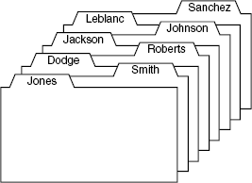
Chapter 7 Searching
中山大学软件学院
Records and Keys
1) A list of records, each record is associated with one a key.
2) One key are asked to search the list to find the record(s) whose key is the same as the key.
3) There may be more than one record with the same key, or there may be no record with a given key.
4) How times one key is compared with another during a search.
5) Internal searching means that all the records are kept in high-speed memory. In external searching, most of the records are kept in disk files.

Slide 82
Chapter 7 Searching
中山大学软件学院
Records and Keys in C++
The records must conform to the following minimal standards:
1) Every Record is associated to a key.
2) Key objects can be compared with the standard operators: ==, !=, <, >, <=, >=.
3) There is a conversion operation to turn any Record into its associated Key.
4) Record objects can be compared to each other or to a Key by first converting the Record objects to their associated keys.

Slide 83
Chapter 7 Searching
中山大学软件学院
Records and Keys in C++
5) Examples of the conversion operation:
5.1) A method of the class Record, with the declaration operator Key () const;
5.2) A constructor for the class Key, with declaration Key(const Record &);
5.3) If the classes Key and Record are identical, no conversion needs to be defined, since any Record is a Key.
6) We do not assume that a Record has a Key object as a data member, although often it does. We merely assume that the compiler can turn a Record into its corresponding Key.

Slide 84
Chapter 7 Searching
中山大学软件学院
Parameters for Search Functions
Each searching function has two input parameters:
1) First is the list to be searched
2) Second is the target key for searching
Each searching function will also have an output parameter and a returned value:
1) The returned value has type Error_code and indicates whether or not the search is successful in finding an entry.
2) If the search is successful, the success is returned, and the position of the key will locate the target within the list.
3) If the search is unsuccessful, the not_present is returned, and an undefined value.

Slide 85
Chapter 7 Searching
中山大学软件学院
Key Definition in C++
Type definition statements such as:
typedef int Key;
typedef int Record;
Appropriate behavior of Classes key is based on the following skeletons:
class Key {
public:
// Add any constructors and methods for key data.
private:
// Add declaration of key data members here.
};

Slide 86
Chapter 7 Searching
中山大学软件学院
Key Definition in C++
// Declare overloaded comparison operators for keys:
bool operator == (const Key &x, const Key &y);
bool operator > (const Key &x, const Key &y);
bool operator < (const Key &x, const Key &y);
bool operator >= (const Key &x, const Key &y);
bool operator <= (const Key &x, const Key &y);
bool operator != (const Key &x, const Key &y);
class Record{
public:
operator Key (); // implicit conversion from Record to Key.
// Add any constructors and methods for Record objects.
private:
// Add data components.
};

Slide 87
Chapter 7 Searching
中山大学软件学院
Sequential Search and Analysis
Begin at one end of the list and scan down it until the desired key is found or the other end is reached.
Error_code sequential_search(const List<Record> &list,
const Key &target, int &position)
{
int s = list.size();
for (position = 0; position < s; position++) {
Record data;
list.retrieve(position, data);
if (data == target) return success;
}
return not_present;
}

Slide 88
Chapter 7 Searching
中山大学软件学院
Sequential Search and Analysis
To analyze the behavior of an algorithm that makes comparisons of keys, we shall use the count of these key comparisons as our measure of the work done.
The number of comparisons of keys done in sequential search of a list of length n is
1) Unsuccessful search: n comparisons.
2) Successful search
best case: 1 comparison
worst case: n comparisons
average case: (n+1)/2 comparisons
O(1)
O(n)
O(n)

Slide 89
Chapter 7 Searching
中山大学软件学院
Testing Program
class Key {
int key;
public:
static int comparisons;
Key(int x = 0);
int the_key() const;
};
bool operator == (const Key &x, const Key &y);
bool operator > (const Key &x, const Key &y);
bool operator < (const Key &x, const Key &y);
bool operator >= (const Key &x, const Key &y);
bool operator <= (const Key &x, const Key &y);
bool operator != (const Key &x, const Key &y);

Slide 90
Chapter 7 Searching
中山大学软件学院
Testing Program
1) The method the_key inspects a copy of a key's value.
2) The static counter comparisons is incremented by any call to a Key comparison operator.
bool operator == (const Key &x, const Key &y)
{
Key :: comparisons++;
return x.the_key() == y.the_key();
}
3) Static data members must be defined and initialized outside of a class definition. the following statement is included in the Key file key.c:
int Key :: comparisons = 0;
4) Use the class Timer from Appendix C to provide CPU timing information.

Slide 91
Chapter 7 Searching
中山大学软件学院
Test Data for Searching
1) Most searching methods require the data to be ordered, so use a list with integer keys in increasing order.
2) To test both successful and unsuccessful searches, insert only keys containing odd integers into the list.
3) If n denotes the number of entries in the list, then the targets for successful searches will be 1, 3, 5, ... , 2n-1.
4) For unsuccessful searches, the targets will be 0, 2, ... , 2n.

Slide 92
Chapter 7 Searching
中山大学软件学院
Test Data for Searching
We test all possible failures, including targets less than the smallest key in the list, between each pair, and greater than the largest.
To make the test more realistic, use pseudo-random numbers to choose the target, by employing the method from Appendix B.
Random :: random_integer

Slide 93
Chapter 7 Searching
中山大学软件学院
Ordered Lists
Definition An ordered list is a list in which each entry contains a key, such that the keys are in order.
If entry i comes before entry j in the list, then the key of entry i is less than or equal to the key of entry j.
1) All List operations except insert and replace apply without modification to an ordered list.
2) Methods insert and replace must fail when they would disturb the order of a list.

Slide 94
Chapter 7 Searching
中山大学软件学院
Ordered Lists
3) We implement an ordered list as a class derived from a contiguous List.
In this derived class, we shall override the methods insert and replace with new implementations.
class Ordered_list: public List<Record>{
public:
Ordered_list();
Error_code insert(const Record &data);
Error_code insert(int position, const Record &data);
Error_code replace(int position, const Record &data);
};

Slide 95
Chapter 7 Searching
中山大学软件学院
Overloaded Insertion
We overload the method insert so that it can be used with a single parameter. The position is determined so as to keep the resulting list ordered:
Error_code Ordered_list :: insert(const Record &data)
{
int position, s = size();
for (position = 0; position < s; position++) {
Record list_data;
retrieve(position, list_data);
if (data < list_data) break;
}
return List<Record> :: insert(position, data);
}
书上有问题!

Slide 96
Chapter 7 Searching
中山大学软件学院
Overridden Insertion
Error_code Ordered_list :: insert(int position, const Record &data)
{
Record list_data;
if (position > 0) {
retrieve(position - 1, list_data);
if (data < list_data) return fail;
}
if (position < size()) {
retrieve(position, list_data);
if (data > list_data) return fail;
}
return List<Record> :: insert(position, data);
}

Slide 97
Chapter 7 Searching
中山大学软件学院
Binary Search
In searching an ordered list, first compare the target to the key in the center of the list.
If it is smaller, restrict the search to the left half; otherwise restrict the search to the right half, and repeat.
At each step we reduce the length of the list to be searched by half.
Keep two indices, top and bottom, that will bracket the part of the list still to be searched.
The target key, provided it is present, will be found between the indices bottom and top, inclusive.

Slide 98
Chapter 7 Searching
中山大学软件学院
Binary Search
1) Initialization: bottom = 0; top = the_list.size() - 1;
2) Compare target with the Record at the midpoint,
mid = (bottom + top) / 2
3) Change the appropriate index top or bottom to restrict the search to the appropriate half of the list.
4) Loop terminates when top ≤ bottom, if it has not terminated earlier by finding the target.
5) Make progress toward termination by ensuring that the number of items remaining to be searched, top-bottom+1, strictly decreases at each iteration of the process.

Slide 99
中山大学软件学院
The Forgetful Version of Binary Search
Error_code rec_binary_1(const Ordered_list &the_list, const Key &target, int bottom, int top, int &pos)
{
Record data;
if (top < bottom) return not_present;
if (bottom == top) { // List has exactly one entry.
pos = bottom;
the_list.retrieve(bottom, data);
if (data == target) return success;
return not_present;
}
int mid = (bottom + top)/2; // List has more than one entry.
the_list.retrieve(mid, data);
if (data < target) return rec_binary_1(the_list, target, mid+1, top, pos);
return rec_binary_1(the_list, target, bottom, mid, pos);
}

Slide 100

Chapter 7 Searching
中山大学软件学院
Algorithm Verification
The division of the list into sublists is described in the following diagram:
Only entries strictly less than target appear in the first part of the list, but the last part contains entries greater than or equal to target.
When the middle part of the list is reduced to size 1, it will be guaranteed to be the first occurrence of the target.

Slide 101
中山大学软件学院
Nonrecursive Binary Search
Error_code binary_search_1(const Ordered_list &the_list, const Key &target, int &position)
{
Record data;
int bottom = 0, top = the_list.size() - 1;
while (bottom < top) {
int mid = (bottom + top)/2; the_list.retrieve(mid, data);
if (data < target) bottom = mid + 1;
else top = mid;
}
if (top < bottom) return not_present;
position = bottom; the_list.retrieve(bottom, data);
if (data == target) return success;
return not_present;
}

Slide 102
Chapter 7 Searching
中山大学软件学院
Recognizing Equality in Binary Search
Error_code rec_binary_2(const Ordered_list &thelist, const Key &target, int bottom, int top, int &pos)
{
Record data;
if (bottom > top) return not_present;
int mid = (bottom + top) / 2;
thelist.retrieve(mid, data);
if (data == target) { pos = mid; return success; }
if (data < target) return rec_binary_2(thelist, target, mid+1, top, pos);
return rec_binary_2(thelist, target, bottom, mid-1, pos);
}

Slide 103
Chapter 7 Searching
中山大学软件学院
Nonrecursive Version
Error_code binary_search_2(const Ordered_list &thelist, const Key &target, int &position)
{
Record data;
int bottom = 0, top = thelist.size() - 1;
while (bottom <= top) {
position = (bottom + top) / 2;
thelist.retrieve(position, data);
if (data == target) return success;
if (data < target) bottom = position + 1;
else top = position - 1;
}
return not_present;
}

Slide 104

Chapter 7 Searching
中山大学软件学院
Algorithm Verification
The division of the list into sublists is described in the following diagram:
The first part of the list contains only entries strictly less than target, and the last part contains only entries strictly greater than target.
If target appears more than once in the list, then the search may return any instance of the target.
Proof of progress toward termination is easier than for the first method.

Slide 105
Chapter 7 Searching
中山大学软件学院
Comparison Trees: Definitions
The comparison tree of an algorithm is obtained by tracing the action of the algorithm, representing each comparison of keys by a vertex of the tree.
Branches represent the possible outcomes of the comparison. we put either F (for failure) or the location where the target is found at the end of the appropriate branch, which we call a leaf, and draw as a square.
The number of comparisons done by an algorithm is the number of internal vertices traversed in going from the root of the tree, down the appropriate path to a leaf.

Slide 106
Chapter 7 Searching
中山大学软件学院
Comparison Trees: Definitions
The number of branches traversed to reach a vertex from the root is called the level of the vertex. The root itself has level 0, the vertices immediately below it have level 1, and so on.
The largest level that occurs is called the height of the tree.
We call the vertices immediately below a vertex v the children of v and the vertex immediately above v the parent of v.

Slide 107
Chapter 7 Searching
中山大学软件学院
Comparison Trees: Definitions
The vertices immediately below a vertex v the children of v and the vertex immediately above v the parent of v.
The external path length of a tree is the sum of the number of branches traversed in going from the root once to every leaf in the tree.
The internal path length is defined to be the sum, over all vertices that are not leaves, of the number of branches from the root to the vertex.

Slide 108
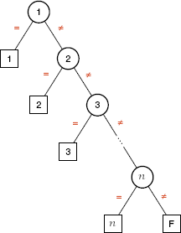
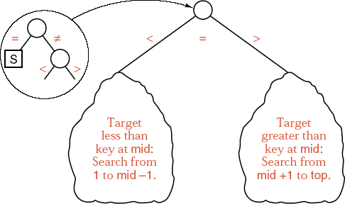
Chapter 7 Searching
中山大学软件学院
Sample Comparison Trees

Slide 109
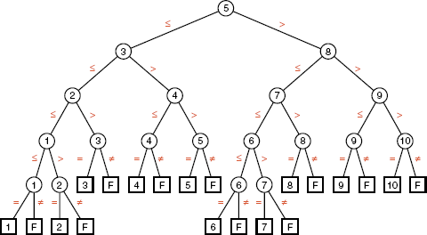
Chapter 7 Searching
中山大学软件学院
Comparison Trees for Binary Search
First version

Slide 110
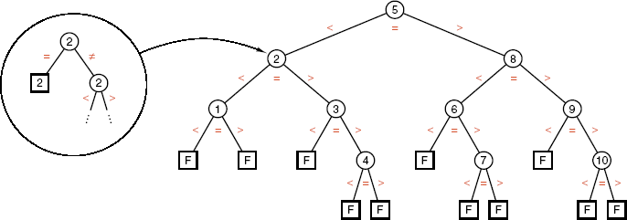
Chapter 7 Searching
中山大学软件学院
Comparison Trees for Binary Search
Second version

Slide 111
Chapter 7 Searching
中山大学软件学院
2-Trees
As 2-tree is a tree in which every vertex except the leaves has exactly two children.
Lemma 7.1 The number of vertices on each level of a 2-tree is at most twice the number on the level immediately above. Hence, in a 2-tree, the number of vertices on level t is at most 2^{t} for t ≥ 0.
Lemma 7.2 If a 2-tree has k vertices on level t , then t ≥ lgk.
The floor of a real number x is the largest integer less than or equal to x, and the ceiling of x is the smallest integer greater than or equal to x.
We denote the floor of x by ⎣x⎦ and the ceiling of x by ⎡x⎤.

Slide 112
Chapter 7 Searching
中山大学软件学院
Binary Search Analysis
The number of comparisons of keys done by binary_ search_1 in searching a list of n items:
The worst case: O(lgn+1)
The average case: O(lgn)
The number of comparisons is independent of whether the search is successful or not.
The number of comparisons done in an unsuccessful search by binary_search_2 is 2lg(n+1).

Slide 113
Chapter 7 Searching
中山大学软件学院
Binary Search Analysis
In a successful search of a list of n entries, binary_search _2 does approximately 2(n+1)lg(n+1)/n - 3 comparisons of keys.
The proof of the above results requires the path length theorem.
Successful search
Unsuccessful search
lgn + 1
Binary_search_1
lgn + 1
2lgn - 3
2lgn
Binary_search_2

Slide 114
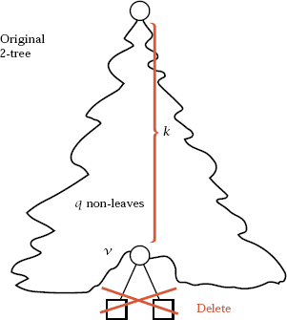
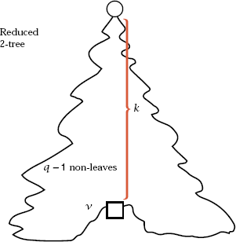
Chapter 7 Searching
中山大学软件学院
The Path-Length Theorem
Theorem 7.3 Denote the external path length of a 2-tree by E, the internal path length by I, and let q be the number of vertices that are not leaves. Then E = I + 2q.

Slide 115
Chapter 7 Searching
中山大学软件学院
The Path-Length Theorem
Theorem 7.4 Assume that, in searching a list of size n, the leaves of the comparison tree correspond to unsuccessful searches, the internal vertices to successful searches, and that two comparisons of keys are made for each internal vertex, except that only one is made at the vertex where the target is found. Then the average numbers S and U of key comparisons done in successful and unsuccessful searches are related by S = (1 + 1/n)U - 3.

Slide 116
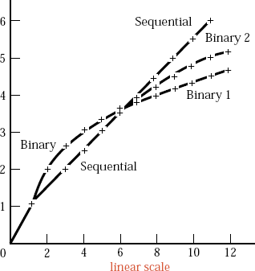
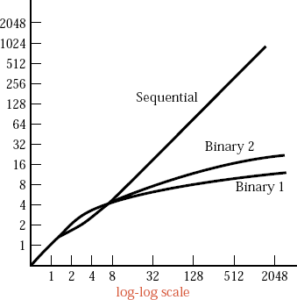
Chapter 7 Searching
中山大学软件学院
Comparison of Average Successful Searches

Slide 117
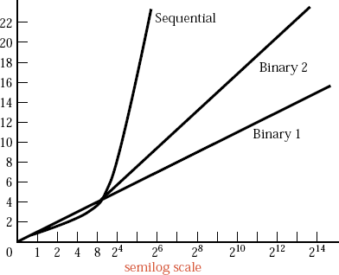
Chapter 7 Searching
中山大学软件学院
Comparison of Average Successful Searches

Slide 118
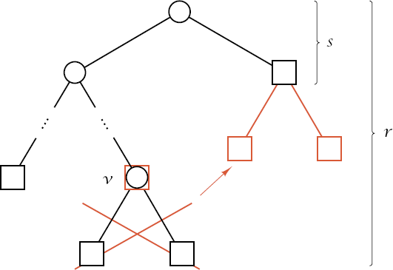
Chapter 7 Searching
中山大学软件学院
Lower Bounds on Path Length
Lemma 7.5 Let T be a 2-tree with k leaves. The height h of T satisfies h ≥ ⎡lgk⎤ and the external path length E(T) satisfies E(T) ≥ klgk.
The minimum values for h
and E(T) occur when all the
leaves of T are on the same
level or on two adjacent
levels.

Slide 119
Chapter 7 Searching
中山大学软件学院
Lower Bounds on Path Length
Theorem 7.6 Suppose that an algorithm uses comparisons of keys to search for a target in a list. If there are k possible outcomes, then the algorithm must make at least ⎡lgk⎤ comparisons of keys in its worst case and at least lgk in its average case.
Corollary 7.7 binary_search_1 is optimal in the class of all algorithms that search an ordered list by making comparisons of keys. In both the average and worst cases, binary_search_1 achieves the optimal bound.

