Slide 1

Data Structures and
Program Design In C++
Robert L. Kruse Alexander J. Ryba
吴 向 军
中山大学软件学院
E-Mail: issxjwu@mail.sysu.edu.cn

Slide 2
Chapter 8 Sorting
中山大学软件学院
8.1. Introduction and Notation
8.2. Insertion Sort
8.3. Selection Sort
8.4. Shell Sort
8.5. Lower Bounds
8.6. Divide-and-Conquer Sorting
8.7. Mergesort for Linked Lists
8.8. Quicksort for Contiguous Lists
8.9. Heaps and Heapsort
8.10. Review: Comparison of Methods

Slide 3
Chapter 8 Sorting
中山大学软件学院
Requirements
In an external sort, there are so many records to be sorted that they must be kept in external les on disks, tapes, or the like.
In an internal sort the records can all be kept internally in high-speed memory. We consider only internal sorting.
We shall sort lists of records into the order determined by keys associated with the records. The declarations for a list and the names assigned to various types and operations will be the same as in previous chapters.

Slide 4
Chapter 8 Sorting
中山大学软件学院
Requirements
If two or more of the entries in a list have the same key, we must exercise special care. To analyze sorting algorithms, we consider both the number of comparisons of keys and the number of times entries must be moved inside a list, in a contiguous list.
Both the worst-case and the average performance of a sorting algorithm are of interest.
To find the average, we shall consider what would happen if the algorithm were run on all possible orderings of the list and take the average of the results.

Slide 5
Chapter 8 Sorting
中山大学软件学院
Sortable Lists
We must access the private data members of the lists being sorted. We shall add sorting functions as methods of List data structures. The augmented list structure forms a new ADT that we shall call a Sortable_List, with the following form.
template <class Record>
class Sortable_list: public List<Record> {
public: // Add prototypes for sorting methods here.
private: // Add prototypes for auxiliary functions here.
};
Hence a Sortable_list is a List with extra sorting methods. The base list class can be any of the List implementations of Chapter 6.
We use a template parameter class called Record to stand for entries of the Sortable_list.

Slide 6
Chapter 8 Sorting
中山大学软件学院
Sortable Lists
Every Record has an associated key of type Key. A Record can be implicitly converted to the corresponding Key. The keys (hence also the records) can be compared under the operations '<', '>', '>=', '<=', '==', and '!='.
Any of the Record implementations discussed in Chapter 7 can be supplied, by a client, as the template parameter of a Sortable_list.

Slide 7
Chapter 8 Sorting
中山大学软件学院
Ordered Insertion
An ordered list is an abstract data type, defined as a list in which each entry has a key, and such that the keys are in order. if entry i comes before entry j in the list, the key of entry i is less than or equal to the key of entry j.
For ordered lists, we shall often use two new operations that have no counterparts for other lists, since they use keys rather than positions to locate the entry.
One operation retrieves an entry with a specified key from the ordered list. Retrieval by key from an ordered list is exactly the same as searching.
The second operation, ordered insertion, inserts a new entry into an ordered list by using the key in the new entry to determine where in the list to insert it.

Slide 8
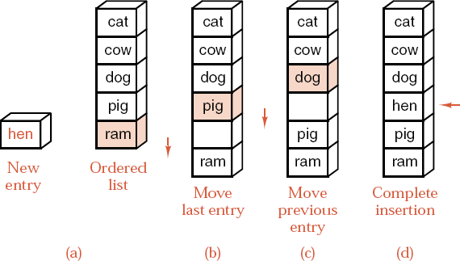
Chapter 8 Sorting
中山大学软件学院
Ordered Insertion
Note that ordered insertion is not uniquely specified if the list already contains an entry with the same key as the new entry, since the new entry could go into more than one position.

Slide 9
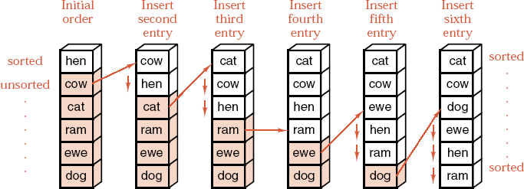
Chapter 8 Sorting
中山大学软件学院
Insertion Sort
Example

Slide 10
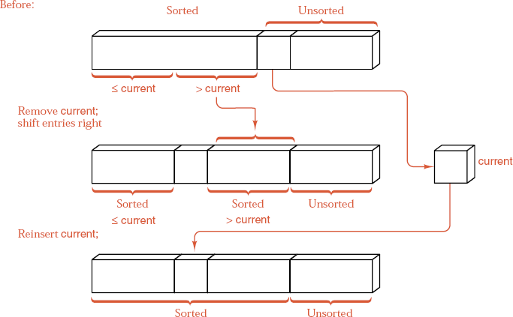
Chapter 8 Sorting
中山大学软件学院
Main step, contiguous case

Slide 11
Chapter 8 Sorting
中山大学软件学院
Contiguous Insertion Sort
template <class Record>
void Sortable_list<Record> :: insertion_sort()
{
int first_unsorted, position;
Record current;
for (first_unsorted = 1; first_unsorted < count; first_unsorted++)
if (entry[first_unsorted] < entry[first_unsorted - 1]) {
position = first_unsorted; current = entry[first_unsorted];
do {
entry[position] = entry[--position];
} while (position > 0 && entry[position - 1] > current);
entry[position] = current;
}
}

Slide 12
Chapter 8 Sorting
中山大学软件学院
Linked Insertion Sort
With no movement of data, there is no need to search from the end of the sorted sublist, as for the contiguous case.
Traverse the original list, taking one entry at a time and inserting it in the proper position in the sorted list.
Pointer last sorted references the end of the sorted part of the list.
Pointer first_unsorted == last_sorted->next references the first entry that has not yet been inserted into the sorted sublist.
Pointer current searches the sorted part of the list to nd where to insert *first_unsorted.
If *first_unsorted belongs before the head of the list, then insert it there.

Slide 13
Chapter 8 Sorting
中山大学软件学院
Linked Insertion Sort
Otherwise, move current down the list until
first_unsorted->entry <= current->entry
and then insert *first_unsorted before *current.
To enable insertion before *current, keep a second pointer trailing in lock step one position closer to the head than current.
A sentinel is an extra entry added to one end of a list to ensure that a loop will terminate without having to include a separate check.
Since last_sorted->next == first_unsorted, the node *first_unsorted is already in position to serve as a sentinel for the search, and the loop moving current is simplified.
A list with 0 or 1 entry is already sorted, so by checking these cases separately we avoid trivialities elsewhere.

Slide 14
Chapter 8 Sorting
中山大学软件学院
template <class Record>
void Sortable_list<Record> :: insertion_sort( )
{
Node <Record> *first_unsorted, *last_sorted, *current, *trailing;
if (head == NULL) return;
last_sorted = head;
while (last_sorted->next != NULL) {
first_unsorted = last_sorted->next;
if (first_unsorted->entry < head->entry) {
last_sorted->next = first_unsorted->next;
first_unsorted->next = head;
head = first_unsorted;
}
else

Slide 15
中山大学软件学院
template <class Record>
void Sortable_list<Record> :: insertion_sort( )
{
...
else {
trailing = head; current = trailing->next;
while (first_unsorted->entry > current->entry) {
trailing = current; current = trailing->next;
}
if (first_unsorted==current) last_sorted = first_unsorted;
else {
last_sorted->next = first_unsorted->next;
first_unsorted->next = current;
trailing->next = first_unsorted;
}
}
}
}

Slide 16
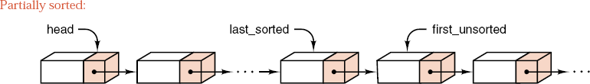
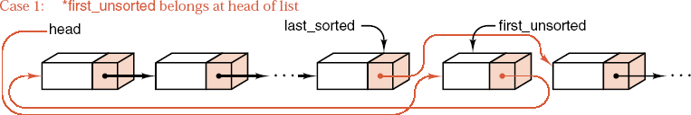
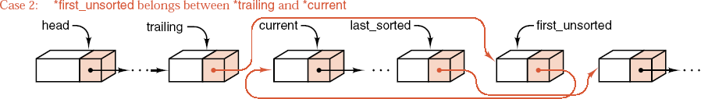
Chapter 8 Sorting
中山大学软件学院

Slide 17
Chapter 8 Sorting
中山大学软件学院
Analysis of Insertion Sort
The average number of comparisons for insertion sort applied to a list of n items in random order is n²/4 + O(n).
The average number of assignments of items for insertion sort applied to a list of n items in random order is also n²/4 + O(n).
The best case for contiguous insertion sort occurs when the list is already in order, when insertion sort does nothing except n-1 comparisons of keys.
The worst case for contiguous insertion sort occurs when the list is in reverse order.

Slide 18
Chapter 8 Sorting
中山大学软件学院
Analysis of Insertion Sort
Theorem 8.1. Verifying that a list of n entries is in the correct order requires at least n-1 comparisons of keys.
Insertion sort verifies that a list is sorted as quickly as any method can.

Slide 19
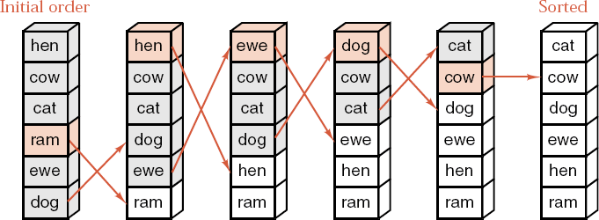
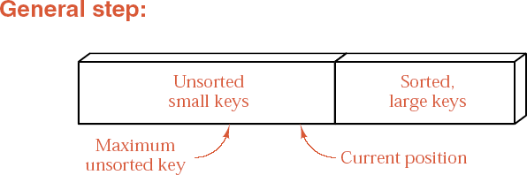
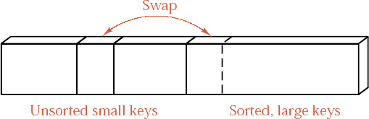
中山大学软件学院
Selection Sort

Slide 20
Chapter 8 Sorting
中山大学软件学院
Selection sort
template <class Record>
void Sortable_list<Record> :: selection_sort( )
{
for (int position = count - 1; position > 0; position--) {
int max = max_key(0, position);
swap(max, position);
}
}
Swap entries
template <class Record>
void Sortable_list<Record>::swap(int low, int high)
{
Record temp;
temp = entry[low];
entry[low] = entry[high];
entry[high] = temp;
}

Slide 21
Chapter 8 Sorting
中山大学软件学院
Find maximum key
template <class Record>
int Sortable_list<Record> :: max_key(int low, int high)
{
int largest, current;
largest = low;
for (current = low + 1; current <= high; current++)
if (entry[largest] < entry[current]) largest = current;
return largest;
}

Slide 22
Chapter 8 Sorting
中山大学软件学院
Analysis and comparison
Selection
Insertion (average)
Assignments of entries
3n + O(1)
0.25n² + O(n)
Comparisons of keys
0.5n² + O(n)
0.25n² + O(n)

Slide 23

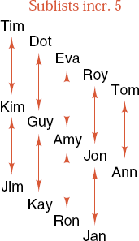
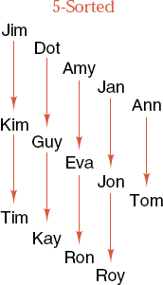

Chapter 8 Sorting
中山大学软件学院
Example of Shell Sort

Slide 24
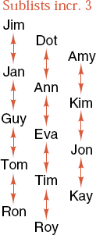
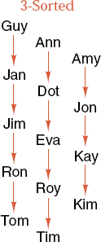
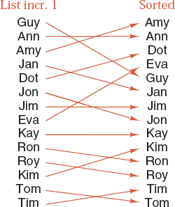
Chapter 8 Sorting
中山大学软件学院
Example of Shell Sort

Slide 25
Chapter 8 Sorting
中山大学软件学院
Shell Sort
template <class Record>
void Sortable_list<Record>::shell_sort( )
{
int increment, start;
increment = count;
do {
increment = increment/3 + 1;
for (start = 0; start < increment; start++)
sort_interval(start, increment);
} while (increment > 1);
}

Slide 26
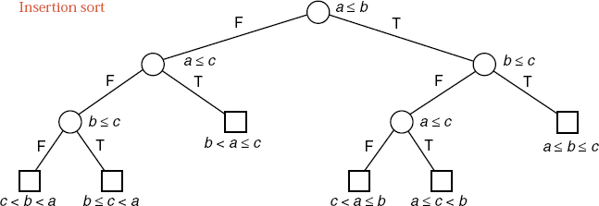
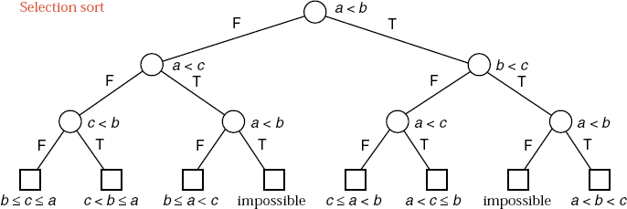
中山大学软件学院
Lower Bounds for Sorting

Slide 27
Chapter 8 Sorting
中山大学软件学院
Lower Bounds for Sorting
Theorem 8.2 Any algorithm that sorts a list of n entries by use of key comparisons must, in its worst case, perform at least ⎡lgn!⎤ comparisons of keys, and, in the average case, it must perform at least lgn! comparisons of keys.

Slide 28
Chapter 8 Sorting
中山大学软件学院
Divide and Conquer Sorting
Outline
void Sortable_list :: sort( )
{
if the list has length greater than 1 {
partition the list into lowlist, highlist;
lowlist.sort( );
highlist.sort( );
combine(lowlist, highlist);
}
}

Slide 29
Chapter 8 Sorting
中山大学软件学院
Divide and Conquer Sorting
Mergesort
We chop the list into two sublists of sizes as nearly equal as possible and then sort them separately. Afterward, we merge the two sorted sublists into a single sorted list.
Quicksort
1) choose a key from the list for which about half the keys will come before and half after. Call this key the pivot.
2) partition the items so that all those with keys less than the pivot come in one sublist, and all those with greater keys come in another.
3) sort the two reduced lists
4) put the sublists together
5) the whole list will be in order.

Slide 30
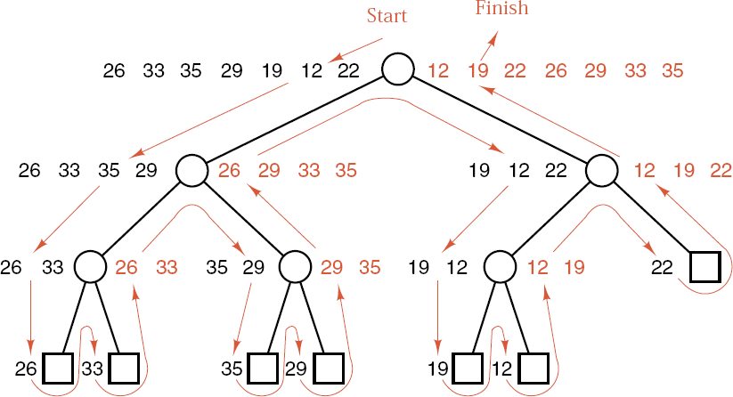
Chapter 8 Sorting
中山大学软件学院

Slide 31
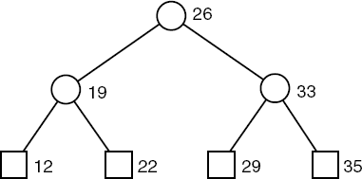
Chapter 8 Sorting
中山大学软件学院
Quicksort of 7 Numbers
Sort (26, 33, 35, 29, 19, 12, 22)
Partition into (19, 12, 22) and (33, 35, 29); pivot = 26
Sort (19, 12, 22)
Partition into (12) and (22); pivot = 19
Sort (12), Sort (22)
Combine into (12, 19, 22)
Sort (33, 35, 29)
Partition into (29) and (35); pivot = 33
Sort (29), Sort (35)
Combine into (29, 33, 35)
Combine into (12, 19, 22, 26, 29, 33 35)

Slide 32
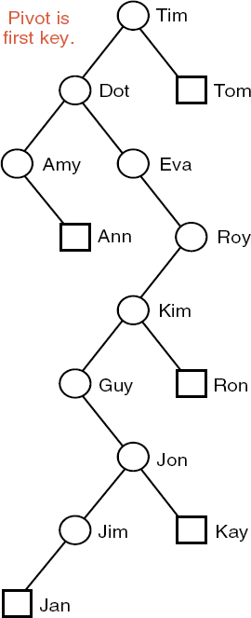
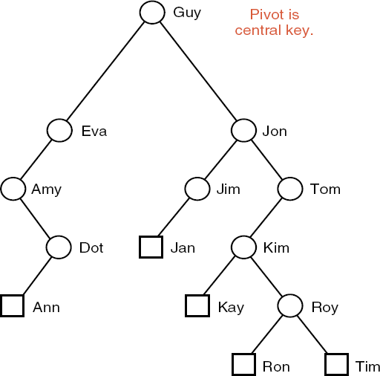
中山大学软件学院

Slide 33
Chapter 8 Sorting
中山大学软件学院
Mergesort for Linked Lists
Interface method
template <class Record>
void Sortable_list<Record> :: merge_sort( )
{
recursive_merge_sort(head);
}
Recursive function
template <class Record>
void Sortable list<Record>::recursive_merge_sort(Node<Record> * &sublist)
{
if (sublist != NULL && sublist->next != NULL) {
Node<Record> *secondhalf = divide_from(sublist);
recursive_merge_sort(sublist);
recursive_merge_sort(secondhalf);
sublist = merge(sublist, secondhalf);
}
}

Slide 34
Chapter 8 Sorting
中山大学软件学院
Divide Linked List in Half
template <class Record>
Node<Record> *Sortable_list<Record>::divide_from(Node<Record> *sublist)
{
Node<Record> *pos, *midpoint, *secondhalf;
if ((midpoint = sublist) == NULL) return NULL;
pos = midpoint->next;
while (pos != NULL) {
pos = pos->next;
if (pos != NULL) midpoint = midpoint->next, pos = pos->next;
}
secondhalf = midpoint->next; midpoint->next = NULL;
return secondhalf;
}

Slide 35
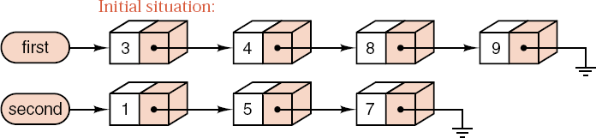
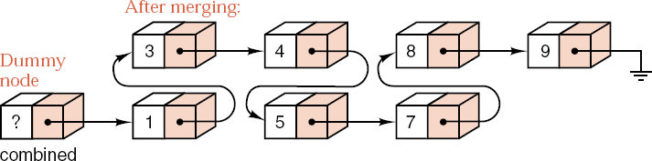
Chapter 8 Sorting
中山大学软件学院

Slide 36
中山大学软件学院
Merge Function
template <class Record>
Node<Record> *Sortable_list<Record>::merge(Node<Record> *first, Node<Record> *second)
{ Node<Record> *last_sorted, combined;
last_sorted = &combined;
while (first != NULL && second != NULL) {
if (first->entry <= second->entry) {
last_sorted->next = first;
last_sorted = first; first = first->next;
}
else {
last_sorted->next = second;
last_sorted = second; second = second->next;
}
}

Slide 37
Chapter 8 Sorting
中山大学软件学院
Merge Function
template <class Record>
Node<Record> *Sortable_list<Record>::merge(Node<Record> *first, Node<Record> *second)
{
Node<Record> *last_sorted, combined;
......
// After one list ends, attach the remainder of the other.
if (first == NULL) last_sorted->next = second;
else last_sorted->next = first;
return combined.next;
}

Slide 38
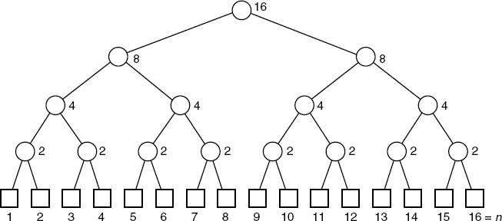
Chapter 8 Sorting
中山大学软件学院
Analysis of Mergesort
Lower bound
lgn! ≈ nlgn - 1.44n + O(lgn)
Mergesort
nlgn - 1.1583n + 1
Insertion sort
n²/4 + O(n)

Slide 39
Chapter 8 Sorting
中山大学软件学院
Quicksort for Contiguous Lists
Interface method
template <class Record>
void Sortable_list<Record> :: quick_sort()
{
recursive_quick_sort(0, count - 1);
}
Recursive function
template <class Record>
void Sortable_list<Record> :: recursive_quick_sort(int low, int high)
{
int pivot_position;
if (low >= high) return;
pivot_position = partition(low, high);
recursive_quick_sort(low, pivot_position - 1);
recursive_quick_sort(pivot_position + 1, high);
}

Slide 40


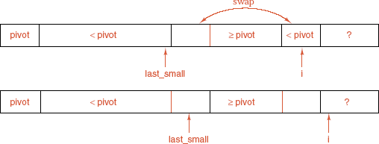

中山大学软件学院
Goal (postcondition):
Loop invariant:
Restore the invariant:
Final position:

Slide 41
Chapter 8 Sorting
中山大学软件学院
Partitioning the List
template <class Record>
int Sortable_list<Record> :: partition(int low, int high)
{
Record pivot;
int i, last_small;
swap(low, (low + high)/2);
pivot = entry[low];
last_small = low;
for (i = low + 1; i <= high; i++)
if (entry[i] < pivot) { last_small++; swap(last_small, i); }
swap(low, last_small);
return last_small;
}

Slide 42
Chapter 8 Sorting
中山大学软件学院
Analysis of Quicksort
Worst-case analysis
If the pivot is chosen poorly, one of the partitioned sublists may be empty and the other reduced by only one entry. In this case, quicksort is slower than either insertion sort or selection sort.
Choice of pivot
First or last entry: Worst case appears for a list already sorted or in reverse order.
Central entry: Poor cases appear only for unusual orders.
Random entry: Poor cases are very unlikely to occur.

Slide 43
Chapter 8 Sorting
中山大学软件学院
Analysis of Quicksort
Average-case analysis
In its average case, quicksort performs
C(n) = 2nlnn + O(n) ≈ 1.39nlgn + O(n)
comparisons of keys in sorting a list of n entries in random order.

Slide 44
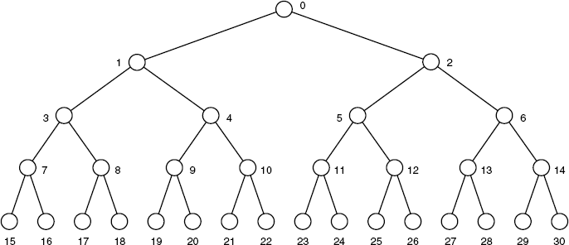
Chapter 8 Sorting
中山大学软件学院
Trees, Lists, and Heaps
If the root of the tree is in position 0 of the list, the left and right children of the node in position k are in positions 2k+1 and 2k+2 of the list, respectively. If these positions are beyond the end of the list, then these children do not exist.

Slide 45
Chapter 8 Sorting
中山大学软件学院
Trees, Lists, and Heaps
Definition A heap is a list in which each entry contains a key, and, for all positions k in the list, the key at position k is at least as large as the keys in positions 2k and 2k+1, provided these positions exist in the list.
Remark Many C++ manuals and textbooks refer to the area used for dynamic memory as the heap; this use of the word .heap. has nothing to do with the present definition.
Heapsort is suitable only for contiguous lists.

Slide 46
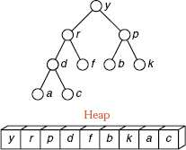
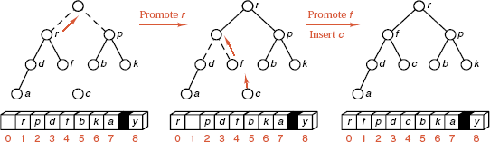
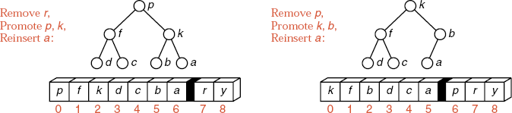
Chapter 8 Sorting
中山大学软件学院
Trees, Lists, and Heaps

Slide 47
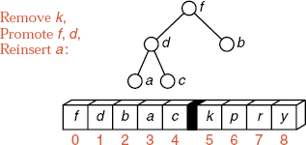
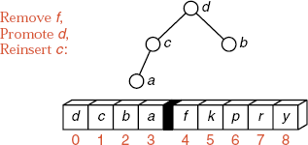
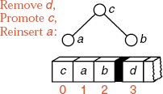
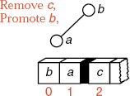
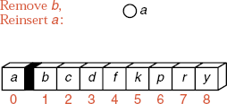
Chapter 8 Sorting
中山大学软件学院
Trees, Lists, and Heaps

Slide 48
Chapter 8 Sorting
中山大学软件学院
Main function for heapsort
template <class Record>
void Sortable_list<Record> :: heap_sort()
{
Record current;
int last_unsorted;
build_heap();
for (k = count - 1; k > 0; k--) {
current = entry[k];
entry[k] = entry[0];
insert_heap(current, 0, k - 1);
}
}

Slide 49
Chapter 8 Sorting
中山大学软件学院
Building the initial heap
template <class Record>
void Sortable_list<Record> :: build_heap( )
{
int low;
for (low = count/2 - 1; low >= 0; low--) {
Record current = entry[low];
insert_heap(current, low, count - 1);
}
}

Slide 50
Chapter 8 Sorting
中山大学软件学院
Insertion into a heap
template <class Record>
void Sortable_list<Record> ::insert_heap(const Record &current, int low, int high)
{
int large;
large = 2 * low + 1;
while (large <= high) {
if (large < high && entry[large] < entry[large+1]) large++;
if (current >= entry[large]) break;
entry[low] = entry[large];
low = large; large = 2 * low + 1;
}
entry[low] = current;
}

Slide 51
Chapter 8 Sorting
中山大学软件学院
Analysis of Heapsort
In its worst case for sorting a list of length n, heapsort performs 2nlgn + O(n) comparisons of keys, and
it performs nlgn + O(n) assignments of entries.

Slide 52
Chapter 8 Sorting
中山大学软件学院
Priority Queues
Definition A priority queue consists of entries, such that each entry contains a key called the priority of the entry. A priority queue has only two operations other than the usual creation, clearing, size, full, and empty operations:
1) Insert an entry
2) Remove the entry having the largest (or smallest) key.
If entries have equal keys, then any entry with the largest key may be removed first.

Slide 53
Chapter 8 Sorting
中山大学软件学院
Comparison of Sorting Methods
Use of space
Use of computer time
Programming effort
Statistical analysis
Empirical testing

Slide 54
Chapter 9 Tables and Information Retrieval
中山大学软件学院
9.1. Introduction: Breaking the lgn Barrier
9.2. Rectangular Arrays
9.3. Tables of Various Shapes
9.4. Tables: A New Abstract Data Type
9.5. Application: Radix Sort
9.6. Hashing
9.7. Analysis of Hashing
9.8. Conclusions: Comparison of Methods
9.9. Application: The Life Game Revisited

Slide 55
Chapter 9 Tables and Information Retrieval
中山大学软件学院
Introduction: Breaking the lgn Barrier
By use of key comparisons alone, it is impossible to complete a search of n items in fewer than lgn comparisons, on average (lowerbound_search_thm).
Ordinary table lookup or array access requires only constant time O(1).
Both table lookup and searching algorithms provide functions from a set of keys or indices to locations in a list or array.
Several steps may be needed to retrieve an entry from some kinds of tables, but the time required remains O(1).

Slide 56
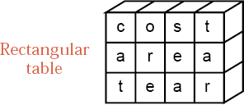
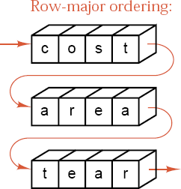
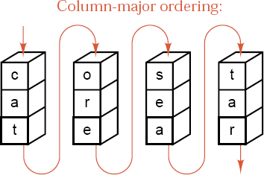
Chapter 9 Tables and Information Retrieval
中山大学软件学院
Rectangular Arrays

Slide 57
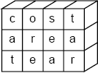
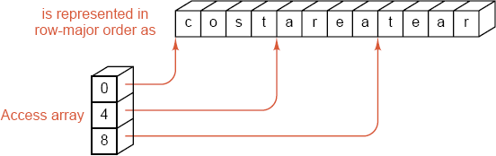
Chapter 9 Tables and Information Retrieval
中山大学软件学院
Rectangular Arrays

Slide 58
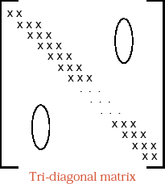
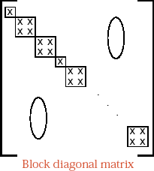
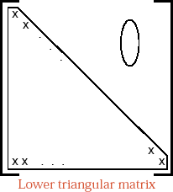
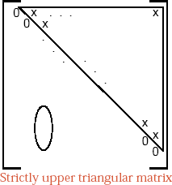
Chapter 9 Tables and Information Retrieval
中山大学软件学院
Matrices of Various Shapes

Slide 59
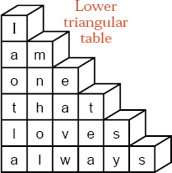
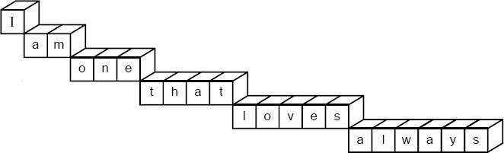

Chapter 9 Tables and Information Retrieval
中山大学软件学院

Slide 60
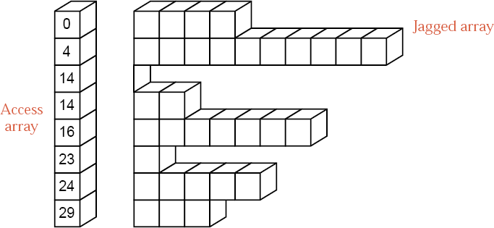
Chapter 9 Tables and Information Retrieval
中山大学软件学院
Jagged Table with Access Table

Slide 61
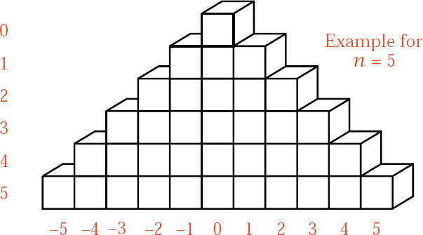
Chapter 9 Tables and Information Retrieval
中山大学软件学院
Symmetrically Triangular Table

Slide 62
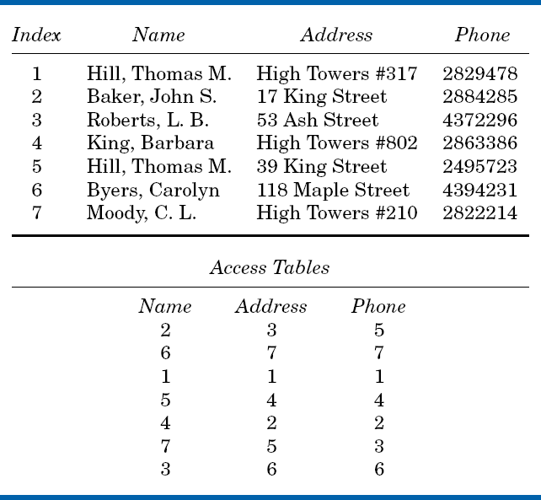
中山大学软件学院
Inverted Table

Slide 63
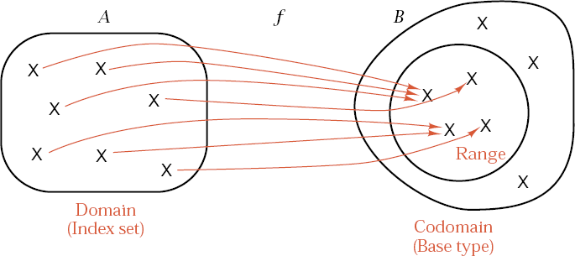
Chapter 9 Tables and Information Retrieval
中山大学软件学院
Functions

Slide 64
Chapter 9 Tables and Information Retrieval
中山大学软件学院
Functions
In mathematics a function is defined in terms of two sets and a correspondence from elements of the first set to elements of the second. If f is a function from a set A to a set B, then f assigns to each element of A a unique element of B.
The set A is called the domain of f, and the set B is called the codomain of f.
The subset of B containing just those elements that occur as values of f is called the range of f.

Slide 65
Chapter 9 Tables and Information Retrieval
中山大学软件学院
Definition A table with index set I and base type T is a function from I to T together with the following operations.
1). Table access: Evaluate the function at any index in I .
2). Table assignment: Modify the function by changing its value at a specified index in I to the new value specified in the assignment.
3). Creation: Set up a new function.
4). Clearing: Remove all elements from the index set I , so there is no remaining domain.
5). Insertion: Adjoin a new element x to the index set I and dene a corresponding value of the function at x.
6). Deletion: Delete an element x from the index set I and restrict the function to the resulting smaller domain.

Slide 66
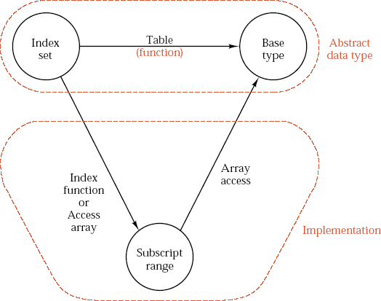
Chapter 9 Tables and Information Retrieval
中山大学软件学院
Functions

Slide 67




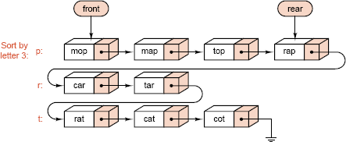


Chapter 9 Tables and Information Retrieval
中山大学软件学院
Radix Sort

Slide 68
Chapter 9 Tables and Information Retrieval
中山大学软件学院
Linked Implementation of Radix Sort
List definition
template <class Record>
class Sortable_list: public List<Record> {
public:
void radix_sort( );
private:
void rethread(Queue queues[]); // 回收在队列中的数据
};

Slide 69
Chapter 9 Tables and Information Retrieval
中山大学软件学院
Linked Implementation of Radix Sort
Record definition
class Record {
public:
char key_letter(int position) const;
Record( ); // default constructor
operator Key ( ) const; // cast to Key
};
Record::key_letter(int position)
{
return data[position];
}

Slide 70
Chapter 9 Tables and Information Retrieval
中山大学软件学院
Auxiliary Functions, Linked Radix Sort
Selecting a queue
int alphabetic_order(char c)
{
if (c == 0) return 0;
if ('a' <= c && c <= 'z') return c − 'a' + 1;
if ('A' <= c && c <= 'Z') return c − 'A' + 1;
return 27;
}

Slide 71
Chapter 9 Tables and Information Retrieval
中山大学软件学院
Sorting Method, Linked Radix Sort
const int max_chars = 28;
template <class Record>
void Sortable_list<Record> :: radix_sort()
{
Record data;
Queue queues[max_chars];
for (int pos = key_size - 1; pos >= 0; pos--) {
while (remove(0, data) == success) {
int k = alphabetic_order(data.key_letter(pos));
queues[k].append(data);
}
rethread(queues);
}
}

Slide 72
Chapter 9 Tables and Information Retrieval
中山大学软件学院
Auxiliary Functions, Linked Radix Sort
Connecting the queues
template <class Record>
void Sortable_list<Record> :: rethread(Queue queues[])
{
Record data;
for (int i = 0; i < max_chars; i++)
while (!queues[i].empty()) {
queues[i].retrieve(data);
insert(size(), data);
queues[i].serve();
}
}

Slide 73
Chapter 9 Tables and Information Retrieval
中山大学软件学院
Analysis of Radix Sort
The time used by radix sort is Θ(nk), where n is the number of items and k is the number of characters in a key.
The relative performance of radix sort to other methods will relate to the relative sizes of nk and nlgn.
If the keys are long but there are few of them, then k is large and lgn small, and other methods (such as mergesort) will outperform radix sort.
If k is small (the keys are short) and there are a large number of keys, then radix sort will be faster than any other method.

Slide 74

Chapter 9 Tables and Information Retrieval
中山大学软件学院
Hash Tables

Slide 75
Chapter 9 Tables and Information Retrieval
中山大学软件学院
Hash Tables
Start with an array that holds the hash table.
Use a hash function to take a key and map it to some index in the array. This function will generally map several different keys to the same index.
If the desired record is in the location given by the index, then we are finished; otherwise we must use some method to resolve the collision that may have occurred between two records wanting to go to the same location.
To use hashing we must (a) find good hash functions and (b) determine how to resolve collisions.

Slide 76
Chapter 9 Tables and Information Retrieval
中山大学软件学院
Choosing a Hash Function
A hash function should be easy and quick to compute.
A hash function should achieve an even distribution of the keys that actually occur across the range of indices.
The usual way to make a hash function ia to take the key, chop it up, mix the pieces together in various ways, and thereby obtain an index that will be uniformly distributed over the range of indices.
If the function is evaluated more than once on the same key, it must give the same result every time.

Slide 77
Chapter 9 Tables and Information Retrieval
中山大学软件学院
Choosing a Hash Function
Truncation: we ignore part of the key, and use the remaining part as the index.
Folding: We may partition the key into several parts and combine the parts in a convenient way.
Modular arithmetic: We may convert the key to an integer, divide by the size of the index range, and take the remainder as the result.
A better spread of keys is often obtained by taking the size of the table (the index range) to be a prime number.

Slide 78
Chapter 9 Tables and Information Retrieval
中山大学软件学院
C++ Example of a Hash Function
We write a hash function in C++ for transforming a key consisting of eight alphanumeric characters into an integer in the range 0 .. hash_size - 1.
class Key: public String{
public:
char key_letter(int position) const;
void make_blank( );
......
};

Slide 79
Chapter 9 Tables and Information Retrieval
中山大学软件学院
C++ Example of a Hash Function
The method key_letter (int position) return the character in a particular position of the Key, or return a blank if the Key has length less than n. The final method make blank sets up an empty Key.
int hash(const Key &target)
{
int value = 0;
for (int pos = 0; pos < 8; pos++)
value = 4 * value + target.key_letter(pos);
return value % hash_size;
}

Slide 80

Chapter 9 Tables and Information Retrieval
中山大学软件学院
Collision Resolution with Open Addressing
Linear Probing
Linear probing starts with the hash address and searches sequentially for the target key or an empty position. The array should be considered circular, so that when the last location is reached, the search proceeds to the first location of the array.
Clustering

Slide 81
Chapter 9 Tables and Information Retrieval
中山大学软件学院
Collision Resolution with Open Addressing
Quadratic Probing
If there is a collision at hash address h, quadratic probing goes to locations h+1, h+4, h+9, ... , that is, at locations h + i² (mod hashsize) for i = 1, 2, ... .
Other methods
1) Key-dependent increments
2) Random probing

Slide 82
Chapter 9 Tables and Information Retrieval
中山大学软件学院
Hash Table Specifications
const int hash_size = 997;
class Hash_table {
public:
Hash_table( );
void clear( );
Error_code insert(const Record &newentry);
Error_code retrieve(const Key &target, Record &found) const;
private:
Record table[hash_size];
};

Slide 83
Chapter 9 Tables and Information Retrieval
中山大学软件学院
Hash Table Specifications
Hash_table :: Hash_table( );
Post: The hash table has been created and initialized to be empty.
void Hash_table :: clear( );
Post: The hash table has been cleared and is empty.
Error_code Hash_table :: retrieve(const Key &target, Record &found) const;
Post: If an entry in the hash table has key equal to target, then found takes on the value of such an entry, and success is returned. Otherwise, not_present is returned.

Slide 84
Chapter 9 Tables and Information Retrieval
中山大学软件学院
Hash Table Insertion
Error code Hash table :: insert(const Record &new_entry)
{
Error_code result = success;
int probe_count, increment, probe;
Key null;
null.make_blank( );
probe = hash(new_entry);
probe_count = 0; increment = 1;
while (table[probe] != null && table[probe] != new_entry &&
probe_count < (hash_size + 1)/2) {
probe_count++;
probe = (probe + increment) % hash_size;
increment += 2;
}
if (table[probe] == null) table[probe] = new_entry;
else if (table[probe] == new_entry) result = duplicate_error;
else result = overflow;
return result;
}

Slide 85

Chapter 9 Tables and Information Retrieval
中山大学软件学院
Chained Hash Tables

Slide 86
Chapter 9 Tables and Information Retrieval
中山大学软件学院
Chained Hash Tables
The linked lists from the hash table are called chains.
If the records are large, a chained hash table can save space.
Collision resolution with chaining is simple; clustering is no problem.
The hash table itself can be smaller than the number of records; overflow is no problem.
Deletion is quick and easy in a chained hash table.
If the records are very small and the table nearly full, chaining may take more space.

Slide 87
Chapter 9 Tables and Information Retrieval
中山大学软件学院
Code for Chained Hash Tables
Definition
class Hash_table {
public:
// Specify methods here.
private:
List<Record> table[hash_size];
};
The class List can be any one of the generic linked implementations of a list in Chapter 6.
Constructor: The implementation of the constructor simply calls the constructor for each list in the array.

Slide 88
Chapter 9 Tables and Information Retrieval
中山大学软件学院
Code for Chained Hash Tables
Clear: To clear the table, we must clear the linked list in each of the table positions, using the List method clear( ).
Retrieval: sequential_search(table[hash(target)], target, position);
Insertion: table[hash(new_entry)].insert(0, new entry);
Deletion: Error_code Hash_table::remove(const Key type &target, Record &x);
Post: If the table has an entry with key equal to target, a code of success is returned, the entry is deleted fro the hash table and recorded in x. Otherwise a code of not present is returned.

Slide 89
Chapter 9 Tables and Information Retrieval
中山大学软件学院
Analysis of Hashing
A probe is one comparison of a key with the target.
The load factor of the table is λ= n/t, where n positions are occupied out of a total of t positions in the table.
Retrieval from a chained hash table with load factor requires approximately 1 + λ/2 probes in the successful case and probes in the unsuccessful case.
Retrieval from a hash table with open addressing, random probing, and load factor λ requires approximately ln(1/(1-λ))/λ probes in the successful case and 1/(1-λ) probes in the unsuccessful case.

Slide 90
Chapter 9 Tables and Information Retrieval
中山大学软件学院
Analysis of Hashing
Retrieval from a hash table with open addressing, linear probing, and load factor requires approximately
(1 + (1-λ)⁻¹)/2 and (1 + (1- λ)⁻²)/2
probes in the successful case and in the unsuccessful case, respectively.

Slide 91

Chapter 9 Tables and Information Retrieval
中山大学软件学院
Theoretical comparisons

Slide 92

Chapter 9 Tables and Information Retrieval
中山大学软件学院
Theoretical comparisons

Slide 93
Chapter 9 Tables and Information Retrieval
中山大学软件学院
Conclusions: Comparison of Methods
Four principal methods of information retrieval: two for lists and two for tables.
Sequential search is Θ(n).
Sequential search is the most flexible method. The data may be stored in any order, with either contiguous or linked representation.
Binary search is Θ(logn).
Binary search demands more, but is faster: The keys must be in order, and the data must be in random-access representation (contiguous storage).

Slide 94
Chapter 9 Tables and Information Retrieval
中山大学软件学院
Conclusions: Comparison of Methods
Table lookup is Θ(1)
Ordinary lookup in contiguous tables is best, both in speed and convenience, unless a list is preferred, or the set of keys is sparse, or insertions or deletions are frequent.
Hash-table retrieval is Θ(1)
Hashing requires the most structure, a peculiar ordering of the keys well suited to retrieval from the hash table, but generally useless for any other purpose. If the data are to be available for human inspection, then some kind of order is needed, and a hash table is inappropriate.

