Slide 1

Software Engineering Analysis Presentation
ADIL AKARKACH
LIU HUIYU
MAOYUQING
ZHUYING

Slide 2
SOFTWARE ENGINEERING ANALYSIS
project Introduction
Team Member
WHAT
HOW
WHO
ADIL AKARKACH
LIU HUIYU
MAOYUQING
ZHUYING

Slide 3
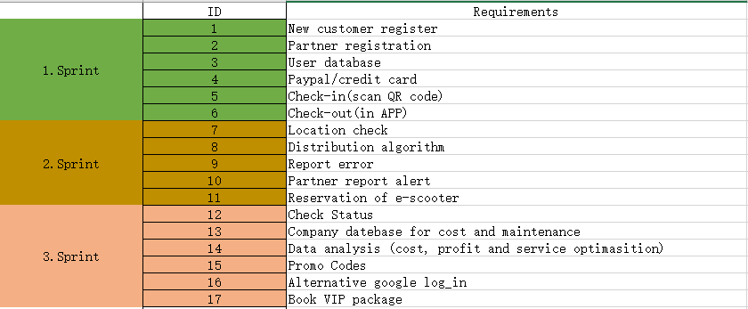
BACKLOG ITEMS

Slide 4
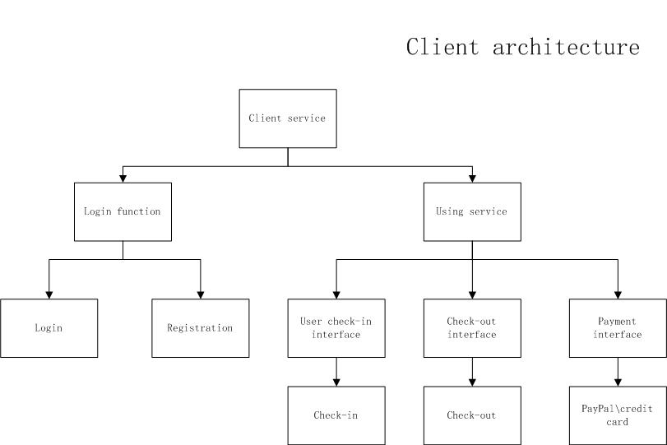
HIGH-LEVEL SYSTEM ARCHITECTURE

Slide 5
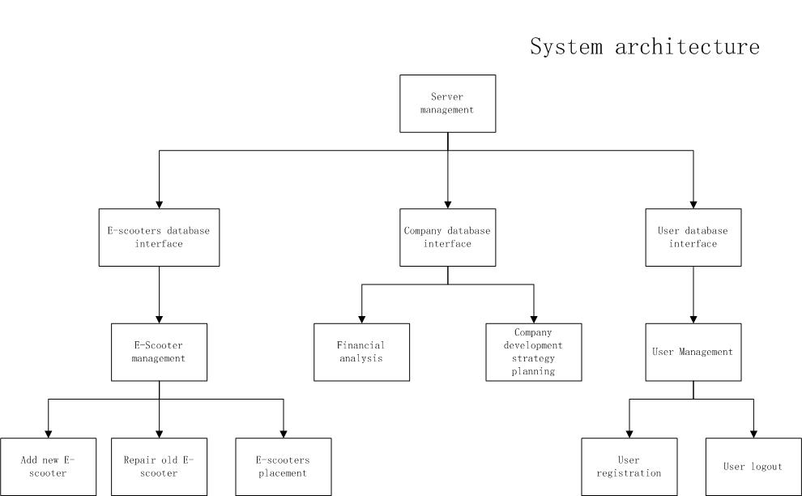
HIGH-LEVEL SYSTEM ARCHITECTURE

Slide 6
SPECIFIC BACKLOG ITEM: PayPal/credit card
User Story
What it contains?
User story
Use case
Use case diagram
Sequence diagram
Activity diagram
As a customer ,I have two kinds of payment by PayPal or by credit card , various payment methods provide convenience to customer.

Slide 7
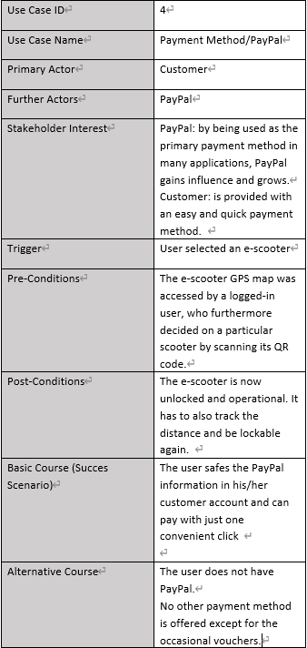
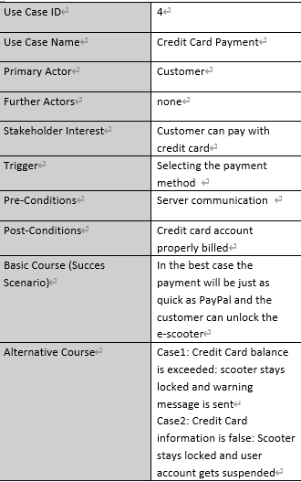
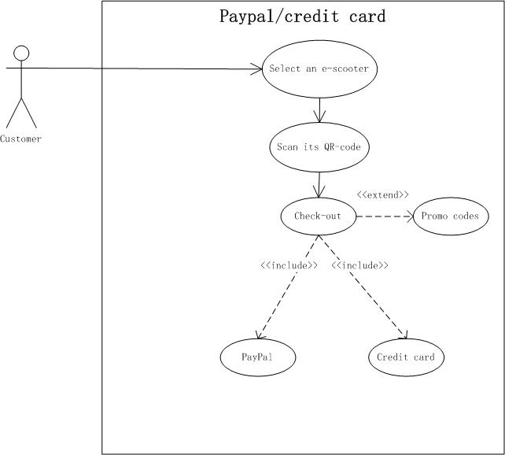
Use Case
Use Case Diagram

Slide 8
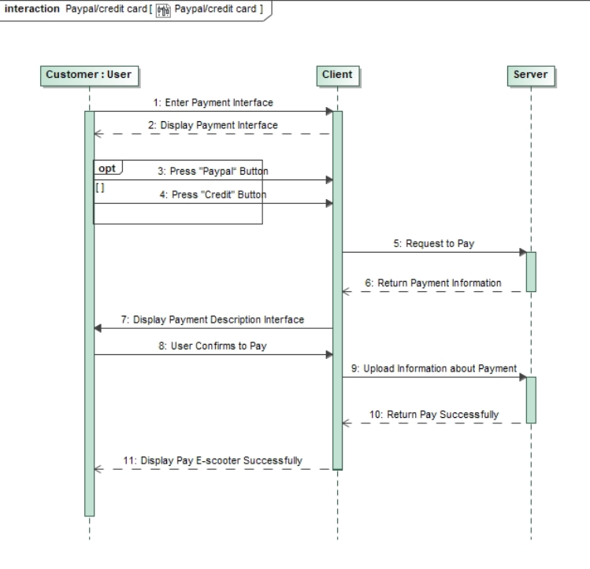
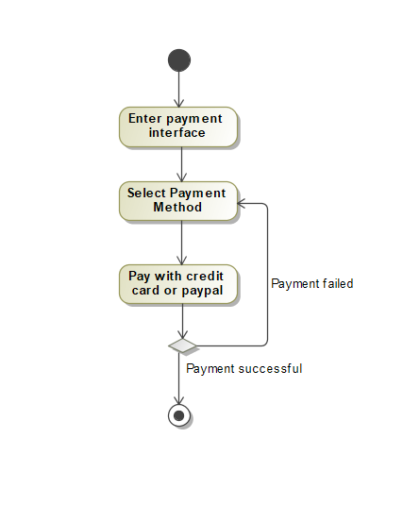
Sequence Diagram
Activity Diagram

Slide 9
SCRUM PROCESS
SPRINT 1:
-good: estimate met / learned using the software
-to be improved: planning & distributing tasks
SPRINT 2:
-good: using software became routine
-to be improved: integrity of names in the document
SPRINT 3:
-good: routine in SCRUM process
-to be improved: document structure/formatting

Slide 10
RESULTS
•What we gained?
Cooperation
Team spirit
Communication
•What we learned?
Agile Mode
UML
Planning a project

