Slide 1

Software Engineering Analysis Presentation
ADIL
LIU HUIYU
MAOYUQING
ZHUYING

Slide 2
SOFTWARE ENGINEERING ANALYSIS
project Introduction
Team Member
WHAT
HOW
WHO
ADIL
LIU HUIYU
MAOYUQING
ZHUYING

Slide 3
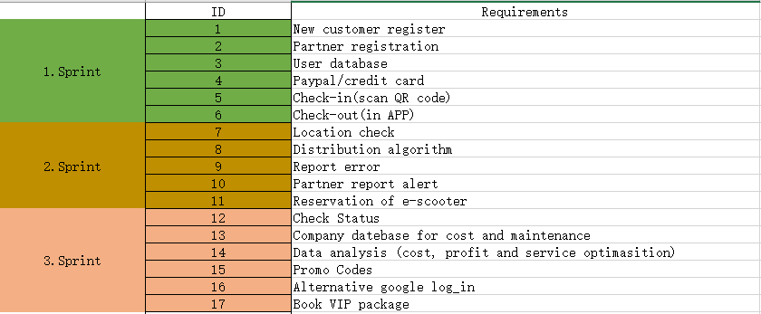
BACKLOG ITEMS

Slide 4
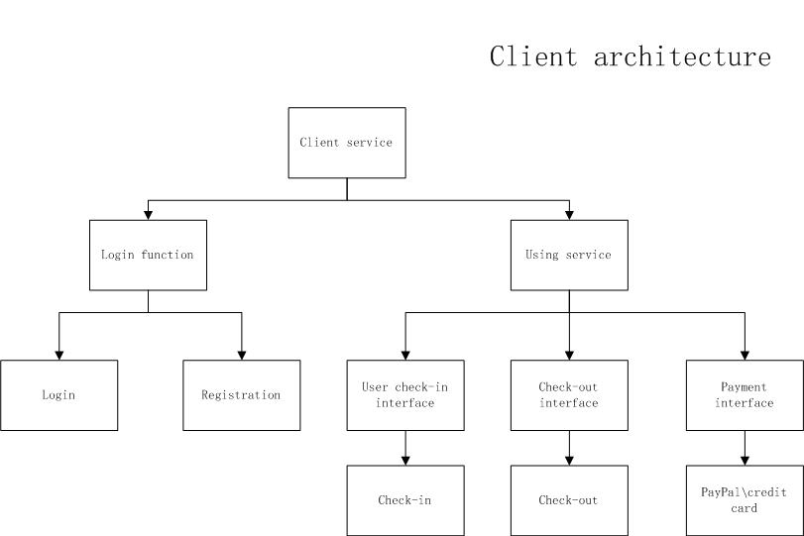
HIGH-LEVEL SYSTEM ARCHITECTURE

Slide 5
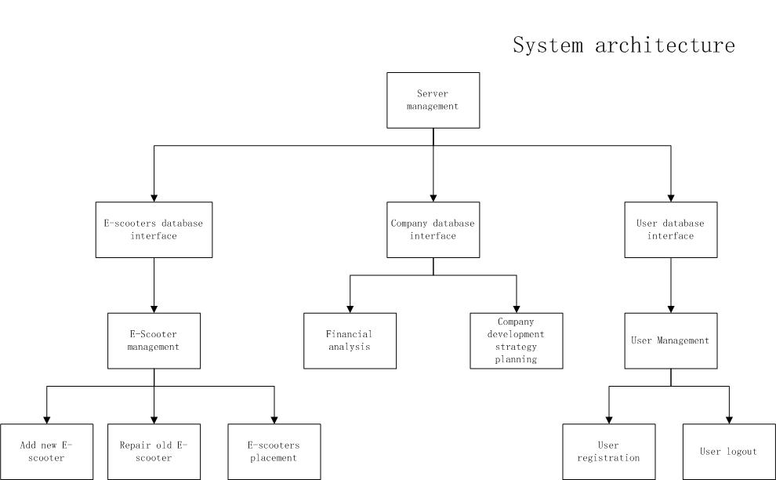
HIGH-LEVEL SYSTEM ARCHITECTURE

Slide 6
SPECIFIC BACKLOG ITEM: PayPal/credit card Team Member: Mao Yuqing
User Story
What it contains?
User story
Use case
Use case diagram
Sequence diagram
Activity diagram
As a customer ,I have two kinds of payment by PayPal or by credit card , various payment methods provide convenience to customer.

Slide 7
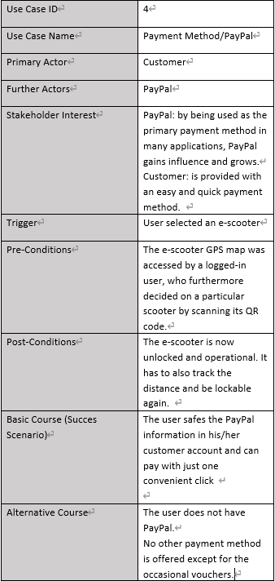
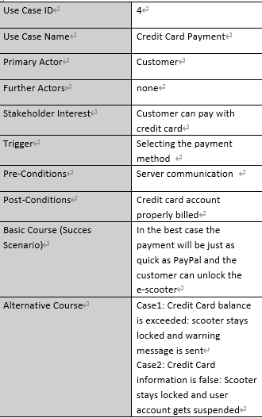
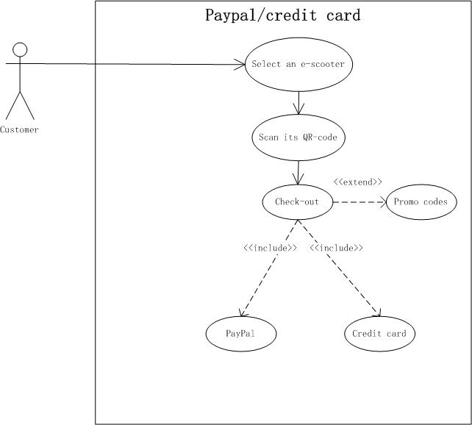
Use Case
Use Case Diagram

Slide 8
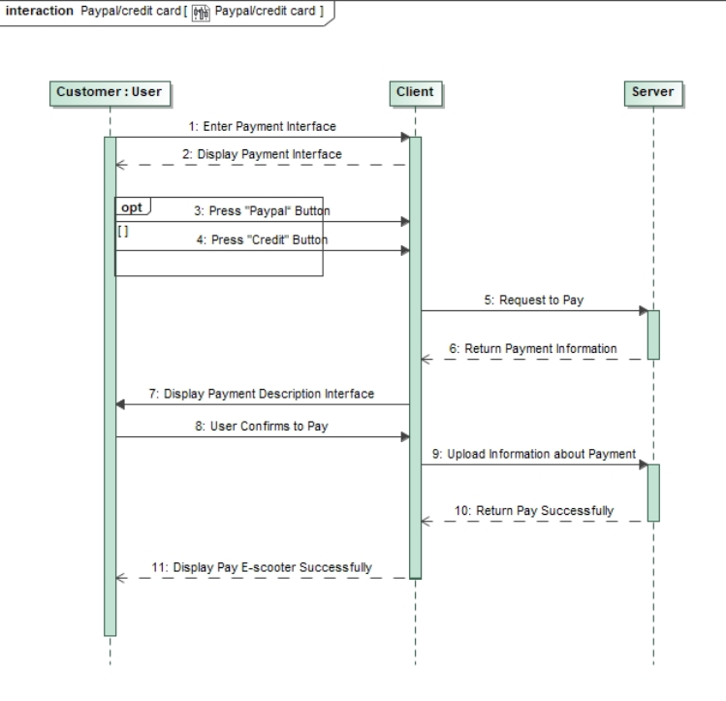
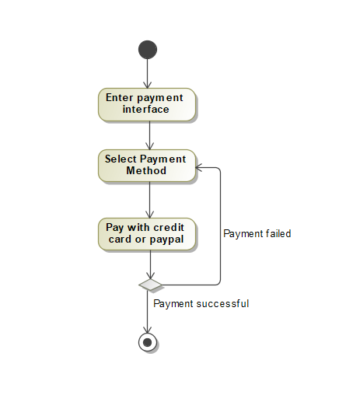
Sequence Diagram
Activity Diagram

Slide 9
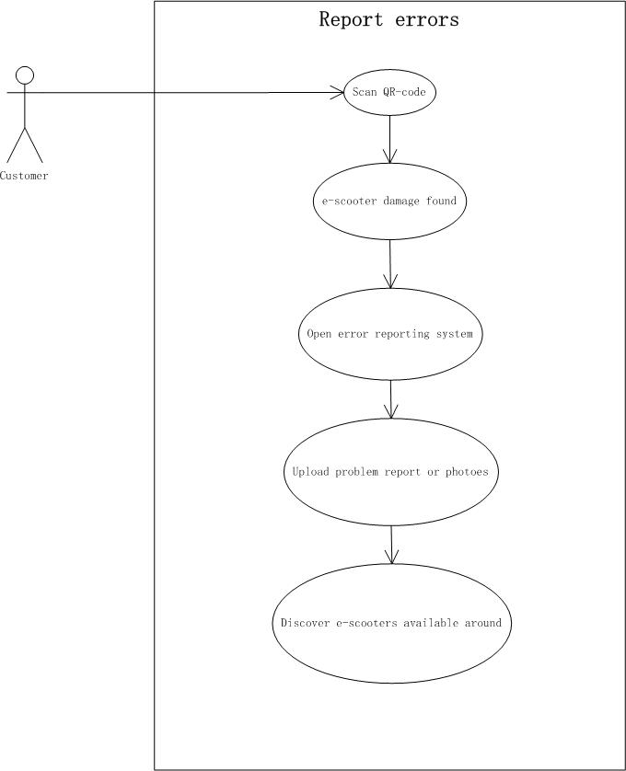
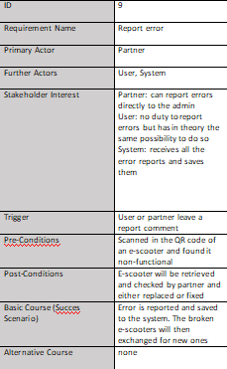
SPECIFIC BACKLOG ITEM: Report error Team Member: LIU Huayu
User story As a customer,I can give feedback to the partner when I encounter a problem with the e-scooter.

Slide 10
SCRUM PROCESS

Slide 11
RESULTS

