Slide 1

Software Engineering Analysis Presentation
ADIL
LIU HUIYU
MAOYUQING
ZHUYING

Slide 2
SOFTWARE ENGINEERING ANALYSIS
project Introduction
Team Member
WHAT
HOW
WHO
ADIL
LIU HUIYU
MAOYUQING
ZHUYING

Slide 3
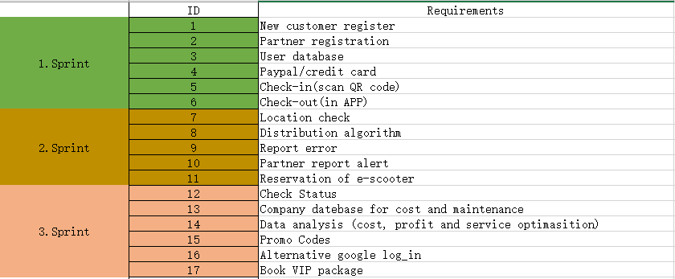
BACKLOG ITEMS

Slide 4
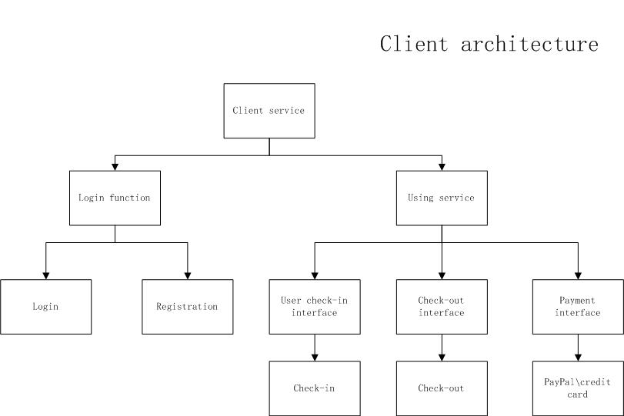
HIGH-LEVEL SYSTEM ARCHITECTURE

Slide 5
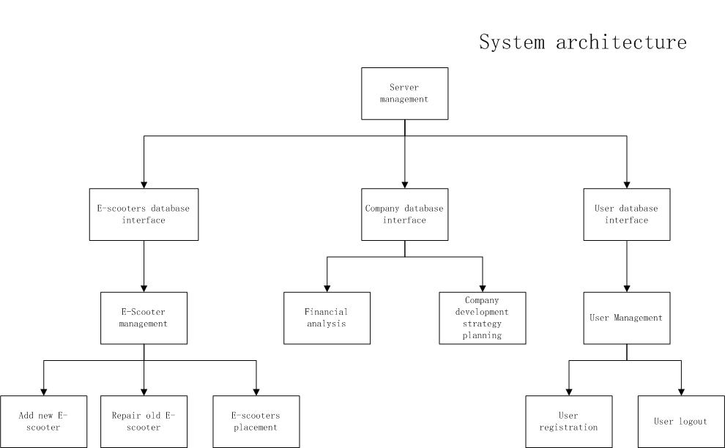
HIGH-LEVEL SYSTEM ARCHITECTURE

Slide 6
SPECIFIC BACKLOG ITEM: PayPal/credit card Team Member: Mao Yuqing
User Story
What it contains?
User story
Use case
Use case diagram
Sequence diagram
Activity diagram
As a customer ,I have two kinds of payment by PayPal or by credit card , various payment methods provide convenience to customer.

Slide 7
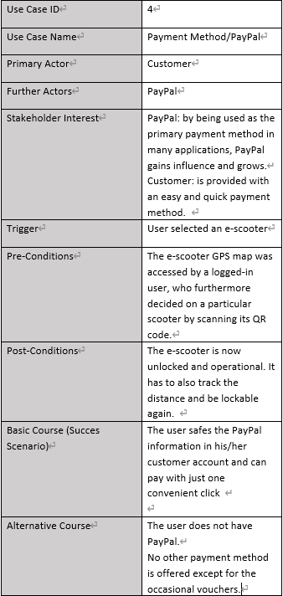
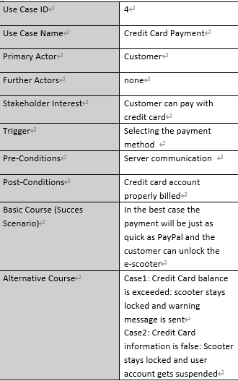
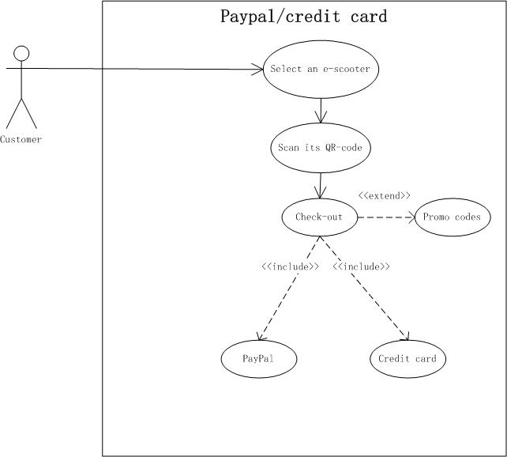
Use Case
Use Case Diagram

Slide 8
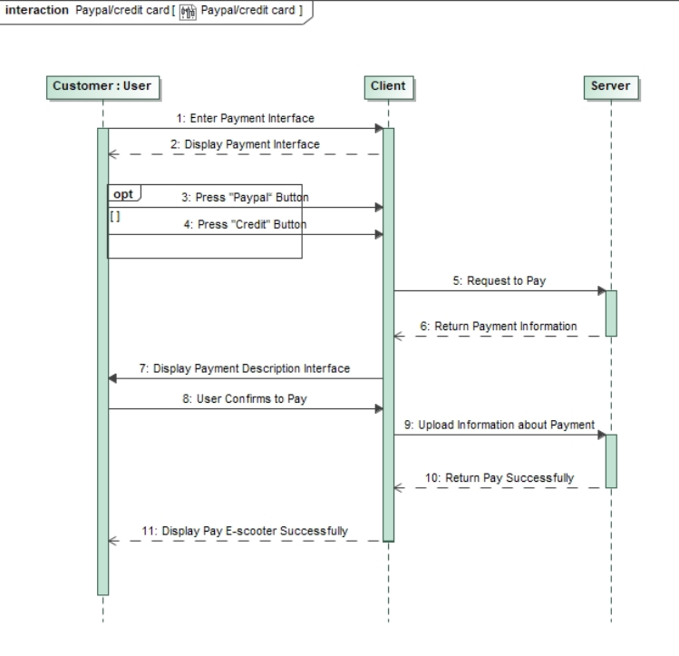
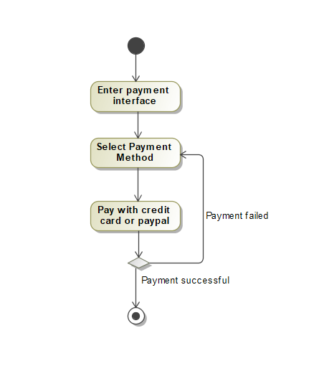
Sequence Diagram
Activity Diagram

Slide 9
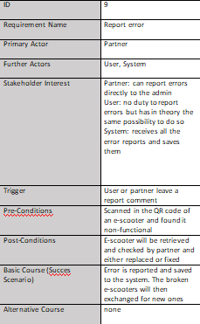
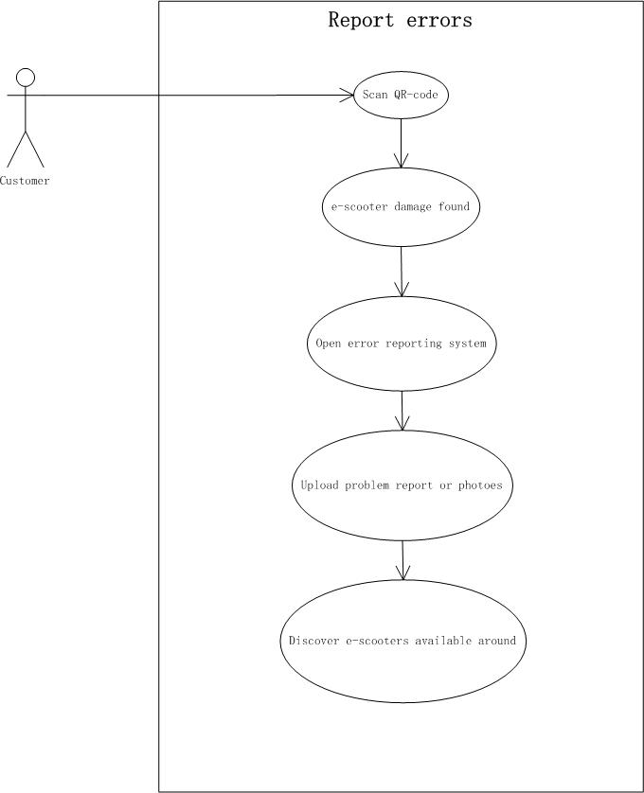
SPECIFIC BACKLOG ITEM: Report error Team Member: LIU Huayu
User story As a customer,I can give feedback to the partner when I encounter a problem with the e-scooter.

Slide 10
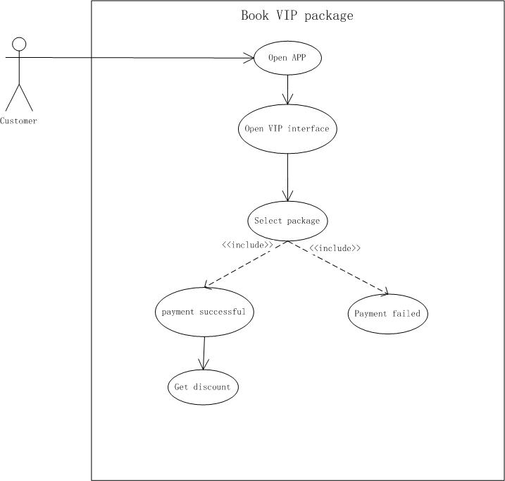
SPECIFIC BACKLOG ITEM: Book VIP package Team Member: Zhu Ying
ID | 17
Use Case Name | Book VIP package
Primary Actor | Customer
Further Actors | Company
Stakeholder Interest | Customer:Have discount riding the E-scooterCompanyAttract more customer.
Trigger | Customer orders the VIP package in app.
Pre-Conditions | Customer log in successfully,and hava effective payment.
Post-Conditions | Customer becomes VIP and could use VIP package
Basic Course (Succes Scenario) | Customer gets a VIP package and can ride E-scooter cheaper.
Alternative Course | Failed use VIP package.There is a deadline,need a voucher.
User story:As a customer,I can book VIP package like 10/20/30 per month

Slide 11
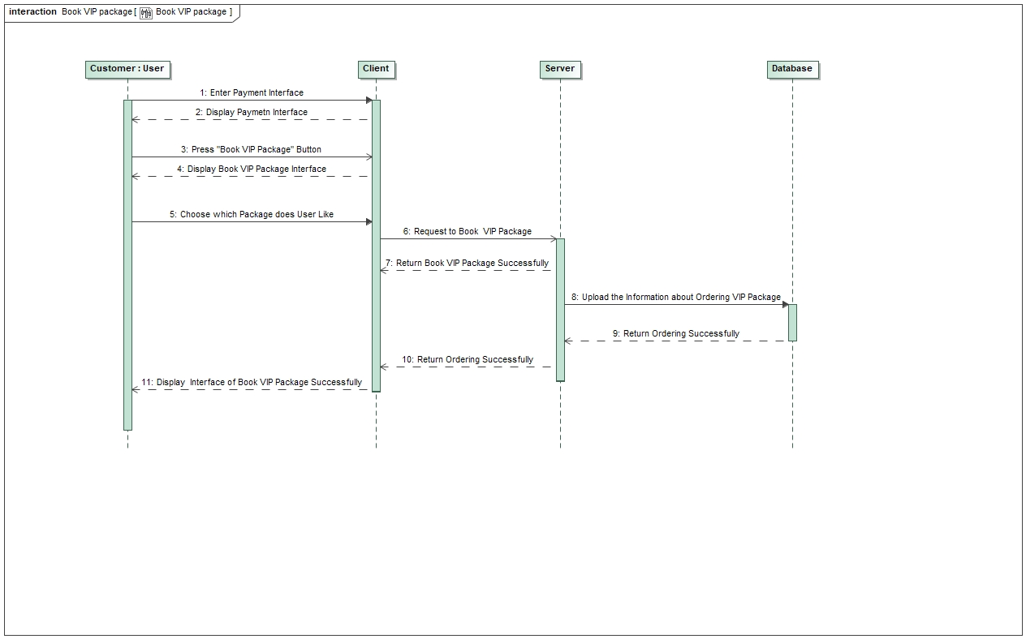
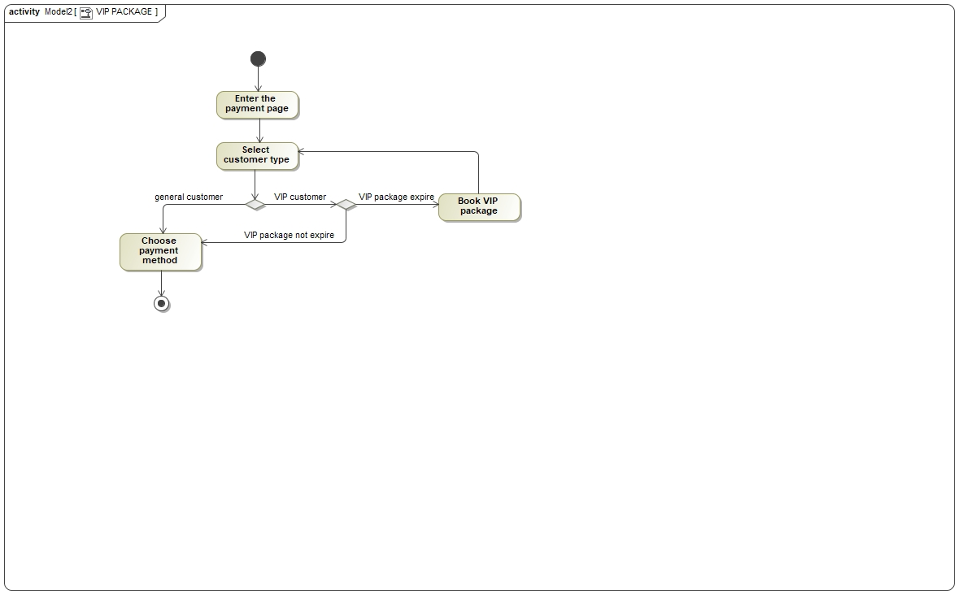
Sequence Diagram
Activity Diagram

Slide 12
SCRUM PROCESS

Slide 13
RESULTS
•What we gained?
Cooperation
Team spirit
Communication
•What we learned?
Agile Mode
UML
Simulation Company

