Slide 1

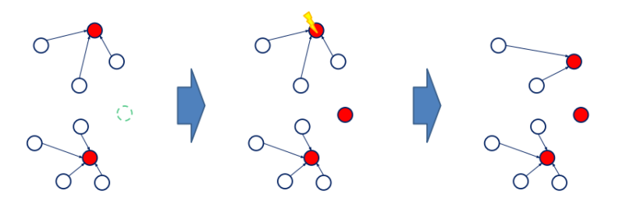
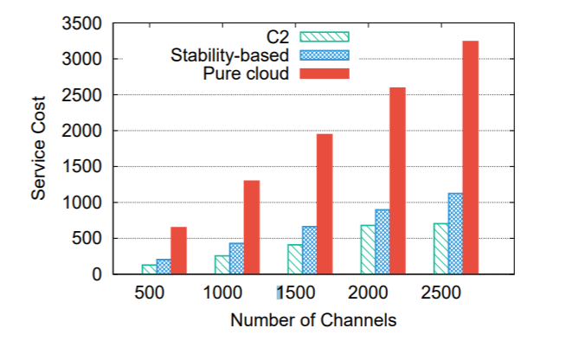
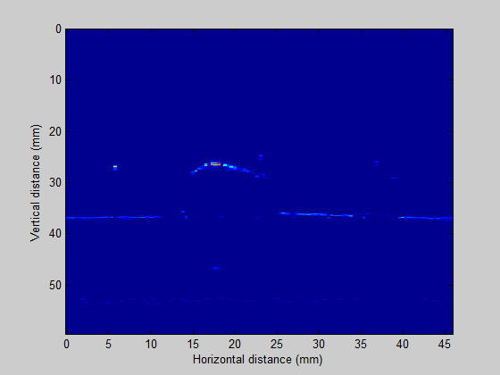
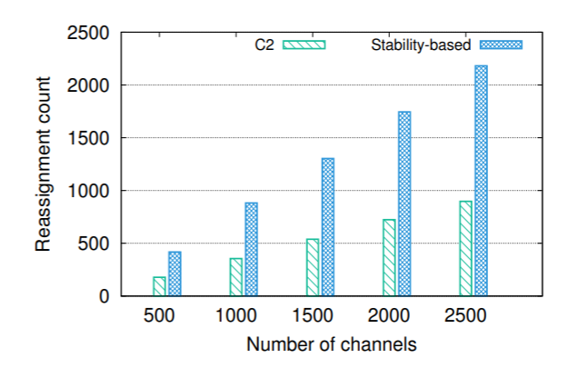
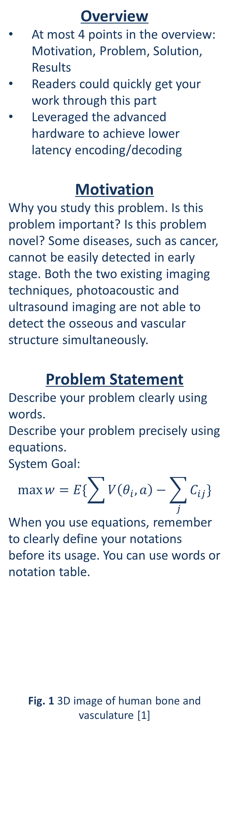
VE444 • Networks
Group# Course Project
Photoacoustic Ultrasound (PAUS) for Co‐Registered Imaging of Bone Structure and Vasculature
Team Members: Aby Xu, Bob Yu, Charlie Ze
Instructor: Prof. Yifei Zhu
Overview
At most 4 points in the overview: Motivation, Problem, Solution, Results
Readers could quickly get your work through this part
Leveraged the advanced hardware to achieve lower latency encoding/decoding
Motivation
Why you study this problem. Is this problem important? Is this problem novel? Some diseases, such as cancer, cannot be easily detected in early stage. Both the two existing imaging techniques, photoacoustic and ultrasound imaging are not able to detect the osseous and vascular structure simultaneously.
Problem Statement
Describe your problem clearly using words.
Describe your problem precisely using equations.
System Goal:
$$\max{w=E\{\sum{V\left(θ_{i},a\right)−\sum_{j}{C_{ij}}}\}}$$
When you use equations, remember to clearly define your notations before its usage. You can use words or notation table.
Fig. 1 3D image of human bone and vasculature [1]
Algorithm Design
This part serves to describe your algorithm in details. Please remember to use tables, algorithms, figures, equations, toy examples instead of simply word descriptions to summarize your design.
Algorithm sketch:
Compute ,,,
Iterating until
,,,
…
Compute
Fig.4 Example for my algorithm
Modeling and Analysis
If you are doing a modelling work, you can focus more on modelling part, what your model looks like. Analysis of your model.
Fig. 5 2D bone profile
Note that usually we need to fill up the whole poster.
Results
Dataset description:
Use words or tables to summarize the basic statistics of your dataset. Source. Size. Diameter. Average degree, etc.
You can also visualize your network using graphs.
Compared approaches:
Approach 1: Briefly describe this approach
Approach 2:Briefly describe this approach
Evaluation results:
Reassignment counts
Service cost comparison
Summarize your presented results in words here.
Any interesting findings 1
Any interesting finding 2
References
At most 3 references
Reference1
Reference2
Reference
[1]At most 3 important references
[1]http://labs.seas.wustl.edu/bme/Wang/index.html
[1]http://labs.seas.wustl.edu/bme/Wang/index.html
Source
Node size
Edge size

