Slide 1


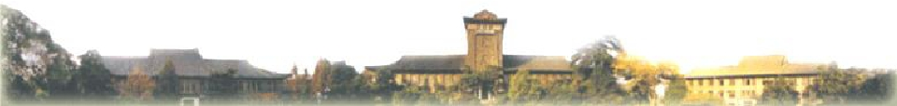
http://lamda.nju.edu.cn
留
On the Margin Theory
保
权
有
for AdaBoost
所
用
专
程
Zhi-Hua Zhou
课
论
导
http://cs.nju.edu.cn/zhouzh/
Email: zhouzh@nju.edu.cn
习
学
器
机
学
LAMDA Group
大
京
National Key Laboratory for Novel Software Technology,
南
Nanjing University, China
16
20

Slide 2

Special focus of this talk: AdaBoost
Significant advantageous:
http://lamda.nju.edu.cn
留
保
权
有
Very accurate prediction
Very simple (“just 10 lines of code” as Schapire said)
Wide and successful applications
Sound theoretical foundation
… …
❐
❐
❐
❐
❐
所
用
专
程
课
论
导
习
学
器
机
学
大
Gödel Prize (2003)
Freund & Schapire, A decision theoretic generalization of on-line
learning and an application to Boosting. Journal of Computer and
System Sciences, 1997, 55: 119-139.
http://cs.nju.edu.cn/zhouzh/
京
南
16
20

Slide 3

The born of AdaBoost
http://lamda.nju.edu.cn
留
保
An open problem [Kearns & Valiant, STOC’89]:
“weakly learnable” ?= “strongly learnable”
a problem is learnable or strongly learnable if there exists an
algorithm that outputs a learner h in polynomial time such
that for all
a problem is weakly learnable if there exists an algorithm that
outputs a learner with error 0.5−1/p where p is a polynomial in
problem size and other parameters
In other words, whether a “weak” learning algorithm that works
just slightly better than random guess can be “boosted” into an
arbitrarily accurate “strong” learning algorithm
http://cs.nju.edu.cn/zhouzh/
权
有
所
用
专
程
课
论
导
习
学
器
机
学
大
京
南
16
20

Slide 4
The born of AdaBoost (con’t)
http://lamda.nju.edu.cn
留
保
➢ Amazingly, in 1990 Schapire proves that the answer is “yes”.
More importantly, the proof is a construction!
This is the first Boosting algorithm
➢ In 1993, Freund presents a scheme of combining weak
learners by majority voting in Phd thesis at UC Santa Cruz
However, these algorithms are not practical
➢ Later, at AT&T Bell Labs, Freund & Schapire published the
1997 journal paper (the work was reported in EuroCOLT’95),
which proposed the AdaBoost algorithm, a practical algorithm
http://cs.nju.edu.cn/zhouzh/
权
有
所
用
专
程
课
论
导
习
学
器
机
学
大
京
南
16
20

Slide 5
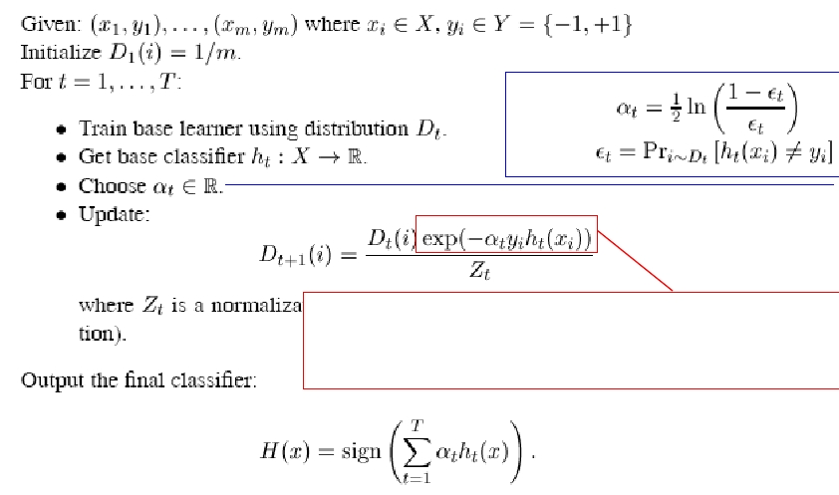
The AdaBoost algorithm
http://lamda.nju.edu.cn
留
保
权
有
所
用
typically
where
the weights of incorrectly classified examples are
increased such that the base learner is forced to
focus on the “hard” examples in the training set
http://cs.nju.edu.cn/zhouzh/
专
程
课
论
导
习
学
器
机
学
大
京
南
16
20

Slide 6
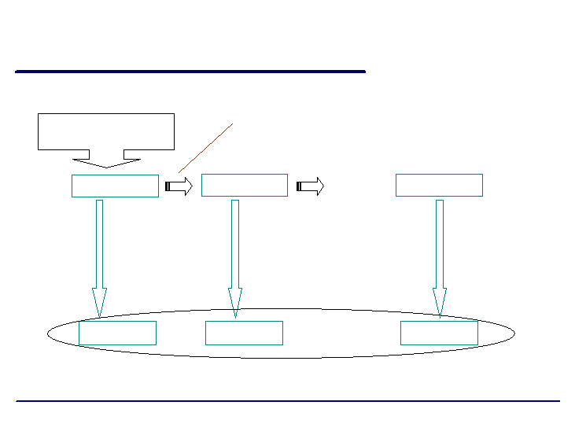
A flowchart illustration
Original training set
http://lamda.nju.edu.cn
training instances that are wrongly predicted
by Learner1 will play more important roles in
the training of Learner2
留
保
权
有
所
用
专
程
… ...
Data set 1
Data set 2
课
Data set T
论
导
习
学
… ...
器
机
学
大
京
… ...
Learner1
南
Learner2
LearnerT
16
20
weighted combination
http://cs.nju.edu.cn/zhouzh/

Slide 7
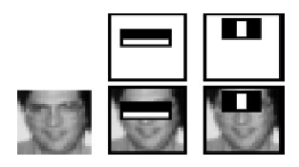
Why AdaBoost high impact?
http://lamda.nju.edu.cn
留
保
First, it is simple yet effective
can be applied to almost all tasks where one wants to apply
machine learning techniques
For example, in computer vision, the Viola-Jones detector
AdaBoost using harr-like features in a cascade structure
in average, only 8 features
needed to be evaluated per
image
http://cs.nju.edu.cn/zhouzh/
权
有
所
用
专
程
课
论
导
习
学
器
机
学
大
京
南
16
20

Slide 8


The Viola-Jones detector
http://lamda.nju.edu.cn
留
保
权
有
“the first real-time face detector”
Comparable accuracy, but
15 times faster than
state-of-the-art of face
detectors (at that time)
Longuet-Higgins Prize (2011)
Viola & Jones, Rapid object detection using a Boosted cascade of
simple features. CVPR, 2001.
http://cs.nju.edu.cn/zhouzh/
所
用
专
程
课
论
导
习
学
器
机
学
大
京
南
16
20

Slide 9
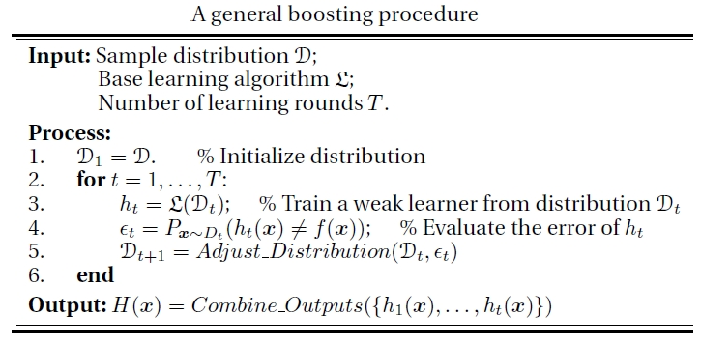
Why AdaBoost high impact? (con’t)
http://lamda.nju.edu.cn
留
保
Second, it generates the Boosting Family of algorithms
A lot of Boosting algorithms:
AdaBoost.M1, AdaBoost.MR, FilterBoost, GentleBoost, GradientBoost,
MadaBoost, LogitBoost, LPBoost, MultiBoost, RealBoost, RobustBoost, …
http://cs.nju.edu.cn/zhouzh/
权
有
所
用
专
程
课
论
导
习
学
器
机
学
大
京
南
16
20

Slide 10





Why AdaBoost high impact? (con’t)
http://lamda.nju.edu.cn
留
保
Third, there are sound theoretical results
Freund & Schapire [JCSS97] proved that the training
error of AdaBoost is bounded by:
where
Thus, if each base classifier is slightly better than random
such that for some , then the training error
drops exponentially fast in T because the above bound is
at most
http://cs.nju.edu.cn/zhouzh/
权
有
所
用
专
程
课
论
导
习
学
器
机
学
大
京
南
16
20

Slide 11
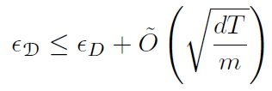
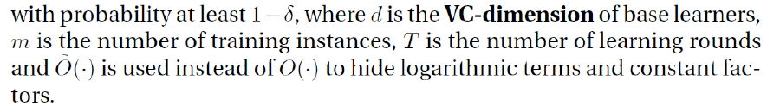
Generalization bound
http://lamda.nju.edu.cn
留
保
Freund & Schapire [JCSS97] proved that the generalization
error of AdaBoost is bounded by:
It implies that AdaBoost will overfit if T is large
Overfit (过拟合): The trained model fits the training data too much
such that it can exaggerate minor fluctuations in the training data,
leading to poor generalization performance
http://cs.nju.edu.cn/zhouzh/
权
有
所
用
专
程
课
论
导
习
学
器
机
学
大
京
南
16
20

Slide 12
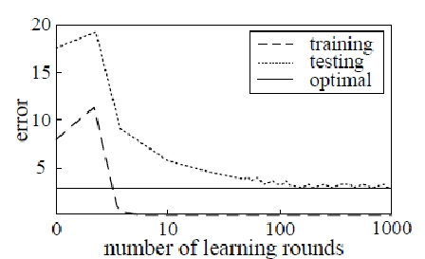
The Mystery
http://lamda.nju.edu.cn
留
保
However, AdaBoost often does not overfit in real practice
权
有
A typical performance plot of
AdaBoost on real data
所
用
专
Seems contradict with
the Occam’s Razor
程
课
论
导
习
Knowing the reason may
inspire new methodology for
algorithm design
Understanding why AdaBoost seems resistant to overfitting
is the most fascinating fundamental theoretical issue
学
器
机
学
大
京
南
16
20
Figure replot based on [Schapire, Freund, Bartlett & Lee,
Ann. Stat. 1998]
http://cs.nju.edu.cn/zhouzh/

Slide 13
Major theoretical efforts
http://lamda.nju.edu.cn
留
保
权
❐ Margin Theory
Started from [Schapire, Freund, Bartlett & Lee, Boosting the
margin: A new explanation for the effectiveness of voting methods.
Annals of Statistics, 26(5):1651–1686, 1998]
❐ Statistical View
Started from [Friedman, Hastie & Tibshirani. Additive logistic
regression: A statistical view of boosting (with discussions). Annals of
Statistics, 28(2):337–407, 2000]
http://cs.nju.edu.cn/zhouzh/
有
所
用
专
程
课
论
导
习
学
器
机
学
大
京
南
16
20

Slide 14
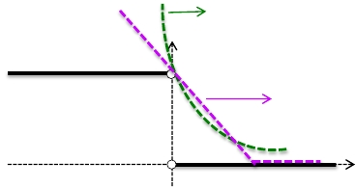


Intuition of the statistical view
http://lamda.nju.edu.cn
留
保
In binary classification, we want to optimize the 0/1-loss
Because it is non-smooth, non-convex, …, in statistical learning
usually we instead optimize a surrogate loss
exponential
1
hinge
O
The key step of the AdaBoost algorithm seems closely related
to the exponential loss:
http://cs.nju.edu.cn/zhouzh/
权
有
所
用
专
程
课
论
导
习
学
器
机
学
大
京
南
16
20

Slide 15

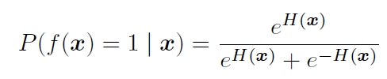

Statistical view of AdaBoost
http://lamda.nju.edu.cn
留
保
Friedman, Hastie & Tibshirani [Ann. Stat. 2000] showed that if
权
we consider the additive model
有
, take a
所
logistic function and estimate probability via
then AdaBoost algorithm is a Newton-like procedure optimizing
the exponential loss function and the log loss function (negative
log-likelihood)
That is, AdaBoost can be viewed as a stage-wise estimation
procedure for fitting an additive logistic regression model
http://cs.nju.edu.cn/zhouzh/
用
专
程
课
论
导
习
学
器
机
学
大
京
南
16
20

Slide 16
Implications of the statistical view
http://lamda.nju.edu.cn
留
保
As alternatives, one can fit the additive logistic regression model
by optimizing the log loss function via other procedures, leading
to many variants
e.g., LogitBoost [Friedman, Hastie & Tibshirani, Ann. Stat. 2000]
LPBoost [Demiriz, Bennett & Shawe-Taylor, MLJ 2002]
L2Boost [Bühlmann & Yu, JASA 2003]
RegBoost [Lugosi & Vayatis, Ann. Stat. 2004], etc.
The statistical view also encouraged the study of some specific
statistical properties of AdaBoost
e.g., for consistency: Boosting with early stopping is
consistent [Zhang & Yu, Ann. Stat. 2004], Exponential and logistic
loss is consistent [Zhang, Ann. Stat. 2004, Bartlett, Jordana &
McAuliffea, JASA 2006], etc.
http://cs.nju.edu.cn/zhouzh/
权
有
所
用
专
程
课
论
导
习
学
器
机
学
大
京
南
16
20

Slide 17
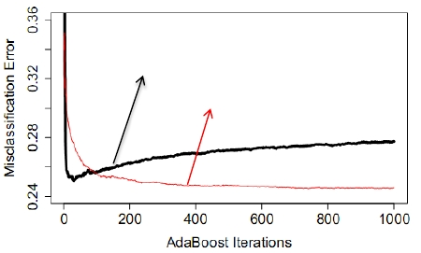
Concerns about the statistical view
http://lamda.nju.edu.cn
留
保
However, many aspects of the statistical view have
been questioned by empirical results
e.g., in a famous article [Mease & Wyner. Evidence contrary to the
statistical view of boosting (with discussions). JMLR, 9:131–201, 2008]
it was disclosed that:
权
有
所
用
专
程
课
论
导
习
Larger-size trees will lead to
overfitting because of higher-
level interaction [Friedman,
Hastie & Tibshirani, Ann. Stat.
2000]
学
器
AdaBoost with stumps
AdaBoost with 8-node tree
机
学
大
京
南
But in practice …
http://cs.nju.edu.cn/zhouzh/
16
20

Slide 18
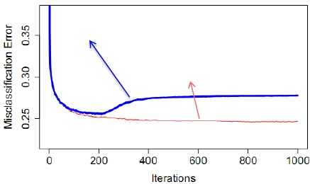
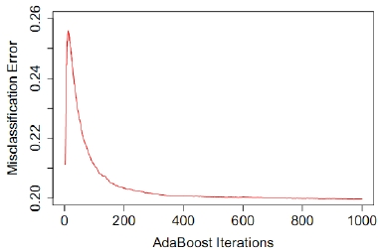
Concerns about the statistical view (con’t)
http://lamda.nju.edu.cn
留
保
LogitBoost is better than
AdaBoost for noisy data
[Hastie, Tibshirani & Friedman,
“The Elements of Statistical
Learning”, Springer 2001]
But in practice …
Early stopping can be used to
prevent overfitting [Zhang & Yu,
Ann. Stat. 2004]
But in practice …
[Mease & Wyner, JMLR 2008]
LogitBoost with 8-node tree
AdaBoost with 8-node tree
http://cs.nju.edu.cn/zhouzh/
权
有
所
用
专
程
课
论
导
习
学
器
机
学
大
京
南
16
20

Slide 19
Major theoretical efforts
http://lamda.nju.edu.cn
留
保
权
❐ Margin Theory
Started from [Schapire, Freund, Bartlett & Lee, Boosting the
margin: A new explanation for the effectiveness of voting methods.
Annals of Statistics, 26(5):1651–1686, 1998]
❐ Statistical View
Started from [Friedman, Hastie & Tibshirani. Additive logistic
regression: A statistical view of boosting (with discussions). Annals of
Statistics, 28(2):337–407, 2000]
The biggest issue:
The statistical view did not explain why
AdaBoost is resistant to overfitting
http://cs.nju.edu.cn/zhouzh/
有
所
用
专
程
课
论
导
习
学
器
机
学
大
京
南
16
20

Slide 20

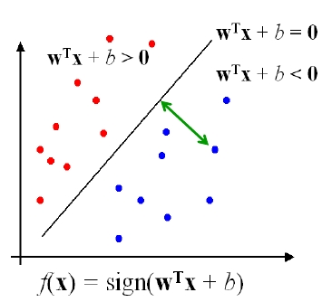



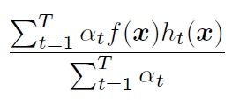
The “margin” (间隔 )
Binary classification can be viewed
as the task of separating classes
in a feature space
margin of this point
http://lamda.nju.edu.cn
For binary classification, the
ground-truth
The margin of a single
classifier h:
For
the margin is
留
保
权
有
所
用
专
程
课
论
导
习
学
器
机
学
大
and the normalized margin:
The bigger the margin,
the higher the predictive confidence
http://cs.nju.edu.cn/zhouzh/
京
南
16
20

Slide 21
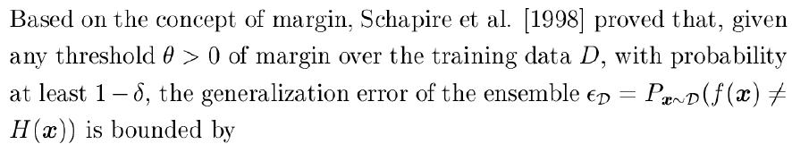
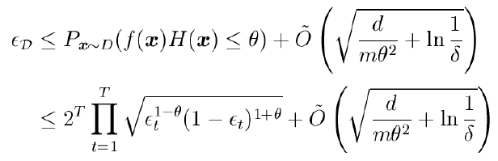
Margin explanation of AdaBoost
http://lamda.nju.edu.cn
留
保
权
有
所
用
专
程
课
论
导
习
学
器
机
学
大
京
This bound implies that, when other variables are fixed,
the larger the margin over the training data, the smaller
the generalization error
http://cs.nju.edu.cn/zhouzh/
南
16
20

Slide 22
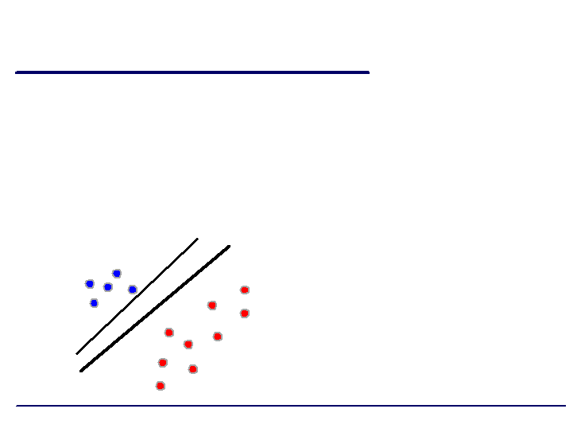
Margin explanation of AdaBoost (con’t)
http://lamda.nju.edu.cn
留
保
Why AdaBoost tends to be resistant to overfitting?
the margin theory answers:
Because it is able to increase the ensemble
margin even after the training error reaches zero
This explanation is quite
intuitive
It receives good support
in empirical study
http://cs.nju.edu.cn/zhouzh/
权
有
所
用
专
程
课
论
导
习
学
器
机
学
大
京
南
16
20

Slide 23


The minimum margin bound
http://lamda.nju.edu.cn
留
保
Schapire et al.’s bound depends heavily on the smallest
margin, because will be small if the
smallest margin is large
Thus, by considering the minimum margin:
Breiman [Neural Comp. 1999] proved a generalization bound,
which is tighter than Schapire et al.’s bound
http://cs.nju.edu.cn/zhouzh/
权
有
所
用
专
程
课
论
导
习
学
器
机
学
大
京
南
16
20

Slide 24
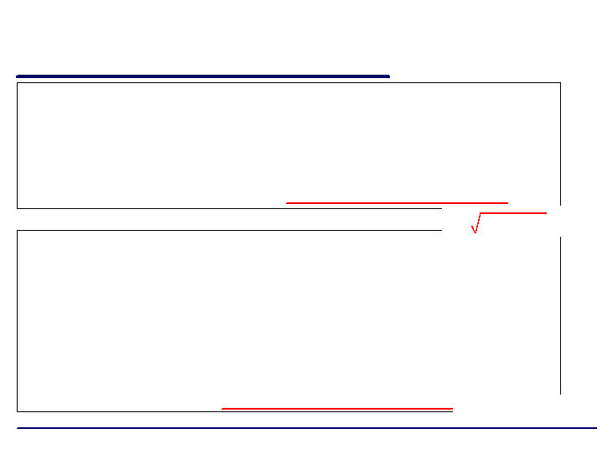
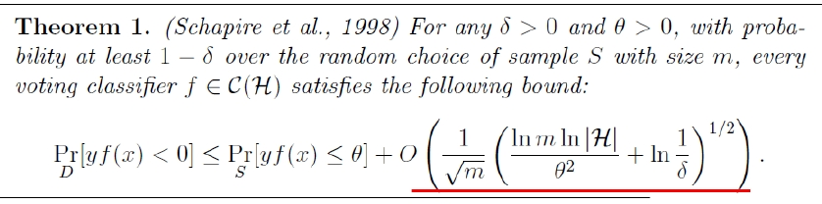
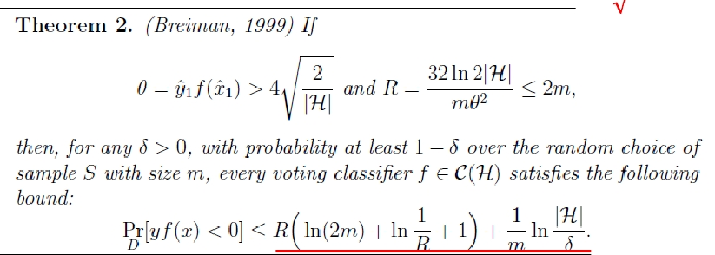
The two generalization bounds
http://lamda.nju.edu.cn
O( log 𝑚 /𝑚)
O(log 𝑚 /𝑚)
http://cs.nju.edu.cn/zhouzh/
留
保
权
有
所
用
专
程
课
论
导
习
学
器
机
学
大
京
南
16
20

Slide 25
The doubt about margin theory
http://lamda.nju.edu.cn
留
保
Breiman [Neural Comp. 1999] designed a variant of AdaBoost,
the arc-gv algorithm, which directly maximizes the
minimum margin
the margin theory would appear to predict that arc-gv should
perform better than AdaBoost
However, experiments show that, comparing with AdaBoost:
• arc-gv does produce uniformly larger minimum margin
• the test error increases drastically in almost every case
Thus, Breiman convincingly concluded that the margin
theory was in serious doubt. This almost sentenced the
margin theory to death
http://cs.nju.edu.cn/zhouzh/
权
有
所
用
专
程
课
论
导
习
学
器
机
学
大
京
南
16
20

Slide 26
7 years later …
http://lamda.nju.edu.cn
留
保
Reyzin & Schapire [ICML’06 best paper] found that, amazingly,
Breiman had not controlled model complexity well in exps
Breiman controlled the model complexity by using
decision trees with a fixed number of leaves
Reyzin & Schapire found that, the trees of arc-gv are
generally “deeper” than the trees of AdaBoost
Reyzin & Schapire repeated Brieman’s exps using decision
stumps with two leaves: arc-gv is with larger minimum
margin, but worse margin distribution
R&S claimed that the minimum margin is not crucial, and
the average or median margin is crucial
http://cs.nju.edu.cn/zhouzh/
权
有
所
用
专
程
课
论
导
习
学
器
机
学
大
京
南
16
20

Slide 27
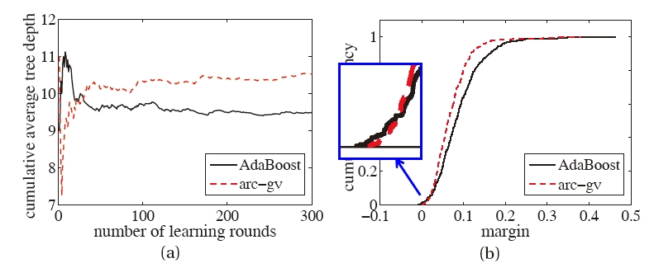
Experimental results
Tree depth
using fixed number of leaves
Figure from [Zhou’s book, 2012]
http://lamda.nju.edu.cn
Margin distribution
using decision stumps
http://cs.nju.edu.cn/zhouzh/
留
保
权
有
所
用
专
程
课
论
导
习
学
器
机
学
大
京
南
16
20

Slide 28
Margin theory survive?
http://lamda.nju.edu.cn
留
保
Not necessarily …
Breiman’s minimum margin bound is tighter
To claim margin distribution is more crucial, we
need a margin distribution bound which is even
tighter
http://cs.nju.edu.cn/zhouzh/
权
有
所
用
专
程
课
论
导
习
学
器
机
学
大
京
南
16
20

Slide 29
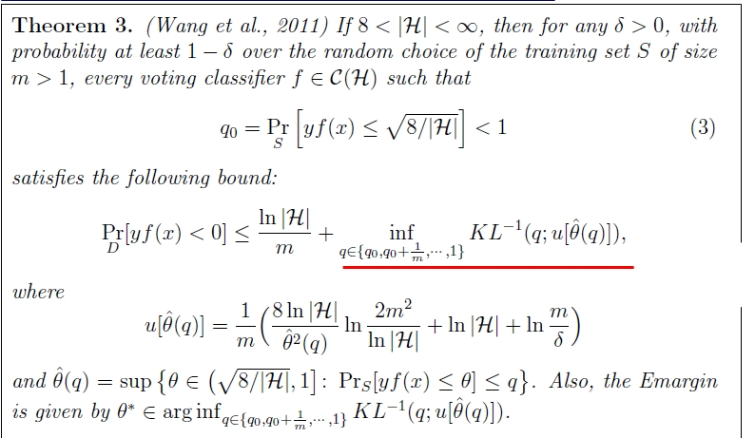
Equilibrium margin (Emargin) bound
O(log 𝑚 /𝑚)
http://lamda.nju.edu.cn
Proved to be tighter
than Breiman’s bound
留
保
权
有
所
用
专
程
课
论
导
习
学
器
机
学
大
京
南
16
• Considered factors different from Schapire et al. and Breiman’s bounds
• No intuition to optimize
20
First presented in [Wang, Sugiyama, Yang, Zhou, Feng, COLT’08]
http://cs.nju.edu.cn/zhouzh/

Slide 30

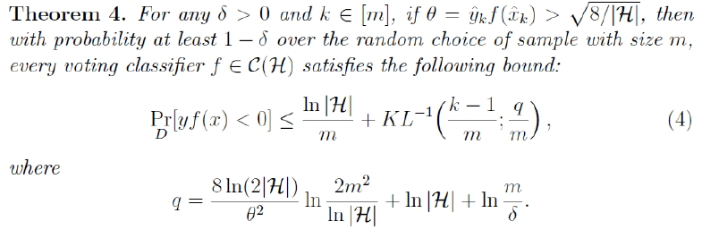
The kth margin bound
http://lamda.nju.edu.cn
留
保
权
有
所
用
专
程
课
论
导
习
学
器
机
学
大
京
南
The minimum margin bound and Emargin bound are special
cases of the kth margin bound, both are single-margin bound
(not margin distribution bound)
16
20
[Gao & Zhou, AIJ 2013]
http://cs.nju.edu.cn/zhouzh/

Slide 31
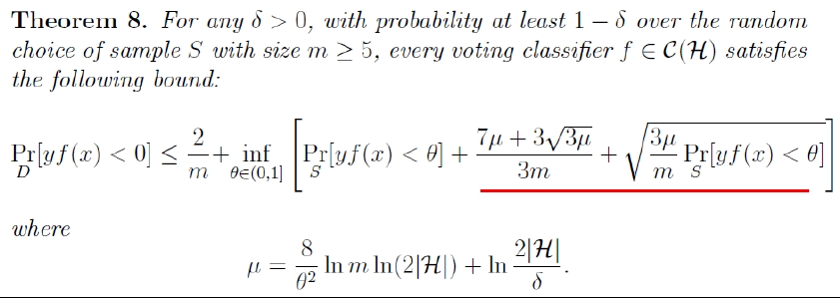
Finally, our margin distribution bound
http://lamda.nju.edu.cn
留
保
权
有
所
用
专
程
课
论
O(log 𝑚 /𝑚)
✓ Uniformly tighter than Breiman’s as well as Schapire et al.’
bounds
✓ Considers the same factors as Schapire et al. and Breiman
thus, defends the margin theory against Breiman’s doubt
导
习
学
器
机
学
大
京
南
16
20
[Gao & Zhou, AIJ 2013]
http://cs.nju.edu.cn/zhouzh/

Slide 32
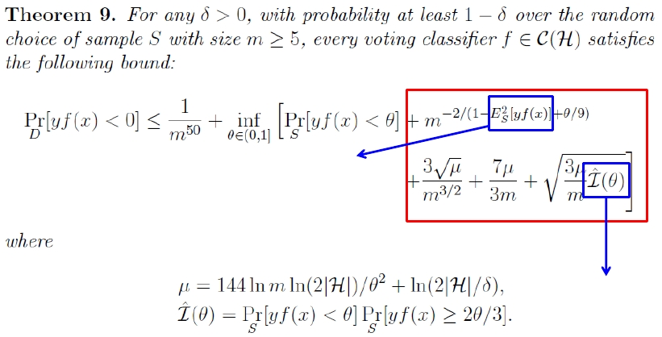
New insight?
http://lamda.nju.edu.cn
留
保
权
有
所
用
专
程
课
论
related to
average margin
O(log 𝑚 /𝑚)
related to
margin variance
We should pay attention to not only the average margin,
but also the margin variance !
导
习
学
器
机
学
大
京
南
16
20
[Gao & Zhou, AIJ 2013]
http://cs.nju.edu.cn/zhouzh/

Slide 33
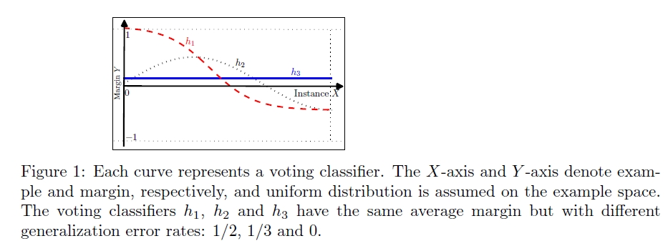
Empirical verification
http://lamda.nju.edu.cn
留
保
权
有
Margin variance really
important
Figure from [Gao & Zhou, AIJ 2013]
[Shivaswamy & Jebara, NIPS 2011] tried to design new boosting
algorithms by maximizing average margin and minimizing
margin variance simultaneously, and the results are encouraging
http://cs.nju.edu.cn/zhouzh/
所
用
专
程
课
论
导
习
学
器
机
学
大
京
南
16
20

Slide 34
Question
http://lamda.nju.edu.cn
留
保
权
有
Do we have direct and principled way to:
maximize the margin mean and minimize the
margin variance simultaneously?
http://cs.nju.edu.cn/zhouzh/
所
用
专
程
课
论
导
习
学
器
机
学
大
京
南
16
20

Slide 35
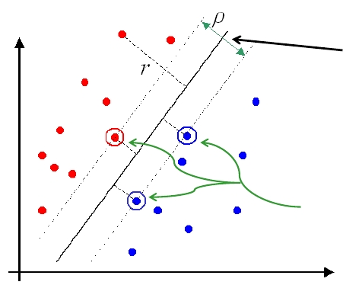
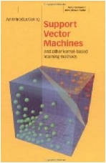
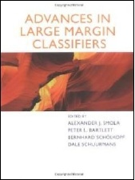
Large margin classifiers
http://lamda.nju.edu.cn
Large margin
classifiers are actually
trying to maximize the
minimum margin
Support
vectors
http://cs.nju.edu.cn/zhouzh/
留
保
权
有
所
用
专
程
课
论
导
习
学
器
机
学
大
京
南
16
20

Slide 36
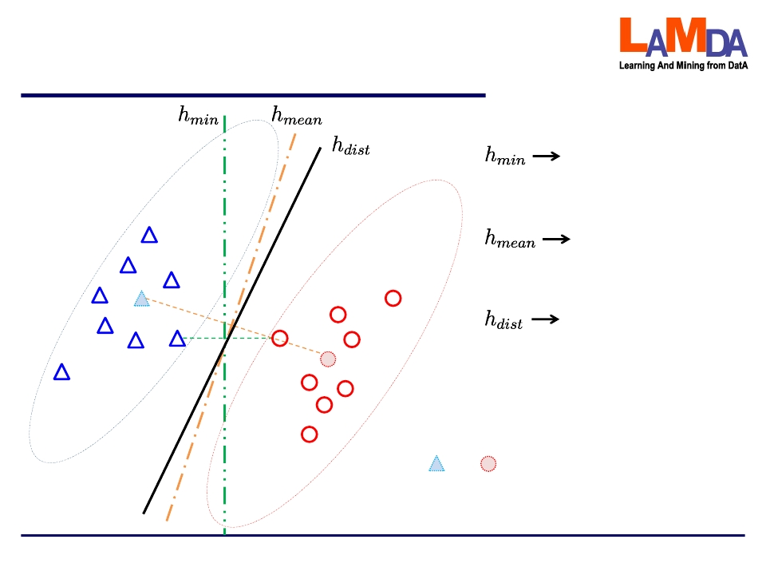
Big difference between
“large margin” and “large margin distribution”
http://lamda.nju.edu.cn
留
保
权
maximizing the
minimum margin
maximizing the
margin mean
optimizing the margin
distribution by
maximizing the margin
mean and minimizing
the margin variance
simultaneously
and are the mean instances
(not necessarily real instances
observed in training data)
http://cs.nju.edu.cn/zhouzh/
有
所
用
专
程
课
论
导
习
学
器
机
学
大
京
南
16
20

Slide 37
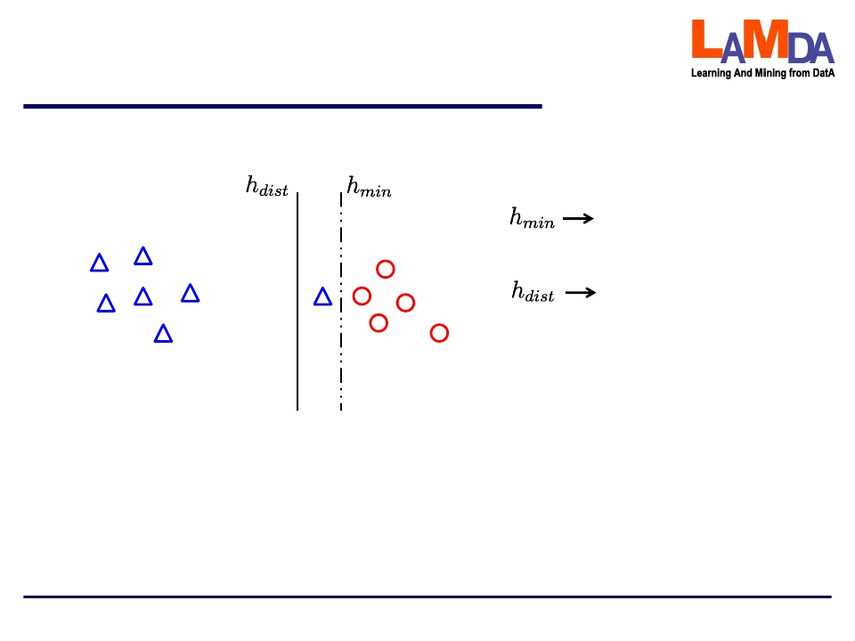
Another advantage of
“large margin distribution learning”
http://lamda.nju.edu.cn
留
保
权
有
所
optimizing the
minimum margin
optimizing the
margin distribution
Less sensitive to outliers or noisy data points
http://cs.nju.edu.cn/zhouzh/
用
专
程
课
论
导
习
学
器
机
学
大
京
南
16
20

Slide 38
Large margin Distribution Machines
http://lamda.nju.edu.cn
留
保
❐ LDM:
T. Zhang and Z.-H. Zhou. Large margin distribution machine.
KDD'14, pp.313-322.
Code: http://lamda.nju.edu.cn/code_LDM.ashx
❐ cisLDM:
Y.-H. Zhou and Z.-H. Zhou. Large margin distribution learning with
cost interval and unlabeled data. IEEE Trans. Knowledge and Data
Engineering, in press.
Code: http://lamda.nju.edu.cn/code_cisLDM.ashx
❐ ... …
http://cs.nju.edu.cn/zhouzh/
权
有
所
用
专
程
课
论
导
习
学
器
机
学
大
京
南
16
20

Slide 39
Long march of margin theory for AdaBoost
http://lamda.nju.edu.cn
留
•
•
•
•
保
1989, [Kearns & Valiant], open problem
1990, [Schapire], proof by construction, the first Boosting algorithm
1993, [Freund], another impractical boosting algorithm by voting
1995/97, [Freund & Schapire], AdaBoost
权
有
所
用
专
程
课
论
• 1998, [Schapire, Freund, Bartlett & Lee], Margin theory
• 1999, [Breiman], serious doubt by minimum margin bound
• 2006, [Reyzin & Schapire], finding the model complexity issue in exps,
emphasizing the importance of margin distribution
• 2008, [Wang, Sugiyama, Yang, Zhou & Feng], Emargin bound, believed
to be a margin distribution bound
• 2013, [Gao & Zhou], a real margin distribution bound, sheding new
insight ; margin theory defensed
http://cs.nju.edu.cn/zhouzh/
导
习
学
器
机
学
大
京
南
16
20

Slide 40
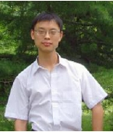
Joint work with my student
http://lamda.nju.edu.cn
留
保
权
有
W. Gao and Z.-H. Zhou. On the doubt about
margin explanation of boosting. Artificial
Intelligence, 2013, 203: 1-18.
(arXiv:1009.3613, Sept.2010)
Wei Gao
(高 尉)
An easy-to-read article:
Z.-H. Zhou. Large margin distribution learning.
ANNPR 2014, pp.1-11. (keynote article)
http://cs.nju.edu.cn/zhouzh/
所
用
专
程
课
论
导
习
学
器
机
学
大
京
南
16
20

Slide 41

Take-Home Messages
http://lamda.nju.edu.cn
留
保
❐ Why AdaBoost is less prone to overfitting?
Margin theory stands
❐ What’s crucial in margin theory?
Margin mean and margin variance, together
❐ Large margin methods good?
Large margin distribution methods better
LDM can be applied to generalize all kinds of large
margin methods
权
有
所
用
专
程
课
论
导
习
学
器
机
学
大
京
南
16
Thanks!
http://cs.nju.edu.cn/zhouzh/
Now we call LDM as ODM (Optimal
margin Distribution Machine)
20

Slide 42

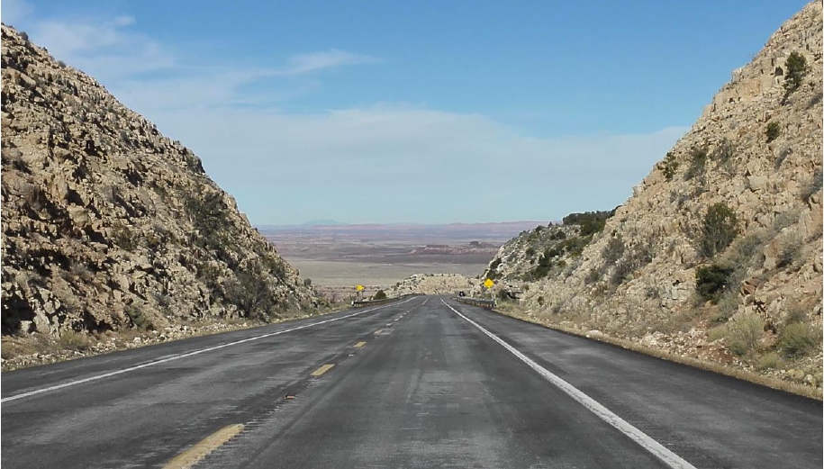
前往 ……
留
保
权
有
所
用
专
程
课
论
导
习
学
器
机
学
大
京
南
16
20

