Slide 1

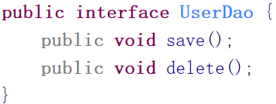
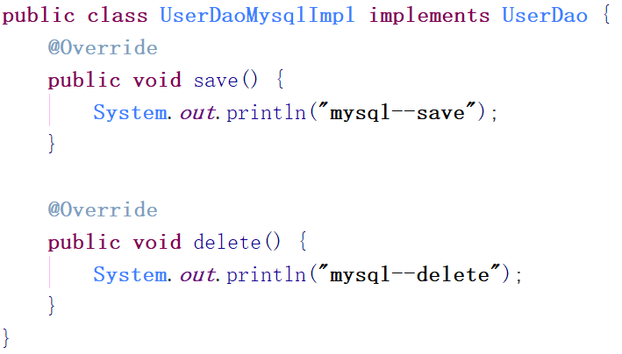
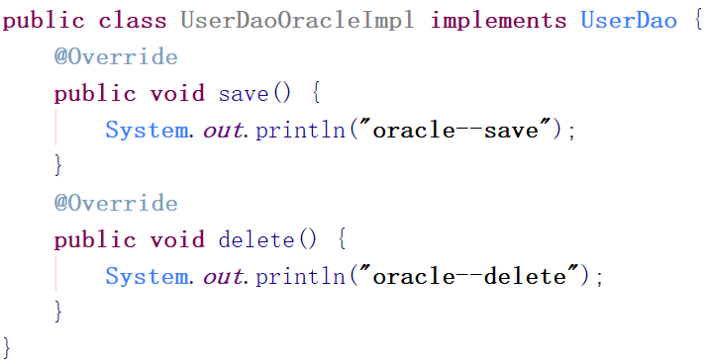
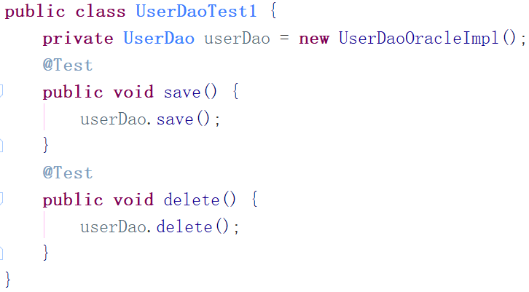
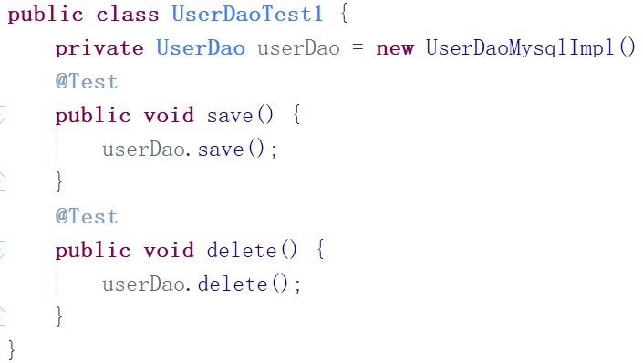
业务和实现类过于紧密，底层业务要修改源代码

Slide 2
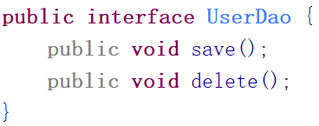
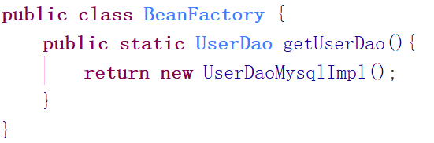
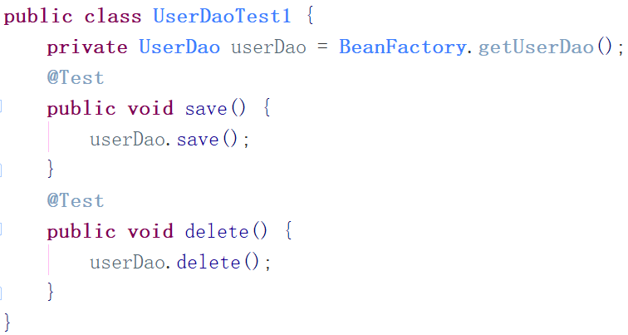
通过工厂可以实现，接口与实现业务的分离。
但是，当需要切换时，BeanFactory还是要修改代码
尽量不修改源码的基础上，对程序进行扩充

Slide 3

<bean id=“userDao” class=“com.myxq.UserDaoMysqlImpl”>
再变化时， 就不需要修改源码，只需要修改配置文件即可
Public class BeanFactory{
public static Object getBean(String id){
解析XML
反射创建对象
Class clazz = Class.forName()
return clazz.newInstance()
}
}

Slide 4
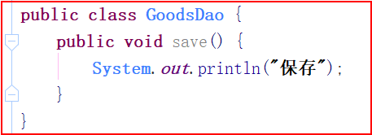
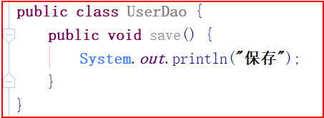
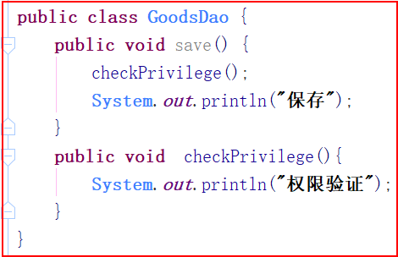
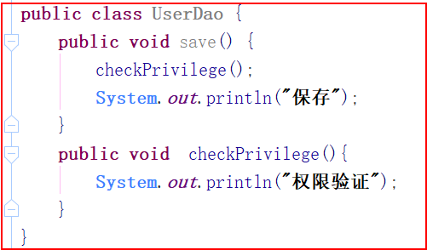
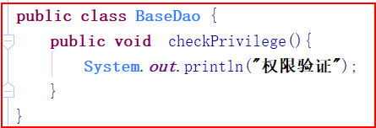
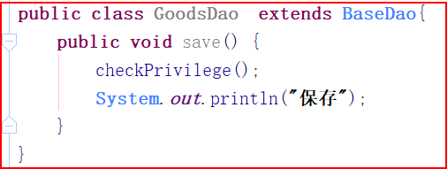
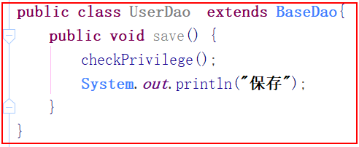
纵向继承

Slide 5
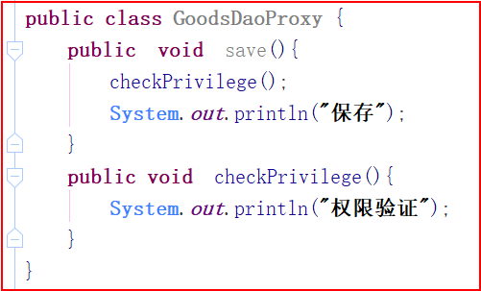
AOP采用横向抽取机制取代了传统纵向继承
不破坏原有的类，生成一个代理类，在原来类的基础上进行增强
可以随时添加，取消添加的功能

Slide 6
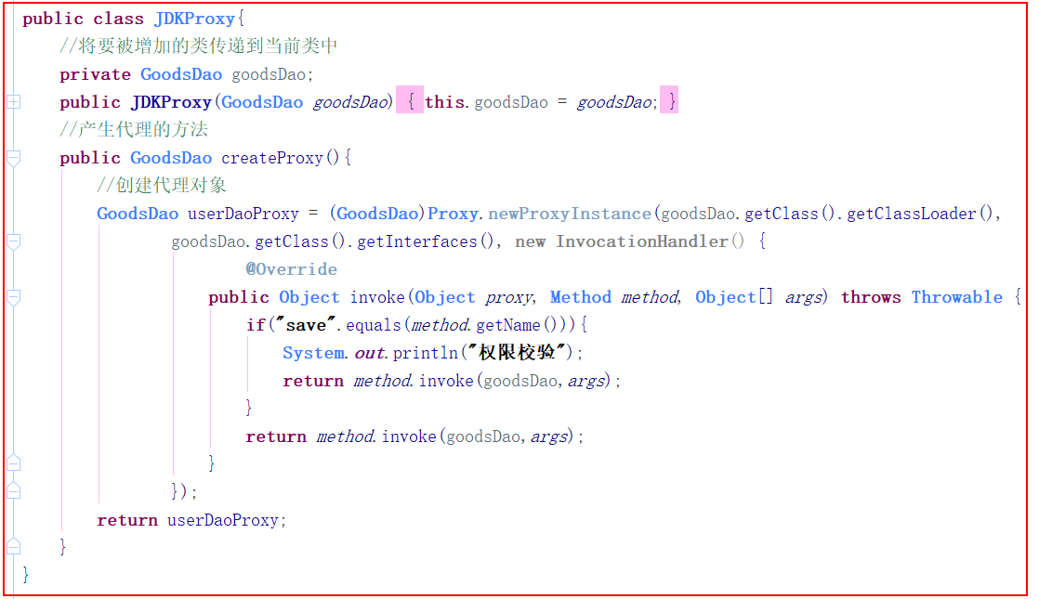
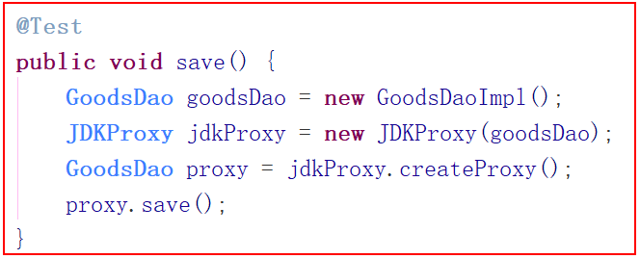

Slide 7
service
Dao
service1{
void A(){
dao1.a();
dao2.b();
}
}
service2{
void B(){
dao3.c();
dao4.d();
}
}
dao1{
void a(){}
}
dao2{
void b(){}
}
dao3{
void c(){}
}
dao4{
void d(){}
}

Slide 8
service
Dao
service1{
void A(){
dao1.a();
dao2.b();
}
}
service2{
void B(){
service.A();
dao3.c();
dao4.d();
}
}
dao1{
void a(){}
}
dao2{
void b(){}
}
dao3{
void c(){}
}
dao4{
void d(){}
}

Slide 9
service
Dao
service1{
void A(){
dao1.a();
dao2.b();
}
}
service2{
void B(){
service.A();
dao3.c();
dao4.d();
}
}
dao1{
void a(){}
}
dao2{
void b(){}
}
dao3{
void c(){}
}
dao4{
void d(){}
}
保存点

Slide 10
public class AccountService { //注入AccountDao private AccountDao accountDao; public void setAccountDao(AccountDao accountDao) { this.accountDao = accountDao; } public void save(Account account){ accountDao.save(account); } }
public class AccountDao { void save(Account account){ //加载hibernate.cfg.xml Configuration cfg = new Configuration().configure(); //构建工厂 SessionFactory sf = cfg.buildSessionFactory(); //获取session Session session = sf.openSession(); //开启事务 Transaction tx = session.beginTransaction(); //保存操作 session.save(account); //提交事务 tx.commit(); //关闭连接 session.close(); } }
<bean id=“accountDao” class=“包名.AccountDao”/>
<bean id=“accountService” class=“包名.AccountService”

Slide 11
public class AccountAction extends ActionSupport implements ModelDriven<Account> { private Account account = new Account(); public Account getModel() { return account; } public String save(){ ServletContext servletContext = this.getServletContext(); /*获取工厂程序启动的时候 保存到serServletContext*/ WebApplicationContext applicationContext = WebApplicationContextUtils.getWebApplicationContext(servletContext); /*获取对象*/ AccountService userService = (AccountService)applicationContext.getBean("userService"); accountService.save(); return null; } }

