Slide 1
构造SecurityManager环境
Subject.login()提交认证
SecurityManage.login()执行认证
Authenticator执行认证
Realm根据身份获取认证信息

Slide 2
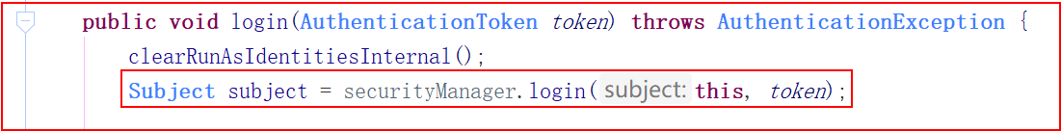
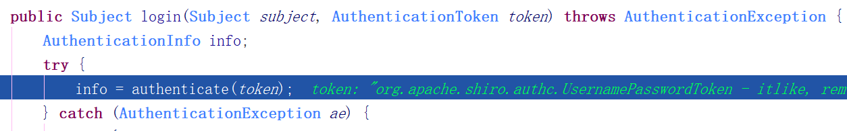
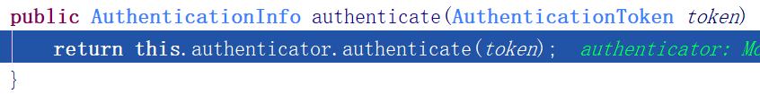
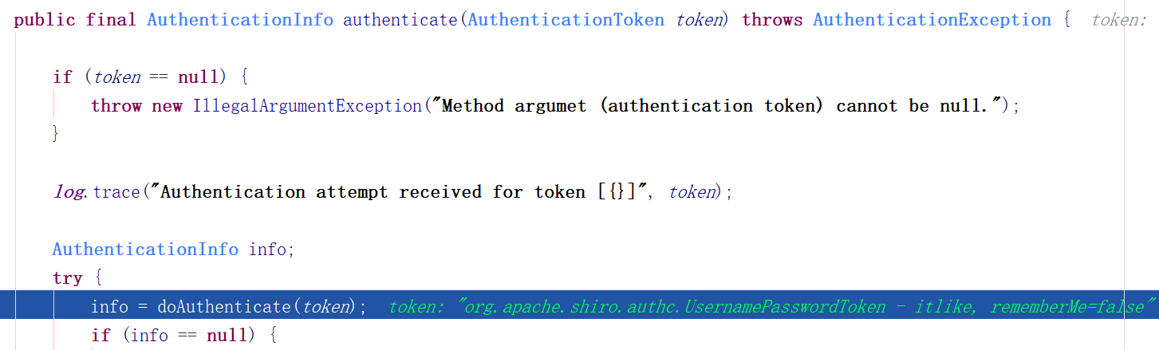

Slide 3
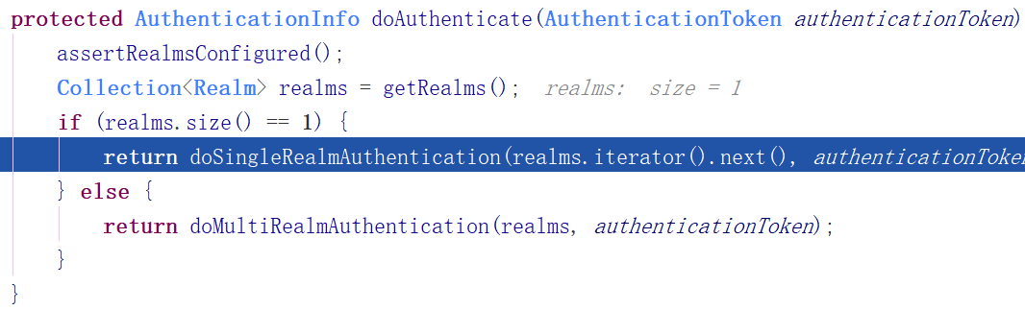
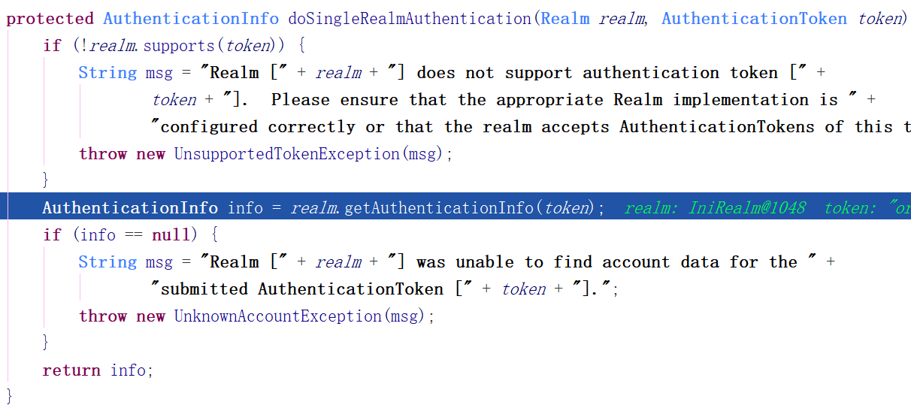
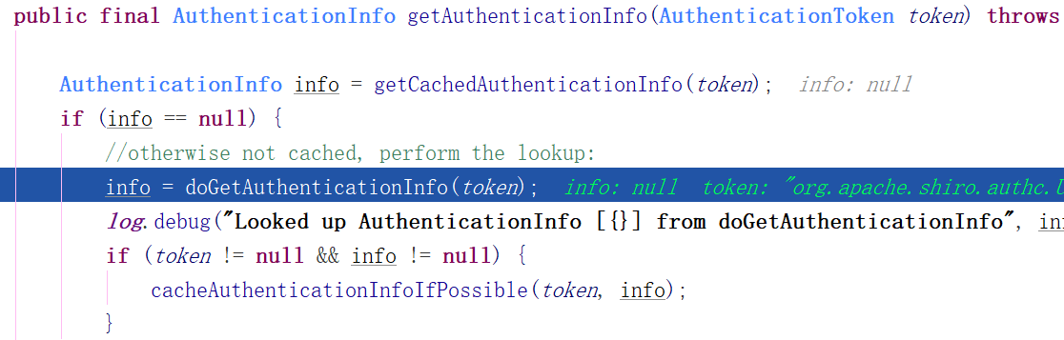

Slide 4
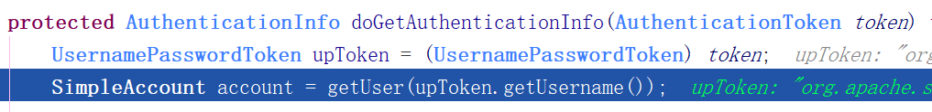
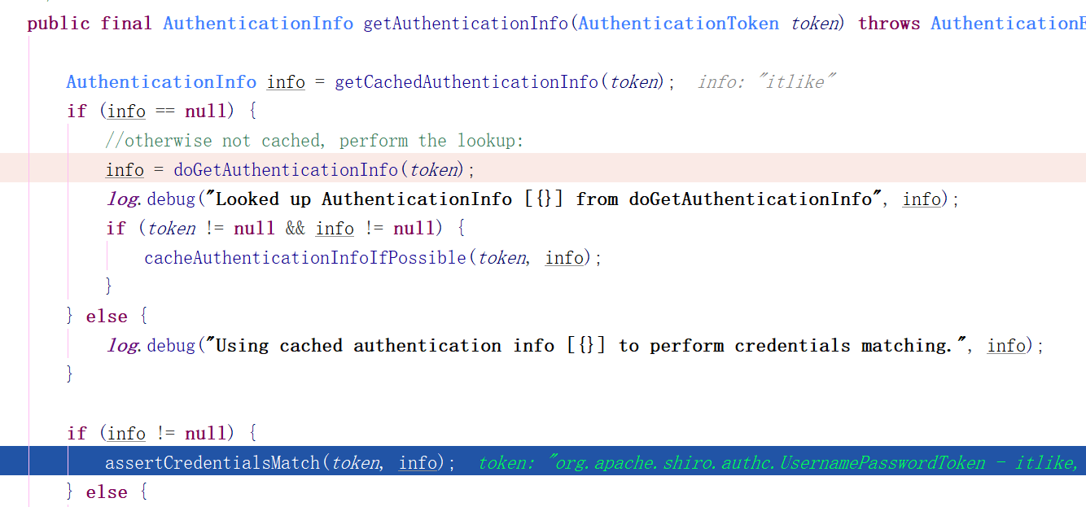

Slide 5
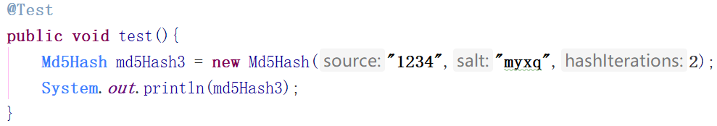


Slide 6

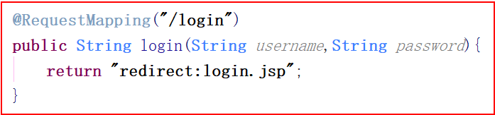
没有认证时, 其它路径都会跳转到LoginUrl进行认证

Slide 7
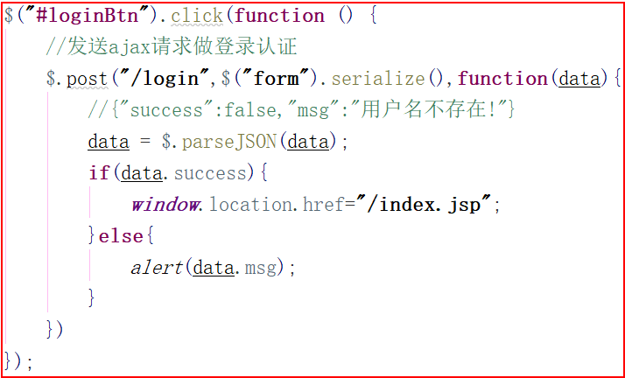
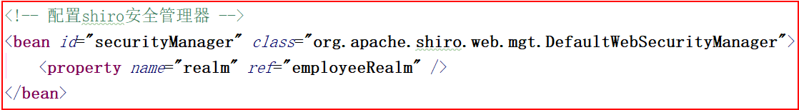

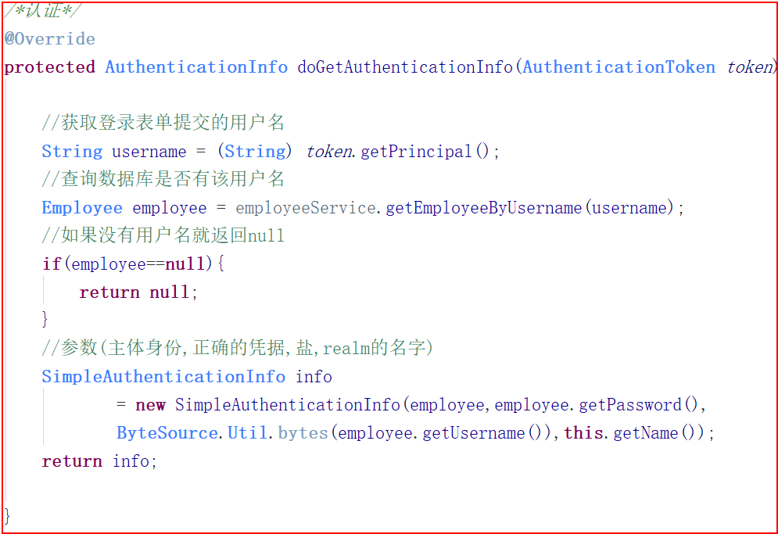

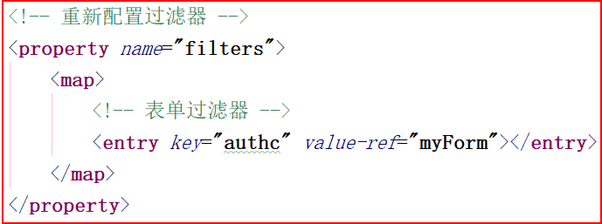

Slide 8
ThreadLocalMap
currentThread
public T get() { Thread t = Thread.currentThread(); ThreadLocalMap map = getMap(t); if (map != null) { ThreadLocalMap.Entry e = map.getEntry(this); if (e != null) { @SuppressWarnings("unchecked") T result = (T)e.value; return result; } } return setInitialValue(); }
ThreadLocalMap
public void set(T value) { Thread t = Thread.currentThread(); ThreadLocalMap map = getMap(t); if (map != null) map.set(this, value); else createMap(t, value); }
public static ThreadLocal<HttpServletRequest> local = new ThreadLocal<>(); public static HttpServletRequest getRequest(){ return local.get(); }
public static ThreadLocal<HttpServletRequest> local = new ThreadLocal<>(); public static void setRequest
(HttpServletRequest request){ local.set(request); }
local.get();

