Slide 1
Feature Selection Challenge
Zhiqian Zhou

Slide 2
Introduction
Source: 2003 NIPS workshop
The datasets were chosen to span a variety of domains and were transformed in the form of Integer with many probes.
Probes: Addition of ‘random’ features distributed similarly to the real features.
All datasets are two-class classification problems. Label: +1, -1. No feature is informative.

Slide 3
Datasets
ARCENE
Cancer Data. Separate cancer vs. normal.
Data Type: Dense
Number of Features: 10000

Slide 4
Datasets
DEXTER
Filter ‘corporate acquisition’ texts.
Data Type: Sparse-Integer.
Number of Features: 20000

Slide 5
Datasets
MADELON
Artificial data.
Data Type: Dense.
Number of Features: 500
Over 90% of the data is probe.

Slide 6
Goal
Classify the datasets using a minimal number of features
Find out how important feature selection can be in the process of classification.

Slide 7
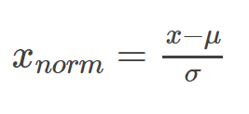
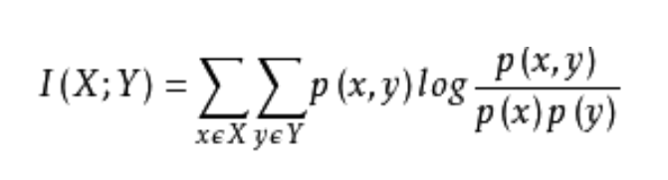
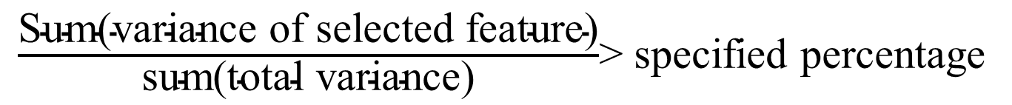
Feature Selection
Standardization
Mutual Information
PCA
$\frac{\text{Sum}\text{(}\text{variance} \text{of} \text{selected} \text{feature}\text{)}}{\text{sum}\text{(}\text{total} \text{variance}\text{)}}$> specified percentage

Slide 8
Classifier
KNN
(non-parameter)
Perceptron + Gradient descent
(Linear)
Naïve Bayes
(Gaussian)

Slide 9
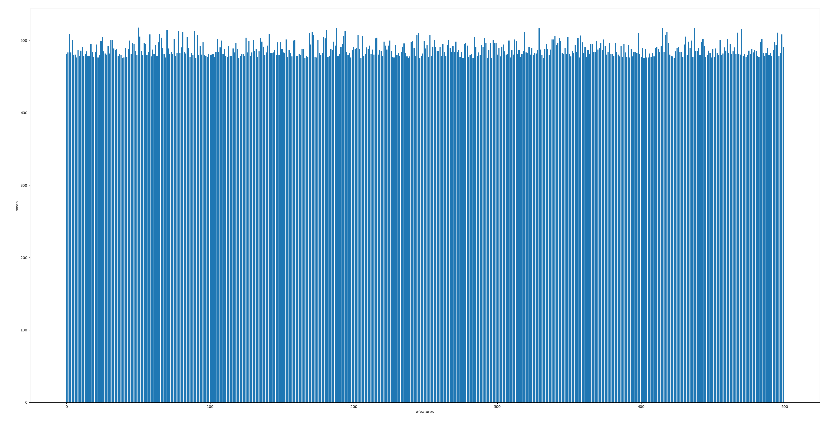
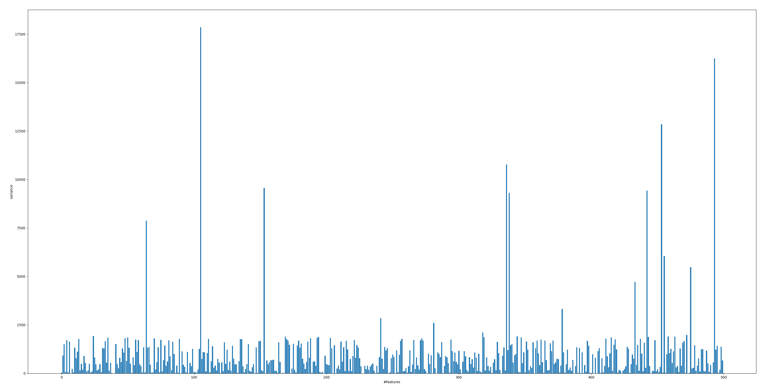
MADELON
Y Label: mean
MADELON
Y Label: variance
X Label: features
2500

Slide 10
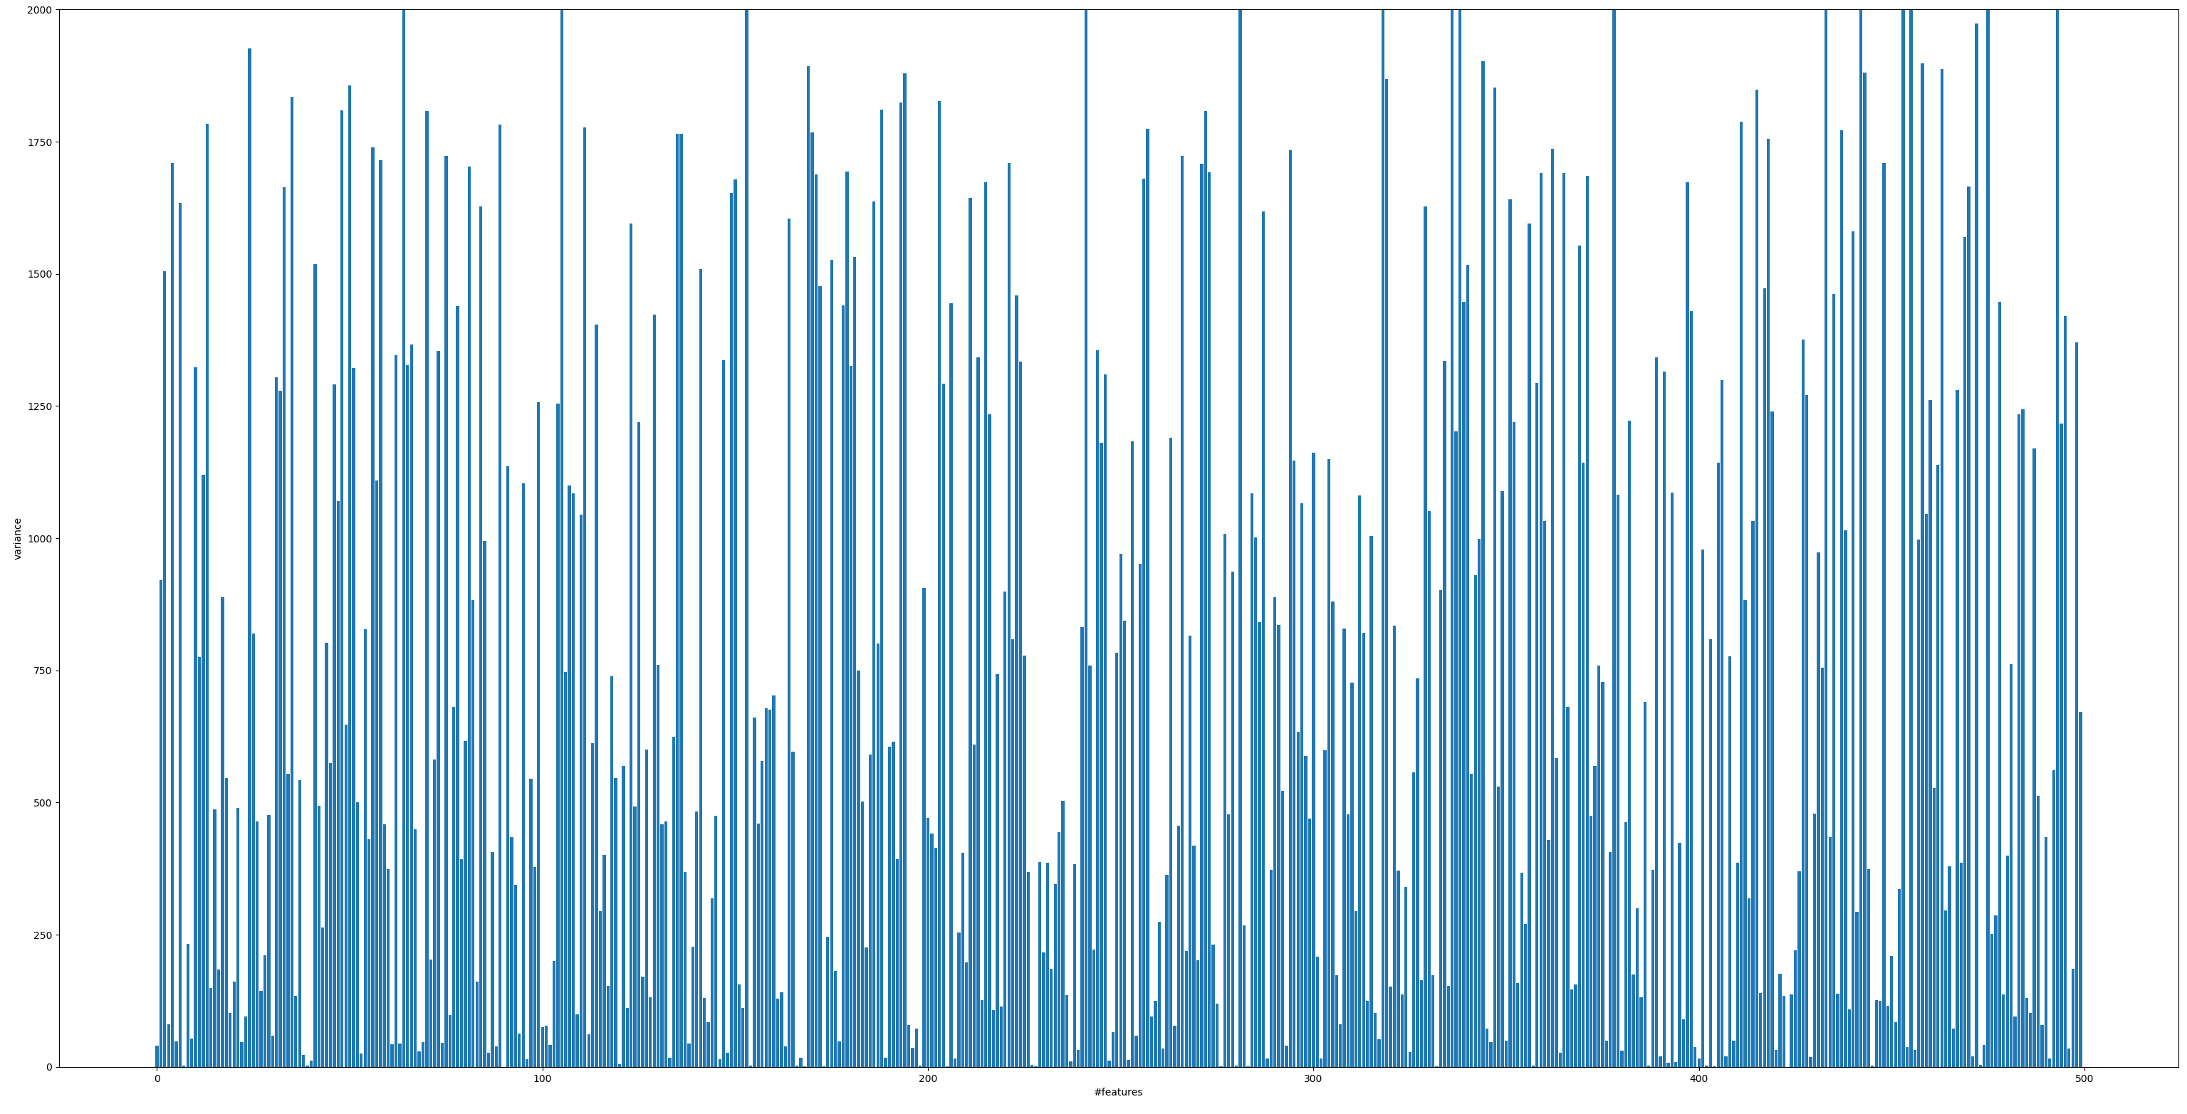
Variance
2000
100

Slide 11
Method
Set Variance Threshold
Standardization
PCA
KNN / Bayes / Perceptron

Slide 12
Result
KNN
Perceptron
Bayes
Accuracy
0.58-0.61
0.50-0.57
0.56-0.60
Using original 500 features
Accuracy
0.76
0.50
0.59
* Standardization of data will lose information in this case.

Slide 13
Process
Set Variance Threshold
Standardization
PCA
KNN / Bayes / Perceptron

Slide 14
Result
KNN
Perceptron
Bayes
Accuracy
0.75-0.78
0.52-0.57
0.55-0.60
Neither Guassian nor Linear.
KNN
Feature# | 500 | 318 | 284 | 251 | 231 | 226 | 222 | 214
Accuracy | 0.761 | 0.765 | 0.766 | 0.768 | 0.767 | 0.775 | 0.77 | 0.711

Slide 15
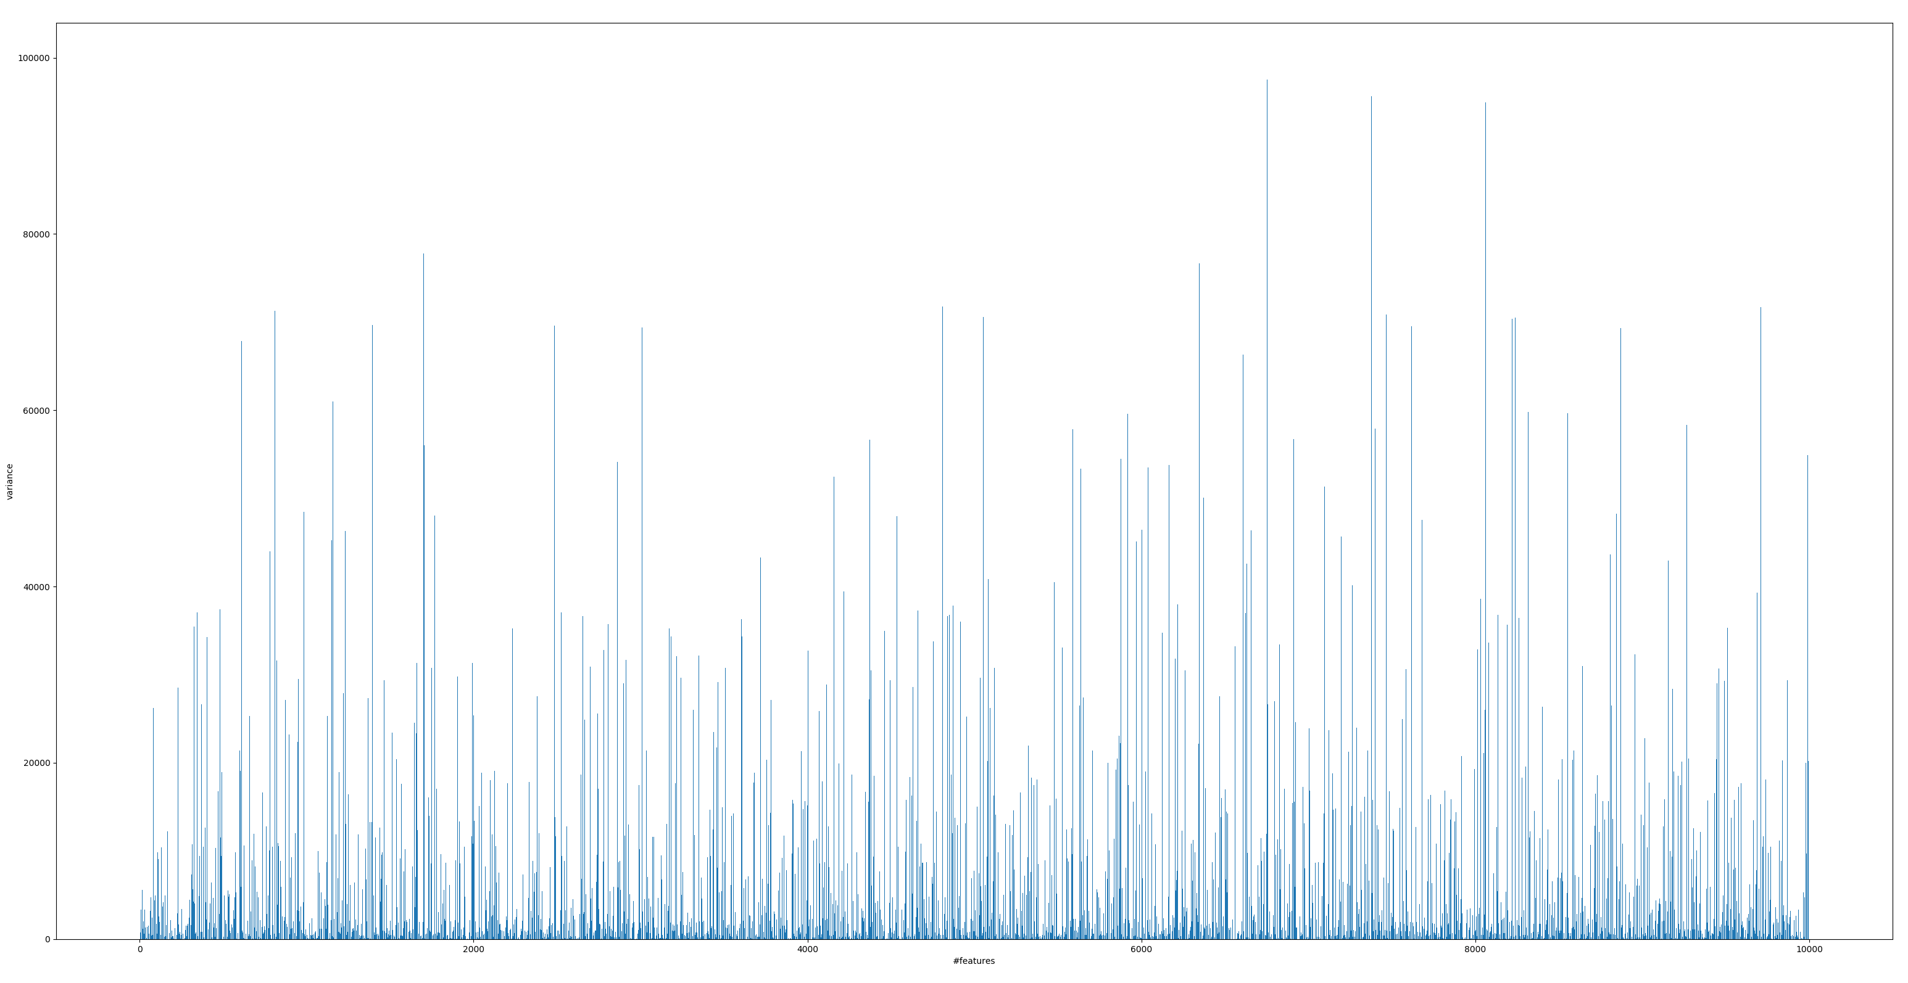
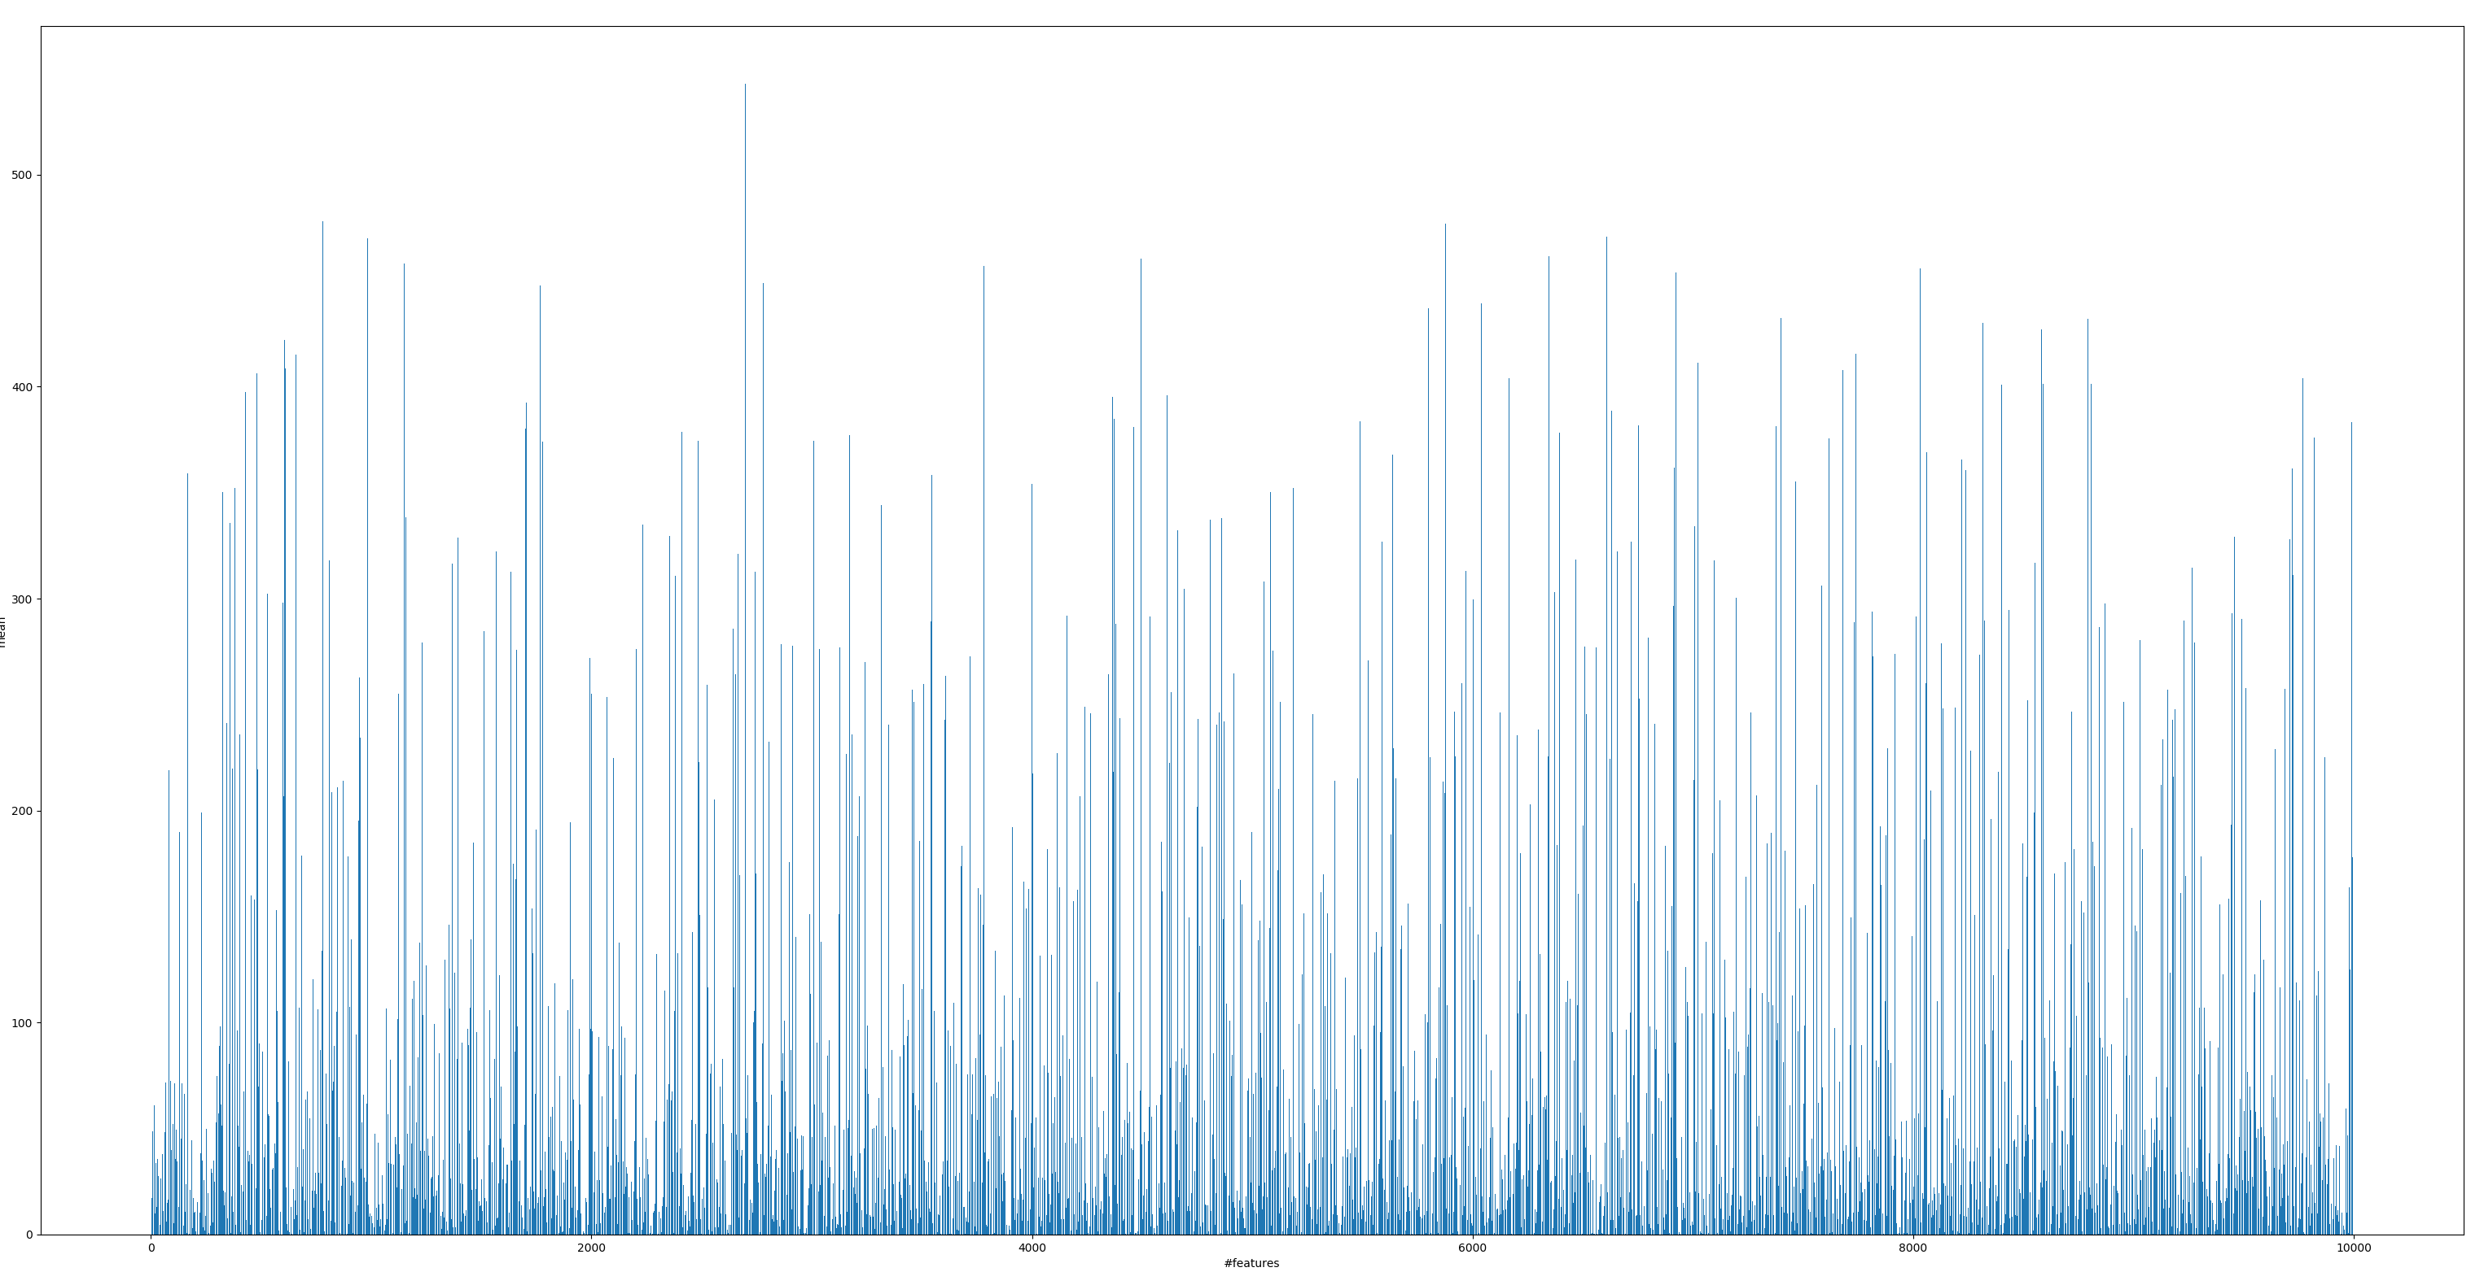
Y Label: mean
ARCENE
Y Label: variance
X Label: features

Slide 16
Method
Mutual Information
Standardization
PCA
KNN / Bayes / Perceptron

Slide 17
Result
KNN
Perceptron
Bayes
Accuracy
0.61-0.64
0.77-0.87
0.60-0.64
Using original 10000 features
Accuracy
0.61
0.81
0.54

Slide 18
Result
Mutual Information
Perceptron
Feature# | 10000 | 9500 | 81 | 78 | 75 | 72 | 69 | 66
Accuracy | 0.81 | 0.81 | 0.81 | 0.81 | 0.82 | 0.84 | 0.83 | 0.77
Mutual Information + PCA

Slide 19
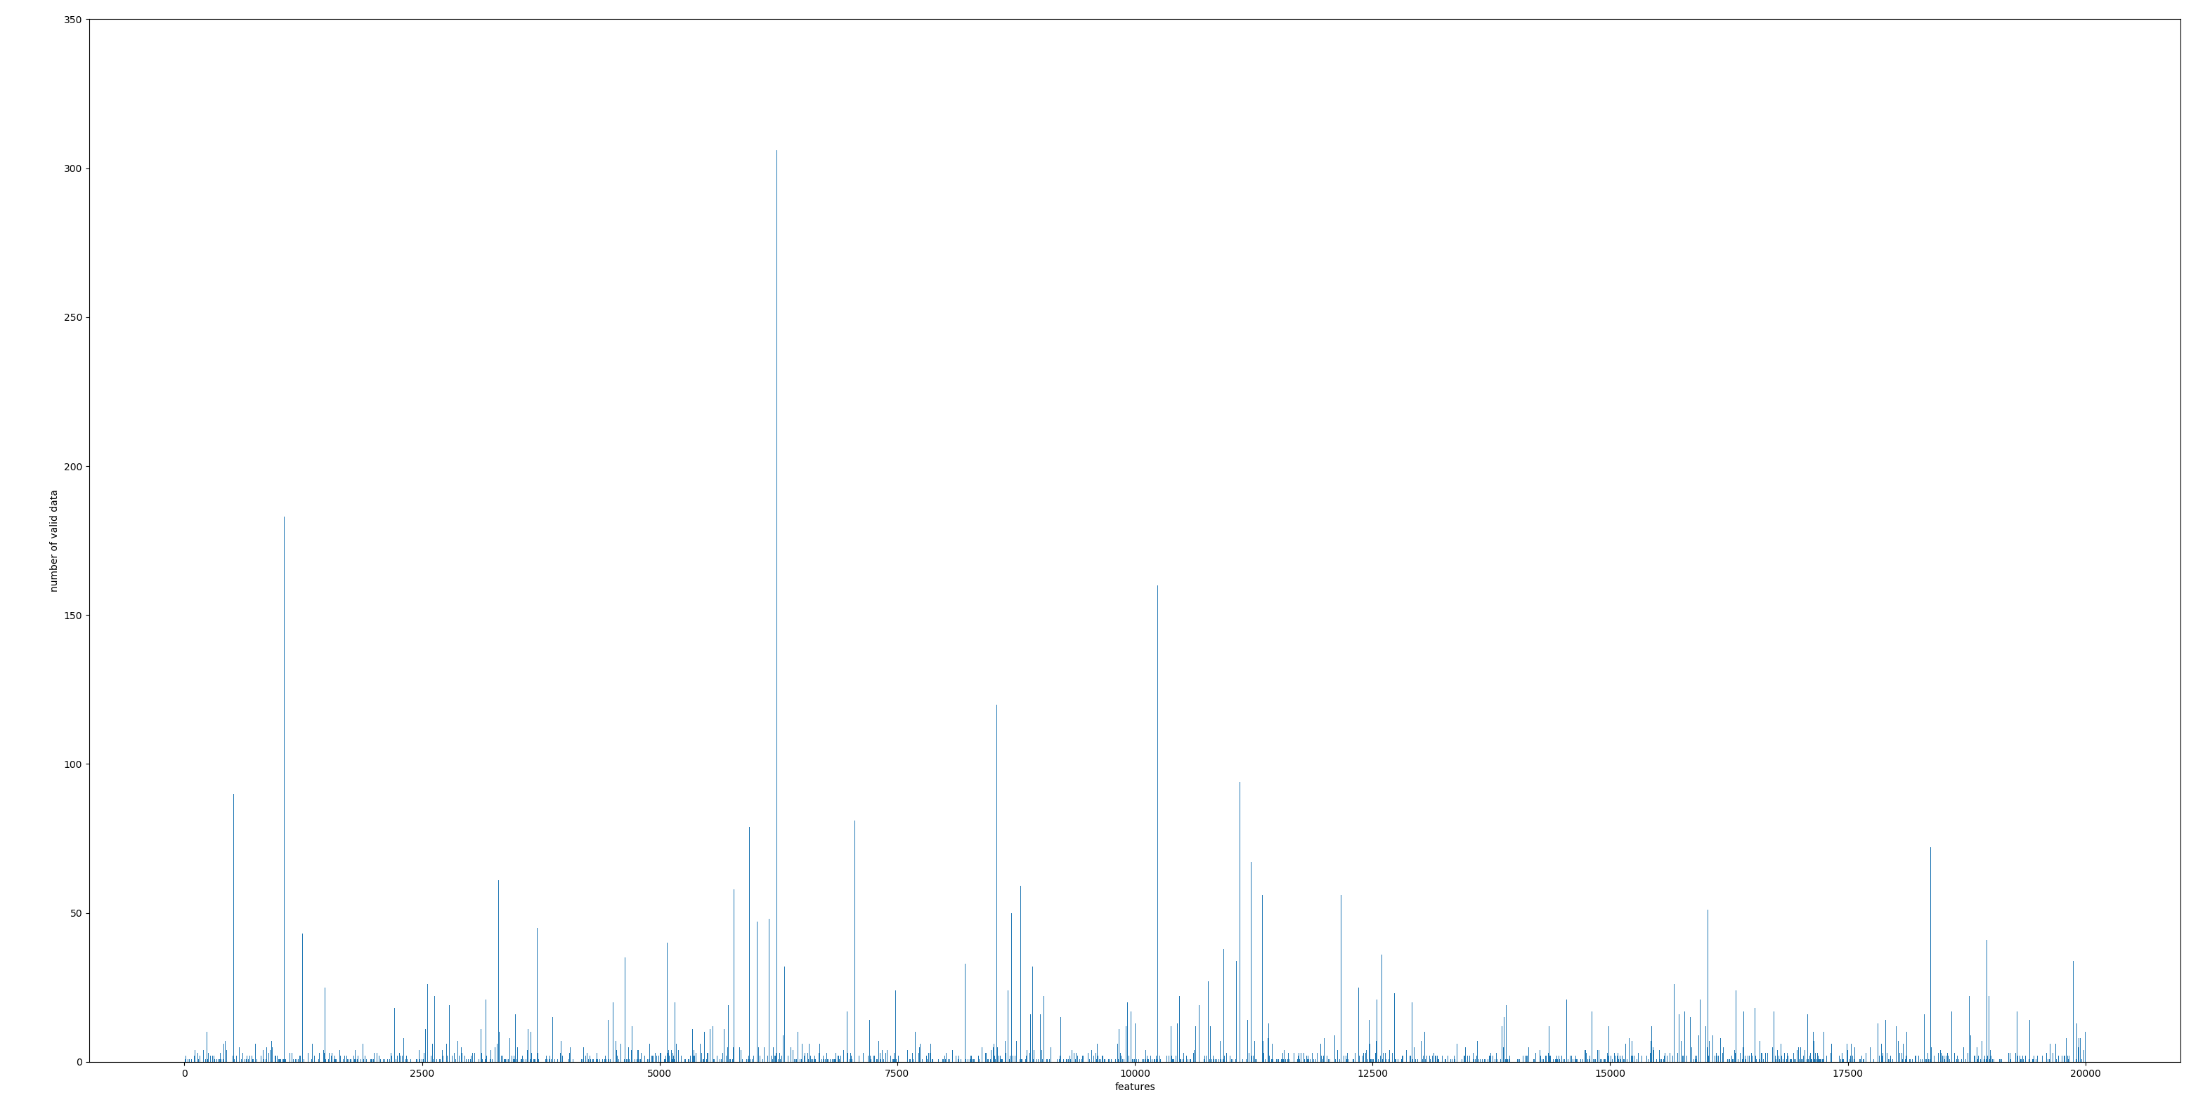
DEXTER
X Label: features
Y Label: number of valid data(not nan)
Sparse Matrix
50

Slide 20
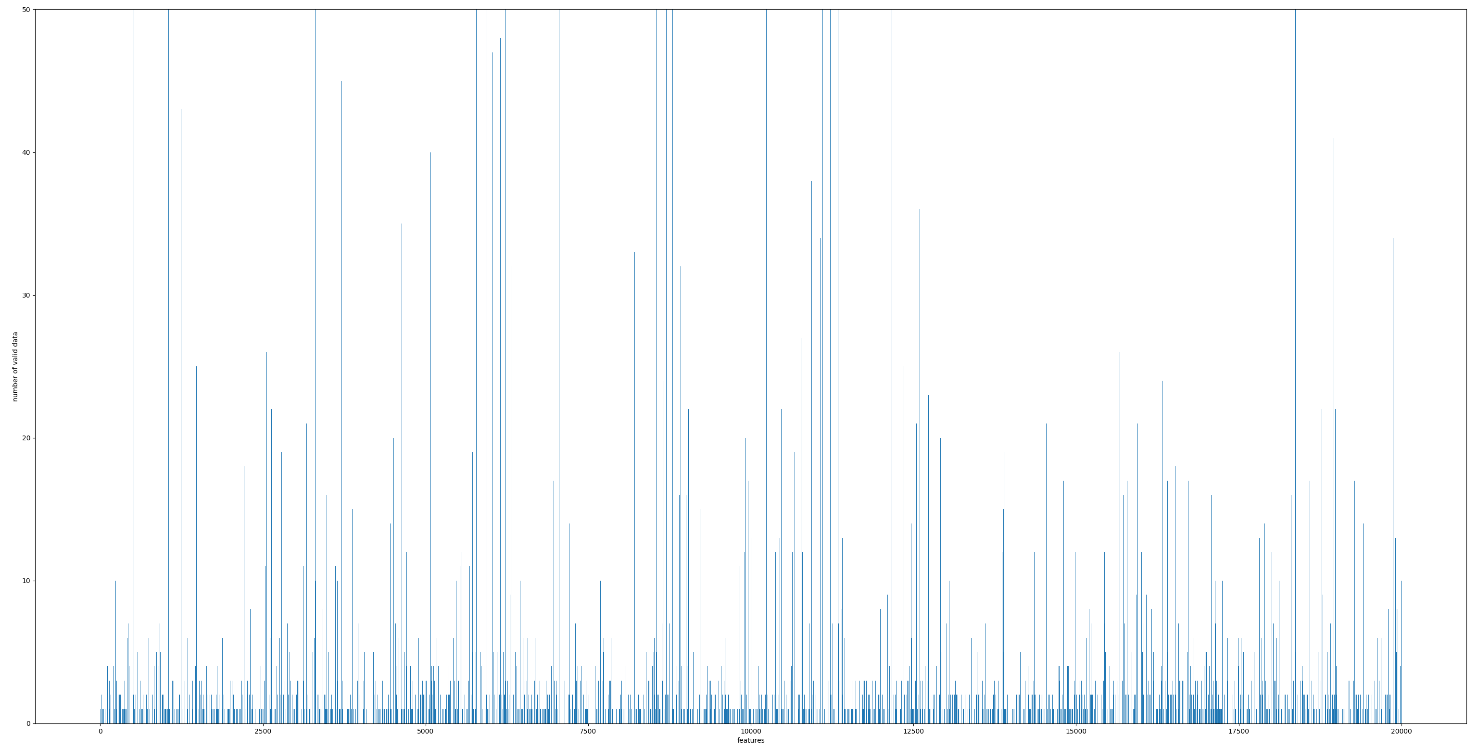
Number of valid data(total: 600)
50
10

Slide 21
Process
Large amount of missing values
Replacing missing data with 0
PCA
KNN / Bayes / Perceptron

Slide 22
Result
KNN
Perceptron
Bayes
Accuracy
0.59-0.72
0.84-0.91
0.86-0.89
Perceptron or Bayes.
Feature# | 1045 | 851 | 785 | 722 | 675 | 625 | 583 | 539
Perceptron | 0.897 | 0.91 | 0.903 | 0.89 | 0.87 | 0.88 | 0.90 | 0.893
Bayes | 0.86 | 0.873 | 0.876 | 0.876 | 0.88 | 0.88 | 0.89 | 0.873

Slide 23
Result
Feature# | 500 | 318 | 284 | 251 | 231 | 226 | 222 | 214
Accuracy | 0.761 | 0.765 | 0.766 | 0.768 | 0.767 | 0.775 | 0.77 | 0.711
MADELON
Feature# | 10000 | 9500 | 81 | 78 | 75 | 72 | 69 | 66
Accuracy | 0.81 | 0.81 | 0.81 | 0.81 | 0.82 | 0.84 | 0.83 | 0.77
ARCENE
Feature# | 1045 | 851 | 785 | 722 | 675 | 625 | 583 | 539
Perceptron | 0.897 | 0.91 | 0.903 | 0.89 | 0.87 | 0.88 | 0.90 | 0.893
Bayes | 0.86 | 0.873 | 0.876 | 0.876 | 0.88 | 0.88 | 0.89 | 0.873
DEXTER

Slide 24
Conclusion
Standardization of data might lose information.
In some cases, we can achieve good classification performance using all the features.
Feature Selection will help increase the accuracy. However, after eliminating noise features, accuracy will not increase as features decreasing. Also, keep eliminating features might lose information.

