Slide 1
Words preprocessing
Only select single word and “not” word
For “not” words, find their antonyms using wordnet.antonyms(), if not find, keep the original form/add ”un” + words.
Divide the words using sentiwordnet.senti_synsets() into 3 categories: Positive, Negative and Neutral
Positive: 262
Negative: 363
Neutral: 201

Slide 2
Words preprocessing2
Define the emotional attribute threshold a=0.25:
if avg_pos>a and avg_pos>avg_neg: “positive”
elif avg_neg>a and avg_neg>avg_pos: ”negative”
else: “neutral”
Only consider positive and negative attributes, using static word embeddings:
Positive: 67
Negative: 127

Slide 3
Words preprocessing3
Convert all nouns to adjectives, and change comparative and superlative forms back to their base form.
A small number of words were not successfully converted.
WordNetLemmatizer.lemmatize()—Comparative and superlative -> base form
https://www.nltk.org/api/nltk.stem.wordnet.html#module-nltk.stem.wordnet
wordnet.synsets.lemmas.derivationally_related_forms() —nouns -> adjectives
https://www.nltk.org/api/nltk.corpus.reader.wordnet.html
Remove duplicate words and Convert uppercase to lowercase
Positive: 61
Negative: 120

Slide 4
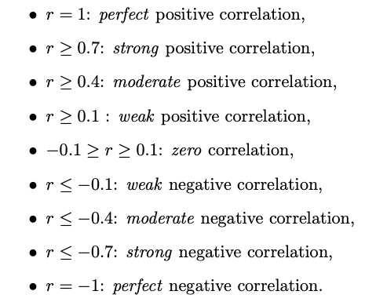
Correlation between signal patterns and Clusters:
n_clusters | GloVe | Word2Vec | FastText
positive | 10 | 7 | 9
negative | 14 | 11 | 12
Seven signal patterns: mean_amplitude, rms, pulse_count, std_pulse_dist, zero_count, mean_onset_strength, spectral_centroid

Slide 5
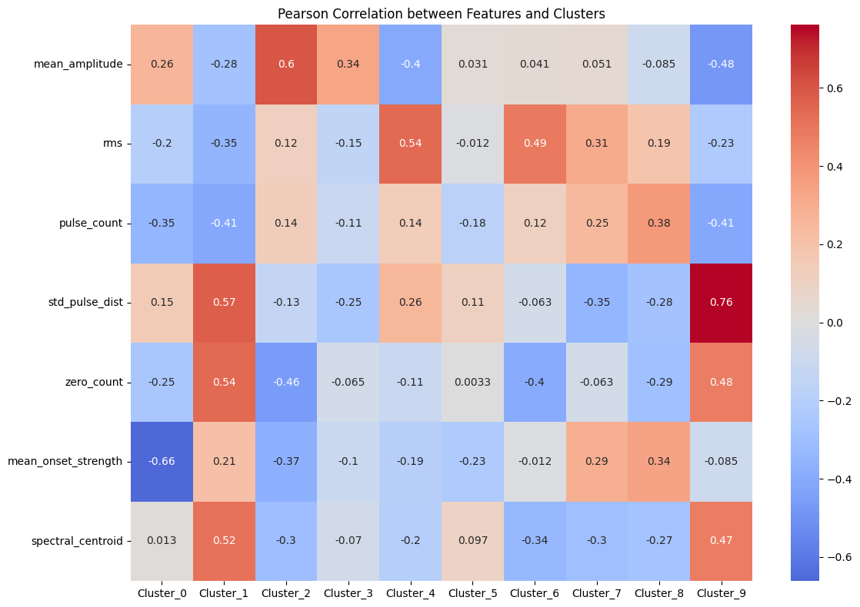
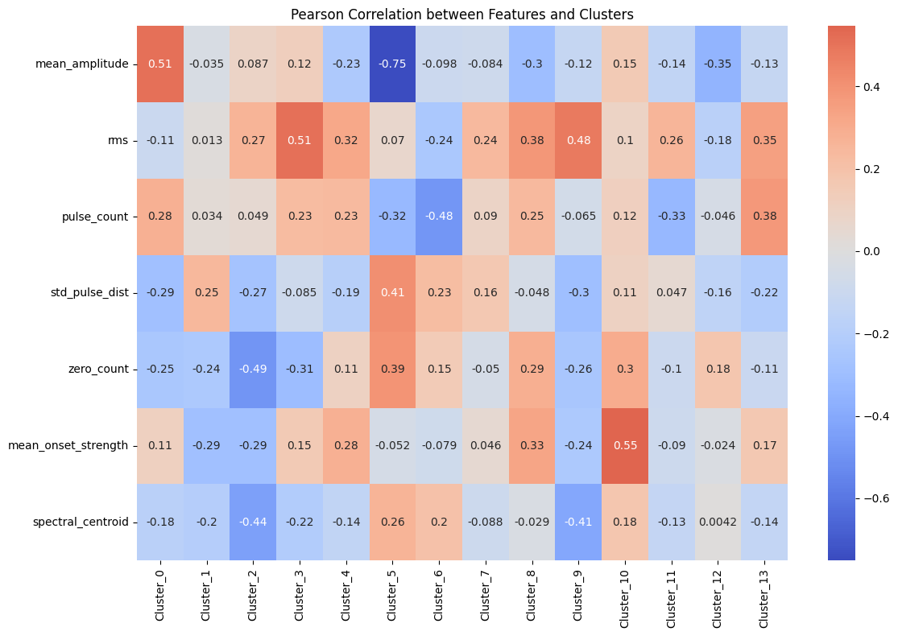
GloVe
Positive
Negative

Slide 6
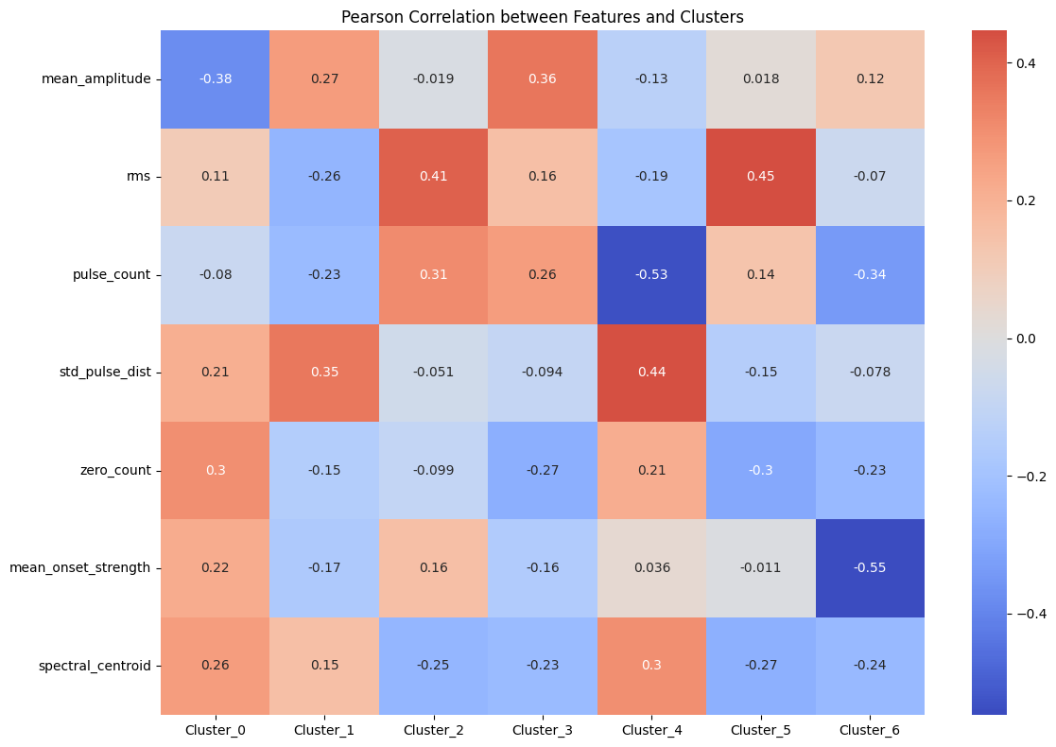
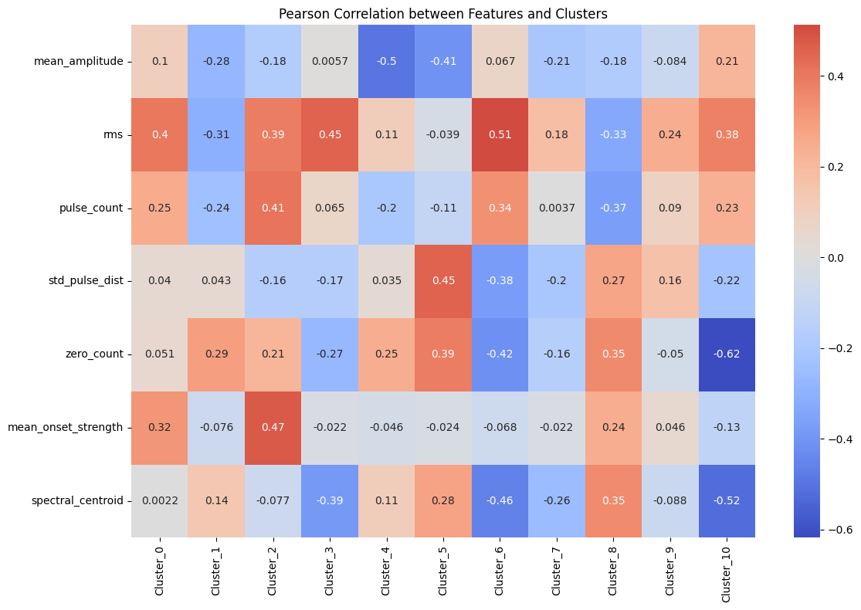
Word2Vec
Positive
Negative

Slide 7
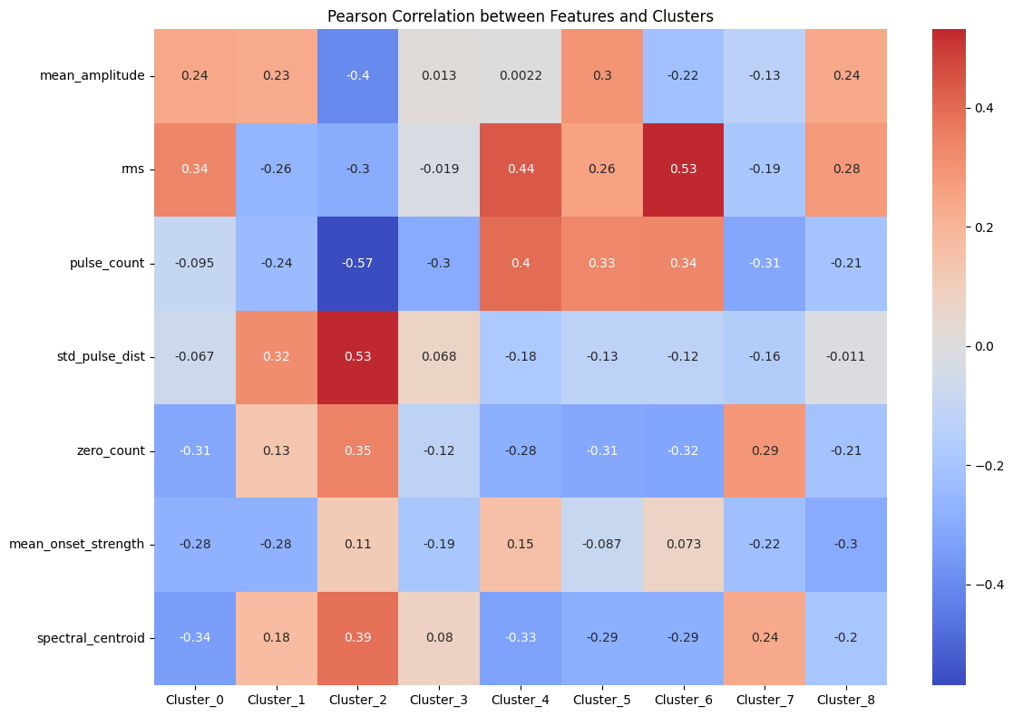
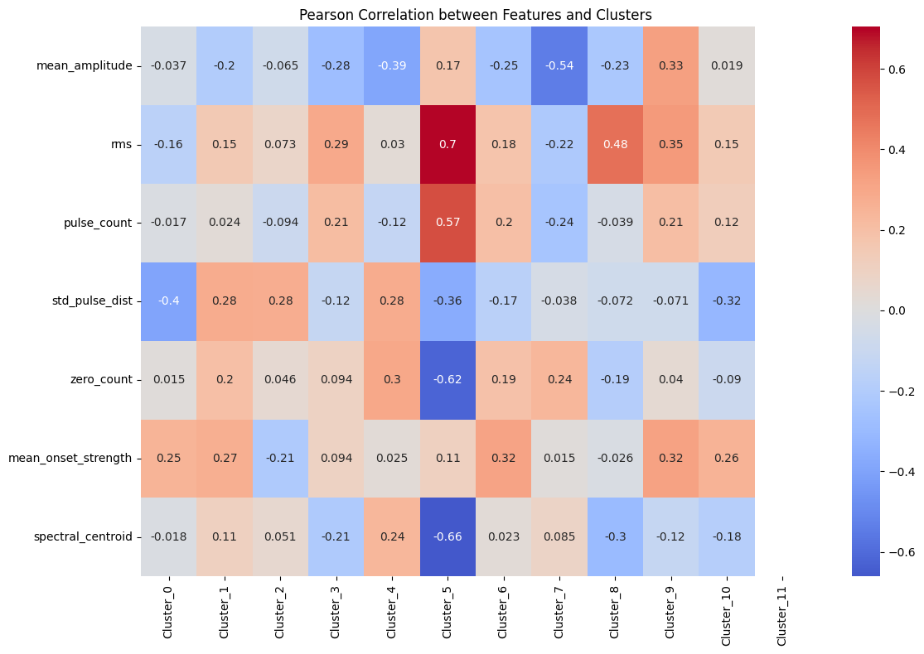
FastText
Positive
Negative

