Slide 1
Words preprocessing
Only select single word and “not” word
For “not” words, find their antonyms using wordnet.antonyms(), if not find, keep the original form/add ”un” + words.
Divide the words using sentiwordnet.senti_synsets() into 3 categories: Positive, Negative and Neutral
Positive: 262
Negative: 363
Neutral: 201

Slide 2
Words preprocessing2
Define the emotional attribute threshold a=0.25:
if avg_pos>a and avg_pos>avg_neg: “positive”
elif avg_neg>a and avg_neg>avg_pos: ”negative”
else: “neutral”
Only consider positive and negative attributes, using static word embeddings:
Positive: 67
Negative: 127

Slide 3
Words preprocessing3
Convert all nouns to adjectives, and change comparative and superlative forms back to their base form.
A small number of words were not successfully converted.
WordNetLemmatizer.lemmatize()—Comparative and superlative -> base form
https://www.nltk.org/api/nltk.stem.wordnet.html#module-nltk.stem.wordnet
wordnet.synsets.lemmas.derivationally_related_forms() —nouns -> adjectives
https://www.nltk.org/api/nltk.corpus.reader.wordnet.html
Remove duplicate words and Convert uppercase to lowercase
Positive: 61
Negative: 120

Slide 4
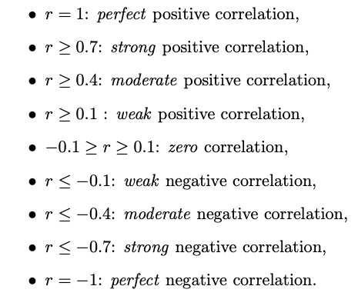
Correlation between signal patterns and Clusters:
n_clusters | GloVe | Word2Vec | FastText
positive | 10 | 7 | 9
negative | 14 | 11 | 12
Seven signal patterns: mean_amplitude, rms, pulse_count, std_pulse_dist, zero_count, mean_onset_strength, spectral_centroid

Slide 5
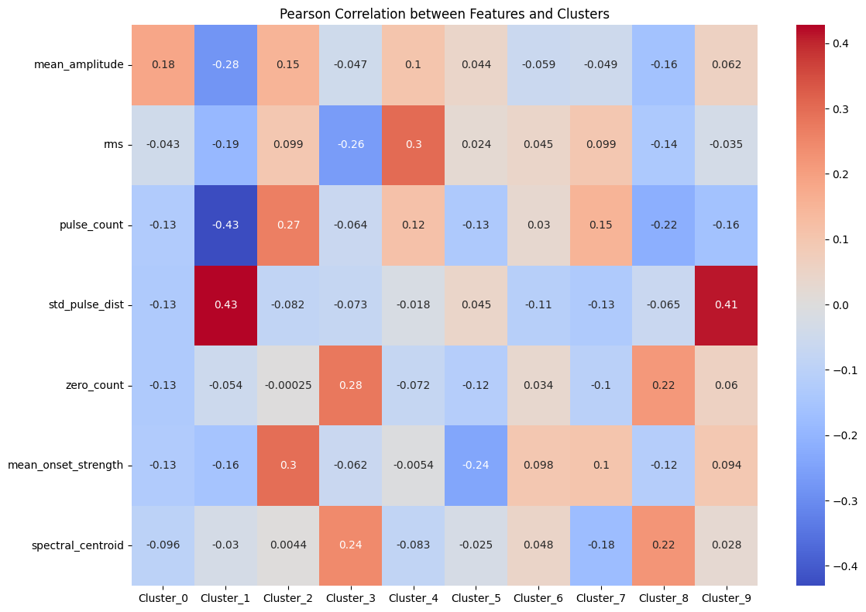
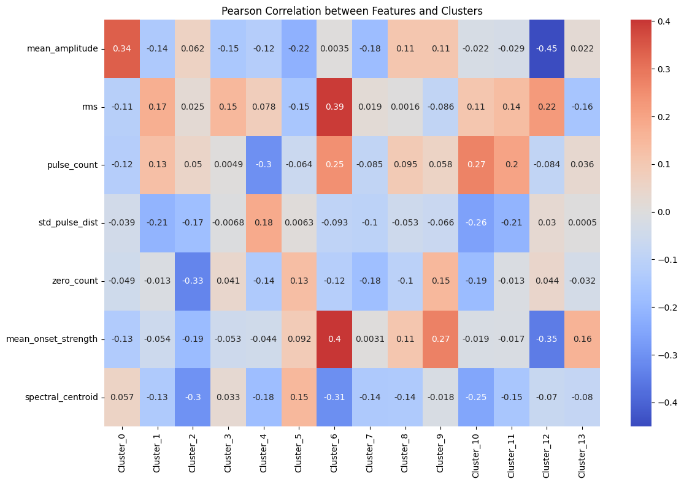
GloVe
Positive
Negative
3&8
10 &11

Slide 6
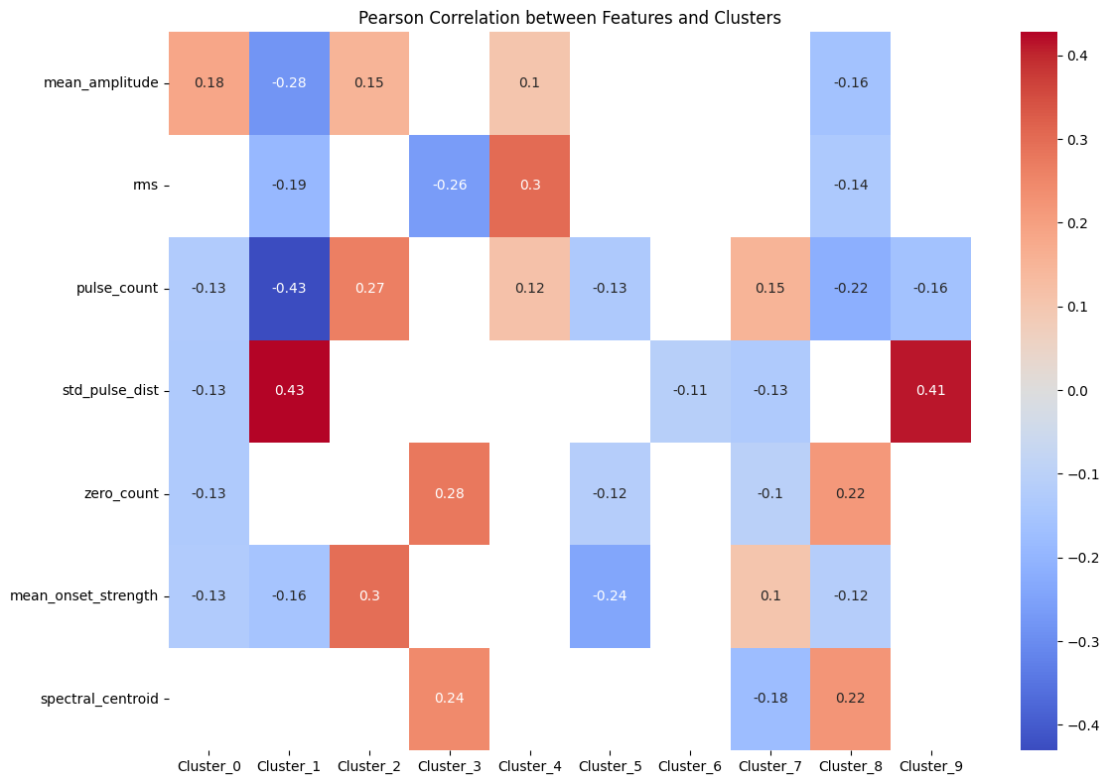
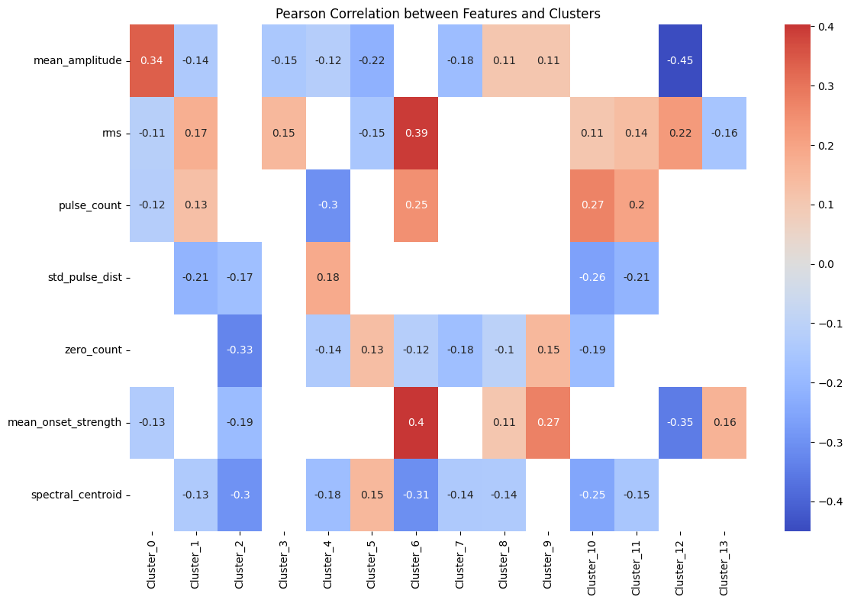
GloVe
Positive
Negative

Slide 7
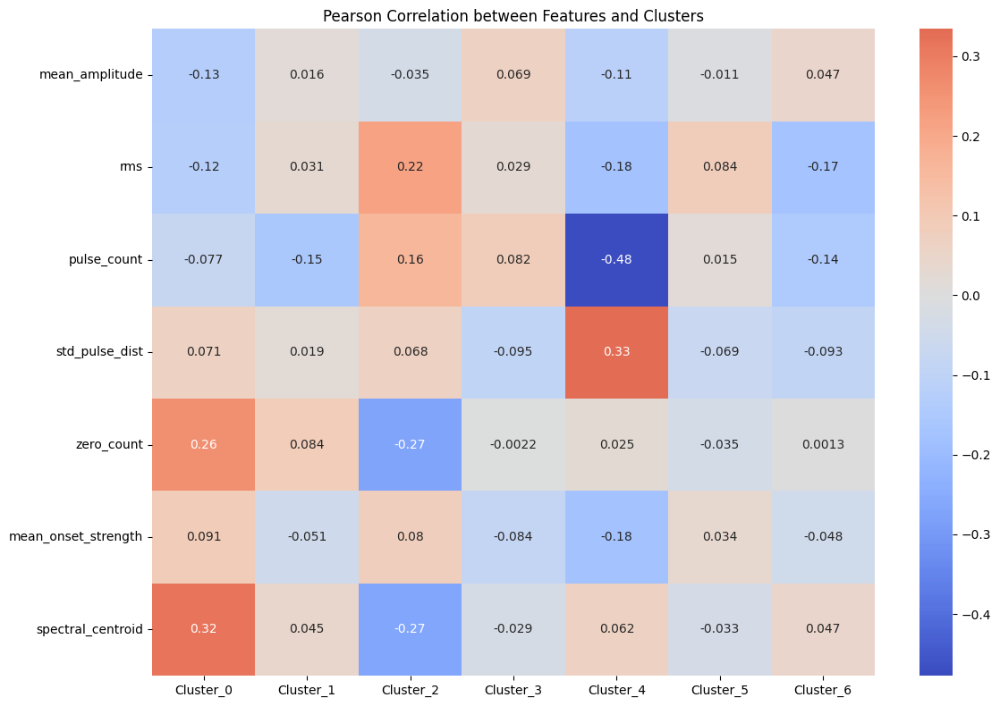
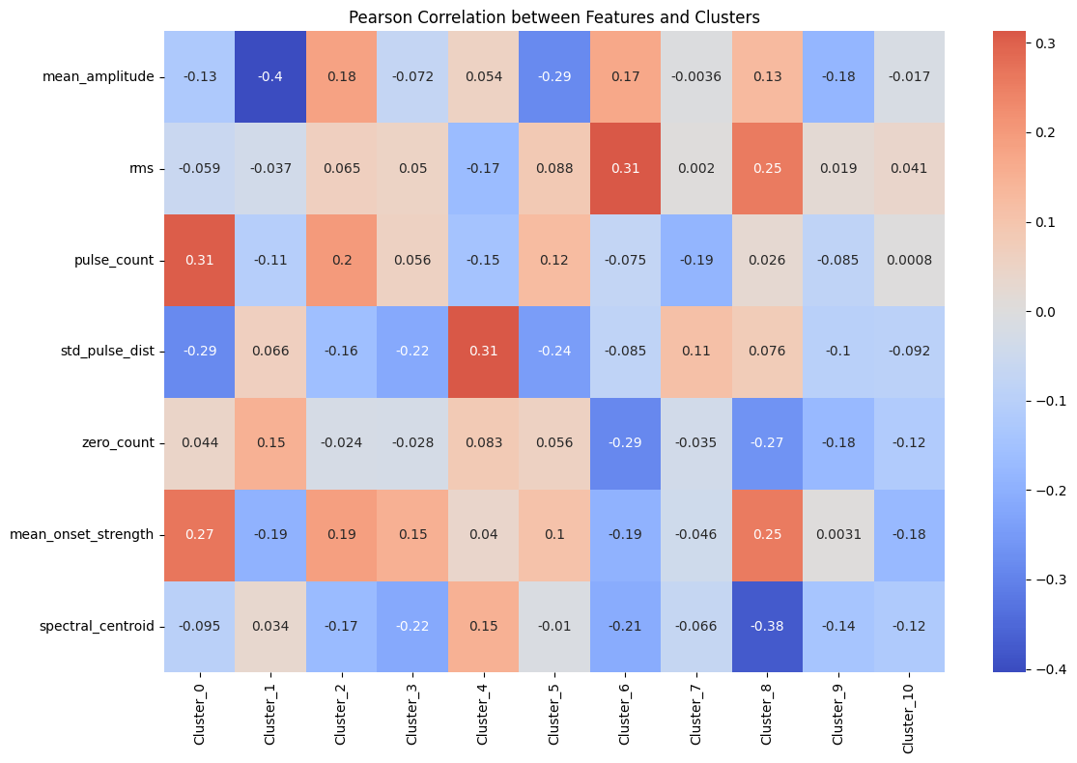
Word2Vec
Positive
Negative

Slide 8
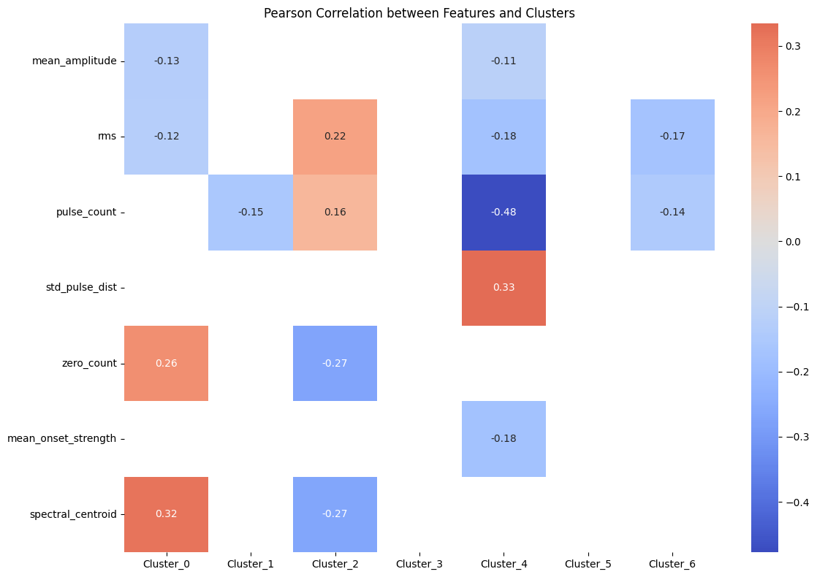
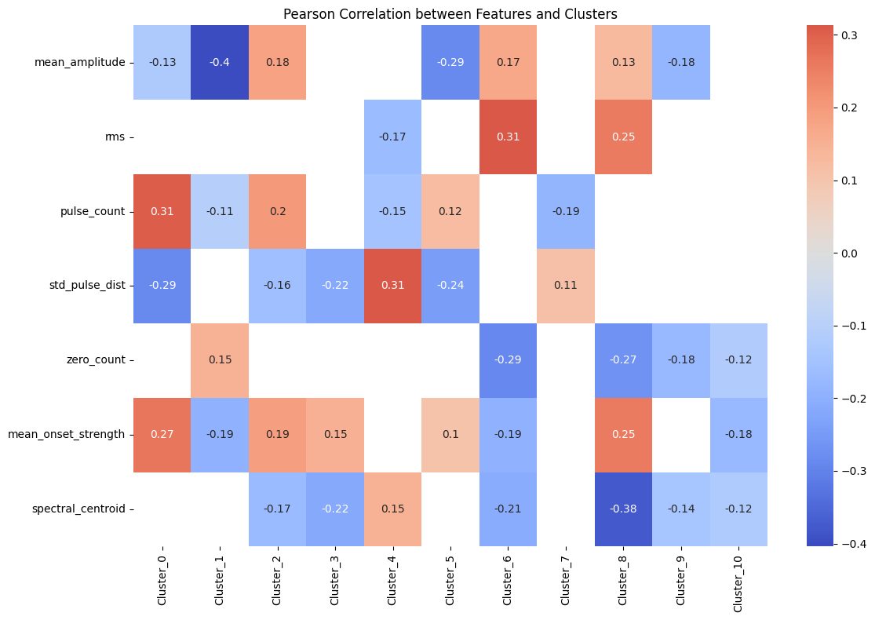
Word2Vec
Positive
Negative

Slide 9
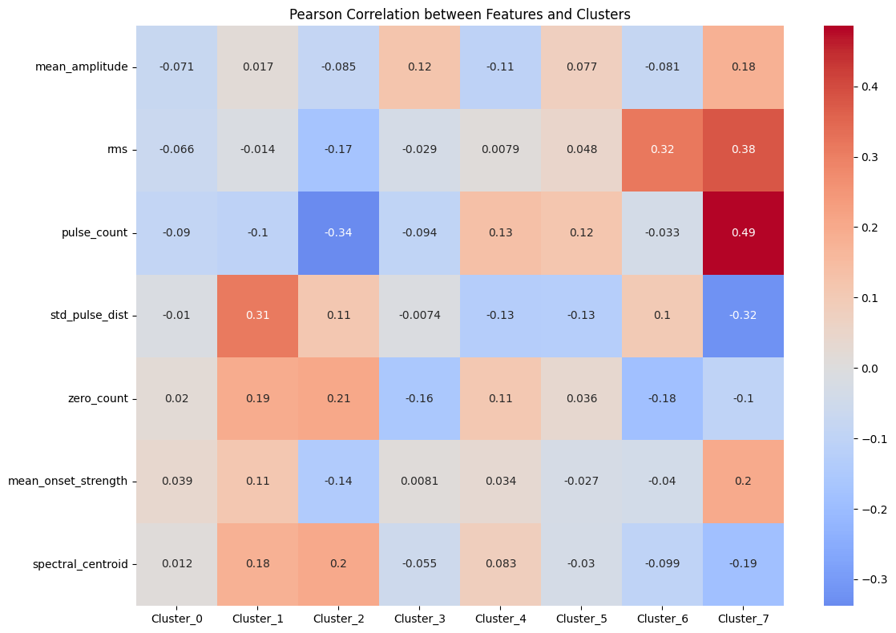
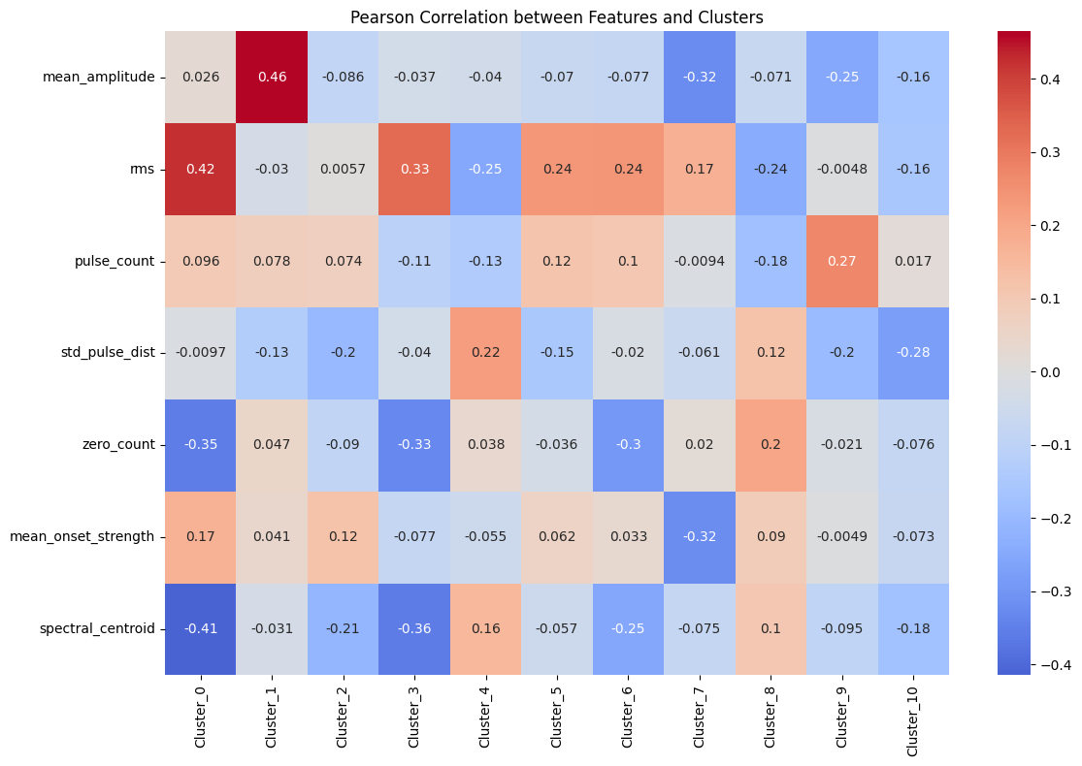
FastText
Positive
Negative

Slide 10
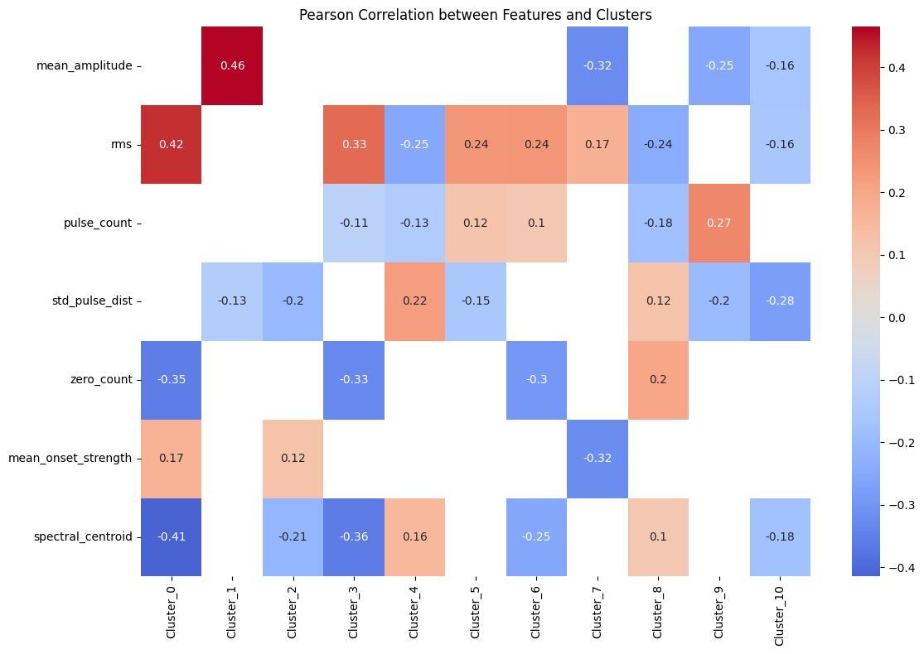
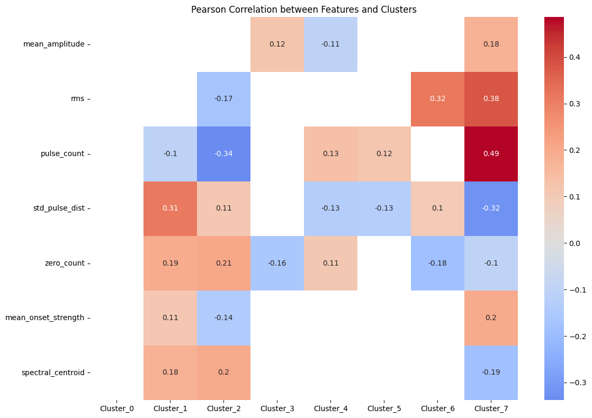
FastText
Positive
Negative

Slide 11
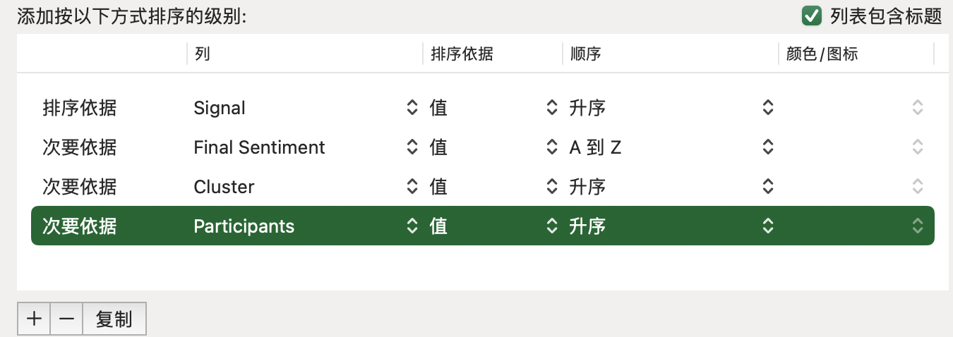

Slide 12
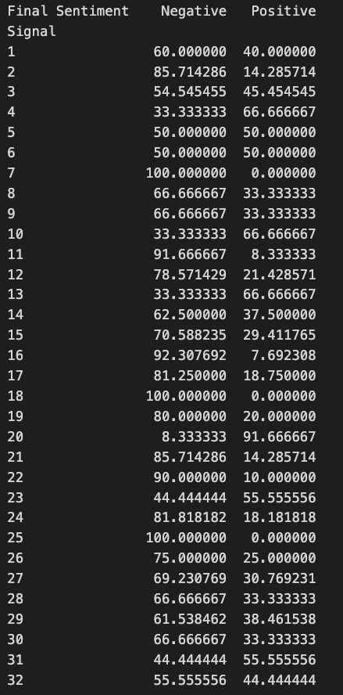
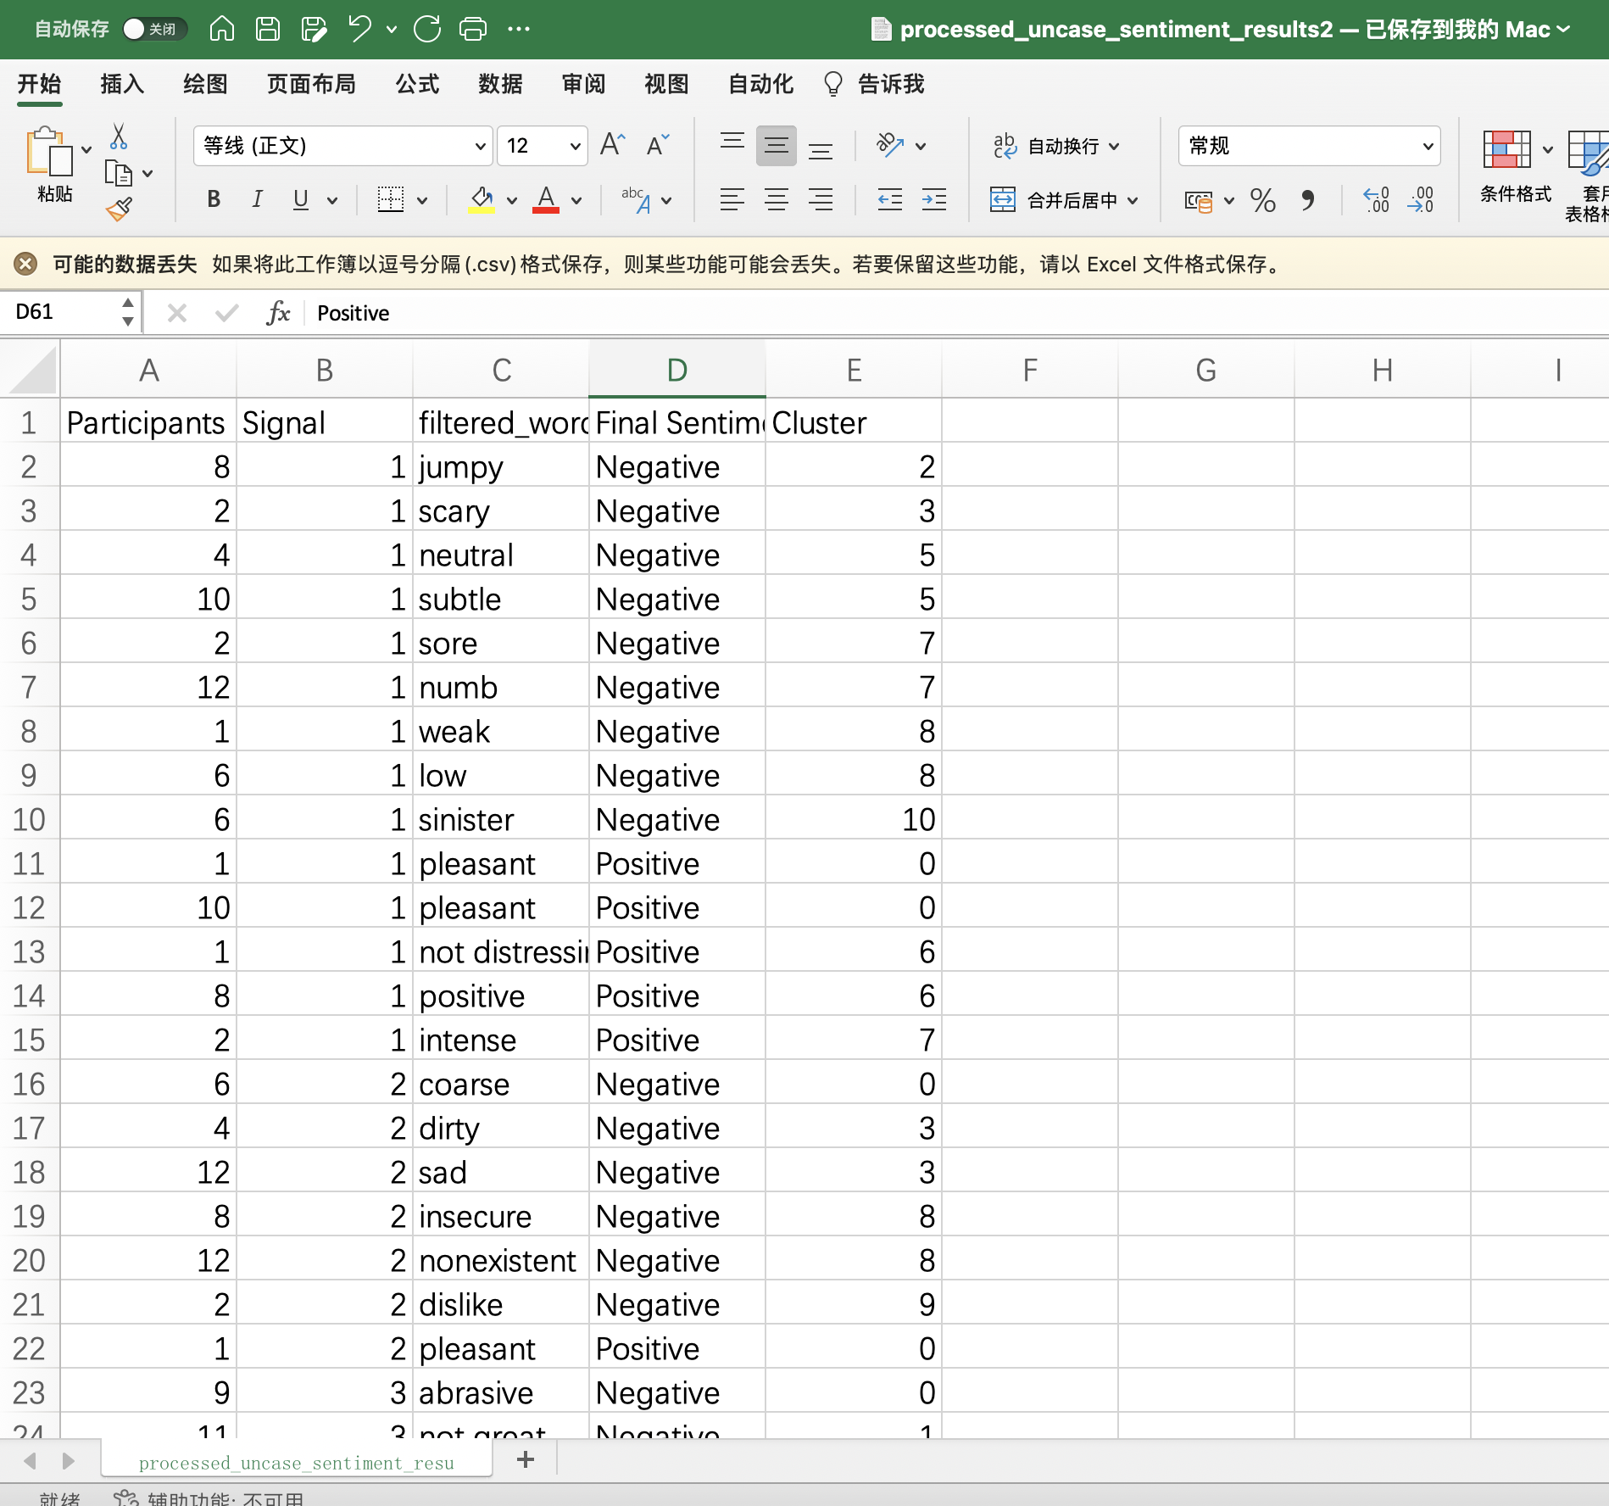
111pos 227neg 32.8%

Slide 13
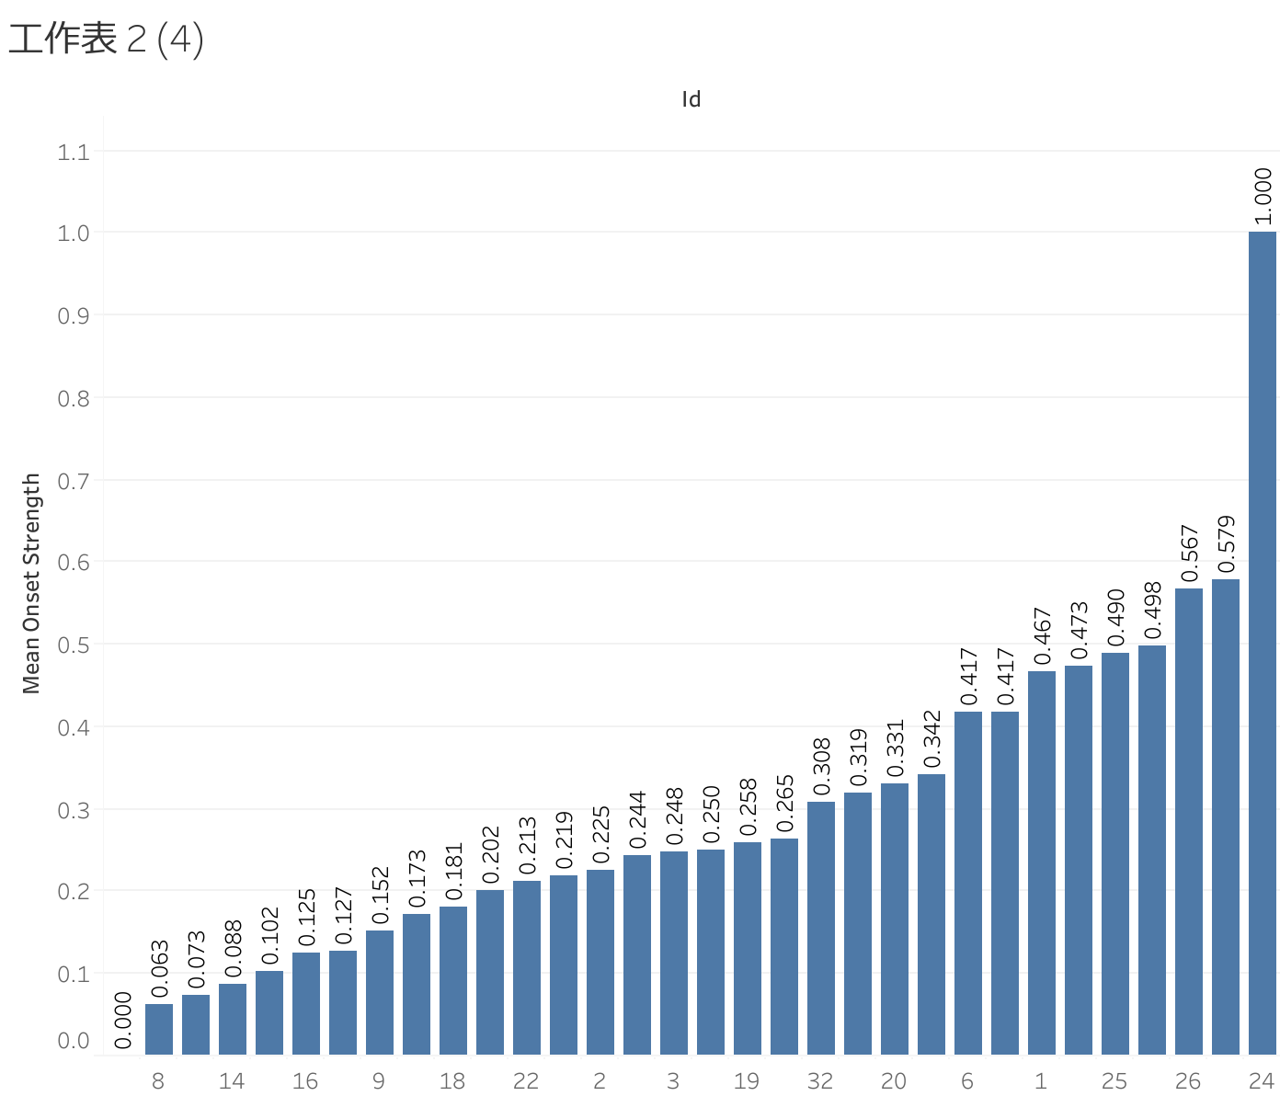
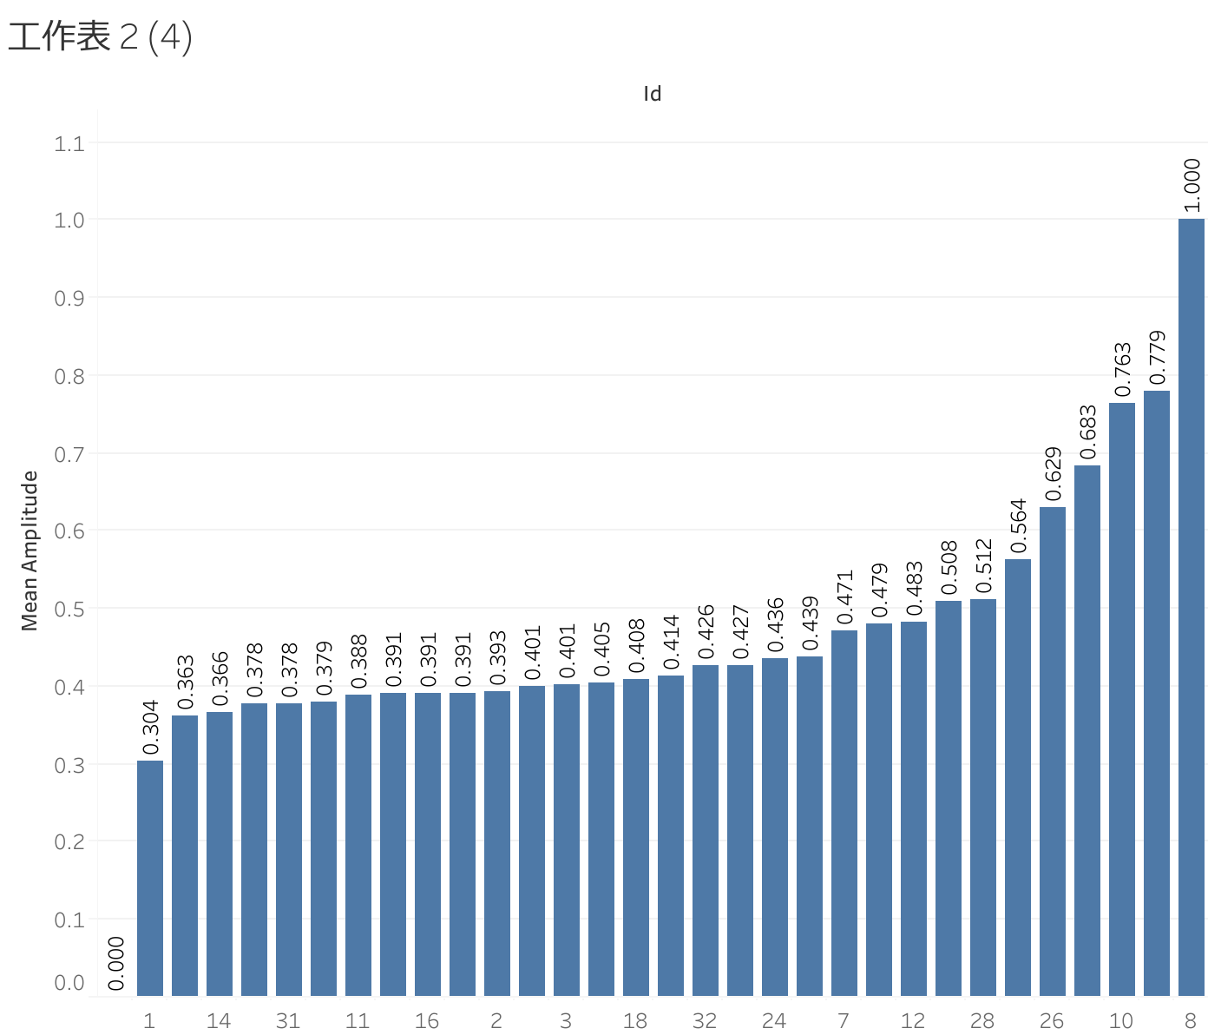
Feature visualization

Slide 14
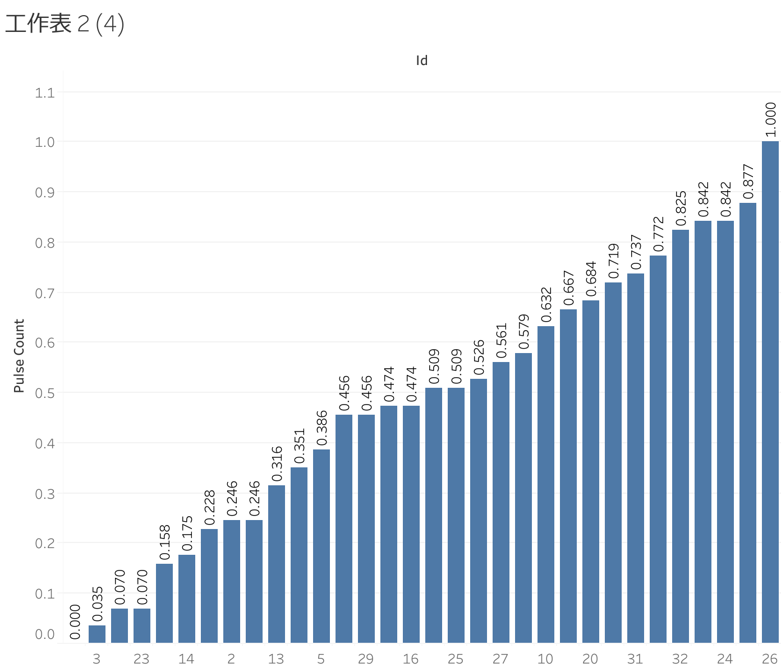
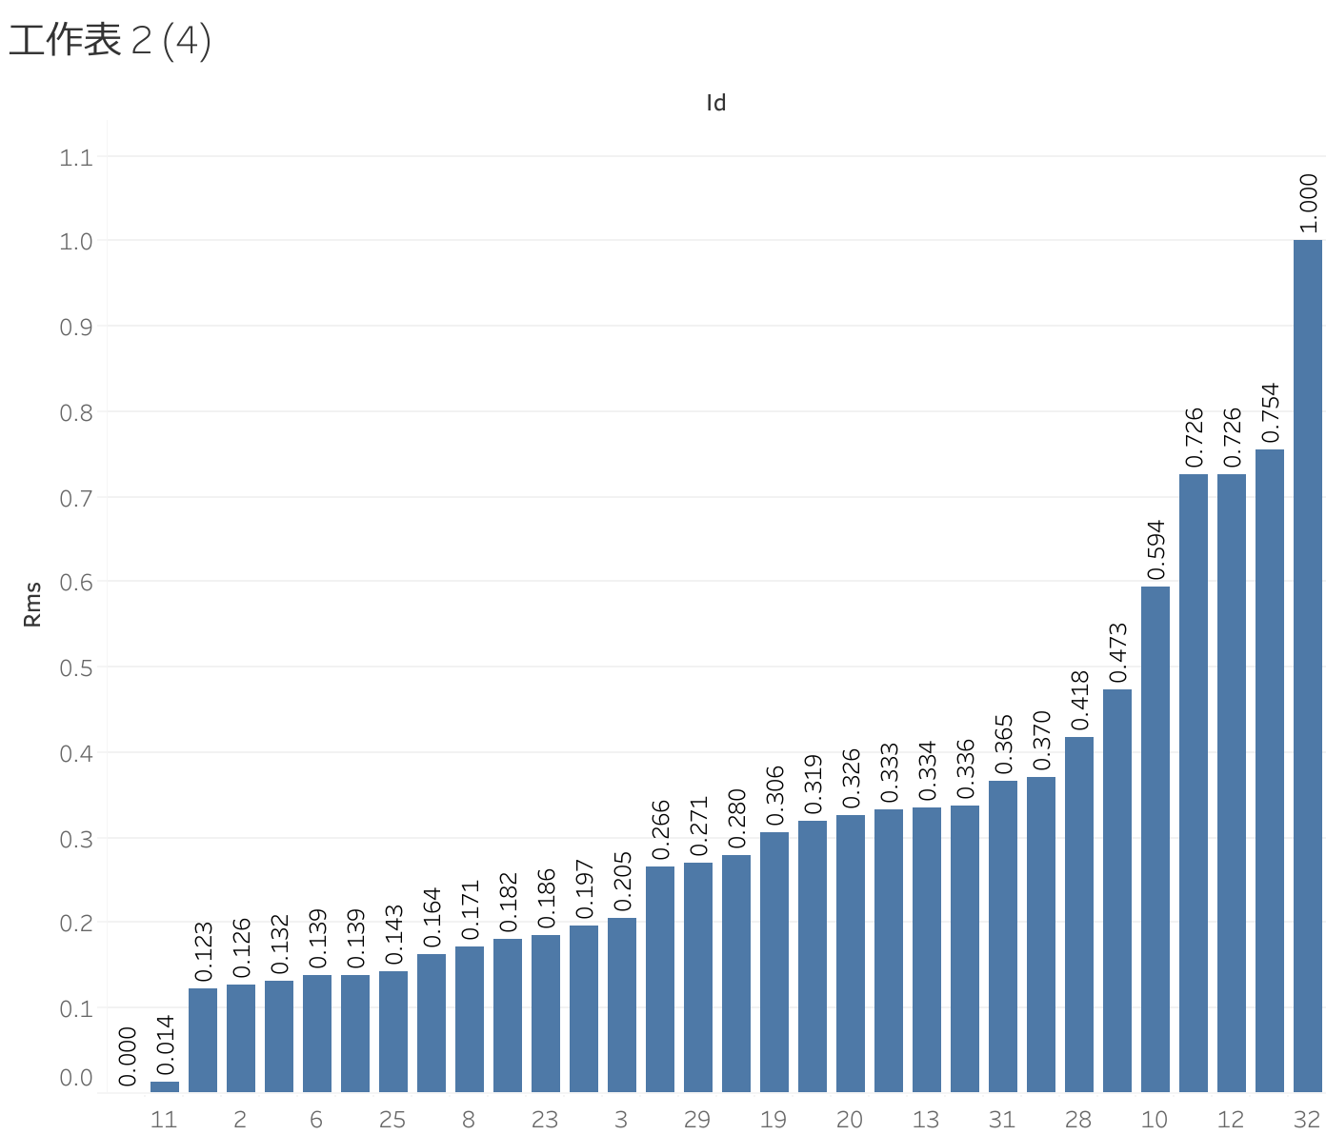
Feature visualization

Slide 15
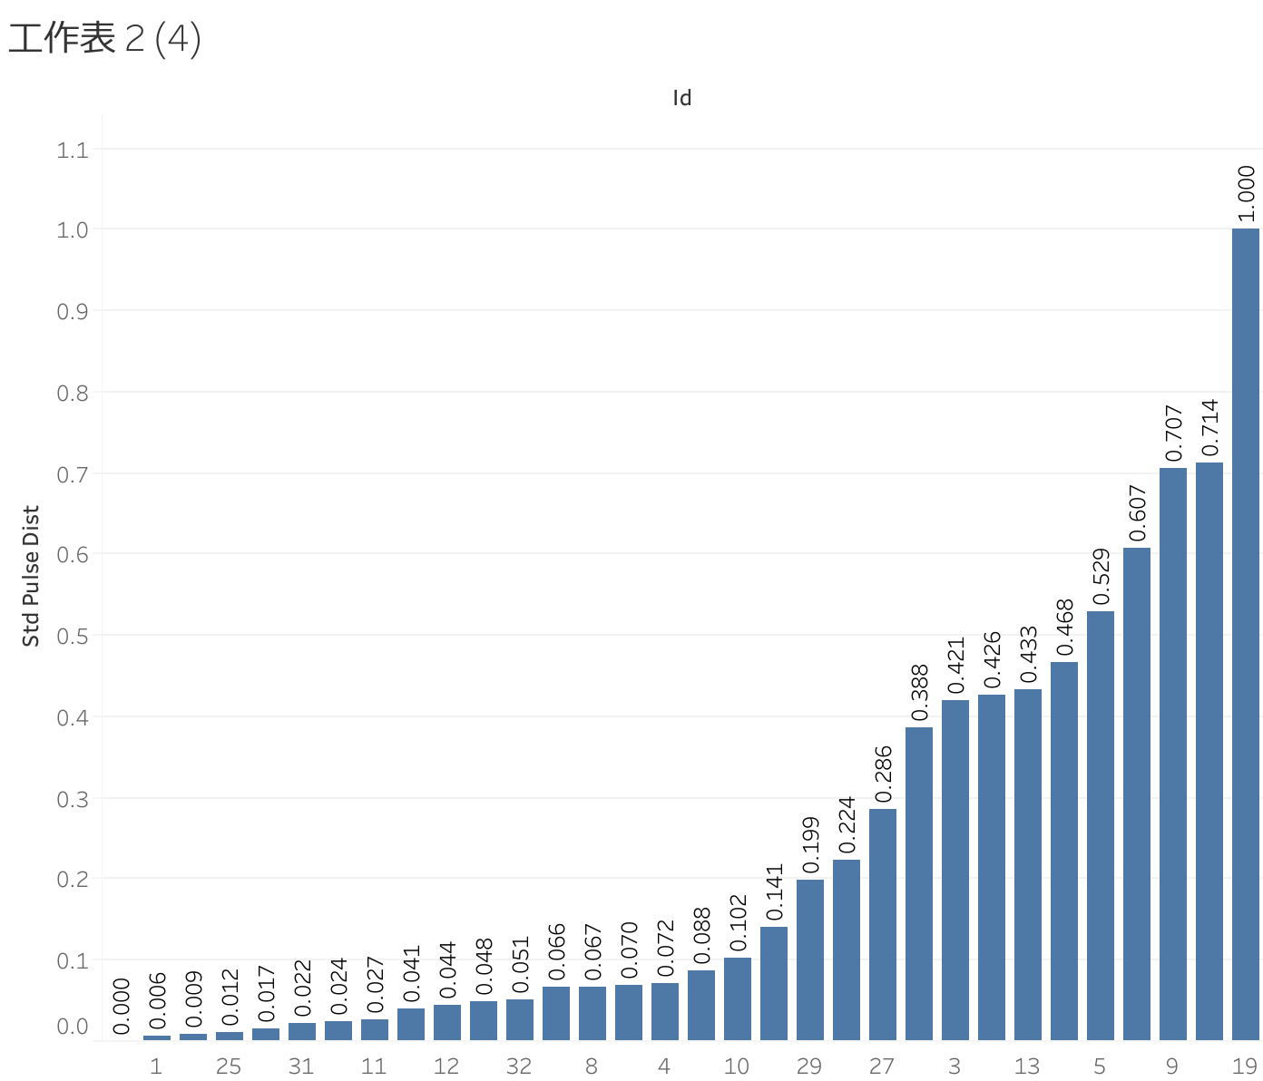
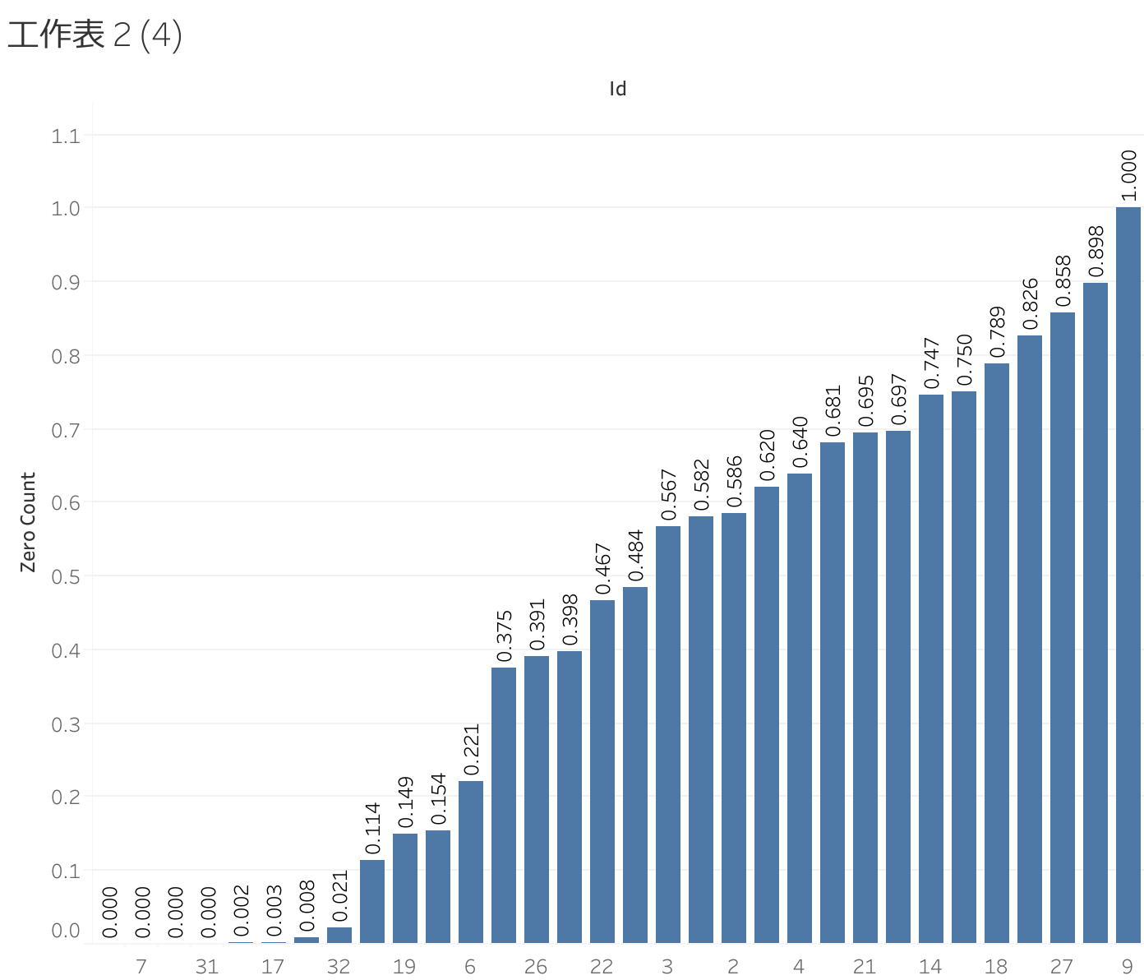
Feature visualization

Slide 16
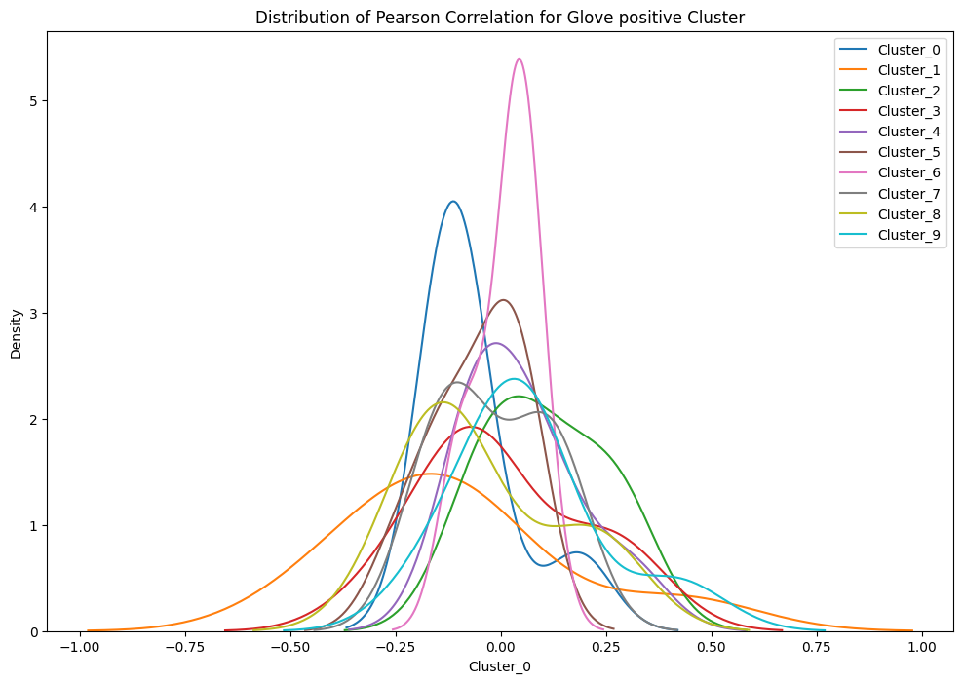
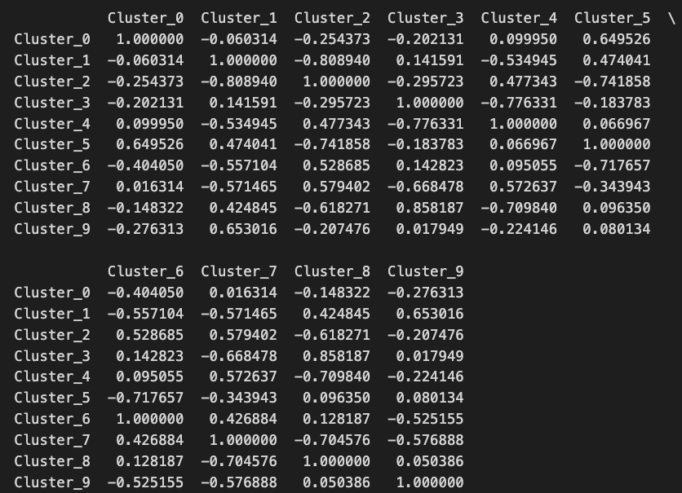
sns.kdeplot and cosine_similarity

Slide 17
cosine_similarity>=0.7
Glove：
Pos：3&8(0.86)
Neg：1&10(0.81), 1&11(0.91), 2&10(0.77), 3&12(0.84), 6&8(0.71), 8&10(0.70), 10&11(0.92),
Word2vec：
Pos：1&4(0.70)
Neg: 0&3(0.77), 2&3(0.70), 6&10(0.76)
FastText：
Pos：5&7(0.81)
Neg：0&3(0.88), 0&6(0.95), 2&10(0.73), 3&6(0.89), 4&8(0.81)

