Slide 1
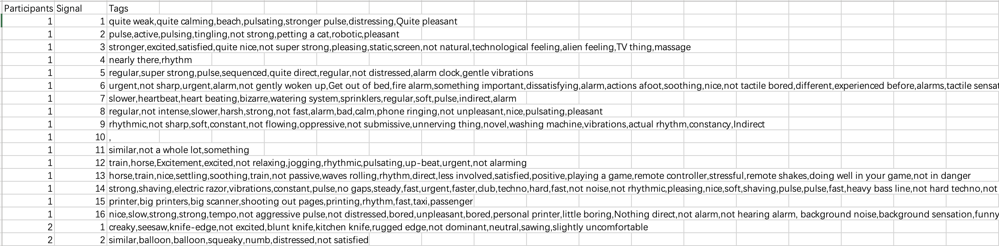
Datasets format
P01.txt to P12.txt contain the descriptions from the 12 participants. Each line has the description for a different signal (e.g., line 1 includes the description for signal 1). 32 signals in total.
Manual_dataset.csv contains the selected phrases (“tags”) from each participant’s description for each signal. Note that if a phrase repeats in the description, all occurrences are considered matches.

Slide 2
Step1: Use GPT-3.5 with fine-tuning method to extract sensational, emotional, metaphoric keywords
Training prompt format:
{"messages":[
{"role": "system", "content": "You are a helpful linguistic assistant. Extract keywords including sensational, emotional, metaphoric, and usage examples from the corresponding texts below: 1. You need to first understand the meaning of the sentence before selection. 2. Remain the negative or positive meaning of the sentences. 3. Only select ADJ and NOUN keywords. 4. Must Remove words \"emotional\", \"sensational\", \"emotion\", \"sensation\", \"feeling\", and their derivatives."},
{"role": "user", "content": ptext_df['Text'].iloc[i] },
{"role": "assistant", "content": cleaned_manual_df['Tags'].iloc[i]} ] }

Slide 3
Step1: Use GPT-3.5 with fine-tuning method to extract sensational, emotional, metaphoric keywords
Divide the data into training and testing sets, with a ratio of 3:7
Testing prompt format: (with no ”assistant” part)
{"messages": [
{"role": "system", "content": "Extract keywords including sensational, emotional, metaphoric, and usage examples from the corresponding texts below."},
{"role": "user", "content": "This feels a little bit more intrusive again. I feel like we're back to the slightly more aggressive ones in a way like it feels a little bit more aggressive. I keep thinking of the sticker again. The sticker stuff, it feels like that. It feels like I expect to take my finger off, and there would be something on my finger that was in the way. It doesn't feel painful or annoying or anything. It's just like there's some kind of obstruction."}],
"Participants": 3,
"Signal": 12}

Slide 4
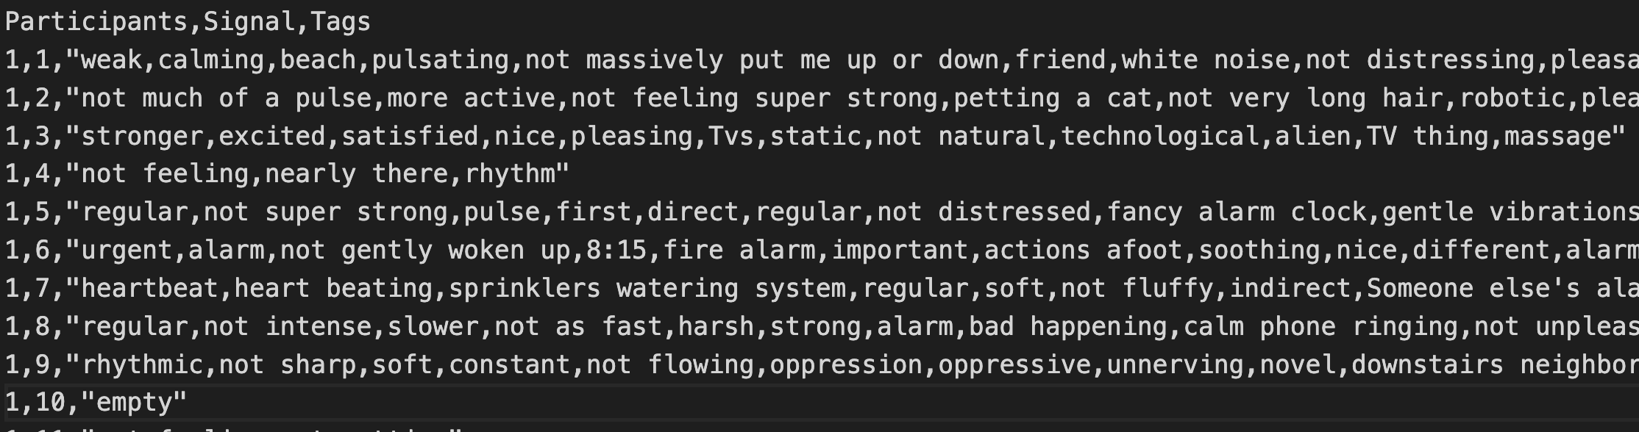
Step1: Use GPT-3.5 with fine-tuning method to extract sensational, emotional, metaphoric keywords
Obtain responses from the model:
response = completion.choices[0].message["content"]
Add Participants, Signal, Tags columns and save to fine_tune_res.csv

Slide 5
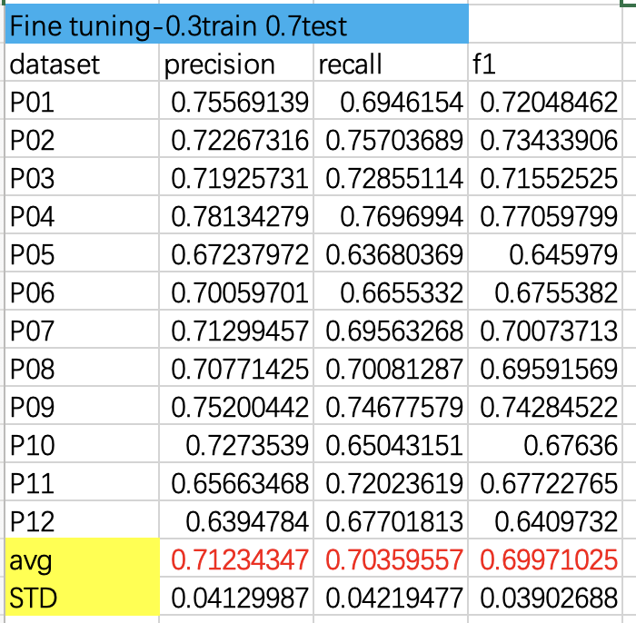
Step2: Calculate strict precision, recall and f1 score of each participants

Slide 6
Step3: Keywords further selection
Only select single word and “not” word
Divide the words using sentiwordnet.senti_synsets() into 3 categories: Positive, Negative and Neutral

Slide 7
Step3: Keywords further selection
Define the emotional attribute threshold a=0.25:
if avg_pos>a and avg_pos>avg_neg: “positive”
elif avg_neg>a and avg_neg>avg_pos: ”negative”
else: “neutral”
For “not”+word, if the word’s avg_pos>=avg_neg, the whole is “negative”; else if the word’s avg_neg>avg_pos, the whole is “positive”
Only consider positive and negative attributes, using static word embeddings

Slide 8
Step3: Keywords further selection
Convert all nouns to adjectives, and change comparative and superlative forms back to their base form.
A small number of words were not successfully converted.
WordNetLemmatizer.lemmatize():
Comparative and superlative -> base form
wordnet.synsets.lemmas.derivationally_related_forms():
nouns -> adjectives
Convert uppercase to lowercase. Remove all duplicate words

Slide 9
Step3: Keywords further selection
For “not” words, find their antonyms using wordnet.antonyms(), if not find, keep the original form (for GloVe and Word2Vec or add ”un” + words (for FastText).
Before:
Positive:111 Negative: 227 Neutral: 1050
After:
Positive: 67 Negative: 127
Notes:
183 218 987
96 115
Phrase:714

Slide 10
Step4: Static word embedding and hierarchical clustering
1. GloVe
Pre-train model: glove.840B.300d, based on Common Crawl
https://nlp.stanford.edu/projects/glove/
2. Word2Vec
Pre-train model: GoogleNews-vectors-negative300.bin:
https://code.google.com/archive/p/word2vec/
3. FastText
Pre-train model: wiki.en.bin
https://fasttext.cc/docs/en/crawl-vectors.html

Slide 11
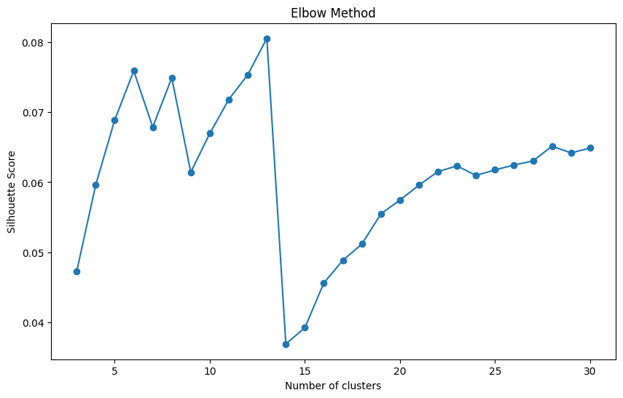
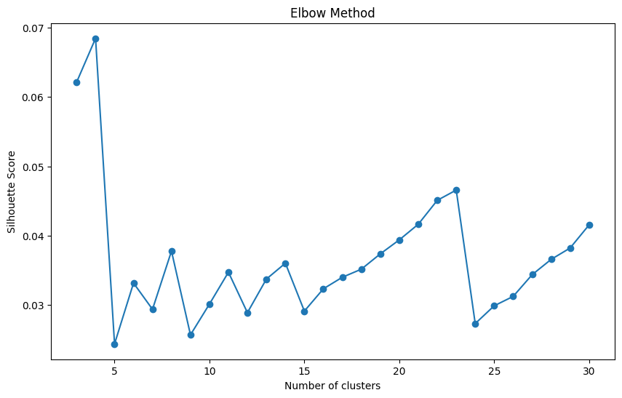
GloVe

Slide 12
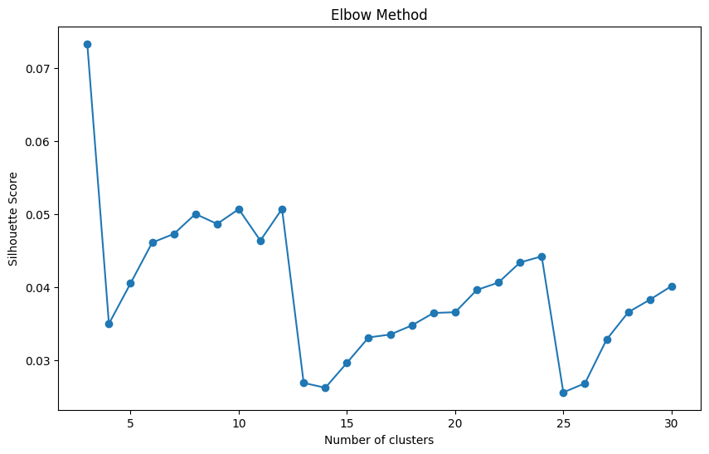
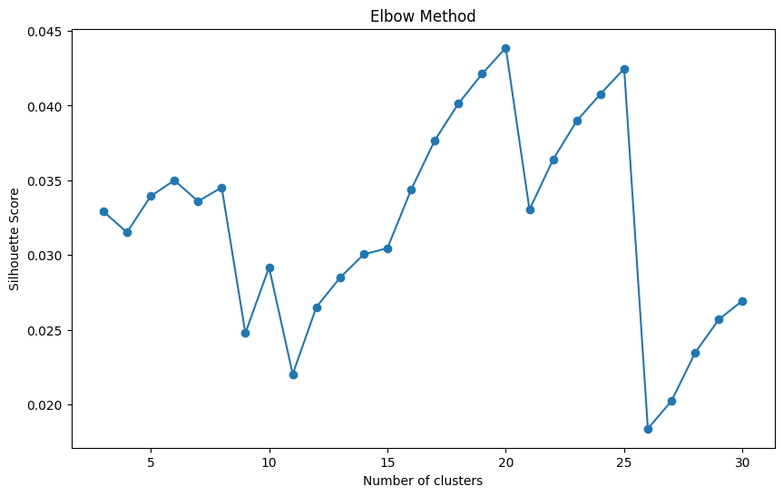
Word2Vec

Slide 13
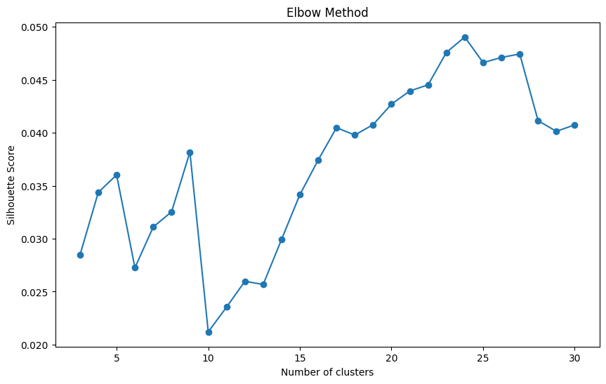
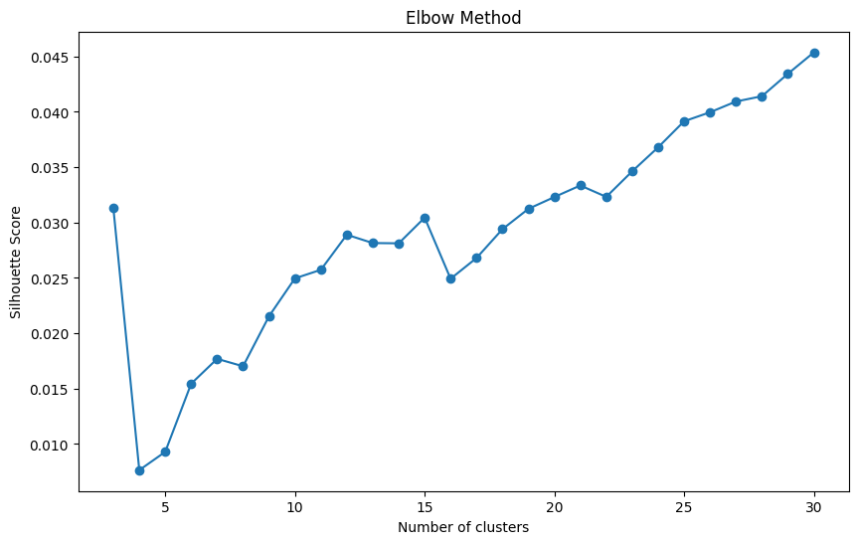
FastText

Slide 14
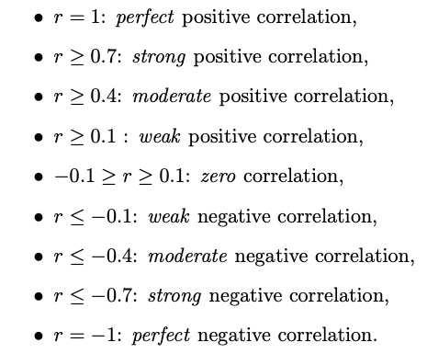
Step 5: Correlation between signal patterns and Clusters:
n_clusters | GloVe | Word2Vec | FastText
positive | 10 | 7 | 9
negative | 14 | 11 | 12
Seven signal patterns: mean_amplitude, rms, pulse_count, std_pulse_dist, zero_count, mean_onset_strength, spectral_centroid

Slide 15
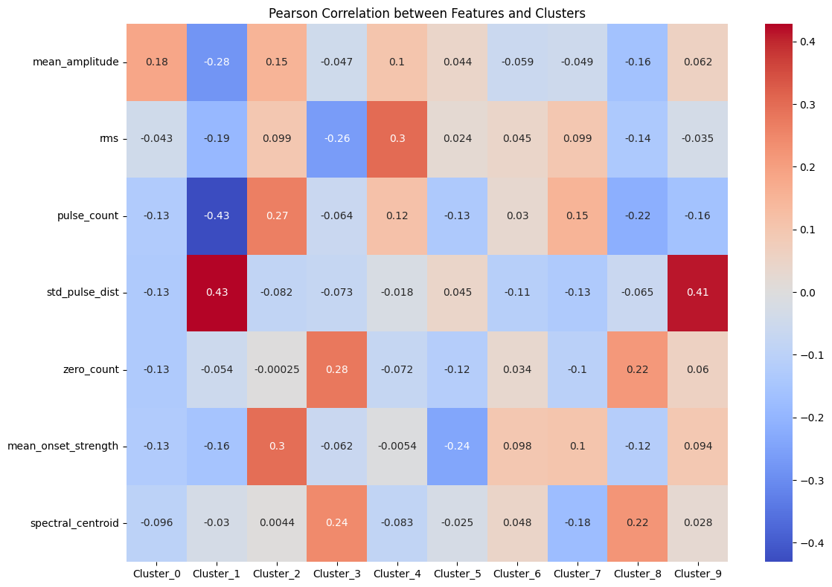
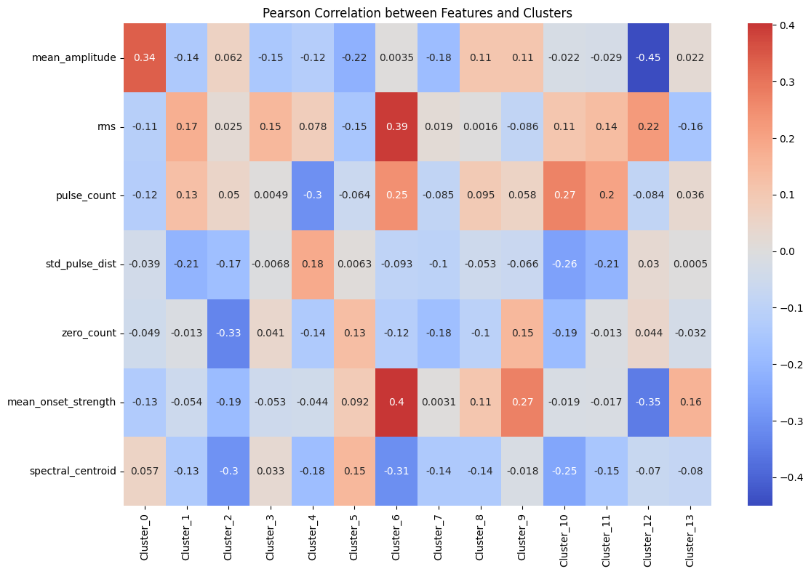
GloVe
Positive
Negative
3&8
10 &11

Slide 16
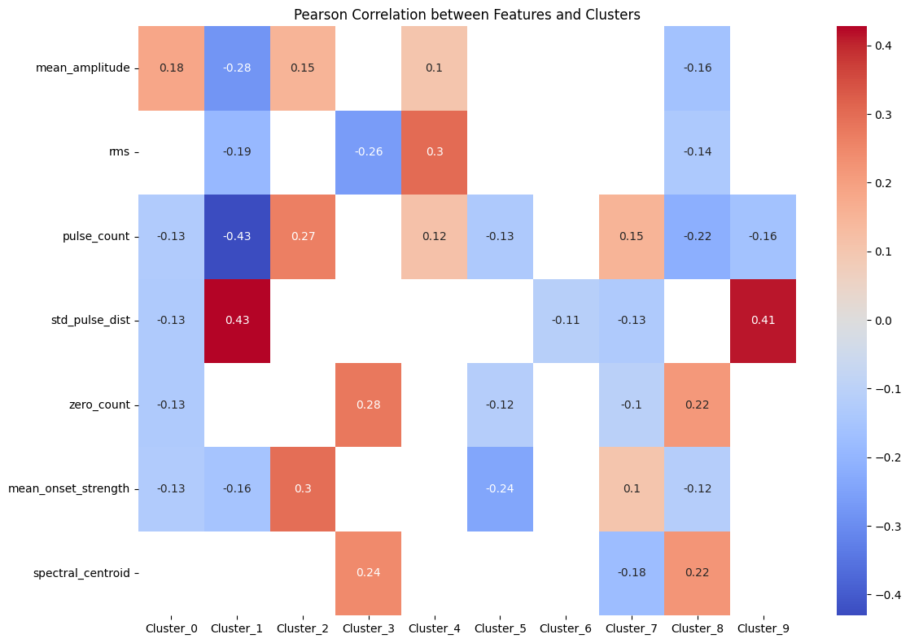
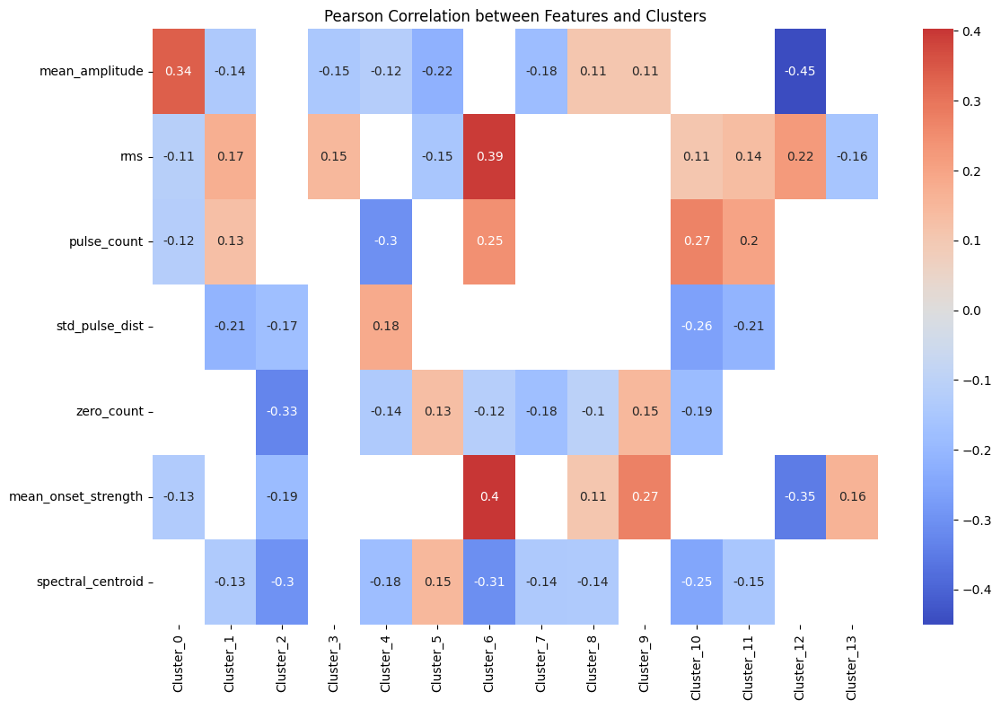
GloVe
Positive
Negative

Slide 17
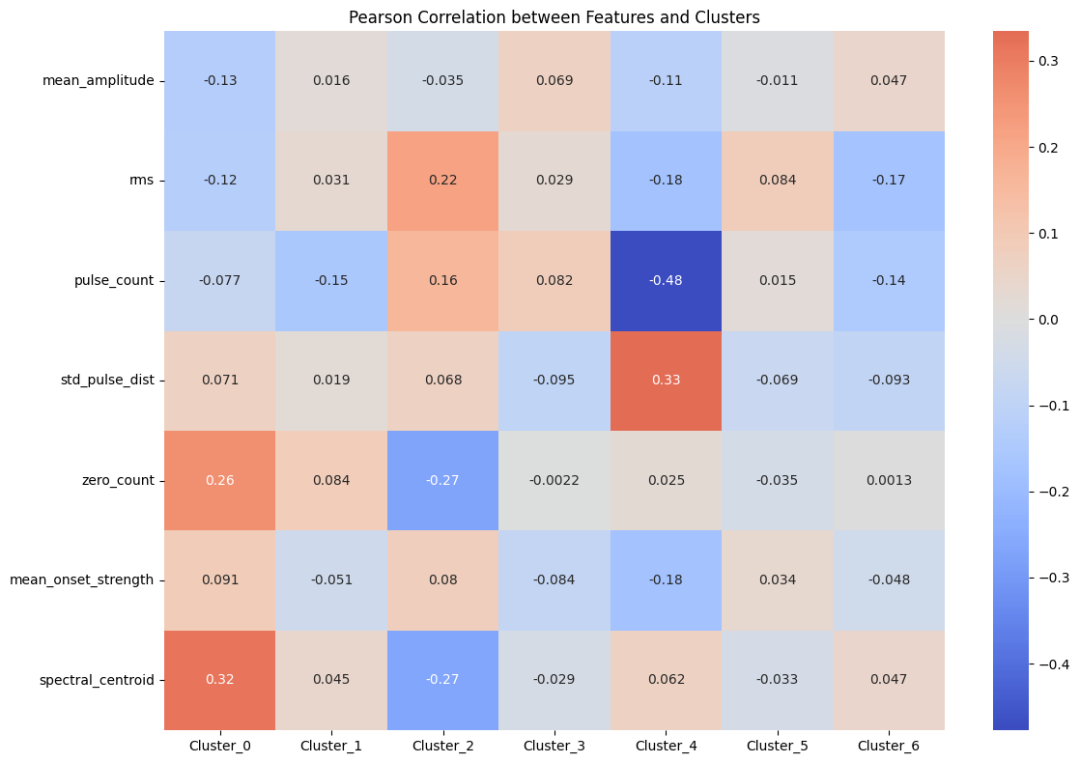
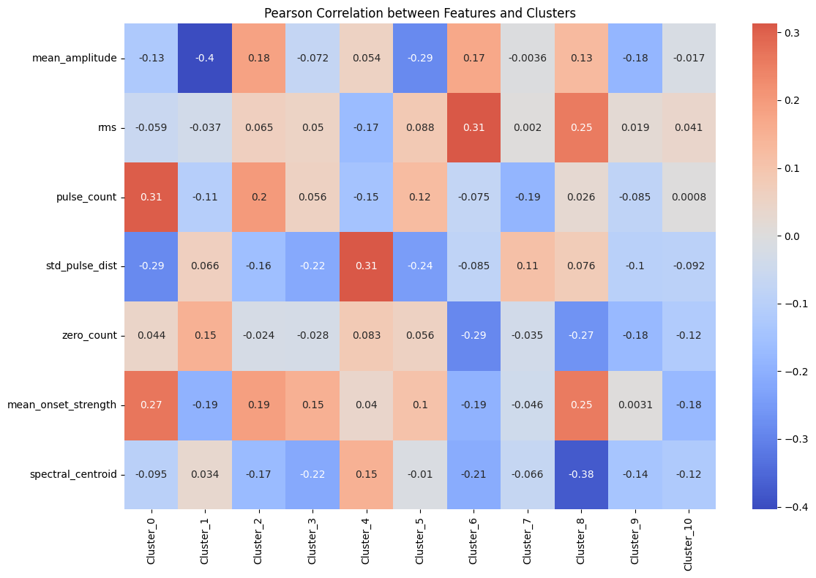
Word2Vec
Positive
Negative

Slide 18
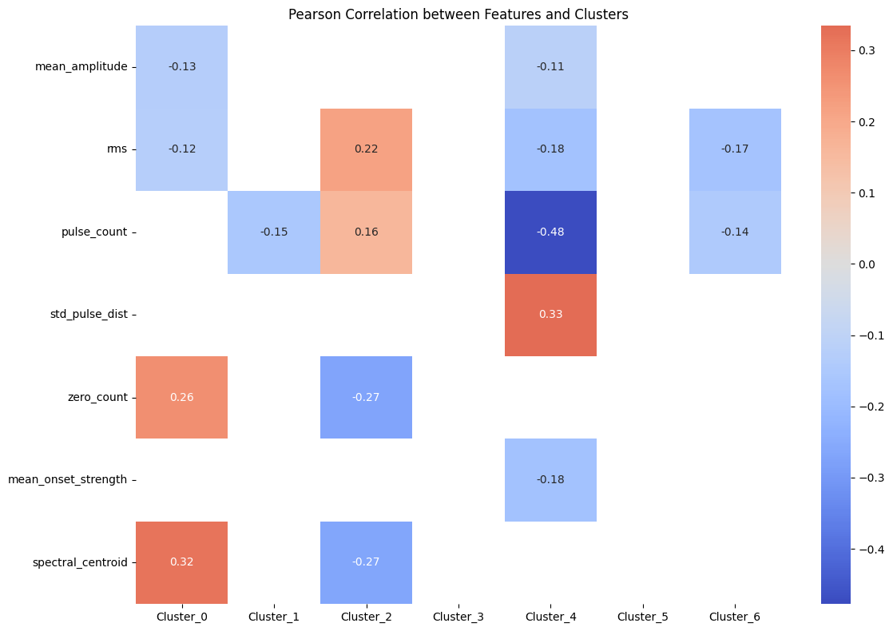
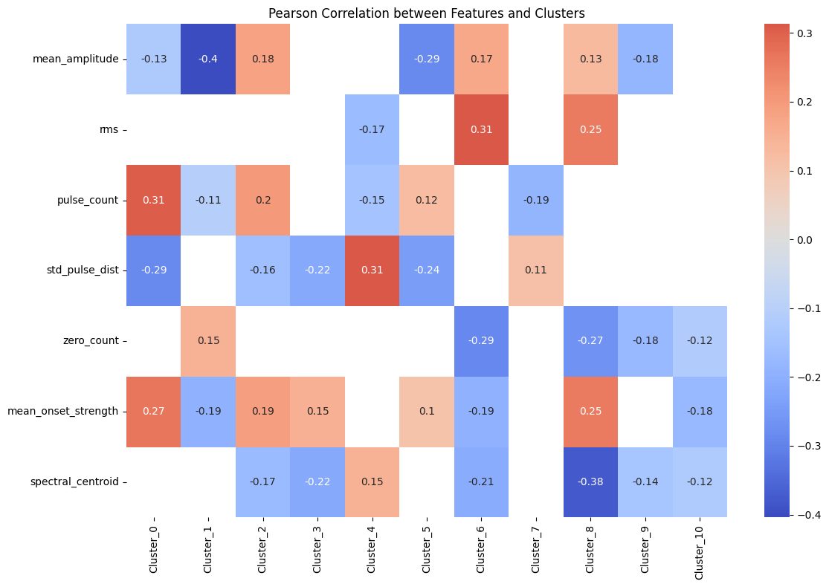
Word2Vec
Positive
Negative

Slide 19
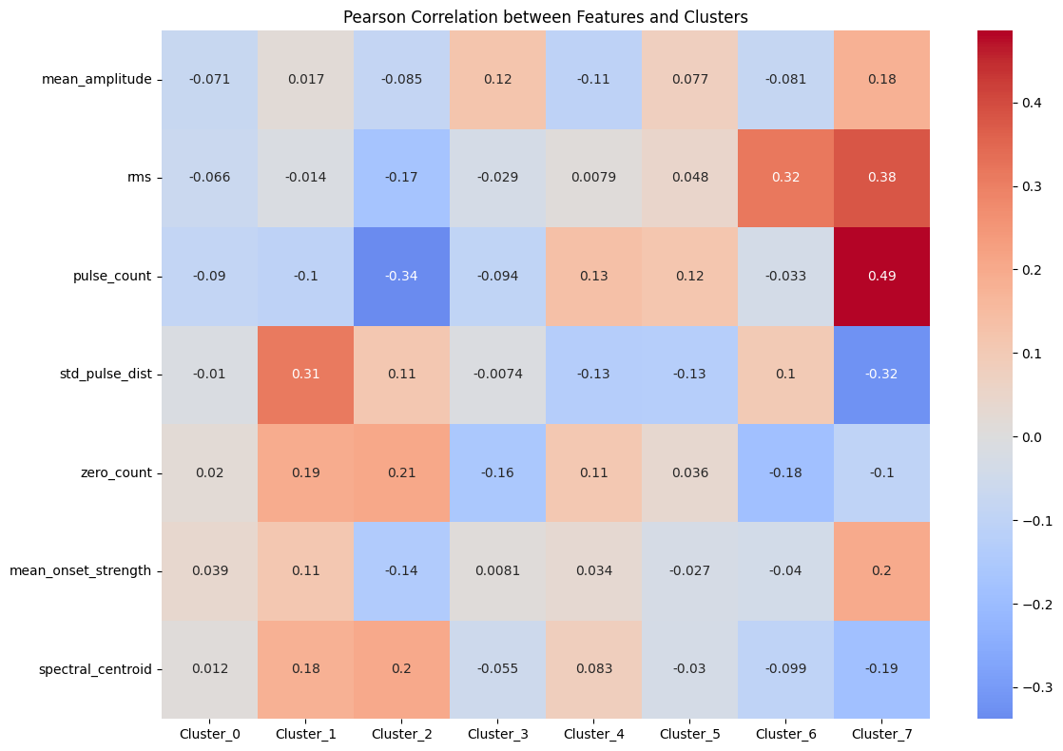
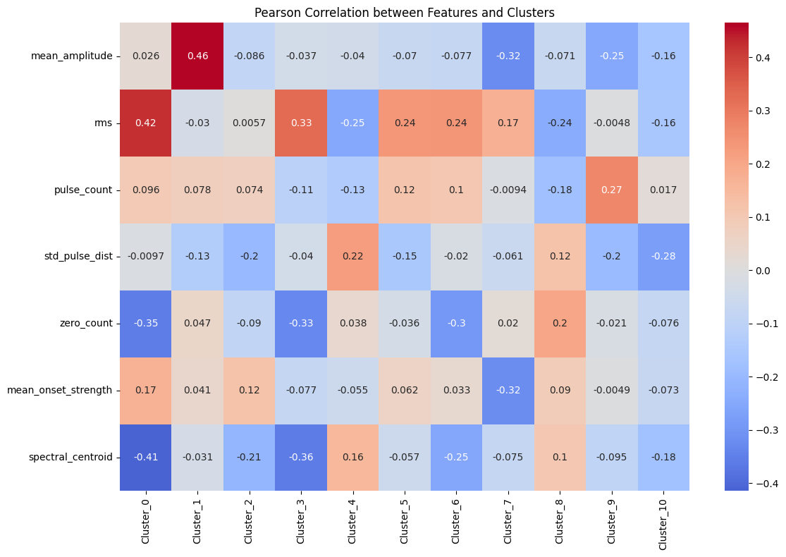
FastText
Positive
Negative

Slide 20
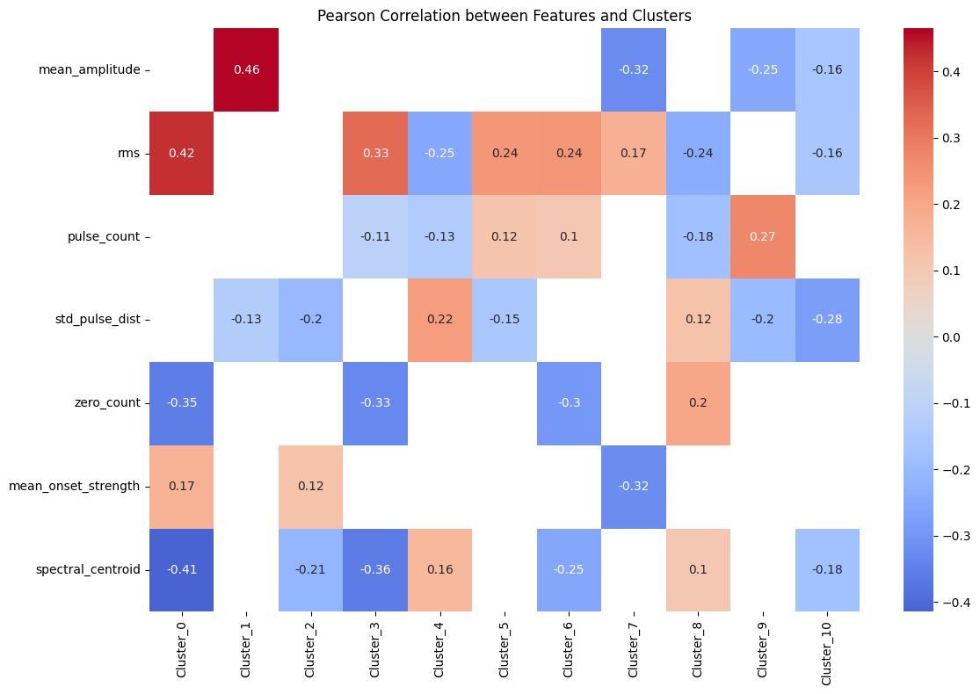
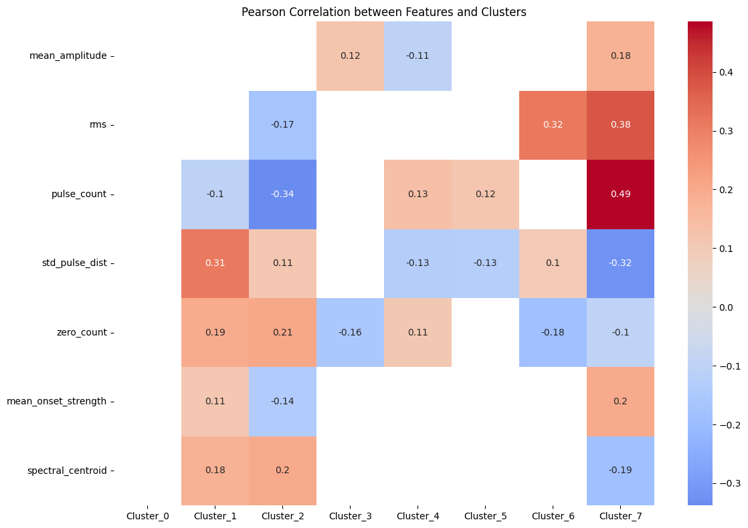
FastText
Positive
Negative

Slide 21
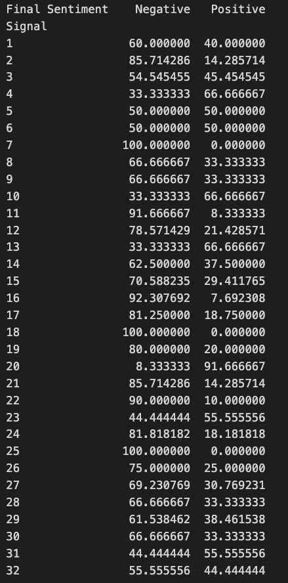
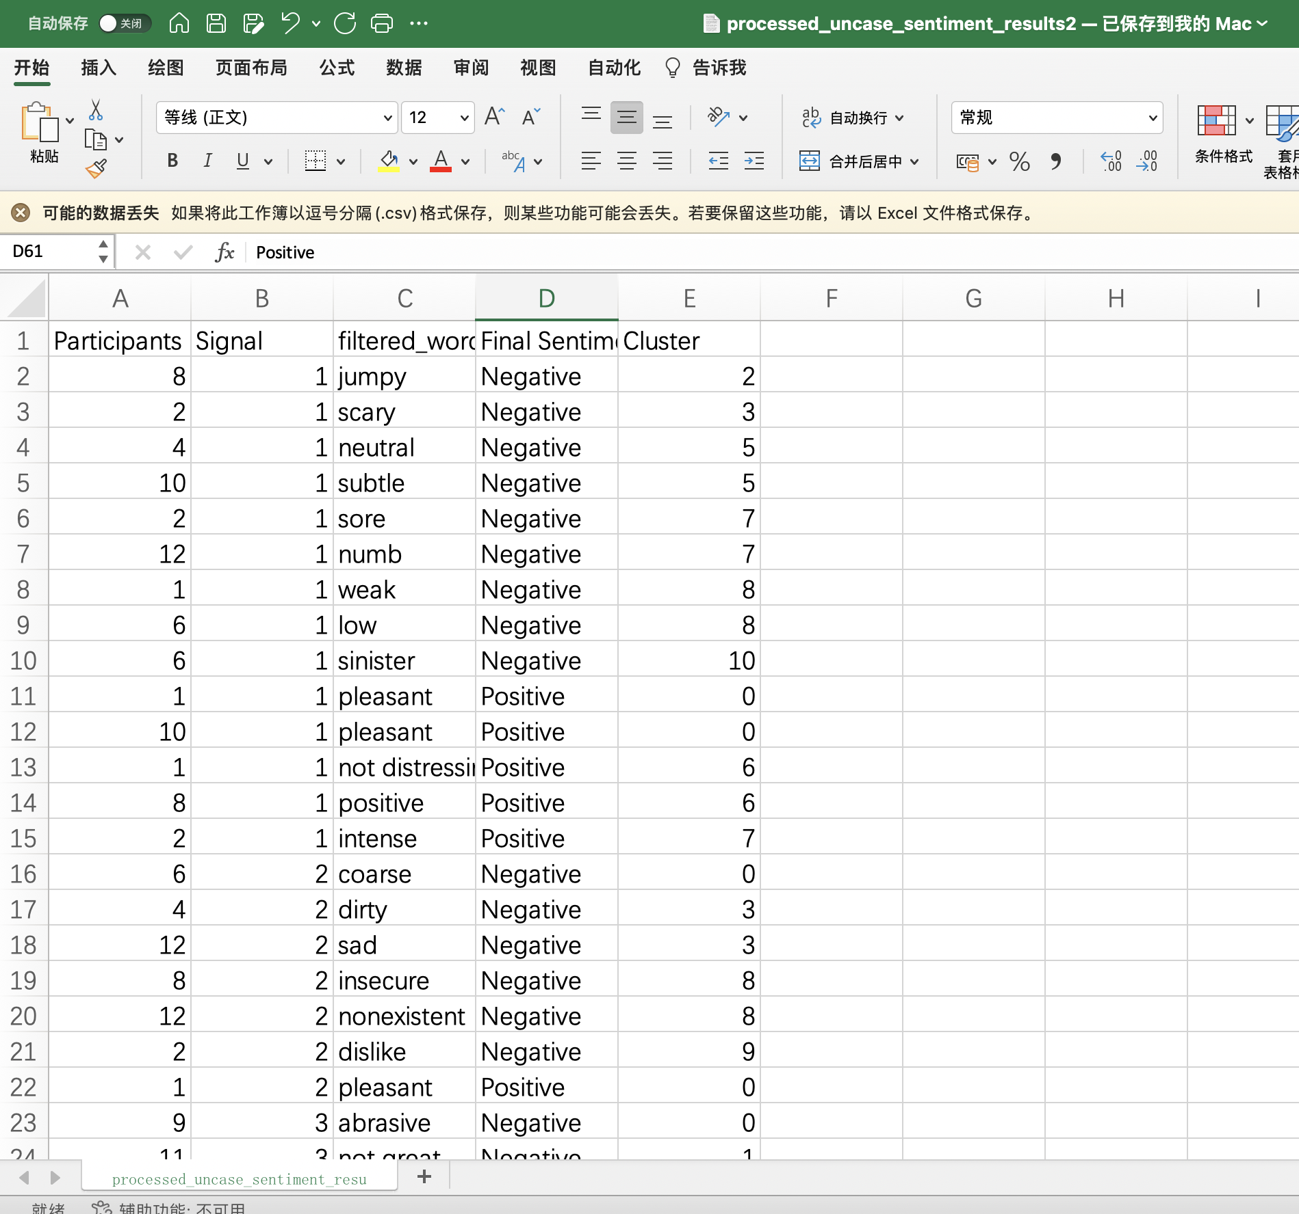

Slide 22
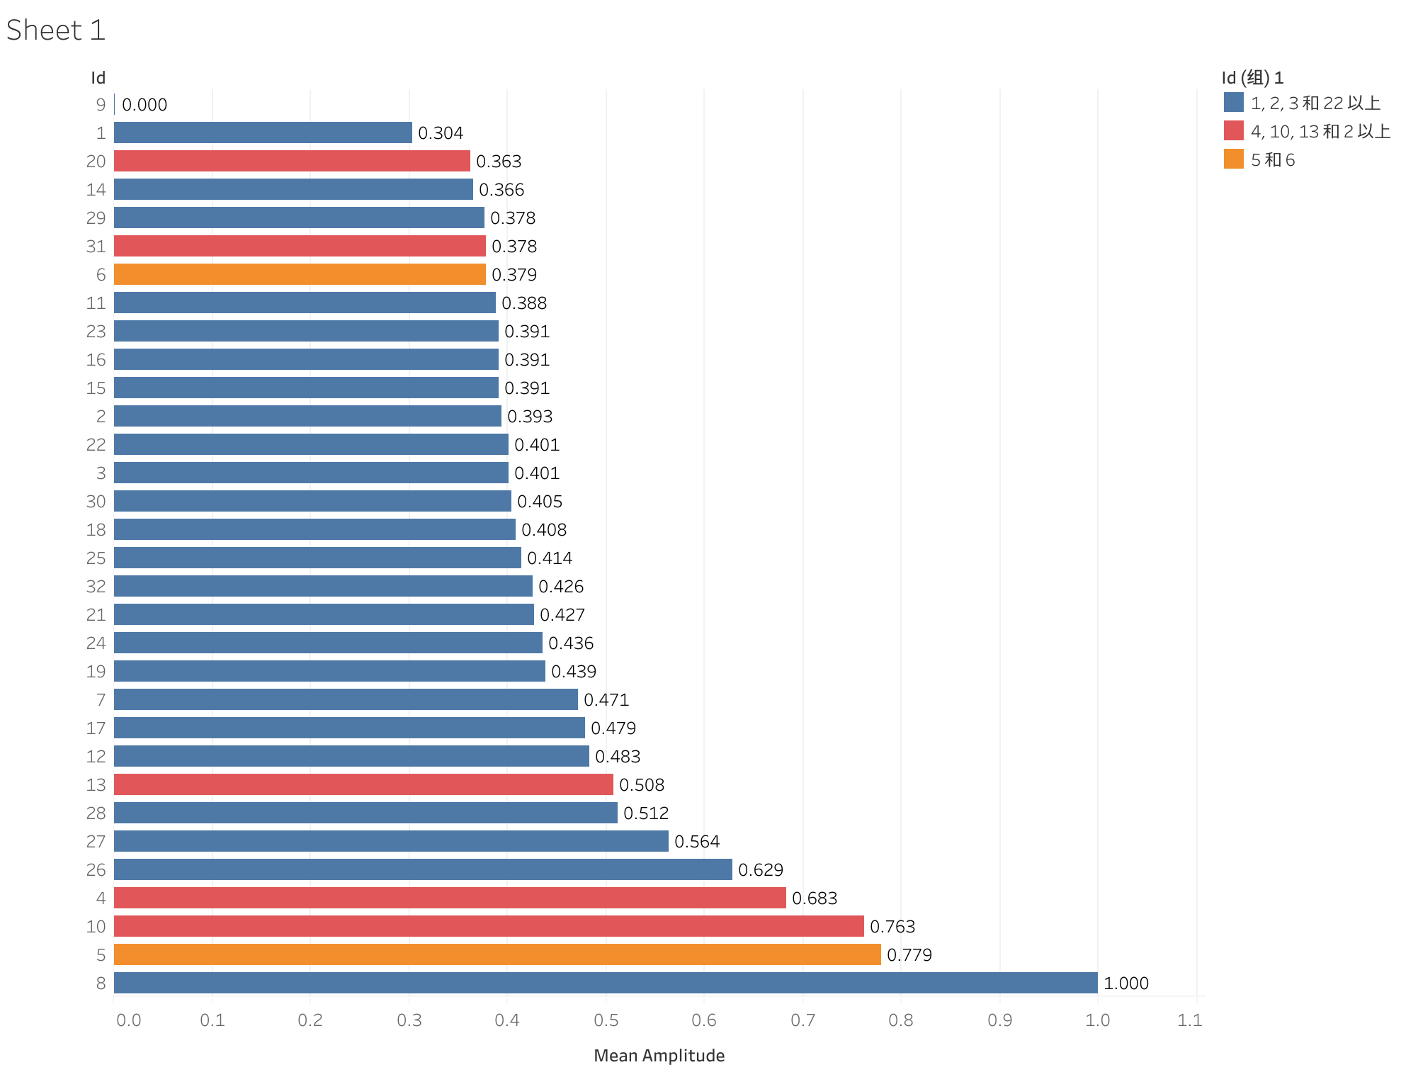
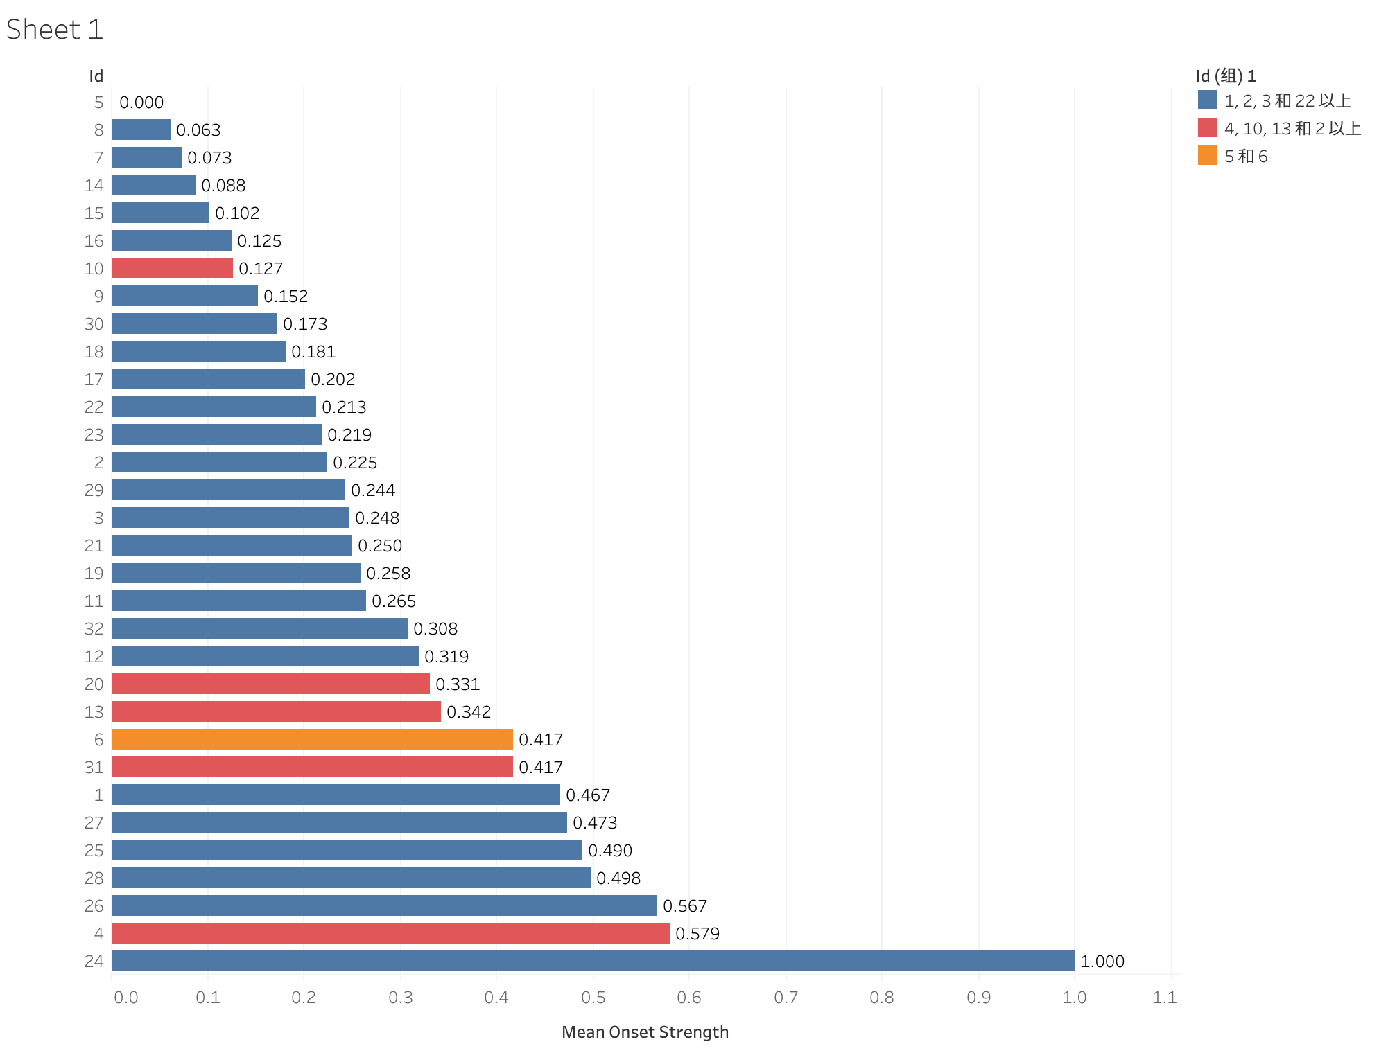
Step 6: Feature visualization according to Ratio of positive and negative

Slide 23
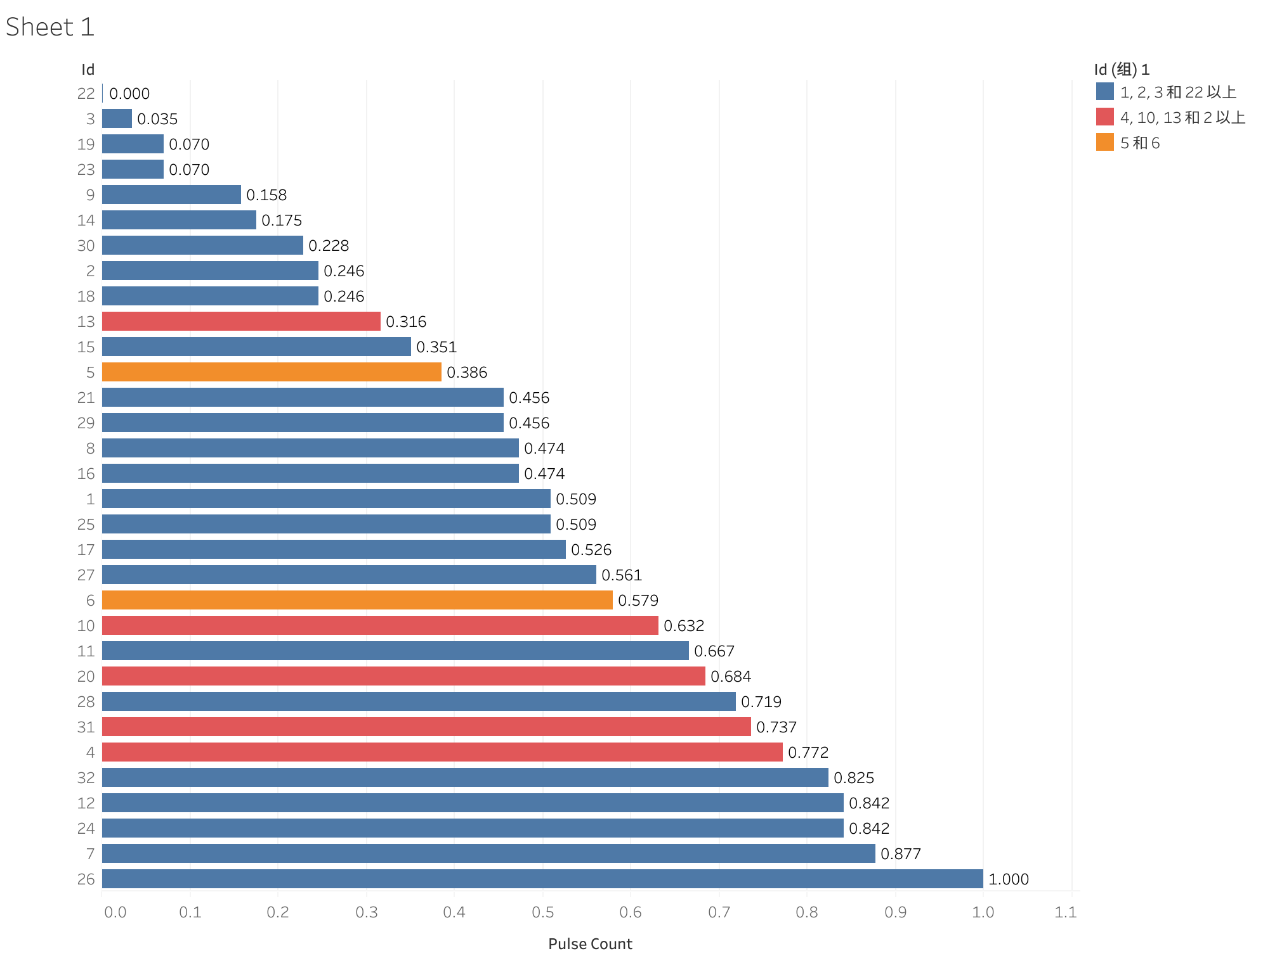
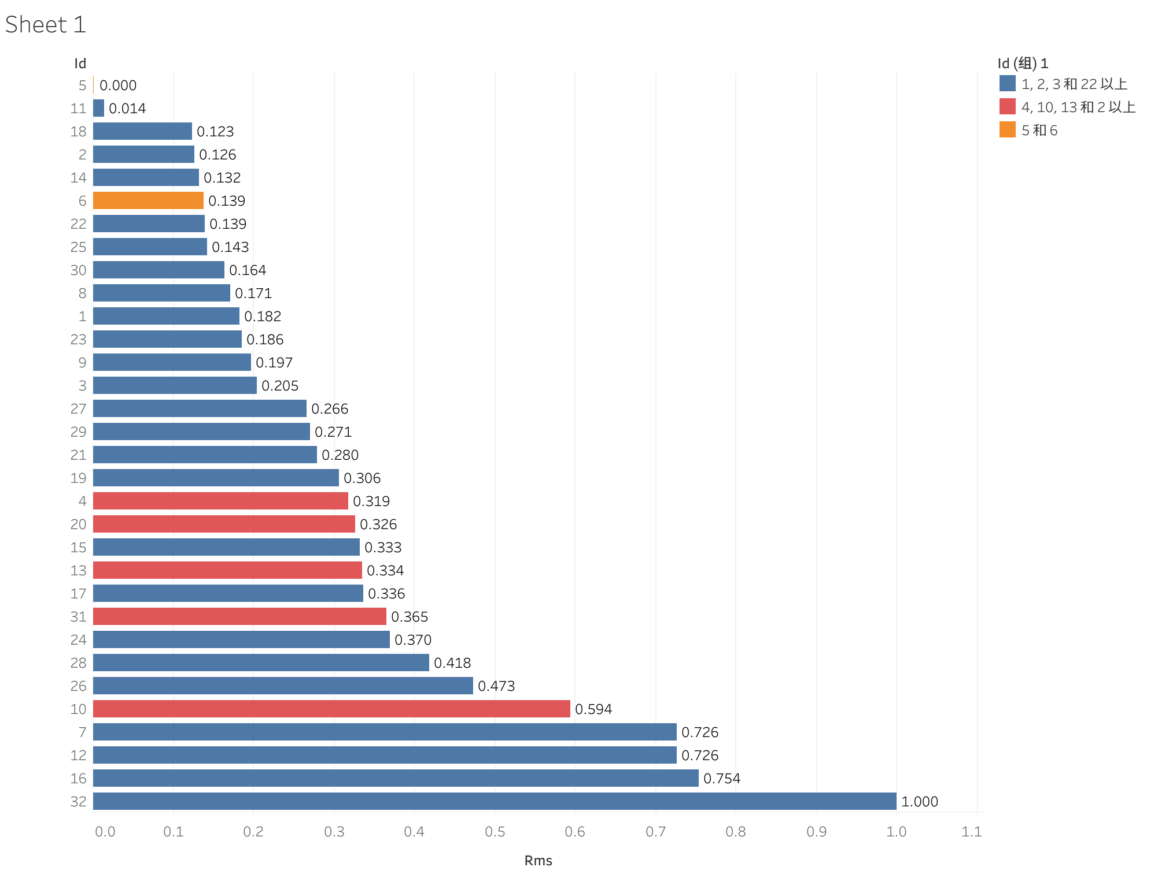
Step 6: Feature visualization according to Ratio of positive and negative

Slide 24
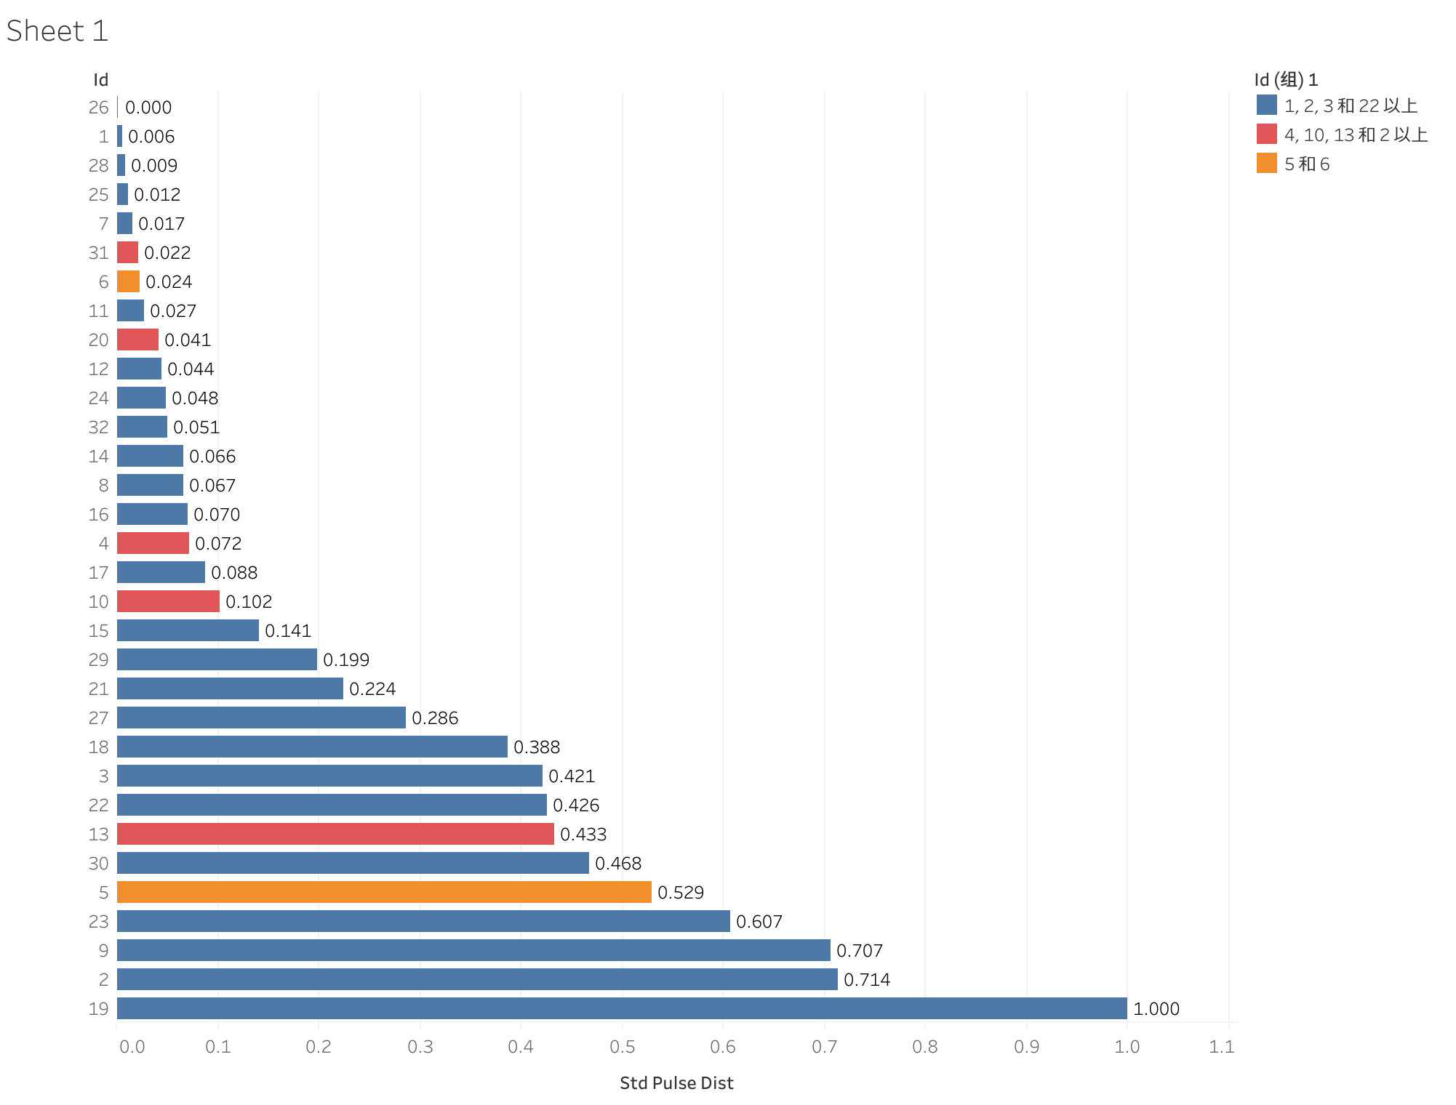
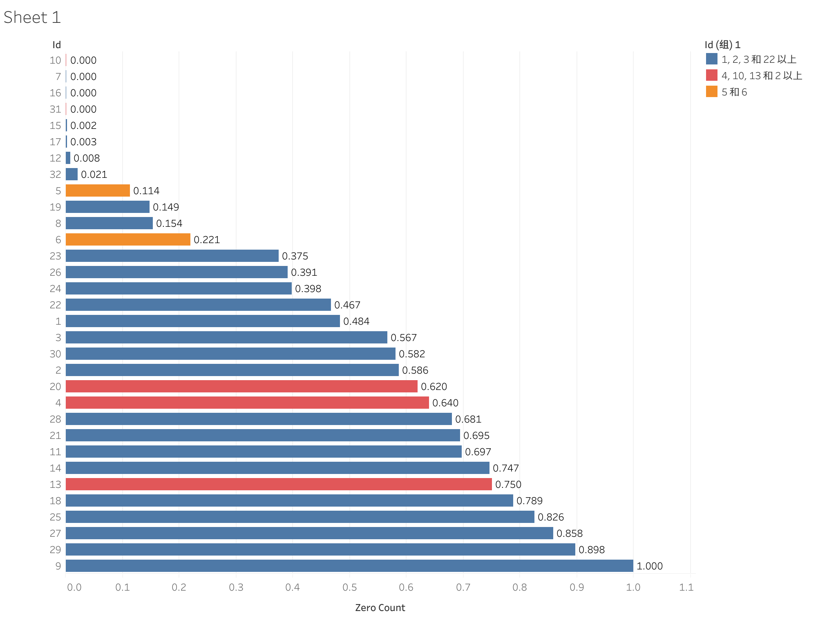
Step 6: Feature visualization according to Ratio of positive and negative

Slide 25
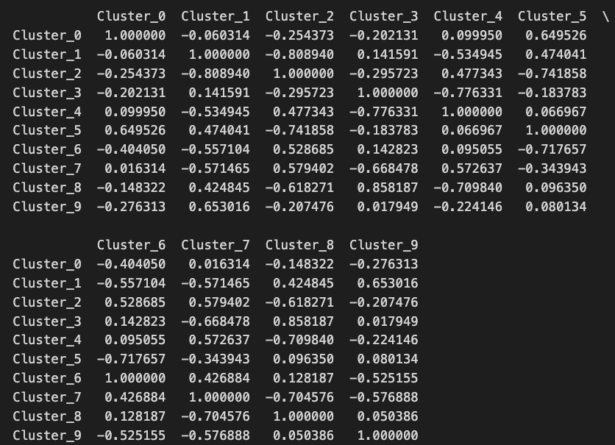
Step 7: The distribution relationship of signal features between different clusters
Cosine similarity

Slide 26
Cosine similarity>=0.7
Glove：
Pos：3&8(0.86)
Neg：1&10(0.81), 1&11(0.91), 2&10(0.77), 3&12(0.84), 6&8(0.71), 8&10(0.70), 10&11(0.92),
Word2vec：
Pos：1&4(0.70)
Neg: 0&3(0.77), 2&3(0.70), 6&10(0.76)
FastText：
Pos：5&7(0.81)
Neg：0&3(0.88), 0&6(0.95), 2&10(0.73), 3&6(0.89), 4&8(0.81)

Slide 27
Next Steps
Find other advanced methods to explore the relationship between signal features and word categories.
Cluster phrases - perhaps Bert can be used.

