Slide 1
Words preprocessing
Only select single word and “not” word
For “not” words, find their antonyms using wordnet.antonyms(), if not find, keep the original form/add ”un” + words.
Divide the words using sentiwordnet.senti_synsets() into 3 categories: Positive, Negative and Neutral
Positive: 262
Negative: 363
Neutral: 201

Slide 2
Words preprocessing2
Define the emotional attribute threshold a=0.25:
if avg_pos>a and avg_pos>avg_neg: “positive”
elif avg_neg>a and avg_neg>avg_pos: ”negative”
else: “neutral”
Only consider positive and negative attributes, using static word embeddings:
Positive: 67
Negative: 127

Slide 3
GloVe
Pre-train model: glove.840B.300d, based on Common Crawl
https://nlp.stanford.edu/projects/glove/
Principle:
Co-occurrence Matrix: Begin by constructing a large matrix of word co-occurrence information. This matrix X contains words as rows and context words as columns, and each entry Xij​ represents how often word i occurs in the context of word j.

Slide 4
GloVe
Highlights:
1. Nearest neighbor
The Euclidean distance (or cosine similarity) between two word vectors provides an effective method for measuring the linguistic or semantic similarity of the corresponding words.
2. Linear substructures
The similarity metrics used for nearest neighbor evaluations produce a single scalar that quantifies the relatedness of two words. This simplicity can be problematic since two given words almost always exhibit more intricate relationships than can be captured by a single number. For example, “man” may be regarded as similar to “woman” in that both words describe human beings; on the other hand, the two words are often considered opposites since they highlight a primary axis along which humans differ from one another.
In order to capture in a quantitative way the nuance necessary to distinguish man from woman, it is necessary for a model to associate more than a single number to the word pair. A natural and simple candidate for an enlarged set of discriminative numbers is the vector difference between the two word vectors. GloVe is designed in order that such vector differences capture as much as possible the meaning specified by the juxtaposition of two words.

Slide 5
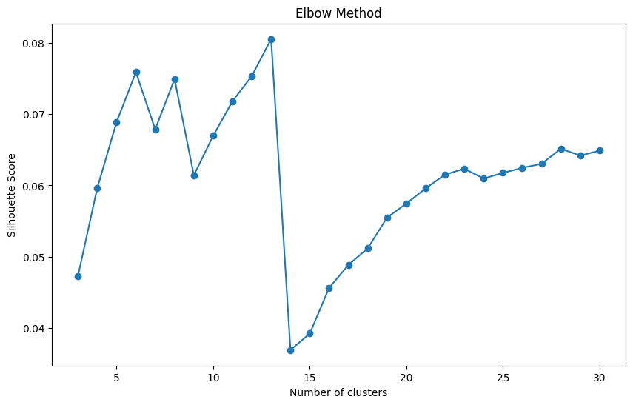
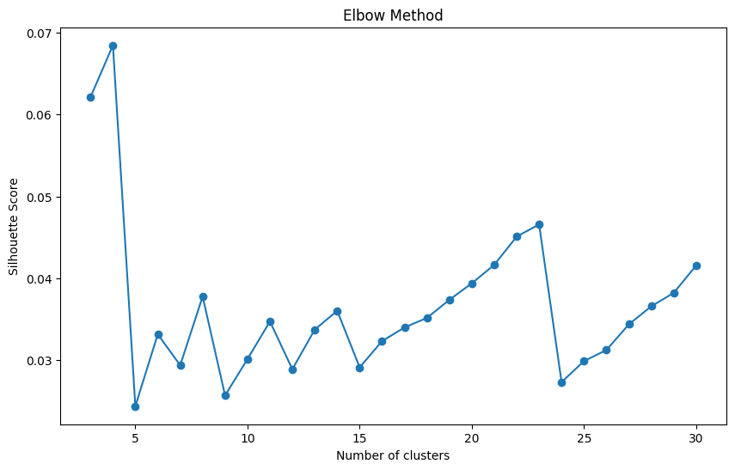
GloVe
Number: 6
Number:8

Slide 6
Word2Vec
Pre-train model: GoogleNews-vectors-negative300.bin:
SG + negative sampling
https://code.google.com/archive/p/word2vec/
Core idea: The meaning of a word can be inferred by the context in which it appears. Word2Vec provides two primary algorithms: CBOW (Continuous Bag of Words) and Skip-Gram
CBOW (Continuous Bag of Words):
Objective: Predict a target word from its surrounding context words.
Example: Given ["the", "cat", "on", "the"], try to predict the center word "sat".
Skip-Gram:(better on small dataset & rare words)
Objective: Predict the surrounding context words from a target word.
Example: Given the word "sat", try to predict its surrounding words like "the", "cat", "on", "the".

Slide 7
Word2Vec
Key features:
Negative Sampling: To speed up the training process, instead of trying to predict every word in the vocabulary in every iteration, the model predicts the positive case (the actual context word) and a small number of negative cases (randomly selected non-context words).
Subsampling Frequent Words: Another optimization in Word2Vec is subsampling of frequent words, reducing the impact of words like "the", "is", "of". The idea is that such frequent words might provide less contextual information relative to their frequency.

Slide 8
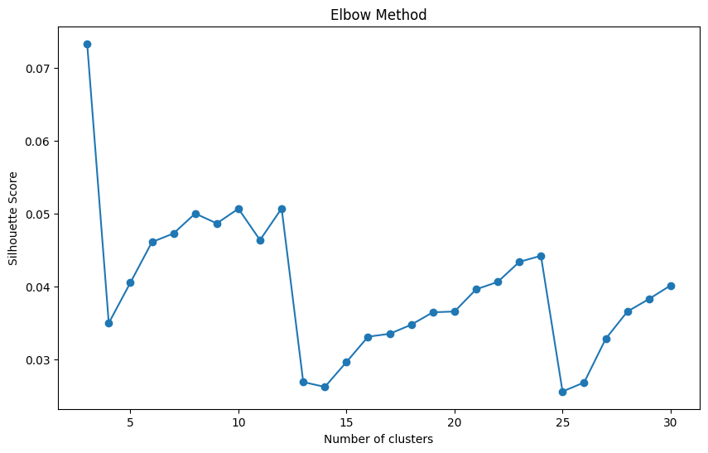
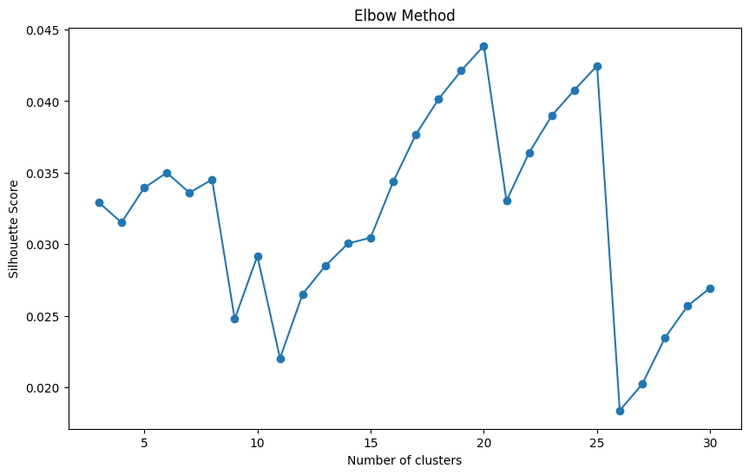
Word2Vec
Number: 7
Number: 6

Slide 9
FastText
Pre-train model: wiki.en.bin
https://fasttext.cc/docs/en/crawl-vectors.html
Subword Embeddings: One of the hallmark features of FastText is that it doesn‘t just generate embeddings for whole words, but also for character n-grams within words. This allows it to handle out-of-vocabulary and rare words and capture morphological nuances.
eg. “apple” and n=3, you‘d have the subwords: “<ap”, “app”, “ppl”, “ple”, “le>”
Word Representation: The vector for a word in FastText is represented as the sum of its constituent subword vectors. This approach allows FastText to generate reasonable embeddings for out-of-vocabulary words since even if the whole word wasn't seen during training, its subwords might have been.

Slide 10
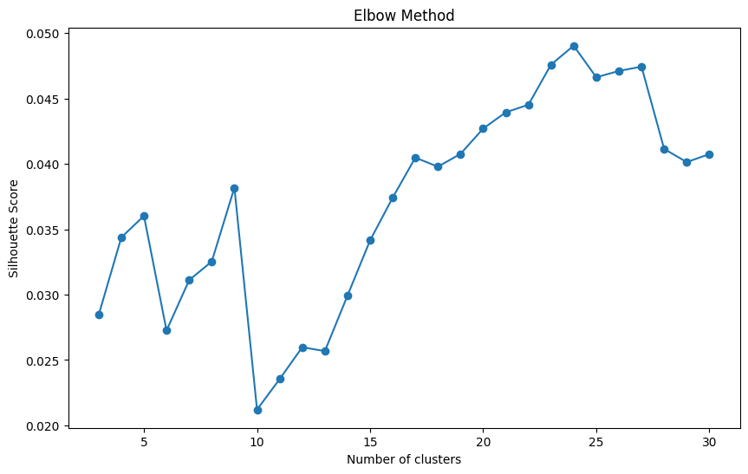
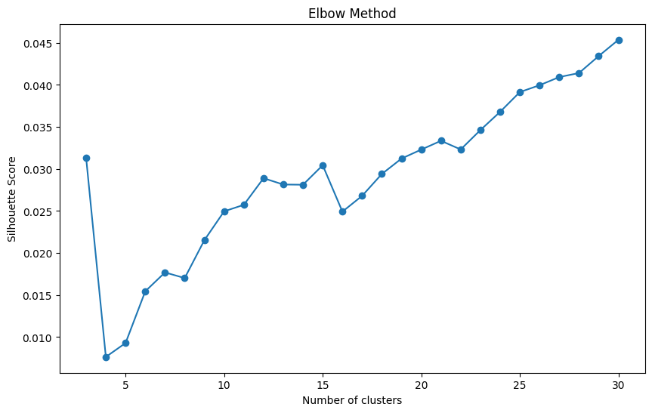
FastText
Number: 5
Number: 9

Slide 11
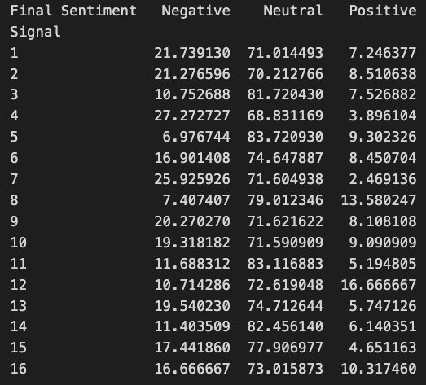
pos/neg/neutral proportions in the description of 16 signals (words only)

