Slide 1
Some POS tagging methods:
NLTK package (simple)
Spacy (thesis)
HMM & Viterbi algorithm (time-consuming)
CRF
RNN (low accuracy)

Slide 2
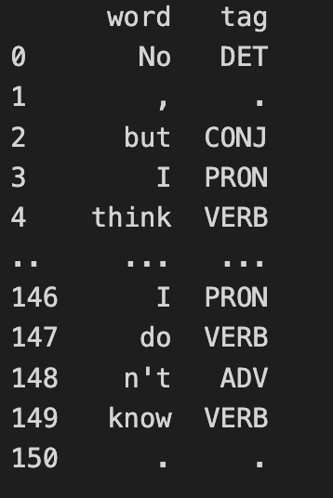
Method 1: Use NLTK’s currently recommended part of speech tagger to tag the given list of tokens.
Use nltk.pos_tag(i,tagset="universal")
Results (part):
Simple and high accuracy

Slide 3
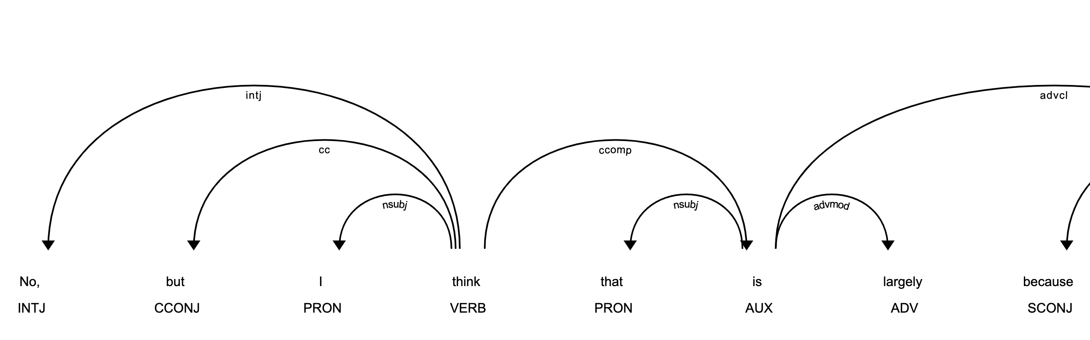
Method 2: Dependency parsing and part-of-speech tagging in spaCy using the linguistic annotations API.
spaCy’s en_core_web_lg language model and the default tokenization configuration
Results (part):

Slide 4
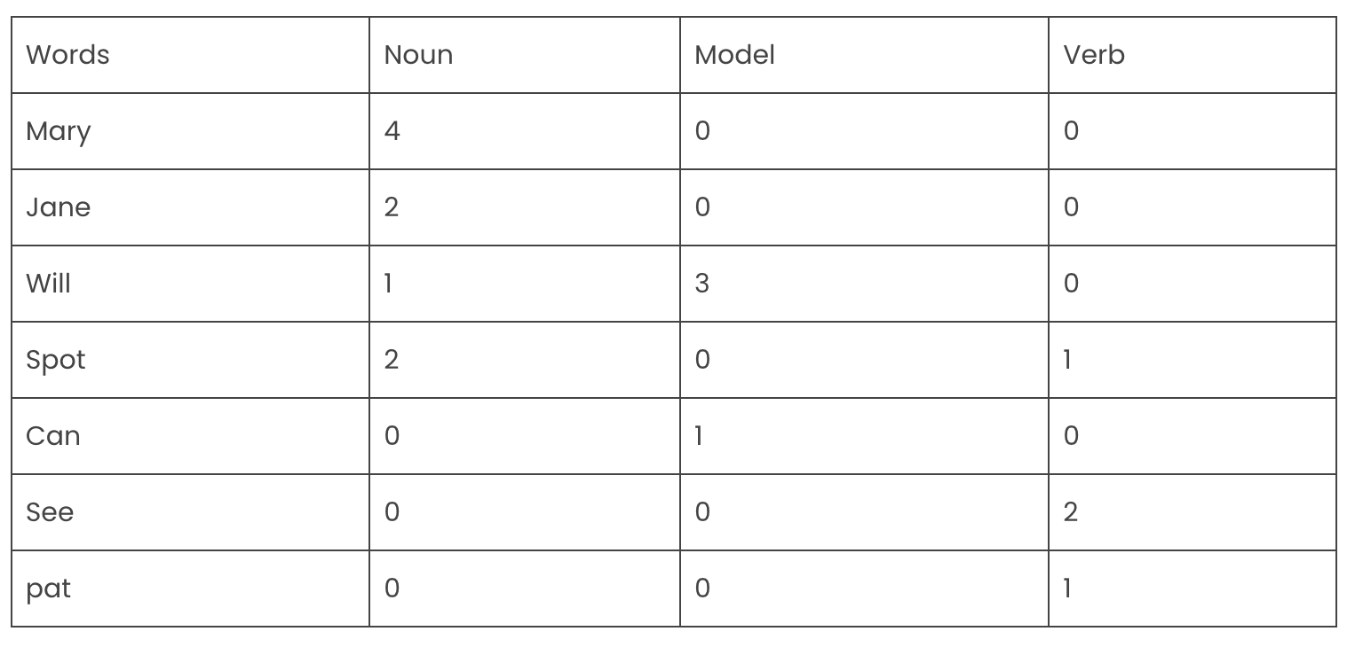
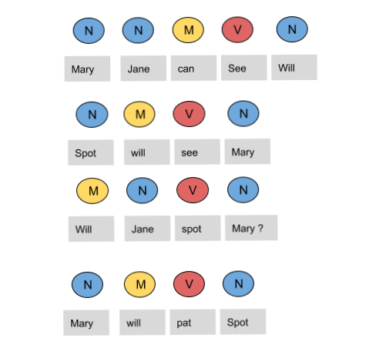
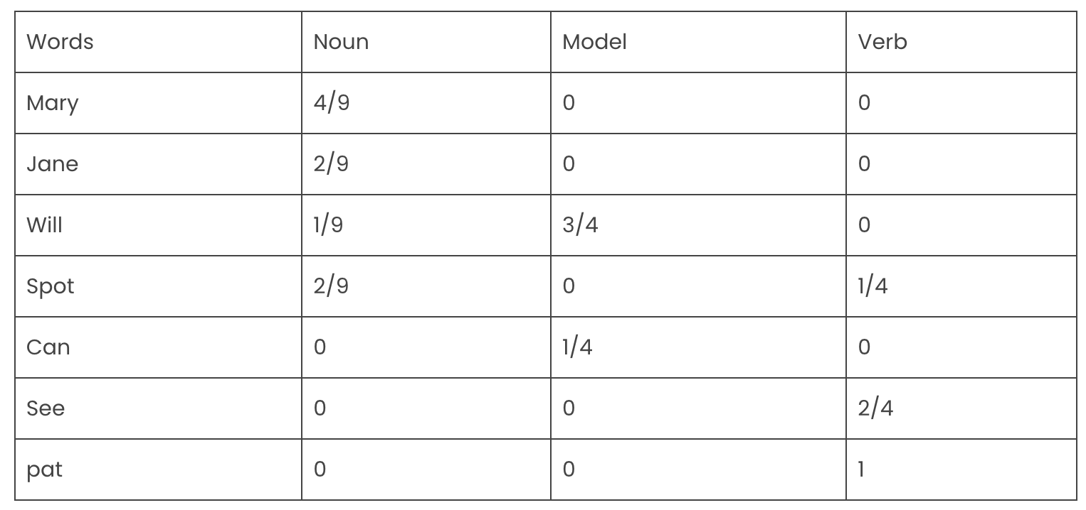
Method 3: Use Hidden Markov Model (HMM) and Optimizing HMM with Viterbi Algorithm
1. emission probabilities

Slide 5
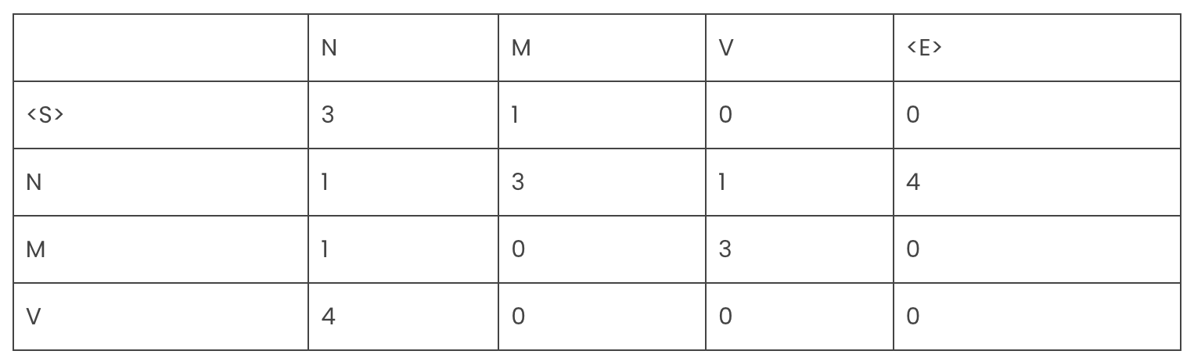
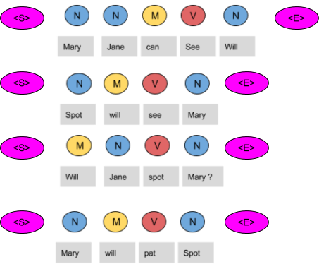
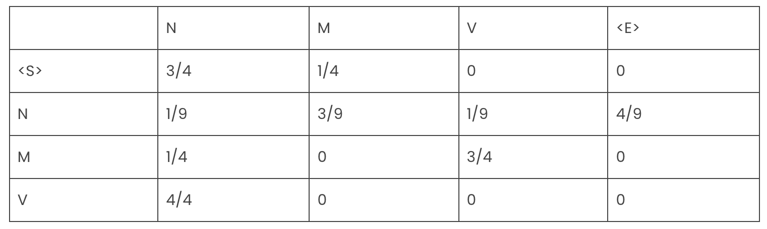
Method 3: Use Hidden Markov Model (HMM) and Optimizing HMM with Viterbi Algorithm
2. transition probabilities

Slide 6
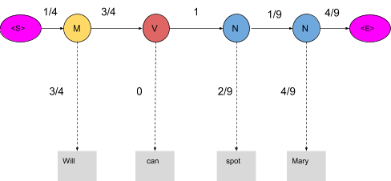
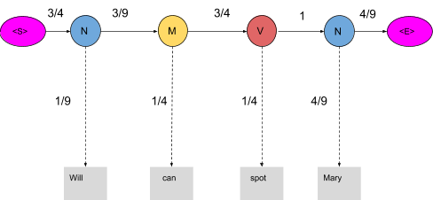
Since the tags are not correct, the product is zero：
1/4*3/4*3/4*0*1*2/9*1/9*4/9*4/9=0
When these words are correctly tagged, we get a probability greater than zero as shown below：
3/4*1/9*3/9*1/4*3/4*1/4*1*4/9*4/9=0.00025720164

Slide 7
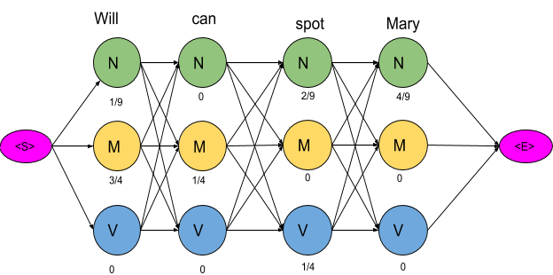
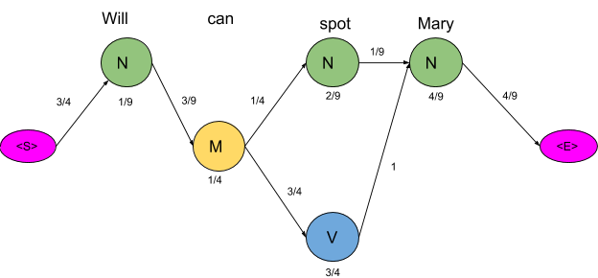
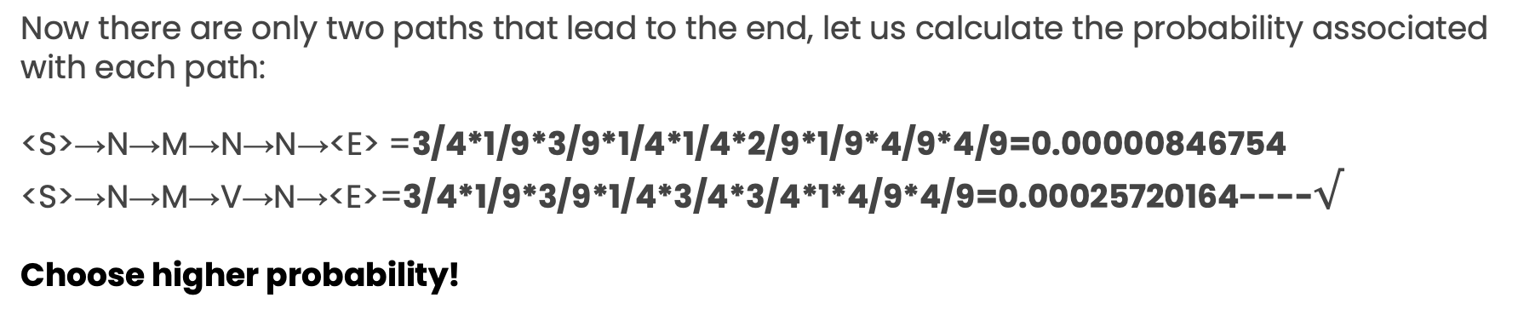
Delete all the vertices and edges with probability zero, also the vertices which do not lead to the endpoint are removed.
Now there are only two paths that lead to the end, let us calculate the probability associated with each path:
<S>→N→M→N→N→<E> =3/4*1/9*3/9*1/4*1/4*2/9*1/9*4/9*4/9=0.00000846754
<S>→N→M→V→N→<E>=3/4*1/9*3/9*1/4*3/4*3/4*1*4/9*4/9=0.00025720164----$√$
Choose higher probability!

Slide 8
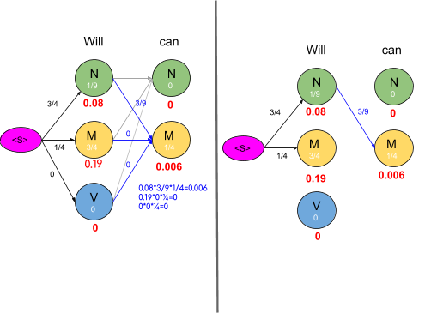
Optimize HMM with Viterbi Algorithm — for finding the most likely sequence of hidden states —called the Viterbi path
Now we are really concerned with the mini path having the lowest probability. The same procedure is done for all the states in the graph as shown in the figure below

Slide 9
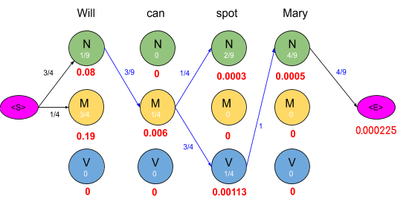
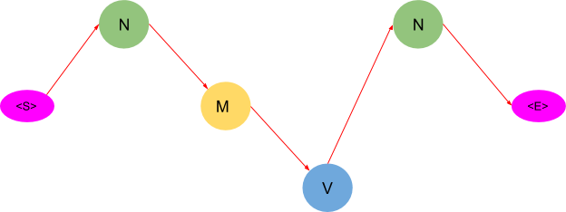
To get an optimal path, we start from the end and trace backward, since each state has only one incoming edge, This gives us a path as shown below

Slide 10
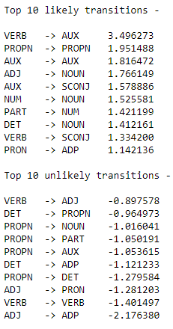
Method 4: Conditional Random Fields (CRF)
In CRF, a set of feature functions are defined to extract features for each word in a sentence. Some examples of feature functions are: is the first letter of the word capitalized, what the suffix and prefix of the word, what is the previous word, is it the first or the last word of the sentence, is it a number etc. These set of features are called State Features.
In CRF, we also pass the label of the previous word and the label of the current word to learn the weights. CRF will try to determine the weights of different feature functions that will maximize the likelihood of the labels in the training data. The feature function dependent on the label of the previous word is Transition Feature
In CRFs, the input is a set of features (real numbers) derived from the input sequence using Feature Functions, the weights associated with the features (that are learned) and the previous label and the task is to predict the current label. The weights of different feature functions will be determined such that the likelihood of the labels in the training data will be maximized.

Slide 11
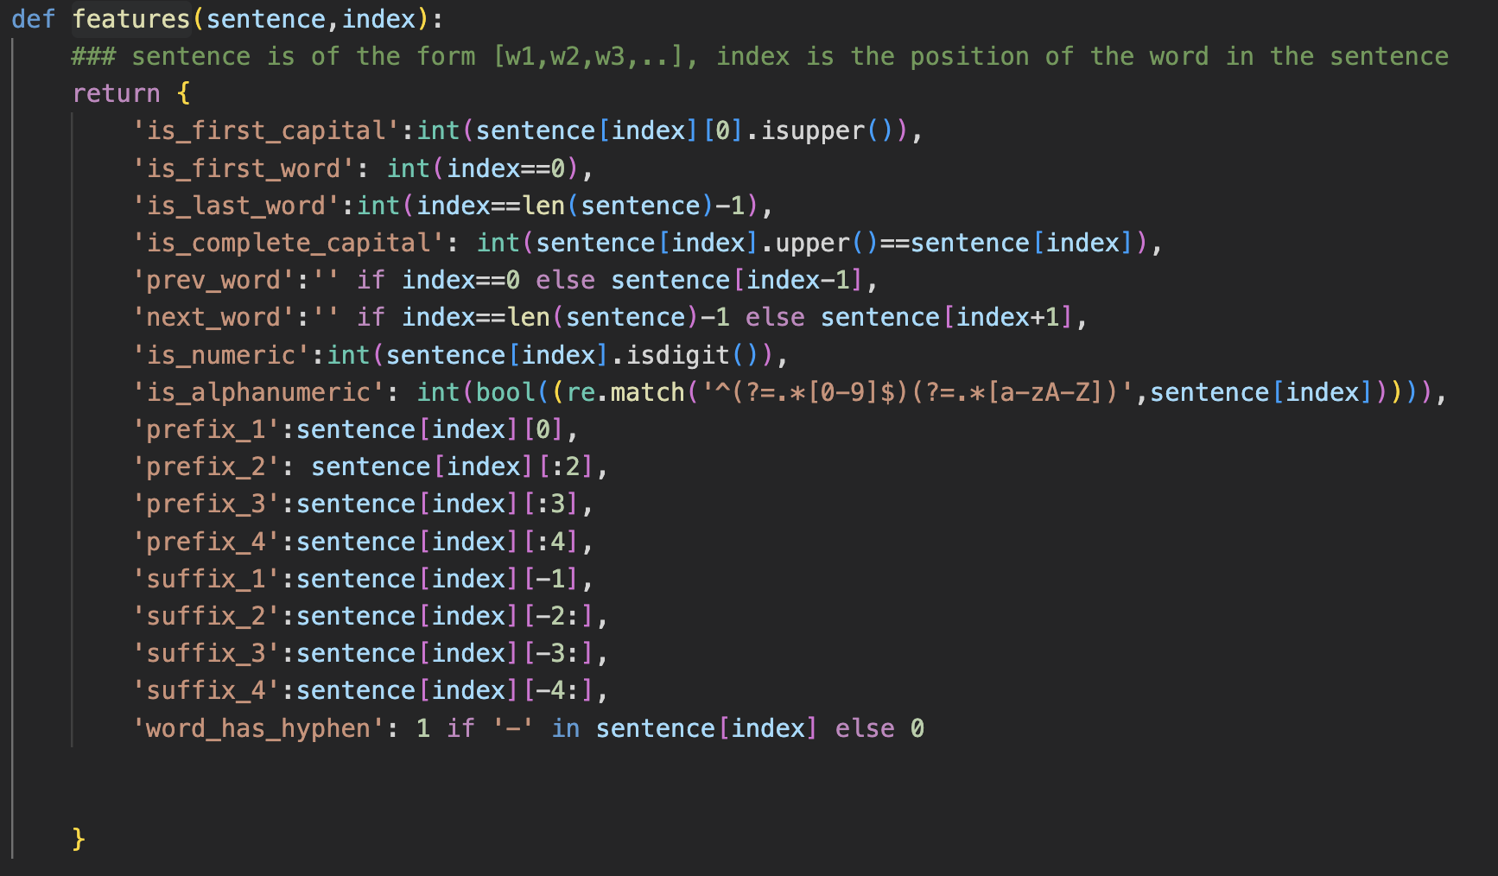
Create feature functions:
Then Fit a CRF Model and predict the giving dataset

Slide 12
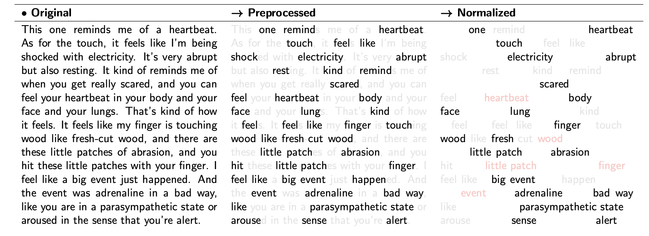
TWO steps:
Original→Preprocessed: eliminate stop words and punctuation tokens
Preprocessed→Normalized: only remain n. and adj. , and remove duplicates

Slide 13
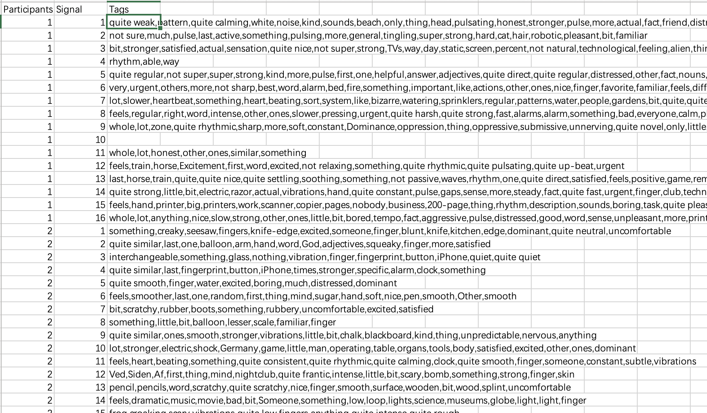
Results follow with other patterns
Modify：
Remain “quite” ”not” etc. before ADJ in a sentence
Language & Semantic Concepts

Slide 14
problem
How to compare the results with the manual_dataset, since they are not complete same?
Original way:
Eg. precision=precision_score(y_label, y_pre,average=‘micro‘),
should be the same dimension

