Slide 1
Precision, Recall and F1 Score for Multi-Label Classification tasks

Slide 2



Precision, Recall and F1 Score for Classification tasks
Precision is the proportion of true positives among all positive predictions.
Recall is the proportion of true positives among all true examples.
F1 score for a certain class is the harmonic mean of its precision and recall.

Slide 3
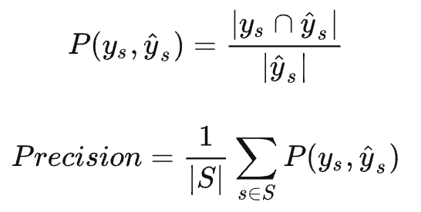
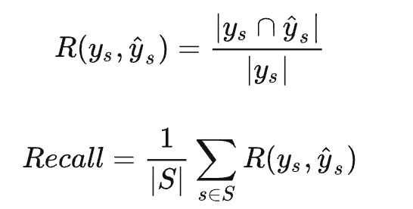
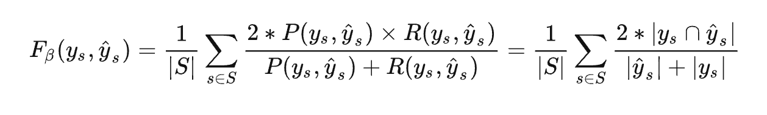
In multi-label classification tasks:

Slide 4
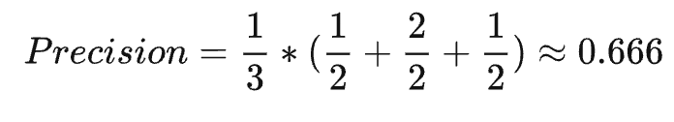
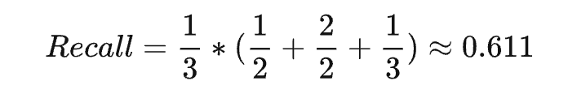
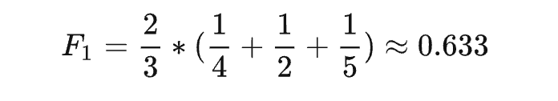
e.g.
y_true = np.array([[0, 1, 0, 1], [0, 1, 1, 0], [1, 0, 1, 1]])
y_pred = np.array([[0, 1, 1, 0], [0, 1, 1, 0], [0, 1, 0, 1]])

Slide 5
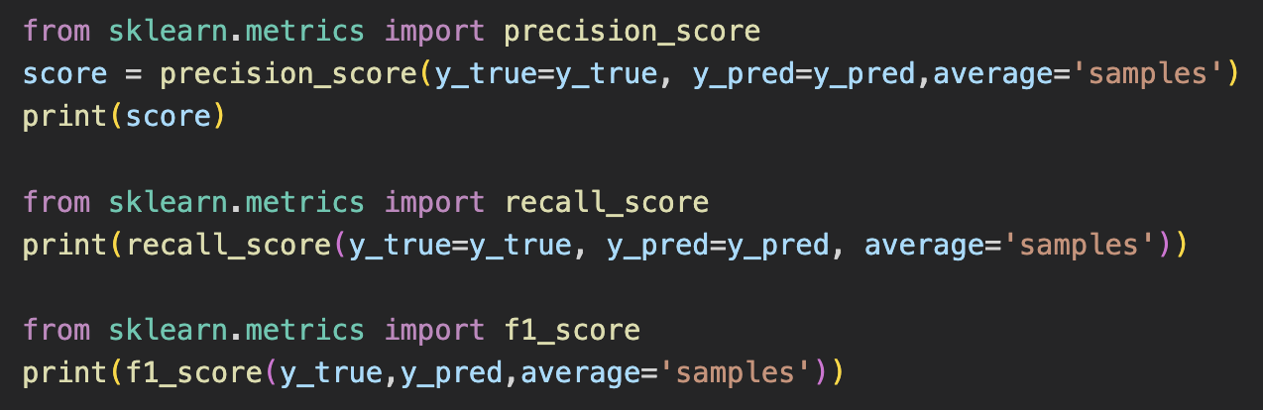
However, the data need to be in same dimension:
Solution: Change the word vectors to 0-1 matrix, and let them be the same length in each row:
mlb = MultiLabelBinarizer(sparse_output=True)

Slide 6
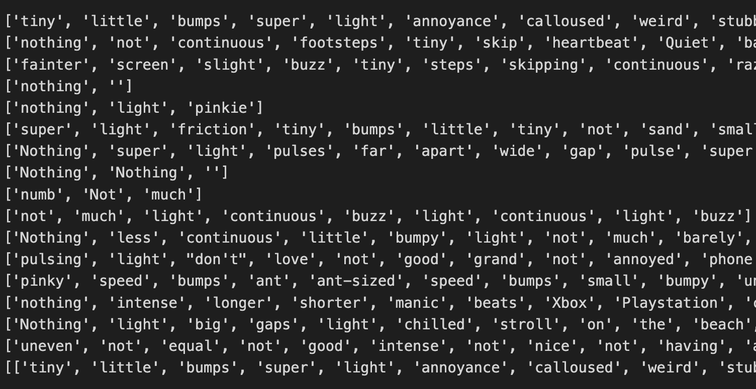
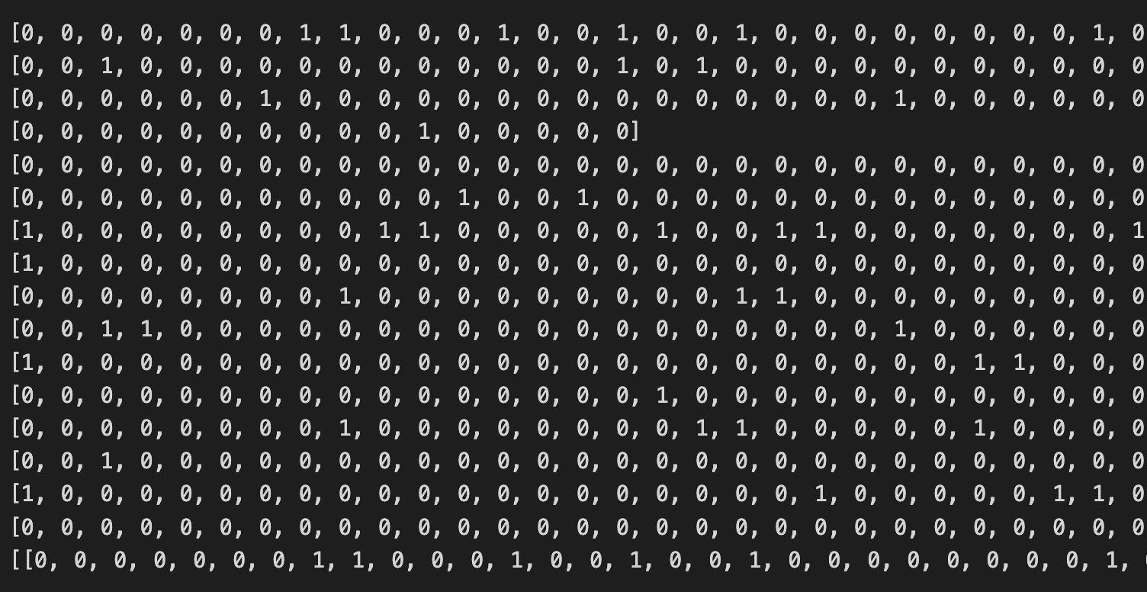
Length=length of dialogue of each signal
(12 lengths of each participant)
Change the length of each row in the extended matrix to the length of the largest row in (manual dataset, predict dataset)

Slide 7
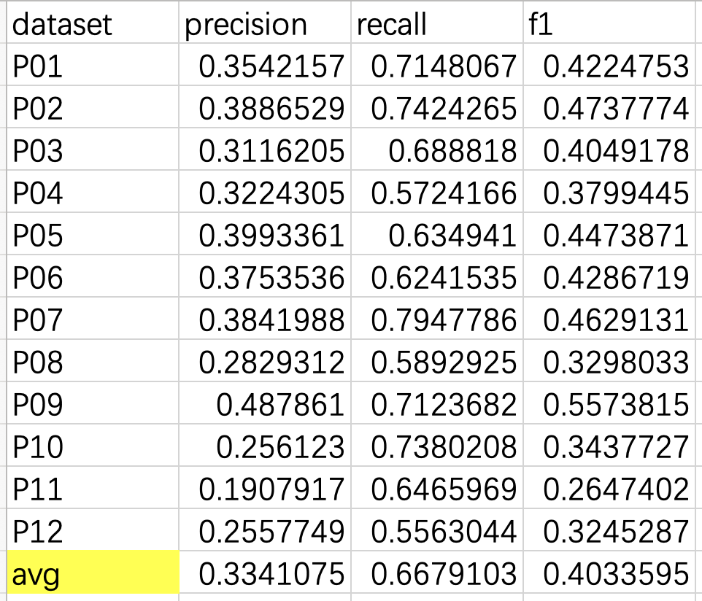
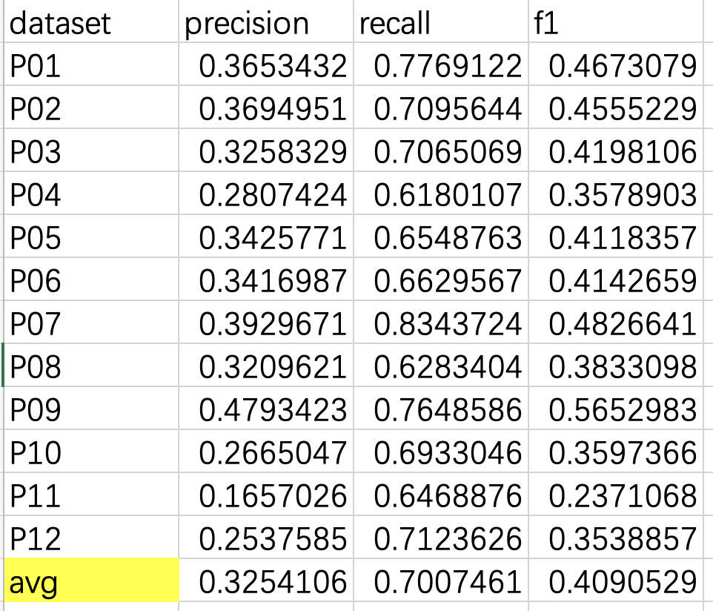
Using Weighted Voting method to combine nltk and spacy tagging
Weight 1: ✅
nltk_weight > 0.5
spacy_weight < 0.5
Weight 2:
nltk_weight < 0.5
spacy_weight >0.5

Slide 8
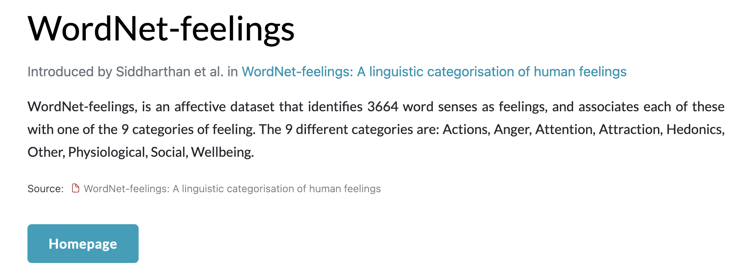
Emotional & sensational & metaphor words
https://paperswithcode.com/dataset/wordnet-feelings

Slide 9
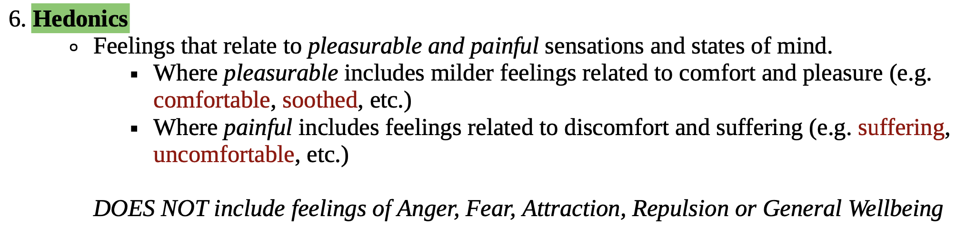
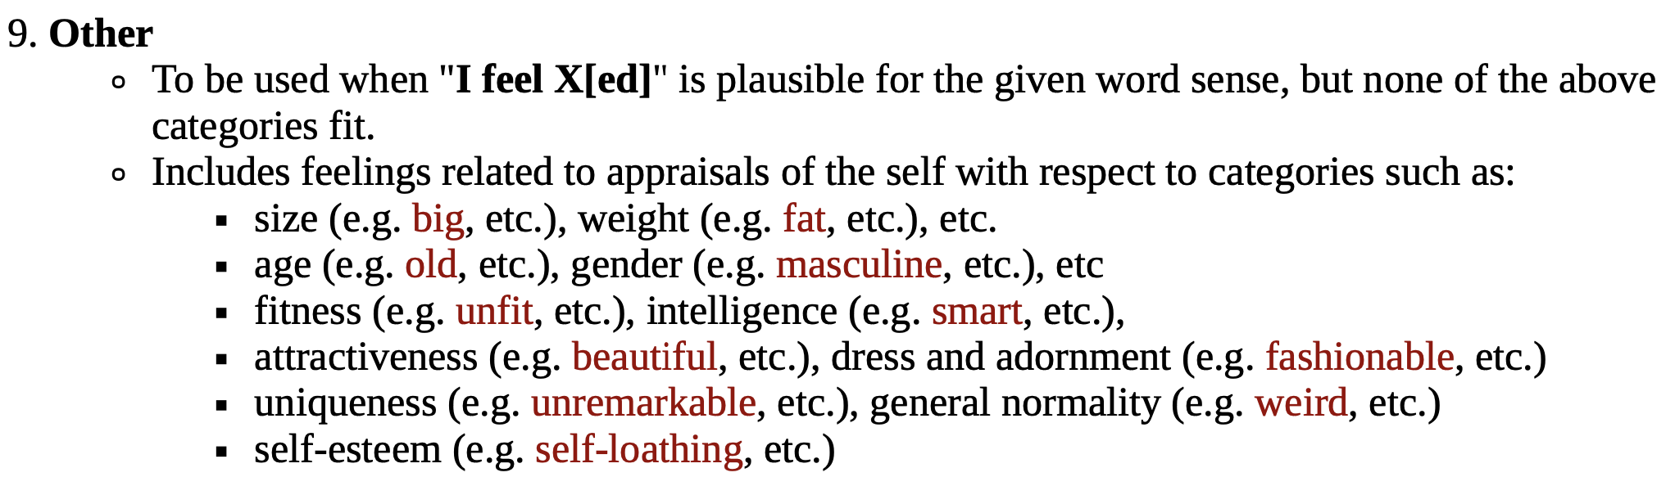
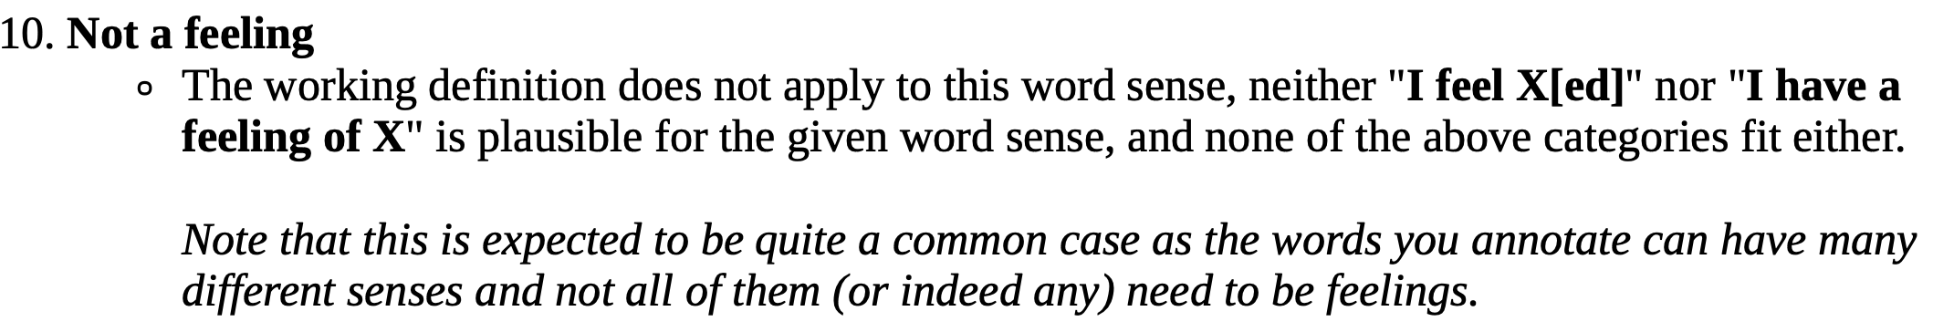
10 Categories:

Slide 10
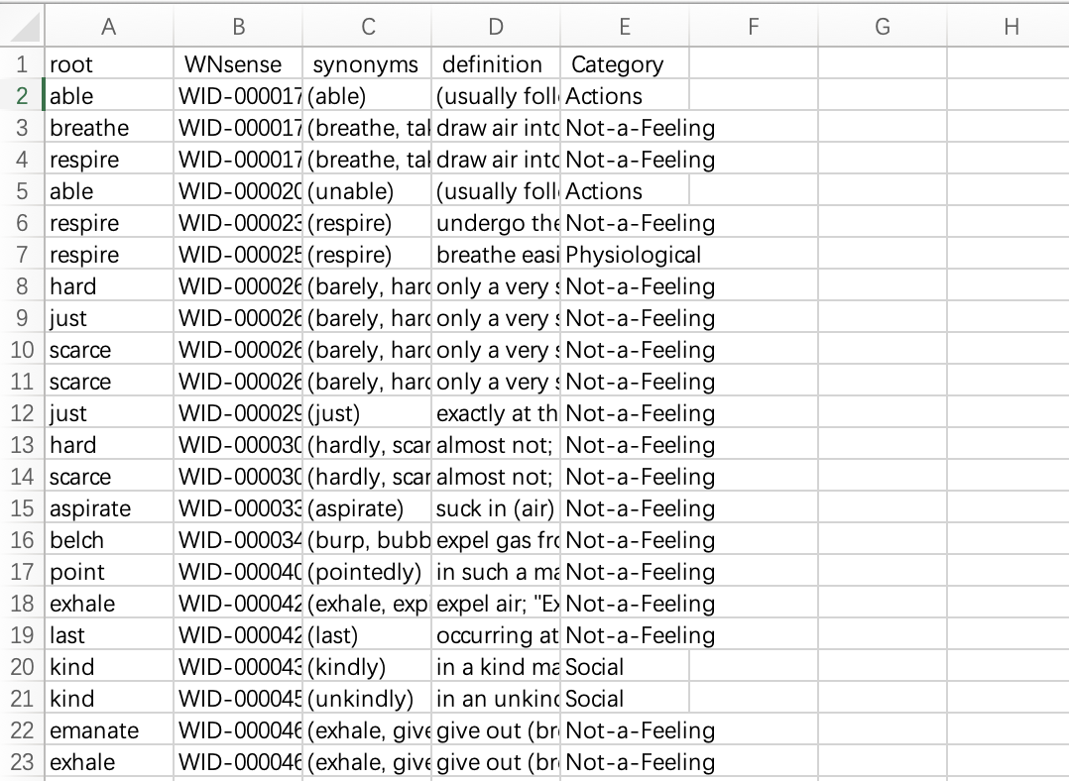
WordNet-feeling dataset

Slide 11
Divide words into nouns and adjectives
Remove “Other” and “Not a feeling” ADJ words -----for Emotional & sensational words
for metaphor, remove “abstract” and “general” words (and find their 5 same pos synonyms)
e.g.
Noun: ['thing', 'pattern', 'one', 'anything', 'other', 'surface', 'sound','kind','fact','sure','percent','feel','adjective','noun','part','ok','okay','sort‘]
ADJ: ['only','other']
synsets = wn.synsets(word, pos=pos)

Slide 12
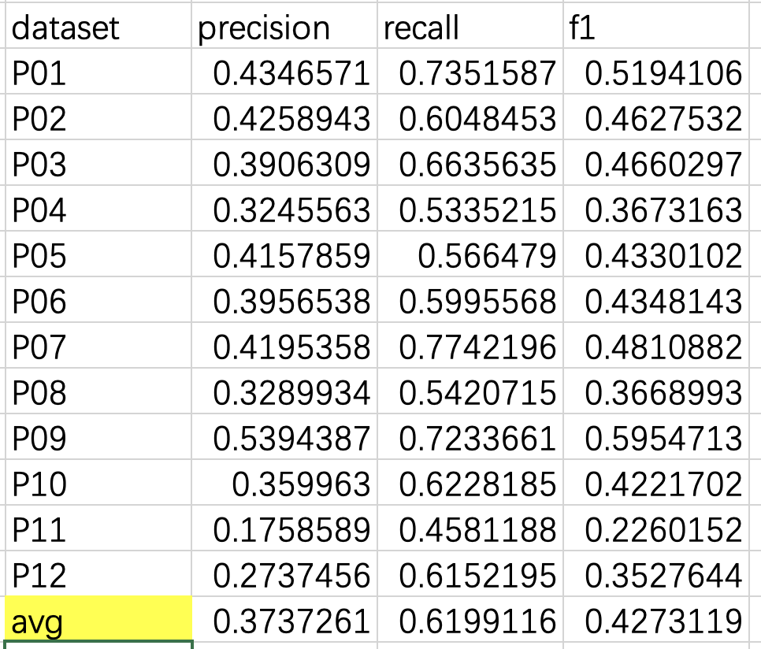
Result

Slide 13
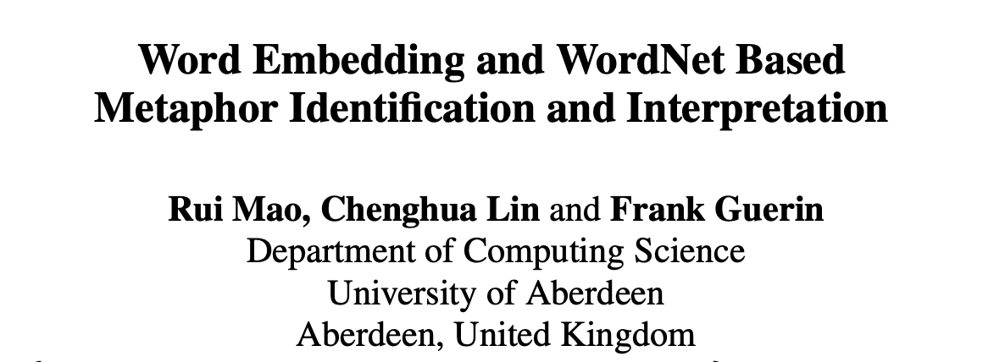
Further Improvement
Find a more accurate way to identify the metaphor words

Slide 14
Mask language learning
LLM GPT3

