Slide 1
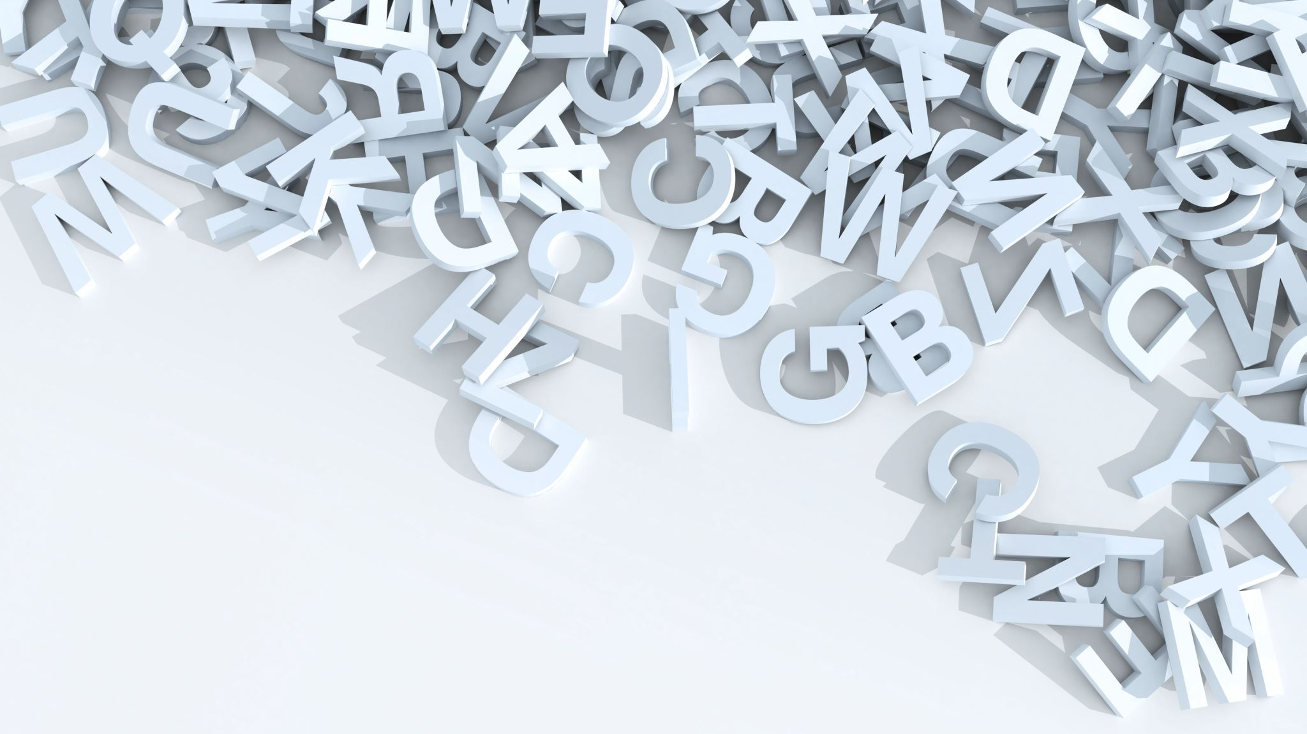
Use GPT-3.5 to divide the sentence into words and phrases

Slide 2
What is GPT prompt engineering?
GPT prompt engineering is the practice of strategically constructing prompts to guide the behavior of GPT language models, such as GPT-3, GPT-3.5-Turbo or GPT-4.
It involves composing prompts in a way that will influence the model to generate your desired responses.
By leveraging prompt engineering techniques, you can elicit more accurate and contextually appropriate responses from the model.

Slide 3
A list of elements that make up a well-crafted prompt:
Context:
e.g., “You are a helpful and friendly customer support agent. You focus on assisting customers troubleshoot technical issues with their computer.”
Instructions:
e.g., “Provide three tips for improving customer satisfaction in the hospitality industry.”
Input Data:
Specific examples
Output Indicator:
Specify the format you want the response in

Slide 4
Best practices for prompt engineering with OpenAI API
https://help.openai.com/en/articles/6654000-best-practices-for-prompt-engineering-with-openai-api
Some practices:
Put instructions at the beginning of the prompt and use ### or """ to separate the instruction and context
Start with zero-shot, then few-shot (example), neither of them worked, then fine-tune

Slide 5
Create my prompt
Extract emotional, sensational and metaphor keywords from the corresponding texts below:
1. You need to first understand the meaning of the sentence before selection.
2. Remain the negative or positive meaning of the sentences.
3. Only select ADJ and NOUN keywords.
4. Please follow the answer form "Emotional, sensational and metaphor keywords:"
Text : No, but I think that is largely because it's quite weak, rather than the pattern itself. No, not yet. It's quite calming, really. Honestly, because of the white noise, it kind of sounds like a beach, and that's the only thing I can have in my head. I don't really know. It's maybe pulsating. I don't know. Again, it's not massively put me up or down, to be honest. I think if it was a stronger pulse, then maybe. No, but again, I think that's partially more to do with the actual fact that I am here with a friend with white noise. It's not a very distressing situation. Quite pleasant, really. I don't know.
Emotional, sensational and metaphor keywords: quite weak, quite calming, beach, pulsating, stronger pulse, distressing, Quite pleasant
###
Text: Maybe something on the first two. Yes, there's my pinky picking something up. Definitely got something. I don't like this one. Why? It feels uneven. The vibrations just aren't equal to each other, and that just doesn't feel good. It's more intense than the others, but not in a nice way. Nothing springing to mind. I'm not having a good time, I would say. Bad. I'm not sad. I'm not angry. What's a bad emotion? Annoyance; get yourself together. Why are you so on even? Yes, someone who is sloppy, messy. I'm annoyed at you. And you're making me uncomfortable.

Slide 6
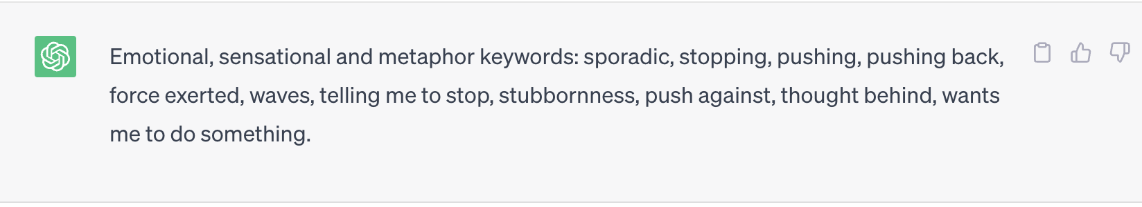
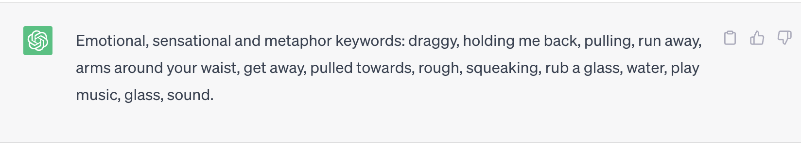
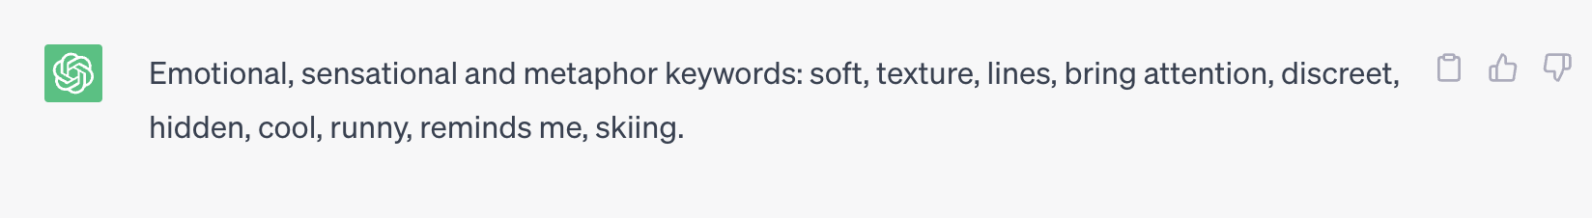
Answer of ChatGPT

Slide 7
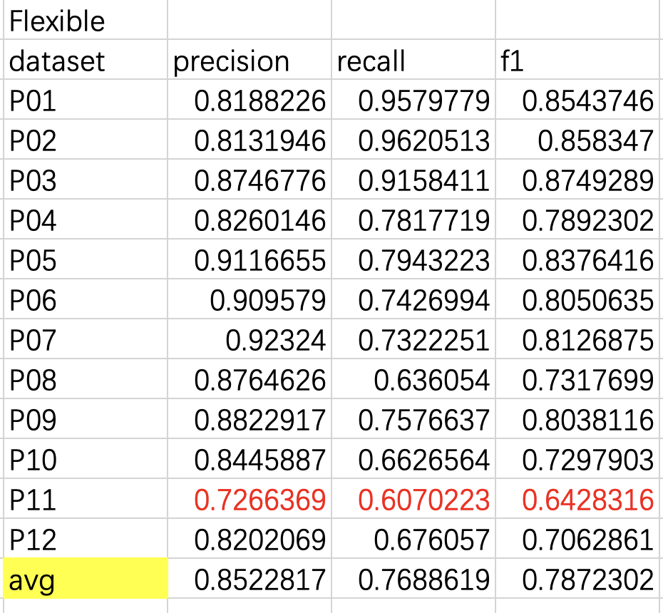
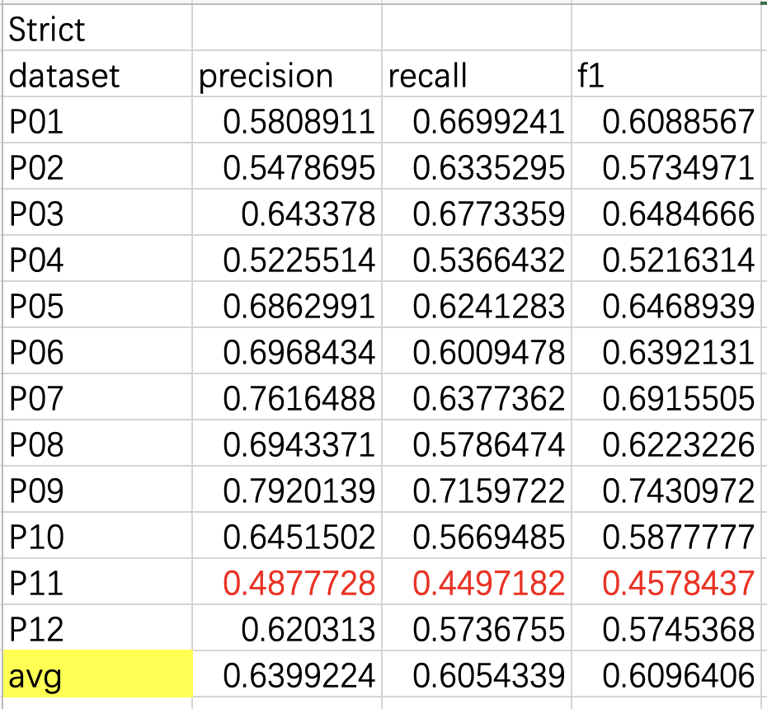
Result——GPT-3.5

Slide 8
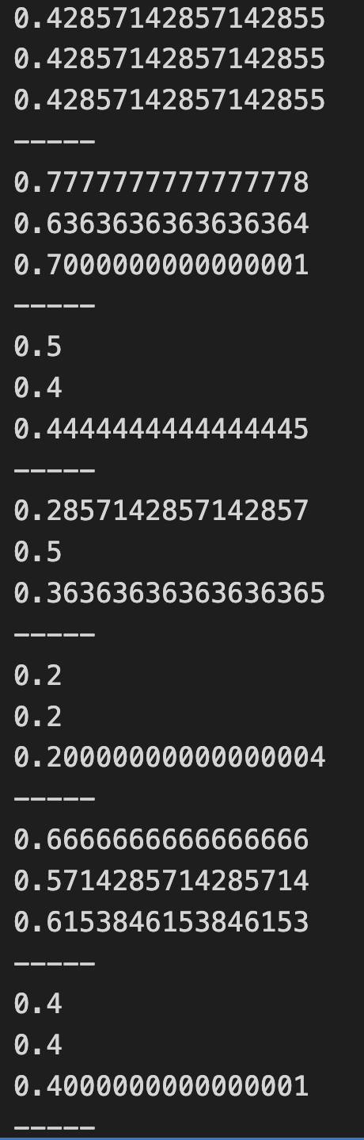
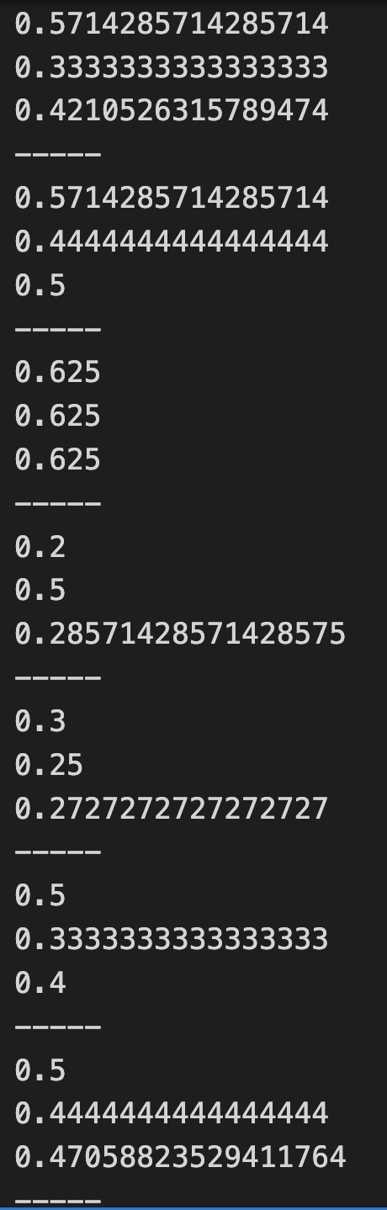
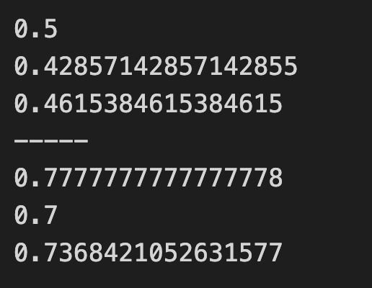
Notes:
4 5 9 11 12
Not separate words

Slide 9
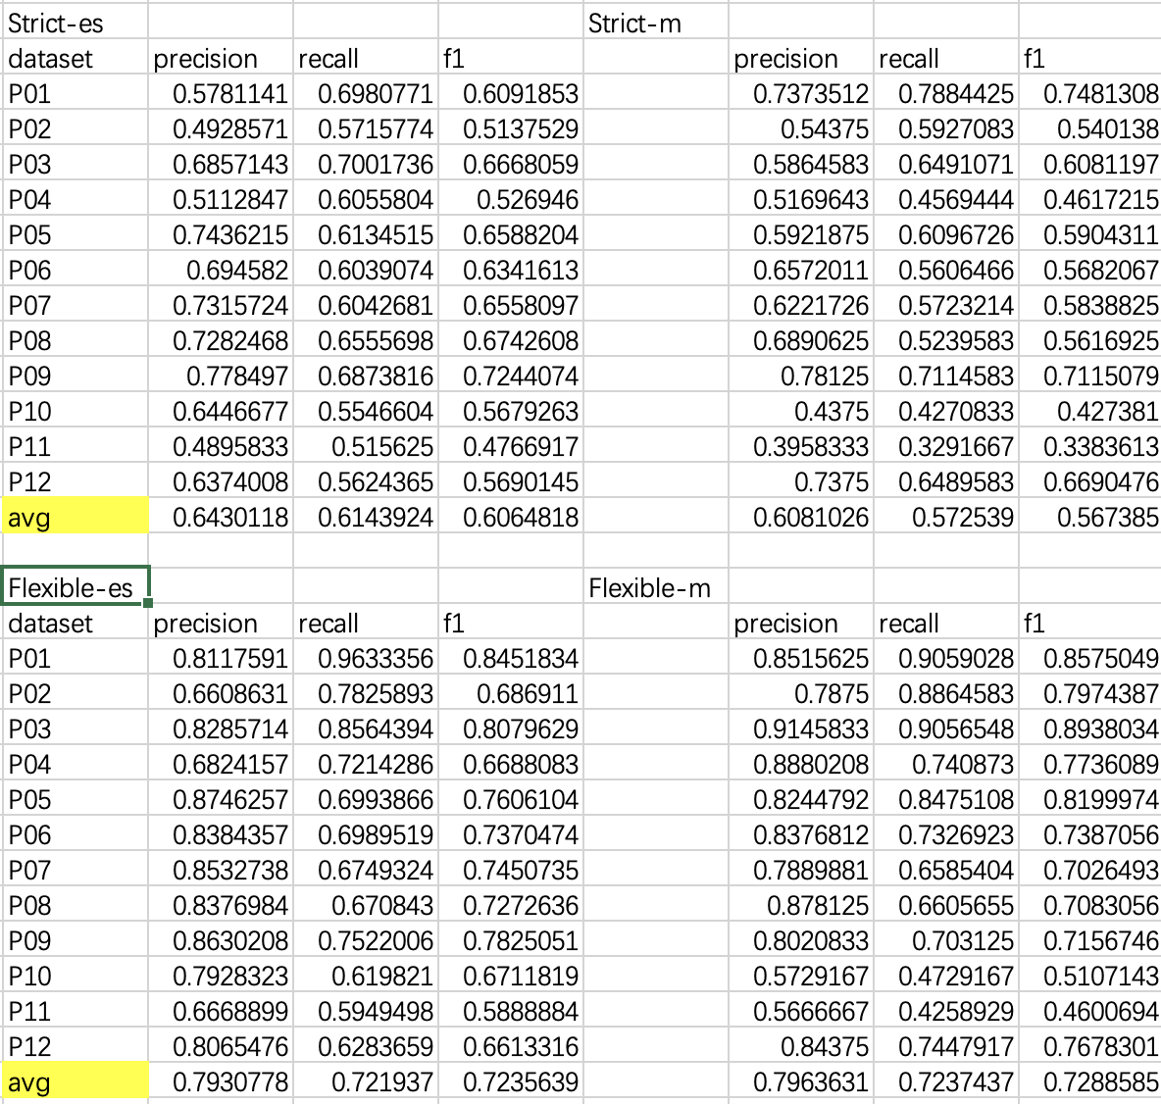
es: emotional & sensational words
m: metaphor words

Slide 10
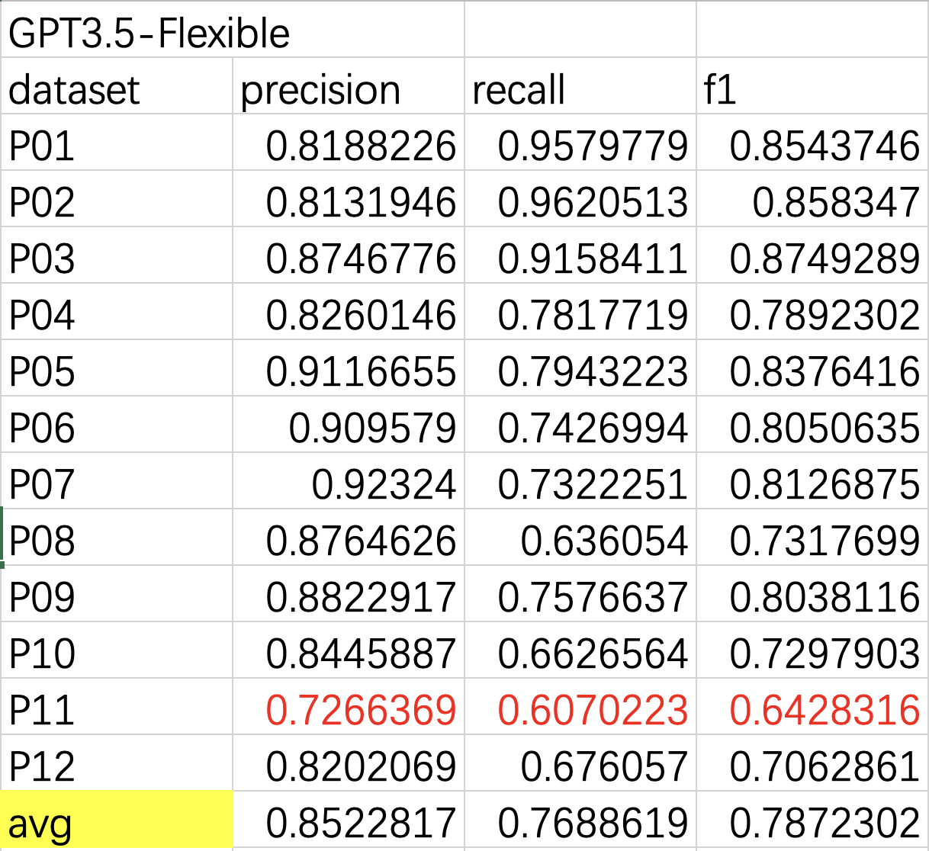
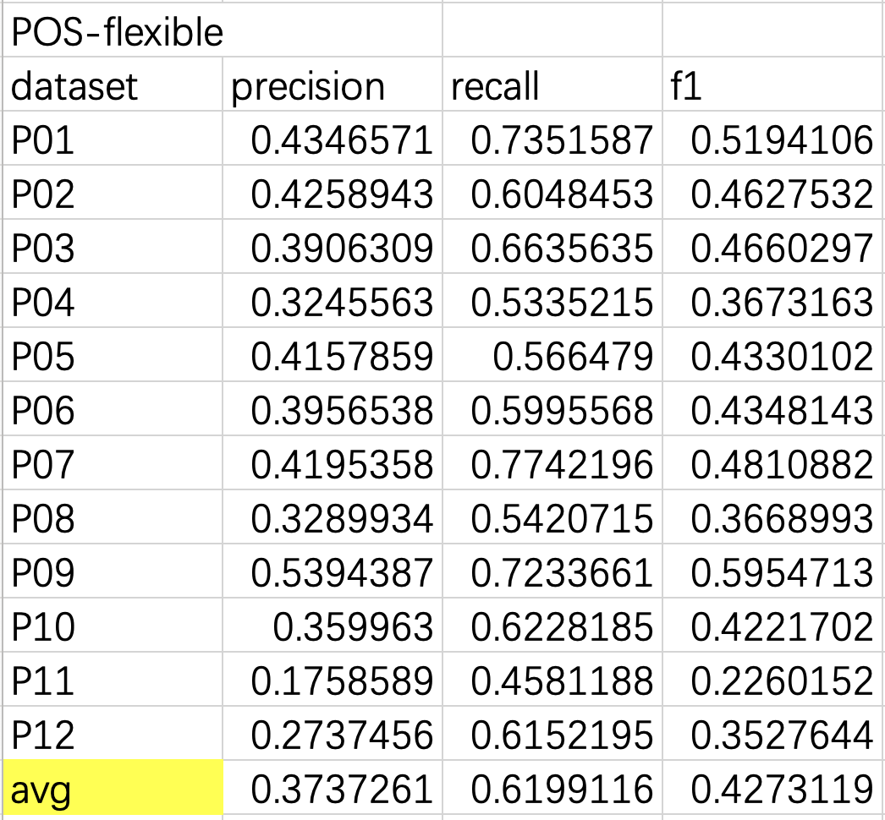
Compare——POS tagging

Slide 11
Pros & cons of two methods
POS Tagging
Pros:
Able to keep duplicate words
Simple procedures to select words according to their POS
Cons:
Hard to recognize metaphor phrases
Low precision, recall and f1 score
Unable to recognize cross-word phrases
Unable to keep duplicated words
Unable to recognize “don’t” and negative meanings
GPT-3.5
Pros:
High precision, recall and f1 score
Simple procedures to create prompt
Can recognize metaphor phrases
Cons:
Maybe need further fine-tune
Unable to recognize all cross-word phrases
Unable to keep duplicated words
Unable to recognize all “don’t” and negative meanings

Slide 12
Other
GPT-3.5 API
https://platform.openai.com/playground/p/default-chat?model=text-davinci-003
Fine-Tune the model:
https://docs.google.com/document/d/1rqj7dkuvl7Byd5KQPUJRxc19BJt8wo0yHNwK84KfU3Q/edit

