Slide 1
Static word embedding method
Model: GloVe.840B.300d
Rules:
If the words or phrases are not in the GloVe dataset, the value is 0
Calculate average embedding for phrases
Evaluation:
Silhouette score

Slide 2
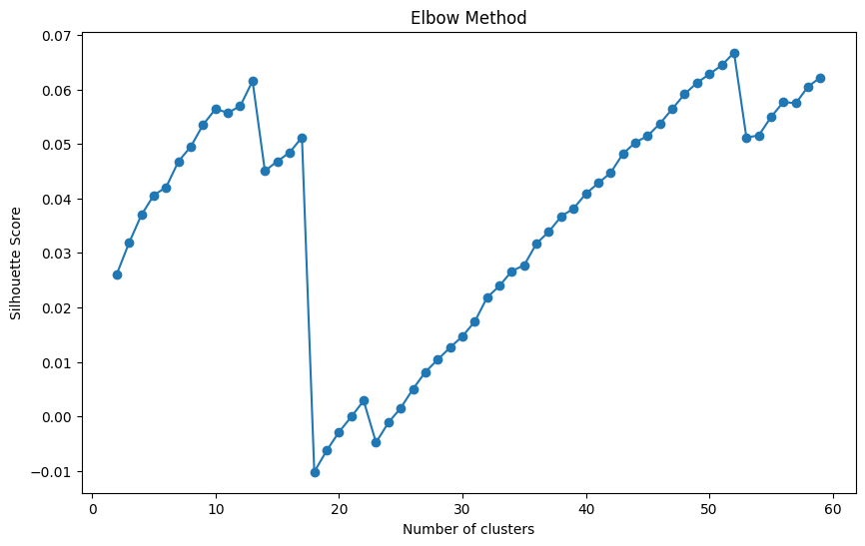
Silhouette score
Number of clusters: 13，52

Slide 3
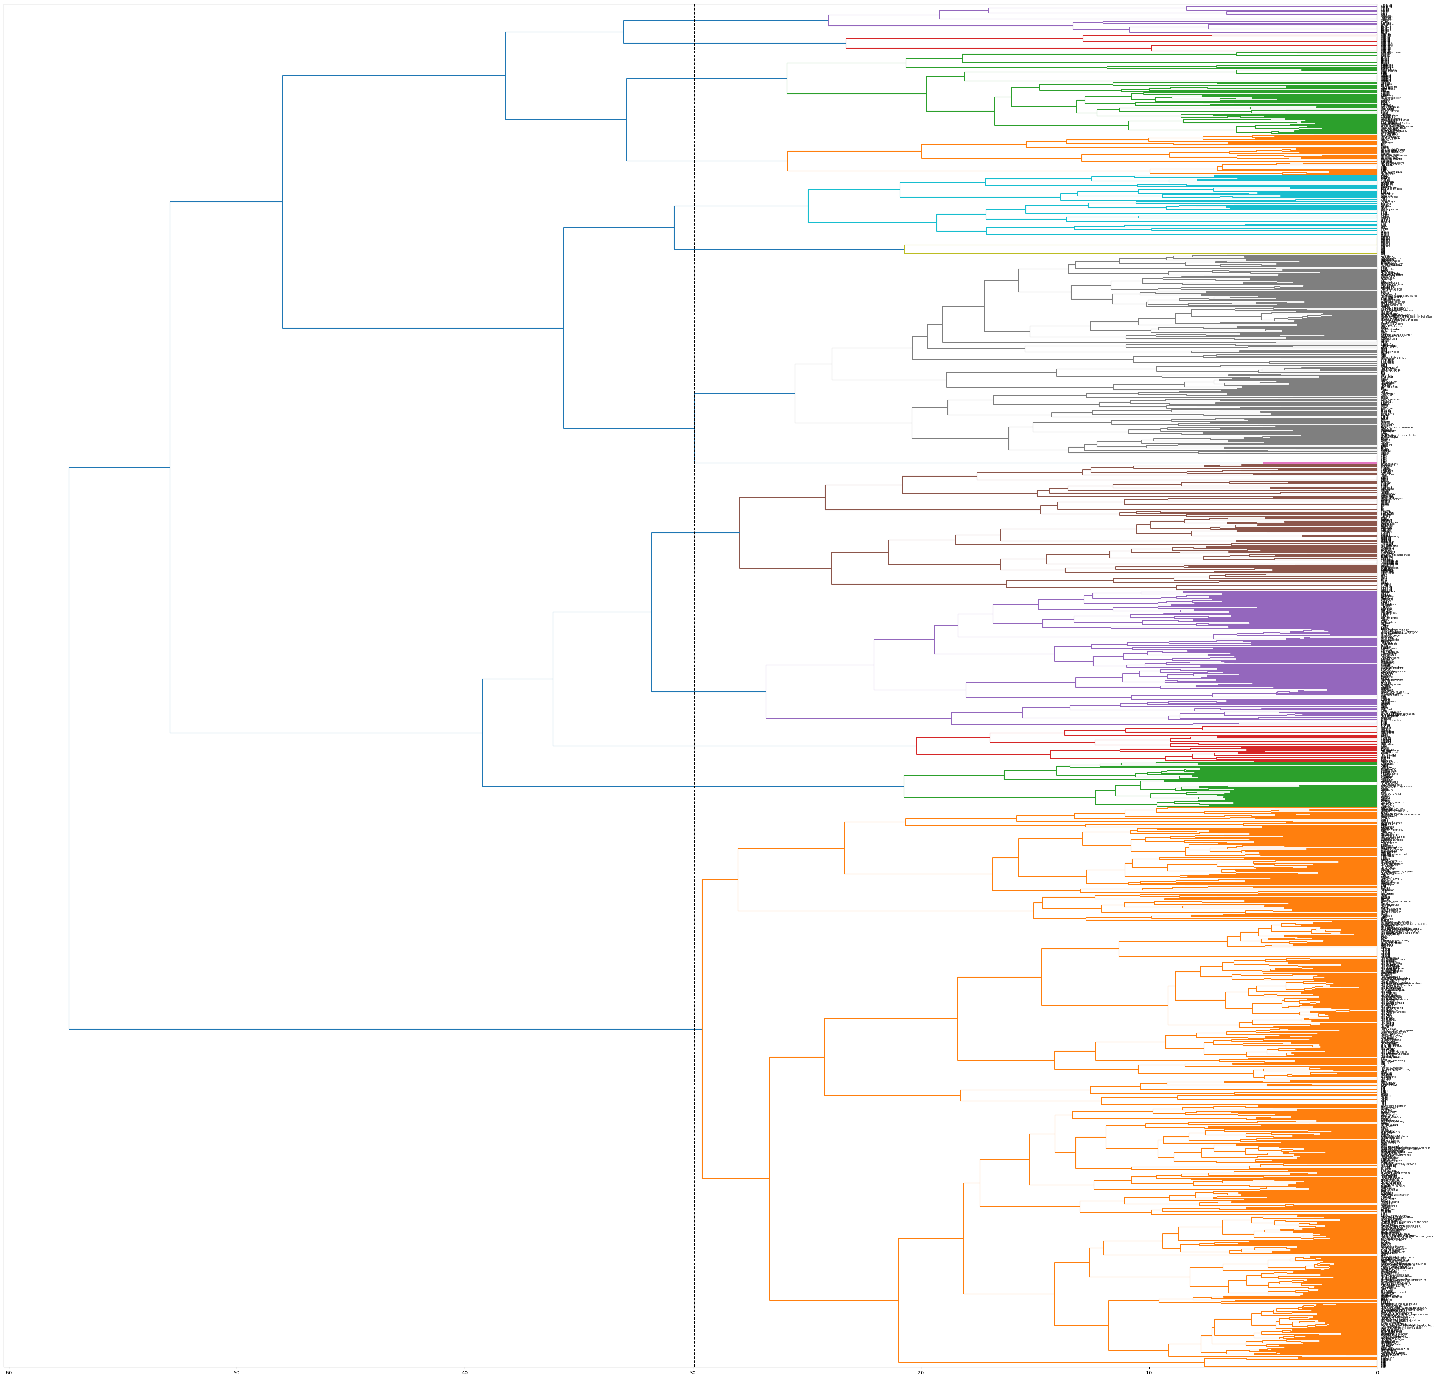
Result-n=13

Slide 4
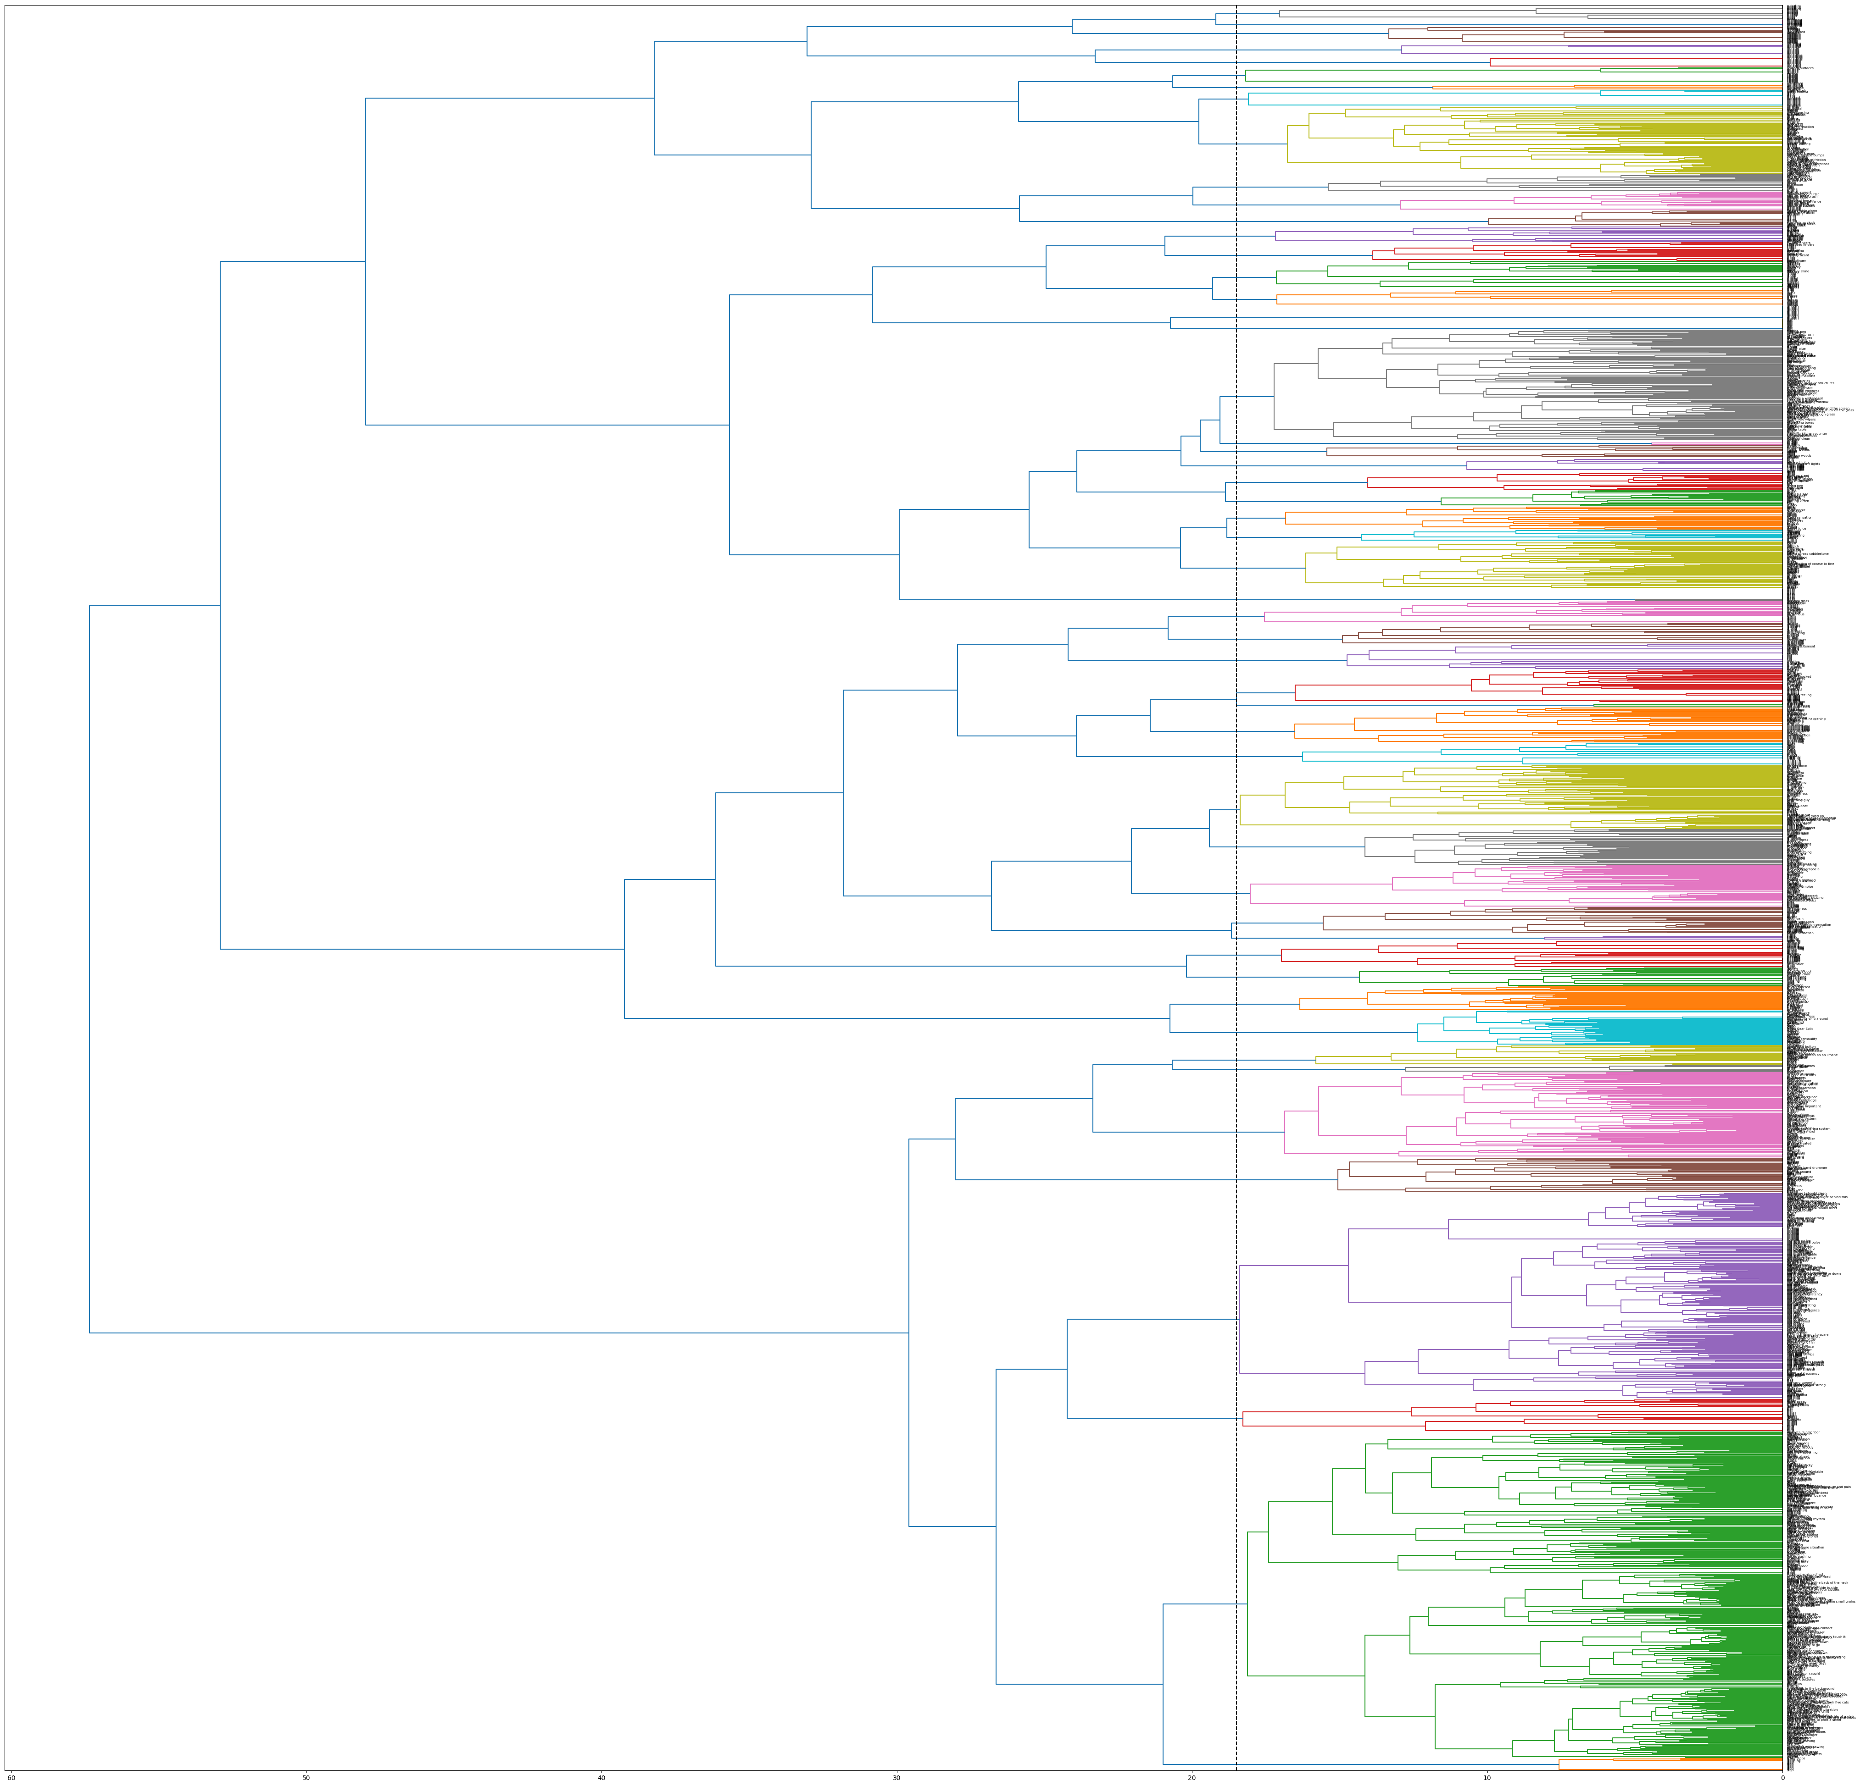
Result-n=52

Slide 5
Next step:

