Slide 1
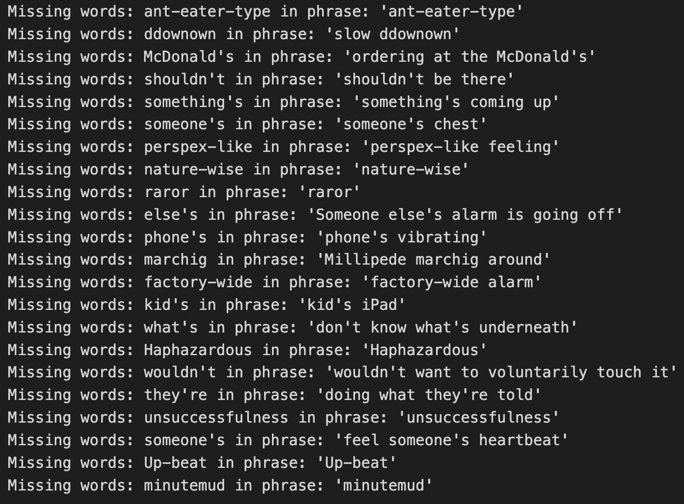
Static embedding is zero:

Slide 2
Method1: Use GloVe only + Hierarchical Clustering
Model: GloVe.840B.300d
Rules:
If the words or phrases are not in the GloVe dataset, the value is 0, and remove them during the Clustering
Calculate average embedding for phrases
Evaluation:
Silhouette score
n_clusters from 10 to 100

Slide 3
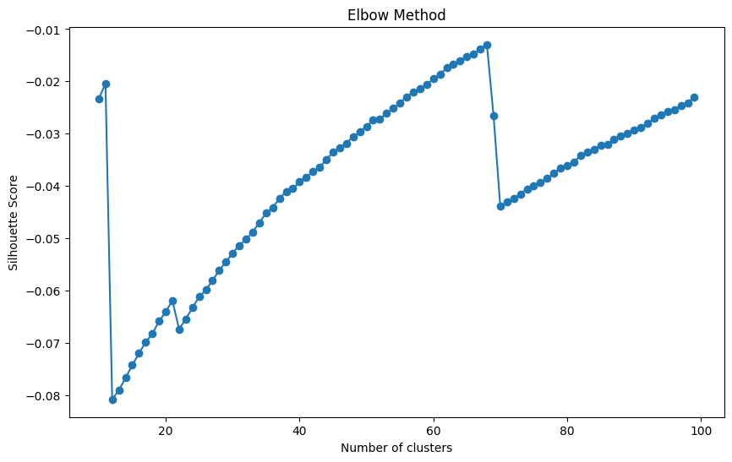
Result
All negative values!

Slide 4
Method2: Use GloVe for words and Bert for phrases + Hierarchical Clustering
Model: GloVe.840B.300d, Bert-base-cased/uncased 768d
Rules:
If the words are not in the GloVe dataset, the value is 0, and remove them during the Clustering
Calculate average embedding for phrases
For Bert, add ”I feel ” in front of every phrase
Using PCA to reduce BERT embeddings to 300 dimensions equivalent to GloVe
Evaluation:
Silhouette score
n_clusters from 10 to 100

Slide 5
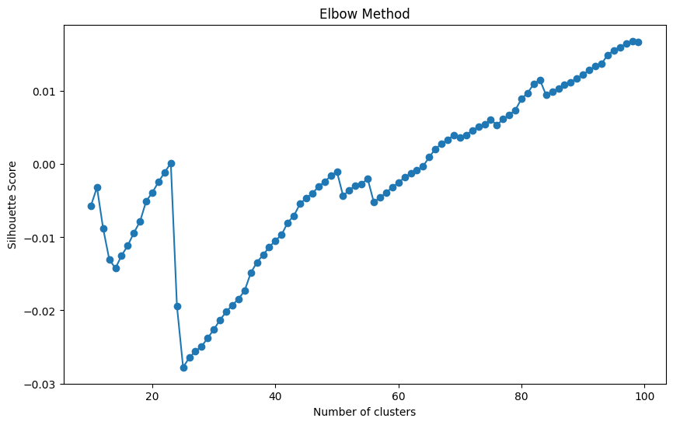
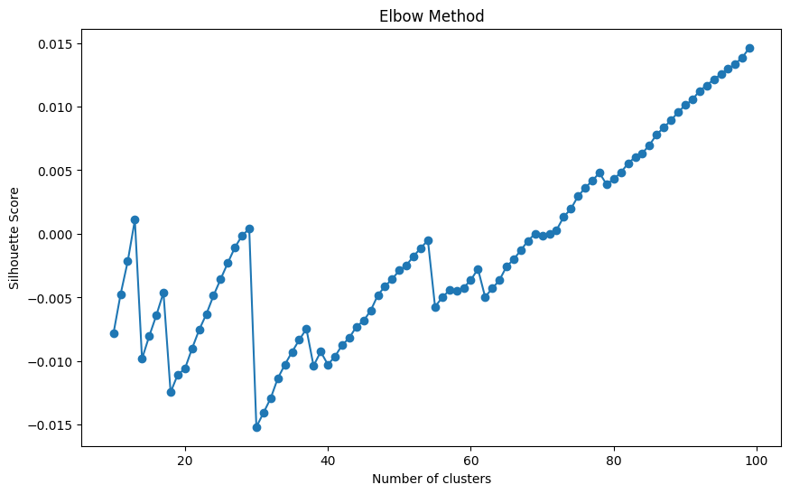
Result
uncased, 100
Cased, 98

Slide 6
Method3: Use Bert Only + Hierarchical Clustering
Model: Bert-base-cased/uncased 768d
Rules:
Calculate average embedding for phrases
For Bert, add ”I feel ” in front of all words and phrases
Evaluation:
Silhouette score
n_clusters from 10 to 100
Notes:
Bert cased vs Bert uncased:
Cased: remain all capitalization words
Uncased: automatically turn all words into uncased form

Slide 7
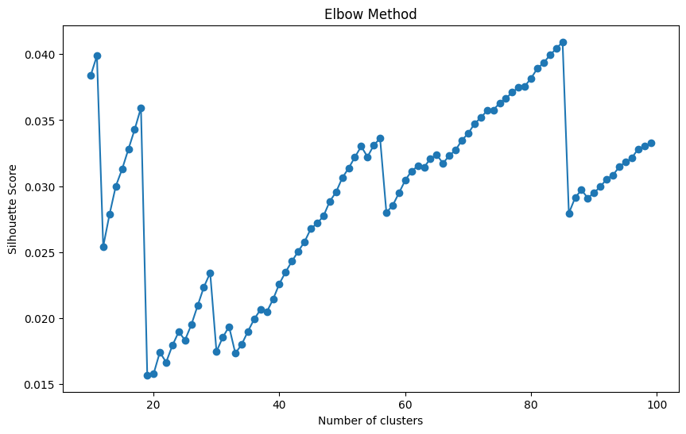
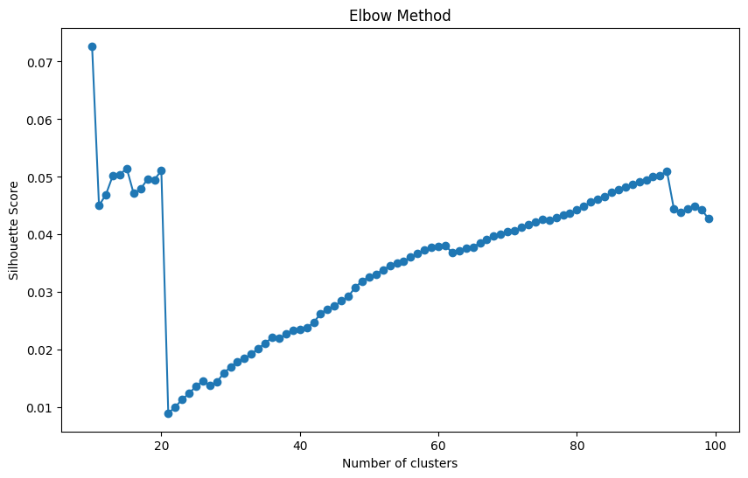
Result
Cased, 85
uncased, 10

Slide 8
Method4: Concatenate GloVe and Bert + Hierarchical Clustering
Model: GloVe.840B.300d, Bert-base-cased/uncased 768d
Concatenate to 1068d
Rules:
If the words or phrases are not in the GloVe dataset, the value is 0, and remove them in Bert and during the Clustering
Calculate average embedding for phrases
For Bert, add ”I feel ” in front of every words and phrases
No need PCA
Evaluation:
Silhouette score
n_clusters from 10 to 100

Slide 9
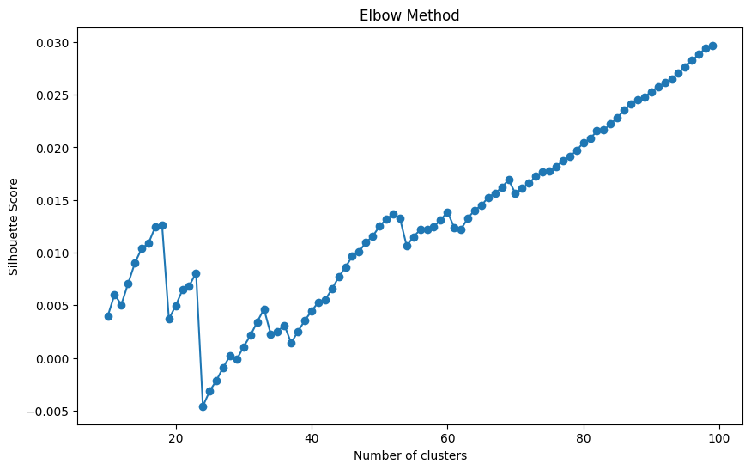
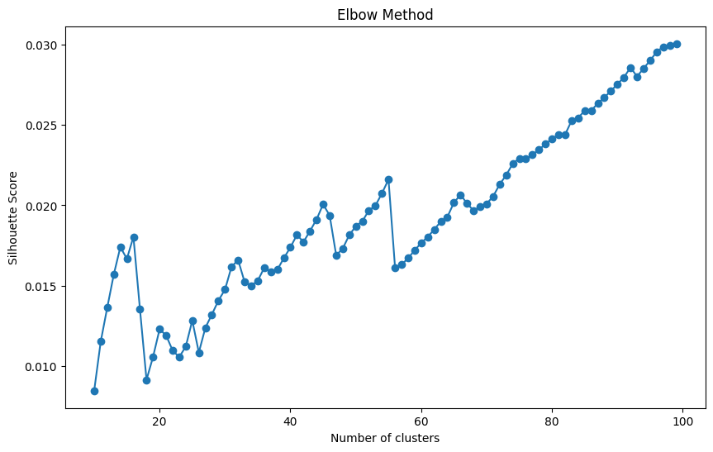
Result
Cased, 100
uncased, 100

Slide 10
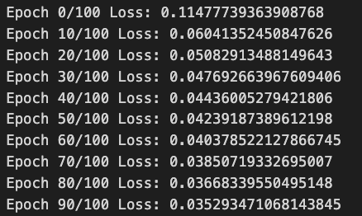
Method5: GloVe and Bert concatenate + Autoencoder + Hierarchical Clustering
Model: GloVe.840B.300d, Bert-base-cased/uncased 768d
Compress to 128d using Autoencoder
Rules:
For Autoencoder:
ReLU as activation function
lr=0.001
MSE as criterion
Epochs=100
Evaluation:
Silhouette score
n_clusters from 10 to 100

Slide 11
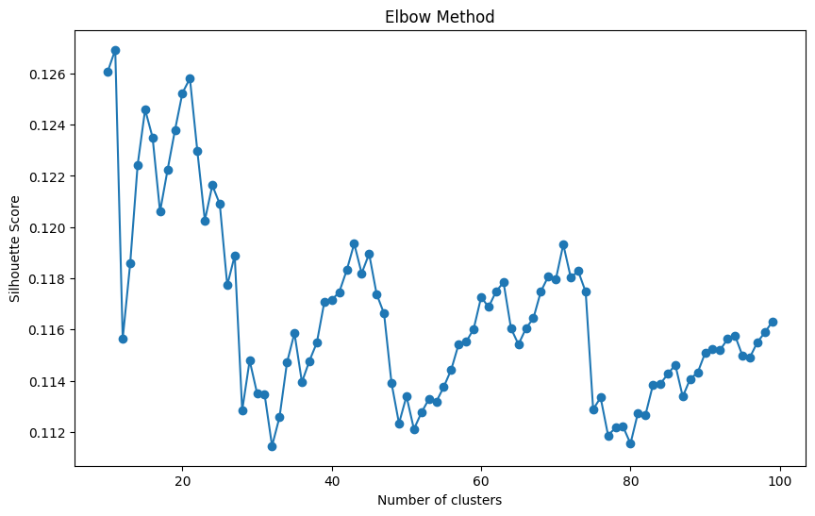
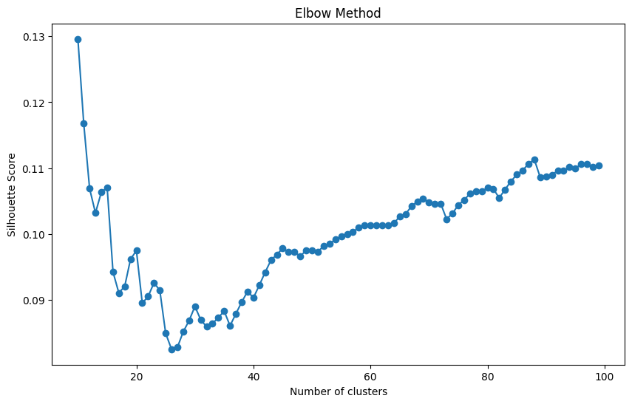
Result
Cased, 21
uncased, 10, 88

Slide 12
Method6: SVD(LSA) and Bert concatenate + Autoencoder + Hierarchical Clustering
Model: LSA (d=300), Bert-base-cased/uncased 768d
Compress to 128d using Autoencoder
Rules:
For Autoencoder:
ReLU as activation function
lr=0.001
MSE as criterion
Epochs=100
Evaluation:
Silhouette score
n_clusters from 10 to 100
Notes:
LSA Latent Semantic Analysis
SVD Singular Value Decomposition
Advantages: One of the main advantages of LSA is its ability to capture semantic relationships, such as synonyms and polysemy,
which is difficult to achieve in traditional methods based on the Bag of Words model.

Slide 13
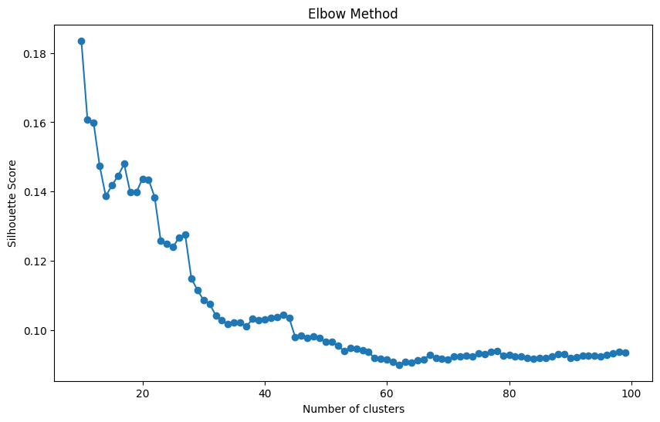
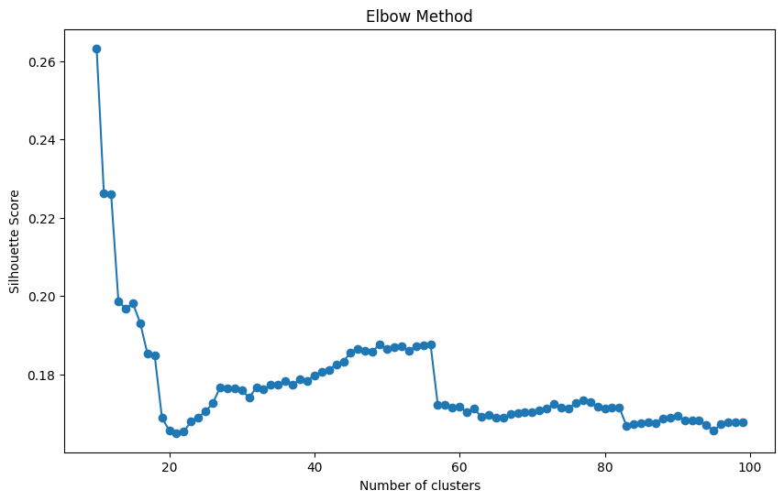
Result
Cased, 13
uncased, 10, 15, 56

Slide 14
Method7: SVD(LSA) and Bert + DualInputNetwork + Hierarchical Clustering
Model: LSA d=300, Bert-base-cased/uncased 768d
Two pathway in the network: Bert & LSA 128d
Combine pathways, 128d
Rules:
For DualInputNetwork :
ReLU as activation function
Evaluation:
Silhouette score
n_clusters from 10 to 100

Slide 15
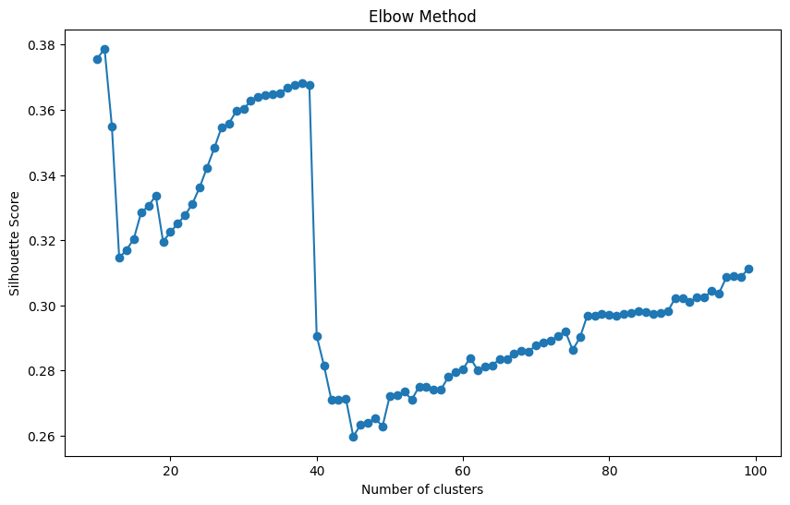
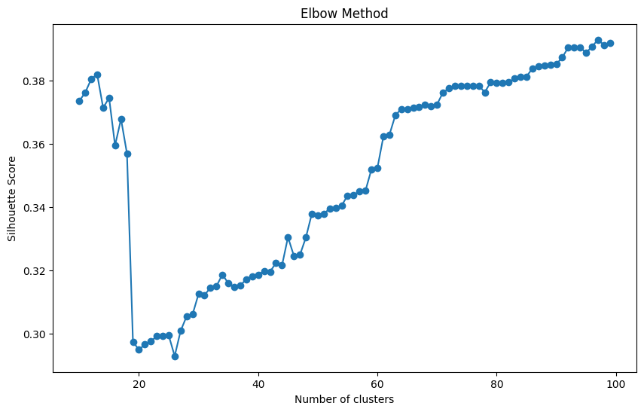
Result
Cased, 11, 38
Uncased,97

Slide 16
Method8: GloVe and Bert + DualInputNetwork + Hierarchical Clustering
Model: GloVe.840B.300d, Bert-base-cased/uncased 768d
Two pathway in the network: Bert & GloVe 128d
Combine pathways, 128d
Rules:
ReLU as activation function
Evaluation:
Silhouette score
n_clusters from 10 to 100

Slide 17
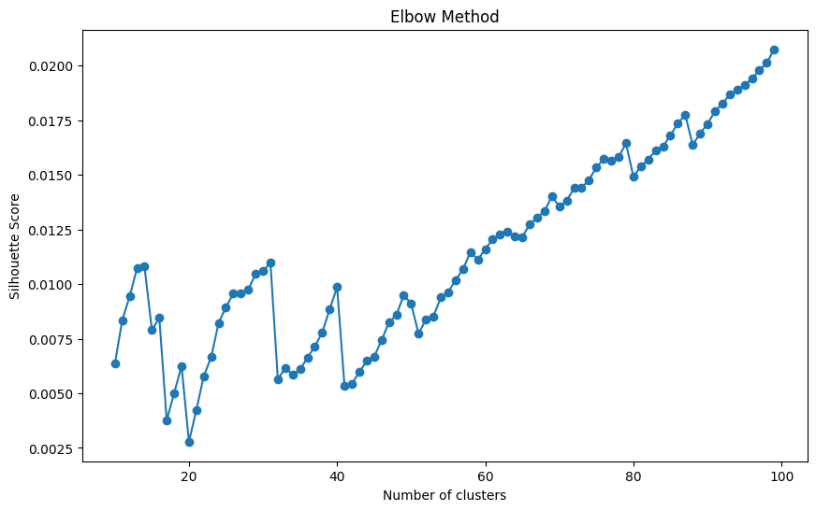
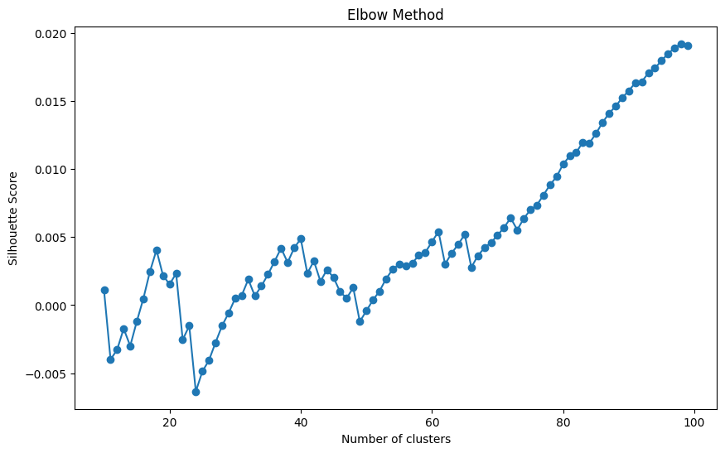
Result
Cased, 100
Uncased, 100

Slide 18
Next Step:
Determine the emotional attributes of words (positive, negative, or neutral) for better clustering

