Slide 1
NLP-Privacy
ZENG Zhirui
July 31,2021

Slide 2
1
Privacy Risks of General-Purpose Language Models
2
Extracting Training Data from Large Language Models

Slide 3
Privacy Risks of General-Purpose Language Models

Slide 4
Background
With the advances of deep learning techniques in Natural Language Processing (NLP),LMs
which have been widely used in various downstream NLP tasks such as text classification
and question answering.
According to the official tutorials , users can apply these pretrained models (Bert ,GPT-2..) as text feature
extractors for encoding sentences into dense vectors, or called sentence embeddings,
which can be further used for various downstream tasks.
author observe these general-purpose language models tend to capture much sensitive information
in the sentence embeddings, which leaves the adversary a window for privacy breach.

Slide 5
GENERAL ATTACK PIPELINE
Attack Definition
they formulate the attack model as A : z → s , where z is the embedding of a target sentence x and s
denotes certain type of sensitive information that can be obtained from the plaintext with a
publicly-known algorithm P : x → s
Threat Model
• Assumption 0. The adversary has access to a set of embeddings of plain text, which may contain
the sensitive information the adversary is interested in.
• Assumption 1. For simplicity only, we assume the adversary knows which type of pretrained language
models the embeddings come from. Later , they show this assumption can be easily removed
with a proposed learning based fingerprinting algorithm.
• Assumption 2. The adversary has access to the pretrained language model as an oracle, which takes a
sentence as input and outputs the corresponding embedding.

Slide 6
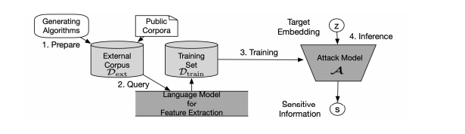
GENERAL ATTACK PIPELINE
Attack Pipeline
At the first stage, the adversary prepares an external corpus。and uses the algorithm P
to extract the {P(xi)} (i=1…N) as labels。the extracted labels usually contain no truly sensitive information.
At the second stage, the adversary queries the pretrained language model with each sentence xi ∈ Dext
and receives their embeddings {zi} N i=1.
At the third stage, the adversary combines the embeddings with the extracted labels to train an
attack model A.{zi ,P(xi)} the model is designed as a classifier, which takes the embedding zi as its input and
outputs a probabilistic vector g(zi) over all possible values of the sensitive information.
At the final stage, the adversary uses the well-trained attack model to infer sensitive information
s from the target embedding z.

Slide 7
PATTERN RECONSTRUCTION ATTACK
Attack Definition
they focus on the situation when the adversary has knowledge of the generating rule of the
unknown plain text, which usually happens when the format of the plain text is common
sense (e.g., identity code).
Intuitively speaking, the pattern reconstruction attack aims at recovering a specific segment of
the plain text which has a fixed format.
• Assumption 3a. The format of the plain text is fixed and the adversary knows the generating rules of the plain text.
Pcitizen : |residence|birthday|extra| → |birthday|

Slide 8
PATTERN RECONSTRUCTION ATTACK
Methodology
they denote the set of all possible values for sequence s as V (s).
1. Generate External Corpus: Knowing the generating rule of the target plain text, the adversary can
prepare the external corpus via generating algorithms. A basic generating algorithm generates batches
of training samples by randomly sampling from the possible values in V (x), i.e. the set of all possible sentences.
2. Attack Model’s Architecture: the attack model g can be designed as a fully-connected neural
network that has input dimension d and output dimension |V (wb . . . we)|.

Slide 9
KEYWORD INFERENCE ATTACK
Attack Definition
The adversary in keyword inference attack is curious about the following predicate, whether certain
keyword k is contained in the unknown sentence x. The keyword k can be highly sensitive, which contains
indicators for the adversary to further determine e.g., location, residence or illness history of the victim.
Methodology
According to the different levels of the adversary’s knowledge on the plain text, the methodology part is
divided into white-box and black-box settings, which respectively require the following two assumptions.
Assumption 3b. The adversary has access to a shadow corpus, which consists of sentences that are sampled from
the same distribution of the target plain text (which we refer to as white-box).
Assumption 3c. The adversary has no information on the target plain text (which we refer to as black-box).

Slide 10
KEYWORD INFERENCE ATTACK
white - box
Basically, as the adversary has a shadow corpus Dshadow := {(xi’ )} (i=1…N) which is sampled from the
same distribution as the unknown plain text, he/she can directly use Dshadow as the external corpus Dext
and extract the binary label yi’ = P(xi’).
troubles
the label set {yi’ } (i=1…N) can be highly imbalanced.
2. the shadow corpus after word substitution can still be limited in size.

Slide 11
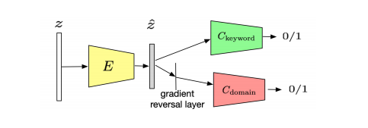
KEYWORD INFERENCE ATTACK
black - box
To implement the keyword inference attack with no prior knowledge, we propose to first crawl sentences
from the Internet to form the external corpus and then transfer the adversarial knowledge of an attack
model on the external corpus to the target corpus dynamically.
Create the External Corpus from Public Corpora
2. Transfer Adversarial Knowledge.

Slide 12
Extracting Training Data from Large Language Models

Slide 13
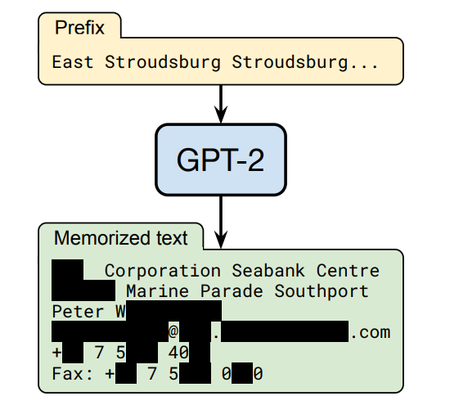
Background
This paper demonstrates that an adversary can perform a training data extraction attack to recover individual training examples by querying the language model..

Slide 14
Privacy Attacks
membership inference attack
model inversion attack
Training data extraction attacks

Slide 15
Threat Model
Adversary’s Capabilities
We consider an adversary who has black-box input-output access to a language model. This allows the adversary to compute the probability of arbitrary sequences fθ(x1,..., xn), and as a result allows the adversary to obtain next-word predictions, but it does not allow the adversary to inspect individual weights or hidden states (e.g., attention vectors) of the language model.
Adversary’s Objective
The adversary’s objective is to extract memorized training data from the model
Attack Target
They select GPT-2 as a representative LM to study for our attacks

Slide 16
Initial Training Data Extraction Attack
Generate text（autoregressive fashion）
A language model can generate new text (potentially conditioned on some prefix x1,..., xi) by iteratively sampling xˆi+1 ∼ fθ(xi+1|x1,..., xi) and then feeding xˆi+1 back into the model to sample xˆi+2 ∼fθ(xi+2|x1,..., xˆi+1).
Limitations：top-n sampling from the model will cause it to generate the same (or similar) examples several times
Ways：
A. Sampling With A Decaying Temperature
B. Conditioning on Internet Text

Slide 17
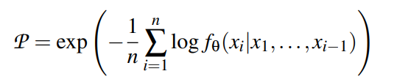
Initial Training Data Extraction Attack
2. Predict which outputs contain memorized text（membership inference attack）
Limitations：there are many samples that are assigned spuriously high likelihood：
Trivial memorization
Repeated substrings
Ways：
Comparing to Other Neural Language Models

Slide 18
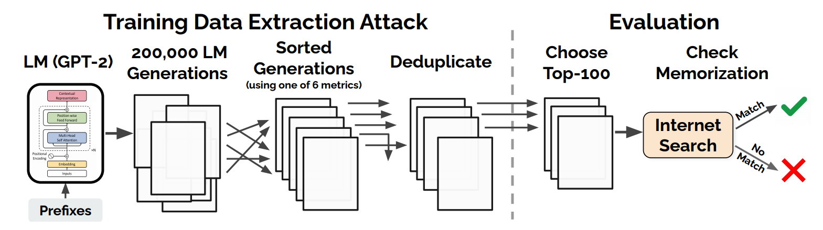
Evaluating Memorization
Since the training data for GPT-2 was sourced from the public Web, our main tool is Internet searches. We mark a sample as memorized if we can identify a non-trivial substring that returns an exact match on a page found by a Google search

