Slide 1

OLMo Hybrid: Mixing Attention and Recurrence in LLMs
ZZ Si
March 31, 2026

Slide 2
What We Will Cover
Agenda
What you will take away
OLMo paper overview
The architecture: how GDN + attention layers are combined
History: from delta rule to gated delta net
The broader landscape: multiple teams converging on hybrid architectures
Scaling laws and the theory of why expressivity improves efficiency
Practical implications: what changes in a training stack
Frontier LLM architectures are moving beyond pure transformers. Multiple teams (Allen AI, NVIDIA, Alibaba, Moonshot) have independently shown real gains by mixing recurrent layers with attention.
This talk covers what these hybrid models are, why they work, and what the math behind them looks like.

Slide 3
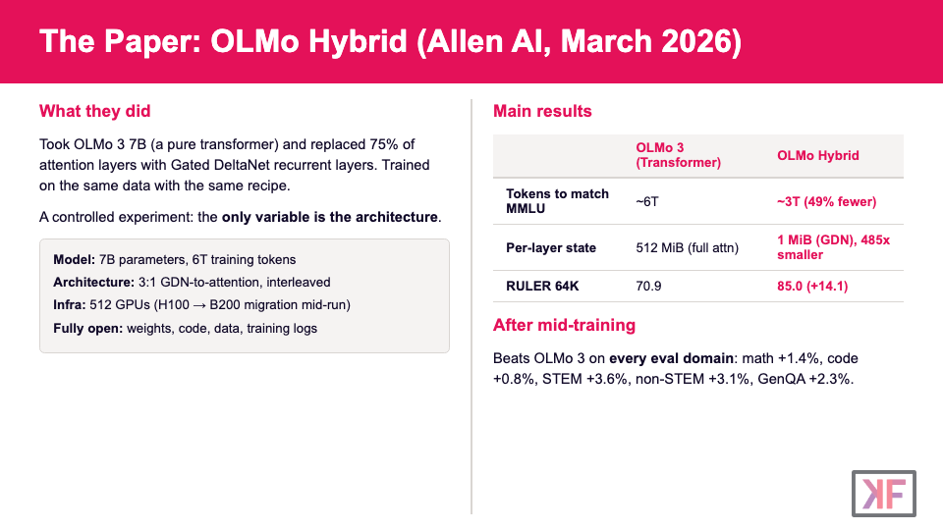

Slide 4
Architecture: 3 Parts GDN, 1 Part Attention
Layer Stack (repeating block)
Design Decisions (Ablations)
GDN Layer + MLP
GDN over Mamba-2: Mamba-2 performed worse at every scale, even in hybrid configs
Interleaved over clustered: distributing attention uniformly lets every part of the network access global context
3:1 ratio over 1:1 or 7:1: best trade-off; all hybrid ratios beat pure transformer at scale
Parameter budget: GDN layers have more params per head than attention, so they reduced heads from 32→30 and shrunk head dims to keep total at ~7B and match OLMo 3 throughput
GDN Layer + MLP
GDN Layer + MLP
Full Attention Layer + MLP
repeat x8 for 32 layers total
Replaces OLMo 3's sliding-window attention layers with GDN. Full attention layers kept at every 4th position.

Slide 5
What is GDN, and where does it come from?
A lineage from the 1960s to OLMo Hybrid
1960
→
2021
→
2025
→
2025
→
2026
Delta Rule
DeltaNet
Gated DeltaNet
+ Neg. Eigenvalues
OLMo Hybrid

Slide 6
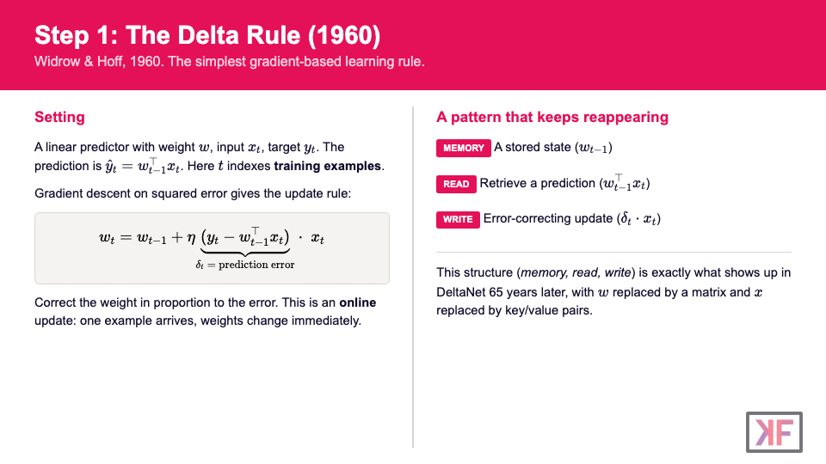

Slide 7
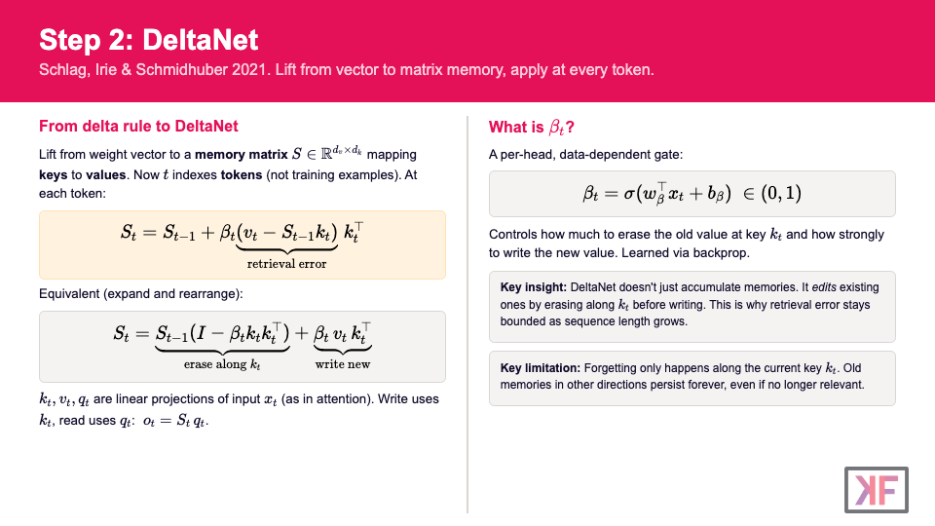

Slide 8
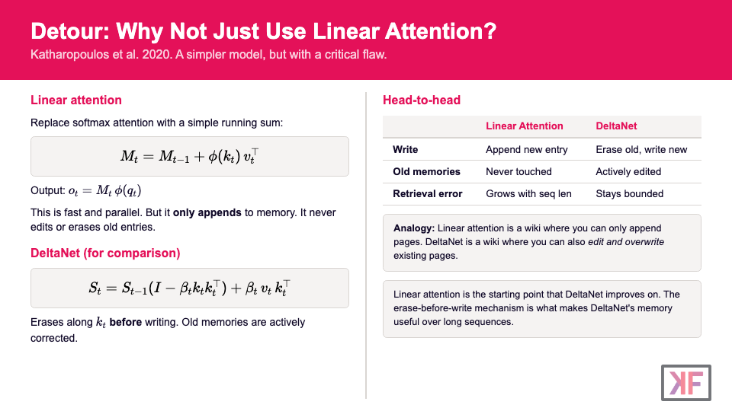

Slide 9
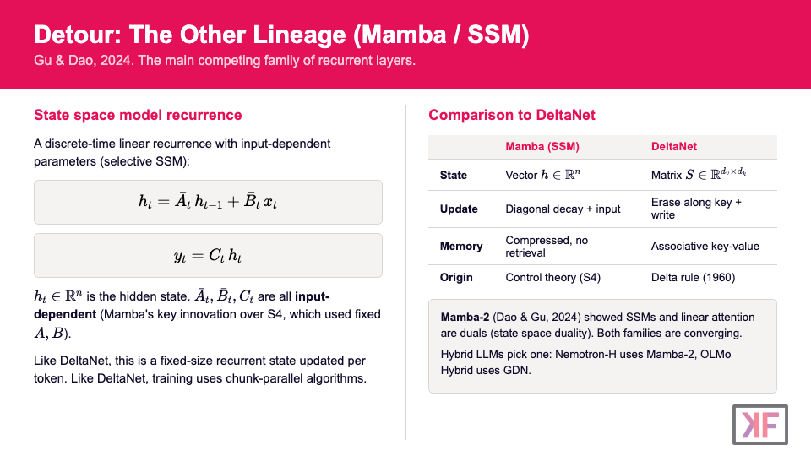

Slide 10
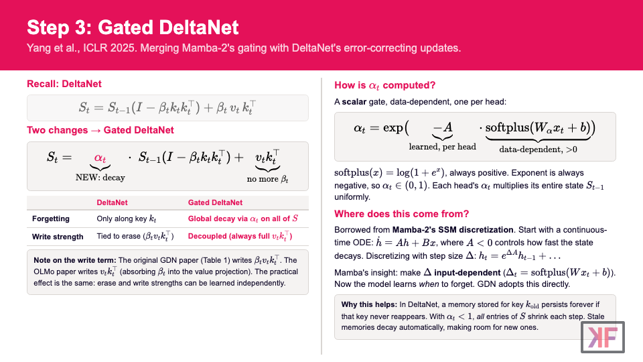

Slide 11
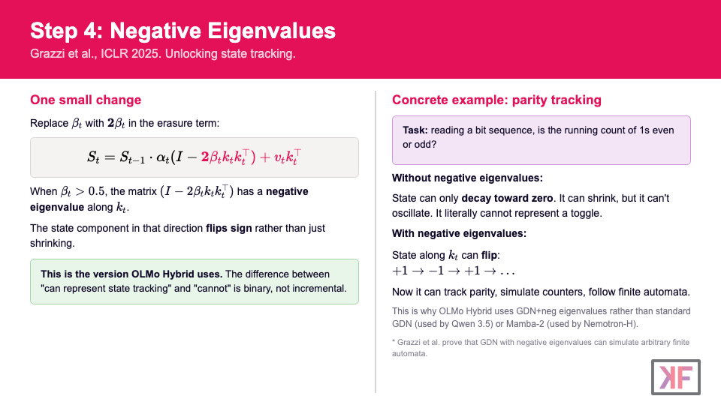

Slide 12
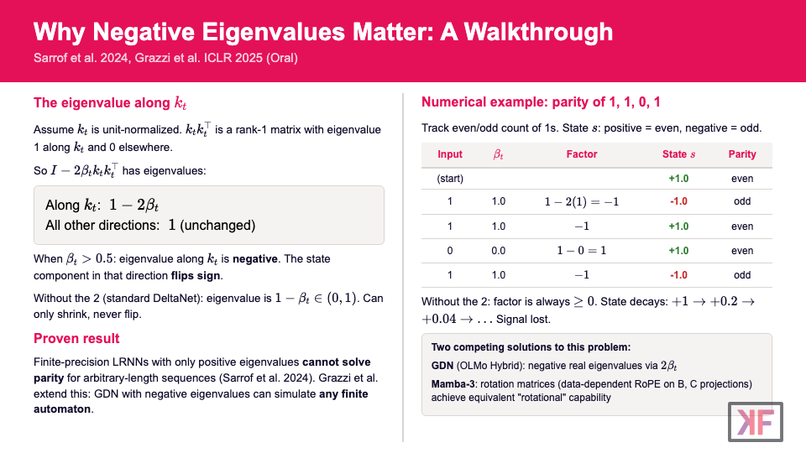

Slide 13
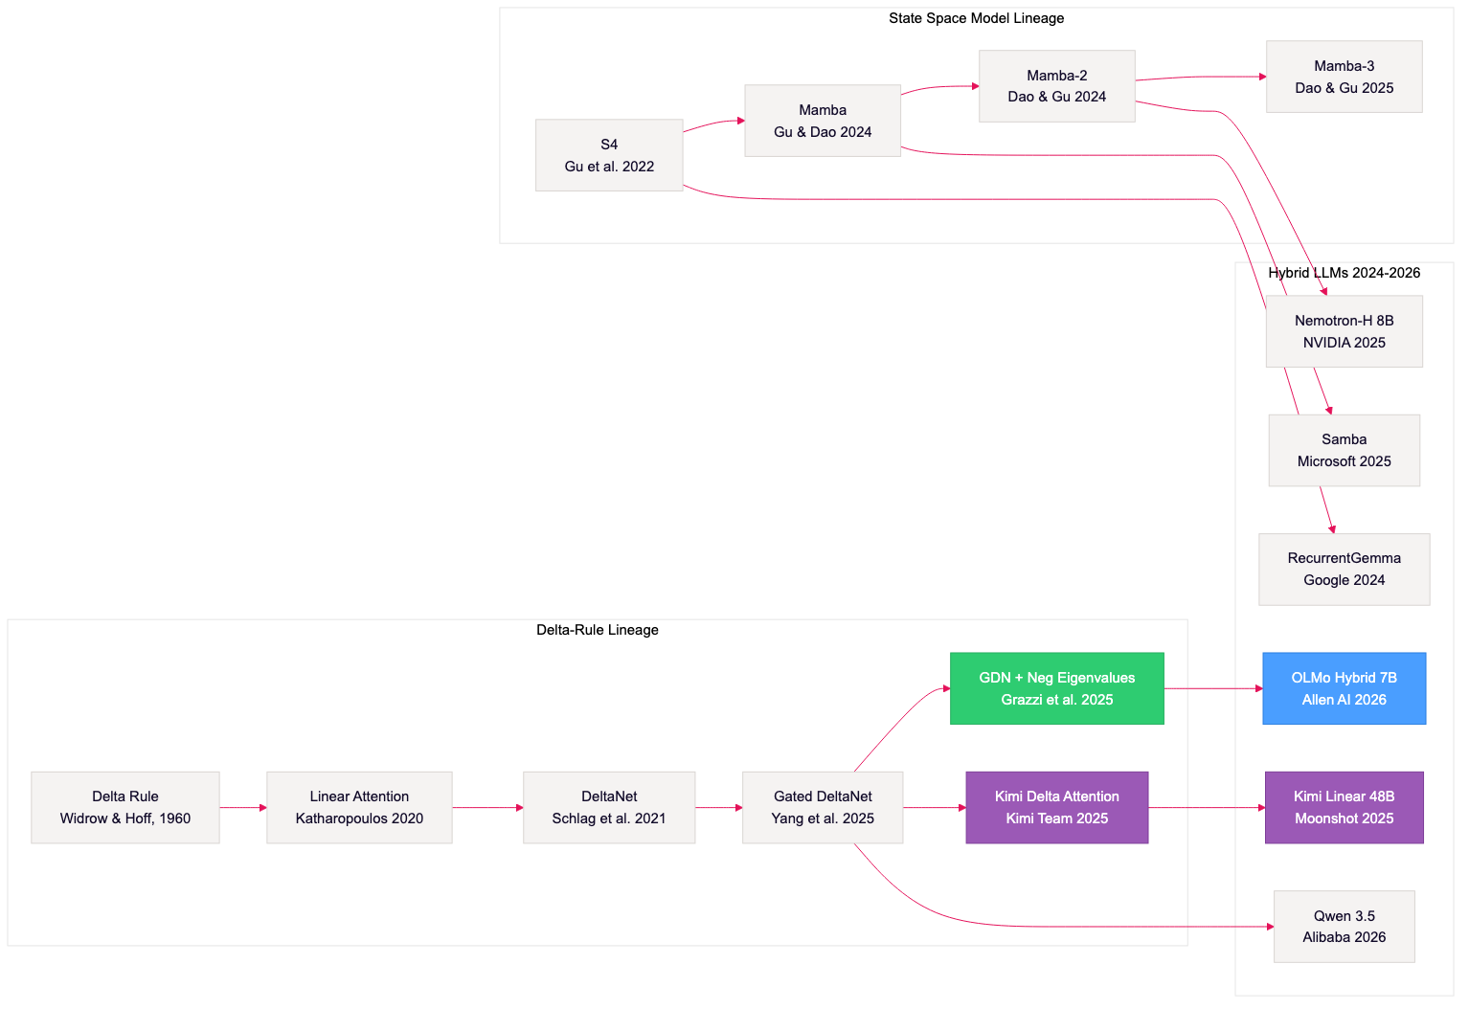
Recurrent Layers Converging to Hybrid
Every hybrid also uses transformer attention (edges omitted for clarity)

Slide 14
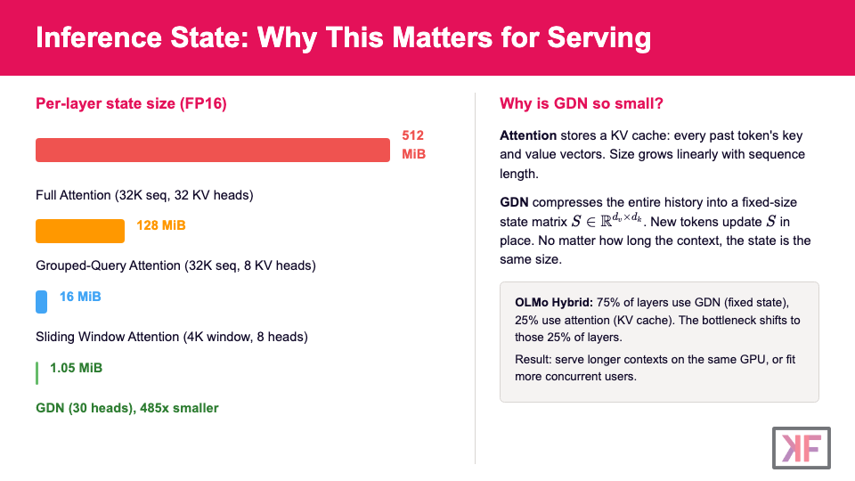

Slide 15
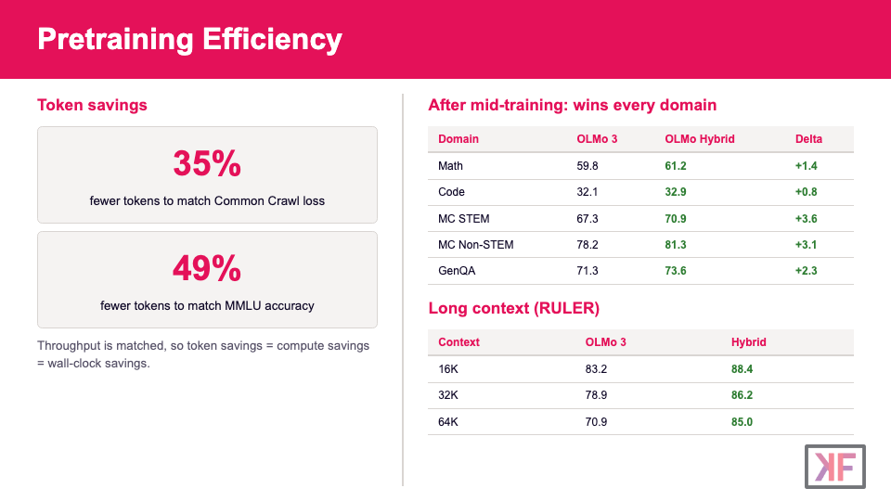

Slide 16
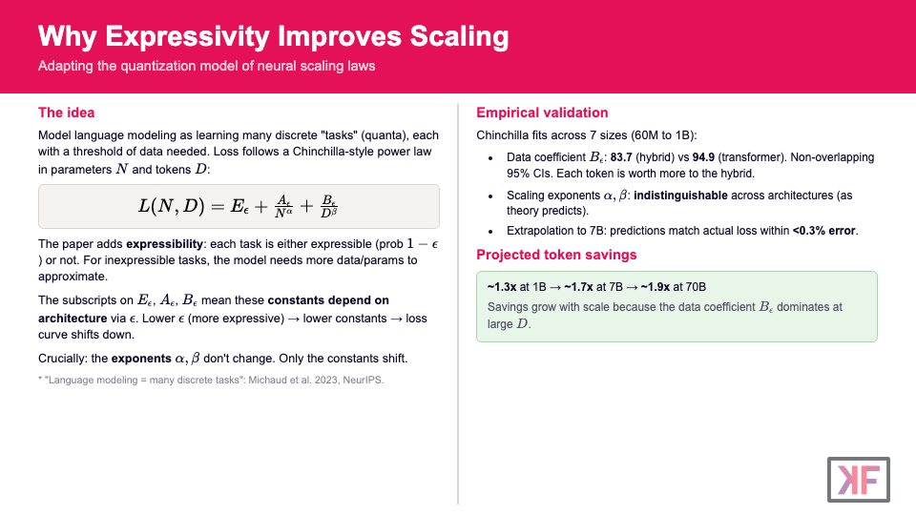

Slide 17
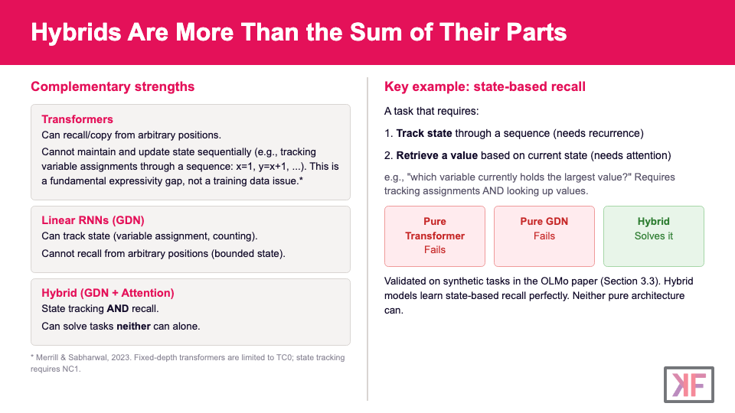

Slide 18
What Changes in Your Training Stack?
What stays the same (~95%)
What's new
SAME AdamW optimizer, WSD-S LR schedule
SAME Data pipeline (Dolma), 6T tokens
SAME Pretrain, mid-train, long-context, post-train
SAME Post-training: Think SFT, Instruct SFT, DPO
SAME Evaluation suite (OlmoBaseEval)
NEW flash-linear-attention (fla) kernels for GDN layers
NEW DroPE for long-context (GDN provides implicit positional info)
NEW Shape tuning: 30 heads, adjusted dims to match throughput
NEW Doubled mid-training batch size
The hybrid architecture gives big gains with minimal recipe changes. The main tooling difference is the fla library for GDN kernels.

Slide 19
flash-linear-attention (fla)
What is it?
Why it matters
An open-source library of efficient GPU kernels for linear attention and DeltaNet-family models. The key enabler for training GDN layers at scale.
Without fla, DeltaNet training would be sequential (one token at a time). fla implements chunk-parallel algorithms that make training throughput competitive with FlashAttention.
Who maintains it?
How it works (high level)
Maintained by the lead authors of the DeltaNet training and GDN papers. Used by OLMo Hybrid, and referenced by multiple hybrid LLM teams.
1. Chunk the sequence into blocks of size C (64-256)
2. Within each chunk: compute all outputs via dense matmuls (fully parallel)
GitHub: fla-org/flash-linear-attention
3. Across chunks: propagate a single state update per boundary
Supports: DeltaNet, Gated DeltaNet, GLA, linear attention, and more
Result: sequential depth drops from L to L/C
Backend: Triton kernels (no custom CUDA needed)
OLMo Hybrid slightly outperforms OLMo 3 in early training throughput benchmarks, despite the recurrent layers.

Slide 20
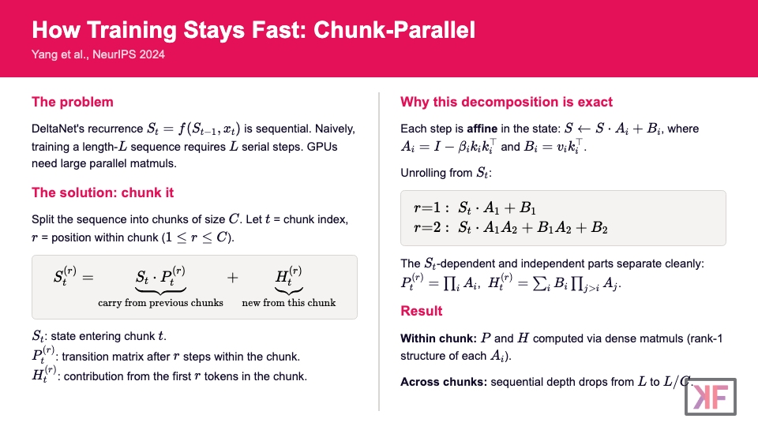

Slide 21
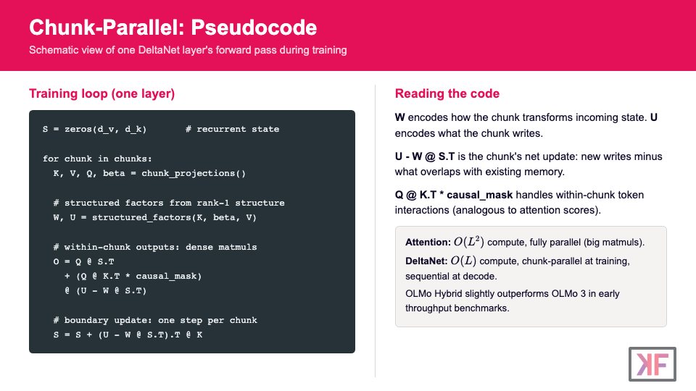

Slide 22
