Slide 1
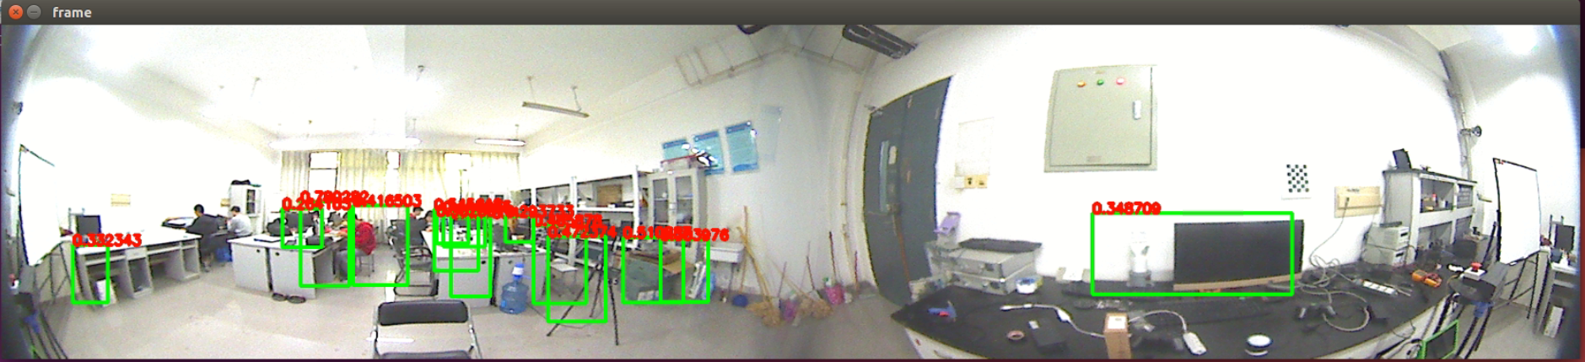
ZZU-SR
360° Panoramic Vision Solution
Provide multi-platform solution(Windows,Ubuntu)

Slide 2
What can it do?
Example:
Body recognition of 360 °
It provides a smoother human-robot interaction experience

Slide 3
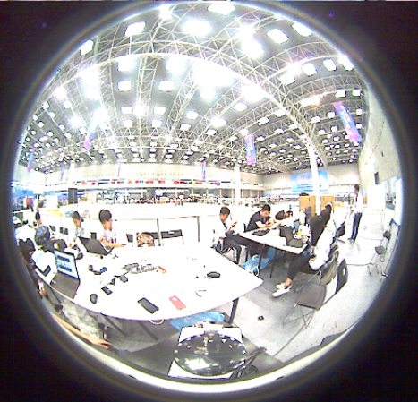
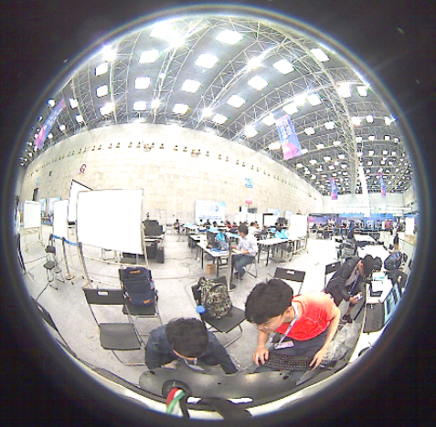
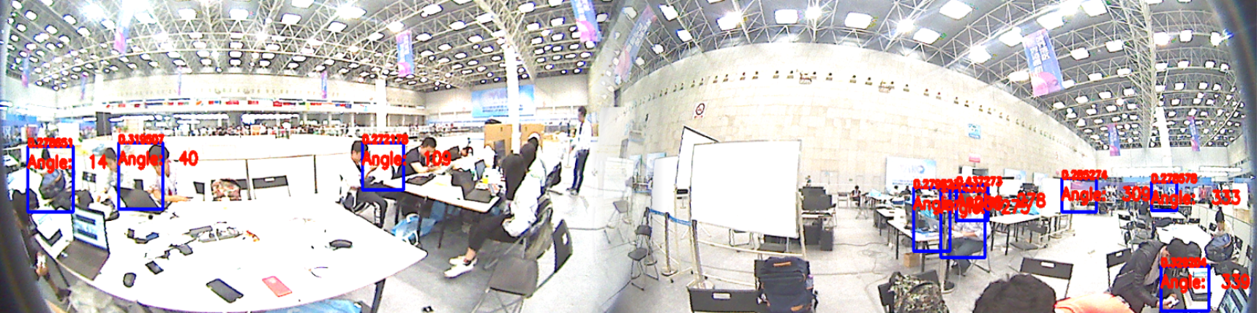
What Solution include?
Fisheye remaping
Image stitching
SSD + Mobilenet(or yolo etc)
Inference engine(optional)

Slide 4
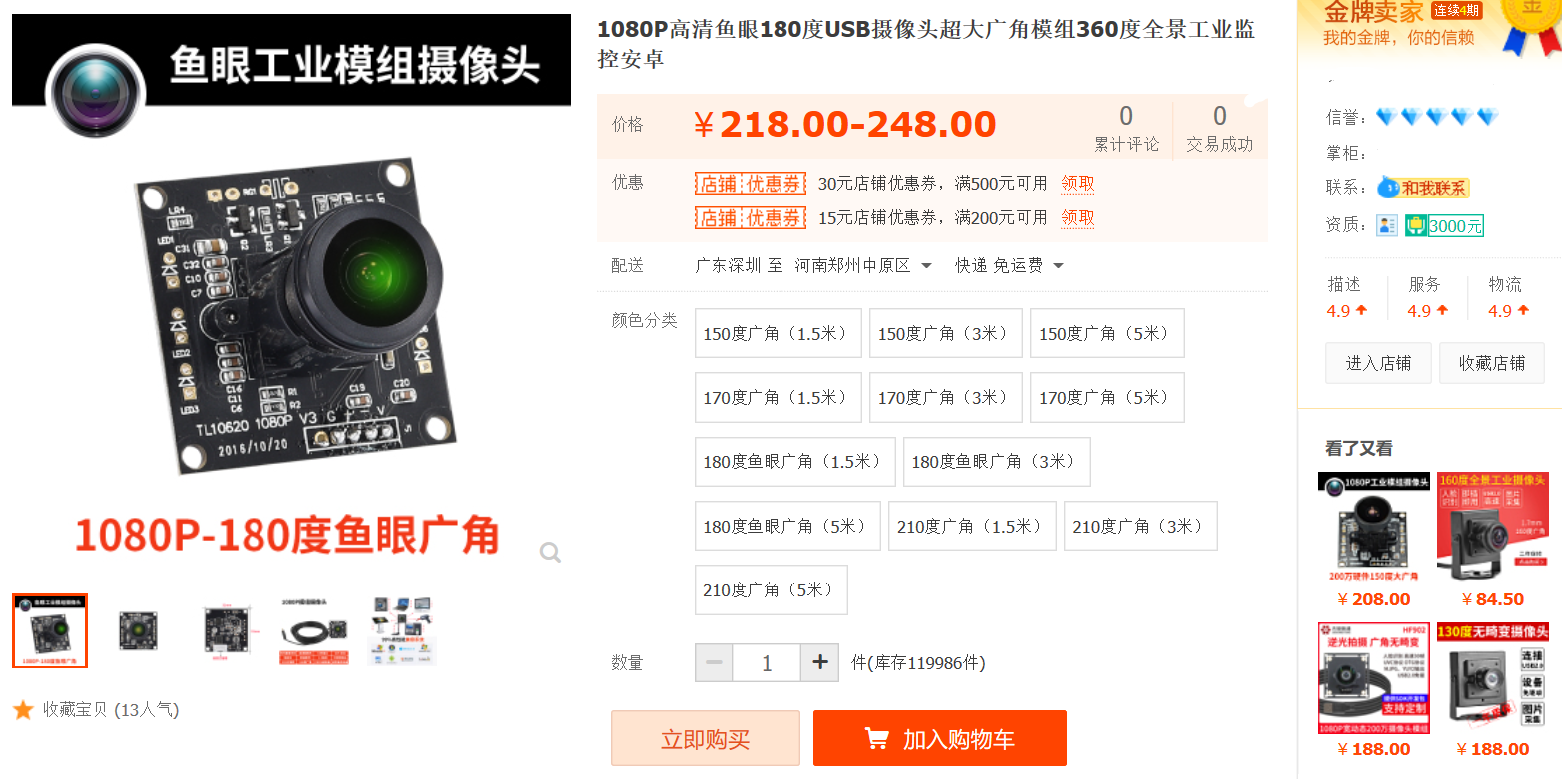
Cheap for developer
1. 2 cheap fisheye cameras ( $30 each)
2. It runs in real time on a cheap CPU

Slide 5
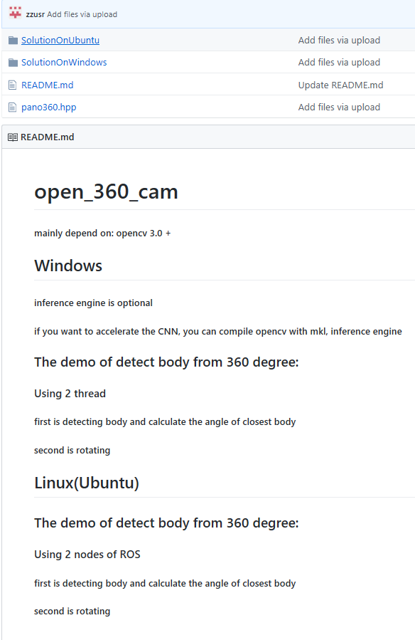
Open source
https://github.com/zzu-Srobot/
Open_360_Cam_Solution
And our algorithm is not perfect.
We want to improve it together.

Slide 6
Demo
It will show how
Panoramic Vision Solution
improve service robot

