Slide 1
Dataacraker(Titanic)
17082871d LI Ruowei
15101119d Bang Junyoung
15100845d Hong Jiseok

Slide 2
Contents
1、 Model summary and leaderboard
2、 Problem Definition
3、 Data understanding and wrangling
4、 Modelling & performance evaluation
5、discussion
6、Final words

Slide 3
Contents
1、 Model summary and leaderboard
2、 Problem Definition
3、 Data understanding and wrangling
4、 Modelling & performance evaluation
5、discussion
6、Final words

Slide 4
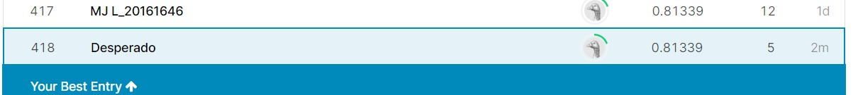
Model Summary and Leaderboard
Classifiers | Accuracy with CV=10 | Parameters after finetuning
Linear Regression | 0.8619 (+/- 0.0409) | 'C': 0.18019765146951916, 'penalty': 'l2'
Support vector machine | 0.8597 (+/- 0.0406) | 'C’: 1, 'decision_function_shape': 'ovo'
K nearest neighbor | 0.8508 (+/- 0.0181) | n_neighbors: 11
Random Forest | 0.8597 (+/- 0.0406) | 'criterion': 'gini', 'max_depth': 4, 'n_estimators': 300
XGBoost | 0.8586 (+/- 0.0397) | 'learning_rate': 0.01, 'max_depth': 2, 'seed': 0
Decision tree | 0.8676 (+/- 0.0385)* | 'criterion': 'gini', 'max_depth': 8, 'max_features': 'auto', 'min_samples_leaf': 5, 'min_samples_split': 0.03
Bagging random forest | 0.8608 (+/- 0.0291)** | criterion': 'gini’, ‘max_depth': 5
Neural network | 0.8530 (+/- 0.0465) | Input layer: 9, hidden 1: 8 units, hidden 2: 3 units
Voting (Hard) | 0.8463 (+/- 0.0970) | Hard
Voting (Soft) | 0.8429 (+/- 0.0887) | Soft
* Best validation results; ** Best model on leaderboard

Slide 5
Contents
1、 Model summary and leaderboard
2、 Problem Definition
3、 Data understanding and wrangling
4、 Modelling & performance evaluation
5、discussion
6、Final words

Slide 6
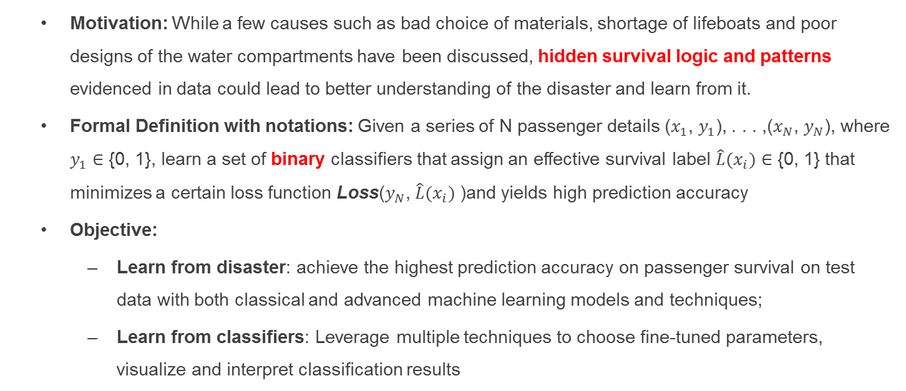
Problem Definition
Motivation: While a few causes such as bad choice of materials, shortage of lifeboats and poor designs of the water compartments have been discussed, hidden survival logic and patterns evidenced in data could lead to better understanding of the disaster and learn from it.
Formal Definition with notations: Given a series of N passenger details ($x_{1}$, $y_{1}$), . . . ,($x_{N}$, $y_{N}$), where $y_{1}$ ∈ {0, 1}, learn a set of binary classifiers that assign an effective survival label $\hat{L}(x_{i})$ ∈ {0, 1} that minimizes a certain loss function Loss($y_{N}$, $\hat{L}(x_{i})$)and yields high prediction accuracy
Objective:
Learn from disaster: achieve the highest prediction accuracy on passenger survival on test data with both classical and advanced machine learning models and techniques;
Learn from classifiers: Leverage multiple techniques to choose fine-tuned parameters, visualize and interpret classification results

Slide 7
Contents
1、 Model summary and leaderboard
2、 Problem Definition
3、 Data understanding and wrangling
4、 Modelling & performance evaluation
5、discussion
6、Final words

Slide 8
Data Overview
Variable | Definition | Values
PassengerId | Passengers identification assigned by Kaggle
Pclass | Ticket class | 1=first class, 2=second class..
Sex | Male or female
Age | Age in years
Sibsp | # of siblings/spouses aboard
Parch | # of parents/children aboard
Ticket | Ticket number
Fare | Fare monetary value
Cabin | Cabin number
Embarked | Port of embarkation | C=Cherbourg, Q=Queenstown, S=Southampton
Name | Name of the passengers | Title (Mrs, Mr) included
Survival | If passengers survived or not | 0=No, 1=Yes
Data downloaded from via Kaggle API
Train data.csv shape: (891 X 12)
Test data.csv shape: (418 x 11, without survival label)
4 features are categorical: Survived, Sex, Embarked, Pclass
4 features are numerical: Age, Fare, SibSp, Parch
Cabin is alphanumeric data type and name only includes letters

Slide 9
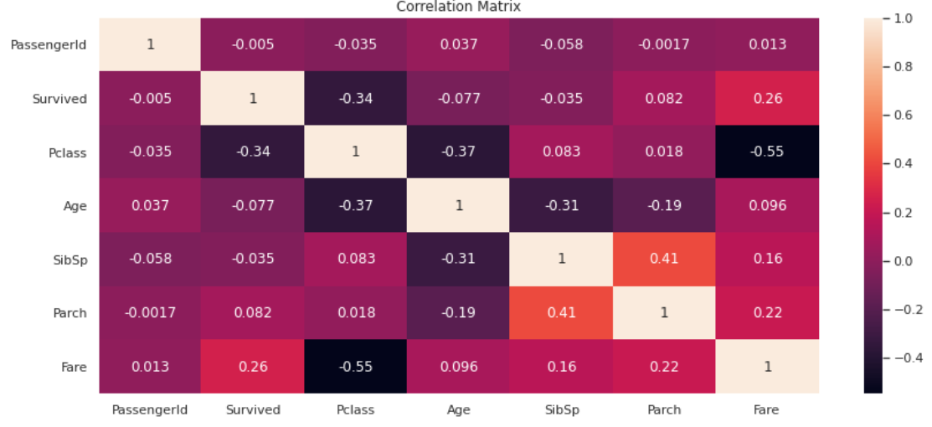
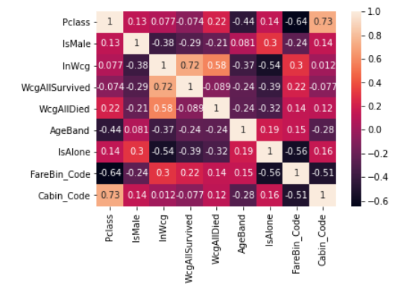
Feature Correlation
- Pclass and Fare has relatively higher correlation with Survived feature respectively to –0.34 and 0.26
- More to see after Feature Engineering

Slide 10
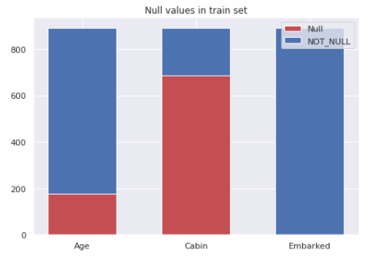
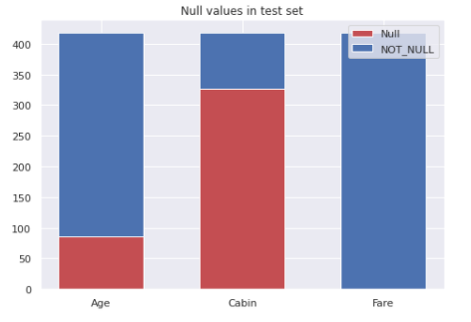
Missing Data
In training, Age, Cabin and Embarked have missing values;
In testing, Age, Cabin and Fare contain missing values.
Train
Test

Slide 11
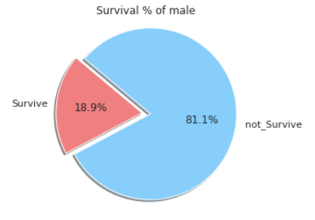
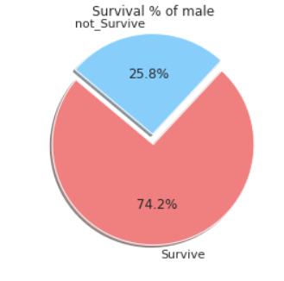
IsMale & survival
Mapping Sex into IsMale (0 for female, 1 for male
From the graph visualization, it is clear that females has survival rate twice higher than males.
gender feature is important
A vanilla classifier that predicts male all dead and females all live achieves 76.56% (!!) on leaderboard.

Slide 12
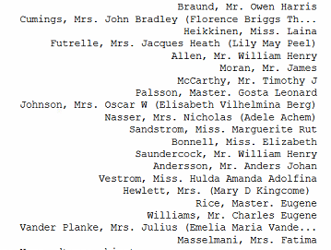
Name
Grown-up male
Married female
Name combines information of “IsMale”, marital status and Age
“Title” can be extracted
Same last name indicates same family
According to blog Titanic using Name only [0.81818], name alone contains significant survival information
Unmarried Female
Male child

Slide 13
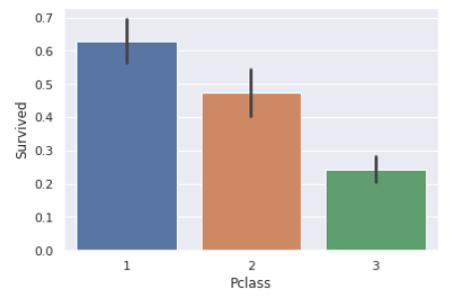
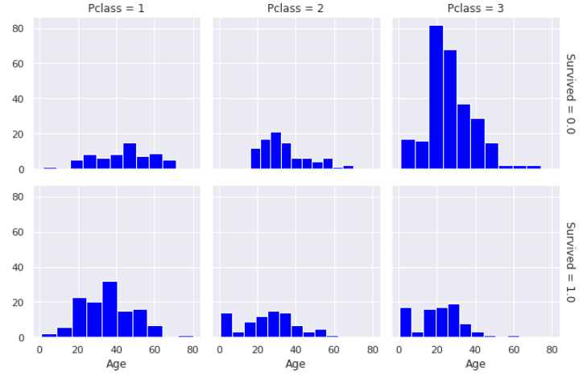
PClass
Price Class indicates the price paid to get aboard. We assume higher Pclass has better services and perhaps access to lifeboats and exits.
As can be seen below, higher Pclass, higher survival rate.

Slide 14
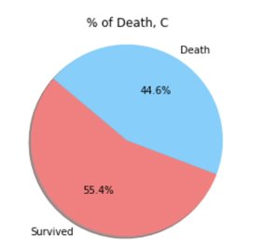
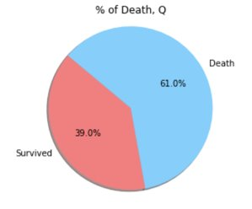
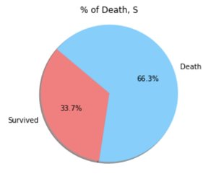
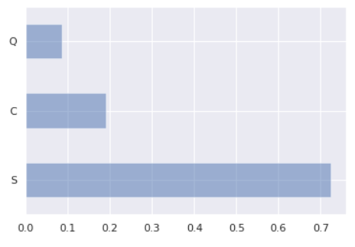
Embarked
Intuitively, where someone embarked shouldn’t correlate with survival (Fig below)
There are small amount of missing values (2 Passengers) to fill up.
We just fill it up with ‘S’, which has the largest portion.

Slide 15
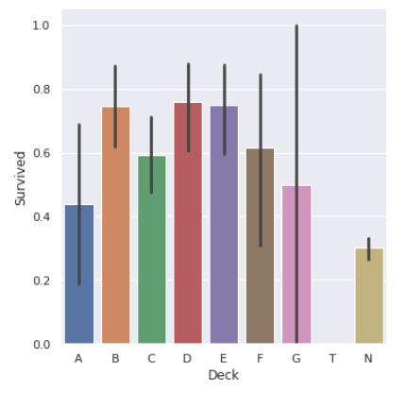
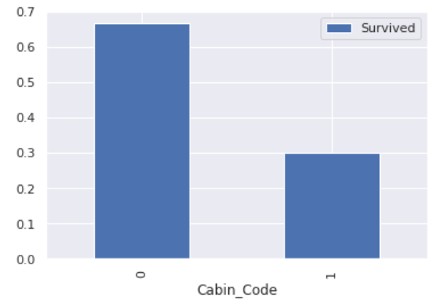
Cabin
We assume that passengers without a cabin have a missing value displayed instead of the cabin number
The first letter of Cabin indicates deck information.
Map Cabin to deck using string extraction
Passengers without Cabin has less survival rate
Further map Cabin into 0: w/t a cabin; 1: w/o a cabin. We get the graph on the right-hand side

Slide 16
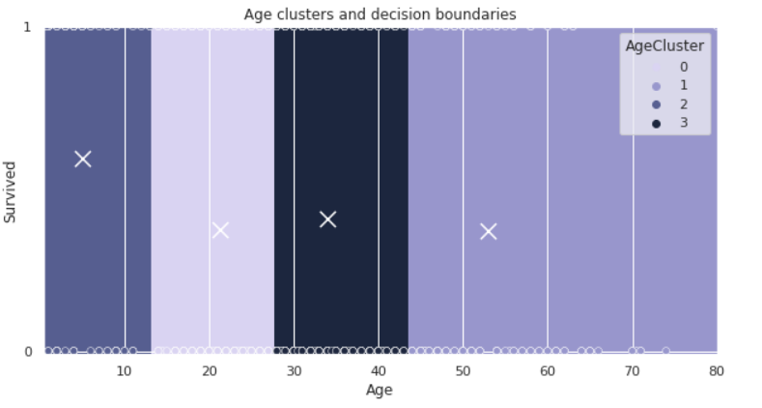
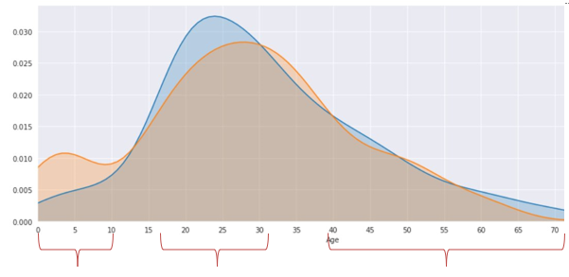
Age Band
As mentioned, Age is an important indicator and both parts of datasets contain NaN values
To convert continuous age values to categorical variables, which trims unnecessary granularity thus preventing overfitting and speeds up the identification of kids and young passengers
Kmeans + decision tree prediction
Related feature matching
Fillna with median
Binning with cut and qcuts
After tryouts all these techniques, we found Kmeans works the best. For each train and test set, Age is divided into four parts with Kmean algorithm to get age boundary.
To fill in null values in Age, Decision Tree (together with Knn and others) to predict NaN values based on existing Age Band for the entire dataset
Pclass, Parch, SibSp, Name (last name), IsMale are extracted from data set for prediction.
The prediction accuracy is around 53.6%

Slide 17
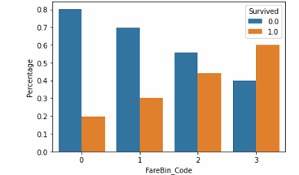
Farebin
Fare is the price they paid for the ticket
Similar to Age, we apply binning to the original numerical data
Pandas.qcut: calculate the size of each bin to ensure the distribution of data in the bins is equal.
Pandas.cut: no guarantee about the distribution of items in each bin.
Here we simply used qcut for simplification
Higher fare, higher survival rate as shown below

Slide 18
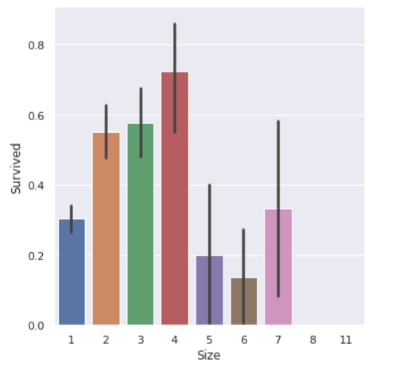
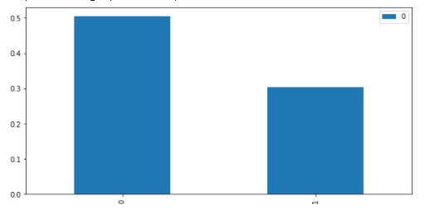
IsAlone
"SibSp" and "Parch" are features related to the family members
Then, we create "FamilySize" ("SibSp" + "Parch" + 1)
As the graph below, "FamilySize" with value 1 has relatively low survival rate
We another binary feature "IsAlone"
0 when "FamilySize" greater than 1, otherwise 1
Survival by IsAlone

Slide 19
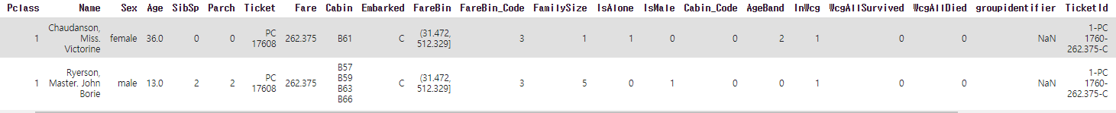
Group Information
We create "GroupIdentifier" combining Lastname, Pclass, ticket, Fare, Embark which are the common features for family members.
We assume that for those who have same "GroupIdentifier" are traveling in groups.
However, the definition of "GroupIdentifier" is too stringent since there are nannies and relatives who do not have common LastName.
So we create "TicketId" combining with Pclass, Fare and Embarked without LastName
Nine relatives or nannies are added to groups

Slide 20
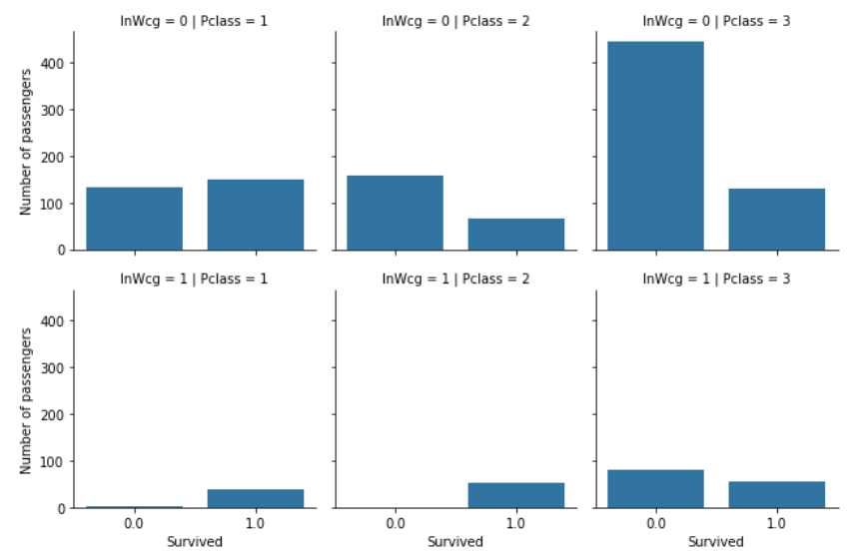
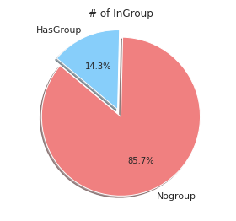
GroupSize & Woman-Child-Group
To continue with “GroupIdentifier”, "GroupSize" is calculated to identify the group size
Previously, we know that female and kids generally have more chance of survival, in Titantic Mega Model - [0.84210], the author lays out a design of Wcg (Woman-Child-Group)
We further engineering the Wcg into WcgAllDied if all the passengers in a Woman-Child-Group die and WcgAllSurvived if all the passengers in a Woman-Child-Group survive
Almost perfect

Slide 21
Contents
1、 Model summary and leaderboard
2、 Problem Definition
3、 Data understanding and wrangling
4、 Modelling & performance evaluation
5、discussion
6、Final words

Slide 22
Modeling and Evaluation
How we trained Classifiers
Simple models
Logistic Regression
Ensemble mechanisms
Boosting
Various Tuning Techniques
Scaling
Cross-Validation
Hyperparameter Tuning
Pipeline
SVM
Decision Tree
Random Forest
Bagging
Voting

Slide 23
Ensembles and Voting mechanisms
What is ensembles methods?
Combining many base models at the same time.
When would we combine them? + How would we combine them? + What are the base models?
Bagging, Stacking, Voting, and Boosting

Slide 24
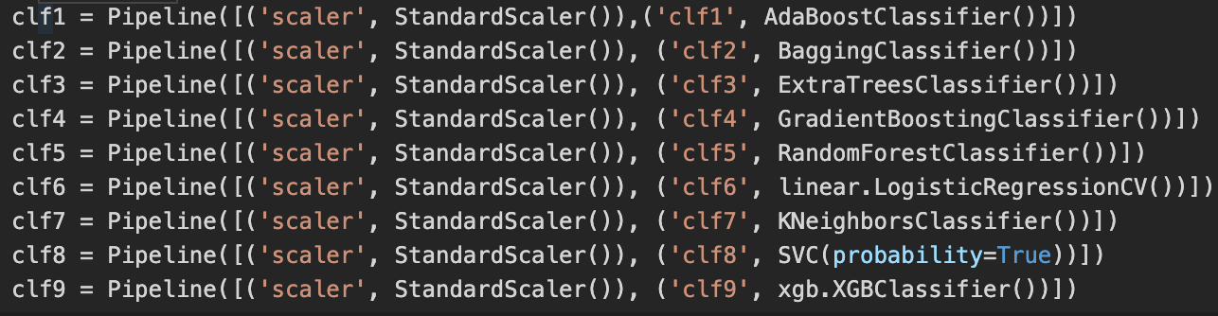
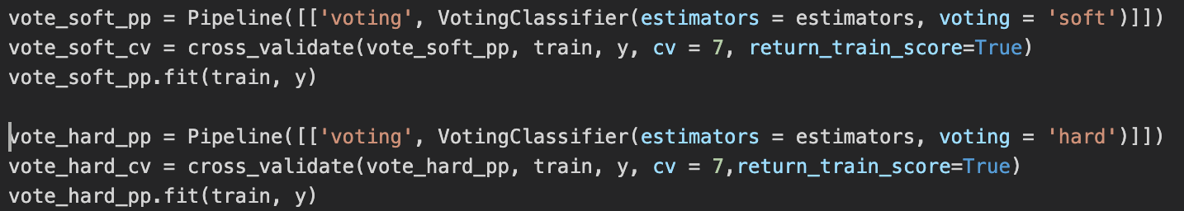
Ensembles and Voting mechanisms
Voting mechanisms (soft/hard)

Slide 25
Scaling and CV
To improve and estimate the performances
After preprocessed and feature-engineered data, we scaled the dataset using StandardScaler.
Cross-validation is a necessary method to tune the machine learning model and estimate the performance of the model on unseen data. Although the basic way of testing the model is to use train_test_split method, CV gives a more reliable measurement of the model's performance.

Slide 26
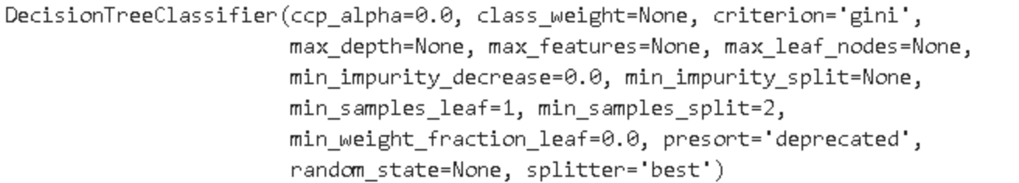
Hyperparameter tuning
Fine-tuning parameters passed to the algorithms is crucial to get the best performance out of whichever algorithms we choose.
Here we tried:
RandomizedSearchCV randomly samples the candidate values of hyperparameters from a given range and distribution specified by the user (more efficient, less accurate)
GridSearchCV exhaustively searches for the best set of parameters using a given parameter grid (less efficient, more accurate)

Slide 27
Pipeline
Pipeline is one good way to automate the ML workflow. For example, we can streamline the preprocessing, scaling, Feature selection, Dimensionality reduction at the same time.
Regarding the data leakage, this could one solution to avoid it.
We applied pipeline to all Machine Learning algorithms.

Slide 28
Contents
1、 Model summary and leaderboard
2、 Problem Definition
3、 Data understanding and wrangling
4、 Modelling & performance evaluation
5、discussion
6、Final words

Slide 29
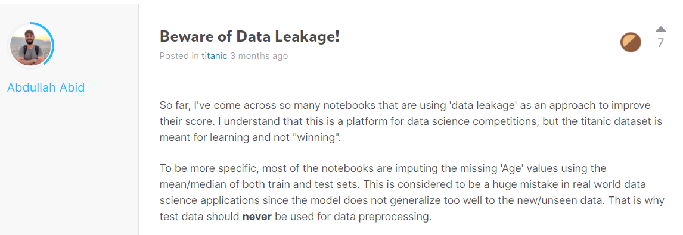
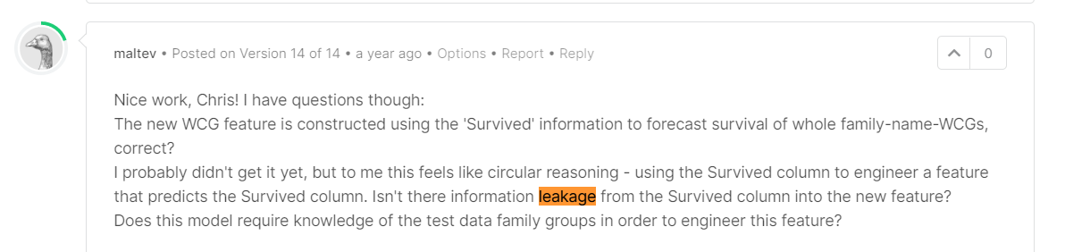
Discussion (1)
One heartfelt issue that our team found is the problem of data leakage, the introduction of target information in the process of data mining which ought not to be legitimately available to mine from (Kaufman et al., 2011).
Data leakage in titanic
Conflicting views on “train-test-contamination”
Things are tricky when Imputation of training features from test samples gives the model more info statistically and decreases model generalization
One Example – when do data scaling w.r.t train_test_split
Before? Scaled to global distribution
After? Workable but the code with CV tends to be more complicated
No scaling? Model convergence suffers
Our Solutions
Careful feature engineering
Example on Age: we only use KMeans to generate the Age Band strictly on training data, e.g. (0, 13.16] years old and apply the band to the rest of the data
Pipelines
As a result, during cross validation, it doesn't use any information from the test fold, it only uses information from the training fold without complicating the programming

Slide 30
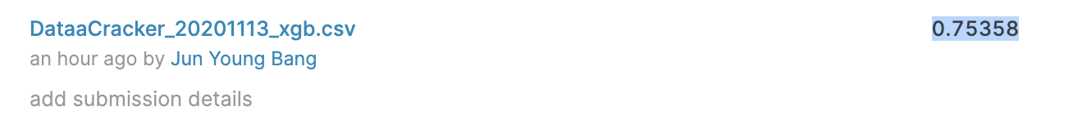
Discussion (2)
What makes the discrepancy between Leaderboard score and CV score?
We've seen some gaps between cv scores of the model we trained and the Leaderboard score from the prediction of test data. Many discussions on Kaggle about improvement of cv score not leading to test score
Potential Cause:
A discrepancy of data in the training and test set with respect to the feature correlations. (Unseen data)
Cross-validation on the training dataset is still optimistic about unseen data. (Overfitting)
Models made additional predictions that were incorrect.
Or simply, not enough training Data
tast
-> the best_score_ of our XgBoost model from the Randomized Grid Search is 0.854, while it's leaderboard score is down to around 0.75.
asdf
Test score w/o test data
Test score w/ test data

Slide 31
Contents
1、 Model summary and leaderboard
2、 Problem Definition
3、 Data understanding and wrangling
4、 Modelling & performance evaluation
5、discussion
6、Final words

Slide 32
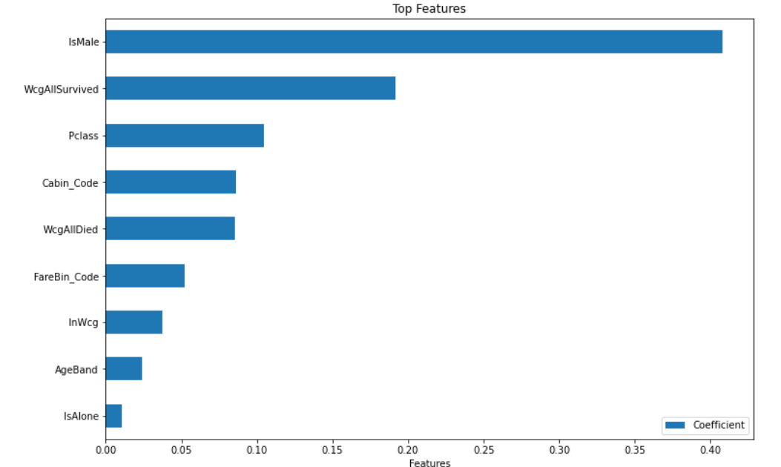
Final words
According to the below feature importance plot from bagging random forest
Sex did play a huge role in the prediction
Woman-Child-Group is highly predictive (very smart feature engineering by other learners)
The difficulty of Feature Engineering (domain knowledge, random tryout, importance of EDA or exploratory data analysis, standing on the shoulders of giants)
The power of ensemble and leveraging “collective wisdom”
A machine learning trap common in data competitions
More details, e.g. learning curves can be found in the report
Future works:
While we have identified the tricky data leakage, statistical (e.g. paired t-test) method can be used the degree and importance of data leakage
The score is far from great, more experiments can be done

Slide 33
Credits & References
Peer learner’s notebooks:
https://www.kaggle.com/dr1t10/surviving-the-titanic-step-by-step-with-groups/notebook
https://www.kaggle.com/cdeotte/titantic-mega-model-0-84210/notebook
https://www.kaggle.com/ylt0609/recursive-forward-elimination-workflow-to-0-82296/comments
https://www.kaggle.com/cdeotte/titanic-wcg-xgboost-0-84688/comments
https://www.kaggle.com/amypeniston/titanic-simple-gender-family-group-model
https://www.kaggle.com/pliptor/optimal-titanic-for-gender-only-0-7655
https://www.kaggle.com/pliptor/how-am-i-doing-with-my-score
Others:
Kaufman, S., Rosset, S., Perlich, C., & Stitelman, O. (2012). Leakage in data mining: Formulation, detection, and avoidance. ACM Transactions on Knowledge Discovery from Data (TKDD), 6(4), 1-21.
https://en.wikipedia.org/wiki/Titanic
https://www.britannica.com/topic/Titanic

